Slide 1
Adruino Basics
Ардуино осноВИТЕ

Slide 2
Ден 6
Индикация с Ардуино

Slide 3
Свързване на 7 segment panel
1 chas

Slide 4
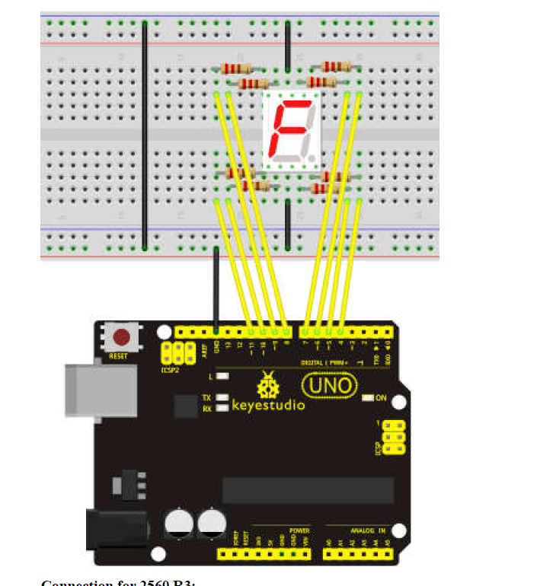
Свързване на 7 segment panel
Notes:
https://create.arduino.cc/projecthub/SAnwandter1/programming-4-digit-7-segment-led-display-2d33f8

Slide 5
Свързване на 16 X 2 LCD panel
40 min

Slide 6
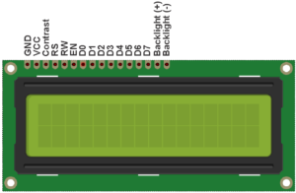
LCD Display

Slide 7
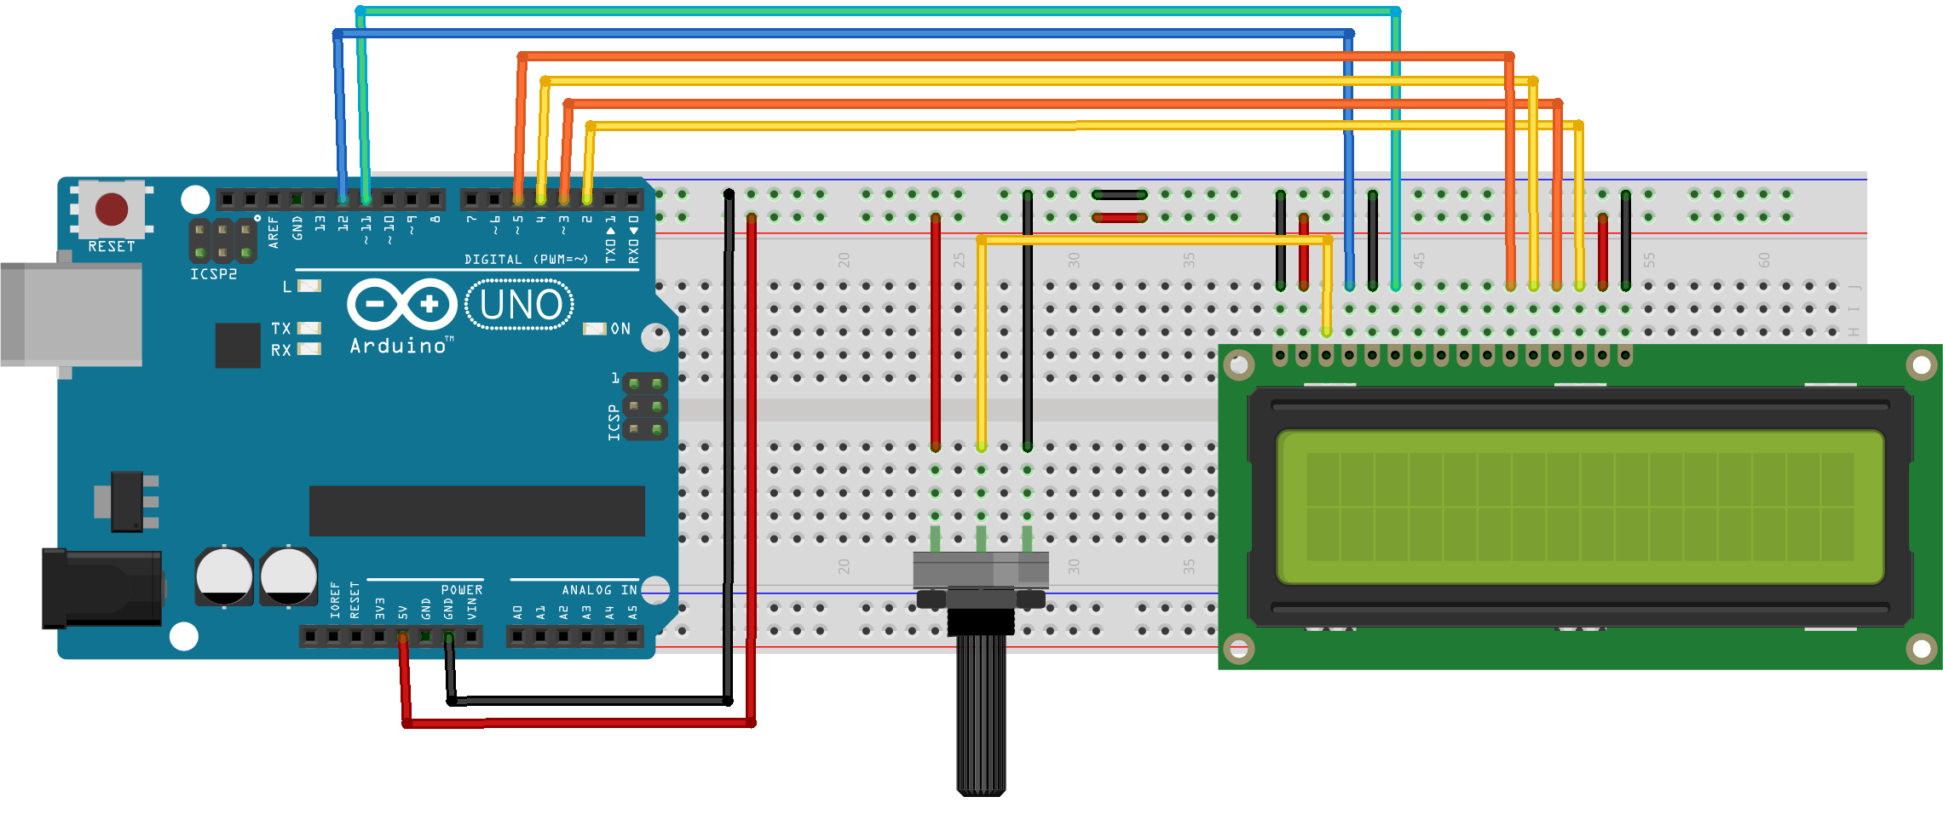
LCD DIsplay
Notes:
https://create.arduino.cc/projecthub/YoussefSabaa/lcd-display-in-real-time-ea0b7b

Slide 8
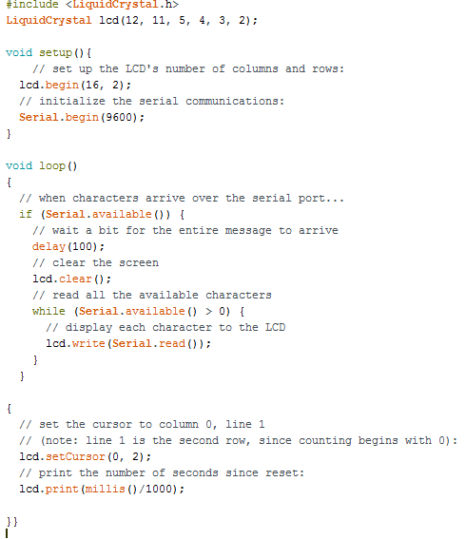
Notes:
https://create.arduino.cc/projecthub/YoussefSabaa/lcd-display-in-real-time-ea0b7b

Slide 9
LyquidCrystal Reference
https://www.arduino.cc/en/Reference/LiquidCrystal

