Slide 1
Business Problem
Idea:
Open a new Asian restaurant in Toronto
Goal:
Find the neighborhood of Toronto in which the least number of the Asian restaurants in relation to the total amount and open there a new one

Slide 2
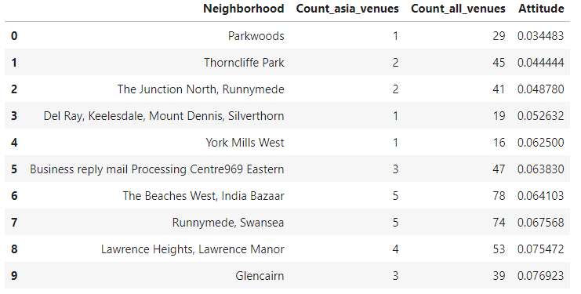
Top 10 neighborhoods

Slide 3
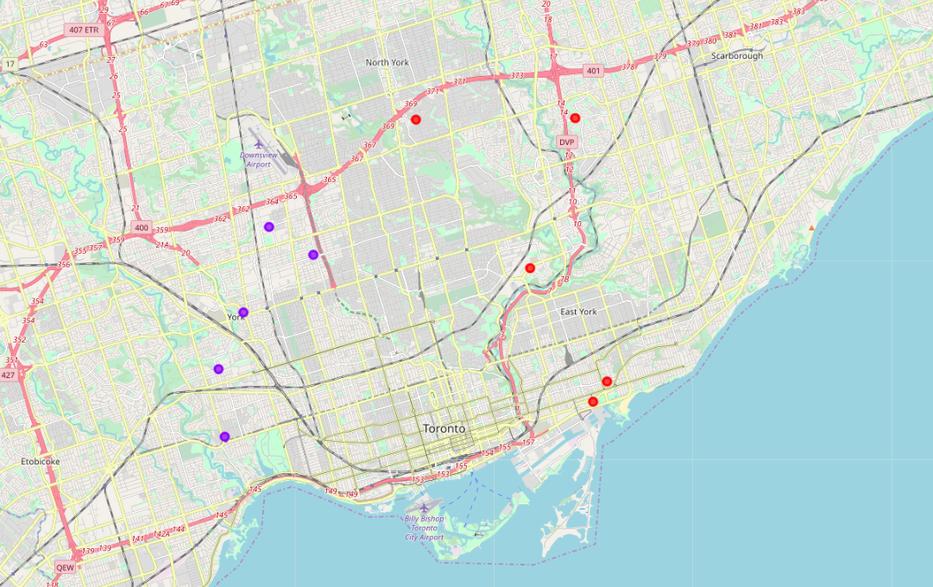
Visualization of data on the map of Toronto

