Slide 1
Test Cases Execution and Defects Logging
created by Alena Basanets
lv-414.TAQC

Slide 2
Agenda
Sprint Overview
Testing Summary, OMS v.2
Testing Summary, OMS v.5
Confirmation testing
Regression testing
Defect Statistic
Test Case Execution Example
Defect Logging Example

Slide 3
Testing Summary, OMS v.2
Test cases “Passed”: 11 (45,83%)
Test cases “Failed”: 13 (54,17%)
Test cases “Blocked”: 0 (0%)
Defects Found: 33

Slide 4
Testing Summary, OMS v.5. Confirmation
Test cases “Passed”: 0 (0%)
Test cases “Failed”: 1 (100%)
Test cases “Blocked”: 0 (0%)
New Defects Found: 1

Slide 5
Testing Summary, OMS v.5. Regression
Test cases “Passed”: 4 (57,14%)
Test cases “Failed”: 3 (42,86%)
Test cases “Blocked”: 0 (0%)
New Defects Found: 5

Slide 6
Defect Statistic by Priority

Slide 7
Defects Removal Efficiency
Defects found in OMS v2: 33
Defects closed in OMS v5: 8
Defects re-opened in OMS v5: 25
Defects Removal Efficiency = (33 – 25)/33 = 24%
*Defects Removal Efficiency, % = (Defects found OMS2 - Re-open OMS5)/Defects found OMS2
Notes:
Defects Removal Efficiency, % = (Defects found OMS2 - Re-open OMS5)/Defects found OMS2

Slide 8
Opened Defect Statistic

Slide 9
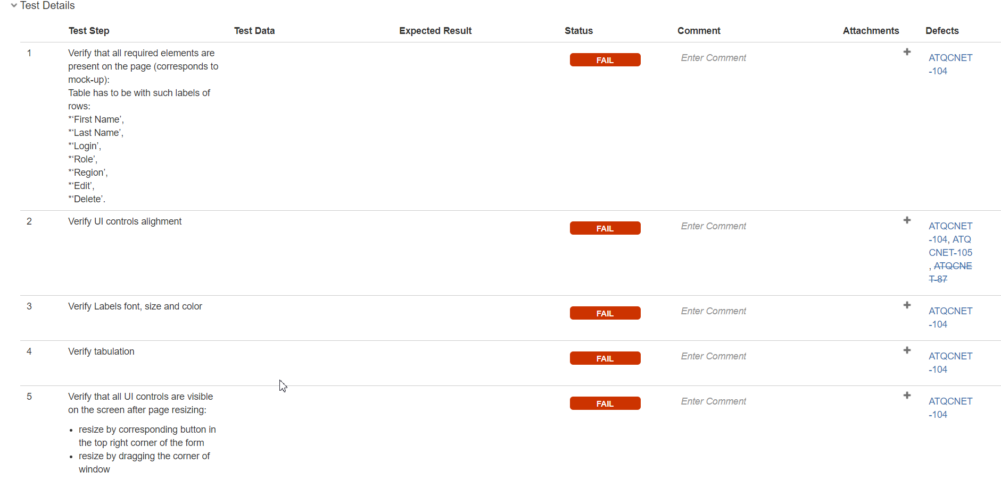
Test Case Execution Example
Notes:
Describe test case

Slide 10
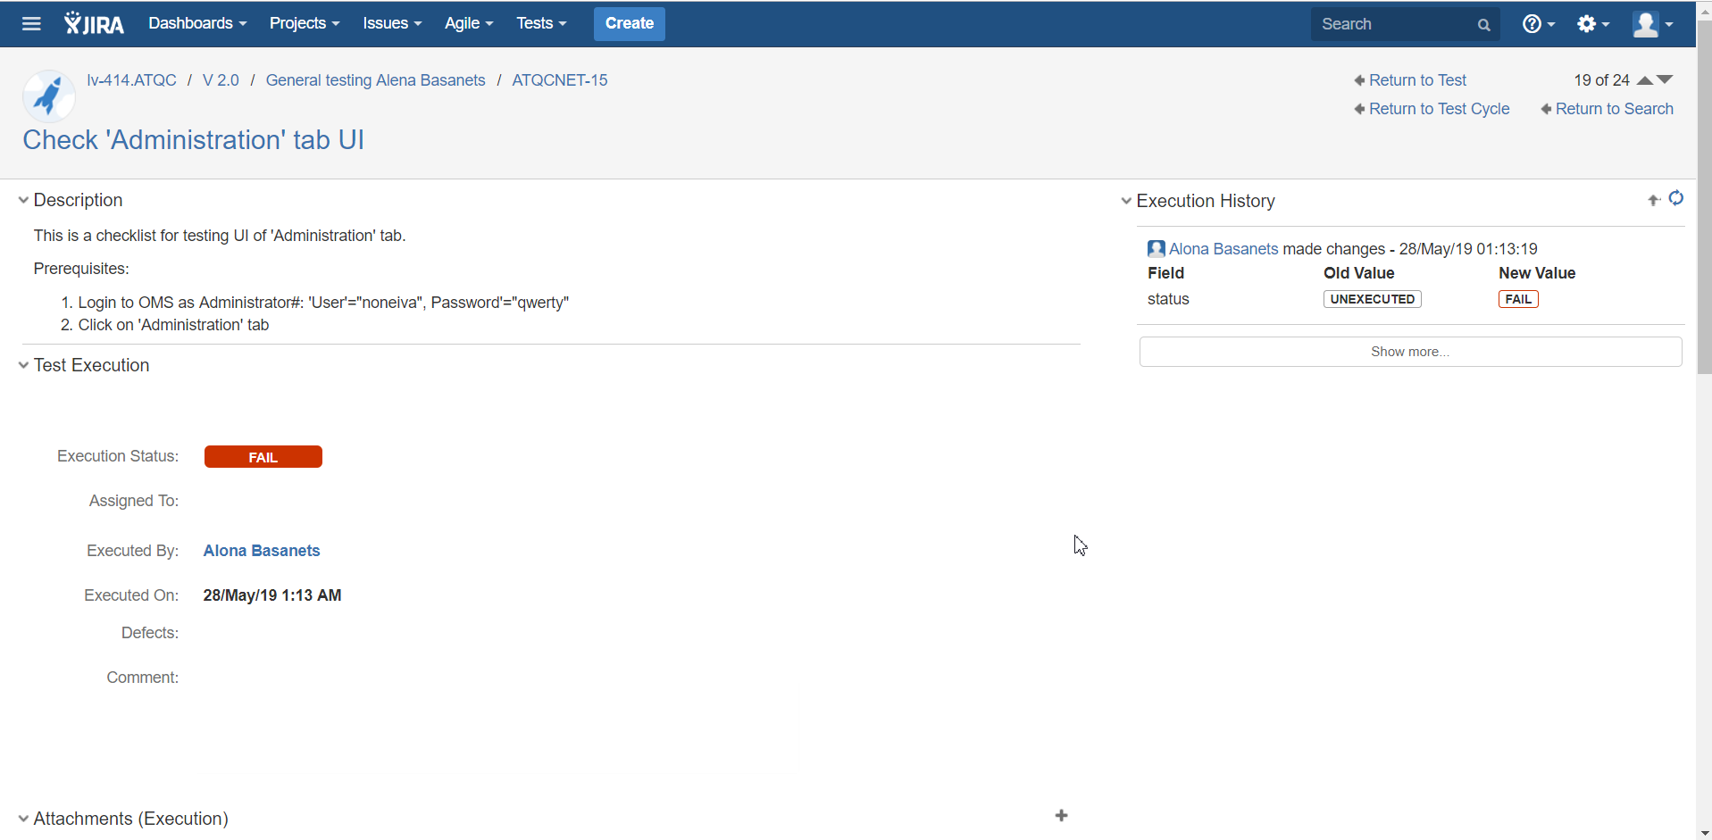
Test Case Execution Example

Slide 11
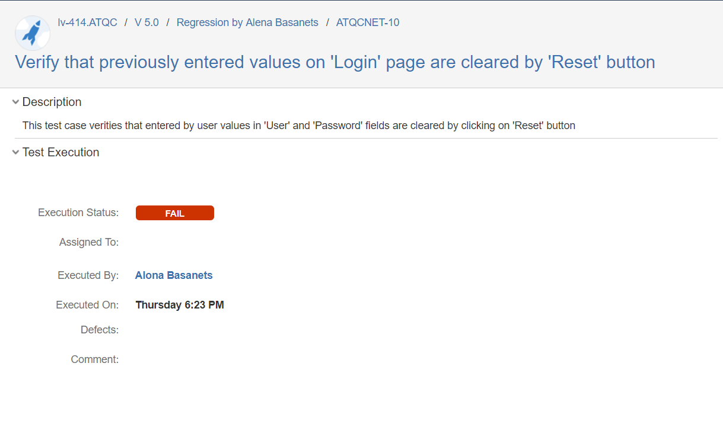
Defect Logging Example

Slide 12
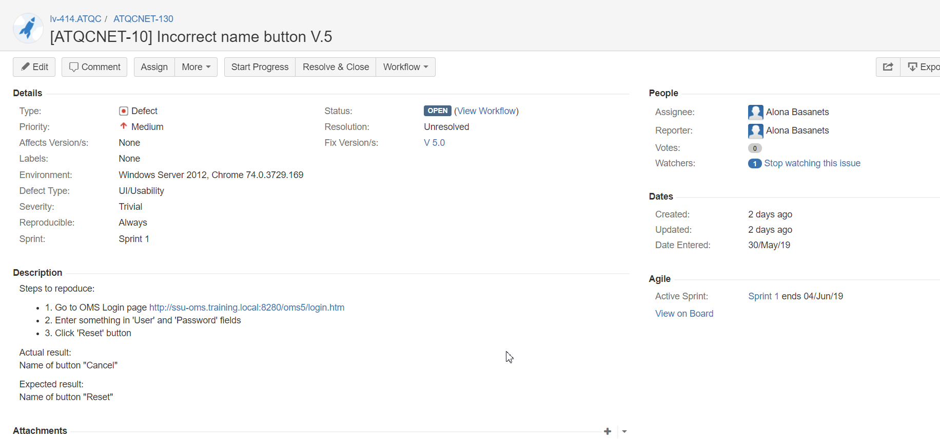
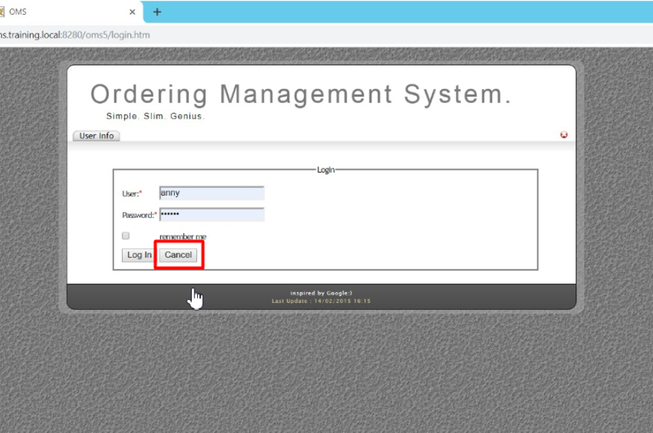
Defect Logging Example

Slide 13
Thanks for Attention!

