Slide 1
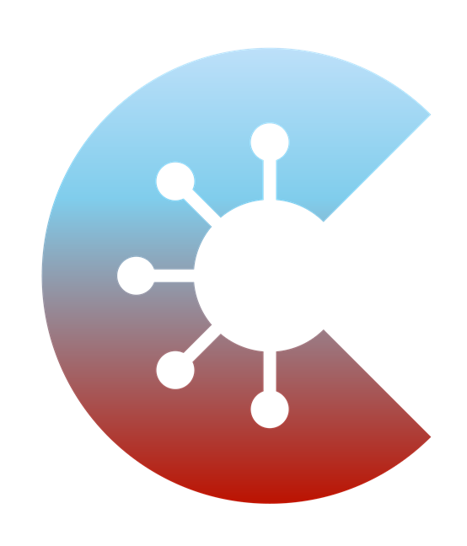

A E* - Analytics on Covid Exposure Networks
Crypto hackathon 2021
Alen Orbanić, Jan Grošelj, Boris Horvat

Slide 2
cryptohackathon.eu
CHALLENGE
WHAT
PROJECT
Apply
Demonstrate a viable application of FE, for example, in the use case of access control or privacy-preserving AI.
Show the practicability and versatility of FE and reduce the entry barrier for researchers, engineers, product owners, architects to deploy FE in their solutions, ranging from prototypes to enterprise-ready products.
A E* - Analytics on Covid-19 Exposure Networks

Slide 3
A E* project in a glance
WHY?
HOW?
WHAT?
The objective of this project is to get insights about the actual social distancing during Covid-19 epidemia, directly from the participants.
Our plan is to leverage the data of actual exposure networks, gathered by multiple Corona-Warn-App (CWA) apps, and their analysis, using decentralized multi- client functional encryption for inner product FE scheme, while at all steps respecting data privacy and safety, by processing a minimum of required personal data, handled with maximum protection.
We have implemented proof-of-concept (PoC) implementation of the core infrastructure for trusted submitting, processing, and visualization of Covid-19 exposure networks, together with working simulation.

Slide 4
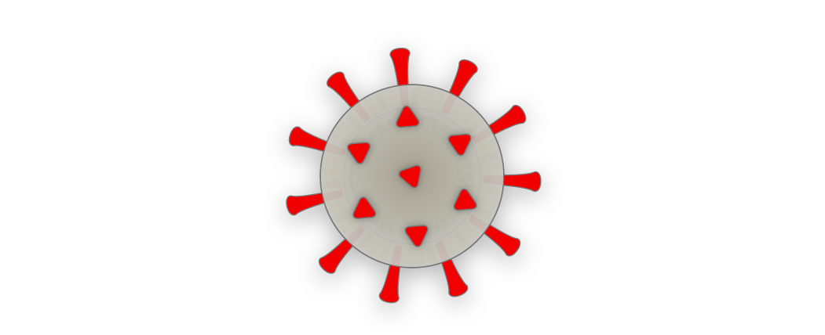
WHY?

Slide 5
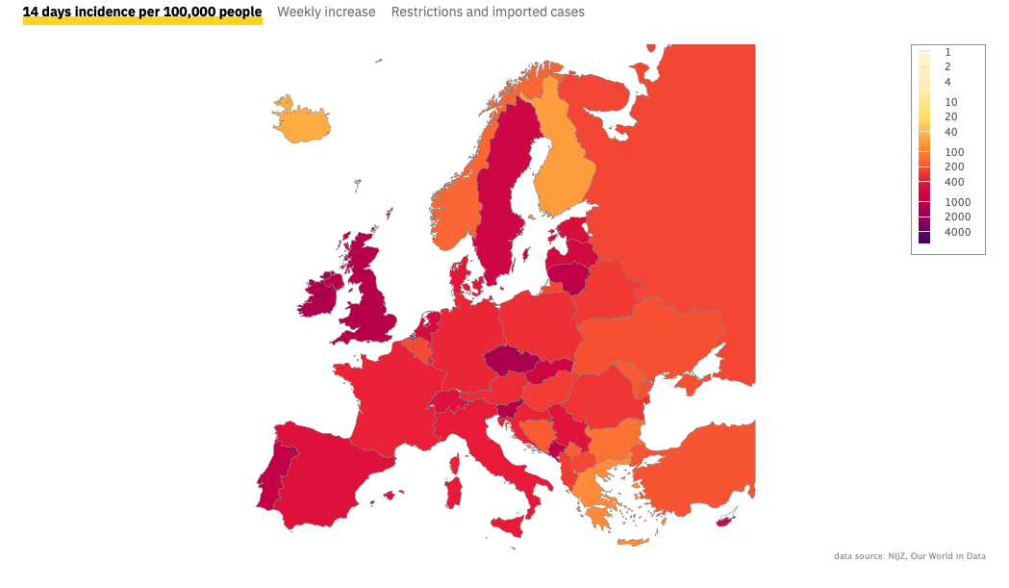
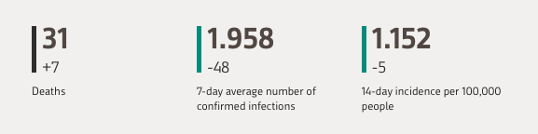
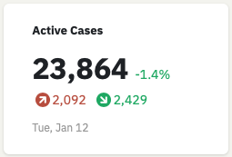
COVID-19 :: Situation in Slovenia (EU) can be better
Source: COVID-19 Tracker Slovenia & NIJZ, obtained on 13.1.2021

Slide 6
Social distancing is the key preventive measure ...*
A person who has been in close contact with another person who tested positive in a coronavirus test, must limit their contact with other people.
In public space, consistently maintain a safe distance of 2m from other people.
Persons with a confirmed infection must inform other close contacts.
All those who have been informed that they have been in close contact with an infected person, must stay home.
* … for restricting the spread of the virus; by Slovenian Health authorities

Slide 7
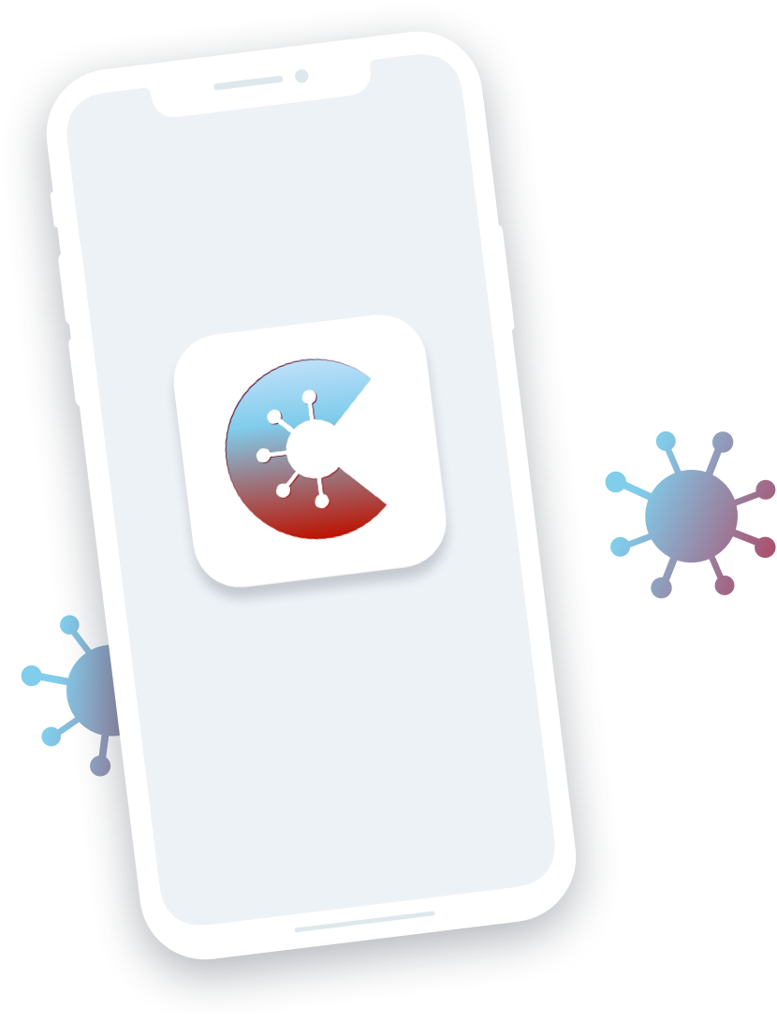
Corona-Warn-App (CWA) - unified tracking approach
CWA is an open source project (mobile app + servers) that helps trace infection chains of SARS-CoV-2, from Germany.
It is uses a decentralized approach, with focus on data privacy and safety, (Privacy-Preserving Contact Tracing specifications by Apple & Google), and notifies users if they have been exposed.
CWA is specifically designed to ensure for each step that the app processes a minimum of required personal data that is handled with maximum protection - for the following 2 objectives:
assess personal risk of infection,
learn COVID-19 test results faster.
Source: https://www.coronawarn.app

Slide 8
CWA is used for tracing exposure to SARS-CoV-2
To assess personal risk of infection, app
automatically collects nearby identifiers (< 2 m or > 15 min),
distributes list of keys of SARS-CoV-2 confirmed users,
checks for exposure to SARS-CoV-2 confirmed users.
To help learning COVID-19 test results faster, app
enables communication (retrieve, inform) of user’s test result, after explicit consent from the user.

Slide 9

#OstaniZdrav (#StayHealthy) = CWA in Slovenia
The #OstaniZdrav application is a CWA app clone (maintained by Slovenian Health Authorities) that
informs the user about contact with an infected person,
enables user to enter TAN code received from the epidemiologist.
Goal: To help contain and manage the spread of infection and reduce the burden on the healthcare system, thus enabling the state to control the virus, by using less coercive measures.
!!! But !!!, the Health Authorities do not have any information about the app usage, virus spread, social distancing, nor control.

Slide 10
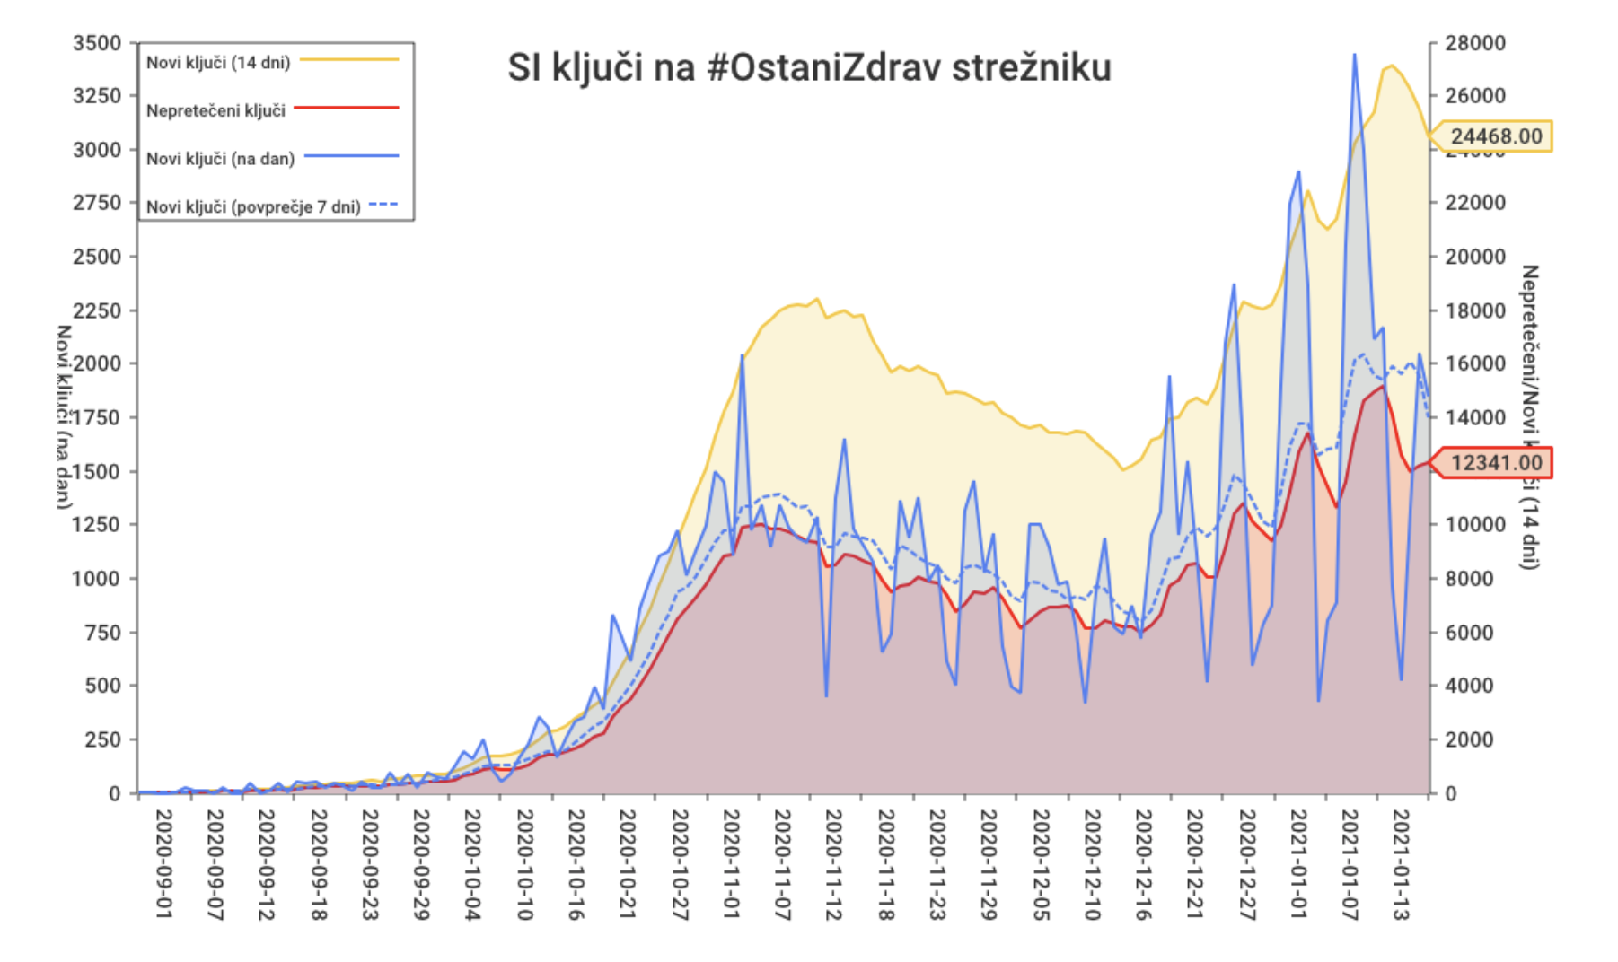
#OstaniZdrav (#StayHealthy) = CWA in Slovenia

Slide 11
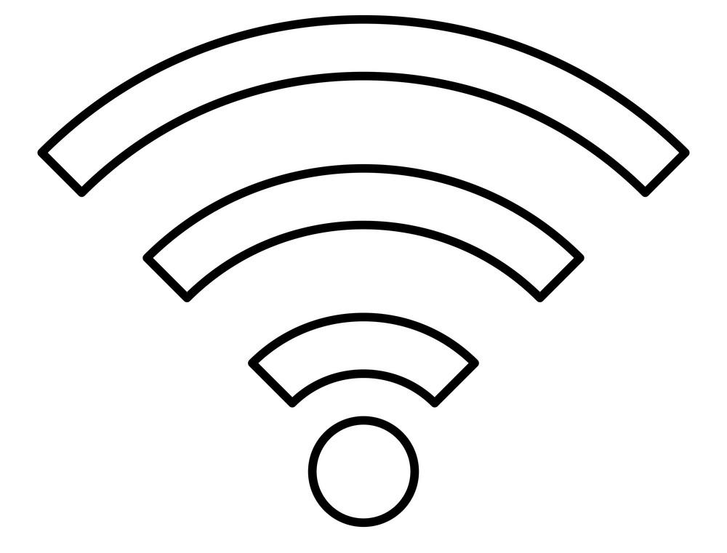
OUR OBJECTIVE
To get insights about the actual social distancing from the field ...*
* … during COVID-19 epidemia, from the CWA app users, to help Health Authorities manage the spread of infection (by using less coercive measures).

Slide 12
HOW?

Slide 13

INTRO TO EXPOSURE NETWORKS
Verification server
Content Delivery Network
Get test result
Get potential exposures,
Configuration
Mobile app #2
Mobile app #1
…
Mobile app #N
Broadcasting of RPI encrypted metadata, Scanning (BLE beacon mechanics),
Proximity and risk detection

Slide 14

INTRO TO EXPOSURE NETWORKS
Verification server
Content delivery network
- Test results for verified TAN
- Aggregated keys of positively tested individuals
- Configuration parameters for the risk scores
Health authorities can set weights for: Bluetooth attenuations, infectiousness of the affected individual and diagnosis report type, notification thresholds.
Decentralized FE scheme
Analytics server
- Meaningful analytics
Mobile app #1
- Public exposure data
PRIVATE DATA + RESTRICTIONS ON LOCATION DATA AND DATA USAGE
- Own Rolling Proximity Identifiers (RPI), changed every ~15 min
Exposure notification framework gives access to local secure storage for up to 14 days:
- Collected RPIs of encounters & metadata: day the contact occurred, how long it lasted and the BT signal strength of the contact
- Own Temporary Exposure Keys (TEK), changed daily, own Diagnosis key

Slide 15
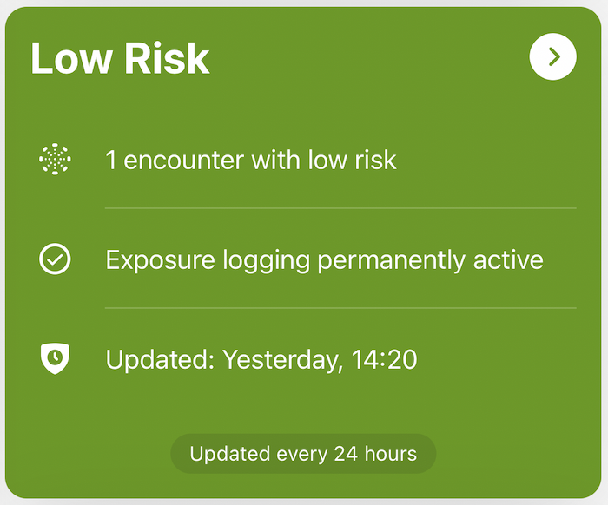
ENF provides no access to the exposure network
Due to privacy preserving, nobody (neither the app) has access to the network, including the local encounters!
Hence, (without the protocol upgrade) we cannot reconstructure the parts of the network.
But, the data about the user’s risk profile and number of identified exposures through the time are available to the mobile app, specifically:
- The number of days since the most recent exposure.
- For up to last 14 days:
- The number of keys that matched for an exposure detection.
- The highest risk score of all exposure incidents (max 255).
- The highest, full-range risk score of all user’s exposures.
- The sum of the full-range risk scores for all exposures for the user.

Slide 16
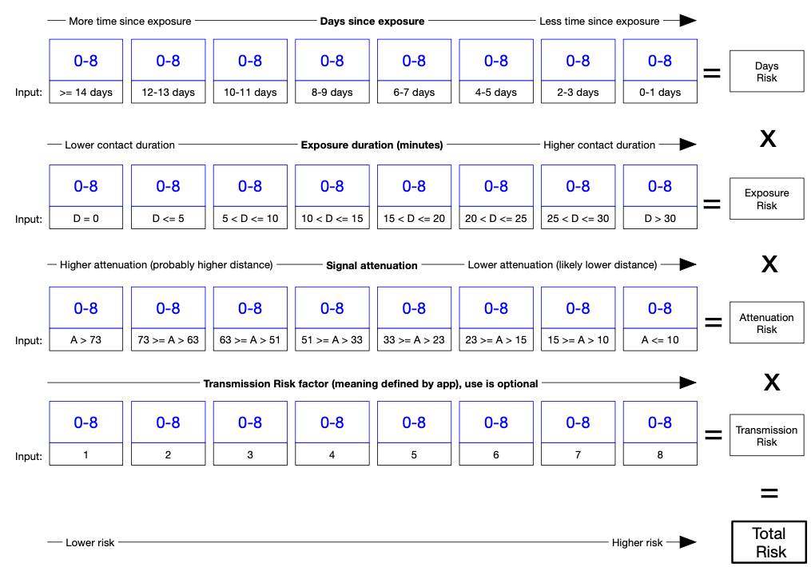
Risk score is calculated in the background < 4096
days of contact X
duration of the contact X
proximity (BT signal strength) of the contact X
transmission risk level (infectiousness, report type weight)

Slide 17
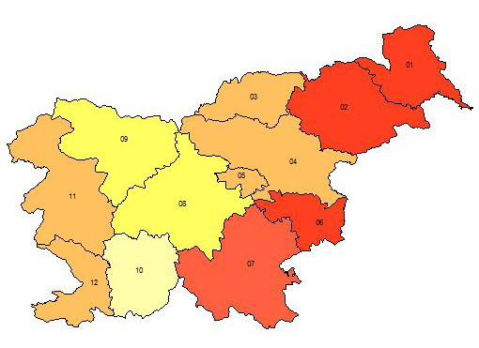
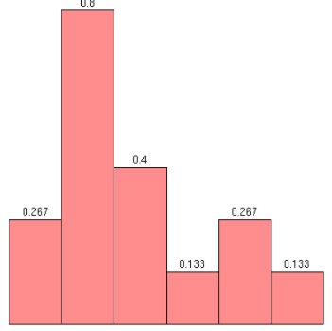
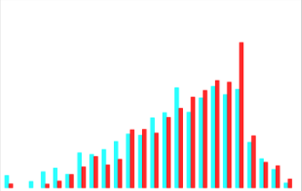
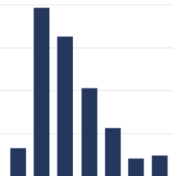
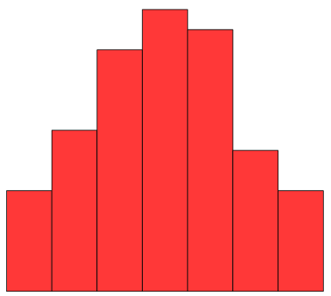
IDEA: Data only accessible to the user has value for HA
Actual information from the field, e.g. about social distancing (days since exposure), yesterday’s risk encounters (nr. of keys matched), and yesterday’s risk received (max, sum), can help in better management of the health crysis with less coercive measures.
These data can be processed for a region, when region label is provided by the user or for the whole country.
Health authorities now have a tool to specify the configuration settings that are used in risk score calculations and notification thresholds. Additionally, by lowering risky encounters (e.g. through efficient policies), the spread of the disease can be lowered, too.

Slide 18
Exposure vectors
Days since exposure
0 | 1 | 2 | 3 | 4 | 5 | 6 | 7 | 8 | 9 | 10 | 11 | 12 | 13
Number of keys matched *
0 | 1-2 | 3-5 | 6-10 | 11-20 | 21-40 | 41+
Max risk received
0 | 1 | 2 | ... | 253 | 254 | 255
Sum risk received
0 | 1 | 2 | ...
* Estimate: 4 trips per day, 50 encounters each trip, 1% known cases are positive

Slide 19
Example :: Exposure Network ⇒ ?
We do not have information about the exposure network’s structure.
But we have all the information we need (about the exposures with the users with positive result) in the nodes.
1
6
3
2
5

Slide 20
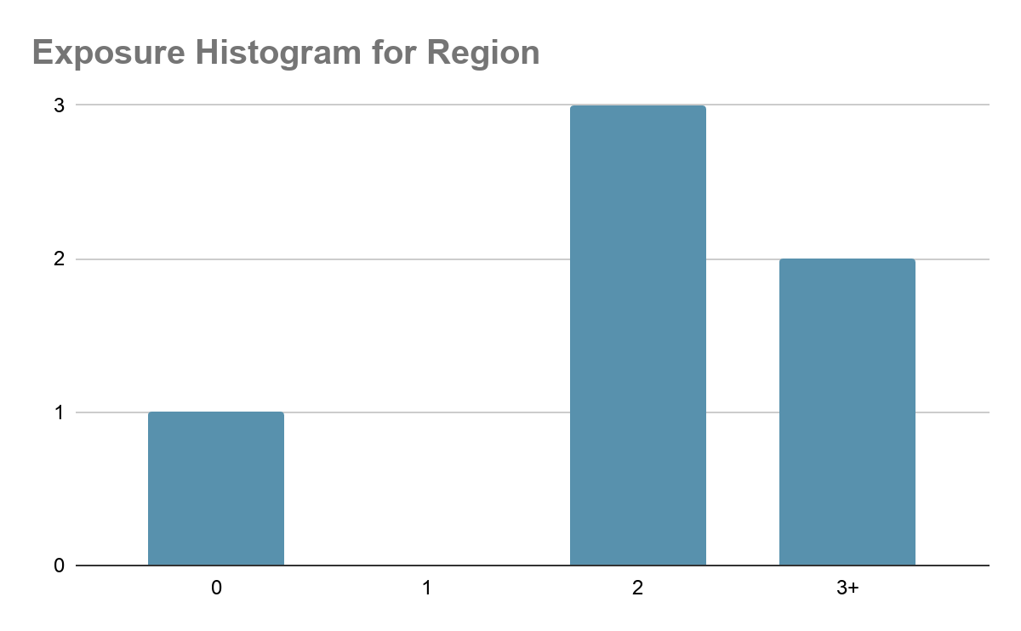
Example :: Exposure Network ⇒ Histogram
Analytics server
3
User has # contacts tested positive | Frequency
0 | 1
1 | 0
2 | 3
3+ | 2
0
4
2
2
Decentralized Multi-Client Functional Encryption for Inner Product
2

Slide 21
OUR PLAN
We use FE to process the data from multiple CWA apps to get meaningful insights about exposure networks. *
* At all steps we continue to respect data privacy and safety.

Slide 22
WHAT?

Slide 23
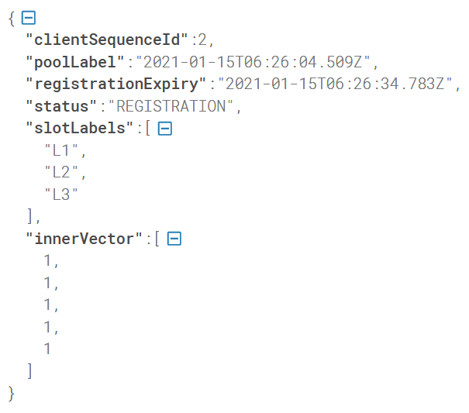
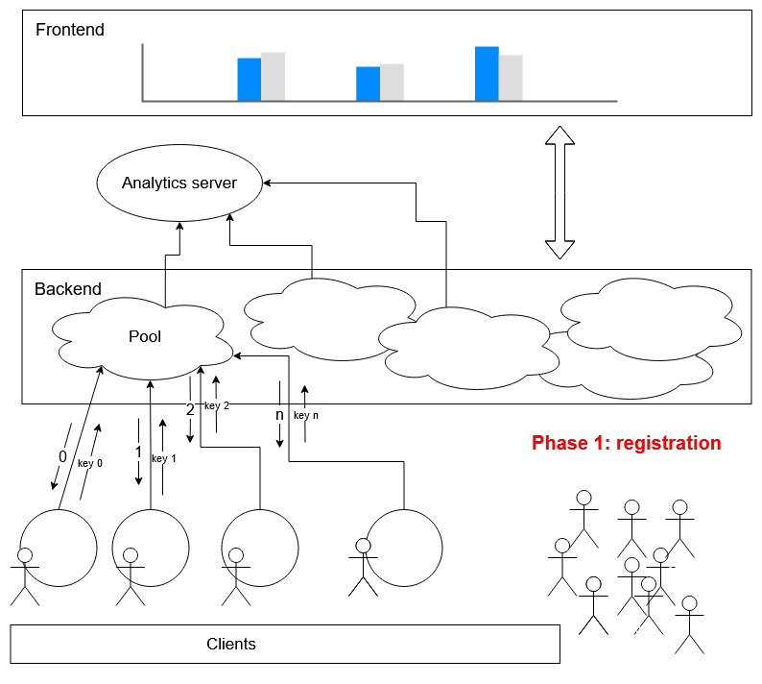
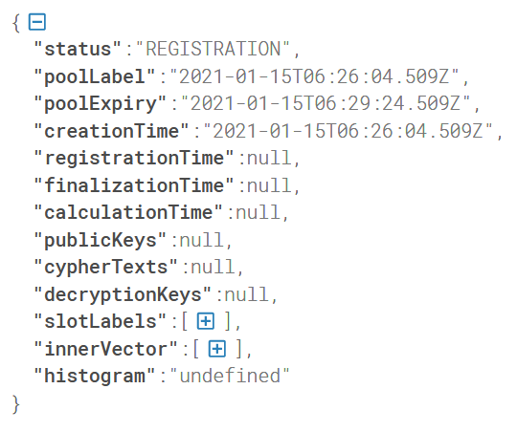
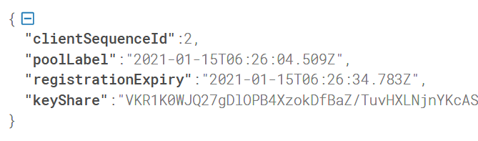
Phase 1: Registration

Slide 24
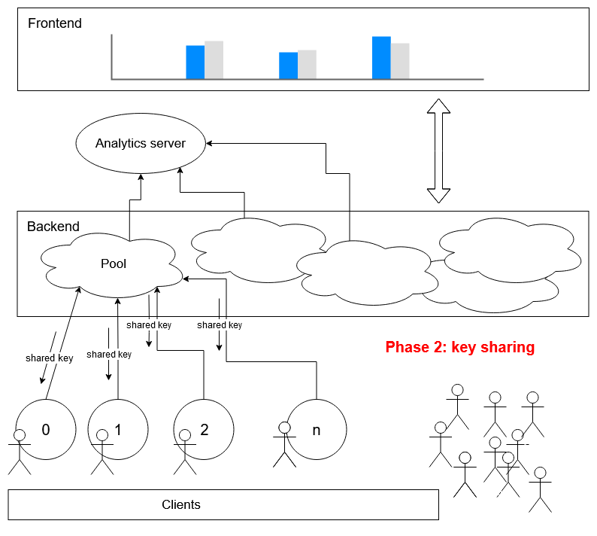
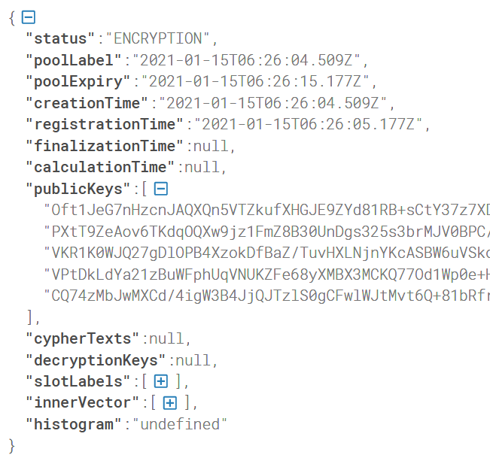
Phase 2: Key sharing

Slide 25
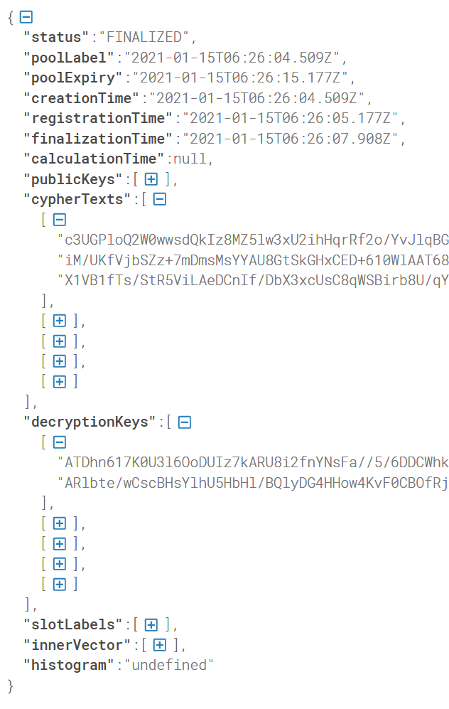
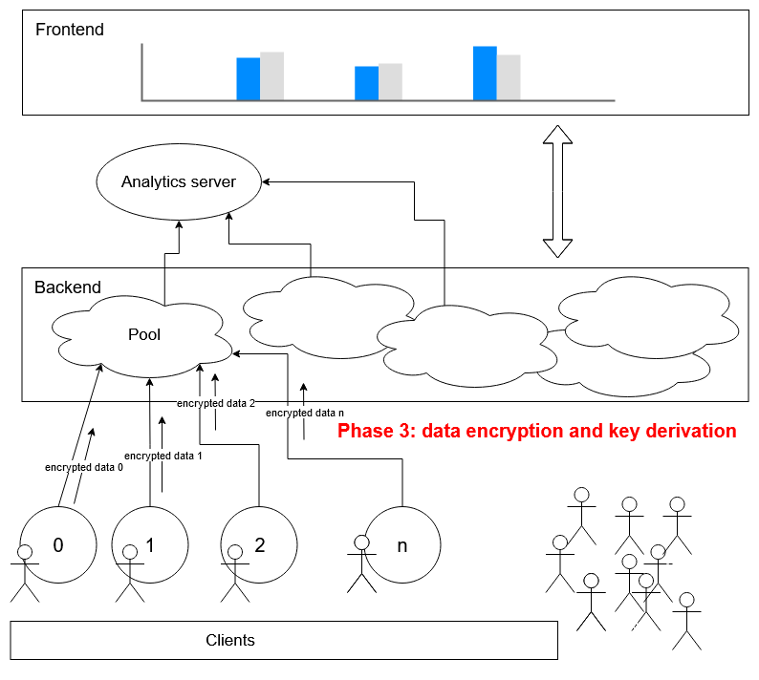
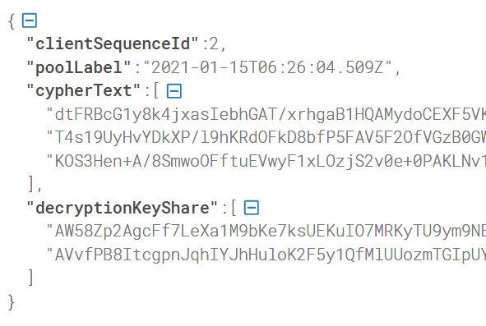
Phase 3: Data encryption

Slide 26
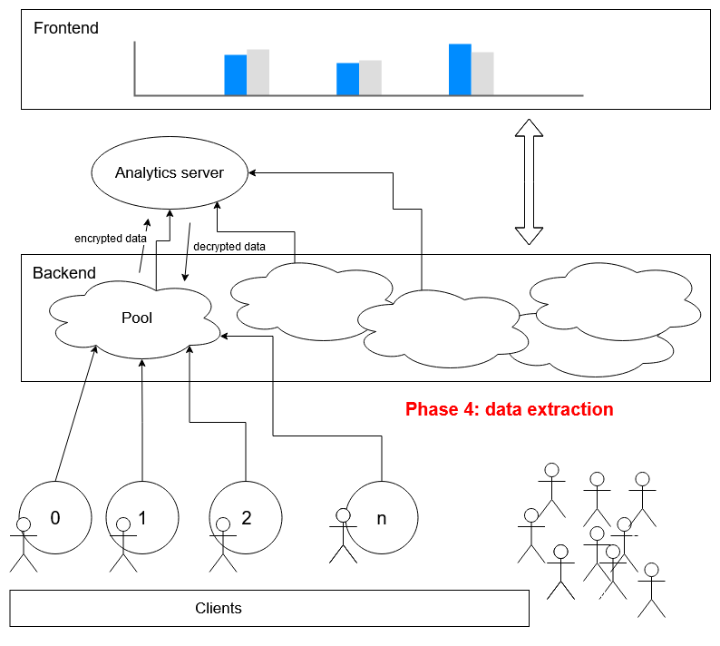
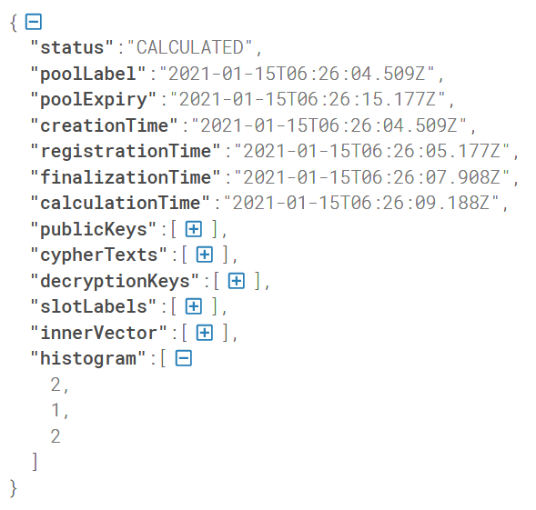
Phase 4: Data extraction

Slide 27
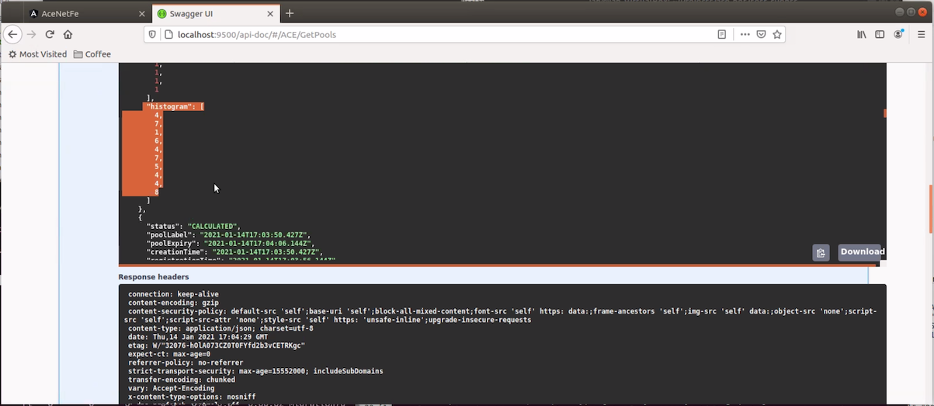
Analytics server (access via API through Swagger)
Calculation finished, result histogram
[4,7,1,6,4,7,5,4,4,5]

Slide 28
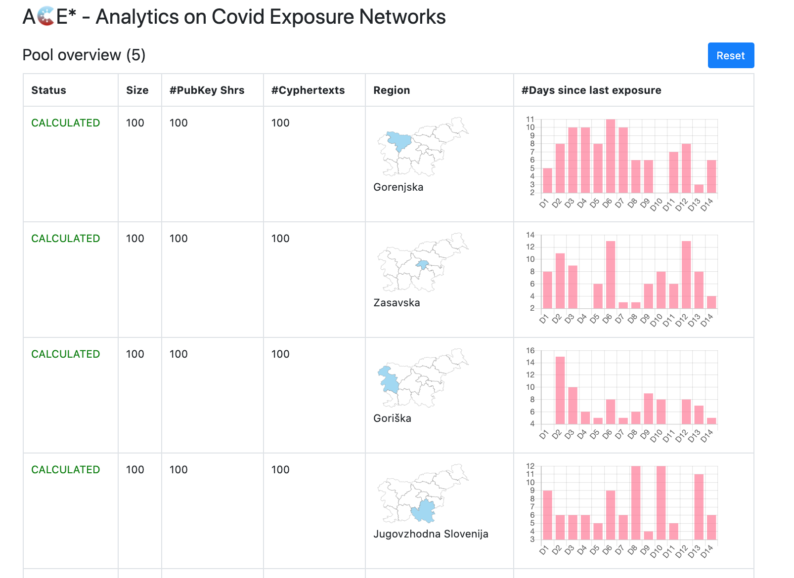
Front end
WebSocket communication with the analytics server in real-time.
Server, clients, histograms etc. are configurable.
[4,7,1,6,4,7,5,4,4,5]

Slide 29
DEMO

Slide 30
Interesting links
FE
Decentralized Multi-Client Functional Encryption for Inner Product https://eprint.iacr.org/2017/989.pdf
Subway heatmap https://github.com/fentec-project/FE-anonymous-heatmap, paper: https://fentec.eu/content/privacy-enhanced-machine-learning-functional-encryption
COVID
COVID-19 Tracker, https://covid-19.sledilnik.org
Understanding metropolitan patterns of daily encounters, https://www.researchgate.net/publication/235009037_Understanding_metropolitan_patterns_of_daily_encounters
Slovenian Temporary Exposure Keys, https://github.com/sledilnik/cwa-scrape
Corona-Warn-APP
Corona-Warn-App, https://www.coronawarn.app, https://github.com/corona-warn-app/cwa-documentation
CWA Solution Architecture, https://github.com/corona-warn-app/cwa-documentation/blob/master/solution_architecture.md
Exposure notification framework for contact tracing https://covid19.apple.com/contacttracing, https://www.google.com/covid19/exposurenotifications
Exposure Notification cryptography specification, https://blog.google/documents/Exposure_Notification_-Cryptography_Specification_v1.2.1.pdf
CWA Risk score calculation, https://www.r-bloggers.com/2020/09/risk-scoring-in-digital-contact-tracing-apps
Contact tracing
Kukkala VB, Saini JS, Iyengar SRS, Privacy preserving network analysis of distributed social networks https://eprint.iacr.org/2016/427.pdf
Kukkala VB, Iyengar SRS, Computing Betweenness Centrality: An Efficient Privacy-Preserving Approach https://link.springer.com/chapter/10.1007/978-3-030-00434-7_2
Kukkala VB, Iyengar SRS, Identifying Influential Spreaders in a Social Network (While Preserving Privacy), https://content.sciendo.com/downloadpdf/journals/popets/2020/2/article-p537.pdf
ACE* project github repository
https://github.com/cryptohackathon/ace-net
https://cryptohackathon.github.io/ace-net

Slide 31
Future work
Bring the results of this project to Corona-Warn-App
“Those who count the votes decide everything” - Voting systems (giving N votes between M >= N options)
Randomising communication patterns, by involving a part (half?) of the requests to be ignored or by submitting data using secret sharing schemes (e.g. partial data, multiple times)
The decentralized nature of the framework fits perfectly to blockchain technologies. The pool management implemented in our backend system (api-back) could be transferred to e.g. Ethereum Virtual Machine ecosystem based on smart contracts.
GoFE problem: "panic: runtime error: invalid memory address or nil pointer dereference [signal SIGSEGV: segmentation violation code=0x1 addr=0x10 pc=0x67689b]"

