Slide 1

Online Clinic Appointment System
Medicare ©
This comprehensive online clinic appointment system streamlines the patient experience, allowing for seamless scheduling, profile management, and payment
- all from the convenience of their preferred device.

Slide 2

Project Overview
Modernize Workflow
Enhanced Patient Experience
Automate and simplify appointment scheduling, patient information management, and payment processing for healthcare providers.
Offer patients a user-friendly platform to conveniently book appointments, access their profiles, and make payments.
Robust Data Management
Scalable Solution
Built with Python and Tkinter, the system can easily adapt to the growing needs of healthcare organizations.
Utilize a secure MySQL database to store and manage patient information and appointment details.

Slide 3
Key Functionalities
User Authentication
Appointment Management
Patient Profiles
Secure login system for patients and staff to access personalized features.
Comprehensive patient records, including medical history and contact information.
Intuitive scheduling, rescheduling, and cancellation of appointments.

Slide 4
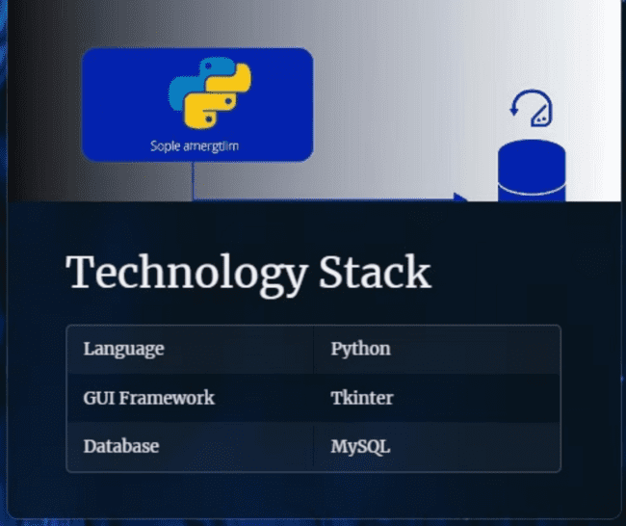

Slide 5
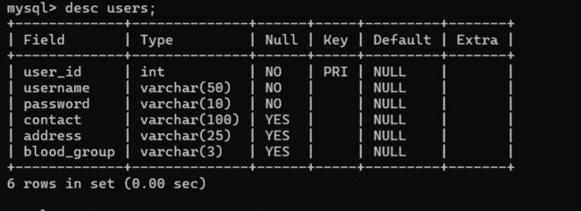

Slide 6
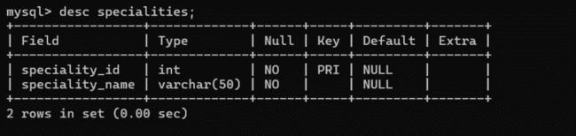

Slide 7
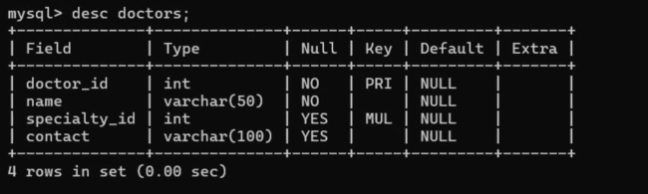

Slide 8
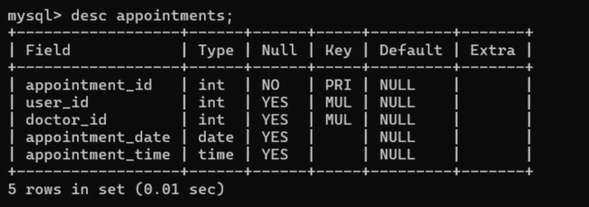

Slide 9
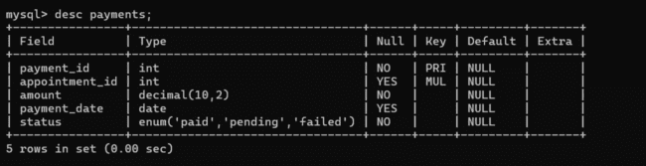

Slide 10
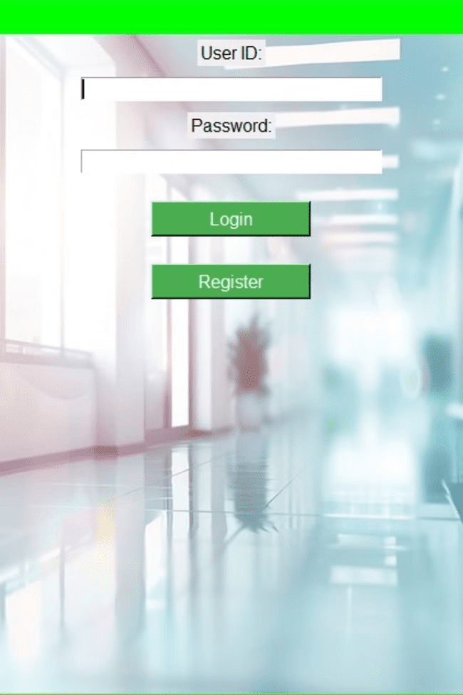
User Authentication
1
Patient Registration
Patients can create secure accounts with unique login credentials.

Slide 11
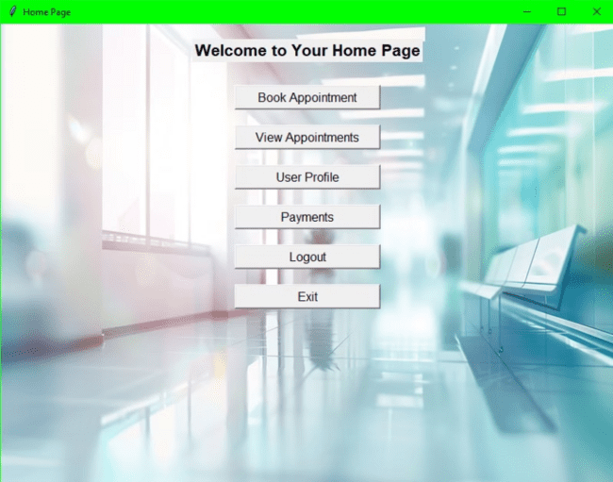
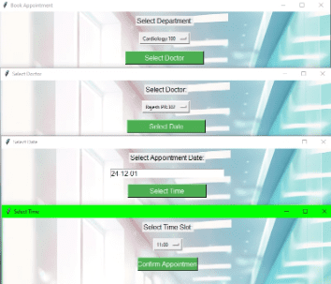
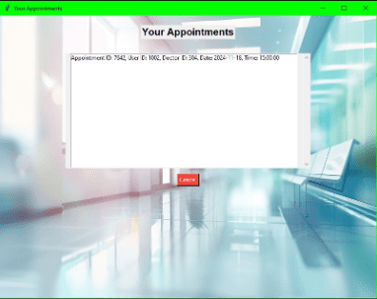
Appointment Management
Book Appointment
Patients can easily select available slots and book appointments.
1
2
Manage Appointments
Patients can view, or cancel their upcoming appointments.

Slide 12
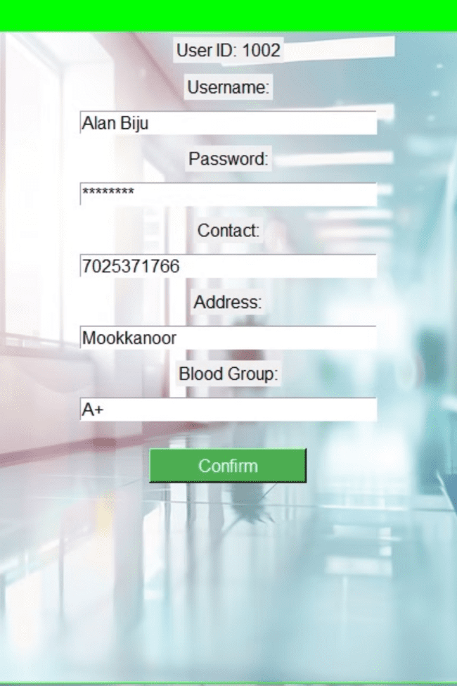
User Profiles
Personal Details
Patients can update their contact information, insurance details, and emergency contacts.

Slide 13


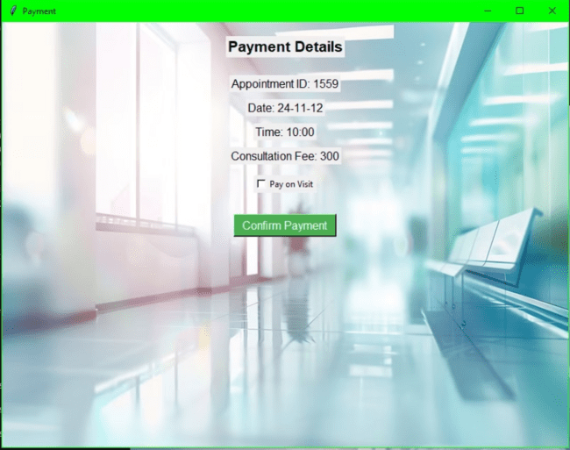
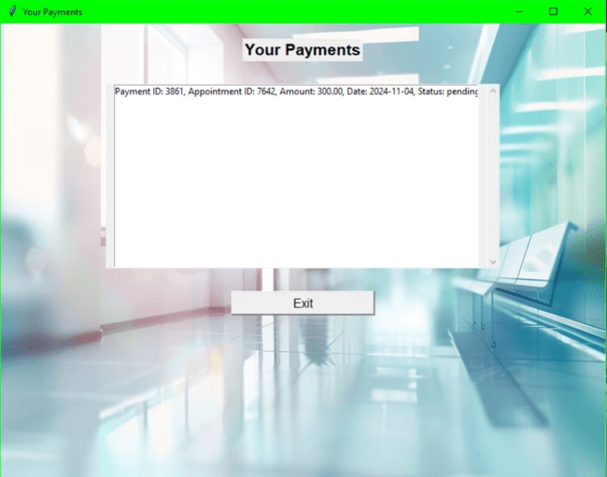
Payment Processing
Secure Payments
Transaction History
Patients can make payments for their appointments.
Patients can view transaction records.

Slide 14
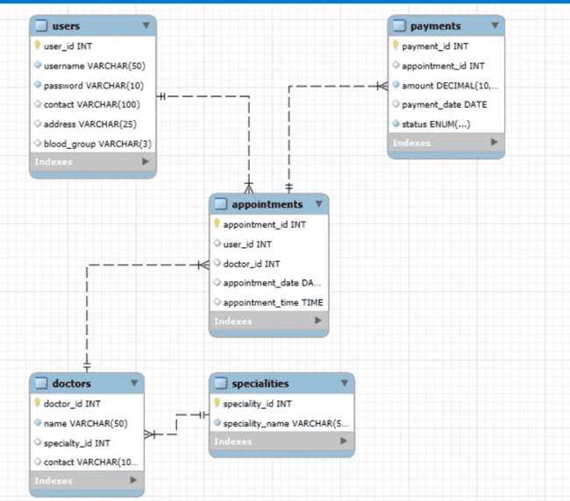

Slide 15




Benefits
Improved Efficiency
Streamlined appointment scheduling and record-keeping for healthcare providers.
Enhanced Patient Satisfaction
Convenient and user-friendly platform for patients to manage their healthcare needs.
Secure Data Management
Robust database integration to protect sensitive patient information.

Slide 16
Ideal for Healthcare Providers
Modernize Operations
Enhance Patient Care
Scalable Solution
Automate and streamline appointment scheduling, patient records, and payment processing.
Provide a seamless and convenient experience for patients to manage their healthcare needs.
The system can easily adapt to the evolving needs of healthcare organizations of all sizes.

Slide 17
Thank you…

Slide 18
DBMS Mini Project
Title: Online Clinic Appointment System
Batch: 7
Submitted by: Alan Biju (17), Alen Bigi(19), Alen Chacko(20), Basil Mathew Santhosh(52)
S5 CSE A 11/04/2024

