Slide 1
JANASEVA
AI-Powered Citizen Grievance Routing
and Accountability Platform
Academic prototype
Notes:
Academic one-district JANASEVA prototype. Source: project implementation and docs/ACADEMIC_REPORT.md. This slide has no claim of verified government integration. Real application screenshot from automated local browser test. Displayed data and account names are synthetic.

Slide 2
Citizen grievance reporting
A citizen can describe a pothole, garbage or a failed streetlight.
Identifying the responsible office adds a separate administrative task.
JANASEVA records the issue once and makes its progress visible.
Notes:
Academic one-district JANASEVA prototype. Source: project implementation and docs/ACADEMIC_REPORT.md. This slide has no claim of verified government integration.

Slide 3
Existing grievance systems
CPGRAMS and Kerala CMO grievance services already support public complaint mechanisms.
JANASEVA explores a complementary orchestration prototype.
Official interoperability needs authorization and verified APIs.
Notes:
Academic one-district JANASEVA prototype. Source: project implementation and docs/ACADEMIC_REPORT.md. This slide has no claim of verified government integration. Public systems: https://pgportal.gov.in/ and https://complaints.cmo.kerala.gov.in/cmoportal/login.htm?lang=en accessed 8 October 2026.

Slide 4
Project motivation
A complete case should preserve the complaint, its location, office actions and repair evidence.
Uncertain classification or geography should trigger human review.
Accountability requires a traceable timeline and measurable deadlines.
Notes:
Academic one-district JANASEVA prototype. Source: project implementation and docs/ACADEMIC_REPORT.md. This slide has no claim of verified government integration.

Slide 5
Proposed JANASEVA
A citizen submits text, location and evidence.
Assisted analysis works with GIS and trusted routing configuration.
Office actions, citizen confirmation and SLA events feed live analytics.
Notes:
Academic one-district JANASEVA prototype. Source: project implementation and docs/ACADEMIC_REPORT.md. This slide has no claim of verified government integration.

Slide 6
Project objectives
Demonstrate one excellent case workflow in a controlled district fixture.
Enforce ownership and office permissions in the backend.
Measure the baseline and document uncertainty, data provenance and limitations.
Notes:
Academic one-district JANASEVA prototype. Source: project implementation and docs/ACADEMIC_REPORT.md. This slide has no claim of verified government integration.

Slide 7
Primary user roles
Citizen
Reports an issue, tracks updates and confirms resolution.
Office
Investigates permitted cases and records resolution evidence.
Admin
Configures responsibility, users, GIS and deadlines.
Notes:
Academic one-district JANASEVA prototype. Source: project implementation and docs/ACADEMIC_REPORT.md. This slide has no claim of verified government integration.

Slide 8
Case workflow
Submission and assisted analysis
Geographic lookup and configured office assignment
Acknowledgement, investigation and evidence
Resolution, citizen confirmation and audit history
Notes:
Academic one-district JANASEVA prototype. Source: project implementation and docs/ACADEMIC_REPORT.md. This slide has no claim of verified government integration.

Slide 9
System architecture
React and TypeScript client with Nginx proxy
FastAPI modular monolith and normalized PostgreSQL/PostGIS
Redis and Celery for periodic SLA checks
MinIO private evidence storage and optional monitoring
Notes:
Academic one-district JANASEVA prototype. Source: project implementation and docs/ACADEMIC_REPORT.md. This slide has no claim of verified government integration.

Slide 10
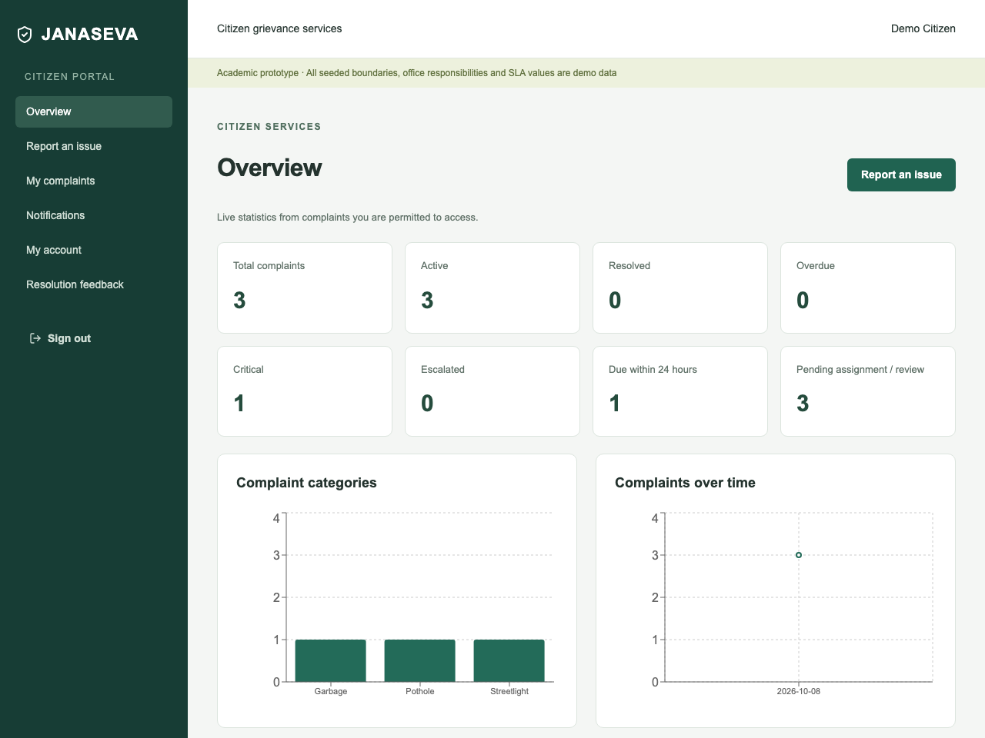
Citizen portal
Report without choosing a department.
Track the case timeline and notifications.
Confirm resolution or request reopening.
Notes:
Academic one-district JANASEVA prototype. Source: project implementation and docs/ACADEMIC_REPORT.md. This slide has no claim of verified government integration. Real application screenshot from automated local browser test. Displayed data and account names are synthetic.

Slide 11
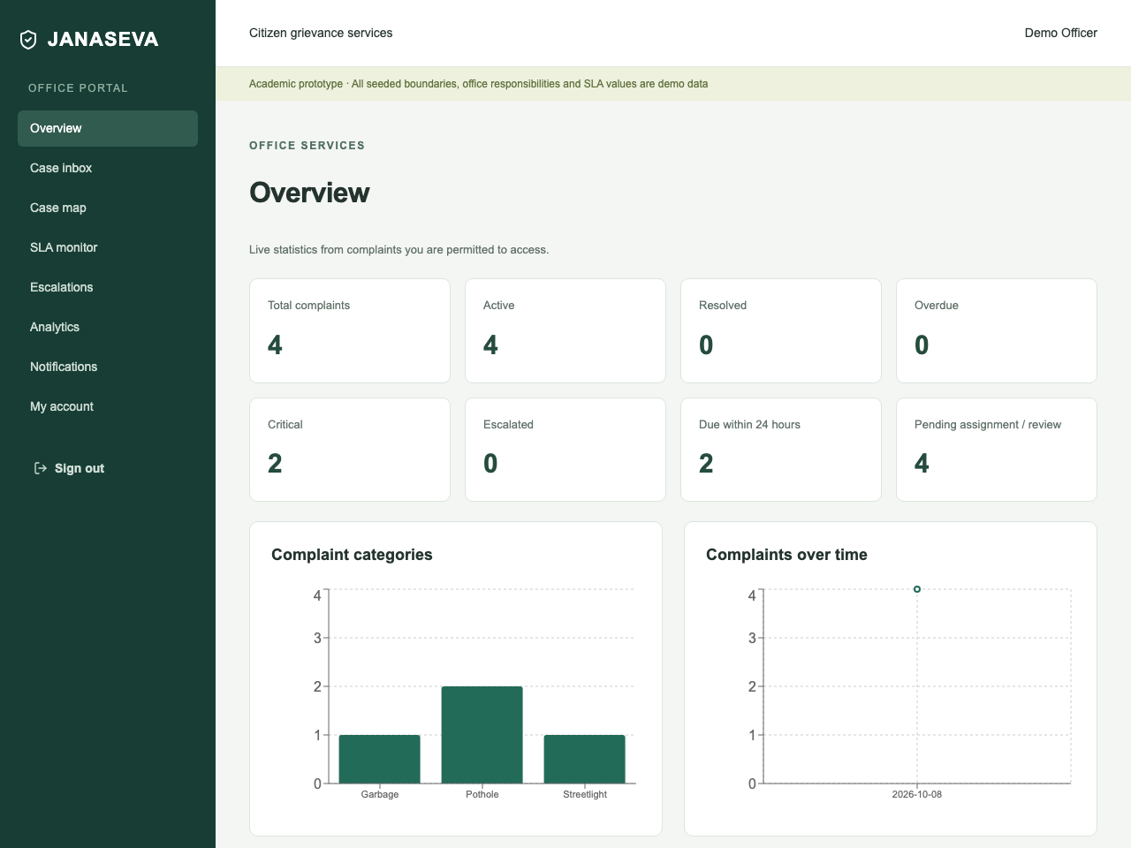
Office portal
Use the permitted case inbox.
Acknowledge, investigate and upload repair evidence.
Resolve with a reason or escalate.
Notes:
Academic one-district JANASEVA prototype. Source: project implementation and docs/ACADEMIC_REPORT.md. This slide has no claim of verified government integration. Real application screenshot from automated local browser test. Displayed data and account names are synthetic.

Slide 12

Admin portal
Configure users, GIS, routing and SLA.
Inspect scoped operational analytics.
Review predictions and audit records.
Notes:
Academic one-district JANASEVA prototype. Source: project implementation and docs/ACADEMIC_REPORT.md. This slide has no claim of verified government integration. Real application screenshot from automated local browser test. Displayed data and account names are synthetic.

Slide 13
AI and ML subsystem
A real supervised text baseline handles classification.
An explainable policy estimates severity from reported text.
Related-report scoring combines category, time, distance and text similarity.
Notes:
Academic one-district JANASEVA prototype. Source: project implementation and docs/ACADEMIC_REPORT.md. This slide has no claim of verified government integration.

Slide 14
Complaint classification
TF-IDF word unigrams and bigrams with logistic regression.
84 synthetic English training examples and 24 held-out examples.
Model and dataset versions accompany stored confidence. Predictions below 0.4 require review.
Notes:
Academic one-district JANASEVA prototype. Source: project implementation and docs/ACADEMIC_REPORT.md. This slide has no claim of verified government integration. Classification methods: https://www.jmlr.org/papers/v12/pedregosa11a.html and https://nlp.stanford.edu/IR-book/html/htmledition/irbook.html

Slide 15
Explainable severity
Reported damage contributes up to 30 points. Safety terms contribute 25.
Sensitive locations, related reports and traffic contribute additional points.
The UI exposes every factor. This prototype does not infer damage from images.
Notes:
Academic one-district JANASEVA prototype. Source: project implementation and docs/ACADEMIC_REPORT.md. This slide has no claim of verified government integration.

Slide 16
Related incident detection
Same-category reports within 150 metres and 30 days become candidates.
TF-IDF cosine similarity and proximity produce a heuristic score.
Clusters retain each citizen report. The score is not a calibrated probability.
Notes:
Academic one-district JANASEVA prototype. Source: project implementation and docs/ACADEMIC_REPORT.md. This slide has no claim of verified government integration.

Slide 17
Geographic jurisdiction
Case points and ward MultiPolygons use WGS84 coordinates.
PostGIS ST_Covers finds the configured ward.
Bundled boundaries are synthetic. Production mode excludes unverified data.
Notes:
Academic one-district JANASEVA prototype. Source: project implementation and docs/ACADEMIC_REPORT.md. This slide has no claim of verified government integration. GIS reference: https://postgis.net/docs/reference.html

Slide 18
Configured responsibility
Routing queries category and ward against active trusted rules.
ML classification cannot determine legal responsibility by itself.
Absent or uncertain configuration creates ROUTING_REVIEW_REQUIRED.
Notes:
Academic one-district JANASEVA prototype. Source: project implementation and docs/ACADEMIC_REPORT.md. This slide has no claim of verified government integration.

Slide 19
SLA and escalation
Category/severity policies establish warning times and deadlines.
A periodic task notifies users and records overdue escalation once.
Continued breaches advance through configured parent offices. All seeded SLA values are prototype policies.
Notes:
Academic one-district JANASEVA prototype. Source: project implementation and docs/ACADEMIC_REPORT.md. This slide has no claim of verified government integration.

Slide 20
Database design
Internal UUIDs remain separate from human-readable public case IDs.
Foreign keys connect identity, offices, geography and complaint records.
Evidence metadata, predictions, SLA instances, events and feedback remain normalized.
Notes:
Academic one-district JANASEVA prototype. Source: project implementation and docs/ACADEMIC_REPORT.md. This slide has no claim of verified government integration.

Slide 21
Security and privacy
Argon2 passwords and expiring JWT sessions.
Backend role, ownership and office-scope checks on protected actions.
Content-validated private uploads, rate limits and immutable audit/event triggers. Synthetic identities only in the demo.
Notes:
Academic one-district JANASEVA prototype. Source: project implementation and docs/ACADEMIC_REPORT.md. This slide has no claim of verified government integration.

Slide 22
Measured results
24 backend tests and 7 frontend tests passed.
Both browser tests passed, including the complete resolution workflow and mobile form check.
Classification accuracy was 95.83% on 24 synthetic test examples. Duplicate recall was 0.4 on eight synthetic pairs.
Notes:
Academic one-district JANASEVA prototype. Source: project implementation and docs/ACADEMIC_REPORT.md. This slide has no claim of verified government integration. Evidence: backend pytest 24 passed, frontend Vitest 7 passed, Playwright 2 passed; ml/evaluation/classification.json and auxiliary.json. Results use tiny synthetic datasets and have no field-validation implication.

Slide 23
Known limitations
Small English corpus and synthetic geographic responsibility fixtures.
No official government integration, Malayalam model or image inference.
Live Docker infrastructure and SMTP need acceptance tests on the deployment host. No operational improvement claim follows from these tests.
Notes:
Academic one-district JANASEVA prototype. Source: project implementation and docs/ACADEMIC_REPORT.md. This slide has no claim of verified government integration.

Slide 24
Future scope
Authorized boundary and responsibility datasets.
Broader multilingual evaluation, calibrated confidence and reviewed clustering.
Multilevel escalation policies, notification delivery and official adapters after authorization.
Notes:
Academic one-district JANASEVA prototype. Source: project implementation and docs/ACADEMIC_REPORT.md. This slide has no claim of verified government integration.

Slide 25
Project conclusion
JANASEVA demonstrates a connected academic complaint workflow.
Its source, test cases and model metrics support reproduction and inspection.
Official data, infrastructure acceptance and field evaluation are required before operational use.
Notes:
Academic one-district JANASEVA prototype. Source: project implementation and docs/ACADEMIC_REPORT.md. This slide has no claim of verified government integration.

Slide 26
Live demonstration
Citizen reports a pothole at demo coordinates 9.965, 76.30.
Office acknowledges, starts work and uploads repair evidence before resolution.
Citizen confirms with feedback. Admin inspects the case, analytics and audit history.
Notes:
Academic one-district JANASEVA prototype. Source: project implementation and docs/ACADEMIC_REPORT.md. This slide has no claim of verified government integration.

