Slide 1
A PACKT COURSE
Beyond GraphRAG
Building an explainable financial advisor with knowledge graphs, Neo4j, and LLM agents
Alessandro Negro
Chief Scientist, GraphAware
Notes:
Title. Beyond GraphRAG — an explainable financial advisor built on a knowledge graph, Neo4j and LLM agents. Alessandro Negro, Chief Scientist at GraphAware.

Slide 2
THE PROBLEM
Good decisions need everything in one place.
Often, the knowledge to make proper decisions is scattered across many sources in many formats. Such knowledge has to be found, aggregated, and summarized before a person can use it.
Beyond GraphRAG
Intro
Notes:
Complex decisions depend on knowledge spread across sources. Plain RAG's flat chunk retrieval is a weak fit — the scattered squares are disconnected chunks with nothing linking them.
Think about multiple scenarios in your own professional and personal life.
The same can apply if you are building an intelligent system for supporting the doctor to heal a patient
If you are building a system that support mission critical intelligence practice
And the list if very long
In general, building an intelligent system requires to create

Slide 3
THE USE CASE
Value investing is a knowledge problem.
Filings (10-Ks, …)
To judge a company, to invest properly, you must know a great deal about it — and that knowledge lives in many different places, never one.
News
A single company
Executives & board decisions
Financial data
10-K — a company's annual report filed with the U.S. SEC.
Beyond GraphRAG
Intro
Notes:
Make it concrete: financial markets and value investing. What you need to know about a company is spread across filings, news, executive/board data, and structured financials.
To make it concrete we would like to consider a scenario that can be very common to many people. Imagine you’d like to create a companion that helps you in finding a good company to invest in.
Here we are not talking about short term investiment or fast trading, we are talking about put a bit of your money on a company and wait for the company to grow.
In this case you need to know a lot about the company about the business
Warren buffet, one of the fathers of value investing, always says that he invests in companies and business he can understand.
So we need to build a system that allows us to underatand a company to know as much as we can about it.

Slide 4
WHAT A REAL ADVISOR MUST ANSWER
Questions that quietly defeat a vanilla RAG pipeline:
What did a CEO change after joining — and how did the business change with them?
What set Company A apart from Company B in the same period — and whose approach played out better?
How did a company's stated priorities shift across consecutive annual reports?
Which executives moved between rival firms — and what happened around each move?
Multi-hop. Cross-document. Comparison. Change over time.
Beyond GraphRAG
Intro
Notes:
These are a few of the questions we can ask to get a better understanding
Look at them, now from high level, some requires just a few lines in a 10K filing, other requires to span multiple documents and gather way more information.
But this is very common to many of the examples we mentioned
These span simple lookups, multi-hop reasoning, comparison, and change-over-time — the full range a real advisor must cover, and where flat RAG falls down.

Slide 5
THE APPROACH
Gather the knowledge, organize it as a graph, access it properly.
That spine — a knowledge graph you can grow and query — is what everything else in the course is built on.
KG (knowledge graph) — entities and the relationships between them, stored as a graph.
Beyond GraphRAG
Intro
Notes:
The framing statement for the whole workshop: gather and organize this information into a knowledge graph, and make it accessible. That's the spine of everything that follows.

Slide 6
RETRIEVAL, DONE RIGHT
RAG stays our best friend.
The question is never whether to retrieve — it's how. RAG has many possible implementations, and the implementation is most of what decides whether it actually works for questions like these.
Beyond GraphRAG
Intro
Notes:
RAG as a concept is still the right tool. But it has many implementations, and the choice of implementation is most of what determines whether it works for this kind of question.

Slide 7
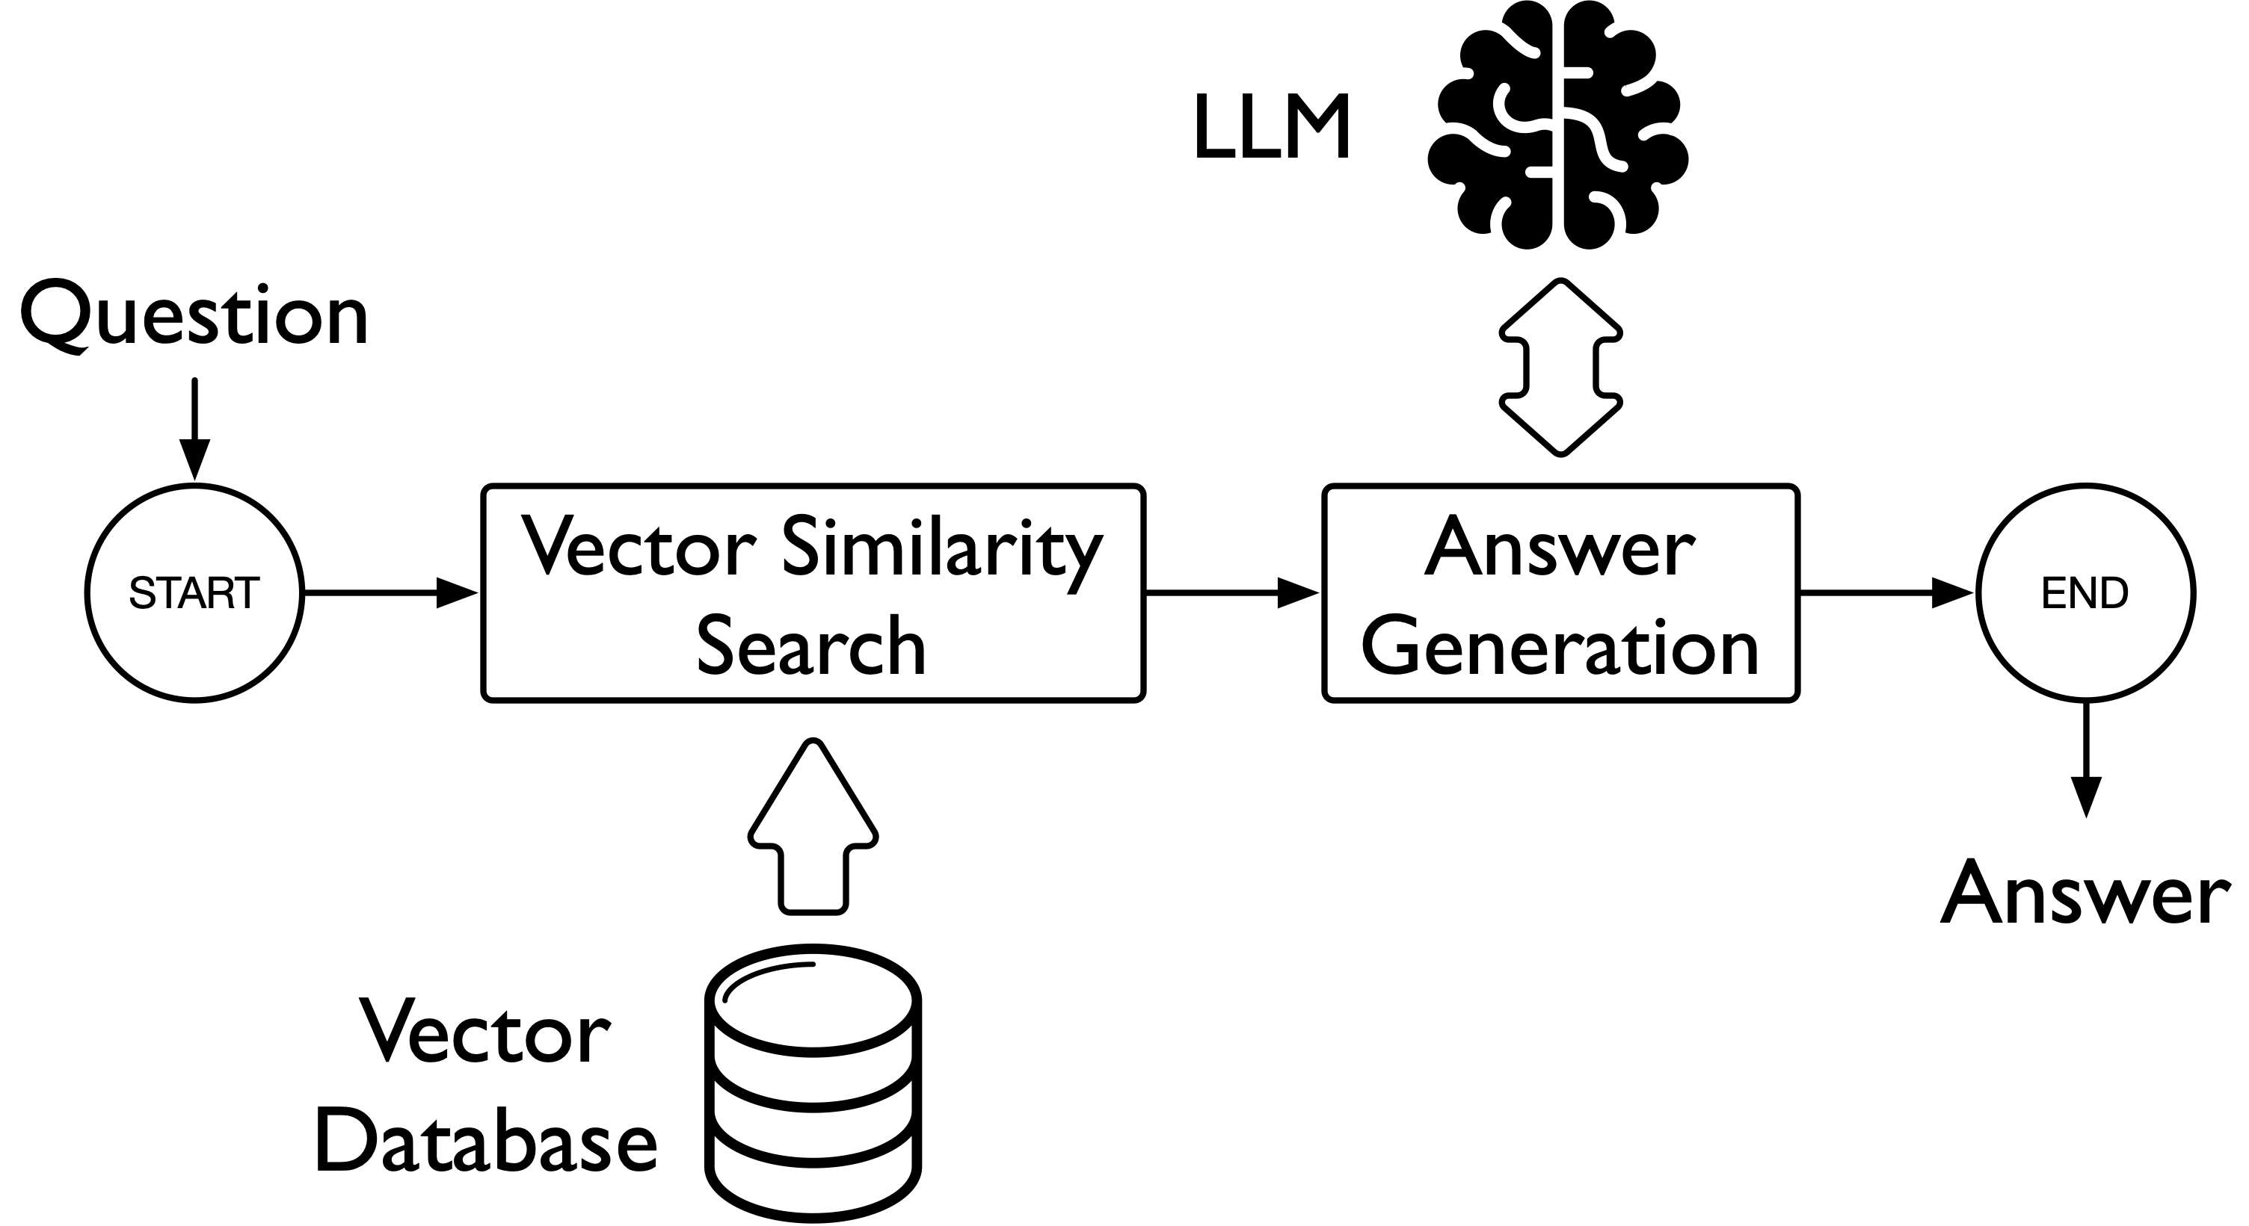
MODULE 01 · WHERE WE START
One-shot RAG.
Question → Retrieve chunks → Context → Answer
It works on easy lookups — and visibly stumbles the moment a question needs more than flat similarity.
Beyond GraphRAG
Intro
Notes:
We start simple: one-shot RAG (Module 1). Embed the question, retrieve chunks, build context, generate an answer. Get the mechanics — then watch it fail on multi-hop, cross-document questions.

Slide 8
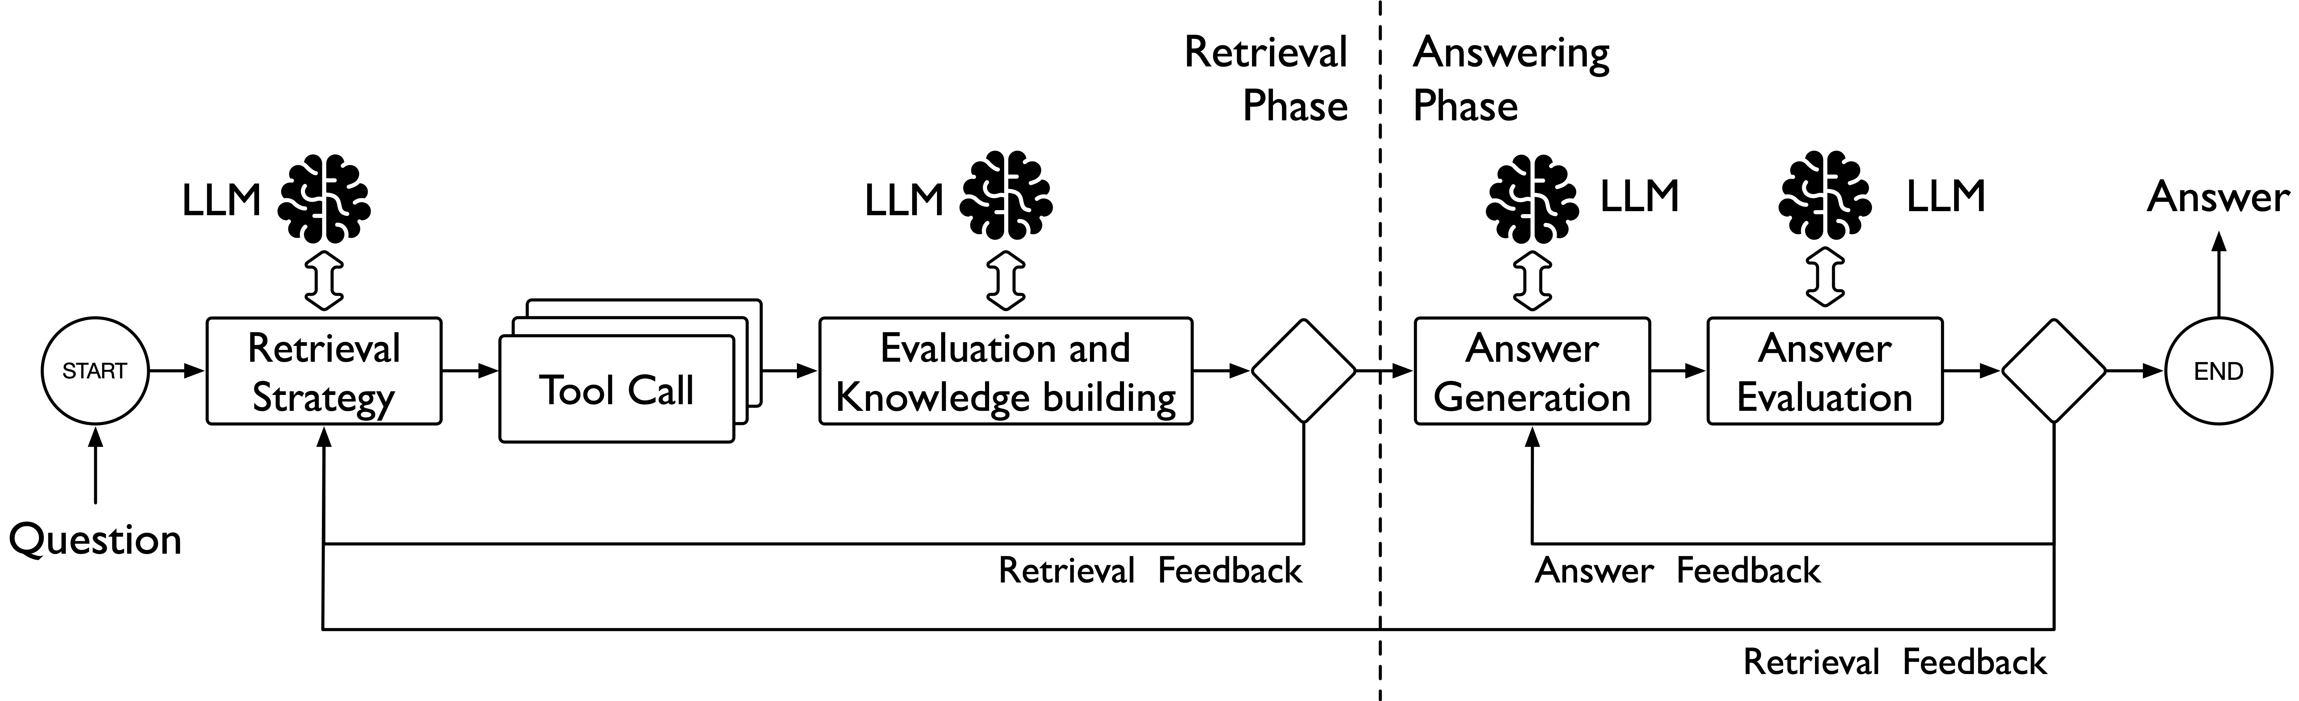
MODULE 02 · A SMARTER LOOP
Agentic RAG.
The agent chooses a tool, uses it, grades the result — and retries when the retrieval or the answer isn't good enough.
Beyond GraphRAG
Intro
Notes:
Module 2: an agentic loop. The agent decides which tool to use, uses it, evaluates the result, and retries when retrieval or the answer isn't good enough.

Slide 9
WHY THE LOOP MATTERS
One loop, many tools.
Once the agent loop exists, every later module adds a new tool to the same agent — no restructuring.
Agent
vector
full-text
navigation
+
+
later modules add tools to the same agent
Beyond GraphRAG
Intro
Notes:
Emphasize how easy the loop is to extend. Every module from 3 onward adds a new tool to the same agent without restructuring it.

Slide 10
THE THESIS
Agentic RAG is only as good as the knowledge base behind it.
A flexible agent is wasted on a store that can't grow. Extensible retrieval has to be paired with an extensible knowledge store —
a knowledge graph, not a flat vector index.
Beyond GraphRAG
Intro
Notes:
The thesis that ties the course together. An agent that can flexibly choose tools is wasted on a knowledge base that can't grow. That's why a knowledge graph is the foundation, not a flat vector index.

Slide 11
THE PATH
Seven layers. Each one earns its place.
01
02
03
04
05
06
07
Baseline
RAG
Agentic
retrieval
Structured
enrichment
LLM
extraction
Similarity &
resolution
Text2Cypher
Evaluation &
production
Every module ends with a system that is visibly better than the last — motivated by a limitation you just watched the previous one hit.
Beyond GraphRAG
Intro
Notes:
The roadmap. This same schematic recurs at every module transition — only the highlight moves. Right now the whole path is ahead of us.

Slide 12
HOW WE'LL BUILD IT
Grow the graph one layer at a time — and use each layer at once.
Never build ahead of what we can demonstrate. Modules 3–7 each add one capability to the graph and one to the agent, in the same step.
Beyond GraphRAG
Intro
Notes:
Stated explicitly because it's how the course is structured: build the knowledge graph step by step and put each extension to use immediately. Never build ahead of what we can demonstrate.

Slide 13
THE STACK
What it's built on.
Neo4j — property graph + native vector index + text search index
LangChain — tool wrapping
LangGraph — agent loop with retrieval- and answer-grading steps, plus retry edges
Azure OpenAI — chat / agent reasoning only
Local embeddings — sentence-transformers, BAAI/bge-m3 — no embedding API call
Docling — PDF parsing & chunking
Pydantic — schema validation throughout
Beyond GraphRAG
Intro
Notes:
The stack, no logos. Azure OpenAI is chat/generation only; embeddings run locally with bge-m3, so no embedding API call. LangGraph is what makes 'evaluates its own results' concrete — explicit grading and retry edges, not a bare ReAct loop. Version note if asked: development ran against Neo4j 2026.x (Enterprise) — Module 2's multi-property vector index + SEARCH clause need Cypher 25 (Neo4j 2026.01+), and the GDS/Louvain work needs the Graph Data Science library installed.

Slide 14
UP FIRST
Module 01
Baseline RAG on filings.
01
02
03
04
05
06
07
Baseline
RAG
Agentic
retrieval
Structured
enrichment
LLM
extraction
Similarity &
resolution
Text2Cypher
Evaluation &
production
Ingest 10-Ks into Neo4j and stand up a one-shot RAG baseline — then find its edges.
Beyond GraphRAG
Intro → Module 01
Notes:
Transition into the first notebook, module_01_baseline.ipynb.

Slide 15
MODULE 01 · RECAP
We have a working baseline.
— 10-K filings ingested into a Company → Document → Chunk graph in Neo4j, embedded locally with bge-m3.
— One-shot vector RAG answers easy lookups end to end.
Design choice — we modeled documents as a graph from day one. The baseline's store is the substrate we'll grow, not a throwaway vector index.
But flat similarity breaks on multi-hop and cross-document questions. Next: smarter access to the same data.
RAG — retrieval-augmented generation.
Beyond GraphRAG
Module 01 · Recap
Notes:
What we built: a graph-modeled baseline. What broke: anything past flat similarity. Bridge to Module 2.

Slide 16
WHERE WE ARE
Module 01 complete.
UP NEXT
01
02
03
04
05
06
07
Baseline
RAG
Agentic
retrieval
Structured
enrichment
LLM
extraction
Similarity &
resolution
Text2Cypher
Evaluation &
production
Up next — turn the one-shot pipeline into an agentic retrieval loop.
Beyond GraphRAG
Module 01 · Recap

Slide 17
MODULE 02 · RECAP
The pipeline is now an agent.
— One-shot retrieval replaced by a LangGraph agent with three tools: semantic search, full-text (Lucene) search, and document navigation.
— Two grading steps — one scores retrieval and can retry, one scores the final answer and can retry or go back to retrieve.
Design choice — explicit grade-and-retry edges, not a plain ReAct loop. The agent evaluates its own retrieval and its own answer.
The extensibility payoff, cashed in for the first time — but the loop is only as good as what it can reach. Time to grow the graph.
LangGraph — a framework for building agent loops as explicit graphs of steps.
Beyond GraphRAG
Module 02 · Recap
Notes:
Built the agent loop with three tools and two grading steps. The design point: self-evaluation via explicit retry edges. Bridge: the loop needs a richer graph to reach into.

Slide 18
WHERE WE ARE
Module 02 complete.
UP NEXT
01
02
03
04
05
06
07
Baseline
RAG
Agentic
retrieval
Structured
enrichment
LLM
extraction
Similarity &
resolution
Text2Cypher
Evaluation &
production
Up next — enrich the graph with structured external data.
Beyond GraphRAG
Module 02 · Recap

Slide 19
MODULE 03 · RECAP
The graph now holds more than text.
— New sources: Wikidata (executives, board, company profile — no API key), Sharadar (fundamentals, corporate actions), and NYT news.
— New node types — Person, Event, Article, FinancialPeriod — grown into a live graph, incrementally and tested at each step.
Every addition was checked to see it improved answers rather than just adding noise.
NYT — The New York Times.
Beyond GraphRAG
Module 03 · Recap
Notes:
Grew the graph with Wikidata, Sharadar and NYT news; added Person, Event, Article, FinancialPeriod. Evolved a live graph safely and tested each step.

Slide 20
AN HONEST CASE STUDY
When two sources disagree, keep the disagreement.
Wikidata and Sharadar sometimes classify the same company's industry or sector differently. We don't silently pick a winner — the conflict is recorded as data the agent can reason over.
Wikidata: Sector A
Company
both kept
Sharadar: Sector B
Beyond GraphRAG
Module 03 · Recap
Notes:
The interesting decision worth surfacing: source disagreement on sector/industry is treated as data, not silently resolved.

Slide 21
WHERE WE ARE
Module 03 complete.
UP NEXT
01
02
03
04
05
06
07
Baseline
RAG
Agentic
retrieval
Structured
enrichment
LLM
extraction
Similarity &
resolution
Text2Cypher
Evaluation &
production
Up next — extract entities and relationships from the text itself.
Beyond GraphRAG
Module 03 · Recap

Slide 22
MODULE 04 · RECAP
We mined structure out of the text.
Naive prompt → noisy output
Single-shot “rigorous” prompt (role, scope, predefined types) → better, still flawed
Two-phase pipeline entities → a reflection pass → relationships → what ships
Design choice — extracted entities collapse into one generic label, not dynamic per-type labels, to avoid collisions before entity resolution exists.
Real failure modes handled along the way: inconsistent outputs and hallucinated links.
LLM — large language model.
Beyond GraphRAG
Module 04 · Recap
Notes:
The teaching arc: naive → rigorous single-shot → two-phase (entities, reflection, relationships). The ADR-style decision: one generic label to avoid collisions before resolution exists.

Slide 23
WHY IT MATTERS
Structure the agent can count on.
On a counting question, the agent without extracted structure burns retries or refuses. With it, the agent answers in fewer rounds — checked against a Cypher-computed ground truth.
Without structure
retries · refuses
With structure
correct, fewer rounds ✓
Cypher — Neo4j's query language, used here to compute the ground-truth count.
Beyond GraphRAG
Module 04 · Recap
Notes:
The payoff: a side-by-side on a counting question. Unstructured agent struggles; structured agent gets it right in fewer rounds, verified against Cypher ground truth.

Slide 24
WHERE WE ARE
Module 04 complete.
UP NEXT
01
02
03
04
05
06
07
Baseline
RAG
Agentic
retrieval
Structured
enrichment
LLM
extraction
Similarity &
resolution
Text2Cypher
Evaluation &
production
Up next — link similar content and resolve duplicate entities.
Beyond GraphRAG
Module 04 · Recap

Slide 25
MODULE 05 · RECAP
We improved the graph itself.
— SIMILAR_TO edges between chunks (vector-index search) drive redundancy-aware re-ranking and exploratory topic clustering (Louvain via GDS).
— Duplicate entities are resolved — fuzzy name matching, then an LLM judging against graph context — and merged onto a canonical EntityGroup node via SAME_AS.
SIMILAR_TO
This is what turns a pile of extracted mentions into a graph you can actually query.
SAME_AS
SAME_AS
EntityGroup
GDS — Neo4j Graph Data Science library. Louvain — a community-detection algorithm.
Beyond GraphRAG
Module 05 · Recap
Notes:
Similarity linking (SIMILAR_TO) for re-ranking and clustering; entity resolution to merge duplicates. Resolution pipeline: fuzzy candidate narrowing (RapidFuzz WRatio) → graph-context enrichment → LLM judgment; confirmed members get a SAME_AS edge to a shared canonical EntityGroup hub node (deliberately a hub, not pairwise entity-to-entity edges — a 3+ duplicate cluster becomes one hub, not an N-way clique, and the hub carries canonical_name/type). Singletons stay ungrouped. Louvain tie-in worth making live given the course title: community detection over a similarity graph + per-community summarization IS the core of Microsoft's GraphRAG — here it's used as a targeted, exploratory tool (topic/boilerplate discovery), not adopted as the whole retrieval architecture. That's the 'Beyond GraphRAG' point. Louvain only beats plain connected components on a dense graph (at a lower threshold); at the 0.92 dedup threshold the graph is too sparse for it to add anything.

Slide 26
WHERE WE ARE
Module 05 complete.
UP NEXT
01
02
03
04
05
06
07
Baseline
RAG
Agentic
retrieval
Structured
enrichment
LLM
extraction
Similarity &
resolution
Text2Cypher
Evaluation &
production
Up next — a text-to-Cypher escape hatch for open-ended questions.
Beyond GraphRAG
Module 05 · Recap

Slide 27
MODULE 06 · RECAP
A last-resort way to ask anything.
— A schema-aware chain translates natural language into Cypher, wired in as an agent tool with write-operation guardrails.
— Reached for only when the curated tools can't answer — powerful, and the one tool we trust least by default.
Curated tools first; generation is the escape hatch, not the default.
Cypher — Neo4j's query language. NL — natural language.
Beyond GraphRAG
Module 06 · Recap
Notes:
Text-to-Cypher as a deliberate tool of last resort: schema-aware prompting, validation, write guardrails, graceful fallbacks.

Slide 28
THE HONEST PART
Powerful, and not yet fully trustworthy.
Building it surfaced a real correctness bug — we found a measured mitigation, but generation stays probabilistic, improved, not guaranteed. And a measured limit: single-hop generated queries are reliable, multi-hop joins are not yet. We present both as genuine limitations, not footnotes.
This is the explainable half of the title doing its work.
Beyond GraphRAG
Module 06 · Recap
Notes:
Honesty slide. The concrete case: the generated query kept selecting Company.name, which is null on the two curated Company nodes (set only on Wikidata-derived stubs), so answers silently dropped names. Mitigation: surface each property's nullability in the schema prompt (a '?' marker from the mandatory flag db.schema.* already returns) — measured 6/8 correct after, vs the earlier severe failures, i.e. better odds, NOT a guaranteed fix (temperature can't be lowered on this Azure deployment). Distinct from that, two infra bugs WERE genuinely fixed while building this — an APOC-free schema serializer (the instance has no usable APOC) and a get_graph() call silently hitting the wrong database on a shared 16-db server. Reliability finding: single-hop generated queries reliable, multi-hop joins not yet. Reinforce 'explainable'.

Slide 29
WHERE WE ARE
Module 06 complete.
UP NEXT
01
02
03
04
05
06
07
Baseline
RAG
Agentic
retrieval
Structured
enrichment
LLM
extraction
Similarity &
resolution
Text2Cypher
Evaluation &
production
Up next — evaluation, and what production actually demands.
Beyond GraphRAG
Module 06 · Recap

Slide 30
MODULE 07 · RECAP
We measured whether any of it worked.
— LLM-as-judge scores correctness, completeness, and grounding — multi-part questions decomposed into independently scored sub-claims.
— Bias fixes: an anchored 1/3/5 rubric, and rationale written before the score — so the number follows the reasoning, not the reverse.
Evaluation ran through the whole build — “did this layer actually help?” — and is consolidated here.
LLM-as-judge — using an LLM to grade another system's answers against explicit criteria.
Beyond GraphRAG
Module 07 · Recap
Notes:
Evaluation consolidated: LLM-as-judge on correctness/completeness/grounding (three separate dimensions, not one blended score), sub-claim decomposition, anchored rubric, and rationale-before-score. Design choice worth surfacing: reference-based single-answer scoring, deliberately NOT a pairwise 'which is better' judge — that's what makes position/order bias structurally not apply, and it yields an absolute score you can aggregate/gate on. Grounding is scored against the system's actual retrieved context when it's passed in, else the gold answer as a weaker fallback. Overall correctness on decomposed questions is computed in code from the sub-claim verdicts, never asked of the model.

Slide 31
NOW WHAT
Running it for real.
Monitoring
·
Graph refresh
·
Cost
·
Governance
The considerations that separate a course demo from a financial decision-support system in production.
Beyond GraphRAG
Module 07 · Recap
Notes:
The 'now what' slide: monitoring, refreshing the graph, cost, and governance for a financial decision-support system.

Slide 32
THE SYNTHESIS
A flexible agent over an extensible graph.
Agentic RAG gave us flexibility in how we retrieve — choose a tool, use it, grade the result, retry. The knowledge graph gave us expansibility in what there is to retrieve — every module added new structure, and the same agent used it the moment it landed.
Agentic RAG
+
Knowledge graph
→
Explainable advisor
flexible retrieval
extensible structure
answers you can trace
Beyond GraphRAG
Conclusion
Notes:
The core claim of the course, stated plainly. Two properties that only pay off together: the agent is flexible (iterative, tool-using, self-grading) but that flexibility is wasted on a store that can't grow; the graph is endlessly extensible but inert without something smart enough to exploit each new layer. Pairing them is the whole design — and because retrieval runs through typed tools and explicit graph structure, every answer traces back to its sources: the 'explainable' in the title.

Slide 33
WHERE WE STARTED
The questions that defeated plain RAG — now in reach.
Each hard question needed a different capability, and each got one: a tool to ask with, and the graph structure to answer from.
— Multi-hop — traverse people, roles, and companies, not just similar text.
— Cross-document & cross-company — links that live in the graph, discovered once and reused.
— Comparison — structured financials and events, side by side.
— Change over time — filings and periods anchored so shifts are queryable.
Beyond GraphRAG
Conclusion
Notes:
Callback to the intro's four question types (Multi-hop · Cross-document · Comparison · Change over time). The point: none of these is solved by better prompting over flat chunks — each needed a graph capability plus an agent tool, added together. This is where the flexibility-meets-expansibility thesis becomes concrete rather than a slogan.

Slide 34
THE PATH, COMPLETE
Seven layers, built and used.
01
02
03
04
05
06
07
Baseline
RAG
Agentic
retrieval
Structured
enrichment
LLM
extraction
Similarity &
resolution
Text2Cypher
Evaluation &
production
An explainable financial advisor, grown one layer at a time.
Alessandro Negro · Chief Scientist, GraphAware
Beyond GraphRAG
Conclusion
Notes:
Close the loop: the whole path is complete. Thank the audience.

Slide 35
Thank You!

