Slide 1

Note: The data and information in this document is reflective of a hypothetical situation and client. This document is to be used for KPMG Virtual Internship purposes only.
Sprocket Central Pty Ltd
Data analytics approach
[Division Name] - [Engagement Manager], [Senior Consultant], [Junior Consultant]

Slide 2
Note: The data and information in this document is reflective of a hypothetical situation and client. This document is to be used for KPMG Virtual Internship purposes only.
Agenda
Introduction
Data Exploration
Model Development
Interpretation

Slide 3

Note: The data and information in this document is reflective of a hypothetical situation and client. This document is to be used for KPMG Virtual Internship purposes only.
Introduction
Analysing Existing Customer information to make better decisions and target the right audience.
We have been supplied with sets of labelled data - Customer demographic, customer address and transactions. Based on the insights provided by these datasets we will be able to predict the suitable target audience that drives maximum value. The process will be broken down into 3 stages - Data Exploration, Model Development and Interpretation.
w
Place any supporting images, graphs, data or extra text here.

Slide 4

Note: The data and information in this document is reflective of a hypothetical situation and client. This document is to be used for KPMG Virtual Internship purposes only.
Data Exploration
Examining and understanding the labelled dataset to gain insights and make informed decisions.
We’ll start by doing an extensive data summarization followed by variable identification. Then identify potential variables that has the most impact on customer values. After analysing the individual variables, we need to learn about the relationship between variables and uncover dependencies and patterns. Cleaning and feature engineering are crucial. Lastly more in-depth domain knowledge to not miss key information.
Place any supporting images, graphs, data or extra text here.

Slide 5

Note: The data and information in this document is reflective of a hypothetical situation and client. This document is to be used for KPMG Virtual Internship purposes only.
Model Development
Developing a model that predicts customer value using the labelled dataset provided.
Merging the initial datasets available using the common column ‘customer_id’ followed by feature selection based on domain. Knowledge. Feature engineering to create new features that provides additional information such as Age from DOB and tenure from transactions. Selecting an appropriate model and training it. Improving the model based based on model evaluation metrics. Deploying the final model and correctly predicting customer value ranks.
Place any supporting images, graphs, data or extra text here.

Slide 6
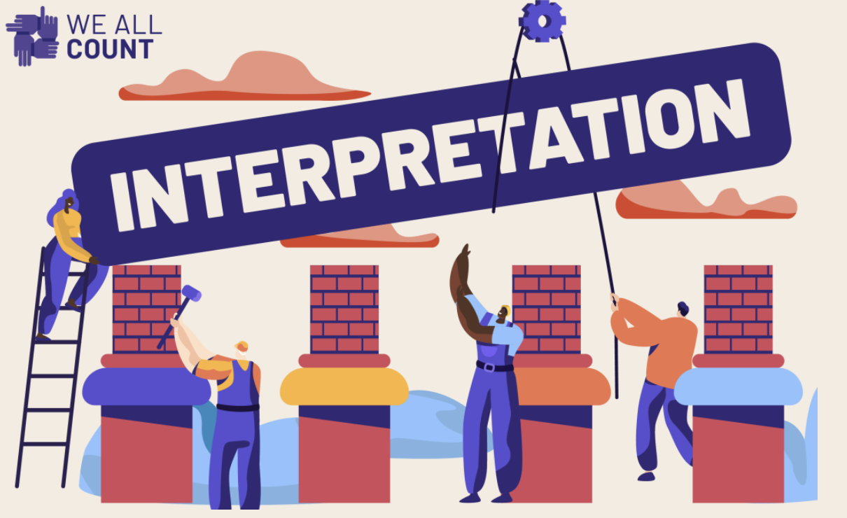
Note: The data and information in this document is reflective of a hypothetical situation and client. This document is to be used for KPMG Virtual Internship purposes only.
Interpretation
Leveraging Data Insights to drive Customer Value
Businesses can use these information to unlock the full potential of their future customers. Businesses could prioritize their resources towards the most influential features and segment the clients based on their rankings in the value chart.
Place any supporting images, graphs, data or extra text here.

