Slide 1
Data Preprocessing
Step 5. Splitting the dataset into test
and training set
Step 1. Importing the required libraries
Step 3. Handling the missing data
We make two partitions of dataset one for training the model called training set and other for testing the performance of the training model called test set. The split is generally 80/20. We import train_test_split() method of sklearn.model_selection library.
Pandas and Numpy are two essential libraries which will be used every time.
Numpy is a library which contains Mathematical Functions.
Pandas is the library used to import and manage datasets.
The data we get is rarely homogeneous. Data can be missing due to various reasons and needs to be handled so that it does not reduce the performance of our machine learning model. We can replace the missing data by the Mean, Mode, Median of the entire column.
Step 6. Feature Scaling
Step 2. Importing the Data
Most of the Machine Learning models uses Euclidean distance between two data points in their computations, features highly varying in magnitudes, units and range pose problems. High magnitude features will weigh more in the distance calculations than features with low magnitudes. Done by feature standardization or Z-score normalization.
Datasets are generally available in .csv format. A comma separated value file store tabular data in plain text. Each line of the file is a data record. We use the read_csv method of the pandas library to read a local CSV file as a dataframe. Then we make separate matrix and vector of independent and dependent variables from dataset.
Step 4. Encoding Categorical Data
Categorical data are variables that contain label values rather than numeric values. The number of possible values is often limited to a fixed set. Example values such as “Yes” and “No” cannot be used in mathematical equations of the model so we need to encode these variables into numbers.

Slide 2
Missing Data
Random Sample Imputation
Arbitrary Imputation
When should we apply?
Random sample imputation consists of taking random observation from the dataset and we use this observation to replace the nan values.
It assumes that the data are missing completely at random.
Advantages
Easy to implement
There is less distortion in variance
Disadvantages
Every situation randomness wont work
Replacing NAN by an arbitrary value
Advantages
Easy to implement
Captures importance of missed data
Disadvantages
Distorts the original distribution of the variable
If missingness is not important, it may mask the predictive power of the original variable by distorting its distribution
Hard to decide which value to use
Main techniques to handle missing data
Mode/Median/Mean replacement.
Random Sample Imputation
Capturing NAN values with a new feature
End of Distribution imputation
Arbitrary imputation
Frequent categories imputation
Mode/Median/Mean
When should we apply?
Mean/median imputation has the assumption that the data are missing completely at random. We solve this by replacing the NAN with the most frequent occurrence of the variables.
Advantages
Easy to implement(Robust to outliers)
Faster way to obtain the complete dataset
Disadvantages
Change or Distortion in the original variance
Impacts Correlation
Frequent categories imputation
Capturing NAN values with a new features
Replacing NAN by an arbitrary value
Advantages
Easy to implement
Faster way to implement
Disadvantages
Since we are using the more frequent labels, it may use them in an over represented way, if there are many nan's
It distorts the relation of the most frequent label
When should we apply?
It works well if the data are not missing completely at random.
Advantages
Easy to implement
Captures importance of missed data
Disadvantages
Creating Additional Features
End of distribution imputation
Replace missing value with extreme data.

Slide 3
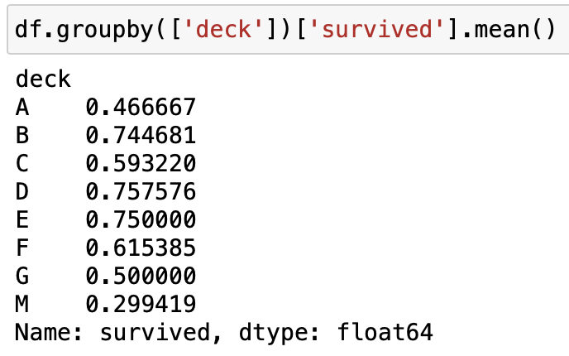
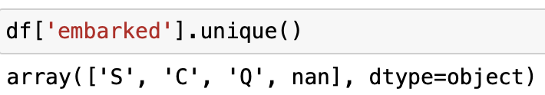
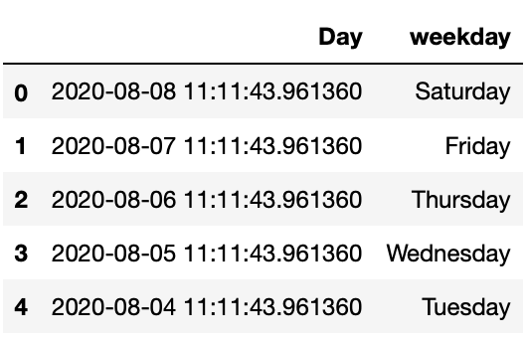
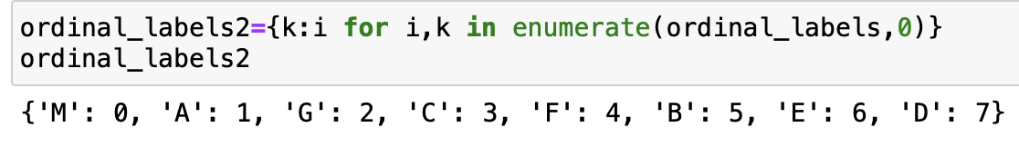
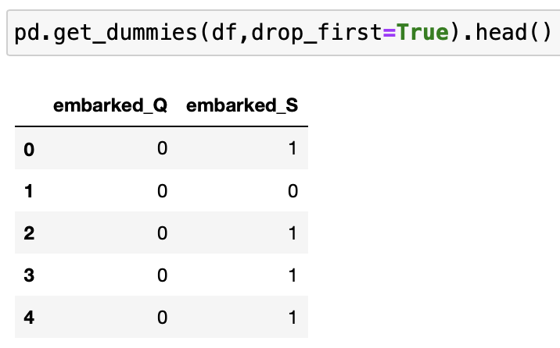
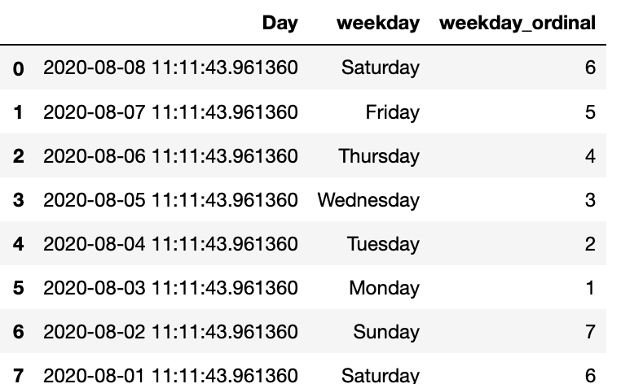
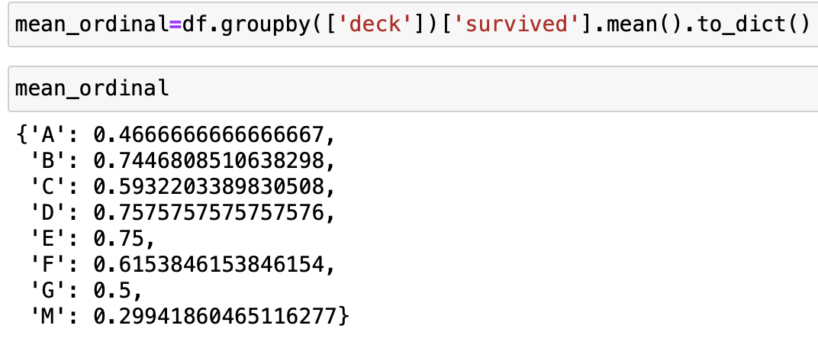
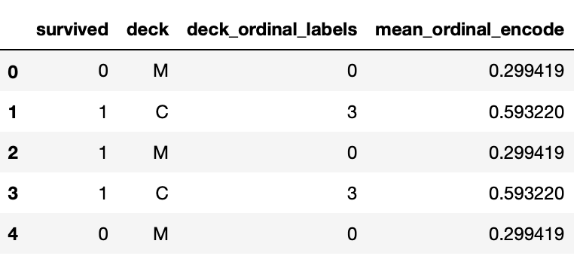
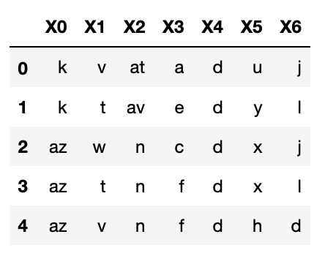
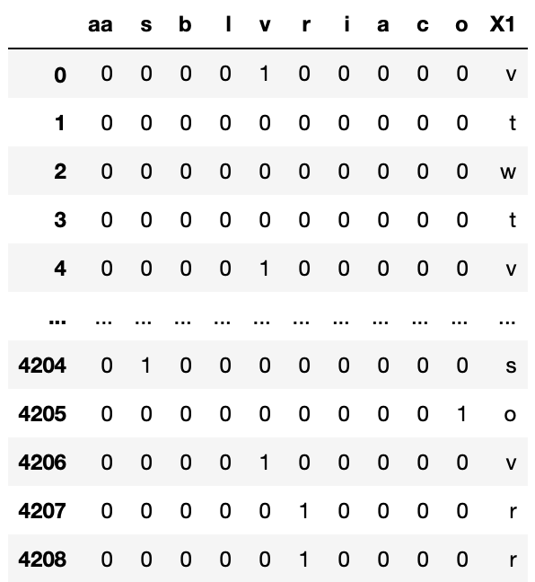
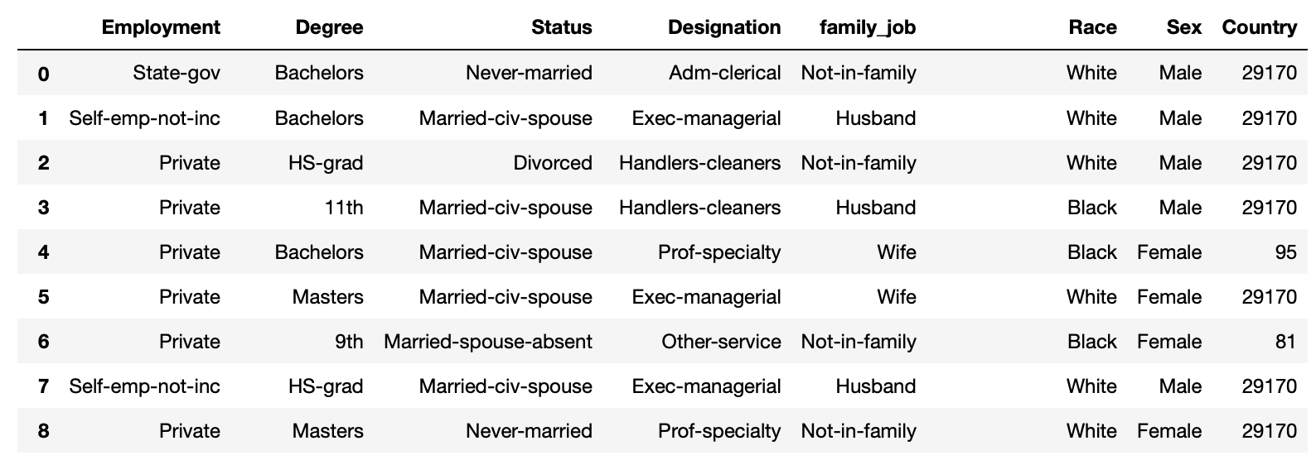
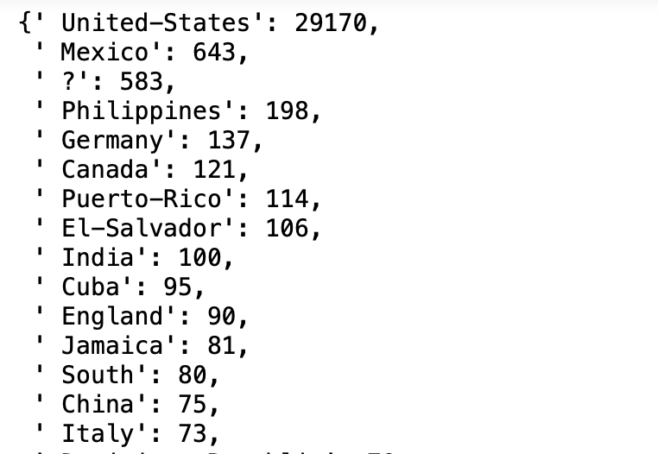
Handling Categorical Features
Target Guided Ordinal Encoding
One Hot Encoding
Ordinal Number Encoding
Mean Encoding
One hot Encoding with many categories
in a feature
Count or Frequency Encoding

Slide 4
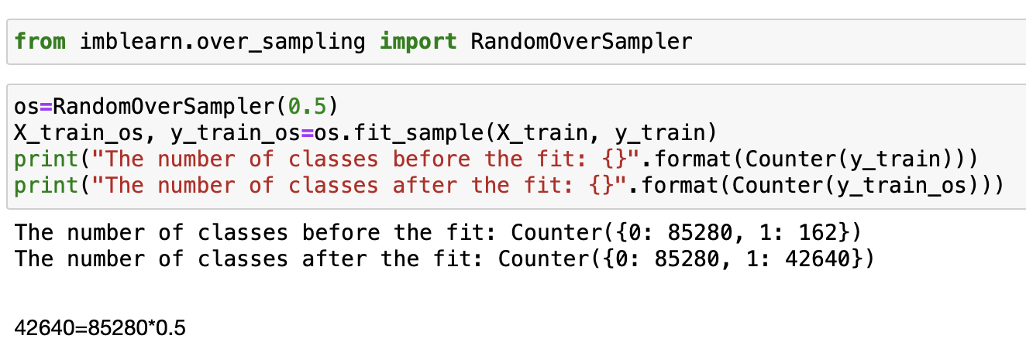
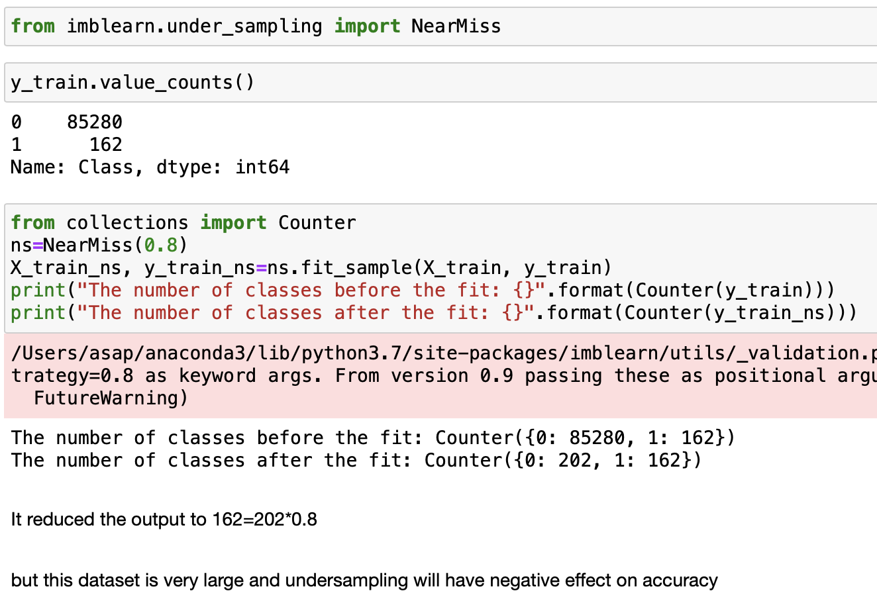
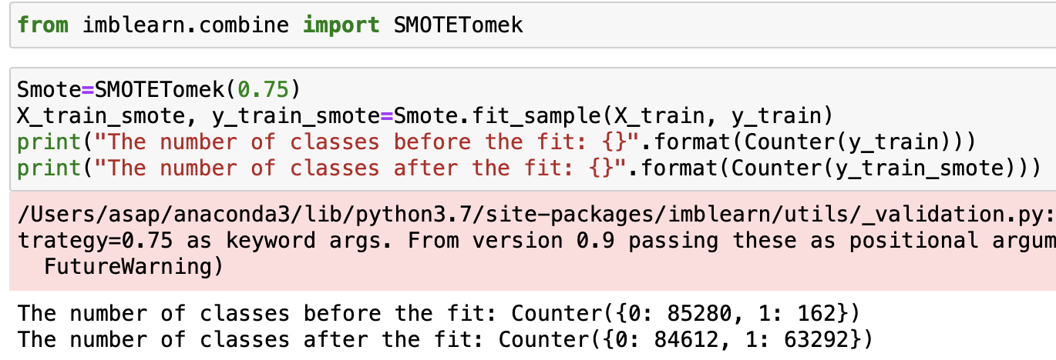
Handling Imbalanced Dataset
Over Sampling
Under Sampling
Increases the points of the minimum labels
Reduces the points of the maximum labels
It is not really practical to use it, only in cases when we use very small datasets
SMOTETomek
It uses both under and over sampling

Slide 5
Normalization and Standardization
Transformation of Features
Why transformation of features are required?
Linear Regression/ Gradient Descent – uses global minima
KNN, K Means Clustering, Hierarichal Clustering – uses Euclidean Distance
Deep Learning Techniques
ANN (Global Minima, Gradient)
CNN
RNN
Types of transformation
Normalization and Standardization
Scaling to minimum and maximum values
Scaling to median and quantiles
Gaussian transformation
Logarithmic transformation
Reciprocal transformation
Square root transformation
Exponential transformation
Box Cox transformation

Slide 6
Outliers
Under Sampling
Reduces the points of the maximum labels
It is not really practical to use it, only in cases when we use very small datasets

Slide 7
Feature Selection
Under Sampling
Reduces the points of the maximum labels
It is not really practical to use it, only in cases when we use very small datasets

Slide 8
Feature Engineering
Under Sampling
Reduces the points of the maximum labels
It is not really practical to use it, only in cases when we use very small datasets

