Slide 1

NU PALS
NATIONAL UNIVERSITY
PEER-ASSISTED LEARNING SYSTEM
Presented By : SAD BULLDOGS
CAPSTONE 1 | 2024

Slide 2
PROJECT CONTEXT
Launched in 2017 within a mandatory first-year law course at La Trobe University, Australia, the podcast features interviews with recent course completers. Its goals are to allow interviewees to reflect on their experiences and offer advice to incoming law students.[3]
Our project aims to develop a comprehensive peer-to-peer website tailored specifically for the university community, providing a platform for seamless exchange of knowledge, resources, and services among students.
By creating a cohesive digital environment, the project aims to improve the overall student experience and promote meaningful relationships and partnerships within the university ecosystem.

Slide 3
PURPOSE AND DESCRIPTION
General Public. This website can foster a sense of community within the National University by providing a platform for students and faculty to connect and collaborate.
National University Students. This website offers students a convenient and efficient way to find peers with similar academic interests, study habits, and skills
University Administration. This website can serve as a valuable tool for the administration by offering insights into the needs and interests of the university community.

Slide 4
PURPOSE AND DESCRIPTION
Future Developers. Developers and technologists can use the insights gained from this website as a foundation for future innovations.

Slide 5
OBJECTIVES
General Objectives
NU PALS aims to facilitate connections and collaborations among students based on shared interests, hobbies, and academic needs.
Specific Objective(s)
The following are the specific objectives of the capstone project:
To develop and implement an intuitive and user-friendly interface
To enhance the accuracy and efficiency of the peer-to-peer buddy matching process.
To evaluate the speed and effectiveness
To develop NU PALS to be accessible and inclusive
To evaluate the system using the FURPS model

Slide 6
SCOPE AND LIMITATION
The NU PALS platform aims to improve academic interactions among students by facilitating conversations and collaboration. It will feature user registration and authentication via university email addresses for security. Users can create profiles showcasing their hobbies, academic interests, and skills to facilitate targeted interactions. The platform will include posting and messaging systems for easier communication, along with a feedback to maintain submission quality.

Slide 7
SCOPE AND LIMITATION
The NU PALS will be restricted to confirmed university students, with academic content and focus exclusively on intellectual and interest exchanges. Although academic verification will be optional, it will help the student verify the credibility of their match and their profile. Monetization initiatives will be limited, with a focus on keeping the site free. The language and cultural background of the website will be predominantly targeted at the National University's demographic, potentially limiting inclusivity beyond this point. Lastly, Students who lack access to reliable internet connectivity or technology may be unable to fully participate in the matching system.

Slide 8
REVIEW OF RELATED LITERATURE
Online Learning Environments and Learner Empowerment (X. Pa)
Peer Mentoring in Higher Education (Alharthi and Nilsson)
Mobile Learning Adoption (R. T. Magsayo)
Peer-to-Peer Support for Adolescents (Peer‐to‐Peer Roundtables: Sharing is Caring)
Data Privacy in Educational Technology (RAND researchers)

Slide 9
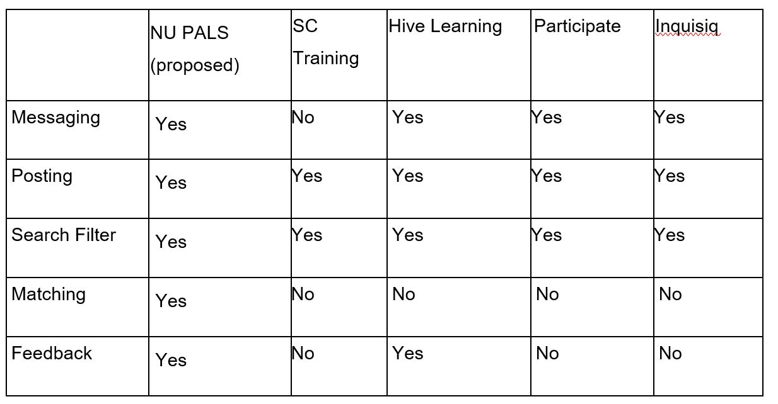
REVIEW OF RELATED SYSTEM

Slide 10
SYNTHESIS
In conclusion, "NU PALS" is not just like other systems. It takes the best parts of those systems and puts them together to fix the problems we found in university platforms. It adds random and also a search/filter matchmaking and a place to share knowledge and skills, making it easier for students to work together. This makes it a big step forward in improving how everyone experiences university life. The reason for making this is to create a platform that brings everyone together, making it easier to share ideas and work together. "NU PALS" is all about making our university community stronger and more connected.

Slide 11
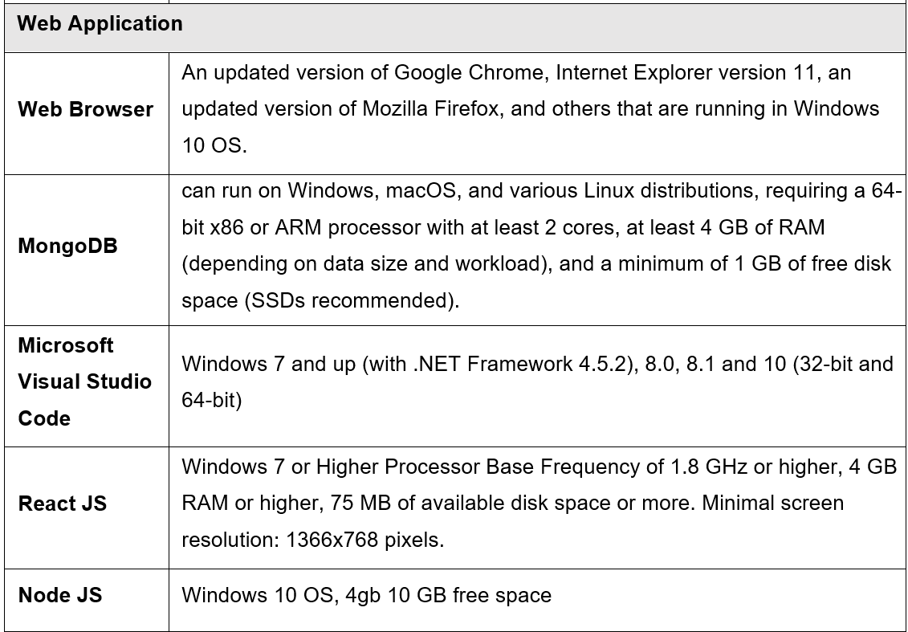
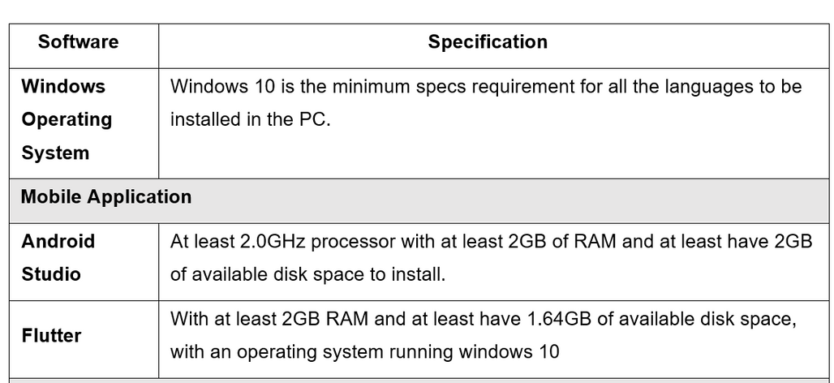
DETAILS OF THE TECHNOLOGY TO BE USED

Slide 12
PROJECT TECHNICAL DESCRIPTION
NU PALS leverages advanced technologies to enhance university experiences. The front end is developed using React.js for its component-based architecture, enhancing user experience through modularity and efficient rendering. Node.js powers the back end with server-side JavaScript, ensuring scalability and non-blocking I/O operations. MongoDB serves as the database management system, offering a flexible, document-based model suitable for unstructured data. The mobile application is built using Flutter, allowing cross-platform development with a single codebase for consistent performance across devices. Cloud hosting services and managed database services like MongoDB Atlas ensure scalability, reliability, and seamless deployment.

Slide 13
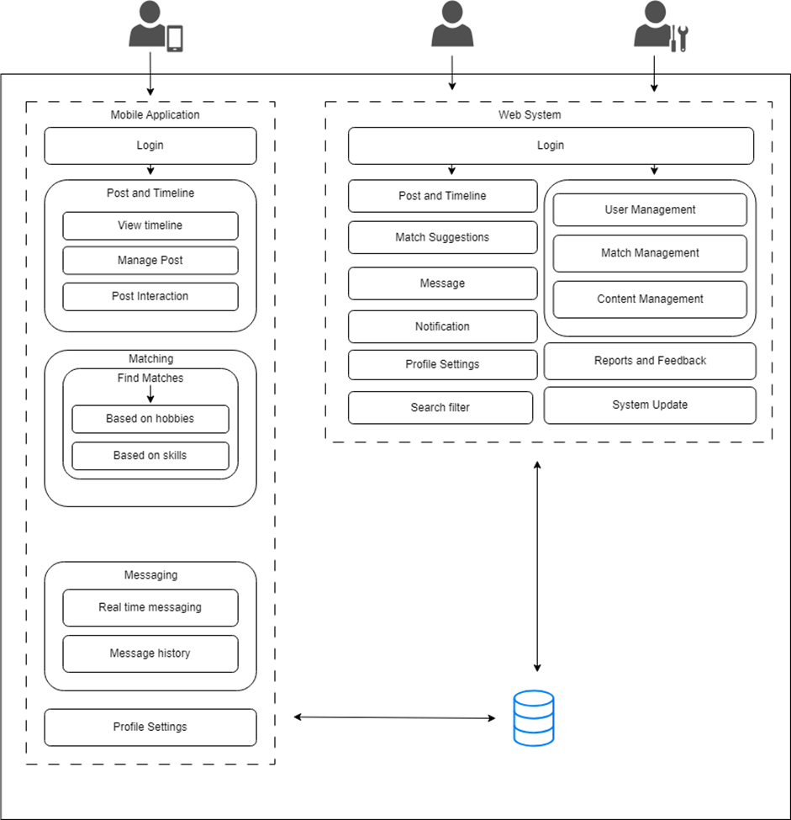
SYSTEM ARCHITECTURE

Slide 14
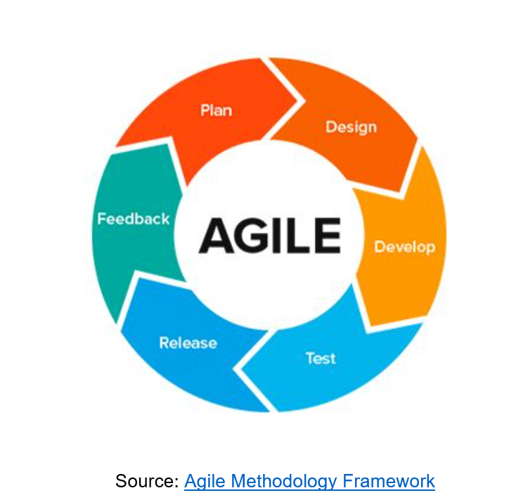
PROJECT DEVELOPMENT METHODOLOGY

Slide 15
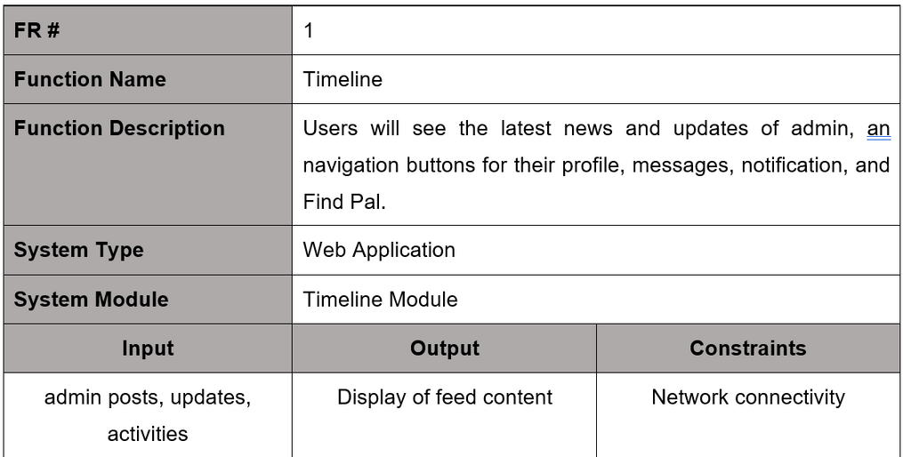
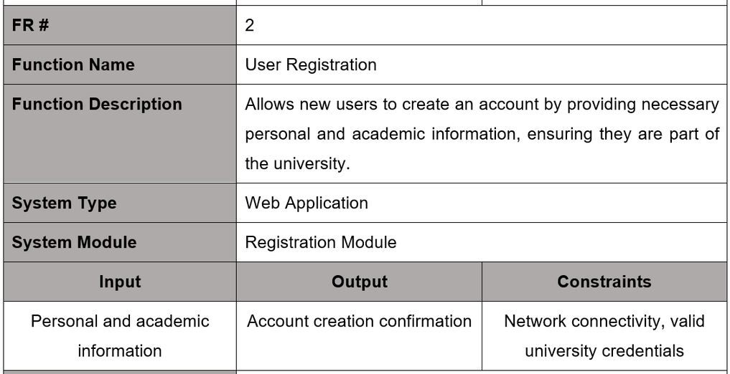
FUNCTIONAL AND NON-FUNCTIONAL REQUIREMENT
Web Application

Slide 16
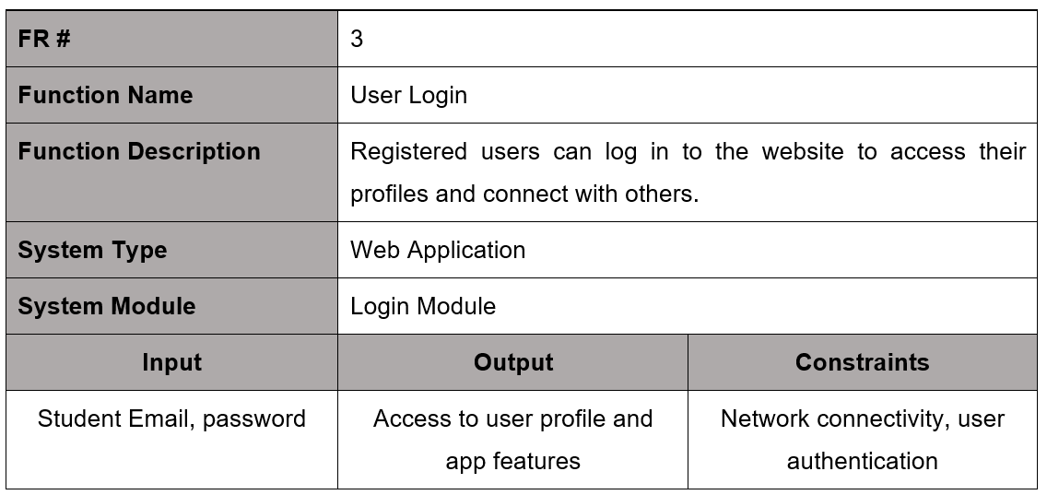
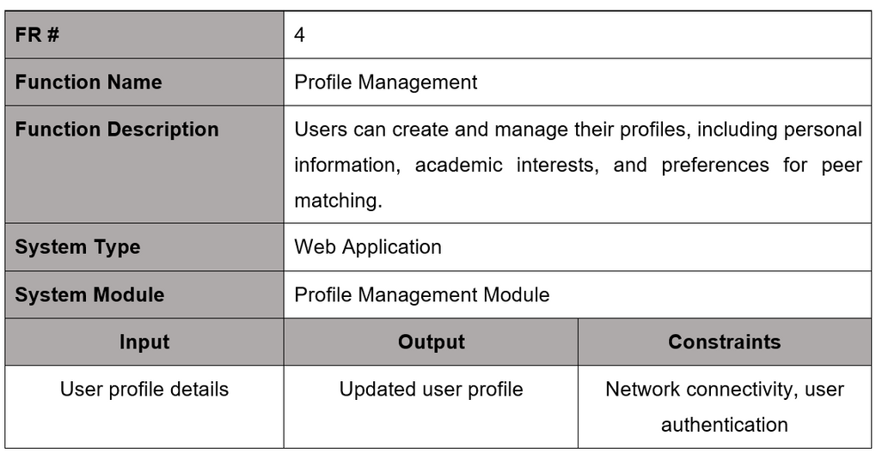
FUNCTIONAL AND NON-FUNCTIONAL REQUIREMENT
Web Application

Slide 17
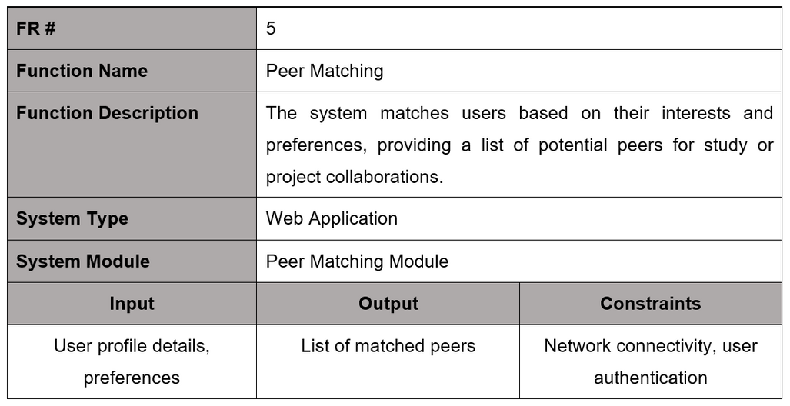
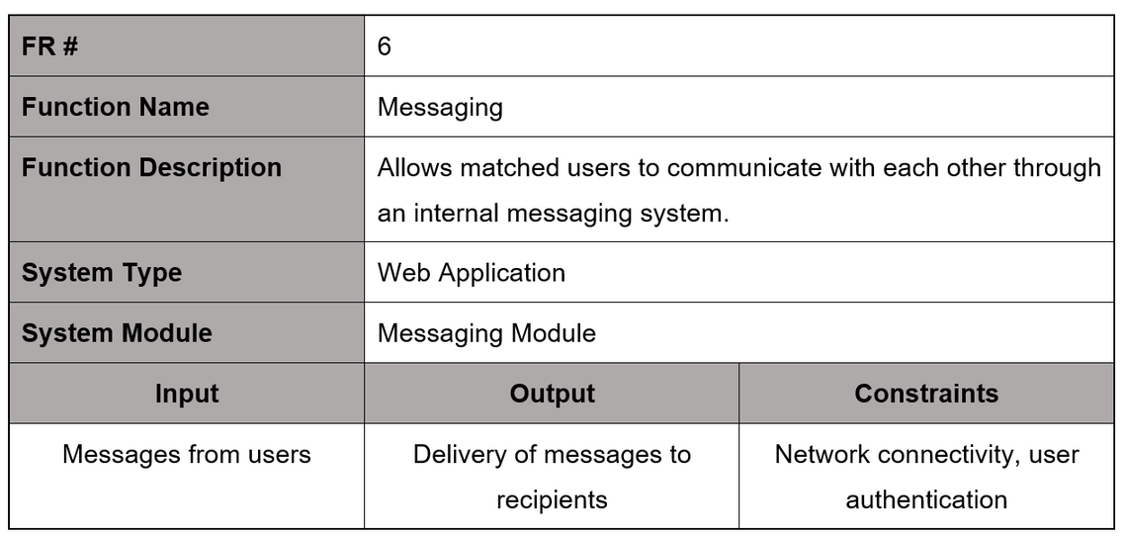
FUNCTIONAL AND NON-FUNCTIONAL REQUIREMENT
Web Application

Slide 18
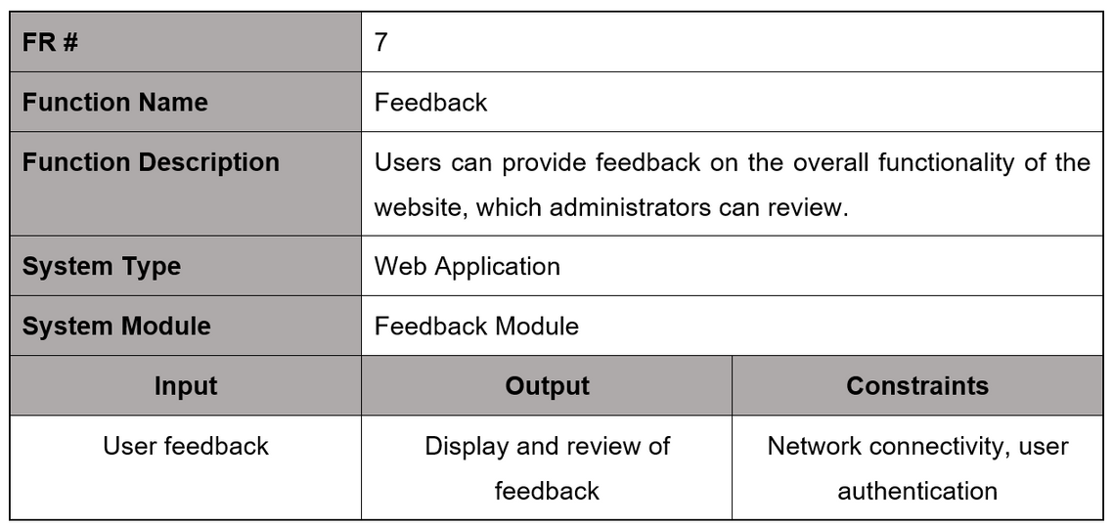
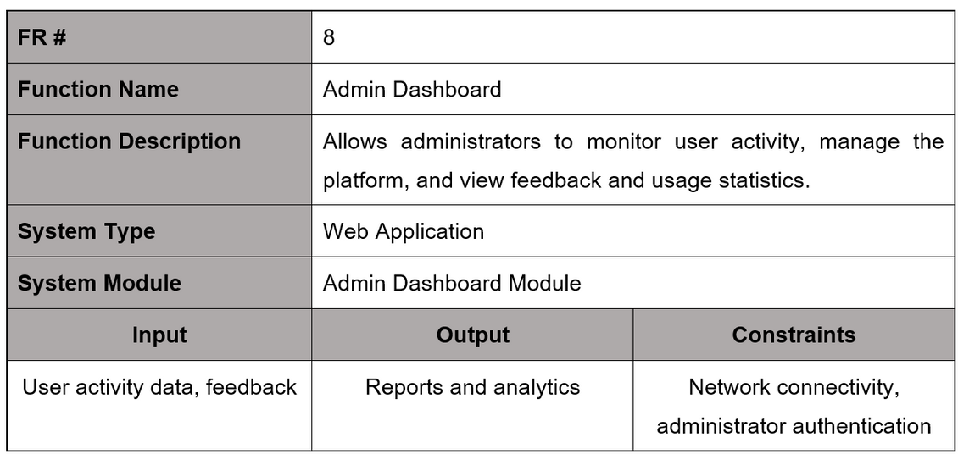
FUNCTIONAL AND NON-FUNCTIONAL REQUIREMENT
Web Application

Slide 19
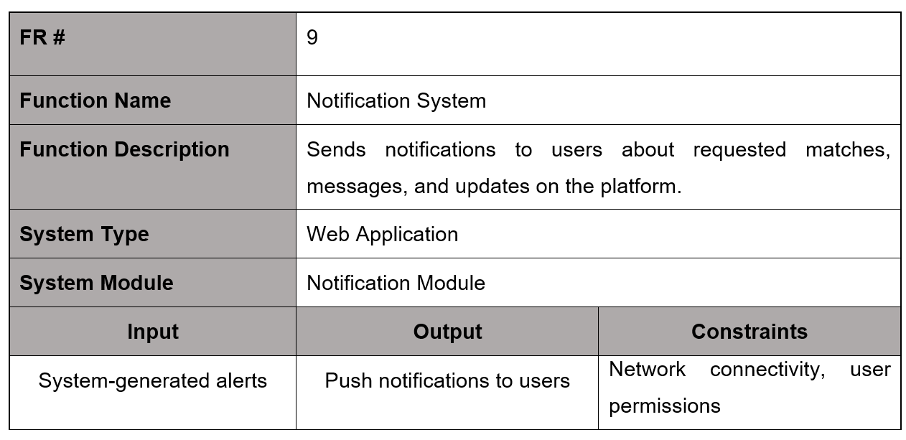
FUNCTIONAL AND NON-FUNCTIONAL REQUIREMENT
Web Application

Slide 20
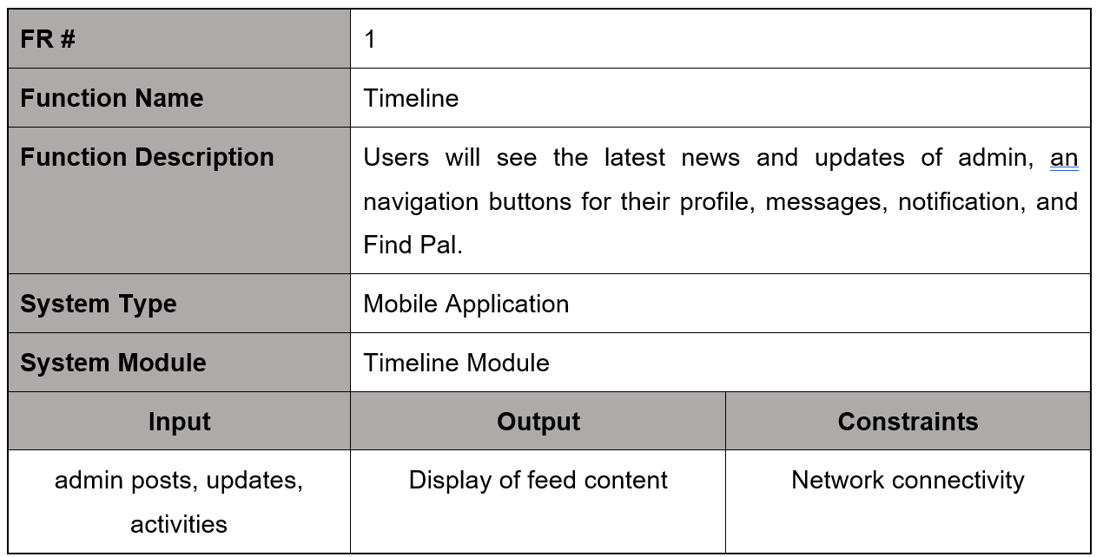
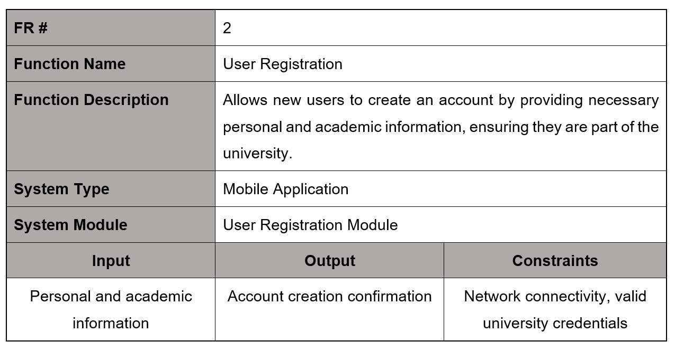
FUNCTIONAL AND NON-FUNCTIONAL REQUIREMENT
Mobile Application

Slide 21
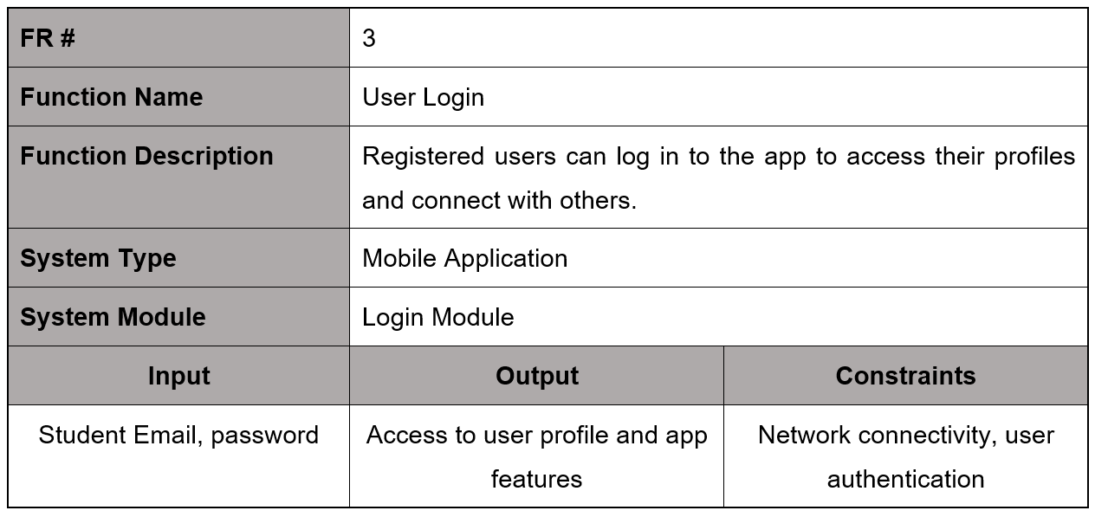
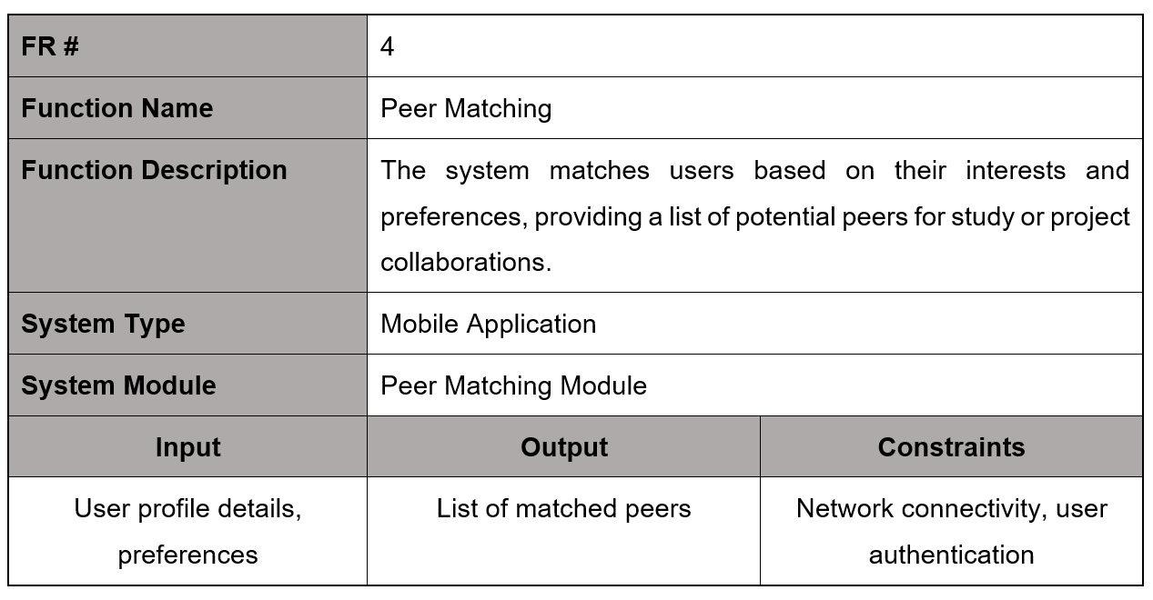
FUNCTIONAL AND NON-FUNCTIONAL REQUIREMENT
Mobile Application

Slide 22
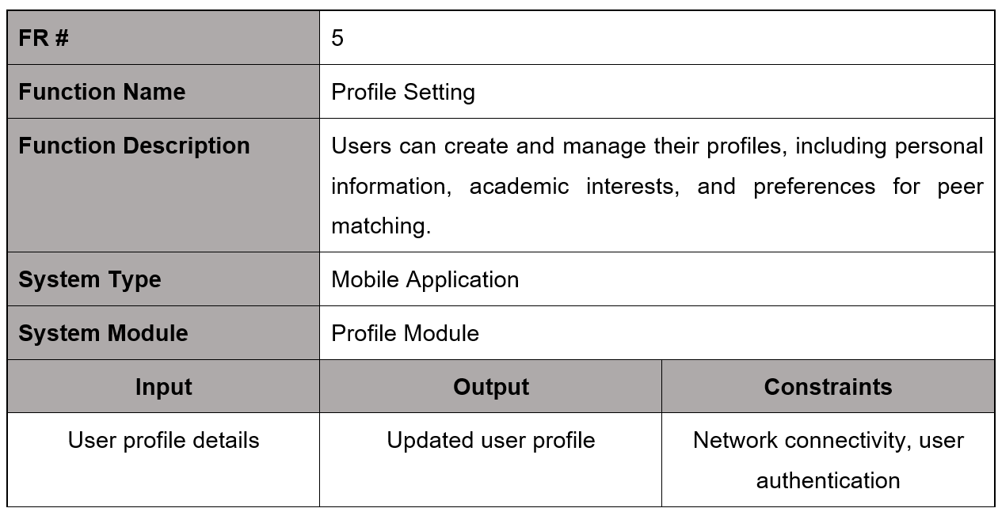
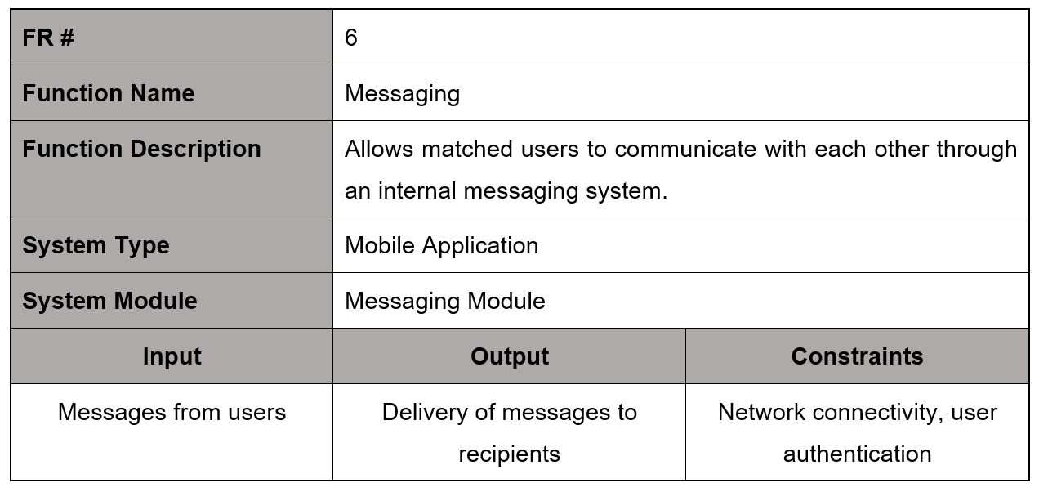
FUNCTIONAL AND NON-FUNCTIONAL REQUIREMENT
Mobile Application

Slide 23
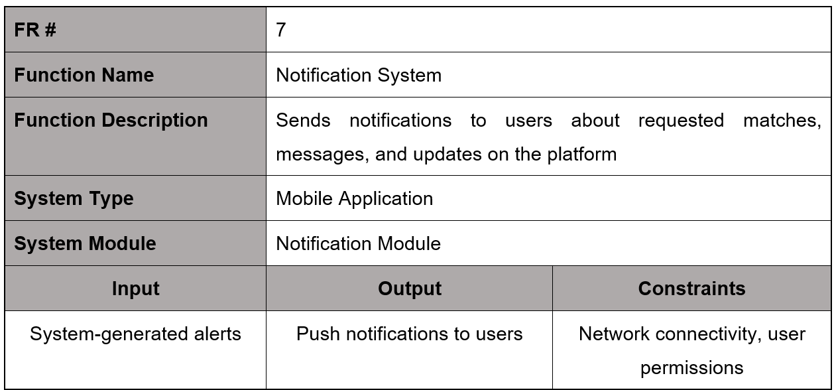
FUNCTIONAL AND NON-FUNCTIONAL REQUIREMENT
Mobile Application

Slide 24
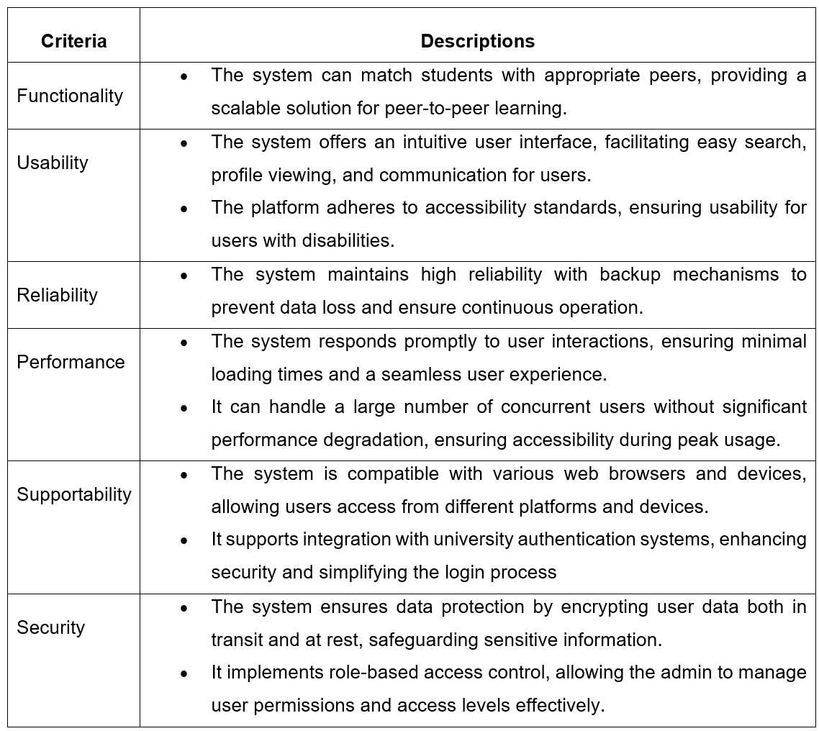
FUNCTIONAL AND NON-FUNCTIONAL REQUIREMENT

Slide 25
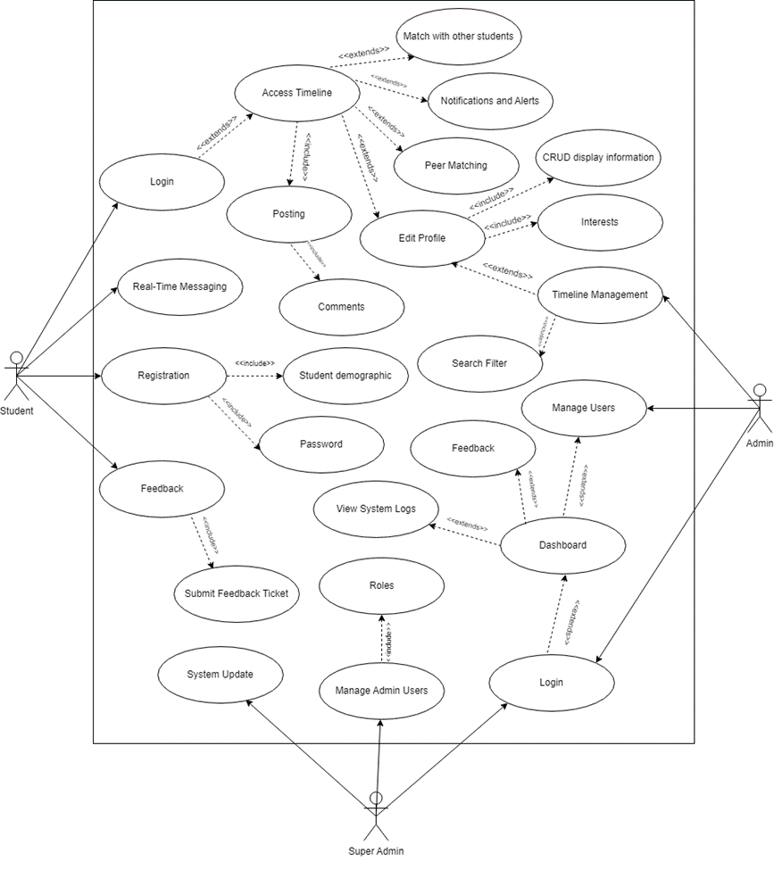
USE CASE DIAGRAM

Slide 26
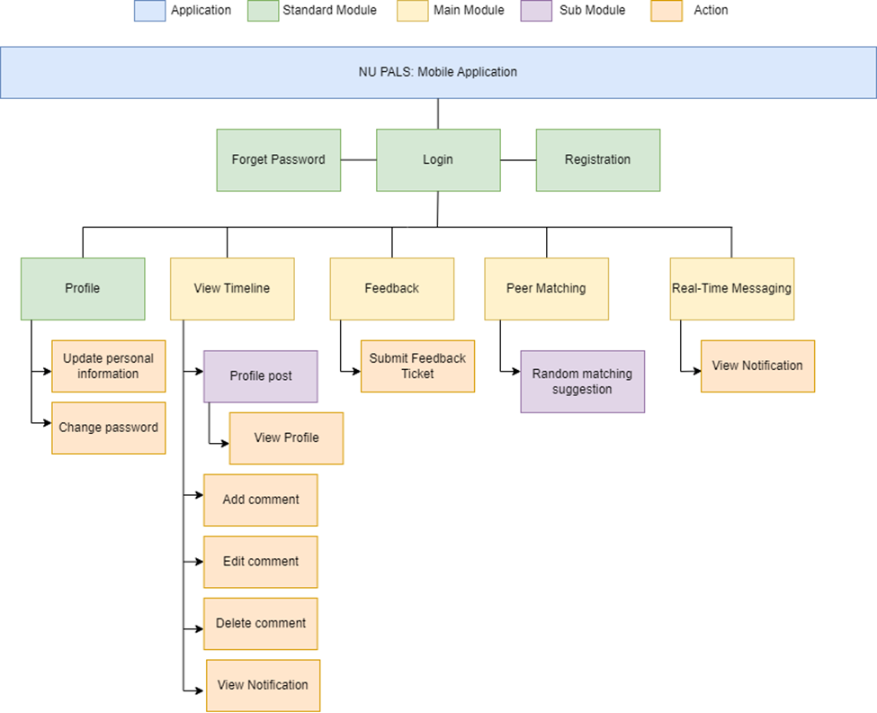
FUNCTIONAL DECOMPOSITION DIAGRAM

Slide 27
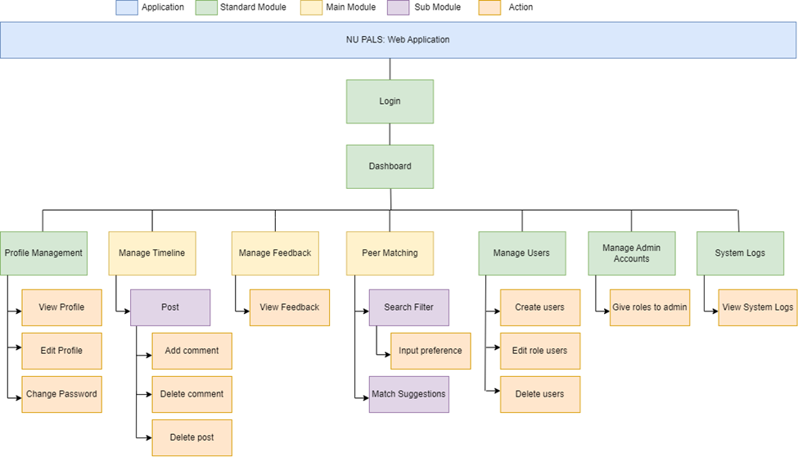
FUNCTIONAL DECOMPOSITION DIAGRAM

Slide 28
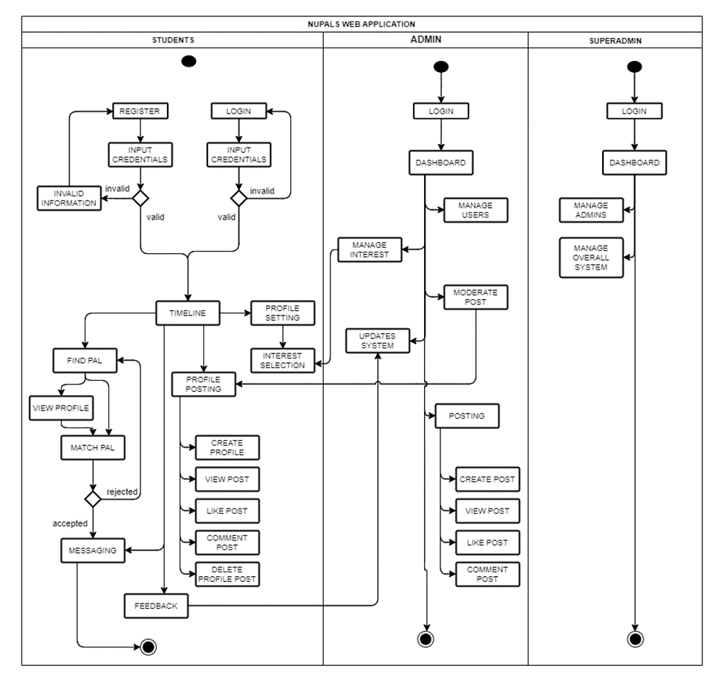
SYSTEM FLOWCHART

Slide 29
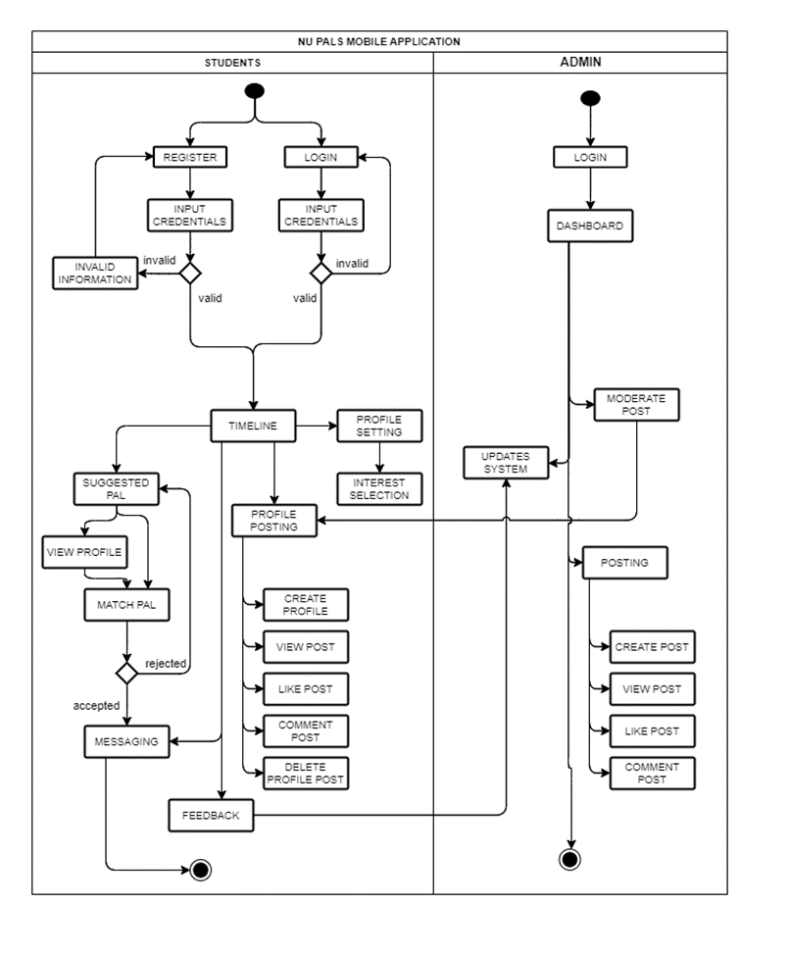
SYSTEM FLOWCHART

Slide 30
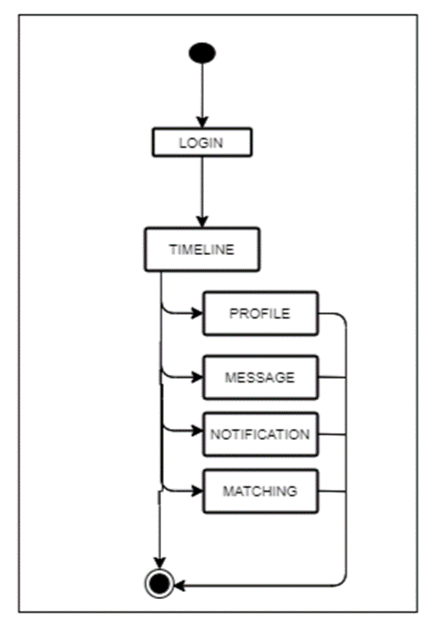
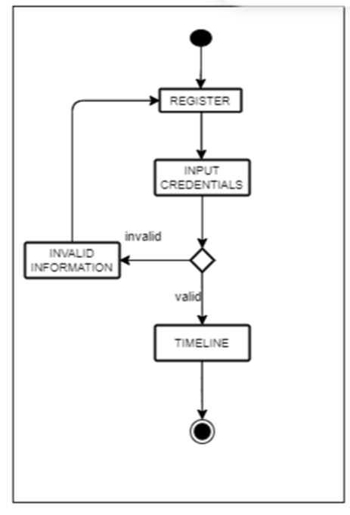
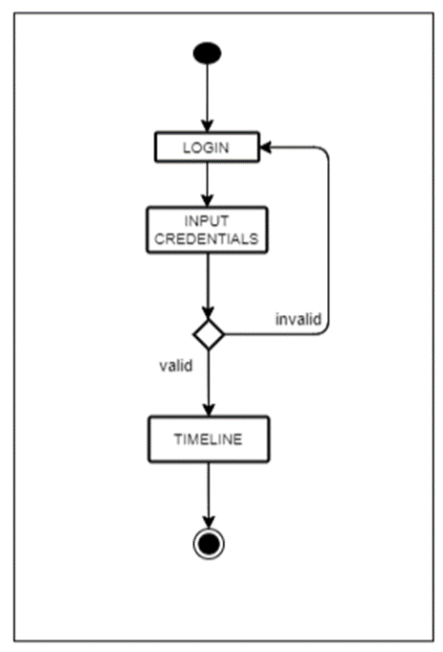
PROCESS FLOW

Slide 31
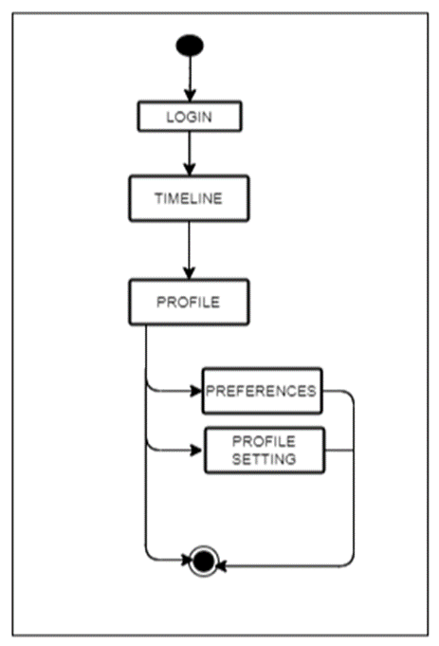
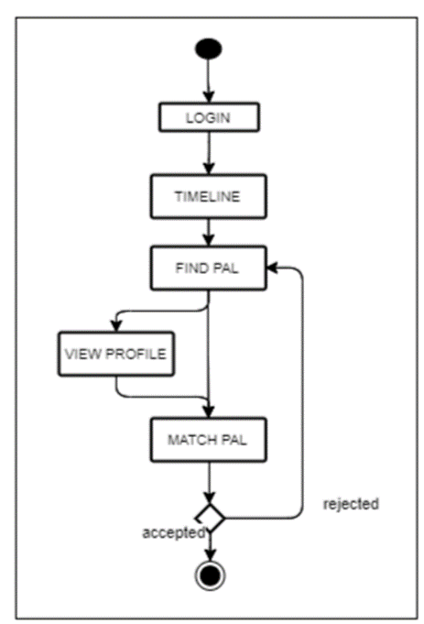
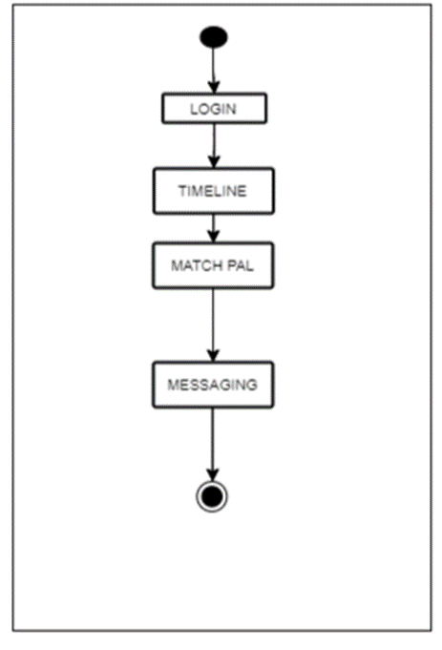
PROCESS FLOW

Slide 32
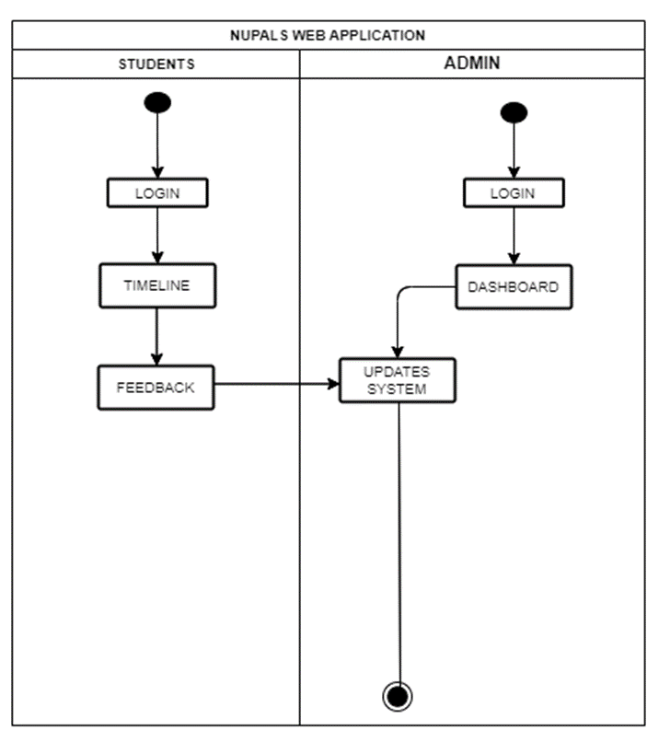
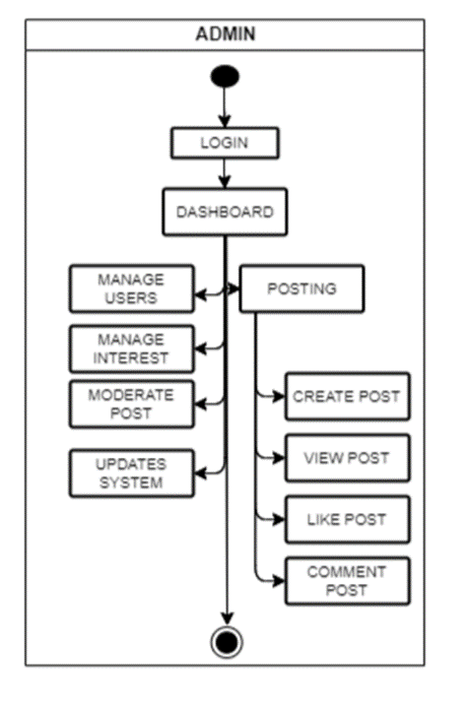
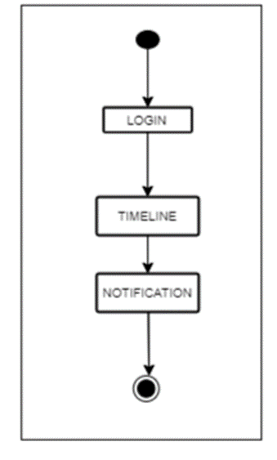
PROCESS FLOW

Slide 33
PROCESS FLOW

Slide 34
PROCESS FLOW

Slide 35
PROCESS FLOW

Slide 36
THANK YOU!
SAD BULLDOGS
CAPSTONE 1 | 2024

