Slide 1

EDA Project - Analysis of AMCAT Data
Alen Peter Data Science Intern

Slide 2
About me
Post graduate
Statistics and Applied Mathematics.
Why Data Science ?
Data science enables innovation by leveraging data to uncover new insights, identify trends, and drive business growth. By harnessing the power of data, individuals can make meaningful contributions to their organizations and society as a whole.
www.linkedin.com/in/alen-peter-041b1a215
https://github.com/alenpeter02/alenpeter02.git

Slide 3
Business Problem and Use Case Domain Understanding:
Understanding the factors influencing salary levels among individuals with different academic backgrounds.
Objective of the Project:
Understand salary distribution across various academic backgrounds.
Identify factors impacting salary levels, such as academic performance and work experience.
Explore relationships between gender, specialization, and salary.
Provide actionable insights and recommendations.

Slide 4
Summary of the Data:
Total Entries: 3998
Columns: 39
Data Types:
Float: 10 columns
Integer: 17 columns
Object: 12 columns
Non-Null Counts: All columns have 3998 non-null entries.
Key Features:
Salary: Target variable, representing salary levels.
Gender: Categorical variable indicating gender.
Specialization: Categorical variable denoting academic specialization.
English, Logical, Quant: Scores in respective subjects.
conscientiousness, agreeableness, extraversion, nueroticism, openess_to_experience: Personality trait scores.
Other Features:
Educational details (percentages, board, graduation year, GPA).
Job details (designation, job city, date of joining/leaving).
College details (ID, tier, state).
Domain-specific skills (Computer Programming, Electronics, Mechanical Engineering, etc.).

Slide 5
Exploratory Data Analysis:
a. Data Cleaning Steps & Data Manipulation Steps:
b. Univariate Analysis Steps:
Plotted Box-Plots, KDE plots for frequency and probability distribution.
Analysed summary statistics for numerical data. Founded outliers in numerical column using boxplot
Bivariate Analysis Steps:
Performed initial exploratory data analysis to understand the distribution of each variable individually. This includes summary statistics, histograms, box plots.
Created a scatter plot to visualize the relationship between the two variables. This allows you to visually assess the direction, form, and strength of the relationship.
Calculated the correlation coefficient between the two variables to quantify the strength and direction of the linear relationship.
Conducted hypothesis tests to determine whether the relationship between the two variables is statistically significant. This may involve t-tests, chi-squared tests.
Replaced placeholder values (-1) with Nan. Formatted date columns (DOB, DOJ, DOL). Converted formatted dates to datetime objects | Calculated Age and Experience from date columns. Replaced 'present' in DOL with the current date. Converted formatted date strings to datetime objects.

Slide 6
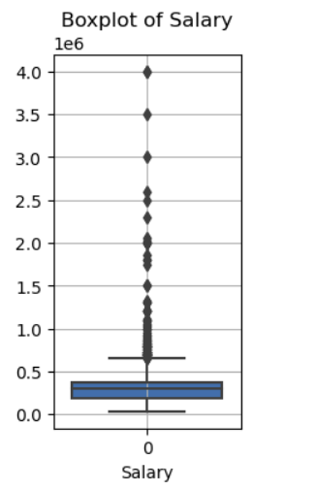
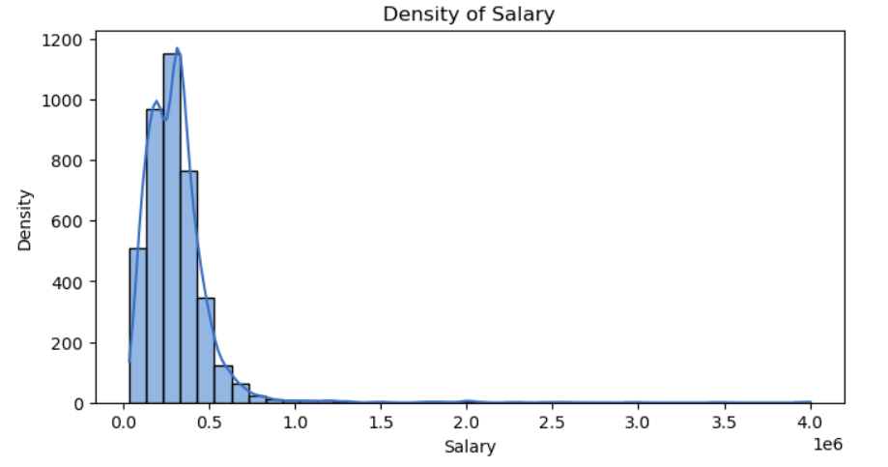
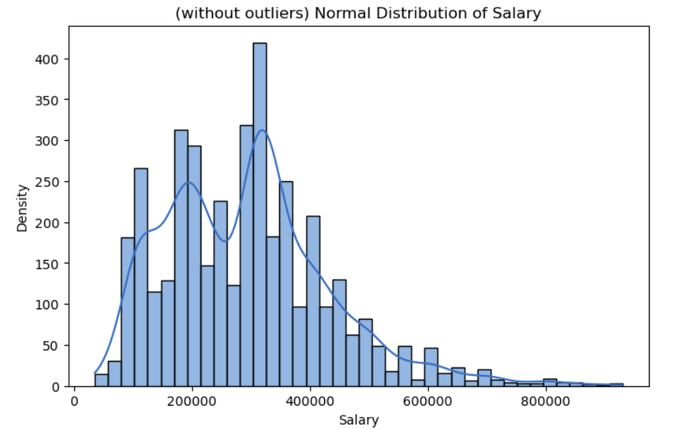
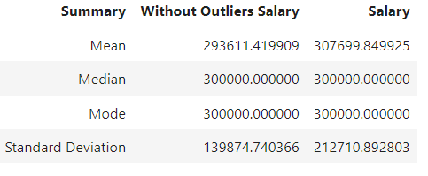
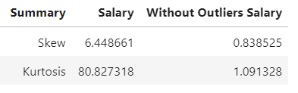
Univariate Analysis: Salary
Excluding outliers from salary data affects measures like mean and standard deviation.
Median and mode remain unchanged by outlier removal.

Slide 7
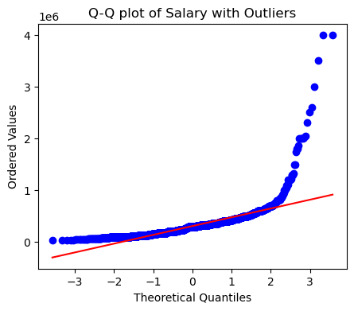
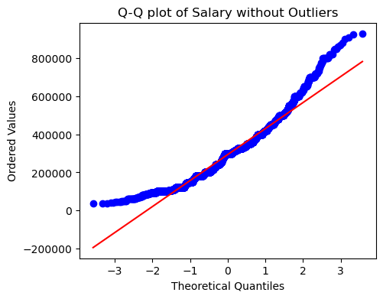
Outlier removal reduces skewness and kurtosis, making the distribution more symmetrical and less peaked.
The distribution plot does not shows the removal of outliers does not give much impact.
Conclusion:
Even after removal of outliers the deviation exist.

Slide 8
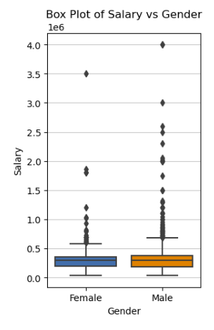
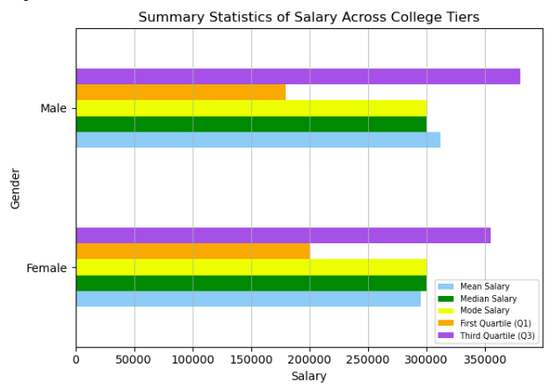
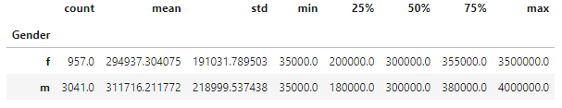
Bivariate Analysis:
Correlation between salary and other numerical variable is founded
Pair plot and summary statistics are found between numerical variables.
Between categorical variables boxplots, barplots are constructed.
Numerical and categorical variables there are chi test and t test have calculated.
Salary Vs Gender

Slide 9
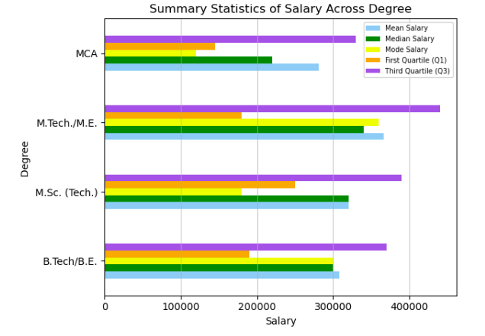
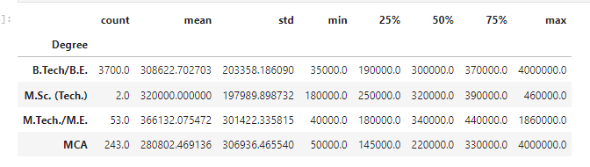
Degree Vs Salary
Inference:
Conclusion:
Wide variability in salaries across different degrees.
M.Tech./M.E. graduates exhibit higher mean salaries but also higher variability.
B.Tech/B.E. and MCA graduates are prevalent, with substantial salary variability.
B.Tech/B.E.: Most common degree with a mean salary of $308,622.70. Wide salary range from $35,000 to $4,000,000. M.Sc. (Tech.): Small sample size (2 instances) with a mean salary of $320,000.00. Moderate salary range from $180,000 to $460,000. | M.Tech./M.E.: Mean salary of $366,132.08 with 53 instances. Wide salary variability from $40,000 to $1,860,000. MCA: 243 instances with a mean salary of $280,802.47. Wide salary range from $50,000 to $4,000,000.

Slide 10
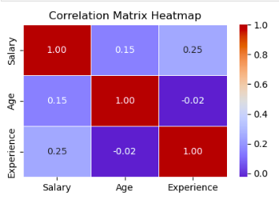
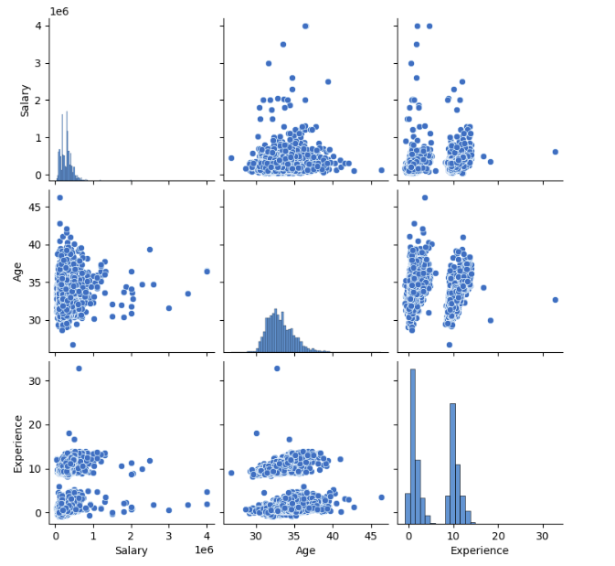
Salary Vs Age Vs Experience
Correlation Matrix:
Salary has strong positive correlation with Age (0.15).
Salary has moderate positive correlation with Experience (0.25).
Scatterplot Analysis:
Positive linear relationship; as age increases, salary tends to increase.
Positive linear relationship; higher experience corresponds to higher salary.
Conclusion:
Age and experience play a role in determining salary.
The positive correlations suggest that older individuals with more experience tend to have higher salaries.

Slide 11
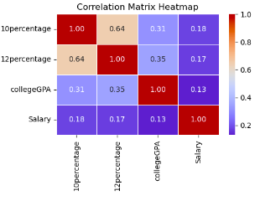
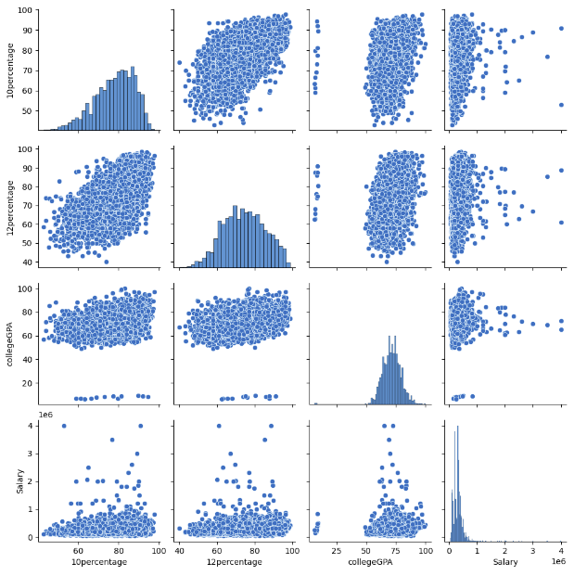
Salary Vs 10percentage Vs 12percentage Vs collegeGPA
Correlation Matrix:
Salary Weak positive correlation with 10percentage (0.18), 12percentage (0.17) , collegeGPA (0.13)
Scatter plot:
Weak positive relationship; higher 10percentage slightly correlates with higher Salary.
Weak positive relationship; higher 12percentage slightly correlates with higher Salary.
Weak positive relationship; higher collegeGPA slightly correlates with higher Salary.
Conclusion:
The strong correlation between 10percentage and 12percentage suggests consistency in academic performance.
collegeGPA also shows positive correlations with both 10percentage and 12percentage.
While Salary has weaker correlations with the other variables, it still shows some positive association.

Slide 12
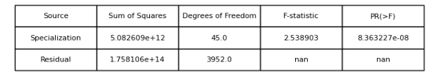
Specialization Vs Salary
Inference:
F-statistic Interpretation: The F-statistic measures the ratio of the variance between groups to the variance within groups. Here, the F-statistic is 2.5389.
P-value Interpretation: The p-value is the probability of obtaining the observed results (or more extreme results) under the assumption that the null hypothesis is true.
Hypothesis (H0):
The null hypothesis assumes that there are no significant differences between the groups (i.e., specializations have no effect on salary).
The alternative hypothesis suggests that there are significant differences between the groups (i.e., specializations have an effect on salary)
Conclusion:
Reject the Null Hypothesis:
Since the p-value is less than the significance level (typically 0.05), we reject the null hypothesis.
There are significant differences between specializations in terms of their effect on salary.

Slide 13
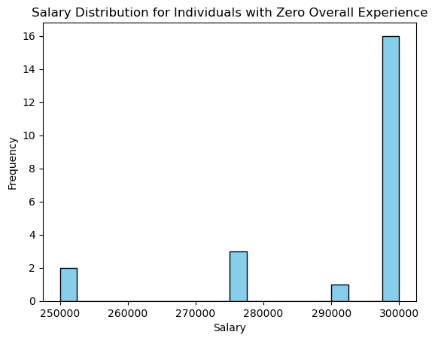
Research Questions: 1) Times of India article dated Jan 18, 2019 states that “After doing your Computer Science Engineering if you take up jobs as a Programming Analyst, Software Engineer, Hardware Engineer and Associate Engineer you can earn up to 2.5-3 lakhs as a fresh graduate.” Test this claim with the data given to you.
Filtering out the data as per conditions:
Computer Science Engineering graduate should be a fresher
The graduate should be in the roles as 'Programming Analyst', 'Software Engineer', 'Hardware Engineer', 'Associate Engineer’.
Hypotheses:
The null hypothesis states that there is no significant difference between the claimed salary range (2.5-3 lakhs) and the actual salaries observed in the dataset.
The alternative hypothesis suggests that there is a significant difference between the claimed salary range (2.5-3 lakhs) and the actual salaries observed in the dataset.
.

Slide 14
Test Statistic:
The test statistic value is 4.844164094103531.
P-value:
The p-value is 8.666886065970804×10−5.
Conclusion:
With a p-value less than the significance level (typically 0.05), we reject the null hypothesis.
There is enough evidence to suggest that the claim of earning 2.5-3 lakhs as a fresh graduate in Computer Science Engineering is true

Slide 15
2) Is there a relationship between gender and specialization? (i.e. Does the preference of Specialization depend on the Gender?)
Hypothesis:
The null hypothesis states that there is no relationship between gender and specialization.
The alternative hypothesis suggests that there is a relationship between gender and specialization.
Chi-square Statistic:
The chi-square statistic is 104.46891913608454.
P-value:
The p-value is 1.2453868176977011×10−6
Degrees of Freedom:
The degrees of freedom are 45.
Conclusion:
With a p-value less than the significance level (typically 0.05) and a high chi-square statistic, we reject the null hypothesis.
There is enough evidence to suggest that there is a relationship between gender and specialization.

Slide 16
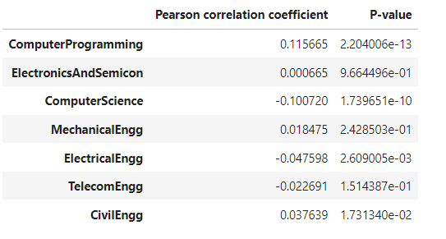
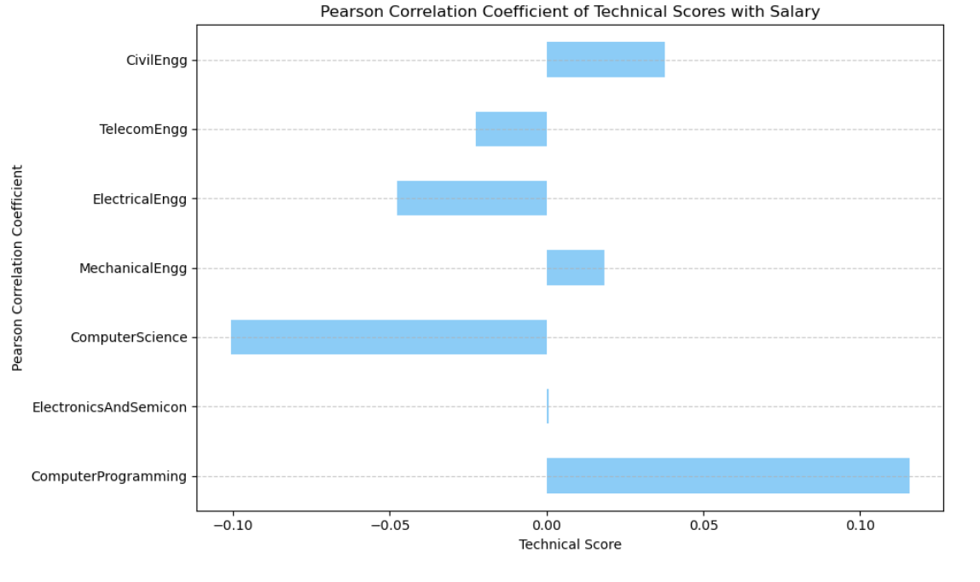
3) Does Salary distribution is affected by ACMAT scores? (Bonus) Pearson Correlation Coefficient of Technical Scores with Salary
Computer Programming:
The correlation coefficient for Computer Programming is approximately 0.116.
The associated p-value is 2.09e-13, which is extremely small.
This suggests a statistically significant positive correlation between Computer Programming and other fields.
Electronics and Semiconductors:
The correlation coefficient for Electronics and Semiconductors is approximately 0.001.
The p-value is 0.964, indicating no significant correlation.
Electronics and Semiconductors do not strongly correlate with other fields.

Slide 17
Computer Science:
The correlation coefficient for Computer Science is approximately -0.101.
The p-value is 1.77e-10, suggesting a strong negative correlation with other fields.
Mechanical Engineering:
The correlation coefficient for Mechanical Engineering is approximately 0.018.
The p-value is 0.242, indicating no strong correlation.
Mechanical Engineering does not significantly correlate with other fields.
Electrical Engineering:
The correlation coefficient for Electrical Engineering is approximately -0.048.
The p-value is 0.00262, suggesting a statistically significant negative correlation with other fields.
Telecom Engineering:
The correlation coefficient for Telecom Engineering is approximately -0.023.
The p-value is 0.152, indicating no strong correlation.
Telecom Engineering does not significantly correlate with other fields.
Civil Engineering:
The correlation coefficient for Civil Engineering is approximately 0.038.
The p-value is 0.017, suggesting a statistically significant positive correlation with other fields.

Slide 18
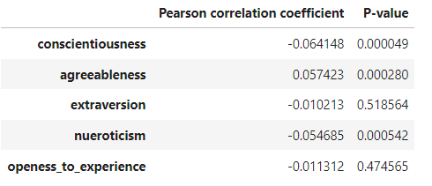
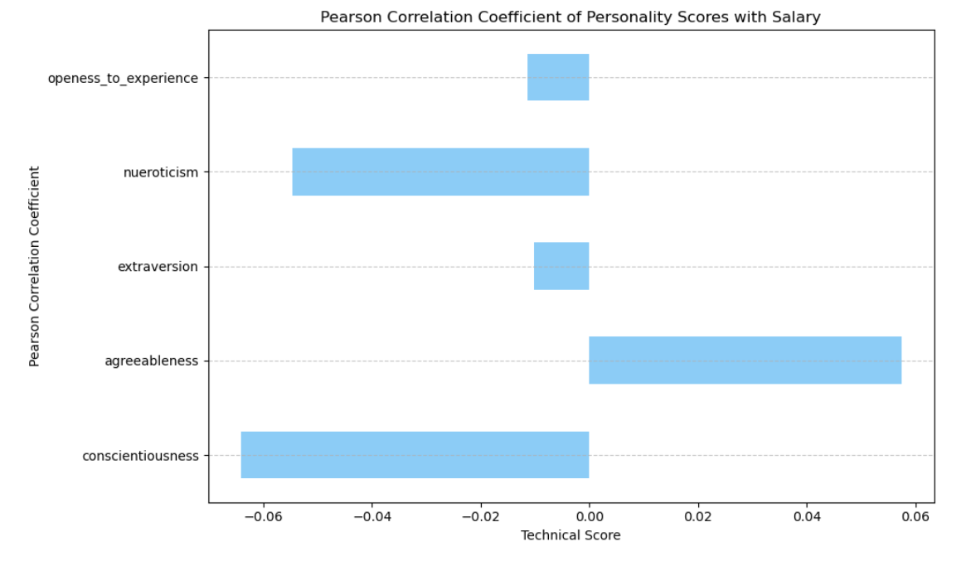
Personality Traits and Salary Correlation:
Conscientiousness:
The correlation coefficient for conscientiousness is approximately -0.064.
The associated p-value is 0.000049, which is statistically significant.
This negative correlation suggests that as conscientiousness increases, other variables tend to decrease.
Agreeableness:
The correlation coefficient for agreeableness is approximately 0.057.
The p-value is 0.000280, indicating statistical significance.
There is a positive correlation between agreeableness and other variables.

Slide 19
Extraversion:
The correlation coefficient for extraversion is approximately -0.010.
The p-value is 0.518564, which is not statistically significant.
Extraversion does not show a strong correlation with other variables.
Neuroticism:
The correlation coefficient for neuroticism is approximately -0.055.
The p-value is 0.000542, suggesting statistical significance.
Neuroticism has a negative correlation with other variables.
Openness to Experience:
The correlation coefficient for openness to experience is approximately -0.011.
The p-value is 0.474565, indicating no strong correlation.
Openness to experience does not significantly correlate with other variables.

Slide 20
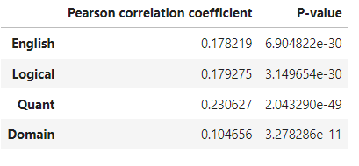
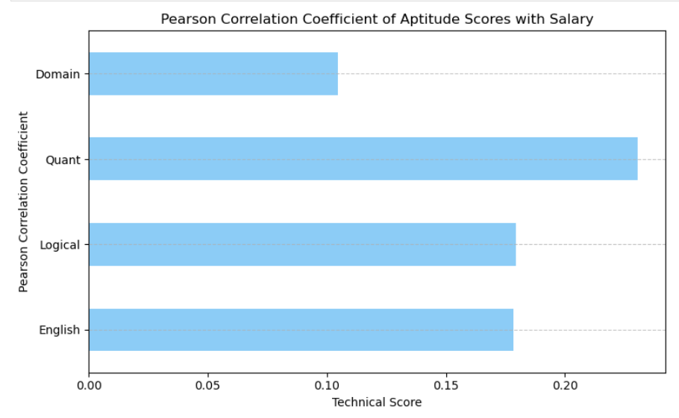
Pearson Correlation Coefficient of Aptitude Scores with Salary
English:
The Pearson correlation coefficient between English scores and other variables is approximately 0.18.
The associated p-value is 6.90e-30, which is extremely small.
This suggests a statistically significant positive correlation between English scores and the other variables.
Logical:
The Pearson correlation coefficient between Logical scores and other variables is approximately 0.18.
The associated p-value is also very small (3.15e-30).
Similar to English, there is a significant positive correlation between Logical scores and the other variables.

Slide 21
Quant:
The Pearson correlation coefficient between Quant scores and other variables is approximately 0.23.
The p-value is 2.04e-49, indicating a strong positive correlation between Quant scores and the other variables.
Domain:
The Pearson correlation coefficient between Domain scores and other variables is approximately 0.15.
The associated p-value is 1.31e-22, which is also very small.
There exists a significant positive correlation between Domain scores and the other variables.
Conclusion:
Engineering Fields Correlation:
Computer Programming, Computer Science, and Electrical Engineering exhibit significant correlations with other fields.
Electronics and Semiconductors, Mechanical Engineering, Telecom Engineering, and Civil Engineering show weaker associations.

Slide 22
Personality Traits Correlation:
Conscientiousness and Neuroticism exhibit negative correlations.
Agreeableness shows a positive correlation.
Extraversion and Openness to Experience have weaker correlations.
Keep in mind that correlation does not imply causation.
English, Logical, Quant, and Domain Correlations:
All these variables exhibit positive correlations with each other.
These findings provide insights into the relationships between different aspects of the data.
Conclusion:
In summary we can say that there are some factors influence the salary distribution and some do not. Therefore, it may not be appropriate to conclude that recruiting candidates solely based on their test scores would lead to better salaries.
While higher test scores may indicate proficiency in certain skills, other factors such as experience, qualifications, and job performance are also important determinants of salary.

Slide 23
Conclusion
Anomalies or outliers were identified, prompting further investigation into potential underlying factors or data quality issues.
Segmentation analysis uncovered distinct subgroups within the dataset, allowing for targeted interventions and tailored approaches to address specific needs.
We identified strong correlations between certain variables, such as college GPA and salary, suggesting that academic performance may influence earning potential.
Trends over time revealed shifts in job preferences and career trajectories among graduates, indicating evolving market demands and industry trends.
The salary distribution among the employees have statistical significance among the certain AMCAT test scores can come to the conclusion that there may be some other significant categories for deciding salary.
Gender biased designations can be seen in the data. There are many careers where each gender prefers.

Slide 24
Challenges:
Grouping the data for research question seemed a challenge. Since there were many subgrouping had to be done.
Category Vs Category bivariate analysis was a challenging since choosing which test for analysing and plotting was confusing.

Slide 25


Slide 26

THANK YOU

