Slide 1

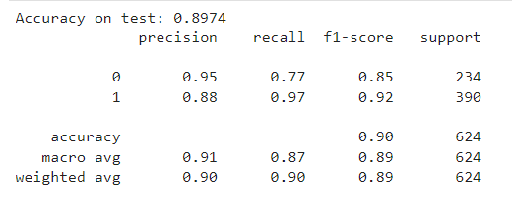
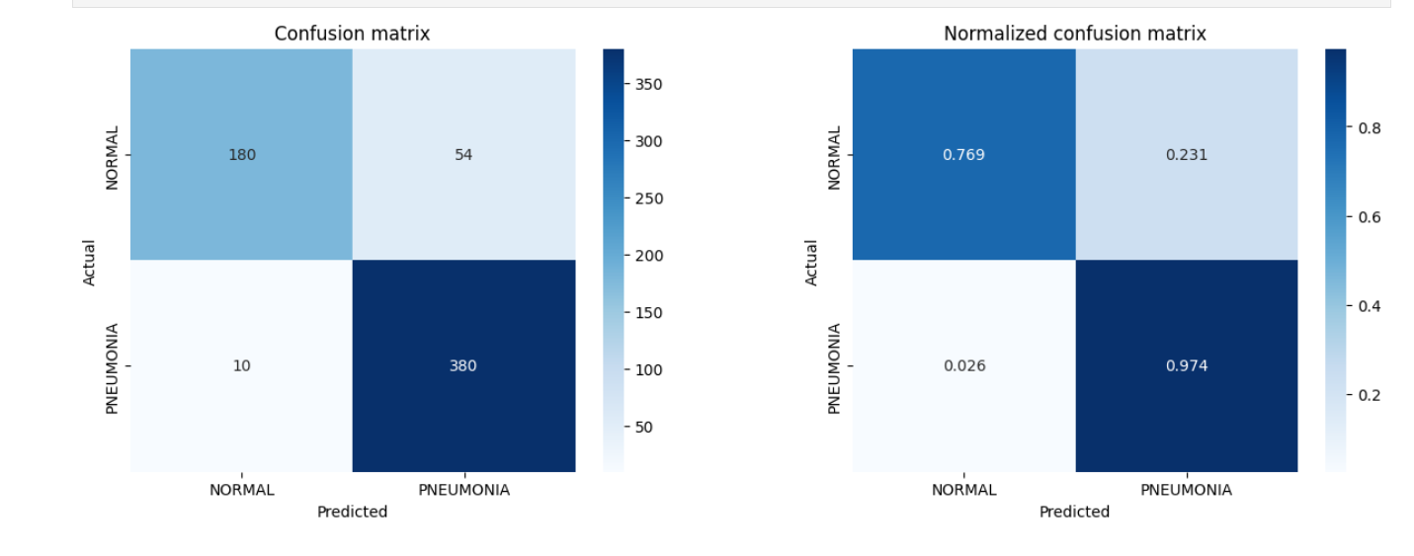
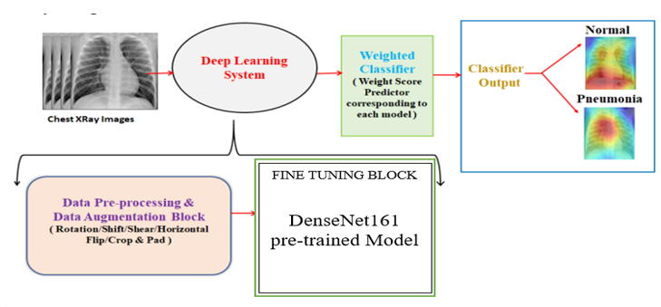
Classification of Pediatric Pneumonia in Chest X-Rays using Deep Learning
ALEN SADIQUE(20BAI1077) AND FATHIMA SONA SHERIN(20BAI1187)
Guide Nam : Dr. Jayanthi R
School Name : SCOPE
INTRODUCTION
The project aims to build a deep learning model that can accurately classify chest X-ray images of pediatric patients as either normal or pneumonia cases. This classification can assist medical professionals in making accurate and timely diagnoses, which is particularly important in pediatric pneumonia cases, as early detection and treatment can significantly improve patient outcomes. The project uses transfer learning, a technique that leverages pre-trained models to improve the accuracy and efficiency of the classification model. By using transfer learning, the project aims to build a reliable and accurate model for pediatric pneumonia classification that can be used in real-world clinical settings.
The motivation is to improve the accuracy and efficiency of diagnosing pediatric pneumonia, which can have a significant impact on patient outcomes. Pneumonia is a leading cause of death among children under five years old, and early detection and treatment are critical for a successful recovery. However, pneumonia diagnosis can be challenging, especially in resource-limited settings where access to specialized healthcare providers and equipment may be limited. The project aims to develop a reliable and accurate machine learning model that can assist medical professionals in quickly and accurately diagnosing pediatric pneumonia using chest X-ray images. By using transfer learning, the project also aims to address the challenge of limited data availability for training a machine learning model, which can be a significant barrier to developing accurate models in medical imaging.
Objectives
To develop a deep learning model that can accurately classify chest X-ray images of pediatric patients as normal or pneumonia cases.
To use transfer learning to leverage pre-trained models and improve the accuracy and efficiency of the classification model.
To evaluate the performance of the trained model using standard evaluation metrics such as accuracy, precision, recall, and F1-score.
To compare the performance of the transfer learning-based model with other traditional machine learning models for pediatric pneumonia classification.
To create a user-friendly interface that allows medical professionals to input chest X-ray images and obtain quick and accurate diagnosis results
SCOPE of the project
The scope of the project is limited to the development of a deep learning model for pediatric pneumonia classification using chest X-ray images. The scope of this project is that it can aid the healthcare professionals with faster and accurate detection of pneumonia in pediatric patients. The scope of the project also covers the use of transfer learning techniques to improve the accuracy and efficiency of the classification model. Publicly available datasets of pediatric chest X-ray images will be used to train and test the model, and standard evaluation metrics such as accuracy, F1-score will be used to evaluate the model's performance.
methodology
The proposed method for the project involves using a pre-trained convolutional neural network (CNN) as a feature extractor, followed by a custom-built classification head to classify chest X-ray images into two categories: normal and pneumonia. The pre-trained CNN is used to extract high-level features from the input images, which are then passed through the classification head to make a prediction. Transfer learning techniques are employed to leverage the pre-trained CNN's ability to extract relevant features from images, reducing the amount of training data required and improving the classification accuracy. The model is trained and validated on publicly available datasets of pediatric chest X-ray images, and evaluation metrics such as accuracy, precision, recall, and F1-score are used to assess its performance. The project also employs a user-friendly interface that allows medical professionals to input chest X-ray images and obtain quick and accurate diagnosis results
Architecture
.
The architecture of the project consists of a pre-trained convolutional neural network (CNN) DenseNet 161 as a feature extractor and a custom-built classification head on top. the architecture of the model would consist of several dense blocks and transition layers, followed by a global average pooling layer and a classification head. The input to the model is a grayscale chest X-ray image, which is passed through the pre-trained CNN to extract relevant features. The output of the pre-trained CNN is then fed into the custom-built classification head, which consists of a global average pooling layer, a fully connected layer with ReLU activation and dropout for regularization, and an output layer with a sigmoid activation function for binary classification. The global average pooling layer computes the mean of each feature map, resulting in a fixed-size feature vector that is fed into the fully connected layer. The output layer produces a binary classification result, indicating whether the input chest X-ray image is normal or shows signs of pneumonia. The model is trained using transfer learning techniques on publicly available datasets of pediatric chest X-ray images, and a user-friendly interface is provided for medical professionals to input images and obtain accurate diagnosis results.
Results and discussion
The accuracy on the test set of the project is 0.8974, which means that the model is able to correctly classify 89.74% of the chest X-rays as either normal or pneumonia cases. The precision for the normal class (0) is 0.95, which means that when the model predicts a chest X-ray as normal, it is correct 95% of the time. The recall for the normal class is 0.77, which means that the model correctly identifies 77% of the normal cases. The precision for the pneumonia class (1) is 0.88, which means that when the model predicts a chest X-ray as pneumonia, it is correct 88% of the time. The recall for the pneumonia class is 0.97, which means that the model correctly identifies 97% of the pneumonia cases. The F1-score is a weighted harmonic mean of the precision and recall, with values ranging from 0 to 1. The F1-score for the normal class is 0.85, and for the pneumonia class is 0.92. The weighted average F1-score is 0.89, which indicates a good balance between precision and recall for both classes.
Conclusion
The results of the trained model's evaluation on the test set have been reported. The accuracy on the test set was 0.8974, with precision and recall values of 0.95 and 0.77 for the normal class, and 0.88 and 0.97 for the pneumonia class, respectively The results suggest that the transfer learning approach used in this project is effective in building a reliable and accurate classification model for pediatric pneumonia. In conclusion, the analysis of the results of this project demonstrates the potential of using transfer learning to build accurate and reliable models for pediatric pneumonia classification, which can help medical professionals make timely and accurate diagnoses.
References
Rajpurkar, P., Irvin, J., Zhu, K., Yang, B., Mehta, H., Duan, T., ... & Lungren, M. P. (2018). Chexnet: Radiologist-level pneumonia detection on chest x-rays with deep learning. arXiv preprint arXiv:1711.05225.
Kermany, D. S., Goldbaum, M., Cai, W., Valentim, C. C., Liang, H., Baxter, S. L., ... & Zhang, K. (2018). Identifying medical diagnoses and treatable diseases by image-based deep learning. Cell, 172(5), 1122-1131.

