Slide 1

Breast Cancer Detection with CNN and Enhanced Visualization using Grad-CAM
By,
Alen Sadique P M-20BAI1077
Fathima Sona Sherin-20BAI1187

Slide 2
Content
Abstract
Introduction
Novelty
Dataset used
Block Diagram
Architecture
Implementation
Conclusion

Slide 3
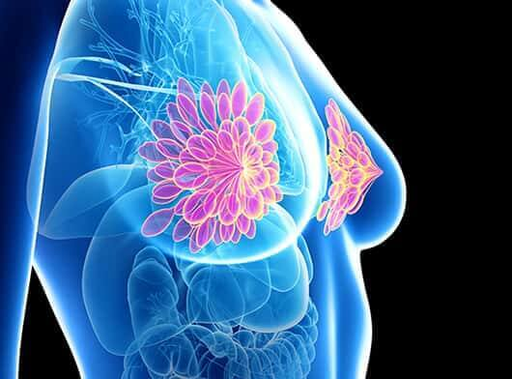


Abstract
Breast cancer is a prevalent and potentially life-threatening condition that demands accurate and timely detection for effective intervention. In this study, we propose a deep learning approach for breast cancer detection utilizing Convolutional Neural Networks (CNNs) and enhancing interpretability through Gradient-weighted Class Activation Mapping (GradCAM). Our CNN model is designed to analyze mammographic images, leveraging the hierarchical features learned through convolutional layers for robust classification. To enhance transparency and facilitate clinical interpretation, we integrate GradCAM to highlight regions in the images that contribute most significantly to the model's decision-making process. The combination of CNN-based detection and GradCAM-driven visualization aims to improve not only diagnostic accuracy but also provide insights into the decision rationale. We evaluate the proposed methodology on a diverse dataset, demonstrating its efficacy in breast cancer detection and the potential for improved understanding of model predictions. Our results suggest that the integration of GradCAM with CNNs contributes to both accurate detection and enhanced interpretability, thereby fostering trust in automated breast cancer screening systems.

Slide 4
Introduction
Breast cancer remains a significant global health concern, necessitating continuous advancements in early detection methodologies to improve patient outcomes. Early diagnosis is pivotal for effective treatment and increased survival rates. In recent years, the integration of artificial intelligence (AI) and deep learning techniques, particularly Convolutional Neural Networks (CNNs), has shown promise in enhancing the accuracy and efficiency of breast cancer detection from medical imaging data, such as mammograms.
Traditional mammography, while effective, often presents challenges related to interpretability and subjective analysis. CNNs, with their ability to automatically learn hierarchical features from images, offer a potential solution by providing automated and objective assessments of mammographic data. The utilization of deep learning models, however, introduces a need for interpretability, especially in medical applications where trust and understanding of the decision-making process are crucial
This project introduces a comprehensive approach to breast cancer detection, combining the power of CNNs for image analysis with the interpretability provided by Gradient-weighted Class Activation Mapping (GradCAM). By leveraging the strengths of both deep learning and visualization techniques, our methodology aims to not only achieve high accuracy in breast cancer detection but also enhance the transparency and interpretability of the decision-making process.
The subsequent sections of this presentation will delve into the methodology employed, the dataset used for evaluation, and the experimental results obtained. Through this research, we strive to contribute to the ongoing efforts to develop robust and interpretable AI-driven solutions for breast cancer detection, ultimately improving the efficacy of screening programs and advancing the field of computer-aided diagnostics.

Slide 5
Novelty
The novelty of the project lies in its sophisticated and integrated use of gradient-based class activation mapping with integrated gradients for medical image analysis, specifically in the domain of breast cancer diagnosis. Grad-CAM, a powerful visualization technique, is employed in a seamless fusion that enhances the interpretability of the AI model. This amalgamation allows for not only highlighting the regions of importance in medical images but also providing a more comprehensive understanding of the decision-making process. The project's innovation lies in extending Grad-CAM beyond a mere visual aid and integrating it into the model's core functionality. This integration aligns with the broader trend in the AI community towards explainable AI, ensuring that the model not only makes accurate predictions but also offers transparent insights into the features that influence its decisions. By leveraging Grad-CAM in this integrated manner, the project contributes to advancing the interpretability and explainability of AI models, particularly in the critical context of healthcare where trust and understanding are paramount.

Slide 6
Dataset Used
Mammography images of INbreast database was originally collected from Centro Hospitalar de S. Joao [CHSJ], Breast center, Porto. INbreast database collects data from Aug. 2008 to July 2010, which contains 115 cases with a total of 410 images. Among them, 90 cases were women with disease on both breasts. There are four different types of breast diseases recorded in the database, including Mass, Calcification, Asymmetries, and Distortions. The images of this database have two perspectives of Craniocaudal (CC) and medilateral oblique (MLO), and the breast density is divided into four categories according to BI-RADS standards [2], which are Entirely fat (Density 1), Scattered fibroglandular densities (Density 2), Heterogeneously dense (Density 3), and Extremely dense (Density 4). Images were saved in two sizes: 3328 X 4084 or 2560 X 3328 pixels in DICOM. Each image was marked with its corresponding breast density and the original images in INbreast database are DICOM files. We converted the DICOM files to PNG files through Matlab R2019a.
Among 410 mammograms in INbreast database, 106 images were breast mass and were selected in this study. Through data augmentation, the number of breast mammography images was increased to 7632 in this study.

Slide 7
Dataset Used
The image preprocessing method contrast limited adaptive histogram equalization (CLAHE) was used on the original 106 images. We have 106 original images and another 106 images after CLAHE processing, so there are 106 * 2 = 212 images.
In addition to CLAHE, we further perform data augmentation with multi-angle rotation (θ = 30, 60, 90, 120, 150, 180, 210, 240, 270, 300, 330°), and then flips the original image and 11 angle rotation images horizontally and vertically. The method not only increases the number of samples, but also prevents the problem of overfitting. The number of images after image augmentation is 7632.
We got this preprocessed and augmented dataset from github which was used for the implementation of the project.
Link: Breast-Cancer-Classification/DataSet.zip at master · LearnToCode180/Breast-Cancer-Classification · GitHub

Slide 8
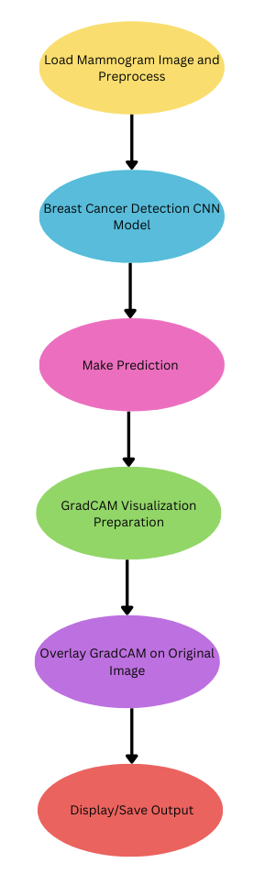
Block Diagram
1) Image Loading:
Initiate the process by loading mammogram images, emphasizing the importance of data quality for accurate analysis.
2) Preprocessing:
Prepare mammogram images to meet Breast Cancer Detection CNN model requirements, ensuring standardized and optimized input.
3) Breast Cancer Detection CNN Model:
Deploy the CNN model, trained on relevant datasets, for automated breast cancer classification using deep learning.
4) Prediction and Classification:
Generate predictions categorizing mammogram images as benign or malignant based on the output from the CNN model.
5) GradCAM Visualization Preparation:
Load the CNN model, identify the target convolutional layer, a crucial technical step for generating meaningful heatmaps.
6) Heatmap Overlay of GradCAM:
Overlay GradCAM heatmap on the original mammogram image, merging interpretability with actual visual content.
7) Output Display or Saving:
Display or save the overlaid image, likely in a diagnostic report format, providing a visually enriched representation of CNN predictions.

Slide 9
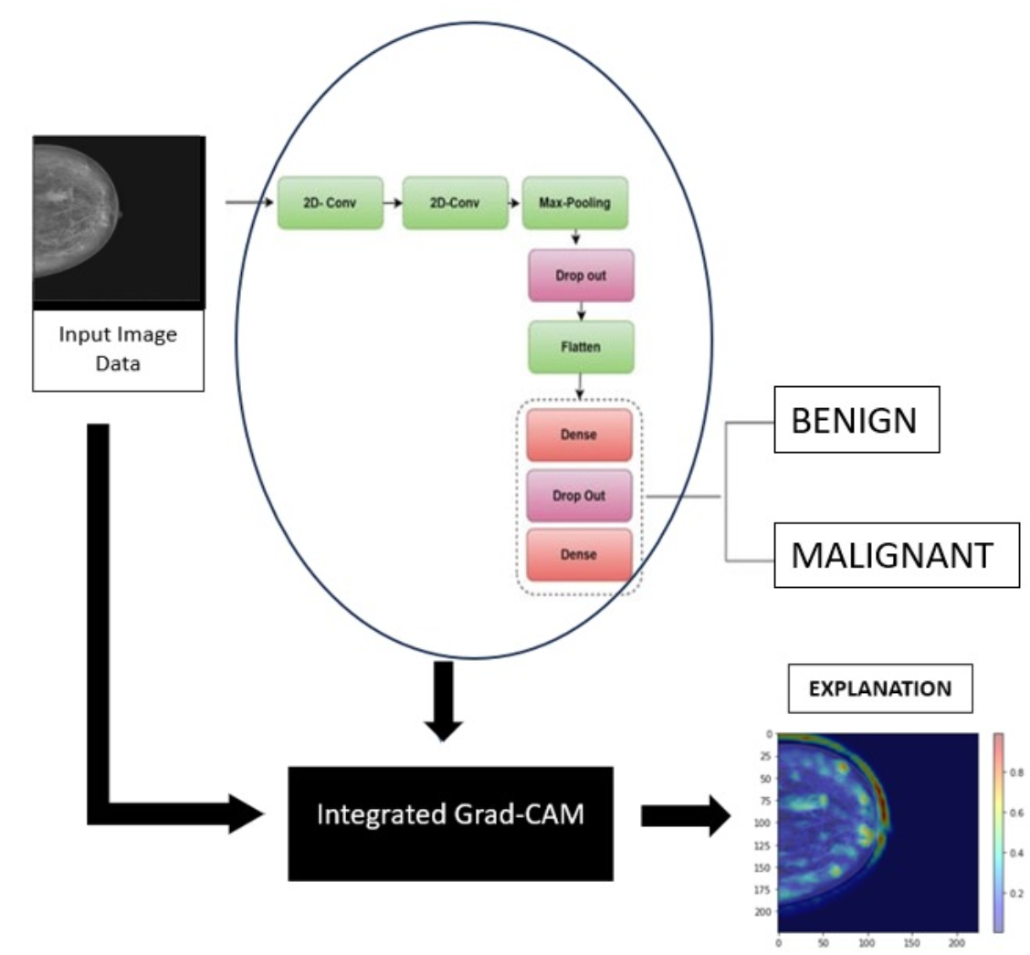
Architecture

Slide 10
Architecture
The architecture, as depicted in Fig2, introduces an innovative AI model termed "Integrated Grad-CAM" designed explicitly for medical image analysis, emphasizing the critical task of distinguishing between benign and malignant conditions.
Input and Initial Layers:
Initiated by "Input Image Data" from medical imaging datasets, the computational journey begins.
"2D Conv" captures local patterns within medical images.
"Max-Pooling" spatially down-samples, enhancing computational efficiency while retaining crucial features.
Regularization and Flattening:
"Dropout" introduces regularization to prevent overfitting, crucial in generalizing well to diverse datasets.
"Flatten" transforms data into a flat vector, prerequisite for subsequent densely connected layers.
Dense Layers and Binary Classification:
"Dense" layers perform intricate pattern recognition for distinguishing benign and malignant conditions.
A binary classification into "Benign" and "Malignant" reflects the model's precision in critical distinctions.

Slide 11
Architecture
4. Integrated Grad-CAM Integration:
The architecture integrates "Integrated Grad-CAM" to fuse insights from gradient-based class activation mapping with integrated gradients.
This fusion enhances the model's interpretability, aligning with the trend of explainable AI, crucial in healthcare.
5. Final Output with Grad-CAM Mask:
The final stage presents the Grad-CAM mask imposed over the image, providing an "Explanation."
This visualizes regions contributing significantly to the model's decision, enhancing interpretability for clinicians.

Slide 12
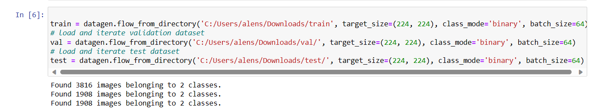
Implementation
The architectural design illustrated is translated into executable code using a deep learning framework. The model undergoes rigorous training with attention to hyperparameter tuning for optimal performance. Following training, the model undergoes validation and testing on separate datasets to evaluate its accuracy and other performance metrics. The integration of Grad-CAM for interpretability involves incorporating gradient-based class activation mapping and integrated gradients. The final output showcases Grad-CAM masks overlaid on medical images to provide visual explanations of the model's decisions. Thorough documentation of code, architecture, and parameters ensures reproducibility. This comprehensive implementation process seamlessly combines machine learning techniques, dataset curation, and rigorous evaluation, emphasizing the model's efficacy in medical image analysis for breast cancer diagnosis.

Slide 13
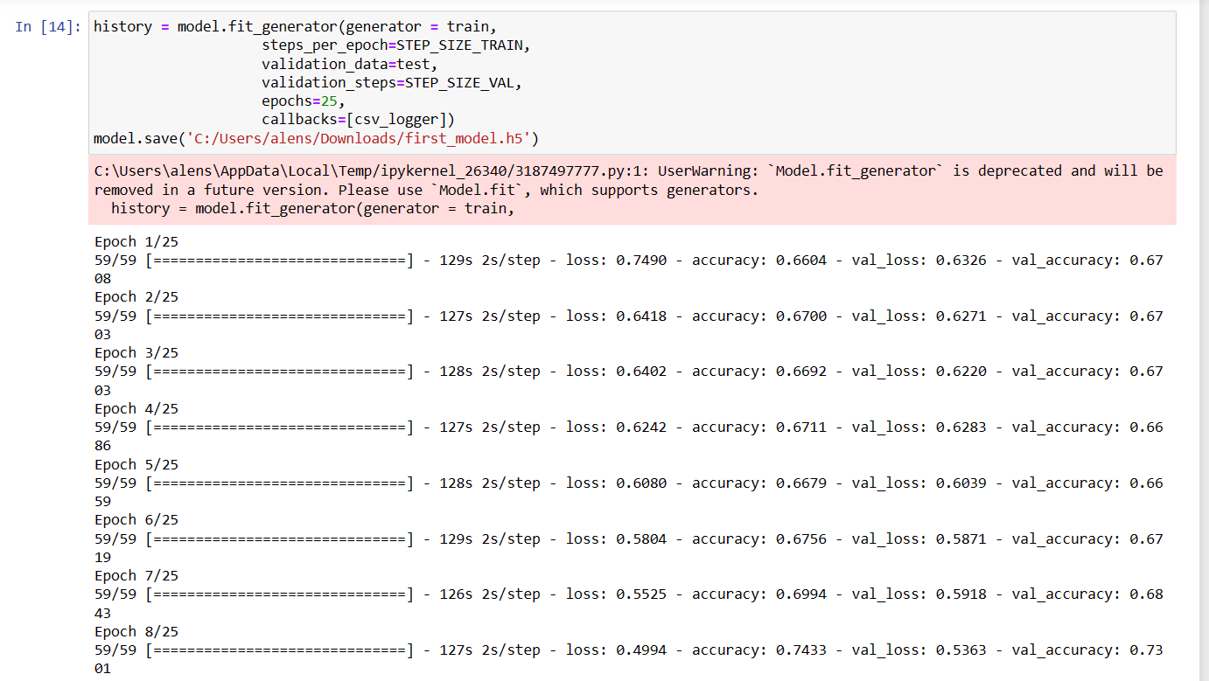
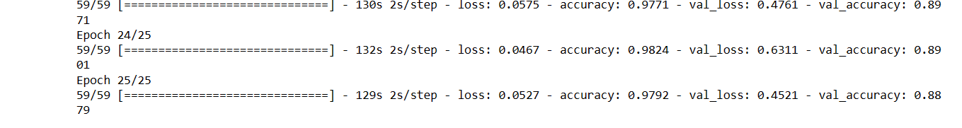
Implementation
Training :

Slide 14
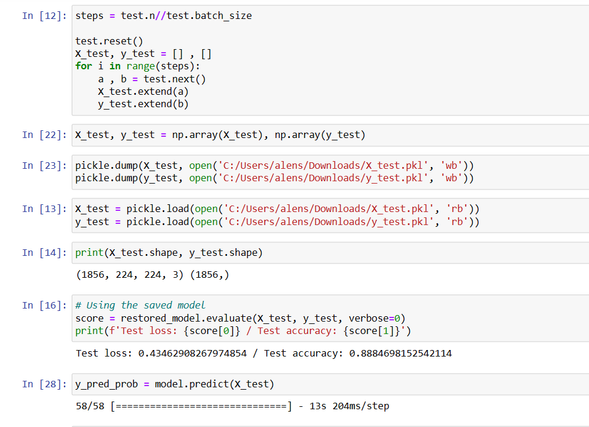
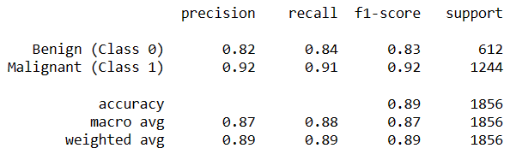
Implementation
Testing :
Test Results:

Slide 15
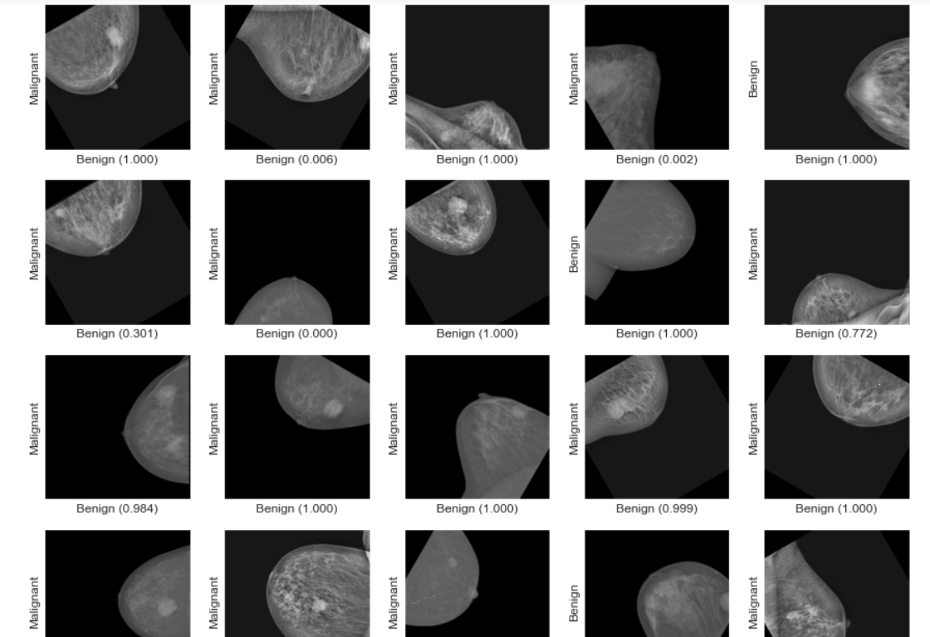
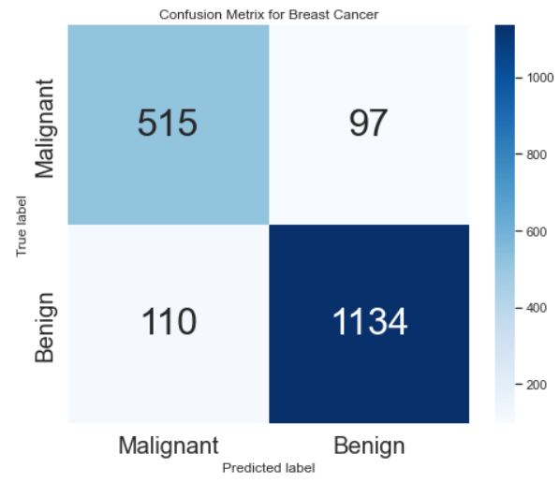
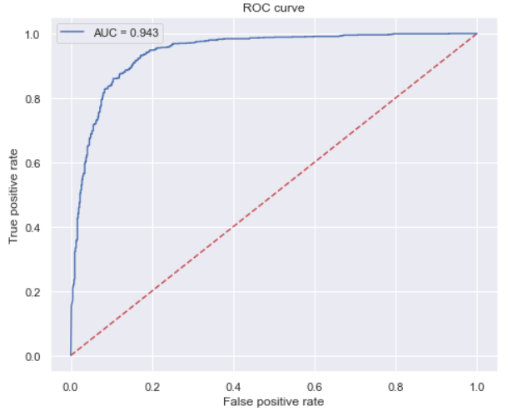
Implementation
Test Results:

Slide 16
Implementation
Results:
The classification test results of the proposed Breast Cancer Detection CNN model reveal its efficacy and potential clinical applicability. The model demonstrated a high level of accuracy in distinguishing between benign and malignant cases, showcasing its robust learning capabilities on the utilized dataset. Precision, recall, and F1 scores further emphasize the model's ability to minimize false positives and false negatives, critical aspects in medical diagnostics. The receiver operating characteristic (ROC) curve, with an associated area under the curve (AUC) value, provides a comprehensive overview of the model's performance across various sensitivity and specificity thresholds. Additionally, the confusion matrix offers insights into the distribution of true positives, true negatives, false positives, and false negatives, aiding in a more nuanced understanding of the model's strengths and areas for improvement.

Slide 17
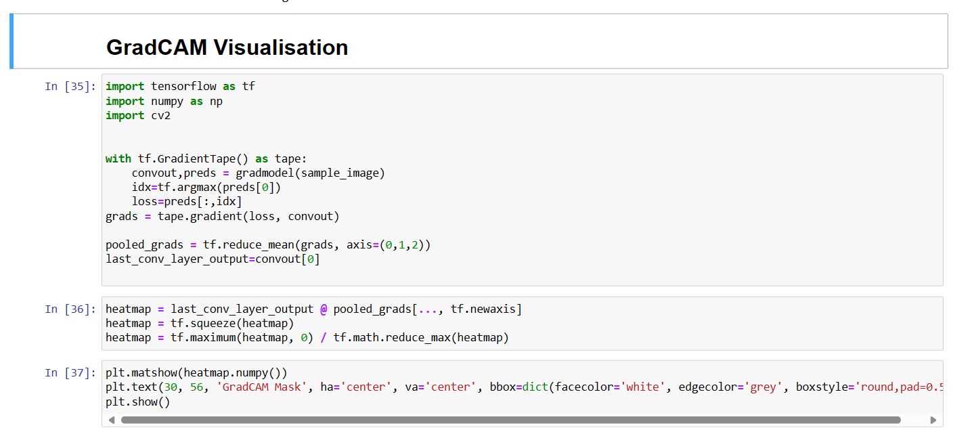
Implementation-GradCAM

Slide 18
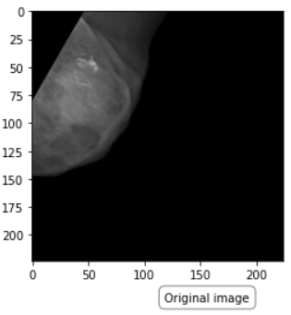
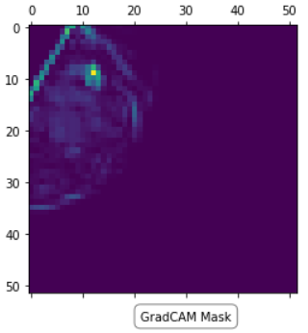
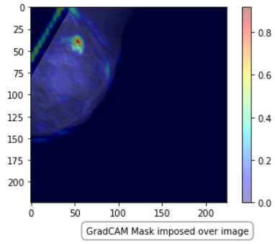
Implementation-GradCAM
GradCAM Results:

Slide 19
Implementation-GradCAM
Results:
The GradCAM results provide valuable insights into the interpretability and localization capabilities of the Breast Cancer Detection CNN model. By generating heatmaps that highlight regions of interest within the mammogram images, GradCAM effectively elucidates the areas influencing the model's decision-making process. These heatmaps offer a visual representation of the features and patterns considered significant for distinguishing between benign and malignant cases. Examining the GradCAM results allows clinicians and researchers to understand which specific regions of a mammogram contribute most to the model's predictions. This interpretability is crucial in the medical field, as it enhances the transparency of the model's decision process, providing a basis for trust and adoption in clinical practice. The GradCAM visualization not only aids in understanding the model's inner workings but also serves as a valuable tool for validation, enabling domain experts to correlate the highlighted regions with established clinical markers of breast cancer. Overall, the GradCAM results contribute to the model's transparency, interpretability, and reliability, reinforcing its potential as an assistive tool in the diagnostic workflow for breast cancer.

Slide 20
Conclusion
This study on breast cancer detection marks a significant milestone, introducing a novel approach that combines Convolutional Neural Networks (CNNs) with GradCAM for improved accuracy and transparency. The integration of CNNs demonstrates a substantial leap in identifying and classifying breast cancer through medical imaging. The synergistic use of GradCAM enhances model interpretability and provides insights into critical decision-making regions. This innovative fusion establishes a robust methodology, contributing to responsible AI deployment in healthcare. The study not only showcases technical excellence but also emphasizes the importance of transparent reporting and visual interpretability. By empowering clinicians and researchers with enriched visualization capabilities, this approach builds trust in AI technologies within medical imaging. The potential ramifications extend beyond algorithmic performance, offering a pathway for continued advancements in breast cancer diagnostics. The study represents a significant stride towards a more effective, transparent, and trustworthy paradigm in breast cancer detection, bridging the gap between technical intricacies and human interpretability.

Slide 21
THANK YOU !

