Slide 1

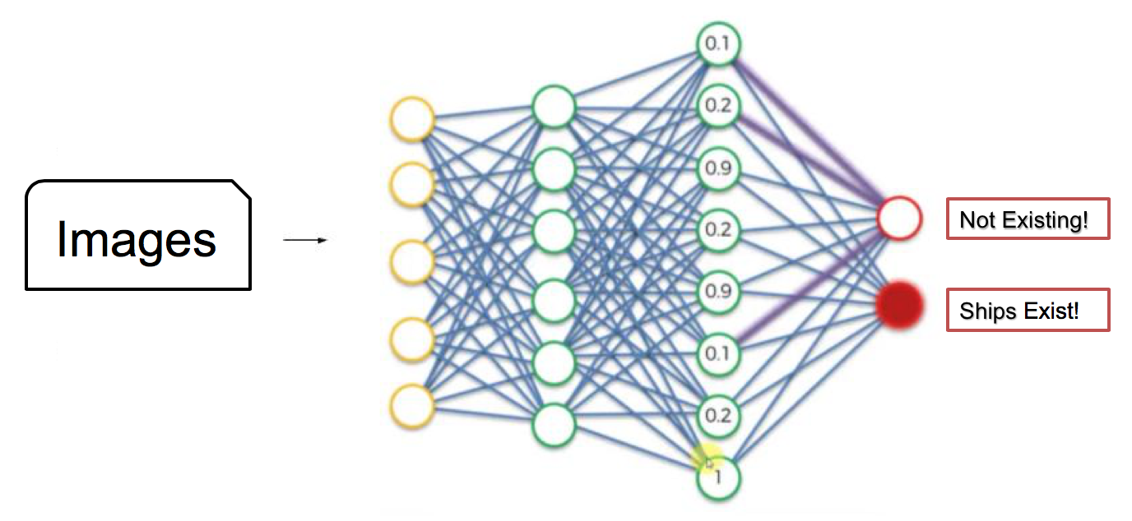

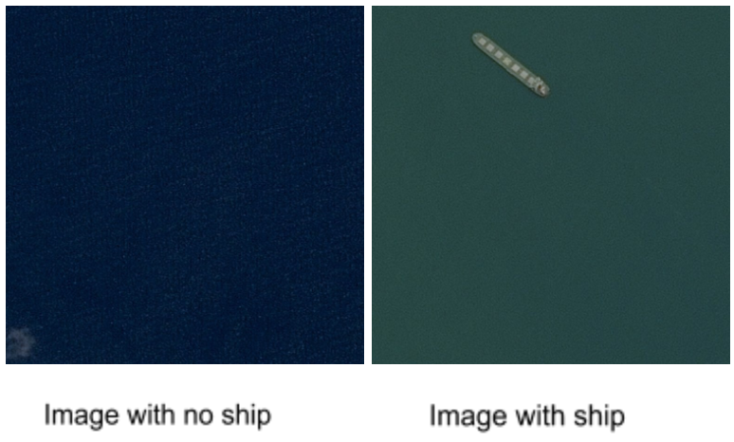
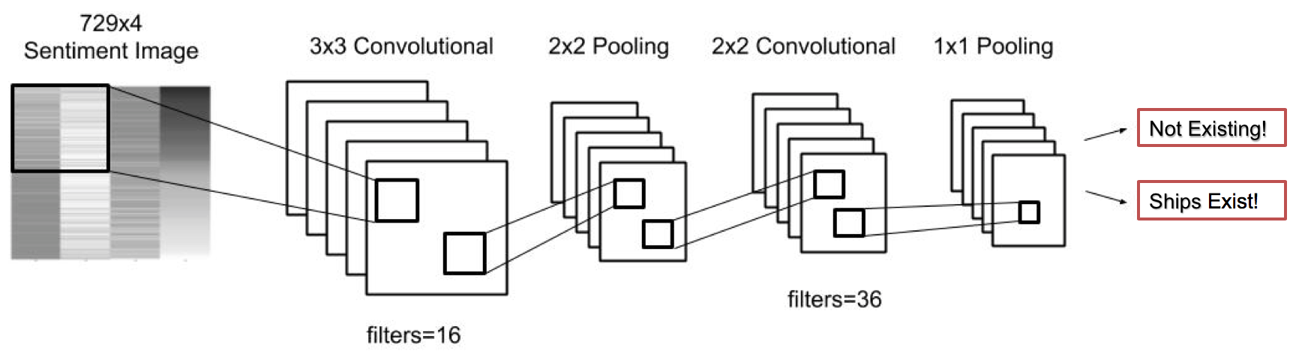
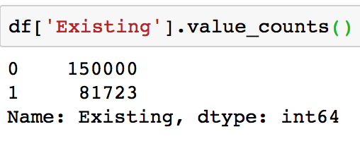
Ship Detection Along Maritime Shipping Routes with Convolutional Neural Networks (CNNs) Methodology Kevin Walsh, Erdong Xia, Ping-Lun Yeh Instructor: Dr. Christopher Asakiewicz
Business Intelligence & Analytics
The Business Problem
There are tons of ships navigating the ocean every day, but few can be detected by satellites or other means quickly and accurately. How can we automate detection and quantification of ships found in satellite imagery, and then make these results easy to access?
Methodology Approach (Concept)
CNNs consist of an input and an output
layer, as well as multiple hidden layers.
The hidden layers of a CNN typically
consist of convolutional layers, pooling
layers, fully connected layers, and
normalization layers.
Data and Scope
We used segments of satellite imagery submitted to the public by Airbus for use in a Kaggle classification competition. This dataset contains a database of more than 200,000 small images of tankers, commercial ships, or fishing ships.
Sample Images:
Methodology Approach (Model)
Convolutional layers apply a convolution
operation to the input, passing the result
to the next layer. The convolution
emulates the response of an individual
neuron to visual stimuli. Each neuron
processes data only for its receptive field.
Ship Existence Rate
0: Ships do not exist in the images
1: Ships exist in the images
Existing Rate is around 35%
Conclusion
The test accuracy is more than 65% which
is excellent. This model can be applied to
satellite images from any area of interest
for ship detection and quantification.
http://www.stevens.edu/school-business/masters-programs/business-intelligence-analytics
Notes:
1

