Slide 1
curatedMetagenomicData: curated taxonomic and functional profiles for thousands of human-associated microbiomes Microbiome working group seminar Dec 1, 2016
Levi Waldron

Slide 2
Motivation
Metagenomic sequencing data publicly available but hard to use
fastq files from NCBI, EBI, ...
bioinformatic expertise
computational resources
manual curation
Wanted to make data easy to use for epidemiologists, biostatisticians, biologists, ...

Slide 3
Sequencing as a Tool for Microbial Community Analysis
16S rRNA
sequencing
Whole-metagenome shotgun
sequencing
Pros
taxonomy to species and even strain
viruses and fungi
gene variants, e.g. ABX resistance
use of many marker genes is less susceptible to biases
more direct + precise functional inference
Cons
expensive – probably no multiplexing
contamination from human DNA
big data (before processing)
Pros
cheap (multiplex hundreds of samples)
relatively small data
provides genus-level taxonomy and inferred metabolic function for bacteria and archaea
Cons
taxonomy reliable only to genus level
indirect inference of metabolic function
use of a single marker gene is susceptible to biases

Slide 4



Taxonomy for WMS: MetaPhlAn2
GATTACATAG
Samples
More than 100x speedup over other accurate methods for WMS taxonomic assignment
Microbes
Relative abundances
Segata N, Waldron L, Ballarini A, Narasimhan V, Jousson O, Huttenhower C: Metagenomic microbial community profiling using unique clade-specific marker genes. Nat. Methods 2012, 9:811–814.
Truong DT, Franzosa EA, Tickle TL, Scholz M, Weingart G, Pasolli E, Tett A, Huttenhower C, Segata N: MetaPhlAn2 for enhanced metagenomic taxonomic profiling. Nat. Methods 2015, 12:902–903.

Slide 5
Metabolic function for WMS: HUMAnN2
Community functional profiling
Databases of genomes, genes, and pathways
UniRef database provides gene family definitions
MetaCyc pathway definitions by gene family
MinPath to identify the set of minimum pathways
DNA and translated searches
Abubucker S, Segata N, Goll J, Schubert AM, Izard J, Cantarel BL, Rodriguez-Mueller B, Zucker J, Thiagarajan M, Henrissat B, White O, Kelley ST, Methé B, Schloss PD, Gevers D, Mitreva M, Huttenhower C: Metabolic reconstruction for metagenomic data and its application to the human microbiome. PLoS Comput. Biol. 2012, 8:e1002358.

Slide 6


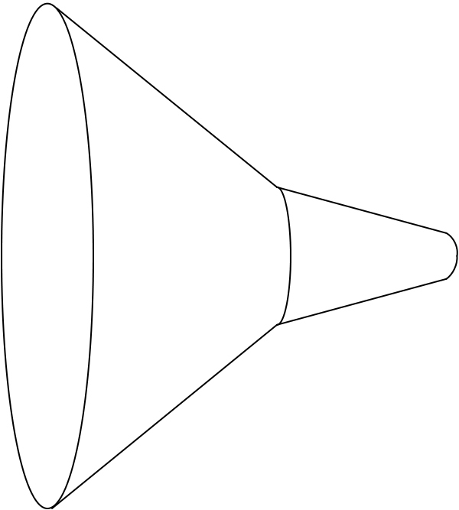

curatedMetagenomicData pipeline
Raw
fastq files
13 datasets
2,875 samples
Study metadata
Age, body site, disease, etc…
Differential abundance
Diversity metrics
Clustering
Machine learning
Convenience download functions
Megabytes-sized datasets
Download (~25TB)
ExperimentHub product
Amazon S3 cloud distribution
Tag-based searching
Dataset snapshot dates
Automatic local caching
Uniform processing
Manual curation
MetaPhlAn2
HUMAnN2
Automatic documentation
species abundance
metabolic pathway abundance
Integrated Bioconductor ExpressionSet objects
Per-patient microbiome data
Per-patient metadata
Experiment-wide metadata
marker
presence
metabolic pathway presence
standardized metadata
marker abundance
gene family abundance
Integration
User
experience
Offline high computing pipeline
> 500 kH CPU, 75TB disk requirements
Notes:
https://upload.wikimedia.org/wikipedia/commons/thumb/7/7e/Funnel_Mech.svg/667px-Funnel_Mech.svg.png
https://pixabay.com/en/cheering-happy-jumping-people-297419/

Slide 7
Automatic documentation
Link to manual

Slide 8
curated*Data Bioconductor packages
curatedMetagenomicData
curatedOvarianData
30 datasets, > 3K unique samples
most annotated for OS, surgical debulking, histology...
curatedCRCData
34 datasets, ~4K unique samples
many annotated for MSS, gender, stage, age, N, M
curatedBladderData
12 datasets, ~1,200 unique samples
many annotated for stage, grade, OS

Slide 9
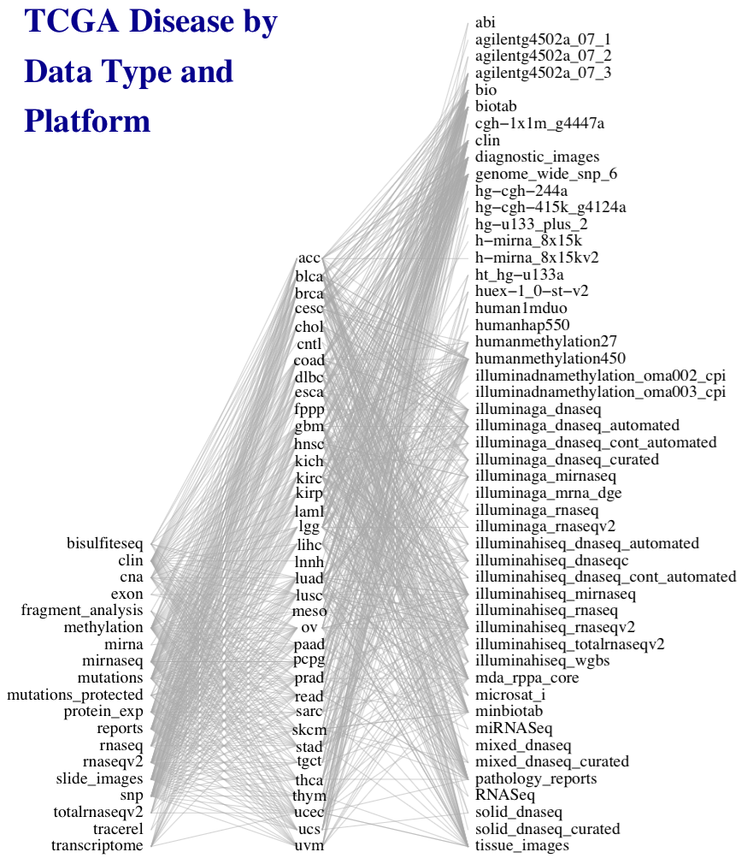
The Cancer Genome Atlas
50 platforms
36 diseases
19 data types
Figure credit: Marcel Ramos

Slide 10
MultiAssayExperiment
Integrative multi-omics data representation and management for Bioconductor
https://bioconductor.org/packages/MultiAssayExperiment
Provide pre-packaged objects for all of TCGA
http://tinyurl.com/MAEOurls

Slide 11
Thank you
Lab (www.waldronlab.org / www.waldronlab.github.io)
Lucas Schiffer
Marcel Ramos, Lavanya Kannan, Hanish Kodali, Rimsha Azar, Carmen Rodriguez, Audrey Renson
Collaborators
Nicola Segata, Edoardo Pasolli (University of Trento, Italy)
Valerie Obenchain, Martin Morgan (Bioconductor core team)
CUNY High-performance Computing Center
Statistical Learning Book Club:
Join us remotely, Fridays at 10am
Currently reading “Data Analysis for the Life Sciences” by Irizarry and Love
http://tinyurl.com/huw8cb5
Notes:
met Jin Xu from East China Normal University, Shanghai

Slide 12
Datasets
Dataset | Samples | Citation
HMP_2012 | 749 | Human Microbiome Project Consortium. Structure, function and diversity of the healthy human microbiome. Nature 486, 207–214 (2012).
KarlssonFH_2013 | 145 | Karlsson, F. H. et al. Gut metagenome in European women with normal, impaired and diabetic glucose control. Nature 498, 99–103 (2013).
LeChatelierE_2013 | 292 | Le Chatelier, E. et al. Richness of human gut microbiome correlates with metabolic markers. Nature 500, 541–546 (2013).
LomanNJ_2013_Hi | 44 | Loman, N. J. et al. A culture-independent sequence-based metagenomics approach to the investigation of an outbreak of Shiga-toxigenic Escherichia coli O104:H4. JAMA 309, 1502–1510 (2013).
LomanNJ_2013_Mi | 9 | Loman, N. J. et al. A culture-independent sequence-based metagenomics approach to the investigation of an outbreak of Shiga-toxigenic Escherichia coli O104:H4. JAMA 309, 1502–1510 (2013).
NielsenHB_2014 | 396 | Nielsen, H. B. et al. Identification and assembly of genomes and genetic elements in complex metagenomic samples without using reference genomes. Nat. Biotechnol. 32, 822–828 (2014).
Obregon_TitoAJ_2015 | 58 | Obregon-Tito, A. J. et al. Subsistence strategies in traditional societies distinguish gut microbiomes. Nat Commun 6, 6505 (2015).
OhJ_2014 | 291 | Oh, J. et al. Biogeography and individuality shape function in the human skin metagenome. Nature 514, 59–64 (2014).
QinJ_2012 | 363 | Qin, J. et al. A metagenome-wide association study of gut microbiota in type 2 diabetes. Nature 490, 55–60 (2012).
QinN_2014 | 237 | Qin, N. et al. Alterations of the human gut microbiome in liver cirrhosis. Nature 513, 59–64 (2014).
RampelliS_2015 | 38 | Rampelli, S. et al. Metagenome Sequencing of the Hadza Hunter-Gatherer Gut Microbiota. Curr. Biol. 25, 1682–1693 (2015).
TettAJ_2016 | 97 | Ferretti, P. et al. Experimental metagenomics and ribosomal profiling of the human skin microbiome. Exp. Dermatol. (2016). doi:10.1111/exd.13210
ZellerG_2014 | 156 | Zeller, G. et al. Potential of fecal microbiota for early-stage detection of colorectal cancer. Mol. Syst. Biol. 10, 766 (2014).
Notes:
Total of 13 datasets with 2,875 samples

