Slide 1
Entity extraction, linking, classification, and tagging for social media
Nicolò Palmiero 1918734
Alessio Papi 1761063
Github repository:
https://github.com/nictuss/WIR-project
Assigned Paper:
Entity Extraction, Linking, Classification, and Tagging for Social Media: A Wikipedia Based Approach
by Abhishek Gattani, Digvijay S. Lamba, Nikesh Garera...

Slide 2

Presentation Outline
Problem definition, goals and simplifying assumptions
N: Our model as compared to the assigned paper’s.
A: Tweets Dataset.
A: Knowledge Base & Prefix Map
N: Mentions Extraction
A: Inverted Index for Classification & Tagging
N: Updating the Knowledge Base
N: Evaluation and Results of Mentions Extraction (before and after update)
A: Evaluation and Results of Classification (before and after update)

Slide 3
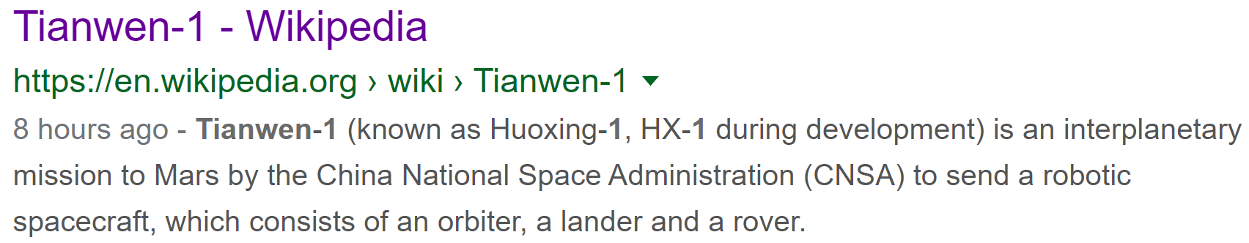
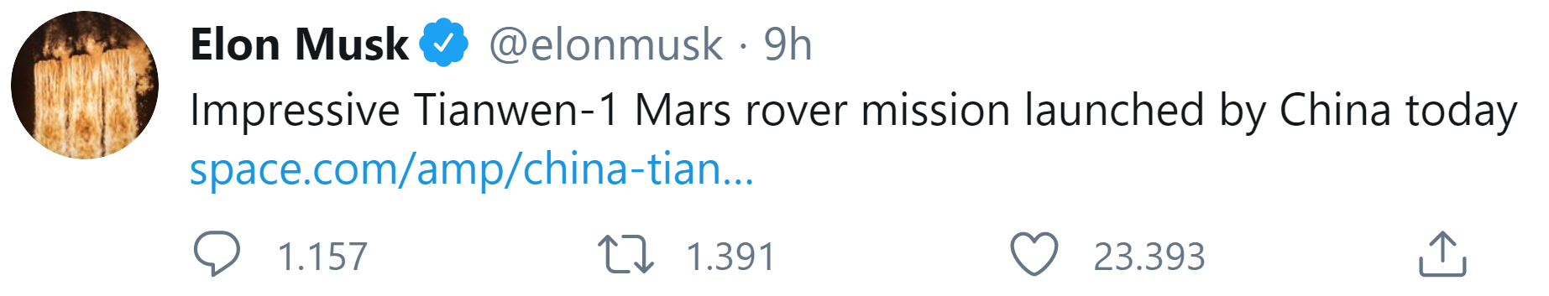
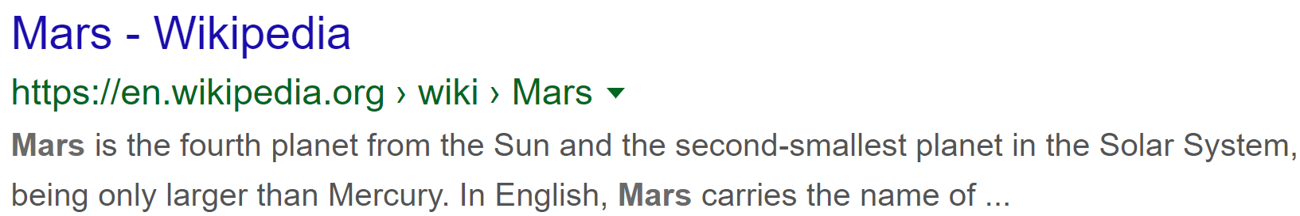
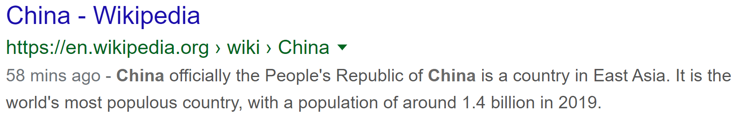
Problem DEFINITION
The problem we faced deals with the processing of social data, in particular tweets, entity extraction (e.g., “Tianwen-1“, “Mars“, “China“ below), the linking of such entities to some Knowledge Base (e.g., Wikipedia), the classification of tweets into a set of predefined topics and the assigning of descriptive tags.
Class: Space mission

Slide 4
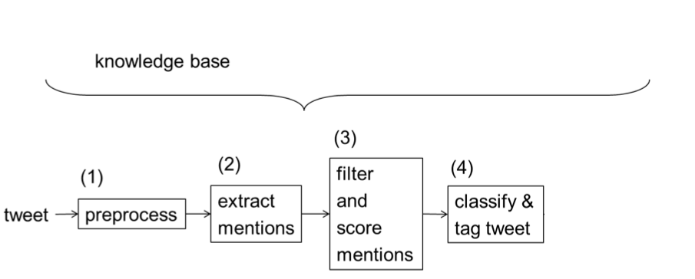
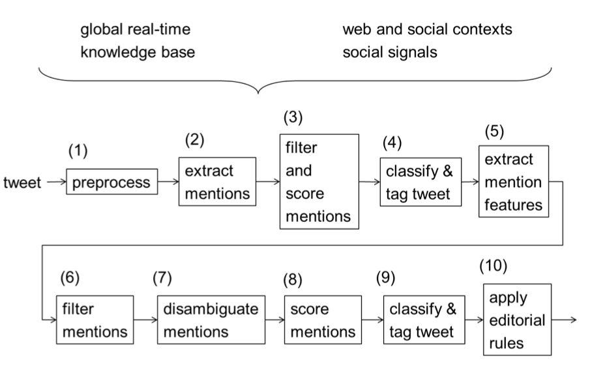
OUR MODEL: simplifying assumptions
As planned during the design process, we realized a simpler model w.r.t. the original one:
We avoided the second iteration of mentions extraction and classification.
We did not implement any analysis of social context nor social signals.
We did not include any real-time analysis (E.G.: Wikipedia traffic, see previous example).
We did not implement any disambiguating technique, due to (2) and (3).

Slide 5
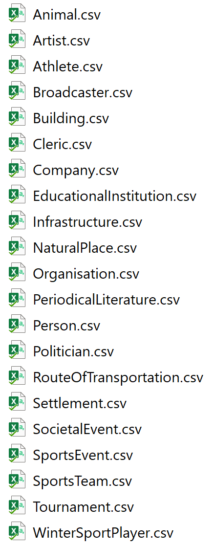
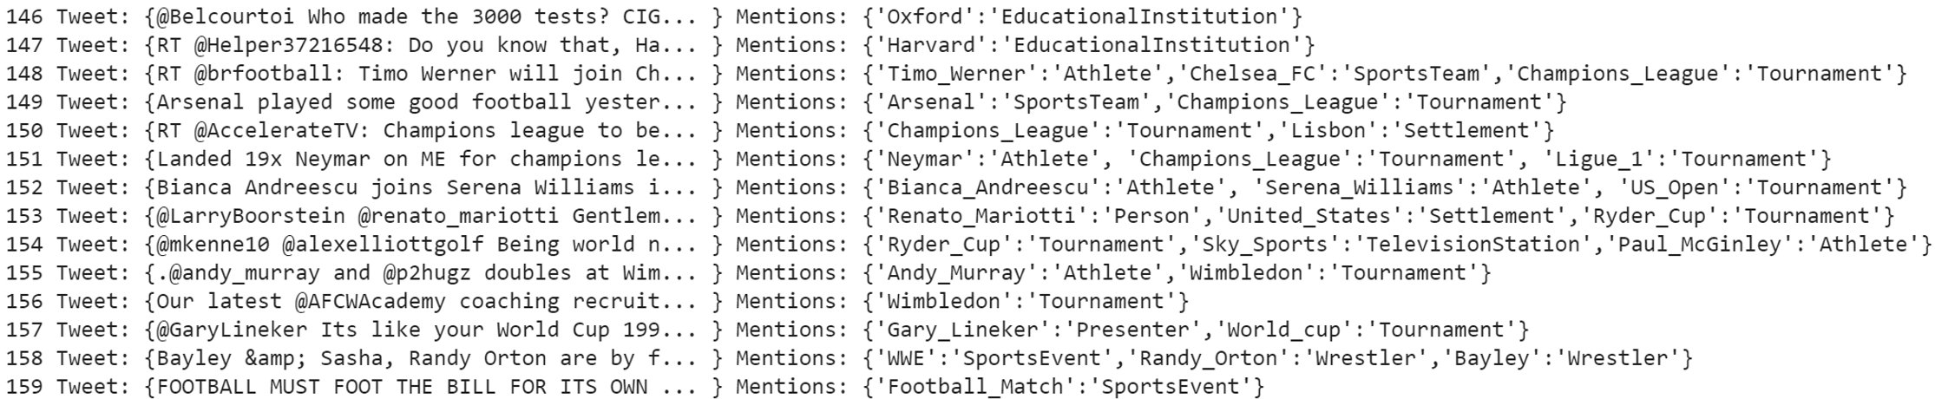
Dataset Collection
Unfortunately, we couldn’t find any pre-existing dataset suiting our purposes.
We have collected a tweets dataset by hand classifying around 200 tweets belonging to 23 different categories.
Tweets were collected in real time by means of the Twitter Developer API, as shown during the lectures. Since we couldn’t sample tweets randomly (a query was necessary) we queried them by category, to ease the classification process.
For each sampled tweet: we manually extracted the contained mentions, as well as their semantic category (explained later).

Slide 6
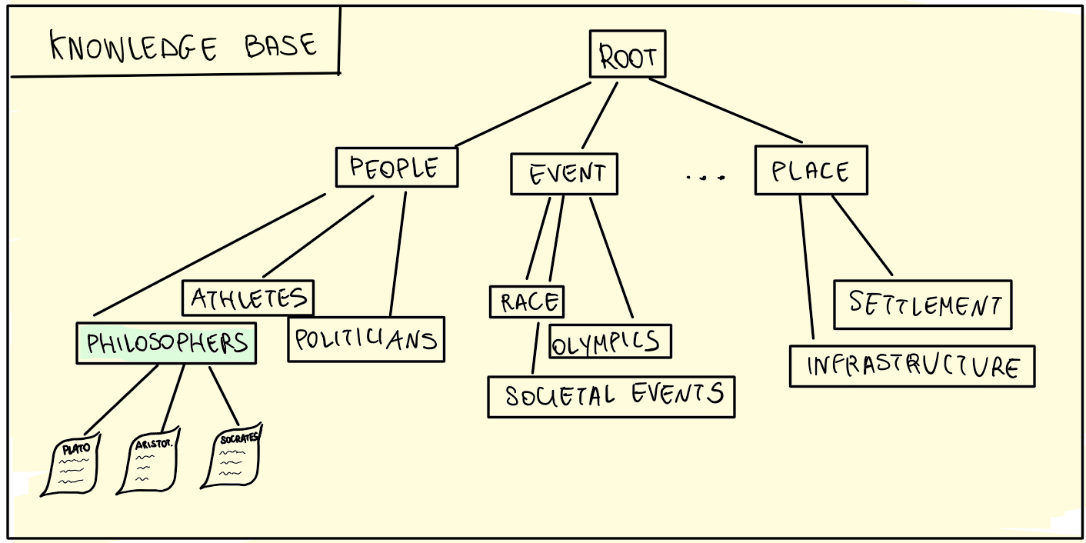
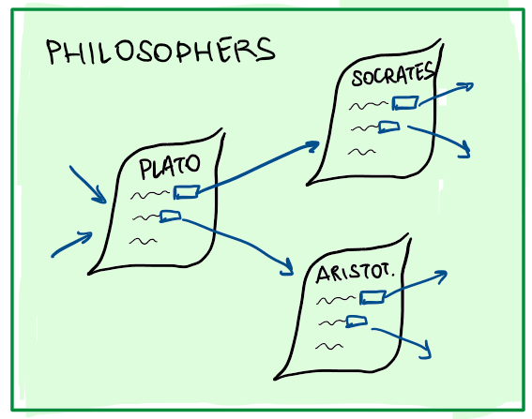
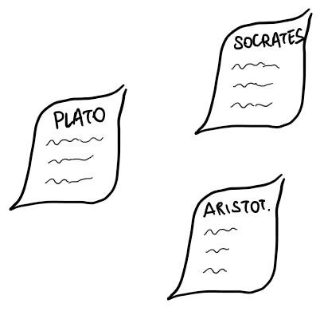
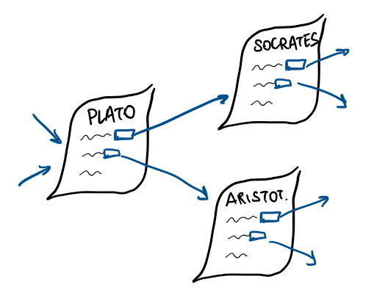
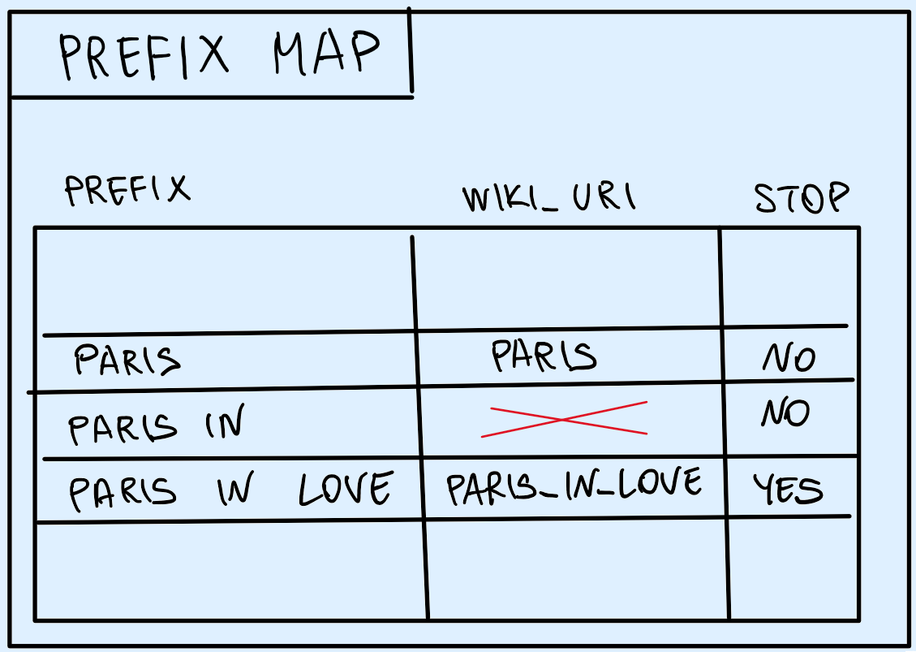
Knowledge base & Prefix Map
The scope of a Knowledge Base is to derive a taxonomy from an ontology (in turn derived by some encyclopedia).
The Knowledge Base is the core of the whole model, the main support for the process of mentions extraction from tweets.
Being our Knowledge Base huge (342782 entities), we needed a data structure for supporting the extraction algorithm: the prefix map.
E.G.: Suppose having the tweet: “Paris in Love is my favorite movie.”

Slide 7
Knowledge base & Prefix Map
The scope of a Knowledge Base is to derive a taxonomy from an ontology (in turn derived by some encyclopedia).
The Knowledge Base is the core of the whole model, the main support for the process of mentions extraction from tweets.
Being our Knowledge Base huge (342782 entities), we needed a data structure for supporting the extraction algorithm: the prefix map.
E.G.: Suppose having the tweet: “Paris in Love is my favorite movie.”

Slide 8
Mentions Extraction
This task consists in iterating through the list of tokens associated with each tweet and giving in output all the entities found so far.
This is done by querying the prefix map, linking each token to its corresponding entity in the knowledge base.
The search algorithm starts with taking the first token, and searching for it in the prefix map, if something is found, it can either stop and return the mention associated with the token (if the stop field of the prefix map is True) or go ahead concatenating the next token and repeating the search operation, until something is found.
If nothing is found the algorithm moves to the next token.

Slide 9
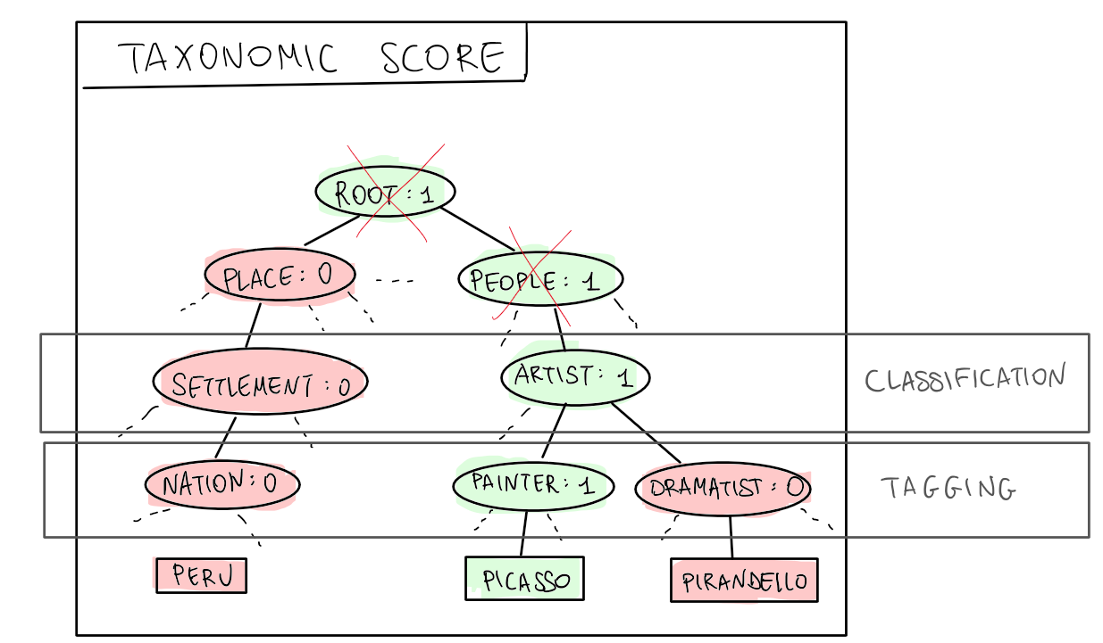
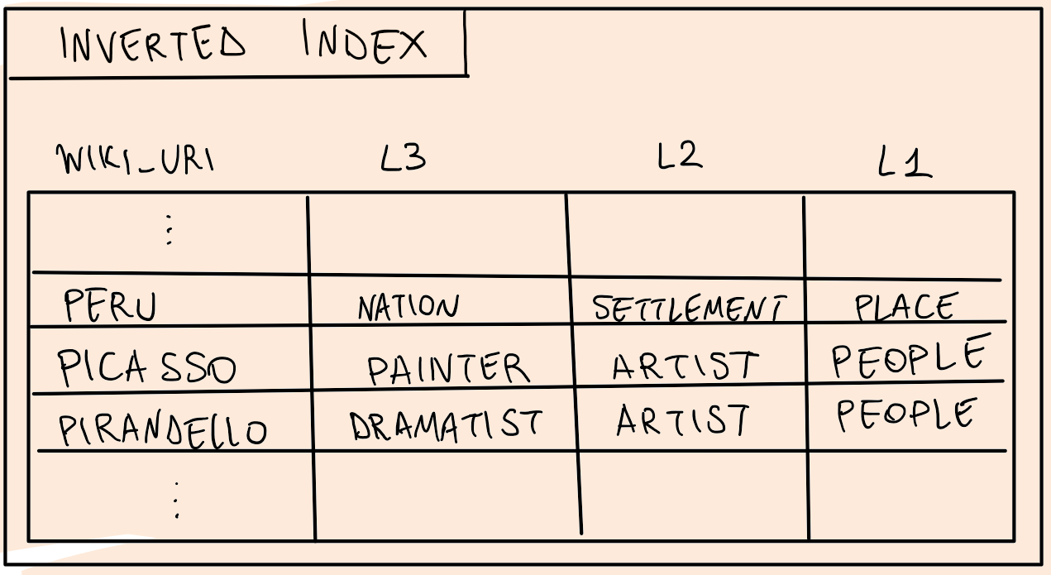
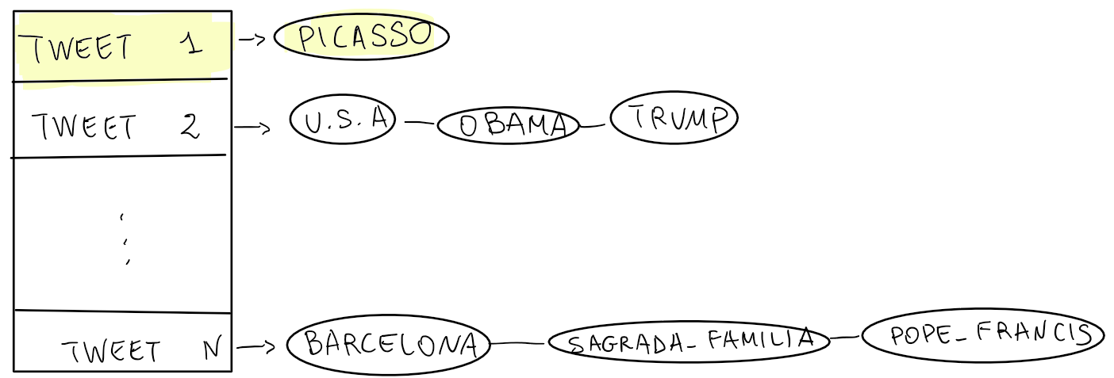
Inverted Index & Taxonomic tree for Classification & tagging
Once extracted all the mentions (at the best of our possibilities), we could proceed classifying and tagging the tweets.
E.G.: “Picasso’s works are enchanting.”→ Artist.
Since we shipped the Knowledge Base as it was (simple .csv file), we needed auxiliary data structures to accomplish those tasks.

Slide 10
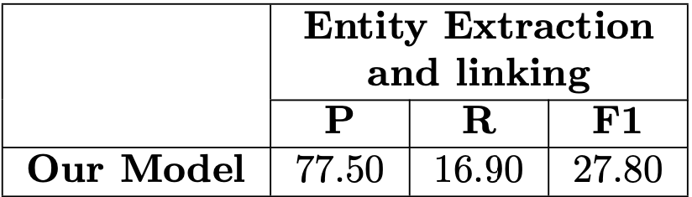
Evaluation and results of Mentions Extraction
P = precision, R = recall, F1 = F1 score
These results in some way respect our initial hypothesys, because our tweet dataset was not so big to include also tweets in which the model had to be context aware, like for example in ’Donald lives in the WhiteHouse’ the system recognises from the context that Donald refers to Donald Trump
This high precision in fact, is related to this, because our model can return only mentions that finds in its knowldege base, else it will return nothing

Slide 11
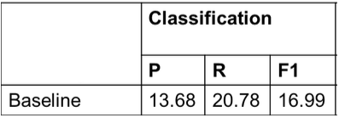
Evaluation & results for Classification
P = precision, R = recall, F1 = F1 score
Our model’s results seems comparable w.r.t. the original one’s, but actually what you see in the chart is not a fair comparison… let’s see why.
Notes:
In a random dataset we would probably get 0 also due to the structure of our knowledge base. We picked as classes the most popular 20 classes from the 84 L2 categories, hence in the taxonomic score, not all entities fall under the categorization.

Slide 12
Evaluation & results for Classification
P = precision, R = recall, F1 = F1 score
Not a fair comparison: random dataset vs biased dataset.
High Precision and Low Recall in our model, because we picked quite standard tweets (language), with almost no slangs nor dialecticisms.
Moreover, our classification results are boosted because of our probabilistic approach in case of draws in the taxonomic score (original model is deterministic).
Notes:
In a random dataset we would probably get 0 also due to the structure of our knowledge base. We picked as classes the most popular 20 classes from the 84 L2 categories, hence in the taxonomic score, not all entities fall under the categorization.

Slide 13
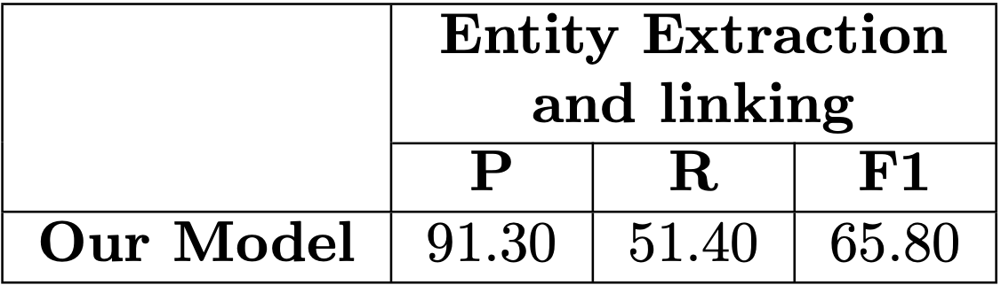
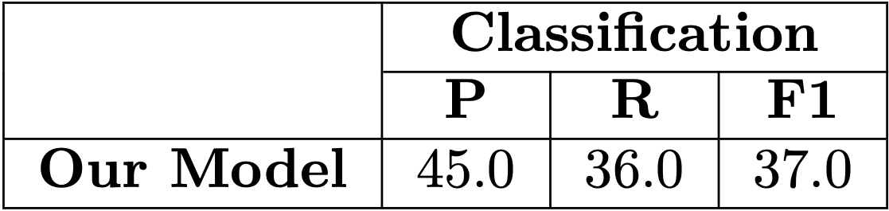
Update of the knowledge base
Both the results of Mentions extraction and Classification highly depend on the size of the knowledge base, and we could not have the same knowledge base as our reference paper
We addressed this problem creating a function that is capable to update the entries of the knowledge base from the ground truth of our tweets dataset
So we split our tweets dataset into a training and a test set and we have evaluated another time the performances of our system
These were the new results for both Classification and Mentions Extraction:

Slide 14
Related Papers & Future Work
To increase results and to have a more balanced knowledge base we could create it from Wikipedia as this paper says:
O. Deshpande, D. S. Lamba, M. Tourn, S. Das, S. Subramaniam, A. Rajaraman, V. Harinarayan, and A. Doan.: Building, maintaining, and using knowledge bases: A report from the trenches. In SIGMOD, 2013.
For classification we could parallelize our actual method with another one based on hashtags like the one described in this article, found from IEEE Xplore:
R. S. Ghaly, E. Elabd and M. A. Mostafa: "Tweets classification, hashtags suggestion and tweets linking in social semantic web" 2016 SAI Computing Conference (SAI), London, 2016
As a future work we think to build a thesaurus of synonims like: ‘Barack -> Barack_Obama’ to find more mentions (increase recall) and to make classification more accurate.
Implementing some disambiguating module in our model, in order to: (1) extract the correct mention in case of ambiguity (E.G.: Apple) and (2) resolve draws in the classification step.

Slide 15
QUESTIONS AND ANSWERS

