Slide 1

Flove
Flow + Love
Science + Intention

Slide 2
The flow of love
Is it a pre-programmed intention?
A 5th dimension?
What presence does it have in our life?
Let’s see!

Slide 3
Flow is
A human View of Really Concentrated
Multidimensional
Universal tension
with Printed Resonance
of brain waves to DNA

Slide 4
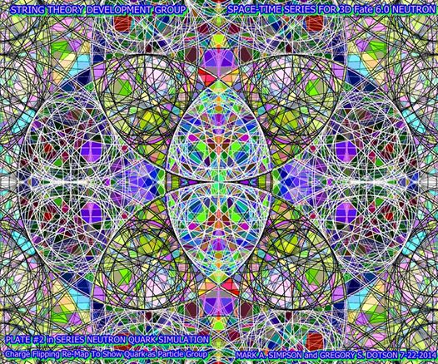
2nd Part: Intention
What is love?
How do we make it?

Slide 5
Flow (in depth)
A human View of an
Universal Lovely expression
Forming Really Concentrated
Multidimensional Universal tension with Printed Resonance of Brain Waves to DNA

Slide 6
Is there an Universal loveliness that is forcing us humans to love?
Yes,
Universal tension has an intention-force on us…
A good name for it is either flow or flove.

Slide 7
Flove vs Flow
“Flove” is aggrupator of all low or higher life’s lovely expressions.
Flove is multidimensional, hence:
“Flow” is lovely universal, first flove.
“Real” is lovely natural, first child of flow.
“Human” is lovely animal, flove’s third child.
...

Slide 8
Love is
The first human flove
(the more universal-natural-real-animal intention we view)
“Love” as in lovely mental passion, not as in couple.
Flove: Flow -> Real -> Human: (View) Love, etc

Slide 9
A human is
By far the more complex biochemical system known floving in the galaxy

Slide 10
Biochemical
y)

Slide 11
Why we humans love
Our peaks of (f)love (or suffering, lack of) cause more energy than the Sun.
Who moves the Sun through the galaxy otherwise?
(A singularity “loves” possible peaks of near energy)

Slide 12
Why we suffer
Scientific version:
Intergalactic time line data from the universal tension deformation gets rewritten when reaching Earth’s electromagnetic field.
Intentional version:
We always miss some ways to love
that our body is always looking for.

Slide 13
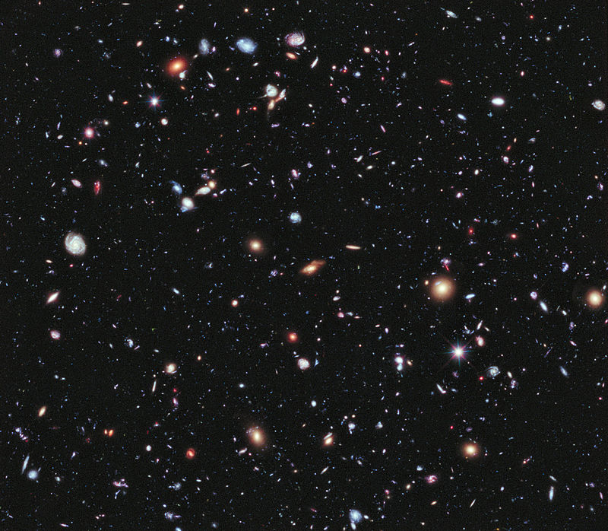
3rd part: Philosopy: where’s flove?
in life

Slide 14
Why Philosophy?
Philo → Love
Sophy → Wisdom
To get to know the more real flow.
To better develop our interactions with it.

Slide 15
Flove Philosophy
Life vs World
(micro vs macro)
Process and System
(dynamic and reductive framework)
Axiology and Rethorics
(moral intention model and beautiful expression)
Can we fit them all in a single definitory phrase? Yes

Slide 16
Life (or flove or intention) is
a process ranking parts
(of energy vibrating in dimensions)
!
Let’s review this...

Slide 17
Life is a
Process
i.e. Constant Change. Time Line. Human Evolution.
Ranking
I.e. Data conservation, Lexicon transmission, Print metrics.
Parts
I.e. Domains Aesthetic connectivity

Slide 18
Life is a process ranking parts of...
...energy (is first part of life and flove its first child)
vibrating (or intensity, resonance, geometry)
in dimensions (layers of human perception)
(This is completely aesthetical, easy to adapt to any cultural view)

Slide 19
Life is a process ranking parts of...
...energy (is first part of life and flove its first child)
vibrating (or intensity, resonance, geometry)
in dimensions (layers of human perception)
(This is completely aesthetical, easy to adapt to any cultural view)

Slide 20
1. Main dimensions & floves
Universal | Flow
Natural | Real
Animal | Human

Slide 21
2. Human dimensions & floves
Mental | View
Rational | Rate
Material | Make

Slide 22
3. Material dimensions & floves
Material | Make
Form | Get
Mechanic | Make
Deal | Offer

Slide 23
4. Deal dimensions & floves
Deal | Offer
Gift | Freed
Share | Shareful
Exchange | Swap

Slide 24
All Main Floves
Flow, Real, Human:
Mental View:
Love, Joy, Wisdom
Rational Rate:
Be, Trustful, Free
Economical Make:
Get, create, offer

Slide 25

3rd Part: Implementing
1 FloveApp example:
View Flove
view.flove.org
A life viewer

Slide 26
View Flove: How
1. Choose one as a title to go next:
Whole – Life - World
2. Choose two (podium is made, next…)
Political – Passional – Cultural
Joy - Wisdom - Love
…
3. Edit -- Save – Send – Flove it! (FloveApps launcher)

Slide 27
View Flove 2.0
Edit - Save - Send (1.0)
Rate - Extend - Fork (2.0)

Slide 28
FloveApps
Whole - Life - World
Love
Choose one

Slide 29
Main FloveApps
...Love...
Flow, Real, Human:
View
Love, Joy, Wisdom
Rate
Be, Trustful, Free
Make
Get, Create, Offer

Slide 30
FloveApps features overview
Flow → Define singularity, express big hipotesys
Real → Define your Physical Standard Model
to identify flow + space bender engine + analitics.
Human → Genetic, bioneurology & anthropology
View → Life viewer app
Love, joy, wisdom → launchers
Be → Profile(r)
Trustful → Trust invitor
Free → Social network
Freed (see next), Shareful (clauser), Swap (...)

Slide 31
Dev.: Easy: Demo: FreedFlove
Add a thing:
(try with most loved, a daily one or one left apart)
Add to the thing:
Info - Histories - Wishes
Freed it
(1: The thing doesn’t have an owner anymore)
(2: etc..)
(save, send)

Slide 32
Development: Easy Apps
Flow, Real, Human:
View
Love, Joy, Wisdom
Rate
Be, Trustful, Free
Make
Get, Create, Offer
Freed – shareful - swap

Slide 33
Development: Medium
Flow, Quantum, Human:
View
Love, Joy, Wisdom
Rate
Be, Trustful, Free
Make
Get, Create, Offer
Freed – Shareful - Swap

Slide 34
Development tactic
1. Basis: Happy, crowdsourced, freest...
2. API for each of the Main Floves creating:
Explanatory default phrases that work as a frontend quizz i.e. in a subdomain of flove.org.
(also launches related Apps & displays feeds).
3. Besides that, anyone following such this big logic, should be able to implement (mixed) parts of it, the easier anywhere, even in other flove.org subdomains

Slide 35
Goodbye & Welcome
Read docs at
wow.wiki.yt
Flove.org
See you soon

