Slide 1
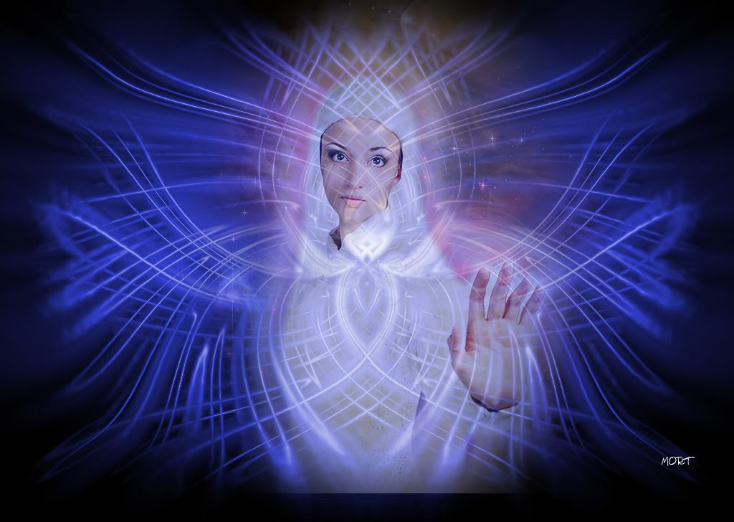
Hi Human

Slide 2
Let’s start with simple questions
Why are you reading this now?
How much do you like your name?
Why would you smile at someone?
What would you like to do tomorrow?

Slide 3
But what about
Big questions
1. Where we come from?
2. Who are we?
3. Why we love?
4. Where are we going?

Slide 4
Where we come from?
(or… or why I wrote for you to read...)
A Human is an Evolution of the
Flove, Universal Flow and Natural Quantum

Slide 5
Who are we?
(or… or why I like so much my name...)
By far the more complex biochemical system known floving in the galaxy

Slide 6
Why we love?
(or… or why I would smile to someone)
Our peaks of (f)love (or suffering) cause more energy than the Sun.
Who moves the Sun through the galaxy otherwise?
(A singularity “loves” possible peaks of near energy)

Slide 7
Where are we going?
(or… or what am I going to do tomorrow)
Evolve myself adapting to my local environtment
Do some social harmonising
Resist suffering

Slide 8
Human Complex Biochemistry

Slide 9
What is the next destination?
(or… or what am I really looking for)
Evolutive leap?
YES, it’s been like this since the beginning!
Despite suffering…

Slide 10
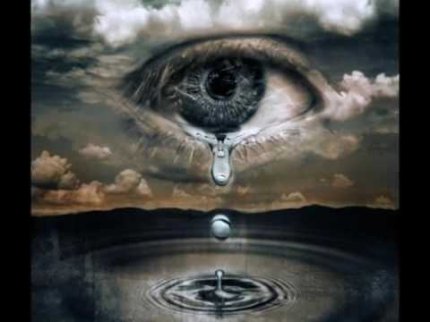
2nd part: Why suffering?

Slide 11
Causes of-for suffering
Universal, Natural
Human Natural
Rational Social
Which is main?

Slide 12
Causes of-for universal (self) destruction:
Multiverse
Universal tension reconfiguration
This tought has it’s flow, but it’s unknowable.
So it is for human mental but not rational purposes.
And so, we don’t go further deep in this slide.

Slide 13
Causes of-for natural (self) destruction:
Galactic, solar collapse (unknowable)
Sun extintion (it’s known: we’ll extinguish ‘as known’ before having leaped more or not)
Ionosfera-etc damage
(let’s hope not)
.

Slide 14
Human Natural Reasons for suffering
Flover supermachine, but limitated
Not evolved self-control of nervous pain
Failed to explain social incoherence

Slide 15
Social incoherence
Social, despite naturally being the lower rational dimension,
it is flown by many as if it was upper i.e. as natural or mental
Faking a reality where many must suffer.

Slide 16
So...
Naturally, mentally and rationally
Main Reason of-for suffering is:
Social

Slide 17
The point is:
If universe or nature would want to commit suicide, it’s ok.
We were made for not wanting it.
Nature made us to evolve love,
even in the lower rational dimensions.

Slide 18
Counter patch
Social is the lowest rational flow
Social is less peak than universal, natural or mental
Be more local to be a higher person
Life leads us humans to an evolutive leap

Slide 19
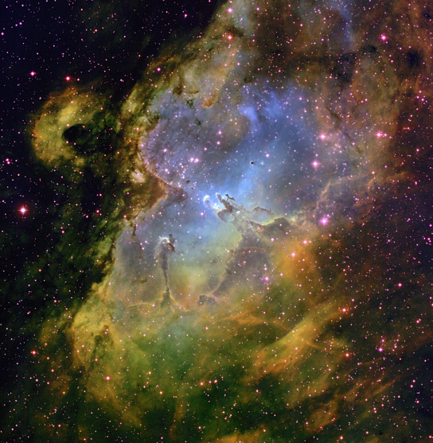
3rd part: Evolutive leap
WoW

Slide 20
Who are we?
By far the more complex biochemical system known floving in the galaxy

Slide 21
Why we love?
Our peaks of (f)love (or suffering) cause more energy than the Sun.
Who moves the Sun through the galaxy otherwise?
(A singularity “loves” possible peaks of near energy)

Slide 22
biochem

Slide 23
Why leap
Is the natural (even social) way to go
Human evolve energy peaks at the galaxy
DNA evolves along and transmits its best

Slide 24
Leap into Flow
Flow is your Concentrated
Multidimensional
Universal tension
Printed resonance of lovely brain waves to DNA

Slide 25
Leap into quantum
All your quantums are connected, but at a different Speed (Length at Time Line)
Multidimensionality Heals Time Dilation

Slide 26
Human leap
Concentrate
Multidimensional
Universal tension
Resonate printed brain quantums to DNA
To evolve flove in the Time Line

Slide 27
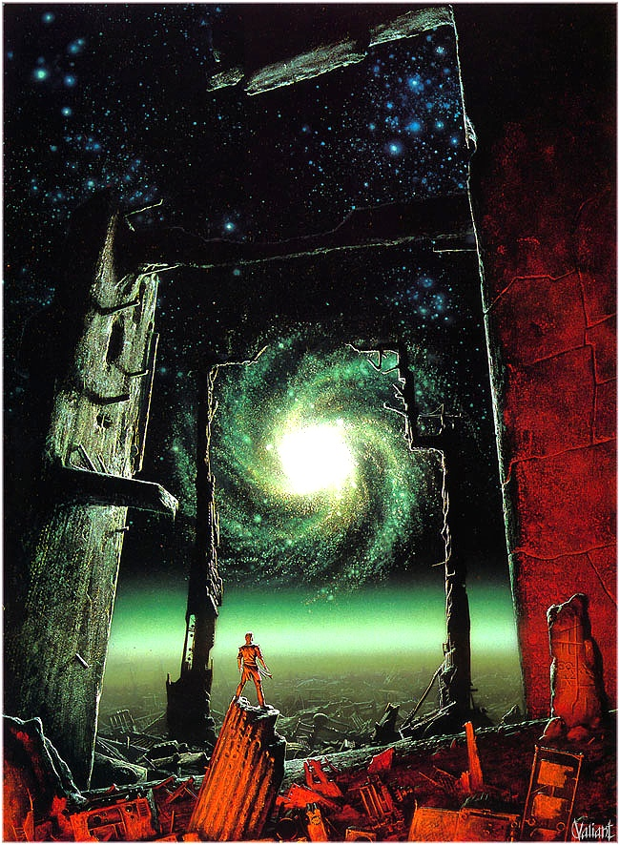
Ways for a human leap

Slide 28
Cause Flove effects
Slowly but surely
Without knowing
or deliberately…

Slide 29
Merge flove peaks
Bending motor
Mass orgasm
Flove day

Slide 30
Apply the peaks
with
Faith or Rational
Flove Prints logic
even with a
Brain waves laser
into volunteers… :)

Slide 31
Good bye!
More at human.flove.org
and leap.flove.org

