Slide 1
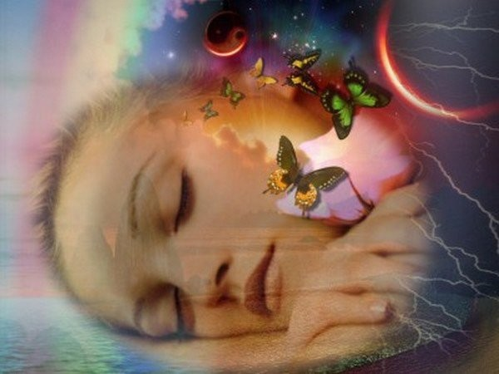
Quantum
Once upon a time,
Some flow coming from the universe…
...formed a quantum...

Slide 2
Quantum as in...
Earth (1st part)
Galaxy (2nd part)
The Physics Standard Model

Slide 3
Physics Standard Model: Pros
Reference for research communication
Rigourous empirical calculus approach
Integrates part of the quantum theory

Slide 4
Physics Standard Model: Cons
Too much based in Newton law
(TimeDilation centrism refuses connectivity)
Faith based in macro-”social” events
(Why DarkMatter is in if maybe there aren’t galaxies?)
Poor, it doesn’t integrate intentionality
(Genetic resonance is not physical?)

Slide 5
What to do?
Quantum.flove.org
Express your Physic Standard Model View

Slide 6
Why Quantum.flove.org?
For easing new phrasings beyond standards i.e:
Once upon a time line,
Some decelerated universal flow formed
its more natural forms:
Quantums

Slide 7
What is a Quantum?
Real TimeLine Info or Bosson Timing?
(speculation)
What is time? Only part of a dimension?
(time dilation centrism)

Slide 8
A Quantum is...
Natural flove, the viewable universal flow
The Natural Property of the Singularity
Decelerated universal tension from the black hole, the smallest part that form (observable) reality.
(miscalled Photon by Newtonians)

Slide 9
Quantums because deceleration
Time is a deceleration effect of singular particles
or
What happens to A Photon in special relativity?

Slide 10
Deceleration implies length
If everything moves at a high speed for us,
wouldn’t everything have a previous length?
...
Photon run over a quantum with length!
and-or
A Quantum with unknown length created time

Slide 11
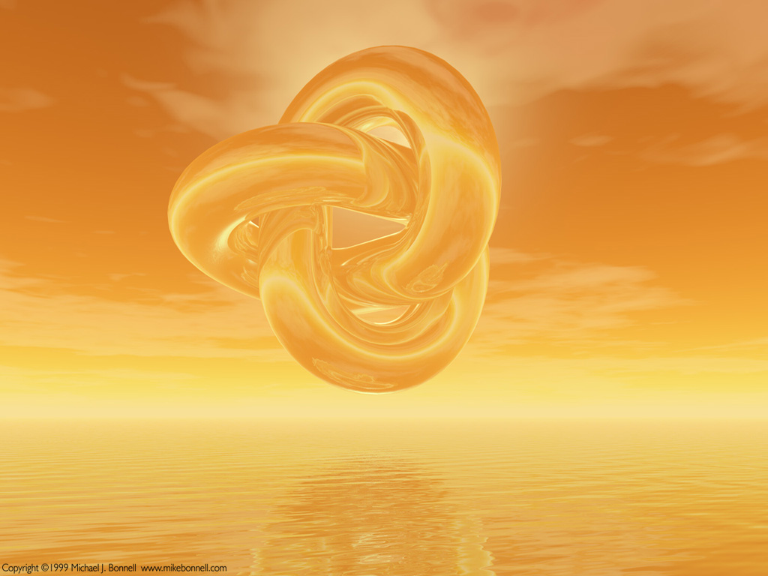
2nd part: Newtonian Quantums

Slide 12
A singular flow
formed a Black Hole.
Some of its photons (Quantums)
didn’t return, went away, crashed (decelerated) at Planck,
get Charged with Mass and formed our Reality

Slide 13
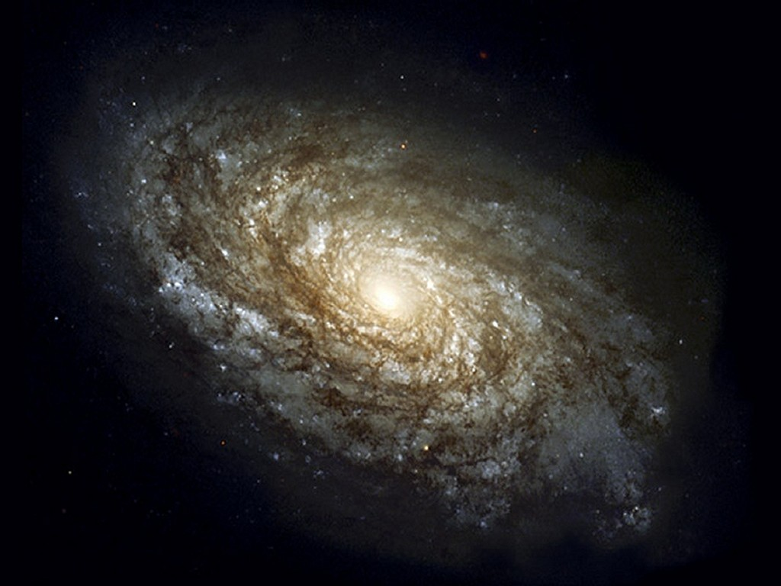
Types of Quantums
or the natural quantum evolution

Slide 14
Quantum mass
Quantums charged with mass form(ed) the galaxy
Galactic quantum mass form(ed) quantum gravity

Slide 15
Quantum gravities
Galactic Quantum Gravities form(ed) the Solar Quantums and Planets and Planet Earth.

Slide 16
Earth Quantums
Earth Quantums form(ed) us humans

Slide 17
Human Quantums
Humans are the better quantums
but
Human Quantums interact with Earth’s Time Dilation

Slide 18
Time Dilation is
Scientific:
The Earth’s Electromagnetic Field Distortion to the Quantum.
Poet:
Time is part of a fourth dimension, a peculiar perception of reality.

Slide 19
Time Dilation, thank you!
You have a big responsibility in having formed us humans.
Thank you!
but… mind the gap...

Slide 20
Time Dilation centrism:
Side effects on humans
Cosmic Timeline Data missing frustation
Rational perversion: Social Newton Earth centrism = Upper Mental Misflow
Faked connectivity i.e. Time is money
-Suffering-

Slide 21
Healing Time Dilation:
All interacting, at different Speed
Speed is Length in the Time Line
Joke: All moneys have a big spiritual distance!

Slide 22
Healing TimeDilation 2
How many total Quantums are?
At a particle level, infinites.
At a possibilities level, infinites.
...practically speaking...

Slide 23
Multidimensionality?
Yes
Different gravities, multiple attached laws
Different particles, more effects to happen.
Time Dilation is only an element for a newtonian meassure.

Slide 24

Quantum calculus
.

Slide 25
1 quantum (length)
Earth age-length (70.000 y/l)
Per Planck
in every particle

Slide 26
Quantum formula
Particle = Dimension
Energy = Mass x Length

Slide 27
When time would end then?
Time is eternal
(sun and fleshy body is not)
In earth, tesseract, multiverse, antimatter or at calculus..

Slide 28
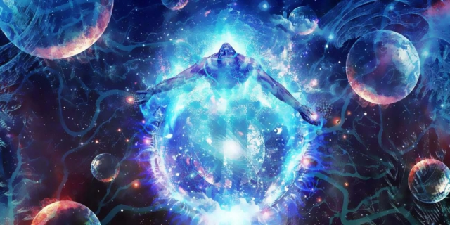
3rd Part: Quantic Quantums
.

Slide 29
Quantum as in Quantic
Interpreting very much inner or outer interactions beyond calculus.

Slide 30
Quantic Time Line
A Universal tension switch
(that reaches a newtonian horizon)

Slide 31
Quantic Intention
Flow zeals us to love
Quantums plays us too

Slide 32
Next Quantic Tale
!
How will humans interact with time
?

Slide 33
See you!
More at
quantum.flove.org

