Slide 1
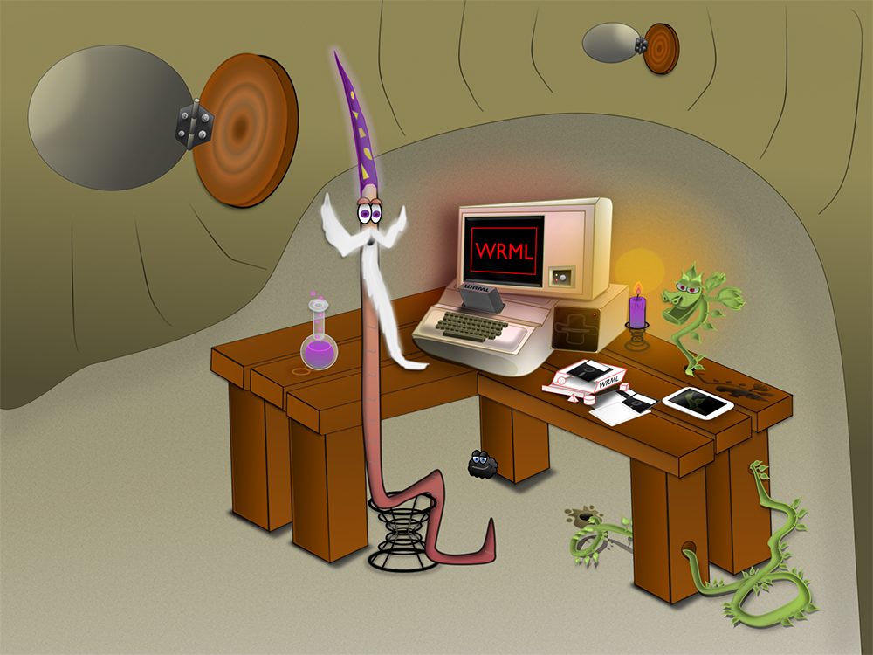

Slide 2

WRML
Web Resource Modeling Language
Design Notes

Slide 3
REST-Oriented Application Architecture
Application Client
API Management
Application Server
App-specific
Code
Frameworks for MVC, Local Storage, etc.
REST API
Client
Framework
Client Keys, Caching,
Security,
Docs,
Throttling,
Quotas,
etc.
REST API
Server
Framework
App-specific
Code
Frameworks for Controller Logic, Remote Storage, etc.
REST
REST

Slide 4
WRML Application Server Architecture
Servlet & Core
Service
Loads and initializes REST API design metadata to be executed
Routes requests to a configured “back-end” Service based upon the target API endpoint’s response document’s Schema
Generates hyperlinks in responses based upon the designs of the API and the response document’s Schema
Represents response documents using a configured Format (e.g. JSON)
To reduce the number of requests per screen, supports embedding linked document(s) within the requested document
To reduce the byte size of responses, supports omission of unused properties from the requested document
Exposes API and Schema metadata to automate generation of code and docs for clients and intermediaries
The core uses API and Schema design metadata to decipher the request’s URI into domain model-specific key identifiers (e.g. “id”, “orderNumber”, etc.)
The core invokes the Service method that corresponds to the request’s HTTP method, passing in the deciphered key(s) along with the pertinent request headers.
A Service is responsible for the implementation of these methods:
init
get
save
delete
invoke
search
Service implementations for these back-ends are provided by the framework:
MongoDB
Web/REST
File system
More to come…
REST
∞
Models

Slide 5
WRML Application Server Internals
REST
WrmlServlet
Engine
Context
ApiLoader
SchemaLoader
SyntaxLoader
FormatLoader
ServiceLoader
Service(s)
The WrmlServlet is a thin wrapper around the WRML core: the Engine and its reloadable Context.
The Context is the heart of the core. It delegates to Services and to a handful of system “loader” classes.
∞
z
Models

Slide 6


REST Interactions with WRML Application Server
Client App
REST
Accept either: application/json, application/wrml, application/html, or any other server-loaded Format’s associated media type.
WrmlServlet
The WrmlServlet handles the direct communication with clients. It is designed to be a minimalistic pass-through layer that translates HTTP-based communication to and from the WRML Context and its core components. Once a REST request has been validated and the target Resource endpoint has been identified, a Service method is invoked to handle the service-specific business logic. The WRML core is designed to maintain a clear separation of concerns between a web service’s client-facing interface and its implementation details (business logic).
Engine
WRML
Context
Request routing and HATEOAS automation
Generic model implementation support
Formatting and parsing text into handy “wrapper” objects
Pluggable serialization in a variety of media types
ApiLoader
SchemaLoader
SyntaxLoader
FormatLoader
ServiceLoader
CRUD, Search, and Invoke implementation (flexible backend)
Service(s)
∞
Models

Slide 7
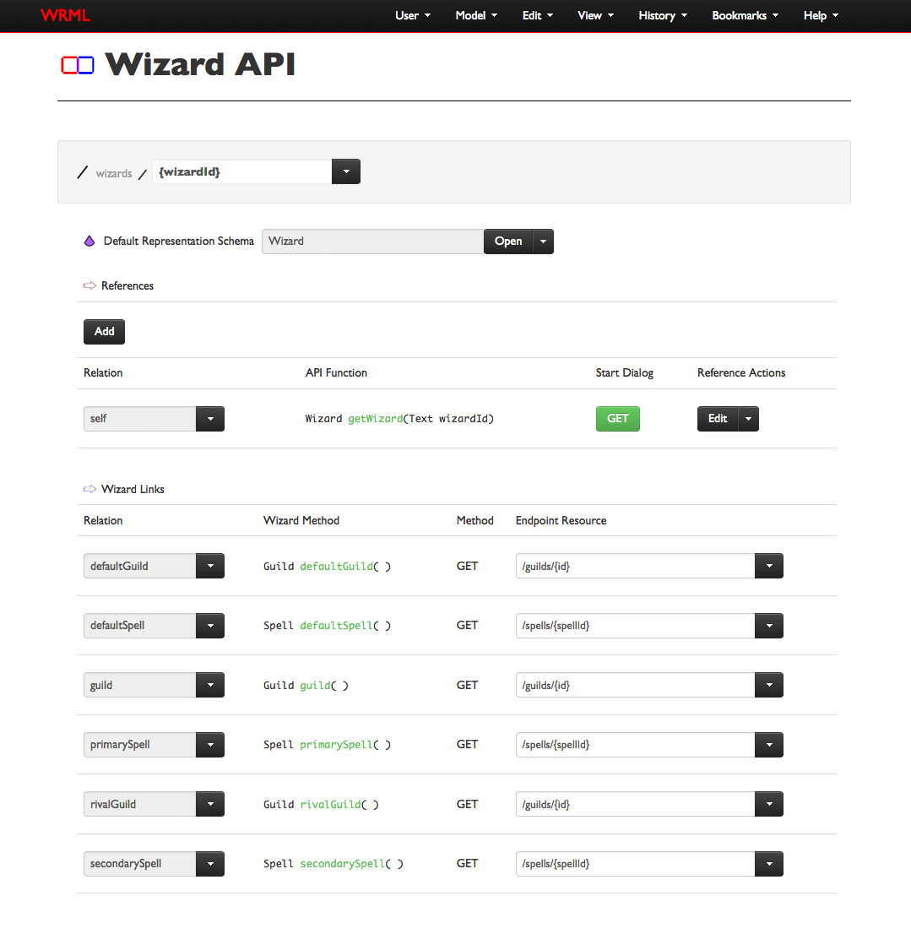
WRML REST API Model
Like I/O Docs, API Blueprint, and Swagger, WRML uses metadata to represent the URI pattern and allowed interactions for each REST API resource endpoint.
WRML expresses REST API metadata as a model described by the WRML Schema identified by: org/wrml/model/rest/Api.
In WRML, an Api model defines the endpoints as a tree of ResourceTemplates. Each ResourceTemplate model has a URI path segment and an optional list of child ResourceTemplates to represent the hierarchical nature of URIs.
The WRML Application Server’s runtime delegates to the ApiLoader component to compile each Api model into a structure that is optimized for request routing and HATEOAS automation.
HATEOAS automation is just a fancy way of saying that WRML uses metadata to generate link href values in response representations.

Slide 8

ApiLoader
Context
ApiLoader
Load
Compile
Execute
Loads System Apis along with any configured Apis on start-up.
Interprets Apis and creates an ApiNavigator component for each one. The ApiNavigator data structure is optimized for execution.
Used for request routing and to decipher URIs into domain-specific identifiers.
Schema
Player
Wizard
Wizard ApiNavigator
Wizard
Api
Wizard
ApiNavigator
(System)
/wizards
/spells
ServiceLoader
Gets Apis
Api Service
z
∞
Any Service can be configured to handle Api documents. Therefore, REST API configurations may be loaded from MongoDB, files, the Web, etc.
Apis

Slide 9

REST API Loading Details
ApiLoader
At present, REST API metadata may be loaded in the WRML JSON format.
The plan is to also support these formats are for API representation:
I/O Docs
API Blueprint
Swagger
Once read, the Api model is cached by the ApiLoader and mapped to an ApiNavigator data structure that aims to optimize runtime execution of API metadata related concerns.
Within the ApiLoader, every loaded REST API (Api model) is wrapped by an ApiNavigator instance.
The ApiNavigator object processes an Api model and creates a Resource object for each of the defined ResourceTemplates.
The Resource objects, together with their parent ApiNavigator enable the WRML runtime to facilitate the routing of inbound REST requests and the generation of hyperlinks (href values) in response documents.
Load
API
Generate Api
Model
Create ApiNavigator
Create Resources
Parse JSON
JSON
TODO
Parse I/O Doc
Create ApiNavigator
Create Resources
I/O Docs
/foo/{fooId}
Parse API Blueprint
API Blueprint
Parse
Swagger
WRML API
ApiNavigator
Resource
Swagger

Slide 10
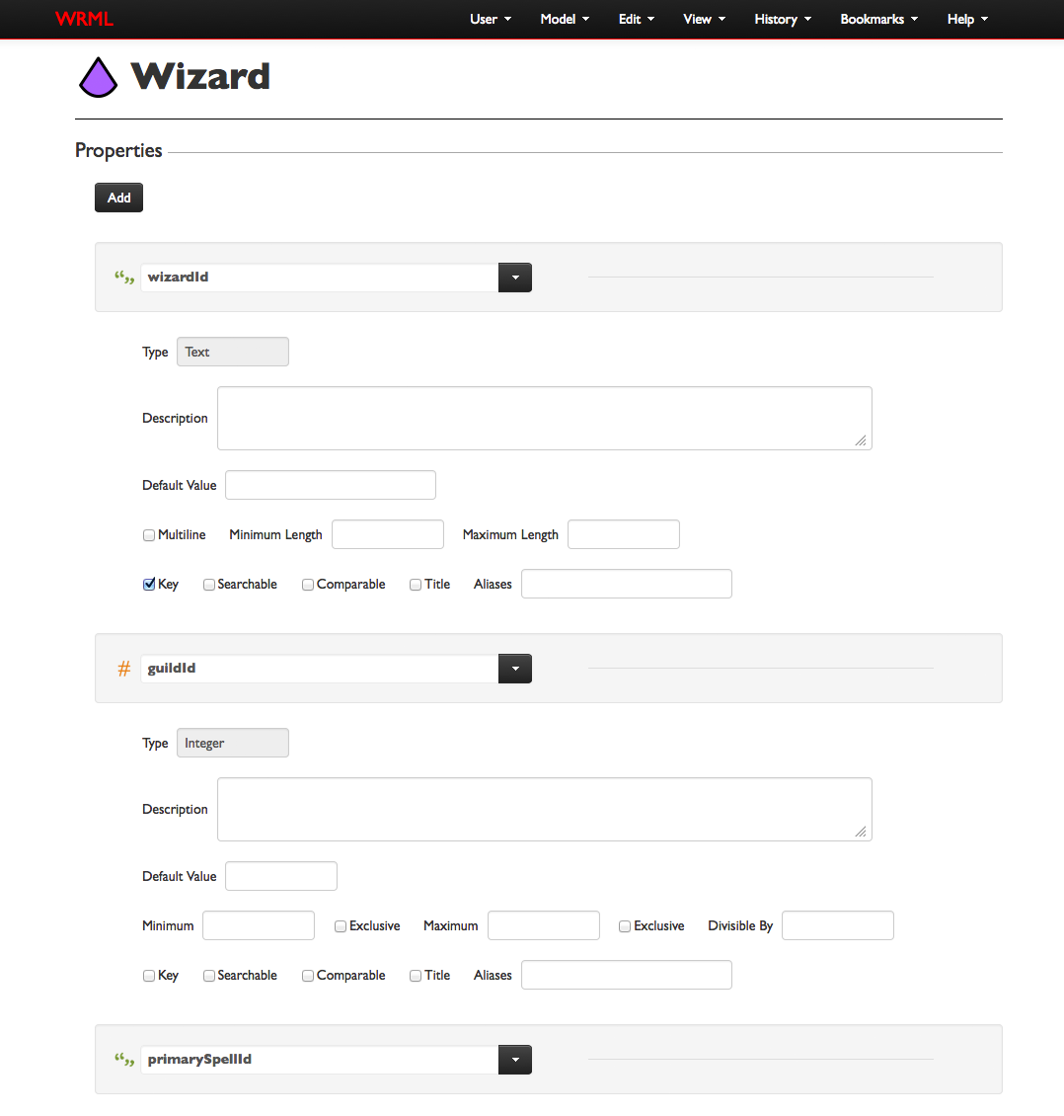
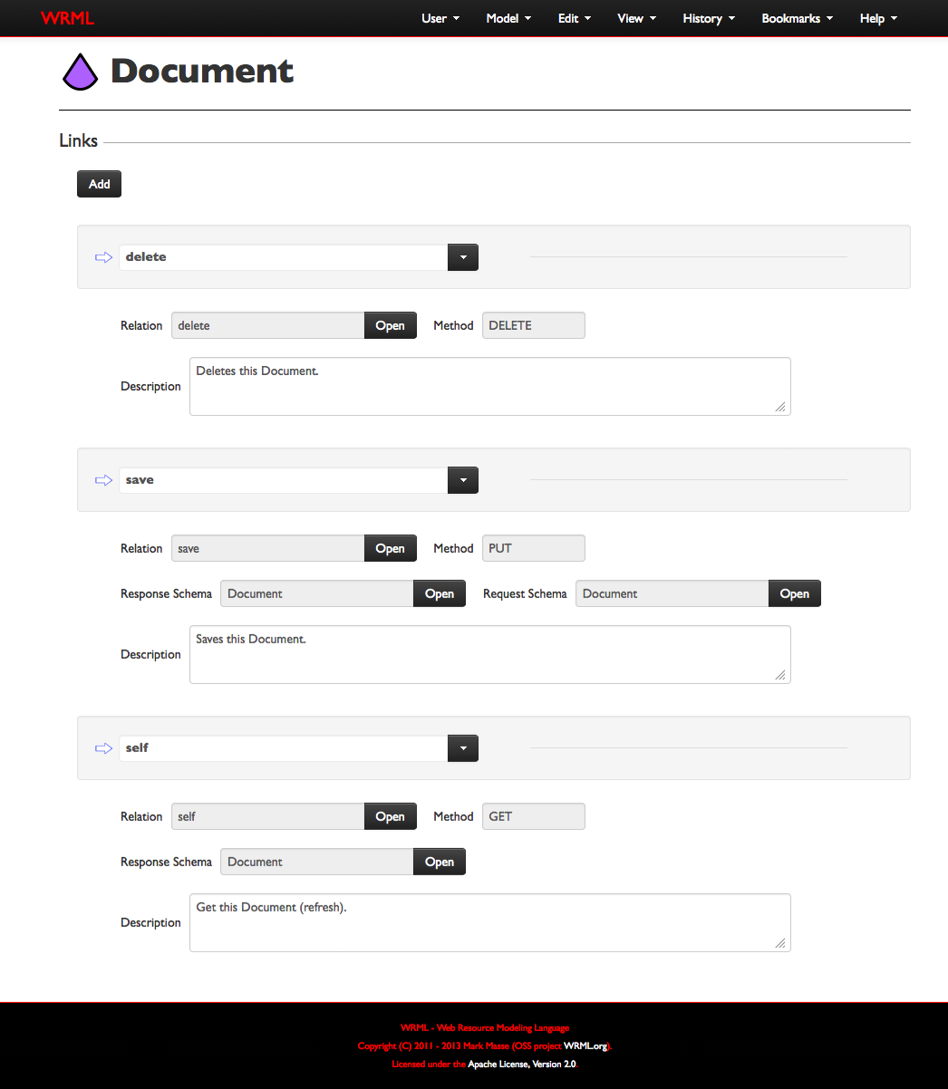
WRML Schema Model
Schemas describe the structure for a “class” of Models. In this way, Schema are like O-O interfaces. Schema models are also a bit like: SQL table structures, XML DTDS, JSON or XML schemas, AVRO schemas, XLS templates, CMS content types, etc.
A Schema may declare any number of name-value slots, with the slot value type being one of the following primitives:

Slide 11











Schemas and the WRML Type System
A Schema may declare any number of name-value slots, with the slot value type being one of the following primitives:
Value Type
Description
JSON Type
Java Type
Boolean
Must be true, false, or null.
true or false
java.lang.Boolean
Date
A date (with an optional time component).
string
java.util.Date
Double
A double-precision 64-bit IEEE 754 floating point number.
number
java.lang.Double
Integer
A 32-bit integer.
number
java.lang.Integer
Link
A simple structure containing URI values for href and rel slots.
object
org.wrml.model.rest.Link
List
A list of values of any single (non-List) type (Text, Integer, etc.).
array
java.util.List
Long
A 64-bit integer.
number
java.lang.Long
Map*
A mapping of Text keys to any single (non-Map) typed value.
object
java.util.Map
Model
An instance of a Schema with a map containing its slot values.
object
org.wrml.model.Model
Single Select
A special Text-based value that is selected from a fixed menu of possible choices.
string
java.lang.Enum
Text
A sequence of zero or more Unicode characters.
string
java.lang.String
* See Issue: WRML-300

Slide 12

SchemaLoader
Context
SchemaLoader
Load
Compile
Execute
Loads System Schemas along with any configured Schemas on start-up.
Interprets Schemas and creates a Prototype component for each one. The Prototype data structure is optimized for execution.
Used for type identification, structural description, and model instance validation.
Format
Player
Wizard
Wizard Prototype
Name
Type
Wizard
Schema
Wizard
Prototype
wizardKey
Text
(System)
guildId
Integer
guild
Link
ServiceLoader
Gets Schemas
Schema Service
A Schema describes the structure (properties and links) of a class of models.
Any Service can be configured to handle Schema documents.
z
∞
Schemas

Slide 13
Schema Loading Details
SchemaLoader
Schemas may be loaded in a variety of formats.
These formats are currently supported for Schemas:
application/wrml (JSON)
JSON Schema
Java Interface
If a Schema is not native, meaning it did not originate as a Java interface (with WRML annotations), then it will be read (desterilized) via a Format-specific Formatter component.
Once read, the Schema model is cached by the SchemaLoader.
The SchemaLoader uses a SchemaGenerator component to create the Java bytecode (.class) representation of the WRML Schema.
This brings the loading process to the same point as if the Schema was expressed natively as a Java interface.
For both native and generated Schemas, the runtime performs a one-time reflection on the Java interface to extract the annotations and method signature information needed to optimize the many uses for Schemas within the WRML runtime.
Load
Schema
Generate Schema
Model
Generate Schema Interface
Generate Schema Prototype
Parse JSON
JSON
Bytecode Generation
One-time
Reflection
Parse JSON Schema
Name
Type
JSON Schema
Java Interface
(.class)
WRML Schema
One-time
Reflection
Java Interface
(.class)
Prototype

Slide 14
SyntaxLoader
Context
SyntaxLoader
Load
Map
Execute
Loads System Syntaxes along with any configured Syntaxes on start-up.
Maps Syntaxes to configured SyntaxHandlers.
Parses and formats text to and from common object wrappers.
URI
Phone Number
Order ID
URI Syntax
URI SyntaxHandler
URI SyntaxHandler
( )
( )
(System)
URI
String
URI
Object
ServiceLoader
Gets Syntaxes
Syntax Service
At runtime, a Syntax is used to automate conversion of text values to and from “wrapper” objects.
Any Service can be configured to handle Syntax documents.
z
∞
Syntaxes

Slide 15
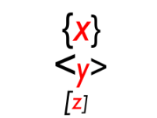
FormatLoader
Context
FormatLoader
Load
Map
Execute
Loads System Formats along with any configured Formats on start-up.
Maps Formats to configured Formatters.
Writes and reads models to and from formatted output and input streams.
JSON
YAML
Avro
JSON
Format
JSON Formatter
JSON Formatter
( )
( )
I/O
Stream
Model
(System)
ServiceLoader
Gets Formats
Format Service
A Format describes a model serialization technique.
Any Service can be configured to handle Format documents.
z
∞
Formats

Slide 16
Service Interface
The Dimensions structure contains the requested Schema URI, to identify the response type, along with any pertinent request header metadata (e.g. Locale).
Context
The Keys structure contains the requested URI, along with any deciphered, domain-specific identifiers.
ServiceLoader
Service
Init
Get
Search
Perform one-time initialization of the Service.
Get a model based on the specified Keys and Dimensions.
Get a set of models based upon the specified SearchCritera.
Get B
Search
C
C
A
A
[
]
B
B
B
B
C
,
Save
Delete
Invoke
Save (PUT) the specified model.
Delete a model based on the specified Keys and Dimensions.
Invokes a functional model with an (optional) parameter model.
Save
B
Delete B
(
)
C
C
Invoke
A
X
C
A
A
A
B
B
Y
B
∞
Models

Slide 17
ServiceLoader
Context
ServiceLoader
Load
Map
Execute
Loads all configured Services on start-up.
Maps configured Schema URI patterns to configured Services.
Services are used to implement the CRUD, search, and invoke operations for a set of models with a variety of Schemas.
Mongo
DB
Files
WWW
Mongo
DB
Wizard
Get “merlin”
Mongo
DB
Wizard
Models
wrml.json
URI patterns with wildcards are supported in the Schema-to-Service mapping so that “groups” of related Schemas may be handled by the same Service.
z
{…}

Slide 18
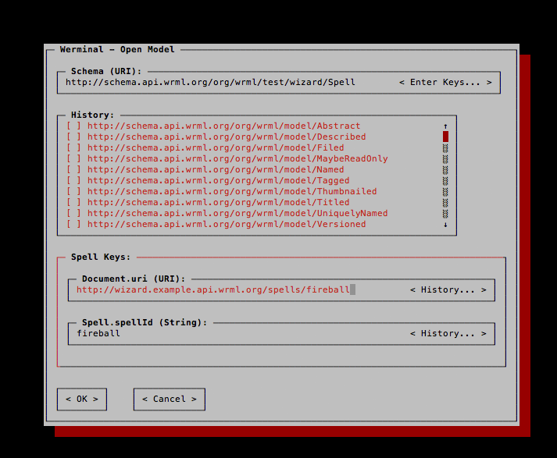
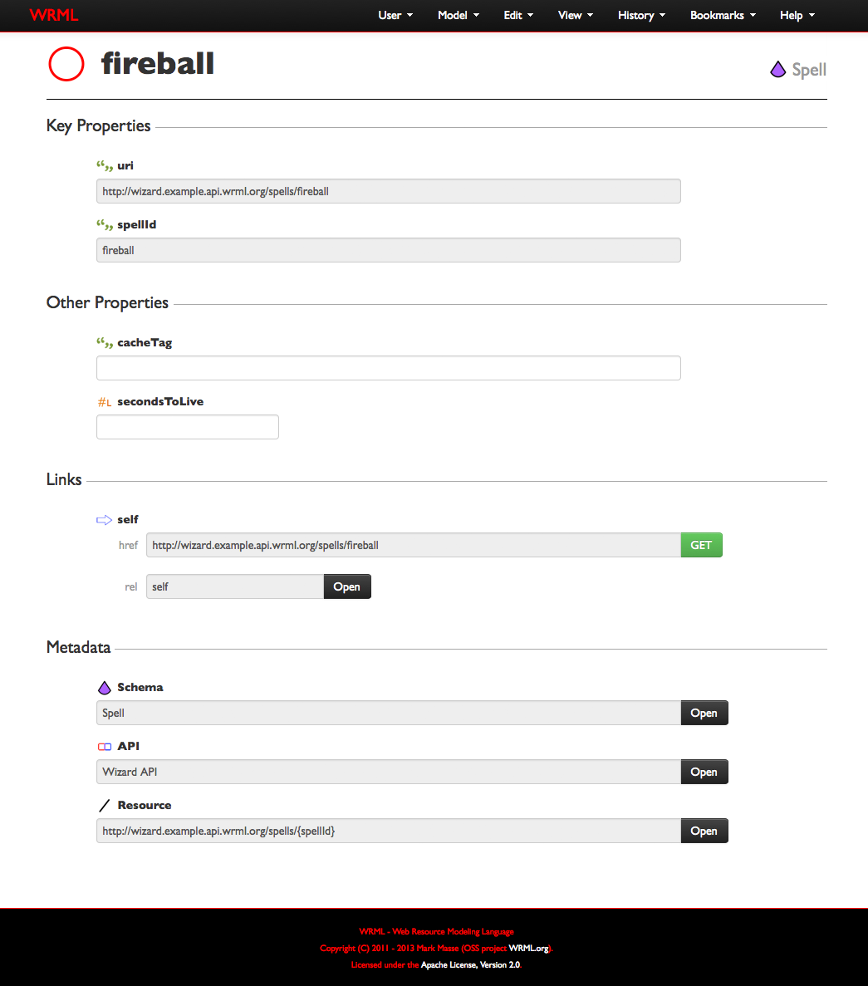
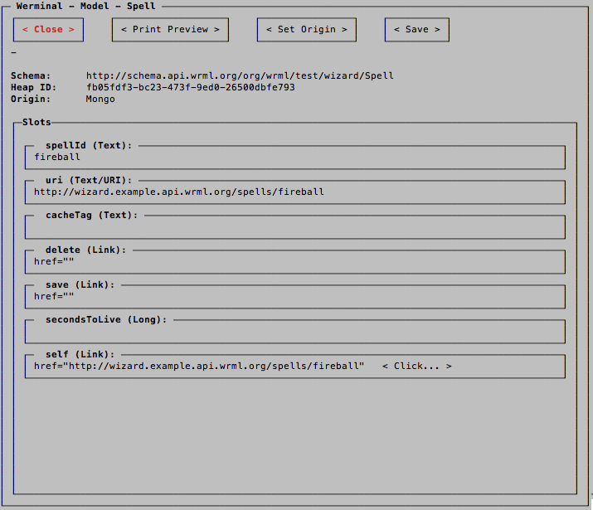
WRML REST API Design Tools
Wrmldoc
Web-based GUI
Werminal
Command-line GUI

