Slide 1
Comparative Language Fuzz Testing Programming Languages vs. Fat Fingers
Diomidis Spinellis
Department of Management Science and Technology
Athens University of Economics and Business
http://www.dmst.aueb.gr/dds
dds@aueb.gr
@CoolSWEng

Slide 2
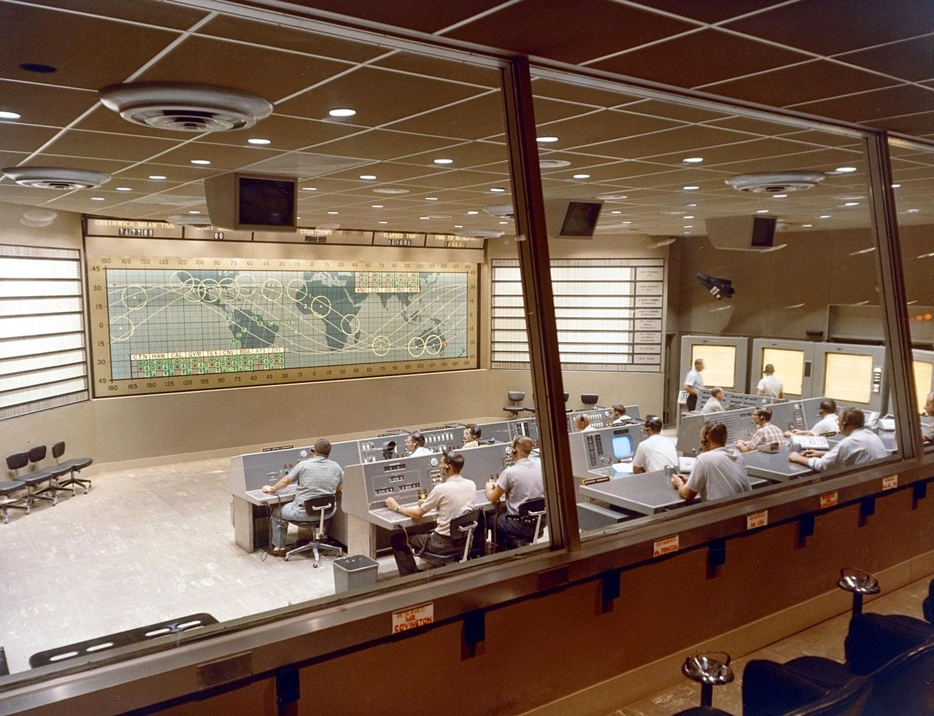
Project Mercury
Notes:
Project Mercury was the first human spaceflight program of the United States.
It ran from 1959 through 1963 with two goals: putting a human in orbit around the Earth, and doing it before the Soviet Union, as part of the early space race
Project Mercury’s FORTRAN code had the following fault:
DO I=1.10 instead of ... DO I=1,10
The fault was discovered in an analysis of why the software did not seem to generate results that were sufficiently accurate.
The erroneous 1.10 would cause the loop to be executed exactly once!

Slide 3
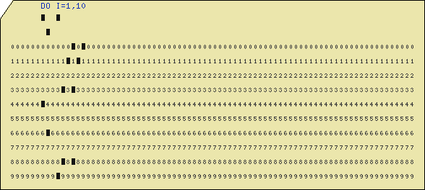
DO I=1,10
Notes:
http://www.kloth.net/services/cardpunch.php

Slide 4
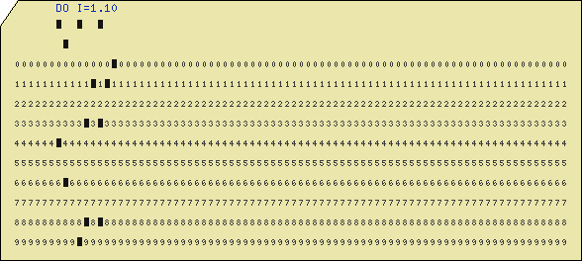
DO I=1.10
Notes:
OK for suborbital missions, but not for Moon and orbital flights

Slide 5
“Consistently separating words by spaces became a general custom about the tenth century A. D., and lasted until about 1957, when FORTRAN abandoned the practice.” —Sun FORTRAN Reference Manual

Slide 6
Many reasons…
Mistyping
Absent mindedness
Automatic refactorings
Complex editor commands
Or even …

Slide 7

Notes:
“My cat walked over the keyboard”

Slide 8
Questions
Q1: How probable are such events?
Q2: How does a language’s design affect likelihood and severity?

Slide 9
Overview
Choose ten popular languages
Obtain a corpus of programs written in all
Construct fuzzer
Fuzz to death
Analyze results
Notes:
Miller 1990 25-33% of Unix utilities crashed

Slide 10
Contribution
Method for evaluating language designs
Actual evaluation

Slide 11
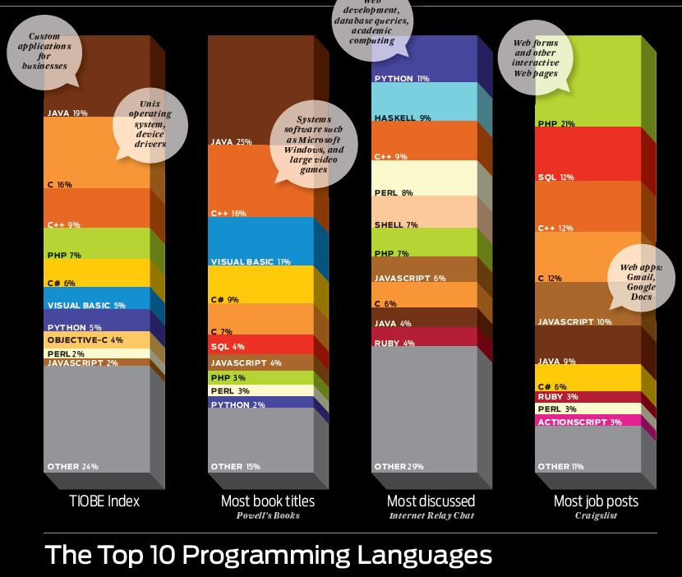
Language selection
Notes:
IEEE Spectrum article

Slide 12
Languages
C
C++
C#
Haskell
Java
JavaScript
PHP
Perl
Python
Ruby
SQL
sh
Objective C

Slide 13
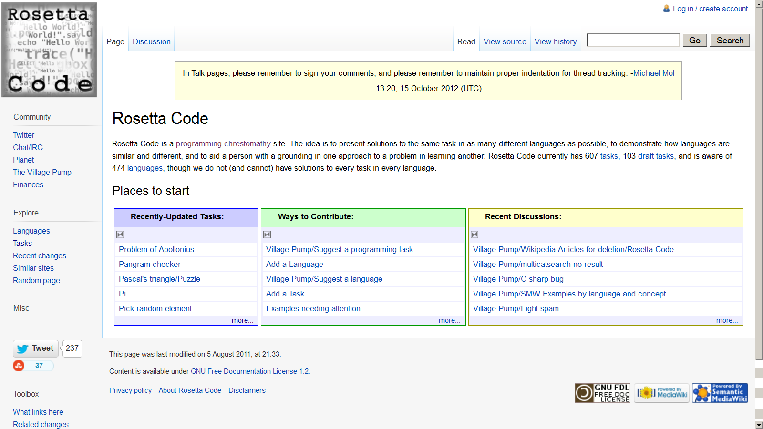
RosettaCode.org

Slide 14
RosettaCode.org
Programming chrestomathy site
600 tasks
Code in 470 languages.

Slide 15
Task crawling
# Create a list of all tasks
curl 'http://rosettacode.org/wiki/Category:Programming_Tasks' |
sed -n 's|^.*<li><a href="/wiki/\([^"]*\).*|\1|p' |
# Download the MediaWiki markup code for each task
while read task
do
taskfile=`echo $task | sed 's|/|__|g'`
curl \ "http://rosettacode.org/mw/index.php?title=$task&action=edit" \ >../rosetta/$taskfile
sleep 2
done

Slide 16
Task selection
# Tasks list ordered by # of our supported languages
for task in *
do
# Print task:language
sed -n "s#=={{header|\([^}]*\).*#$task:\1#p" $task
done |
sort -t: -k2 |
join -1 2 -2 1 -t: - ../lang/ourlangs |
awk -F: '{print $2}' |
sort |
uniq -c |
sort -rn

Slide 17
14 Tasks
AccumFactory
Beers
Dow
FlatList
FuncComp
Hello
Horner
Mult
MutRecursion
ManBoy
Power
Substring
Tokenizer
ZigZag
Notes:
AccumFactory & A function that takes a number $n$ and returns a function that acts as an accumulator and also accepts a number. Each function should return the sum of the numbers added to the accumulator so far.\\
Beers & Print the ``99 bottles of beer on the wall'' song.\\
Dow & Detects all years in a range in which Christmas falls on a Sunday.\\
FlatList & Flattens a series of nested lists.\\
FuncComp & Implementation of mathematical function composition.\\
Horner & Horner's Method for polynomial evaluation.\\
Hello & A typical ``hello, world!'' program.\\
Mult & Ethiopian Multiplication: a method to multiply integers using only addition, doubling and halving.\\
MutRecursion & Hofstadter's Female and Male sequence~\cite{Hof89}.\\
ManBoy & A test to distinguish compilers that correctly implement
recursion and non-local references from those that do not~\cite{Knu64}. \\
Power & Calculation of a set's $S$ power set: the set of all subsets of $S$.\\
Substring & Count the occurrences of a substring.\\
Tokenizer & A string tokenizing program.\\
ZigZag & Produce a square arrangement of the first $N^2$ integers,
where the numbers increase sequentially in a zig-zag along the anti-diagonals of the array.\\

Slide 18
Problems
Compilation
Test harness
New language features
Libraries

Slide 19
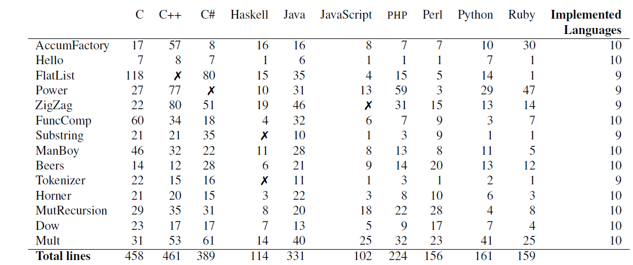
Tasks and Languages

Slide 20
Fuzzer operation
Read program
Tokenize into
identifiers
horizontal white space
integer constants,
floating point constants,
group delimiters
operators
Introduce mutation
Write modified program

Slide 21
Fuzz types
Identifier Substitution
Integer Perturbation
Random Character Substitution
Similar Token Substitution
Random Token Substitution

Slide 22
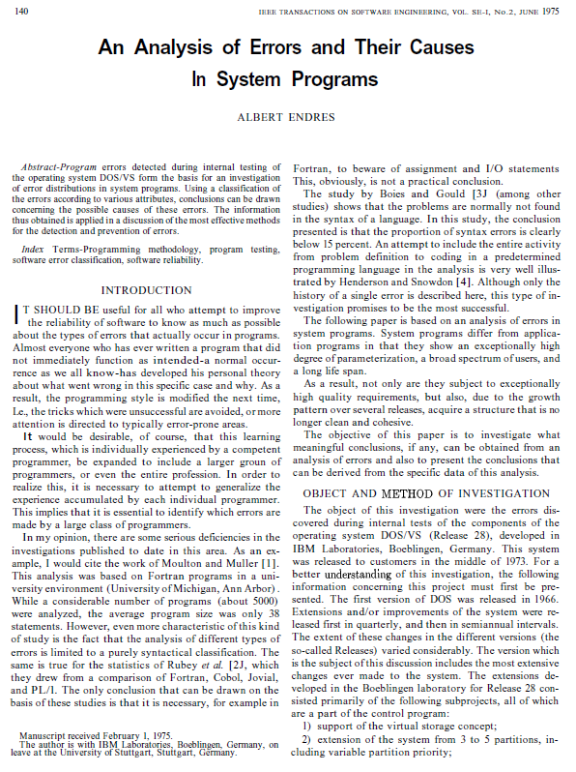
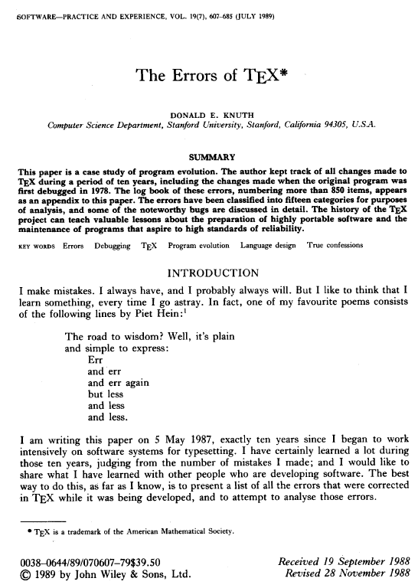
Notes:
In the paper you can find how we categorized them according to …

Slide 23
Operation
Seed base case
Fuzz
Compile
Run
Verify results
Notes:
Every time you stress a compiler, you’re in for a surprise
In one particular case a fuzz (a substitution of a closing bracket with func_t)
caused an Objective C task's compiler to enter into an infinite loop,
producing a 5GB file of error messages.
We side-stepped this problem when we decided to remove Objective C from
the languages we tested.
In another case the Haskell compiler entered an infinite loop.
To avoid such problems we imposed a 20s timeout on the compilation process.

Slide 24
Aggregate results
☹
Notes:
2/3 of errors didn’t allow programs to run
16% run and produced wrong results

Slide 25
Language failure modes
Notes:
High means bad!
Languages with strong static typing (Java, Haskell, C++)
caught more errors at compile and run time than languages
with weak or dynamic type systems
Hence balance: Increased risk for typo delivering wrong results vs increased usability and productivity
Also variation

Slide 26
Statistical analysis
2 × 2 contingency analysis
Fisher exact test
Not x²
Pairs with very low frequencies

Slide 27
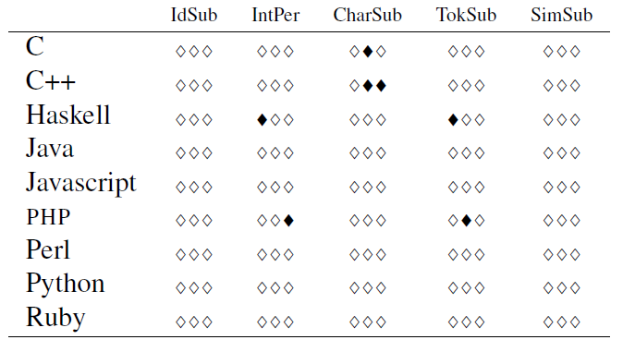
C# more similar to C/C++ than Java
Notes:
C# behaves more like C and C++ and less like Java, despite its surface similarities to the latter.

Slide 28
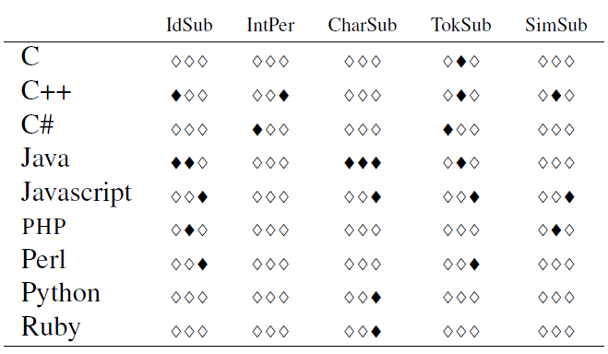
Haskell more similar to Java
Notes:
Haskell behaves more similarly to Java than other languages.

Slide 29
Similarities of statically checked languages

Slide 30
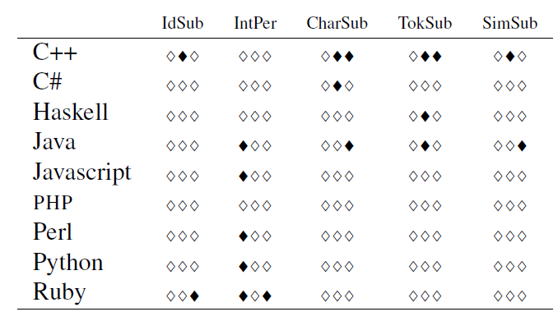
C similar to C++

Slide 31
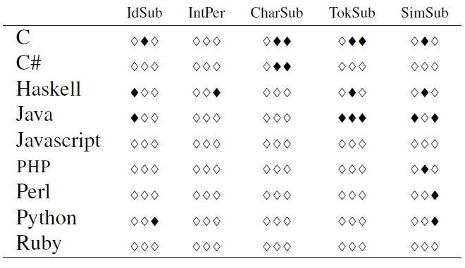
C++ similar to Java

Slide 32
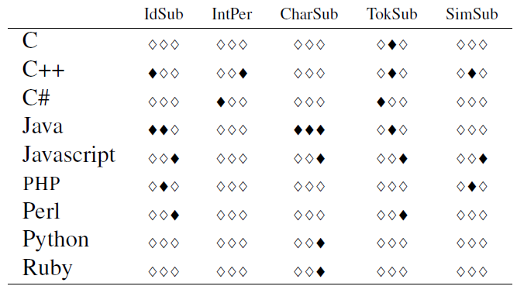
Haskell similar to Java

Slide 33
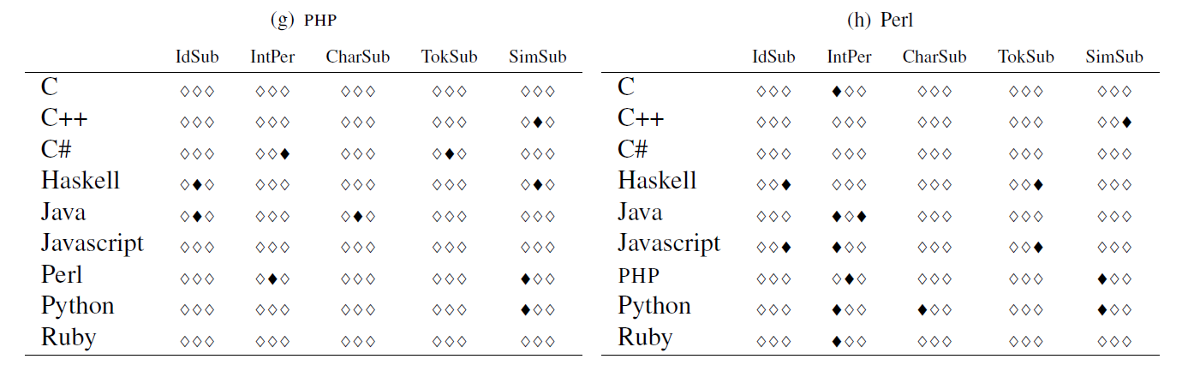
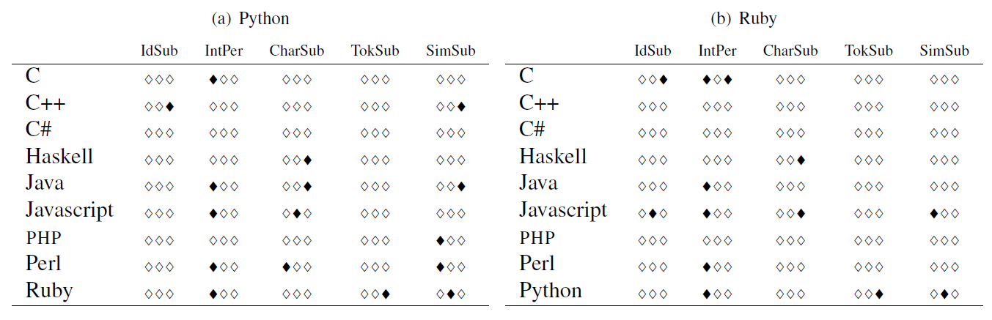
PHP, Perl Python, Ruby
Notes:
However, if we turn our attention to dynamic languages we see
we do not see a comparable pattern in dynamic languages.
To paraphrase Tolstoy,

Slide 34
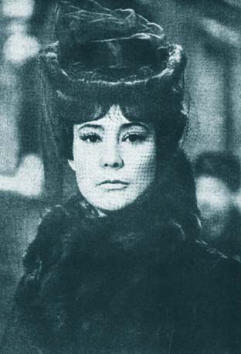
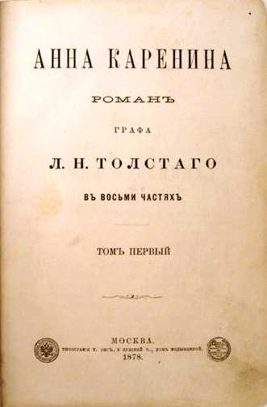
Anna Karenina Principle
Notes:
it would seem that they are different in their own ways.
Anna Karenina principle
Leo Tolstoy's book Anna Karenina, which ... Happy families are all alike; every unhappy family is unhappy in its own way.

Slide 35
Further work
Increase corpus size, task complexity
Improve fuzzing
Derive fuzzing operations systematically
Base fuzzing decisions on empirical data
Manually analyze failure modes
and more broadly…

Slide 36
Broadly…
Comparative language evaluation
Employ reliability engineering in language design
Hazard analysis
Fault-tree analysis
Test coverage analysis

