Slide 1

Notes:
---
layout: pageBar
hideInToc: true
---
# Outline
<Toc/>

Slide 2
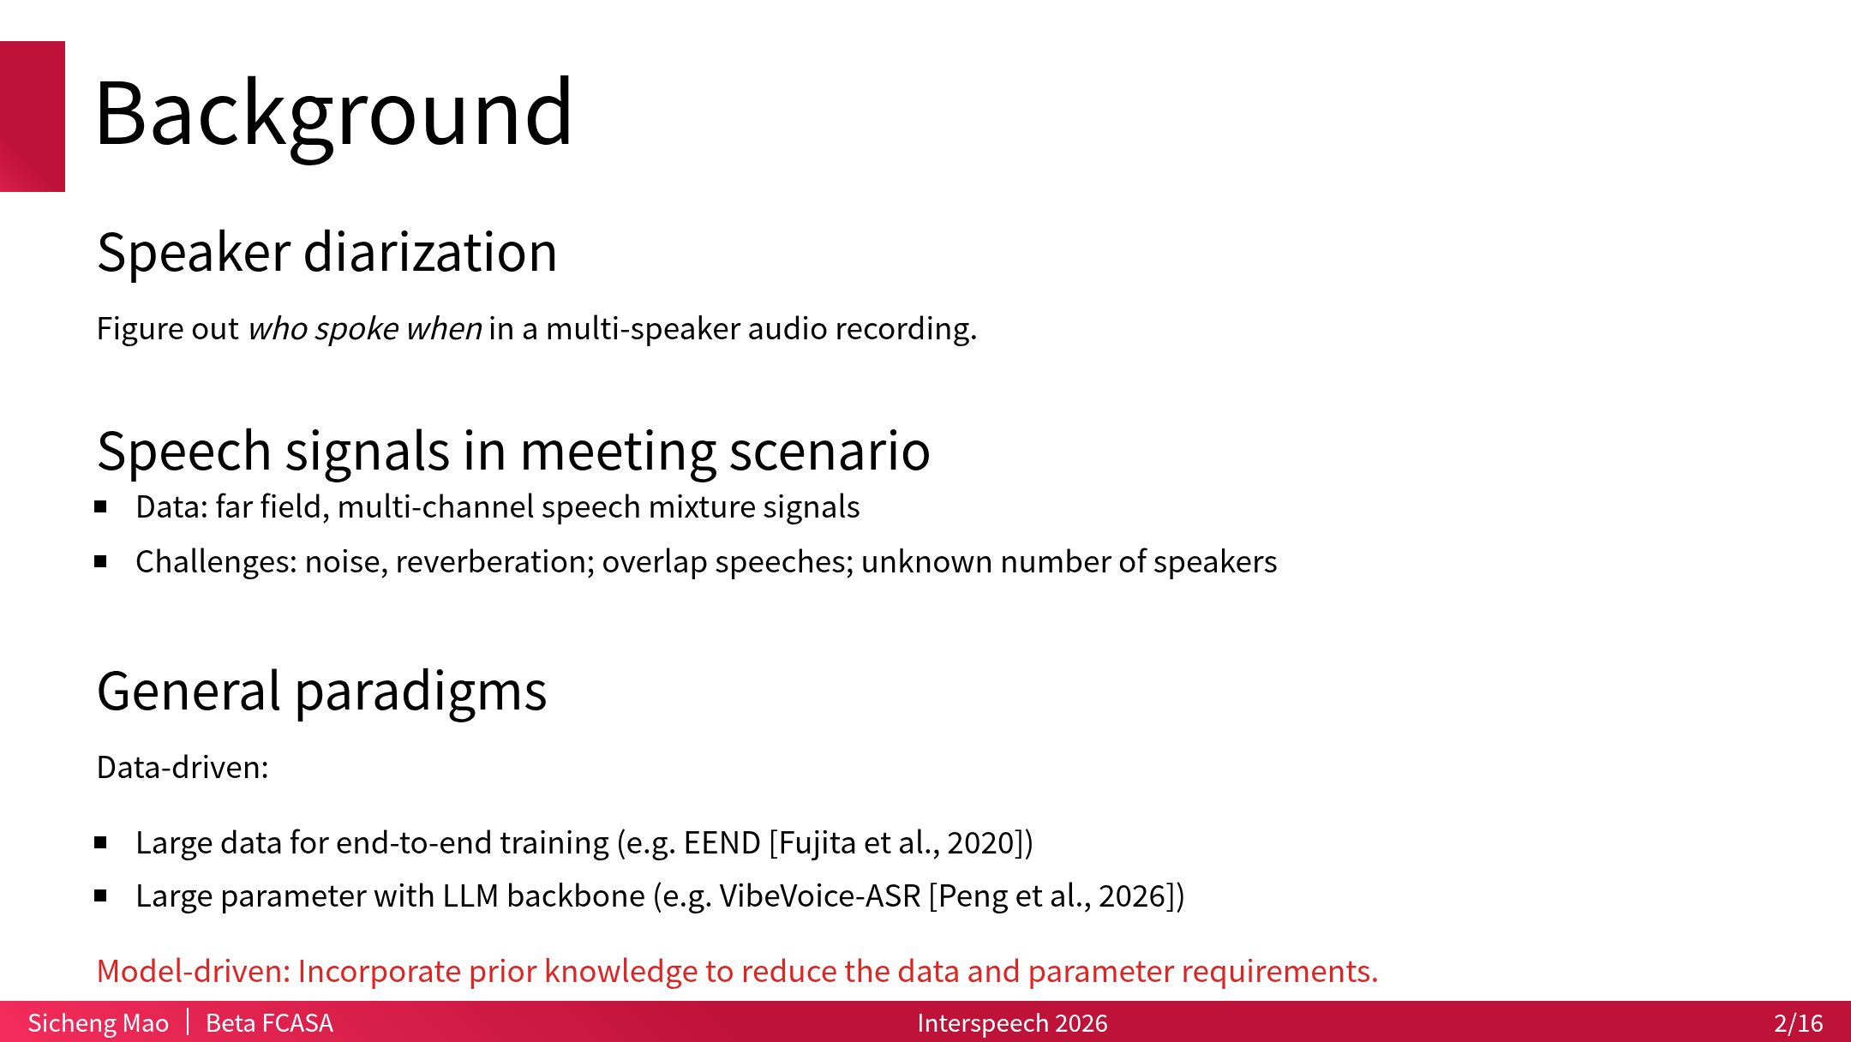
Notes:
This presentation: **multichannel diarization with source separation models**

Slide 3
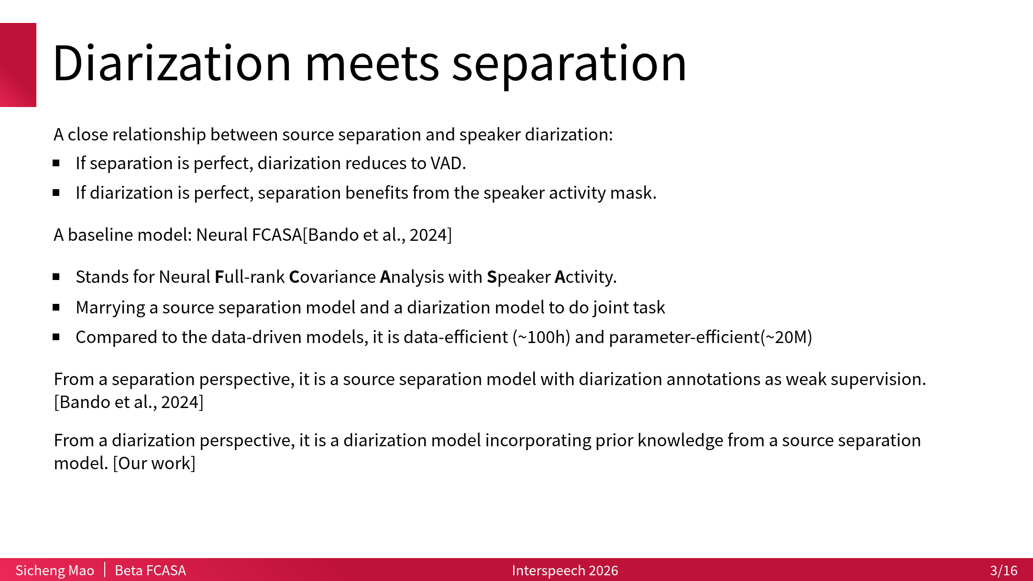
Notes:
Reversely, if we look from the diarization perspective, it only uses diarization annotation and the mixtures. And intuitively, diarization task reduce to VAD if we get clean separated signal, so jointly learn how to diarize and separate help each other.

Slide 4
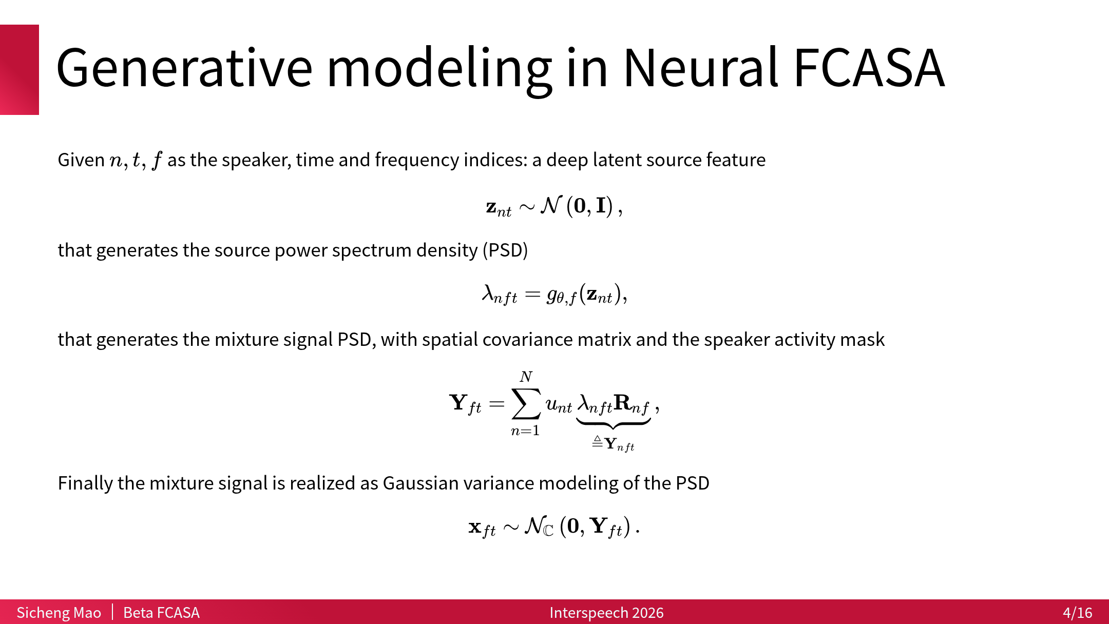

Slide 5
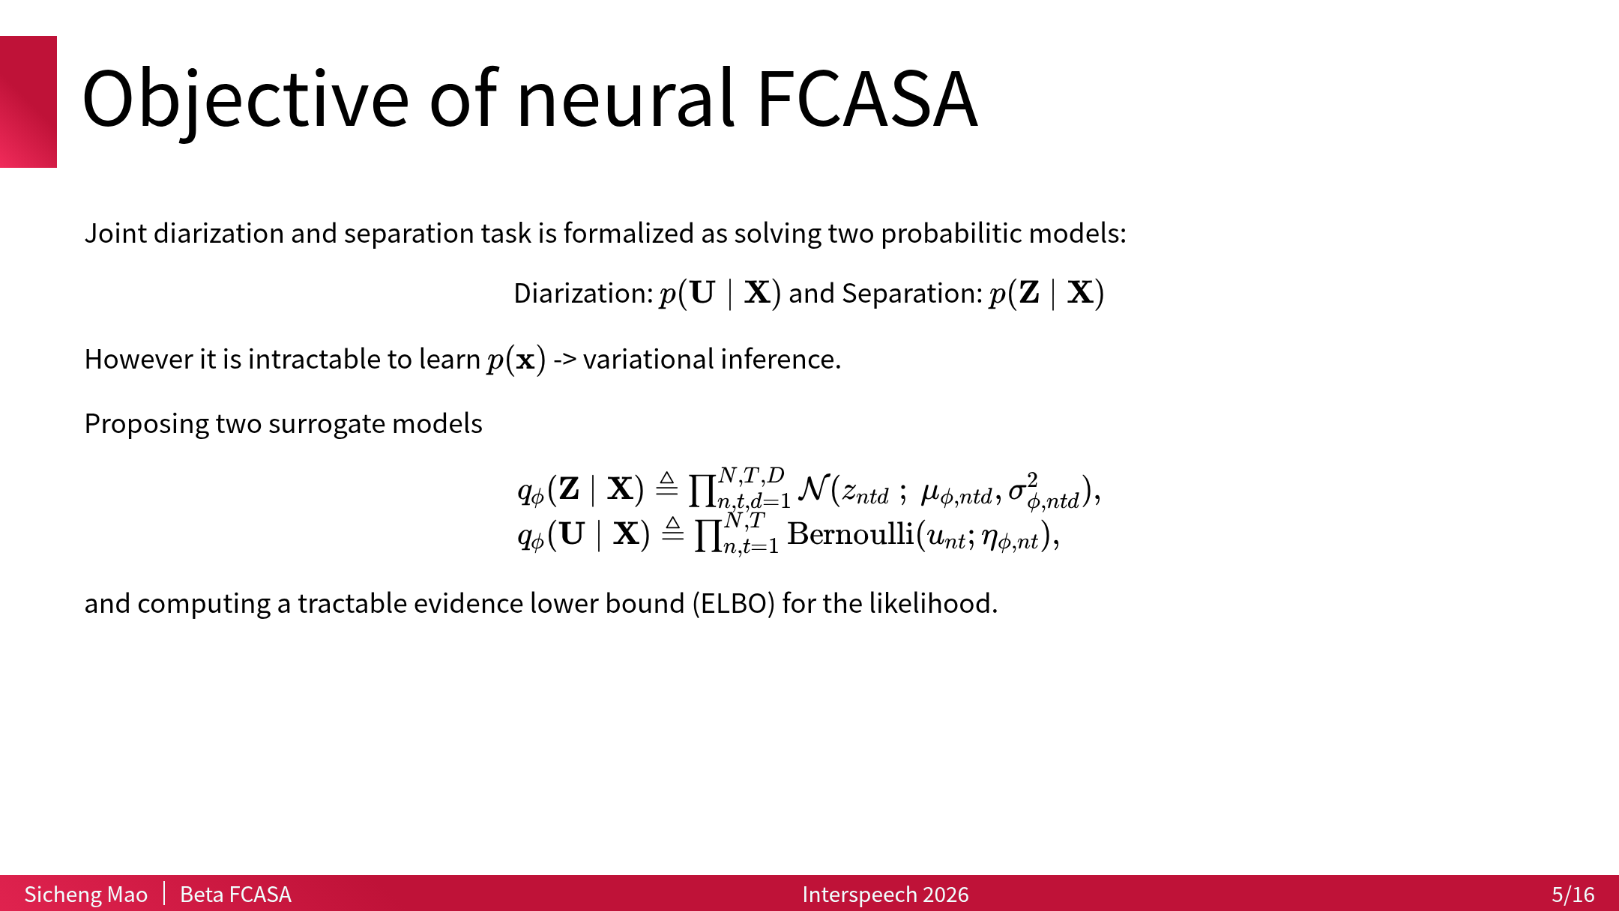

Slide 6
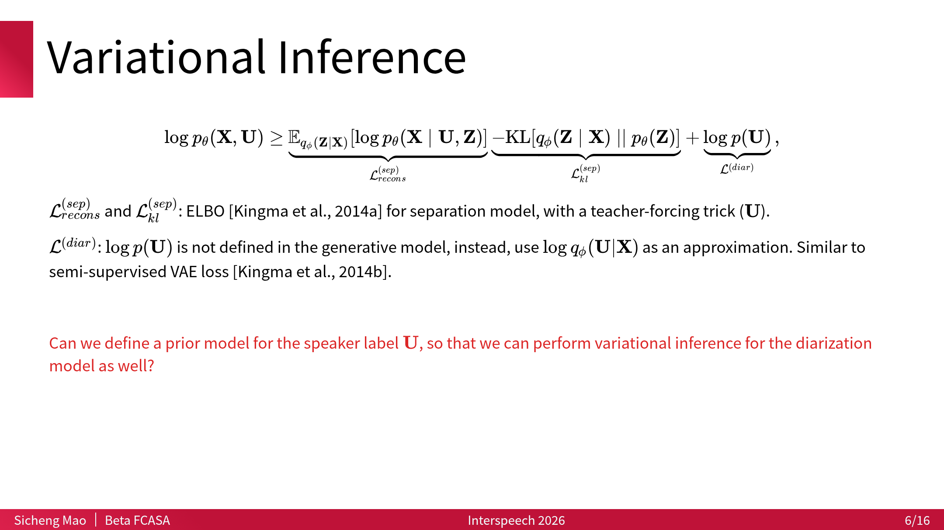

Slide 7
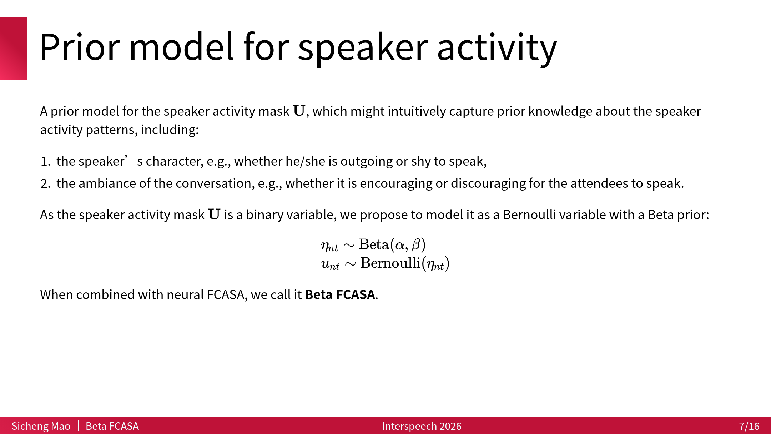

Slide 8
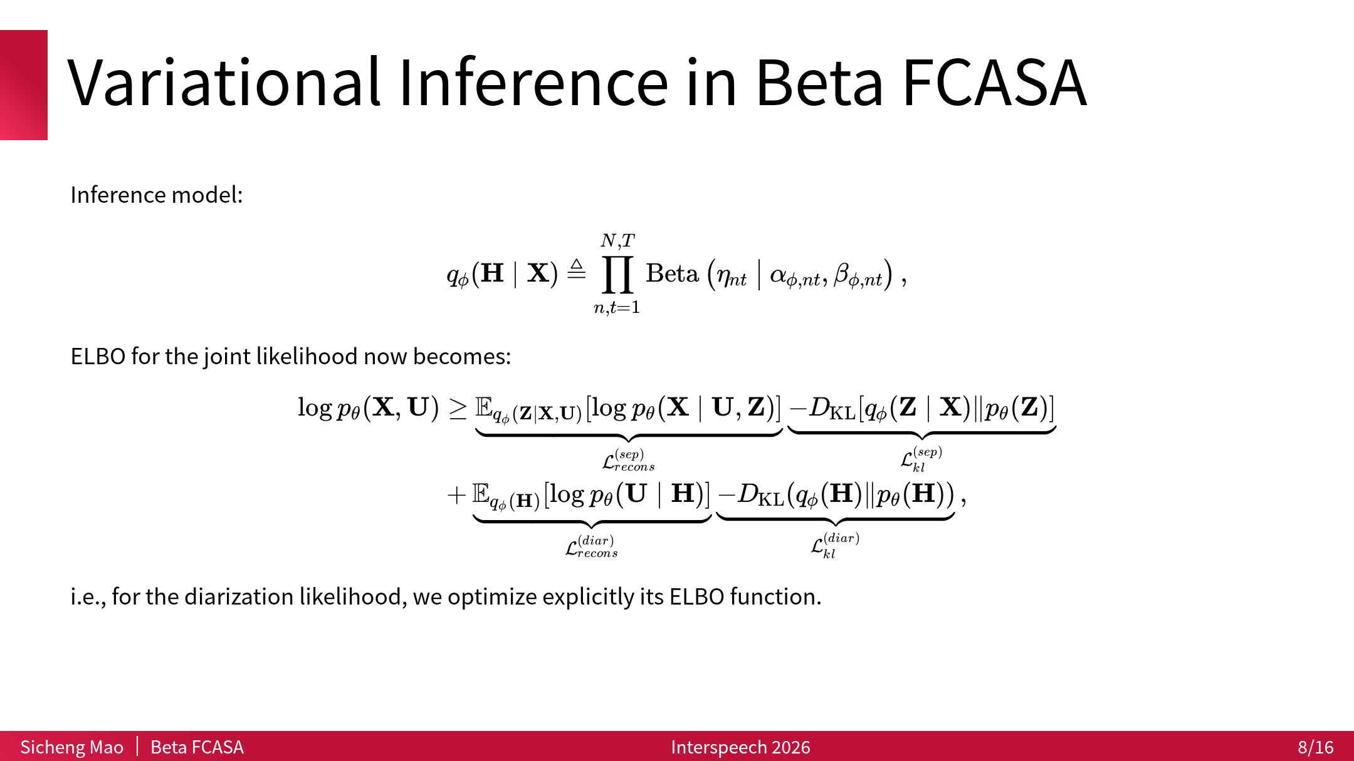

Slide 9
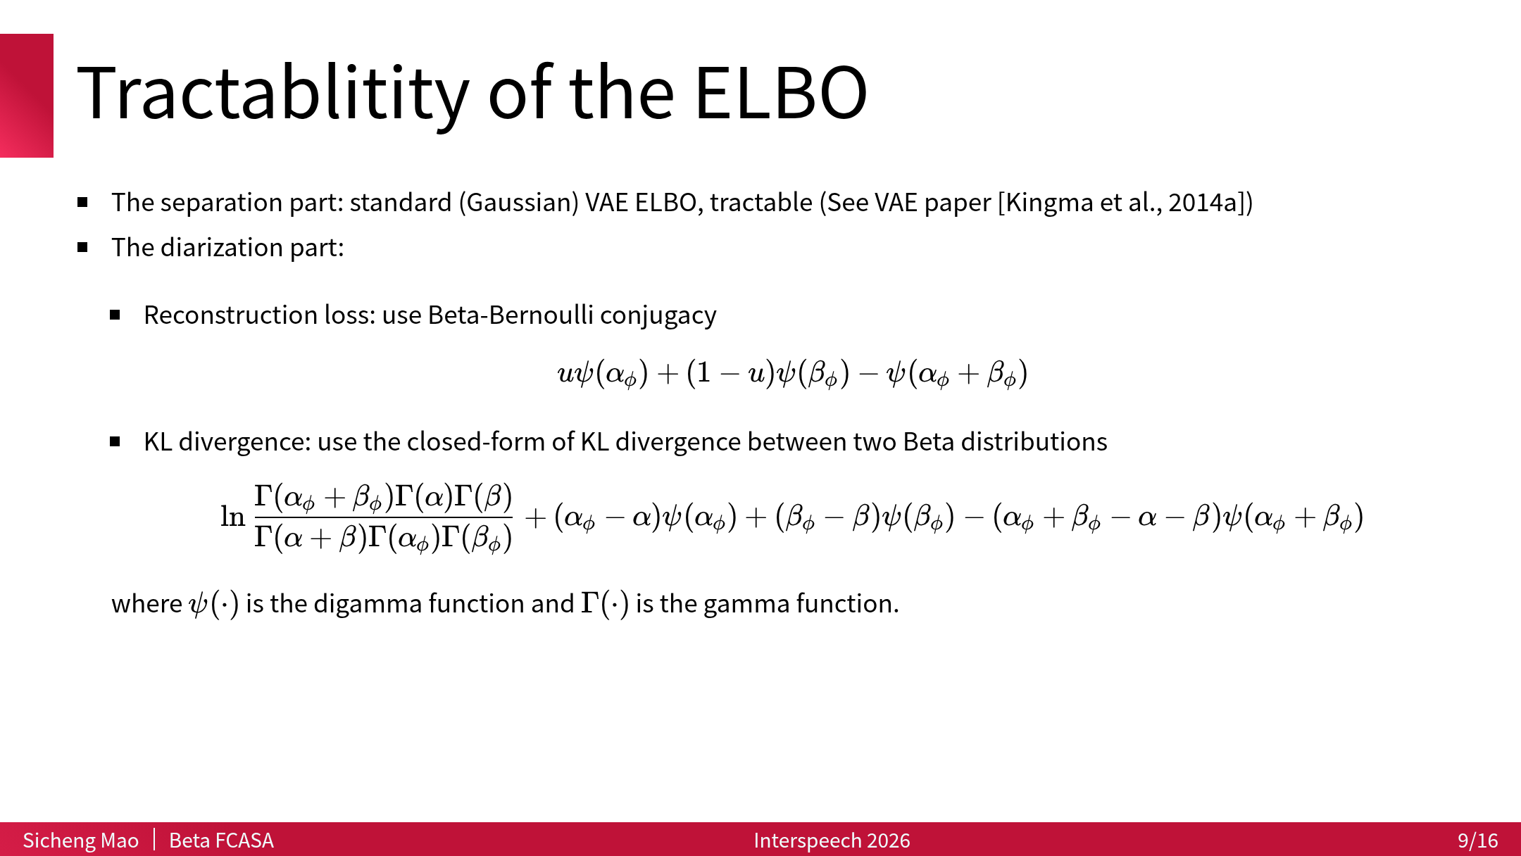

Slide 10
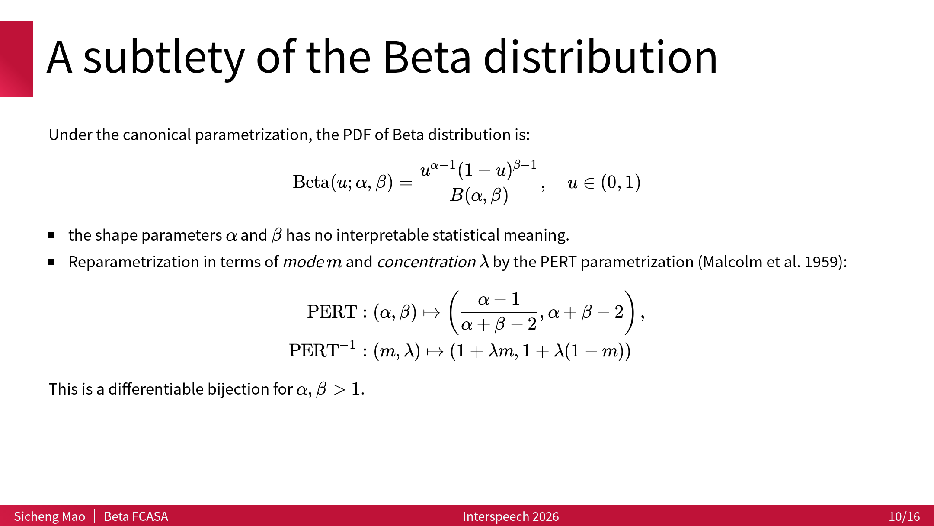

Slide 11
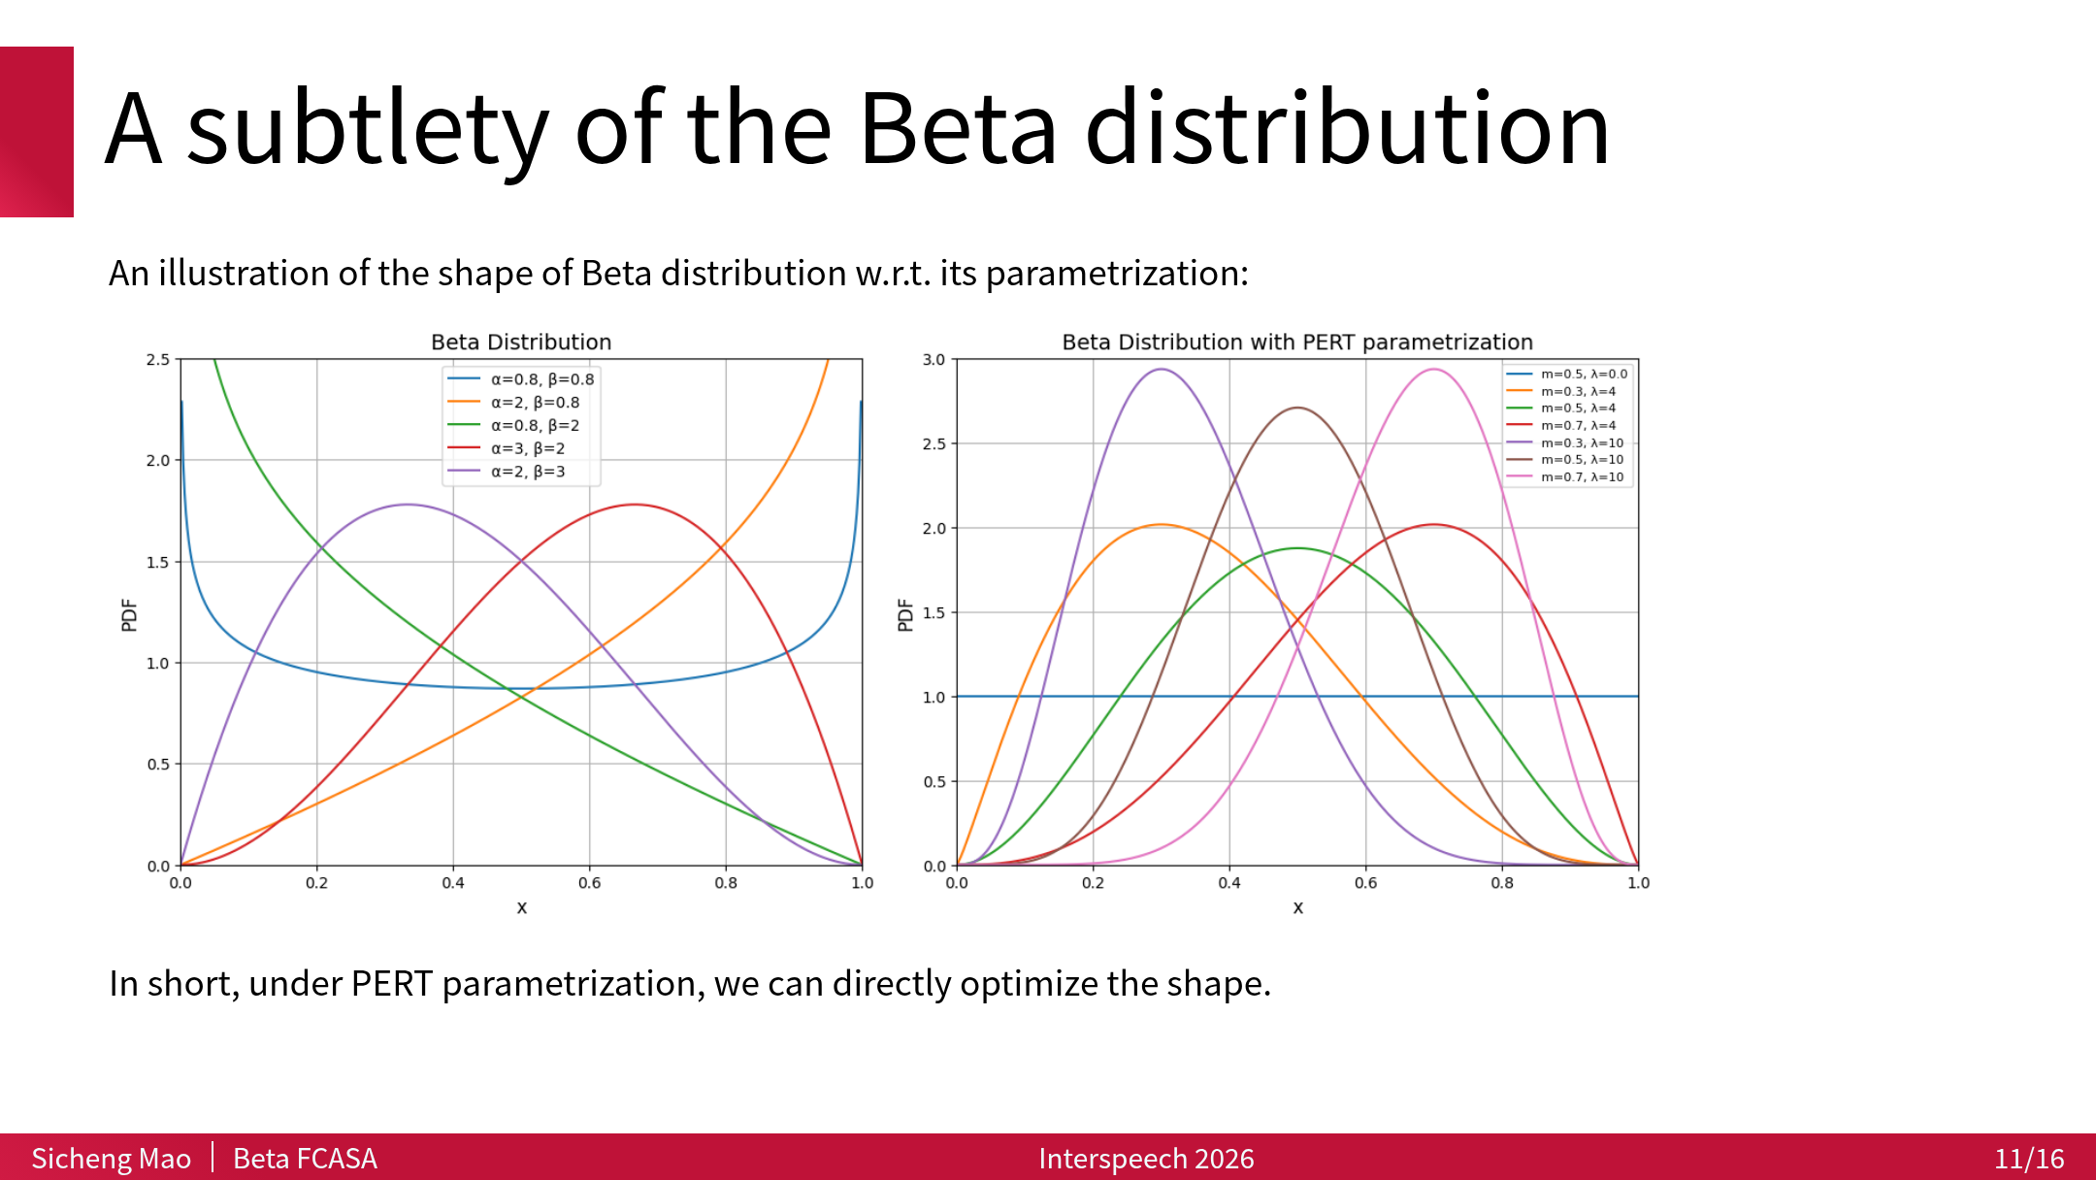

Slide 12
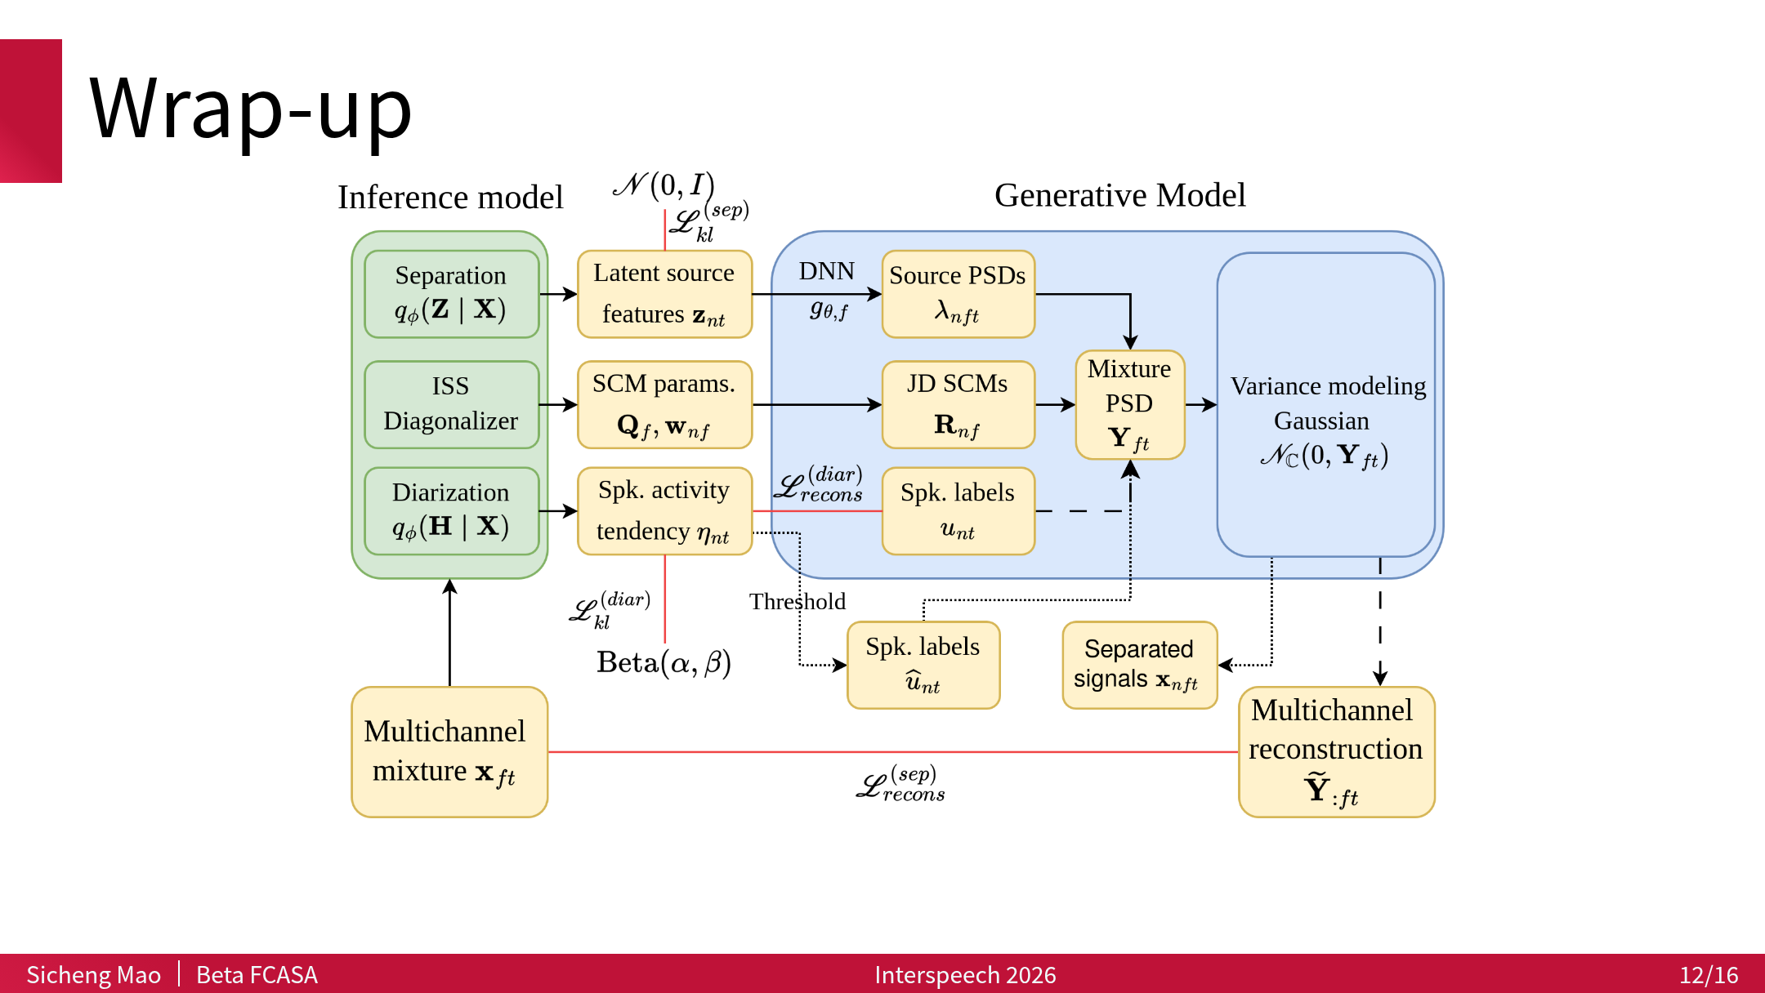

Slide 13
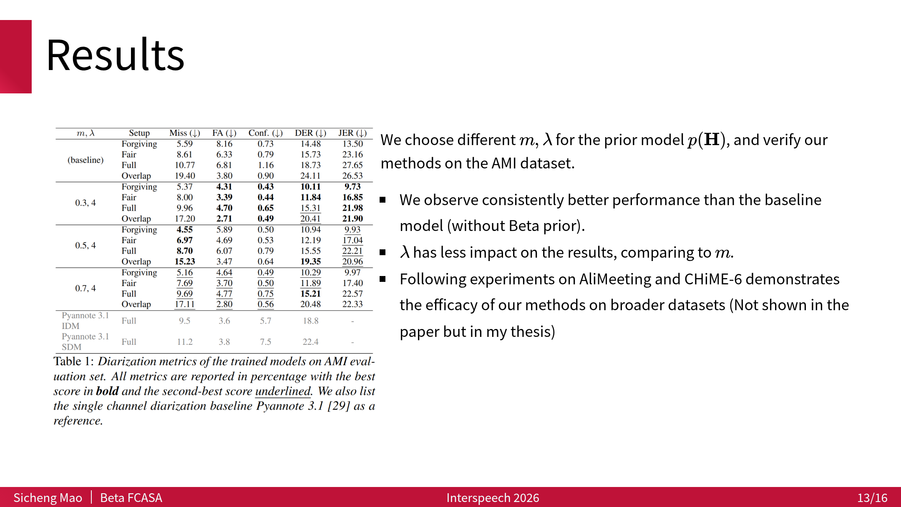

Slide 14
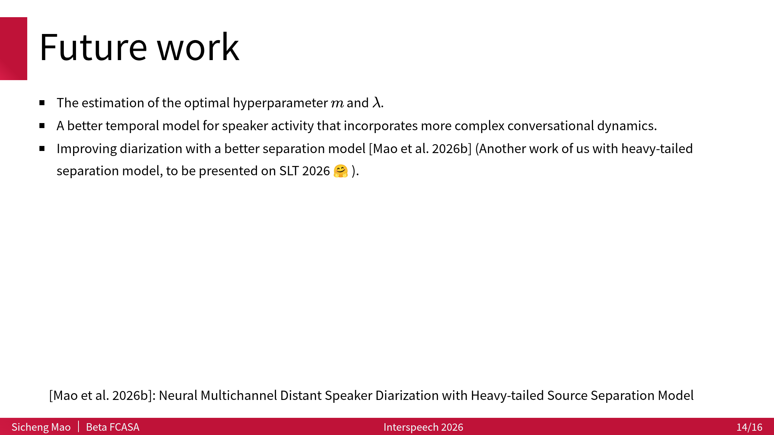

Slide 15
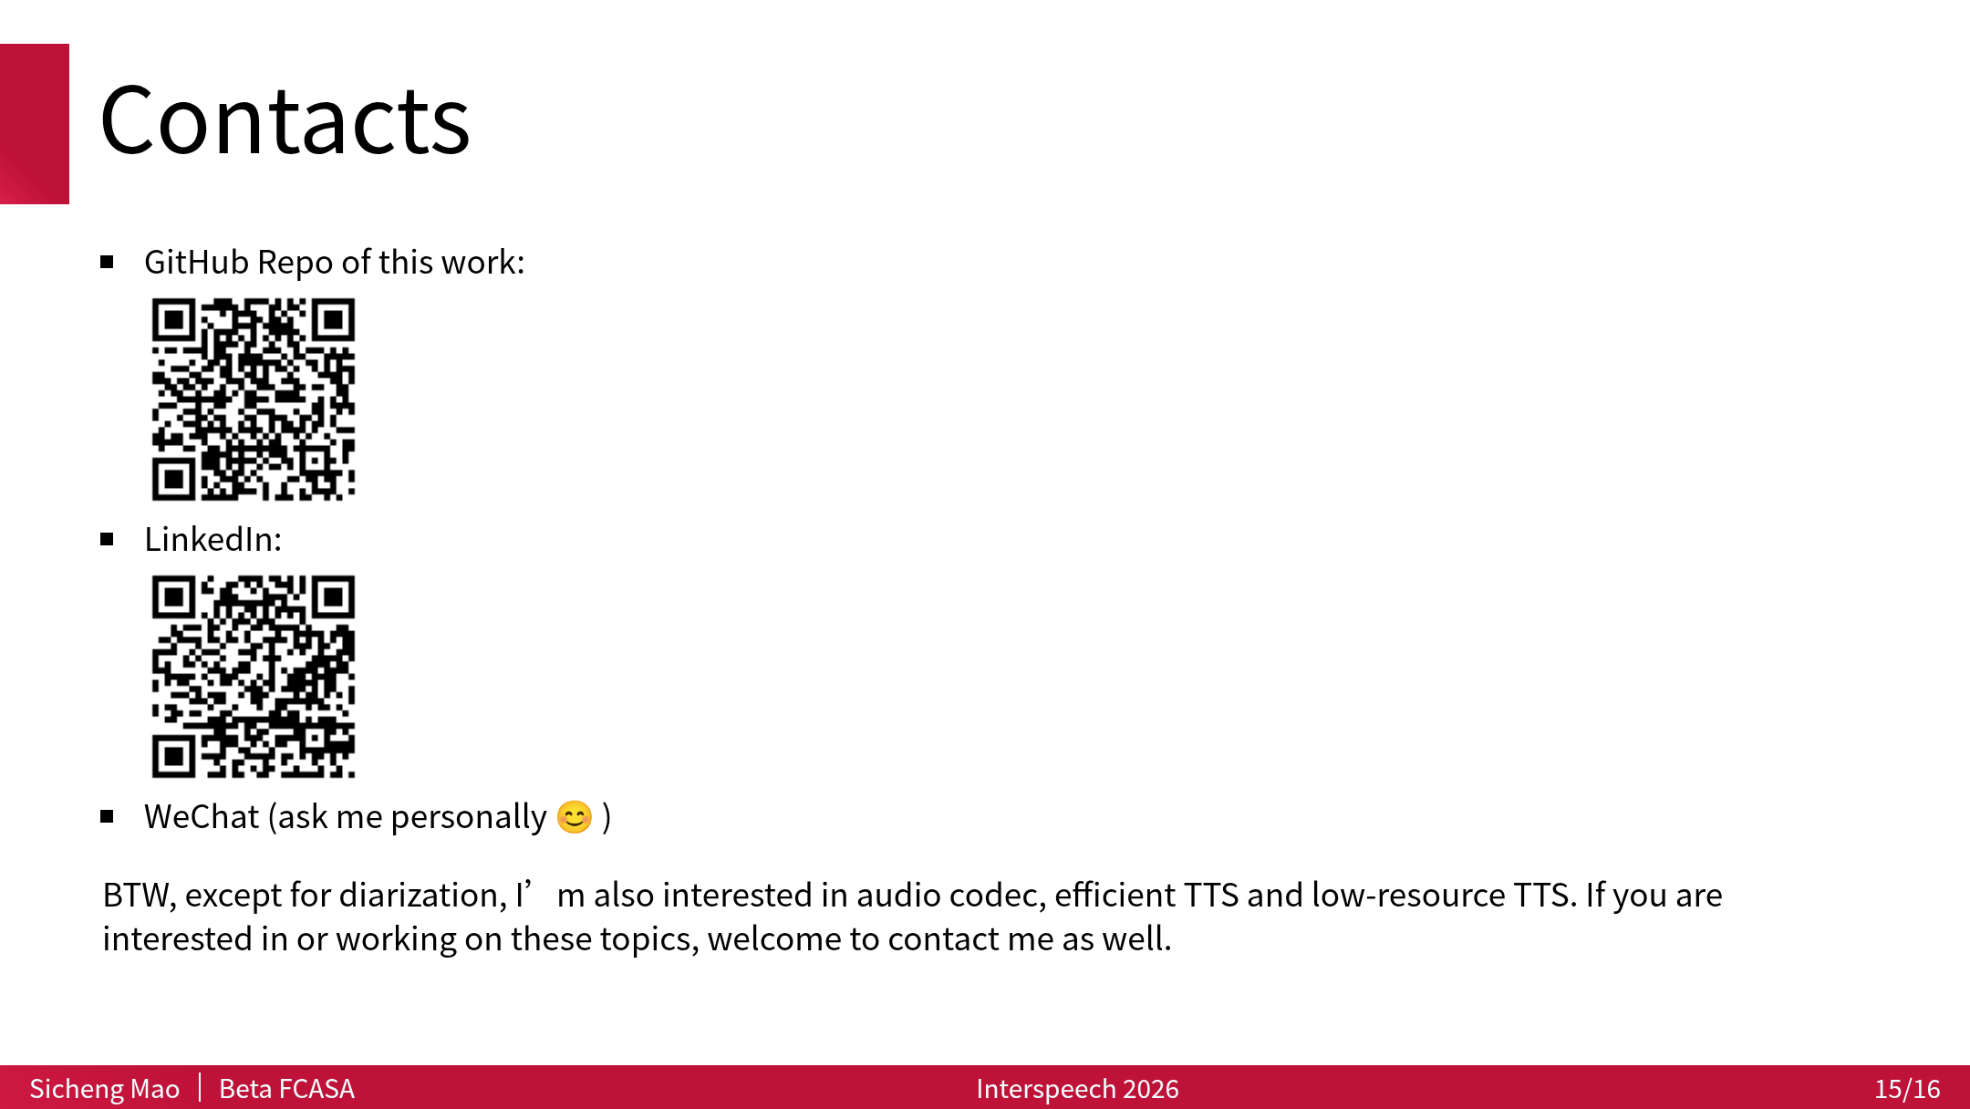

Slide 16


