Slide 1

Cost-Utility Analysis of Medications for Obesity Management
Economics Evaluation II: ICER Project
18th December 2024
Alessio Pignatelli

Slide 2
Clinical Issue

Slide 3
Disease
Obesity is a common chronic disease that increases the risk of other conditions such as diabetes mellitus, cancer, and heart disease as well as death.
The prevalence of obesity surpassed 40% of US adults in 2018
The direct medical costs attributable to obesity were estimated to be $260 billion in the US in 2016.
BMI is the metric commonly used to quantify obesity

Slide 4
Interventions
The following medications are considered:
Semaglutide (SEM)
Lliraglutide (LIR)
Phentermine/topiramate (P/T)
Bupropion/naltrexone (B/N)
All FDA-approved.
SEM and LIR are GLP-1s - also approved for diabetes mellitus

Slide 5
Reporting Checklist and Impact Inventory
Notes:
Objective vs Objectives

Slide 6
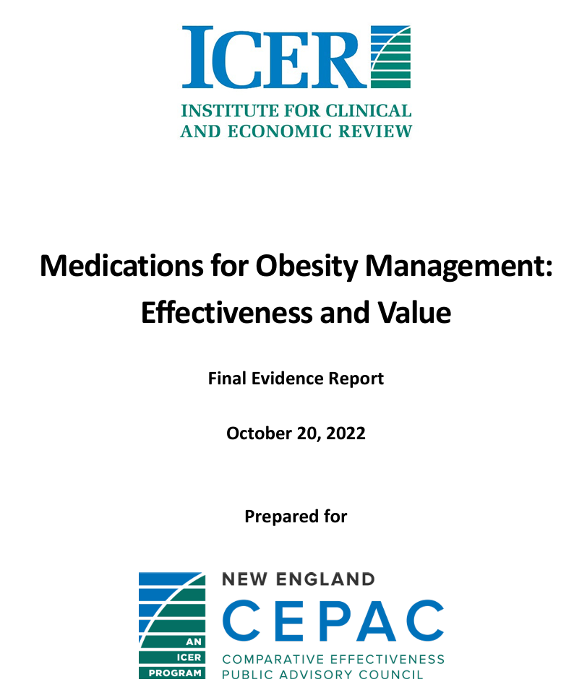
Report
Medications for Obesity Management: Effectiveness and Value

Slide 7
Reporting Checklist
Overall, well-written report.
Main missing items:
Statement of costing year
Statement of method used to adjust costs for inflation

Slide 8
Impact Inventory
Other health effects (e.g., adverse events and secondary transmissions of infections) not included in analysis
One Scenario Analysis from societal perspective: only productivity included

Slide 9
Model
Notes:
Objective vs Objectives

Slide 10
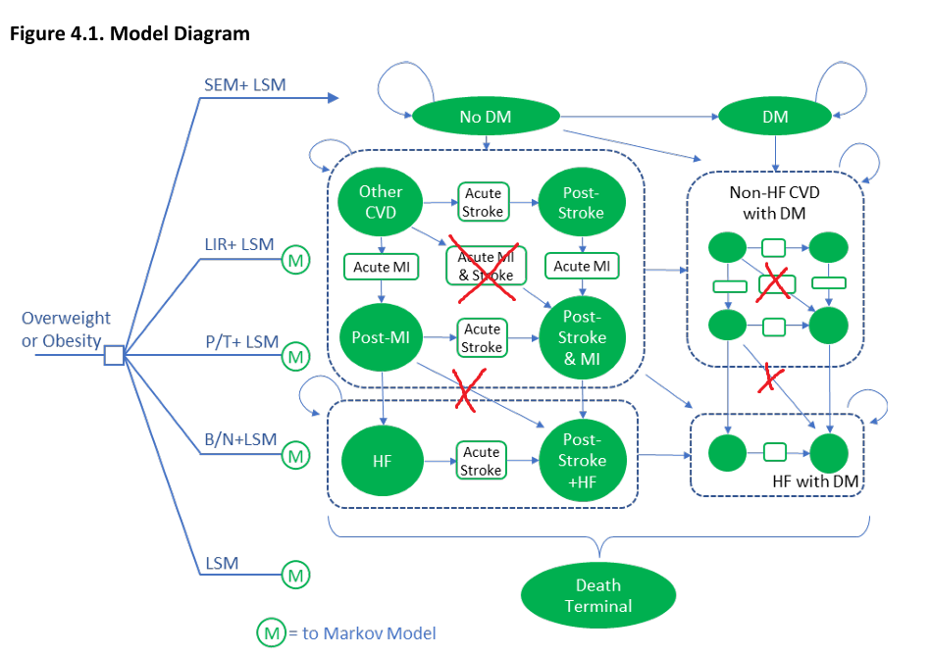
Diagram
As similar as possible to report
Main difference: only one type of CVD event occurs in any given cycle
Some states are split into sub-states for ease of computation

Slide 11
Transition Probabilities
Age-dependent
BMI-dependent
HbA1C-dependent
Hypertension-dependent

Slide 12
Effects of Intervention
Direct effect on BMI and HbA1C
Estimated through network meta-analysis
Indirect effect on Hypertension (through BMI reduction)

Slide 13

Main Modelling Equation
CVD 10-risk modelled through Framingham Risk Calculation Equation
Covariates:
Log(Age)
Log(BMI)
Log(SBP)*1(treated HT)
Log(SBP)*1(not treated HT)
Smoking
Diabetes

Slide 14
Potential Issue
Cost savings are purely functions of lower rates of CVD and Diabetes

Slide 15
Results
Base-case, One-way and Probabilistic Sensitivity Analysis
Notes:
Objective vs Objectives

Slide 16
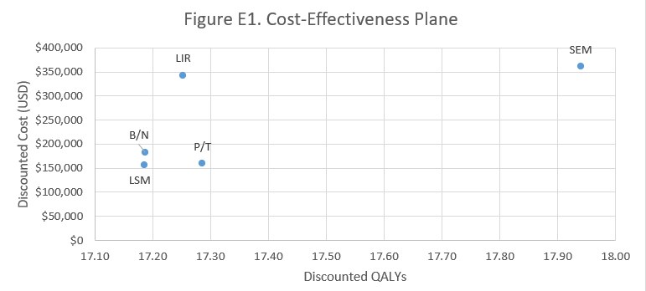
Cost-Effectiveness Plane: My Model

Slide 17
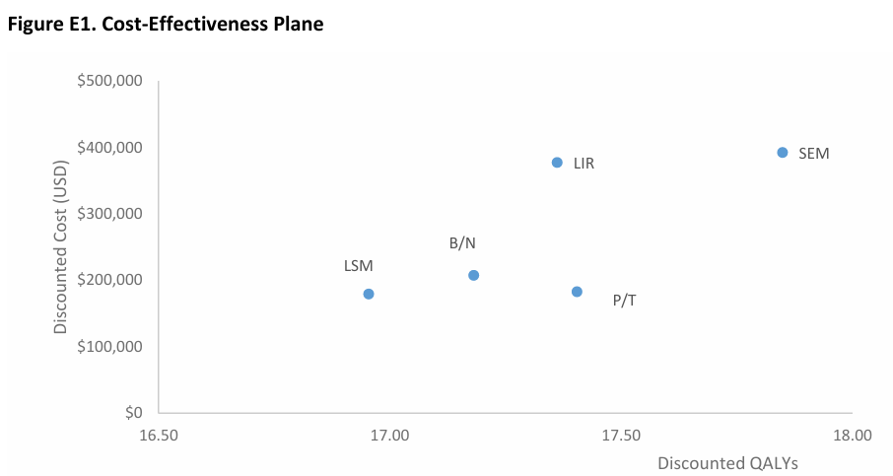
Cost-Effectiveness Plane: Original

Slide 18
Next Steps
Notes:
Objective vs Objectives

Slide 19
Future Development
More in-depth Source Review for PSA
More Diseases
Direct Evaluation

Slide 20
Thank You!
apignat1@jh.edu
https://github.com/alepigna12/eeii_icer_project
Alessio Pignatelli

