Slide 1
Sports Betting

Slide 2
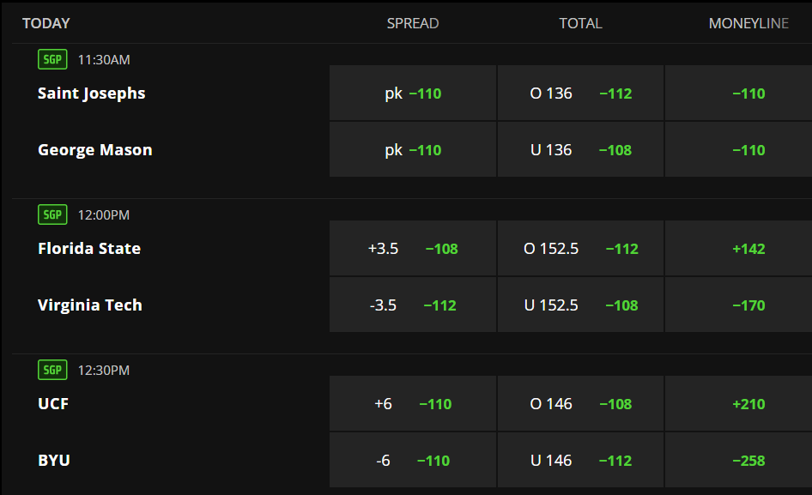
Odds
American
Example from
DraftKings

Slide 3
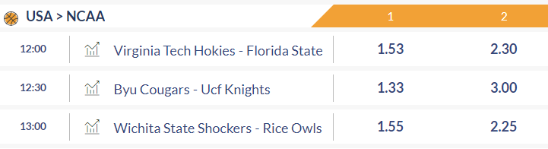
Odds
European/
Decimal
Example from Eurobet
Notes:
European odds will be used in the algorithm.

Slide 4
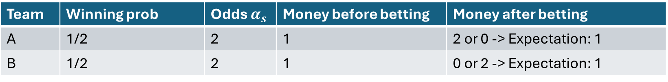
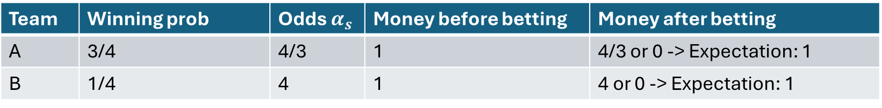

Implied Probability
Fair odds: $\sum{\frac{1}{α_{s}}=1}$ → Induced a probability distribution
Team | Winning prob | Odds $α_{s}$ | Money before betting | Money after betting
A | 1/2 | 2 | 1 | 2 or 0 -> Expectation: 1
B | 1/2 | 2 | 1 | 0 or 2 -> Expectation: 1
Team | Winning prob | Odds $α_{s}$ | Money before betting | Money after betting
A | 3/4 | 4/3 | 1 | 4/3 or 0 -> Expectation: 1
B | 1/4 | 4 | 1 | 4 or 0 -> Expectation: 1

Slide 5
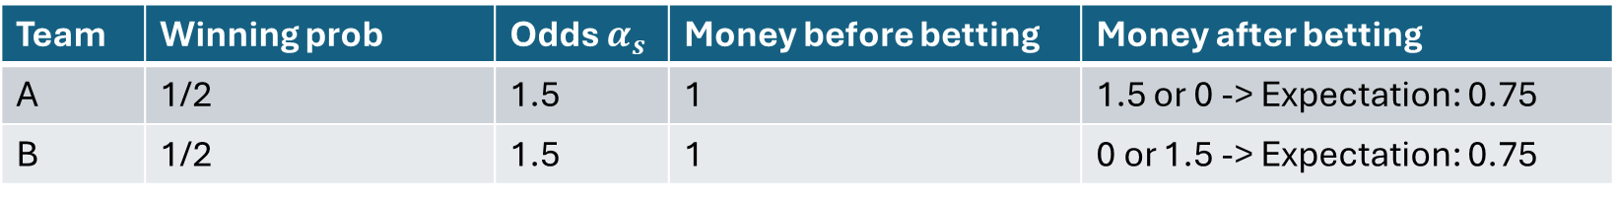

Implied Probability
Subfair odds: $\sum{\frac{1}{α_{s}}>1}$
Team | Winning prob | Odds $α_{s}$ | Money before betting | Money after betting
A | 1/2 | 1.5 | 1 | 1.5 or 0 -> Expectation: 0.75
B | 1/2 | 1.5 | 1 | 0 or 1.5 -> Expectation: 0.75

Slide 6
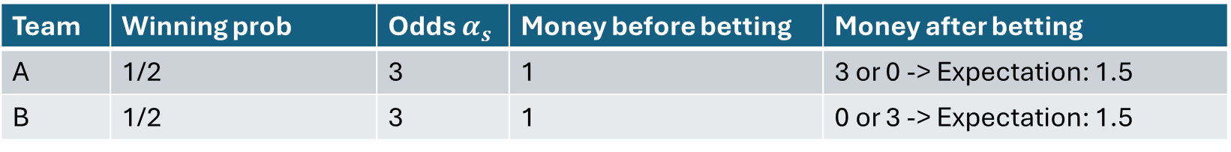
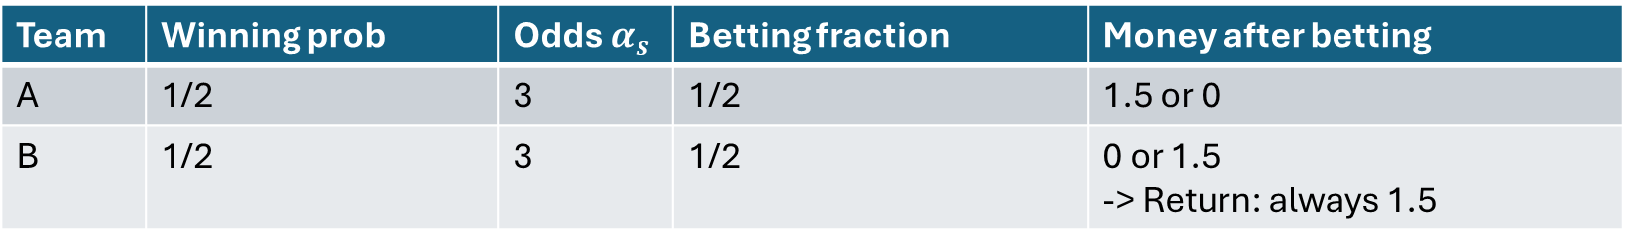

Implied Probability
Superfair odds: $\sum{\frac{1}{α_{s}}<1}$ (Arbitrage Betting)
Team | Winning prob | Odds $α_{s}$ | Money before betting | Money after betting
A | 1/2 | 3 | 1 | 3 or 0 -> Expectation: 1.5
B | 1/2 | 3 | 1 | 0 or 3 -> Expectation: 1.5
Team | Winning prob | Odds $α_{s}$ | Betting fraction | Money after betting
A | 1/2 | 3 | 1/2 | 1.5 or 0
B | 1/2 | 3 | 1/2 | 0 or 1.5 -> Return: always 1.5

Slide 7
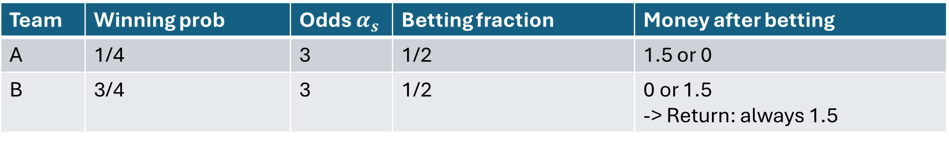
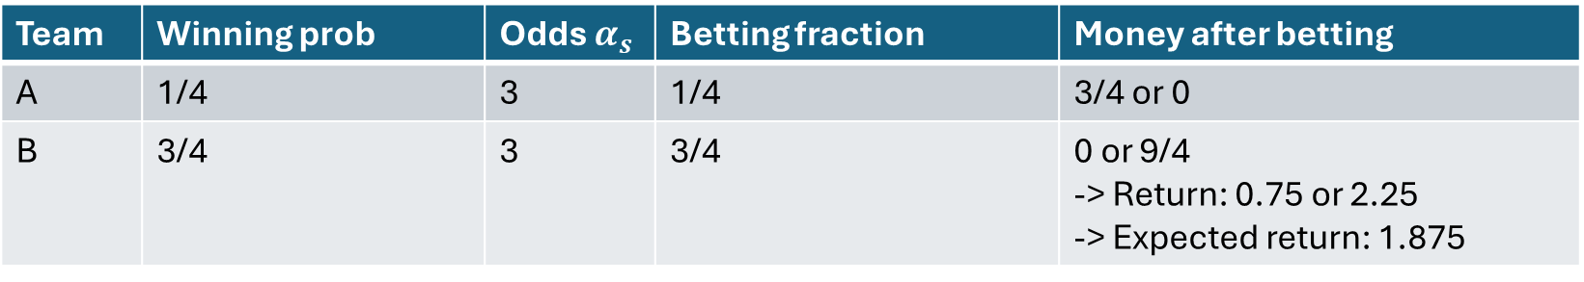
Implied Probability
Implied probability can be different from true probability (superfair example)
Team | Winning prob | Odds $α_{s}$ | Betting fraction | Money after betting
A | 1/4 | 3 | 1/2 | 1.5 or 0
B | 3/4 | 3 | 1/2 | 0 or 1.5 -> Return: always 1.5
Team | Winning prob | Odds $α_{s}$ | Betting fraction | Money after betting
A | 1/4 | 3 | 1/4 | 3/4 or 0
B | 3/4 | 3 | 3/4 | 0 or 9/4 -> Return: 0.75 or 2.25 -> Expected return: 1.875

Slide 8
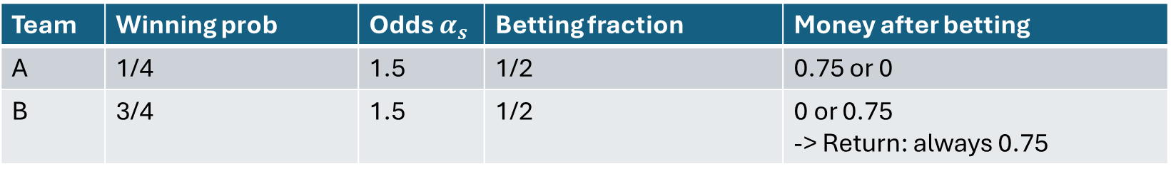
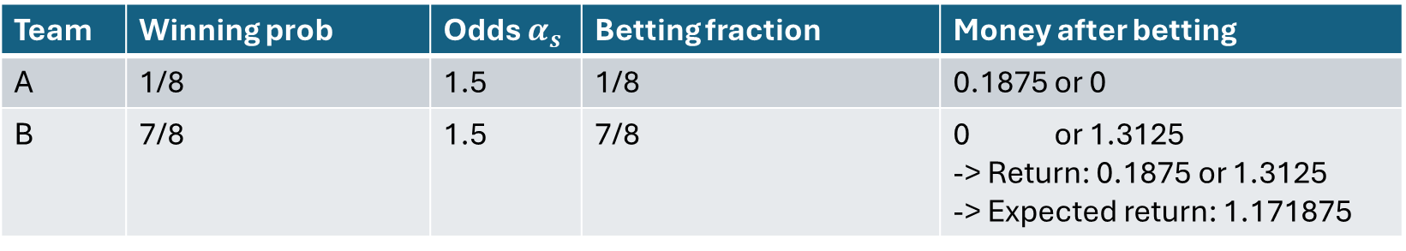
Implied Probability
Implied probability can be different from true probability (subfair example)
Team | Winning prob | Odds $α_{s}$ | Betting fraction | Money after betting
A | 1/4 | 1.5 | 1/2 | 0.75 or 0
B | 3/4 | 1.5 | 1/2 | 0 or 0.75 -> Return: always 0.75
Team | Winning prob | Odds $α_{s}$ | Betting fraction | Money after betting
A | 1/8 | 1.5 | 1/8 | 0.1875 or 0
B | 7/8 | 1.5 | 7/8 | 0 or 1.3125 -> Return: 0.1875 or 1.3125 -> Expected return: 1.171875

Slide 9
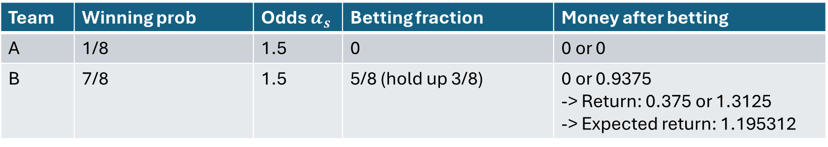
Implied Probability
Implied probability can be different from true probability (subfair example)
Team | Winning prob | Odds $α_{s}$ | Betting fraction | Money after betting
A | 1/4 | 1.5 | 1/2 | 0.75 or 0
B | 3/4 | 1.5 | 1/2 | 0 or 0.75 -> Return: always 0.75
Team | Winning prob | Odds $α_{s}$ | Betting fraction | Money after betting
A | 1/8 | 1.5 | 0 | 0 or 0
B | 7/8 | 1.5 | 5/8 (hold up 3/8) | 0 or 0.9375 -> Return: 0.375 or 1.3125 -> Expected return: 1.195312

Slide 10

Implied Probability
Superfair odds does not guarantee an expected winning
Team | Winning prob | Odds $α_{s}$ | Betting fraction | Money after betting
A | 1/4 | 3 | 1/2 | 1.5 or 0
B | 3/4 | 3 | 1/2 | 0 or 1.5 -> Return: always 1.5
Team | Winning prob | Odds $α_{s}$ | Betting fraction | Money after betting
A | 1/4 | 3 | 7/8 | 21/8 or 0
B | 3/4 | 3 | 1/8 | 0 or 3/8 -> Return: 2.625 or 0.375 -> Expected return: 0.9375

Slide 11
Insights
Odds reflects the bookies’ estimates of winning probability.
The difference between the estimated probability and the true probability gives us an opportunity to earn money.
Insights for a good betting strategy:
Proportional betting
Hold up some money
Find opportunities for arbitrage betting

Slide 12
Betting Strategies

Slide 13
Betting Strategies
Random betting
Bet on the most favorable only
Bet on the least favorable only
Bet according to Kelly criterion

Slide 14
Data Set 1
Betting options: Team 1 win; Team 2 win
14906 games (Basketball)
1398 (9.4%) games with superfair odds
13508 (90.6%) games with fair or subfair odds
Home Team | Median Odds of Home Team | Median Odds of Away Team
Win | 1.53 | 2.65
Lose | 2.50 | 1.59

Slide 15
Probability Estimates
Contrary to theoretical setting, we do not know the probability of each outcome. Therefore, we need to estimate it using (normalized) implied probability. 3 strategies:
“Single prob”: only highest odds for each outcome is considered. Probabilities are estimated as the implied probability of this single odds observation.
“Mean prob”: odds from different bookies give multiple observations of (normalized) implied probabilities, we take the mean as the estimate
“Median prob”: same as above, but we take the median and re-normalize

Slide 16
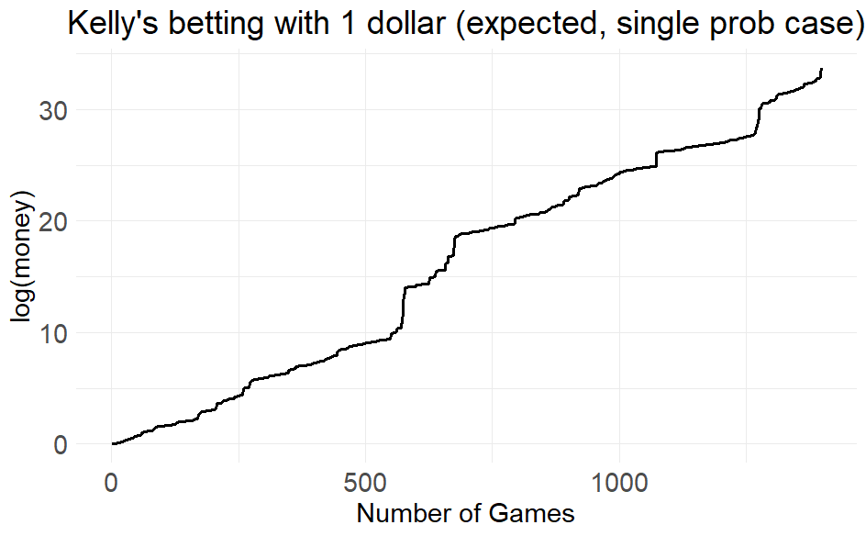
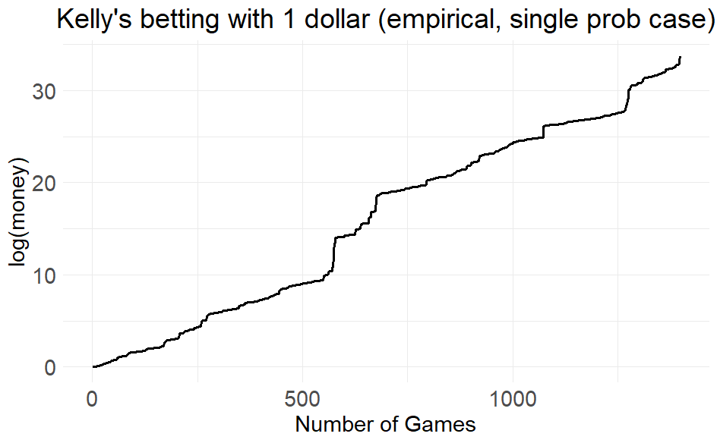
Superfair odds
Strategy | Implied Prob | Expected Median Return | Expected Money Amount | Empirical Median Return | Empirical Money Amount
Kelly | Single Prob | 1.005950 | 4.5 e+14 | 1.005950 | 4.5 e+14
With superfair odds and “Single Prob” estimates, Kelly Strategy reduces to Arbitrage Betting: returns are deterministic

Slide 17
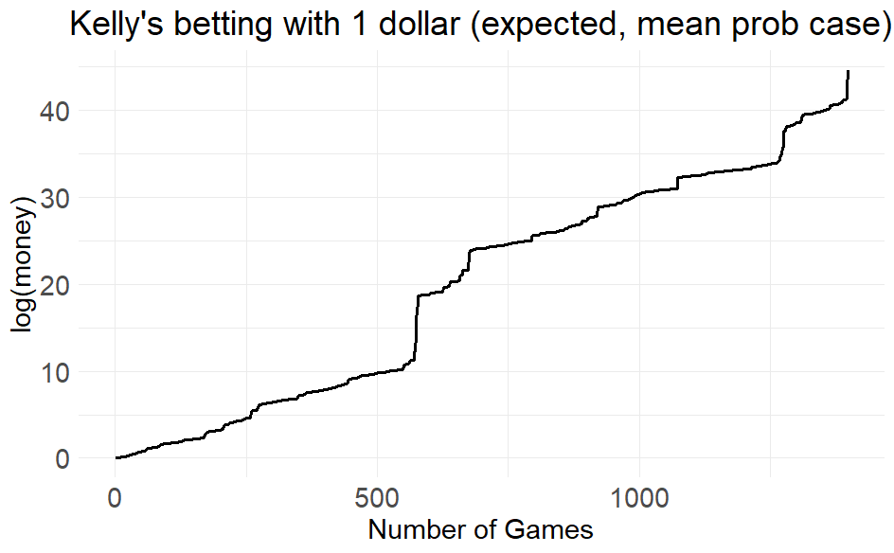
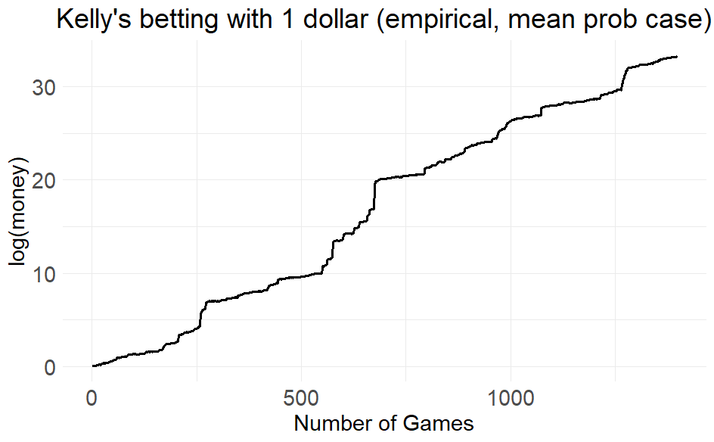
Superfair odds
Strategy | Implied Prob | Expected Median Return | Expected Money Amount | Empirical Median Return | Empirical Money Amount
Kelly | Mean Prob | 1.006602 | 2.5 e+19 | 1.0043205 | 2.9 e+14

Slide 18
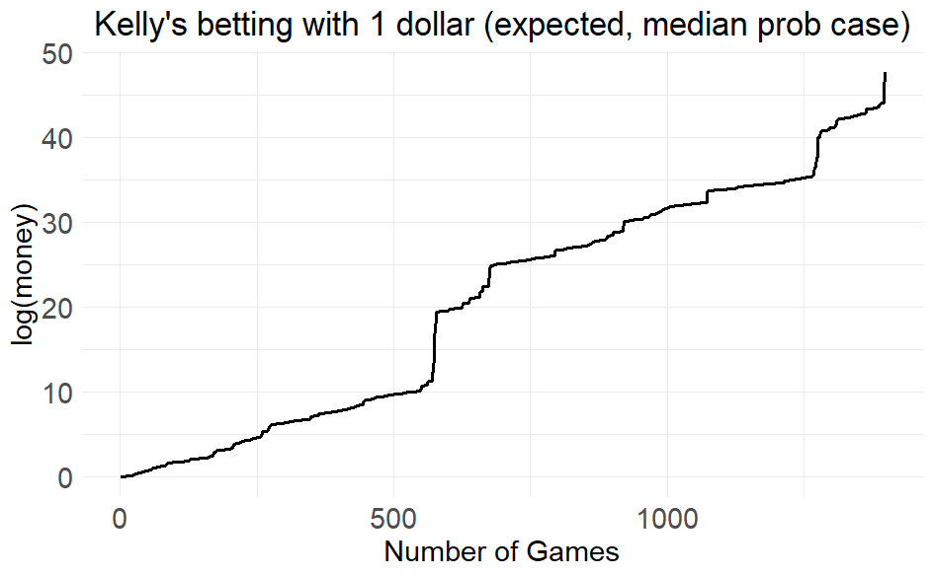
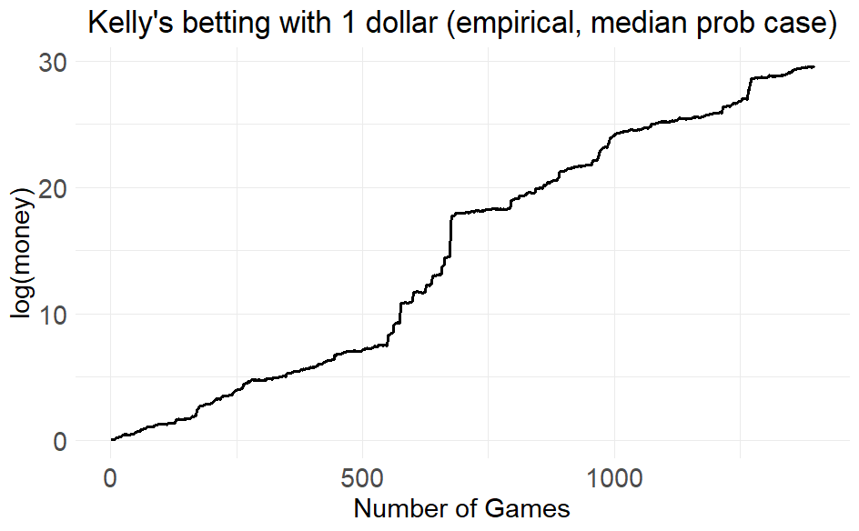
Superfair odds
Strategy | Implied Prob | Expected Median Return | Expected Money Amount | Empirical Median Return | Empirical Money Amount
Kelly | Median Prob | 1.057374 | 5.5 e+20 | 1.0033943 | 6.4 e+12

Slide 19
Superfair odds
Strategy | Implied Prob | Expected Median Return | Expected Money Amount | Empirical Median Return | Empirical Money Amount
Kelly | Single Prob | 1.005950 | 4.5 e+14 | 1.005950 | 4.5 e+14
Kelly | Mean Prob | 1.006602 | 2.5 e+19 | 1.0043205 | 2.9 e+14
Kelly | Median Prob | 1.057374 | 5.5 e+20 | 1.0033943 | 6.4 e+12
Most Favorable (betting frac: 0.5) | Single Prob | 1.002975 | 7.1 e+7 | 1.145 Two Modes | 2.9 e-70
Least Favorable (betting frac: 0.08) | Single Prob | 1.000476 | 23.0 | 0.92 Right Skewed | 8.9
Random | Single Prob | 1.005950 | 4.5 e+14 | 0.925 | 1.1 e-23

Slide 20
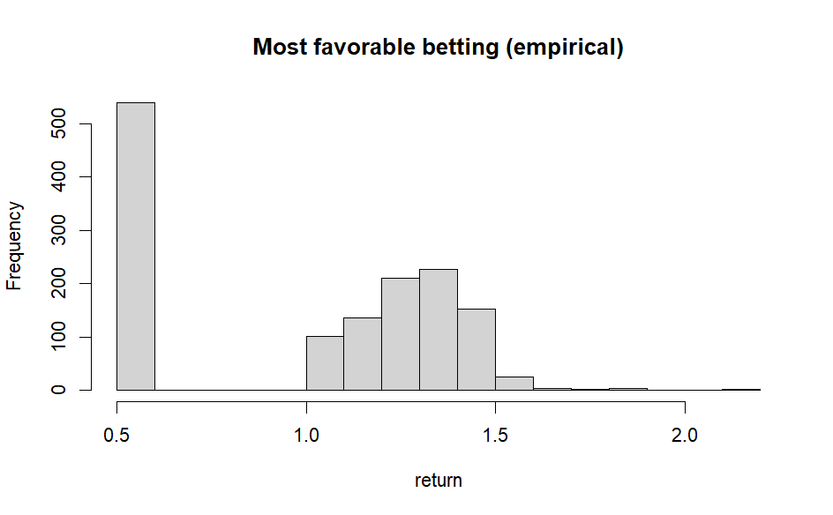
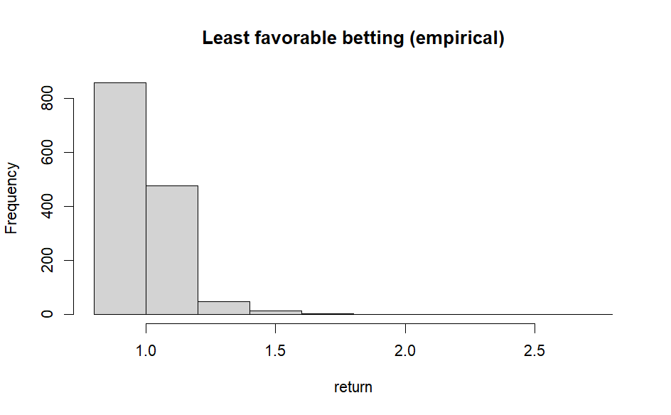

Slide 21
Superfair odds (with betting restriction)
Minimum amount to bet: 1 dollar
Maximum amount to bet: 10,000 dollars
Unit: 5 cents
Initial money: 10 dollars

Slide 22
Superfair odds (with betting restriction)
Strategy | Implied Prob | Expected Median Return | Expected Money Amount | Empirical Median Return | Empirical Money Amount
Kelly | Single Prob | 1.000793 | 650768 | 1.0016535 | 976194
Kelly | Mean Prob | 1.000721 | 1559826 | 0.9991383 | 957754
Kelly | Median Prob | 1.000734 | 1617053 | 0.9991376 | 958503
Most Favorable (betting frac: 0.5) | Single Prob | 1.000948 | 254581 | 1 | 1.96
Least Favorable (betting frac: 0.3) | Single Prob | 1.001481 | 147739 | 1 | 2.45
Random | Single Prob | 1.000786 | 654256 | 1 | 1.72
Notes:
Kelly – single prob – expected mean return is smaller than “Kelly mean prob” and “Kelly median prob”
The empirical mean return for “Kelly mean prob” and “Kelly median prob” >1
Random betting: Fall below 1 dollar -> don’t bet anymore

Slide 23
Fair and Subfair Odds
Strategy | Implied Prob | Expected Mean Return | Expected Money Amount | Empirical Mean Return | Empirical Money Amount
Kelly | Single Prob | 1 | 1 | 1 | 1 (didn’t bet)
Kelly | Mean Prob | 1.000166 | 9.4 | 0.9999781 | 0.28
Kelly | Median Prob | 1.000174 | 10.4 | 0.9999472 | 0.18

Slide 24
Data Set 2
Betting options: Team 1 win; Team 2 win; Tie
479440 games (Soccer 2005-2015)
70509 (15%) games with superfair odds
408931 (85%) games with fair or subfair odds
Randomly select 10,000 games (1497/10000 are superfair games)
Home Team | Median Odds of Home Team | Median Odds of Away Team | Median Odds of Draw
Win | 1.94 | 4.25 | 3.60
Lose | 2.60 | 2.80 | 3.50
Draw | 2.25 | 3.41 | 3.47

Slide 25
Superfair odds (with betting restriction)
Strategy | Implied Prob | Expected Mean Return | Expected Money Amount | Empirical Mean Return | Empirical Money Amount
Kelly | Single Prob | 1.008026 | 966900 | 1.011387 | 429544
Kelly | Mean Prob | 1.008818 | 2202314 | 1.013908 | 489894
Most Favorable (betting frac: 0.5) | Single Prob | 1.007039 | 264806 | 0.999855 | 1.90
Least Favorable (betting frac: 0.3) | Single Prob | 1.006612 | 159567 | 0.9992174 | 2.50
Random | Single Prob | 1.008651 | 2349244 | 0.9993194 | 1.71
Notes:
Most favorable / least favorable – bet only one win or lose, never for a tie

Slide 26
Fair and Subfair Odds
Strategy | Implied Prob | Expected Mean Return | Expected Money Amount | Empirical Mean Return | Empirical Money Amount
Kelly | Single Prob | 0.9541276 | 4.2 e-176 | 0.9541276 | 4.2 e-176
Kelly | Mean Prob | 0.9553148 | 1.3 e-171 | 0.9534331 | 1.1 e-180
Notes:
This is because there many games with fair odds. When our estimation of the probability is poor, we lose money even in games with fair odds.

Slide 27
Summary
Best strategy: betting according to Kelly’s criterion
The gain relies heavily on the estimated probability of winning.
Most profits come from games with superfair odds.
Don’t bet on games with fair or subfair odds when the estimated probability of winning is inaccurate.

Slide 28
Possible future development
With longitudinal data, we could determine which bookies (if any) typically “get odds right”. Then, we could assign a weight to new observed odds base on the bookie’s historical performance. Probability estimates would then be a weighted mean of observations.

Slide 29
References
Cover, Thomas M., and Joy A. Thomas. Elements of Information Theory. John Wiley & Sons, 1991.
Kelly, J. L. “A new interpretation of information rate.” Bell System Technical Journal, vol. 35, no. 4, July 1956, pp. 917–926, https://doi.org/10.1002/j.1538-7305.1956.tb03809.x.

Slide 30
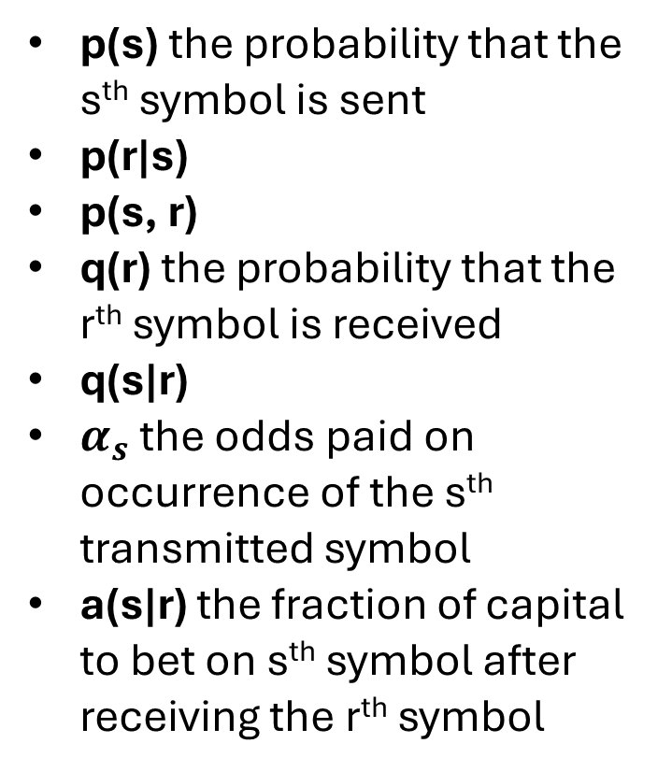
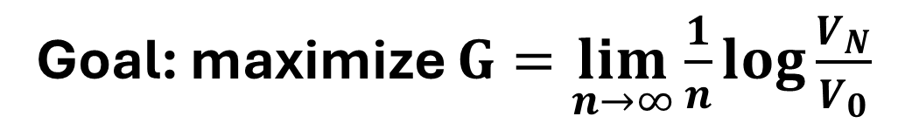
Sender
Receiver
Channel
p(s) the probability that the s^{th} symbol is sent
p(r|s)
p(s, r)
q(r) the probability that the r^{th} symbol is received
q(s|r)
$α_{s}$ the odds paid on occurrence of the s^{th} transmitted symbol
a(s|r) the fraction of capital to bet on s^{th} symbol after receiving the r^{th} symbol
X = 0
X = 1
Y = 0
Y = 1
Goal: maximize $G=\lim_{n→∞}{\frac{1}{n}\log{\frac{V_{N}}{V_{0}}}}$
Notes:
G_max is the rate of transmission

Slide 31
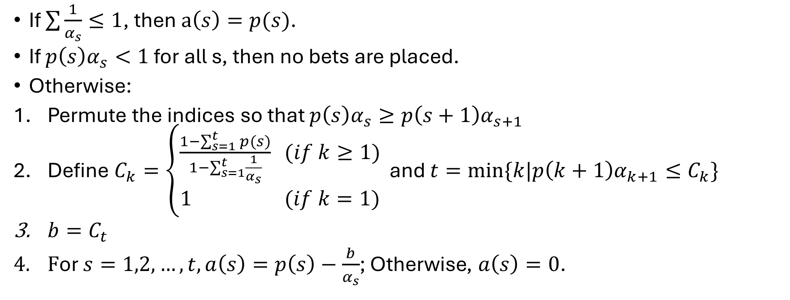
General solution
If $\sum{\frac{1}{α_{s}}≤1}$, then $a\left(s\right)=p(s)$.
If $p\left(s\right)α_{s}<1$ for all s, then no bets are placed.
Otherwise:
Permute the indices so that $p\left(s\right)α_{s}≥p\left(s+1\right)α_{s+1}$
Define $C_{k}=\left\{\begin{aligned}\frac{1−\sum_{s=1}^{t}{p(s)}}{1−\sum_{s=1}^{t}{\frac{1}{α_{s}}}} (if k≥1) \\ 1 (if k=1)\end{aligned}\right.$ and $t=min⁡\{k|p\left(k+1\right)α_{k+1}≤C_{k}\}$
$b=C_{t}$
$\text{F}\text{or} s=1,2,…,t, a\left(s\right)=p\left(s\right)−\frac{b}{α_{s}}$; Otherwise, $a\left(s\right)=0$.

Slide 32
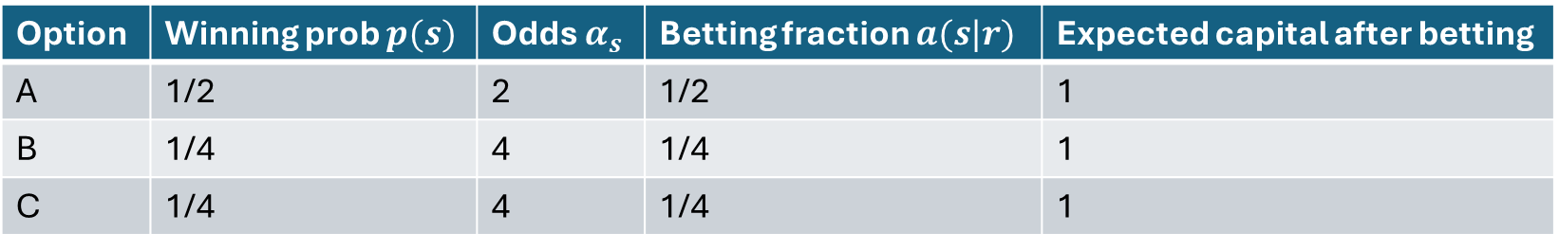
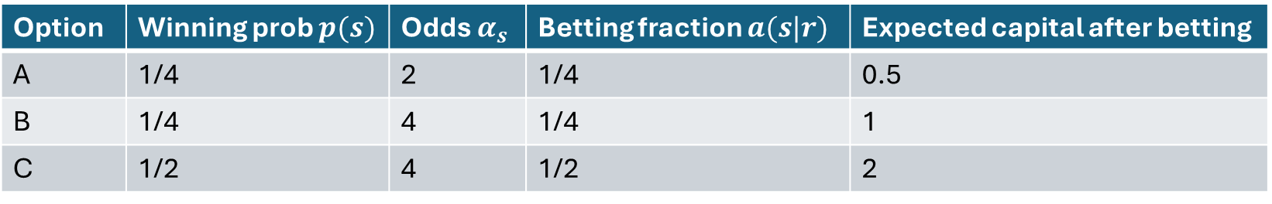
Fair odds
Option | Winning prob $p(s)$ | Odds $α_{s}$ | Betting fraction $a(s|r)$ | Expected capital after betting
A | 1/2 | 2 | 1/2 | 1
B | 1/4 | 4 | 1/4 | 1
C | 1/4 | 4 | 1/4 | 1
Money after betting : $1∗\frac{1}{2}+1∗\frac{1}{4}+1∗\frac{1}{4}=1$
Option | Winning prob $p(s)$ | Odds $α_{s}$ | Betting fraction $a(s|r)$ | Expected capital after betting
A | 1/4 | 2 | 1/4 | 0.5
B | 1/4 | 4 | 1/4 | 1
C | 1/2 | 4 | 1/2 | 2
Money after betting: $0.5∗\frac{1}{4}+1∗\frac{1}{4}+2∗\frac{1}{2}=1.375$

