Slide 1

Introduction to
Computer
Science
Full NAME: Alejandro Suarez
project’s title: Prima Wrap Product Label Printing
GitHub and edX: alepodj
city and country: Niagara Falls, ON, Canada
Date: 27/12/2024
CS50

Slide 2

Hello CS50!
I want to share a story about how a simple application transformed the way a small company manages their inventory.
Hello CS50!
I would like to share a story about how a simple application changed the way a small company manages their inventory.
Prima Wrap, is a family-owned business in Niagara Falls, Ontario, Canada. For years, they relied on an old Microsoft Access app that had been created long ago for inventory and label printing. While it served its purpose, it was becoming increasingly difficult to manage their expanding SKU database and print labels for their inventory system.
As a friend of the family, i found out about this predicament and decided to create a modern application tailored to their needs. Using a combination of JavaScript, HTML, CSS, and Python, I developed an application that connects directly to their product SKU database and with just a few clicks, they can now print labels using ZPL, streamlining their inventory management process. No more manual data entry, unless absolutely necessary or printing errors. Each label includes essential information about the product, such as its name, SKU, and prices. In essence, this application has become an indispensable tool for Prima Wrap, allowing them to focus on selling their unique products.
In the search of a final project idea for CS50, this opportunity presented itself and there's nothing more rewarding than knowing that it has made a positive impact on a business, especially being able to apply previous and current knowledge acquired on CS50 training, in the real world

Slide 3
Core Technologies
HTML5
CSS3
JavaScript
Basic Structure
Visuals
Frontend Logic
Python3
SQL
ZPLII
Backend Logic
Data
Printing

Slide 4

Python Eel Library
Eel is a little Python library for making simple Electron-like offline HTML/JS GUI apps, with full access to Python capabilities and libraries.
Eel hosts a local webserver, then lets you annotate functions in Python so that they can be called from JavaScript and vice versa.
Eel is designed to take the hassle out of writing short and simple GUI applications. If you are familiar with Python and web development, Eel is rather simple yet powerful
https://github.com/python-eel/Eel

Slide 5

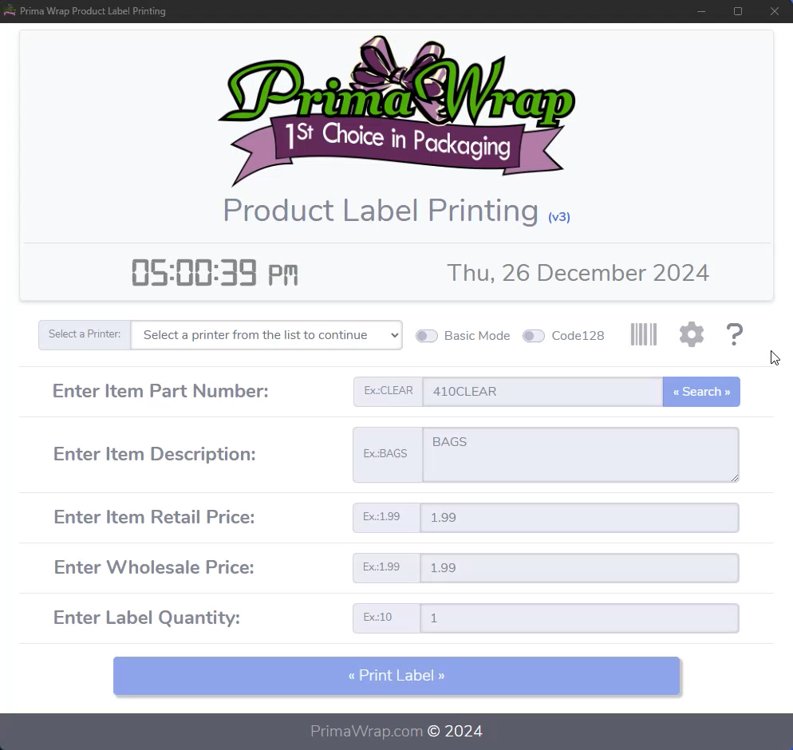
Features (1)
₋
Ease of use and tailored self-support with a descriptive tour feature that walks the user through the application

Slide 6
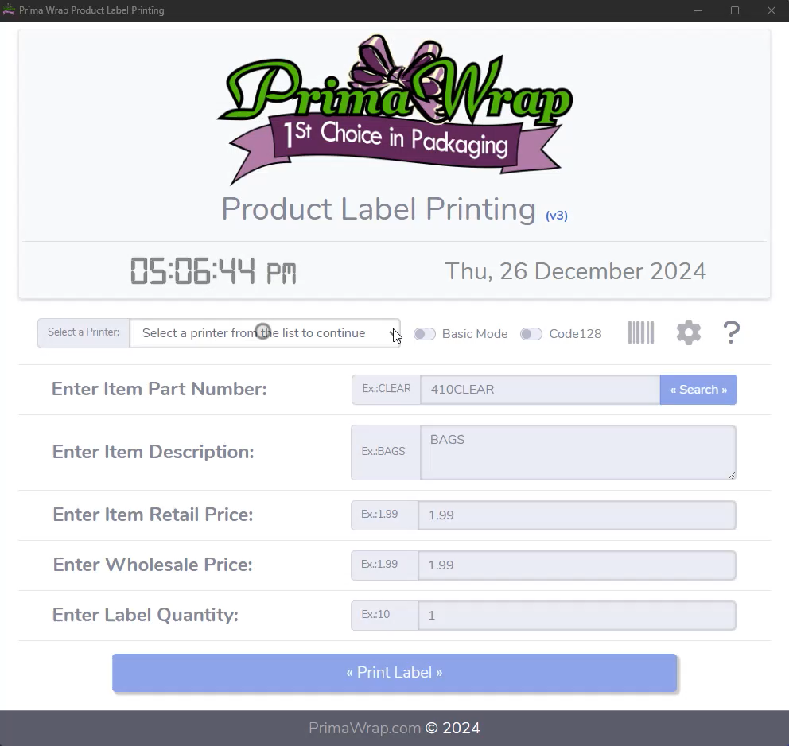
Features (2)
₋
Basic and Expert modes to provide flexibility to all kind of users, but also to make the application smarter overall

Slide 7
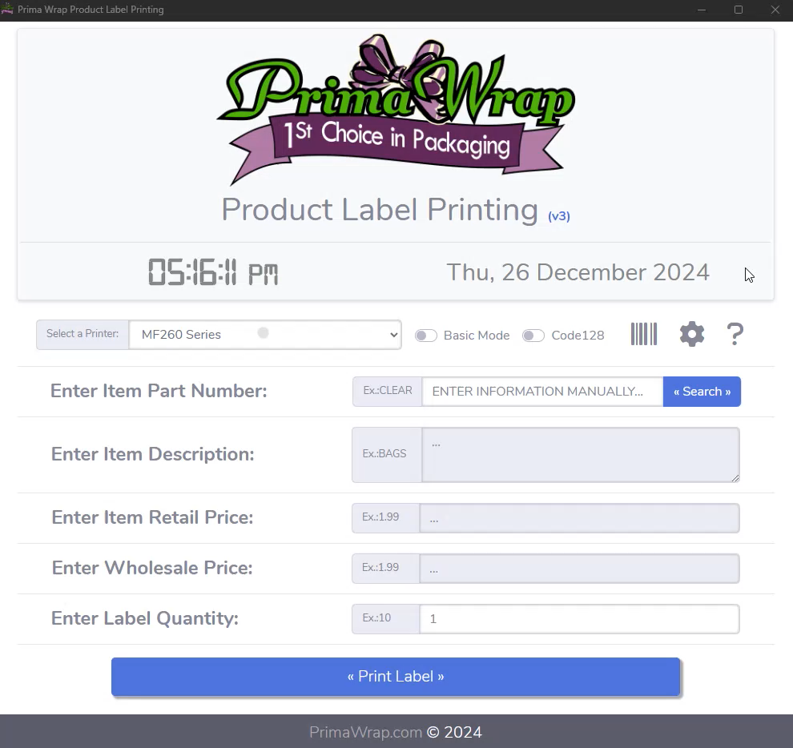
Features (3)
₋
Expert ZPL-PNG-ZPL mode, this provides even more freedom of use and an advance feature for unique scenarios

Slide 8
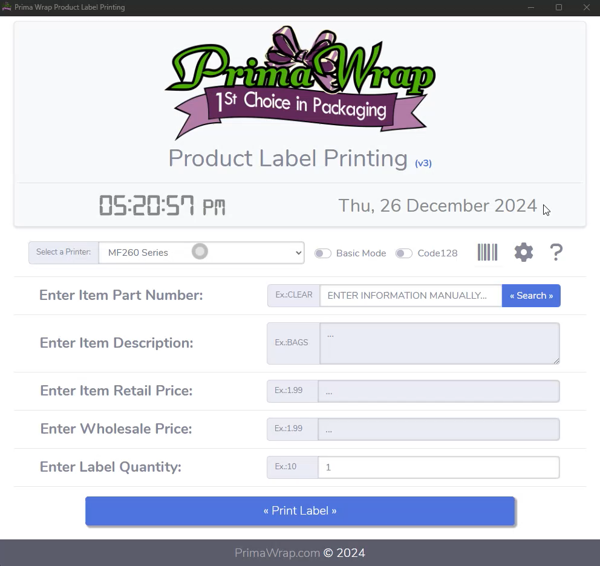
Features (4)
₋
Self-support via Settings, providing the user with one click troubleshooting options using the power of ZPLII commands

Slide 9
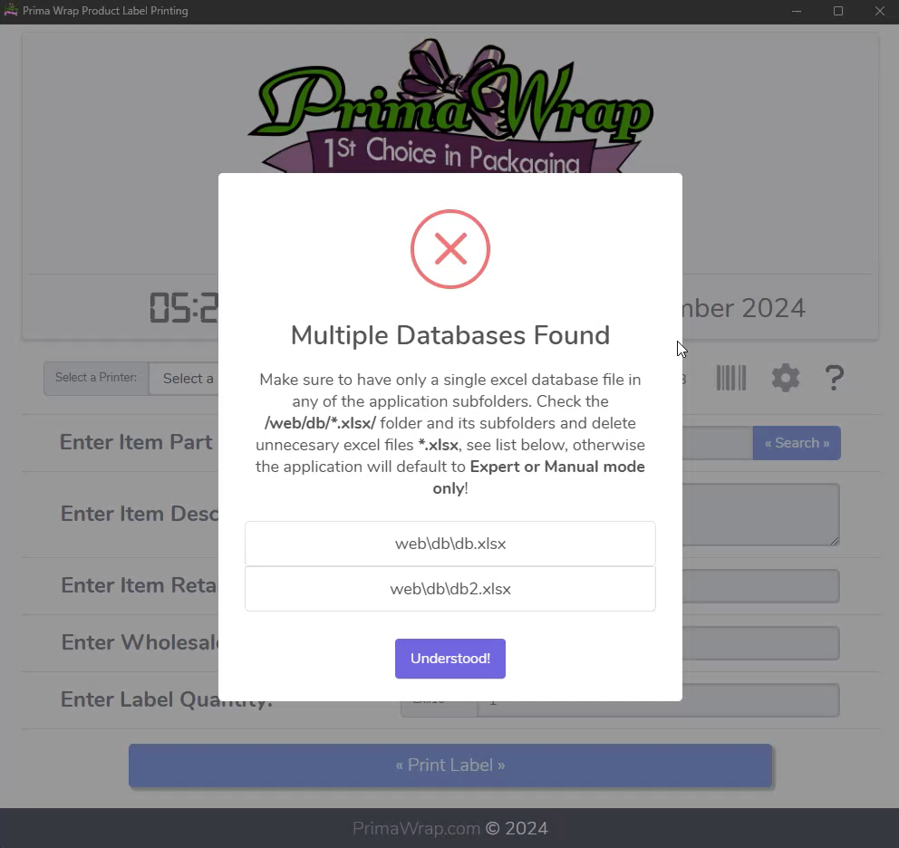
Features (5)
₋
Friendly error handling and seamless fallbacks, provide the user clear indications and path forward during issues

Slide 10
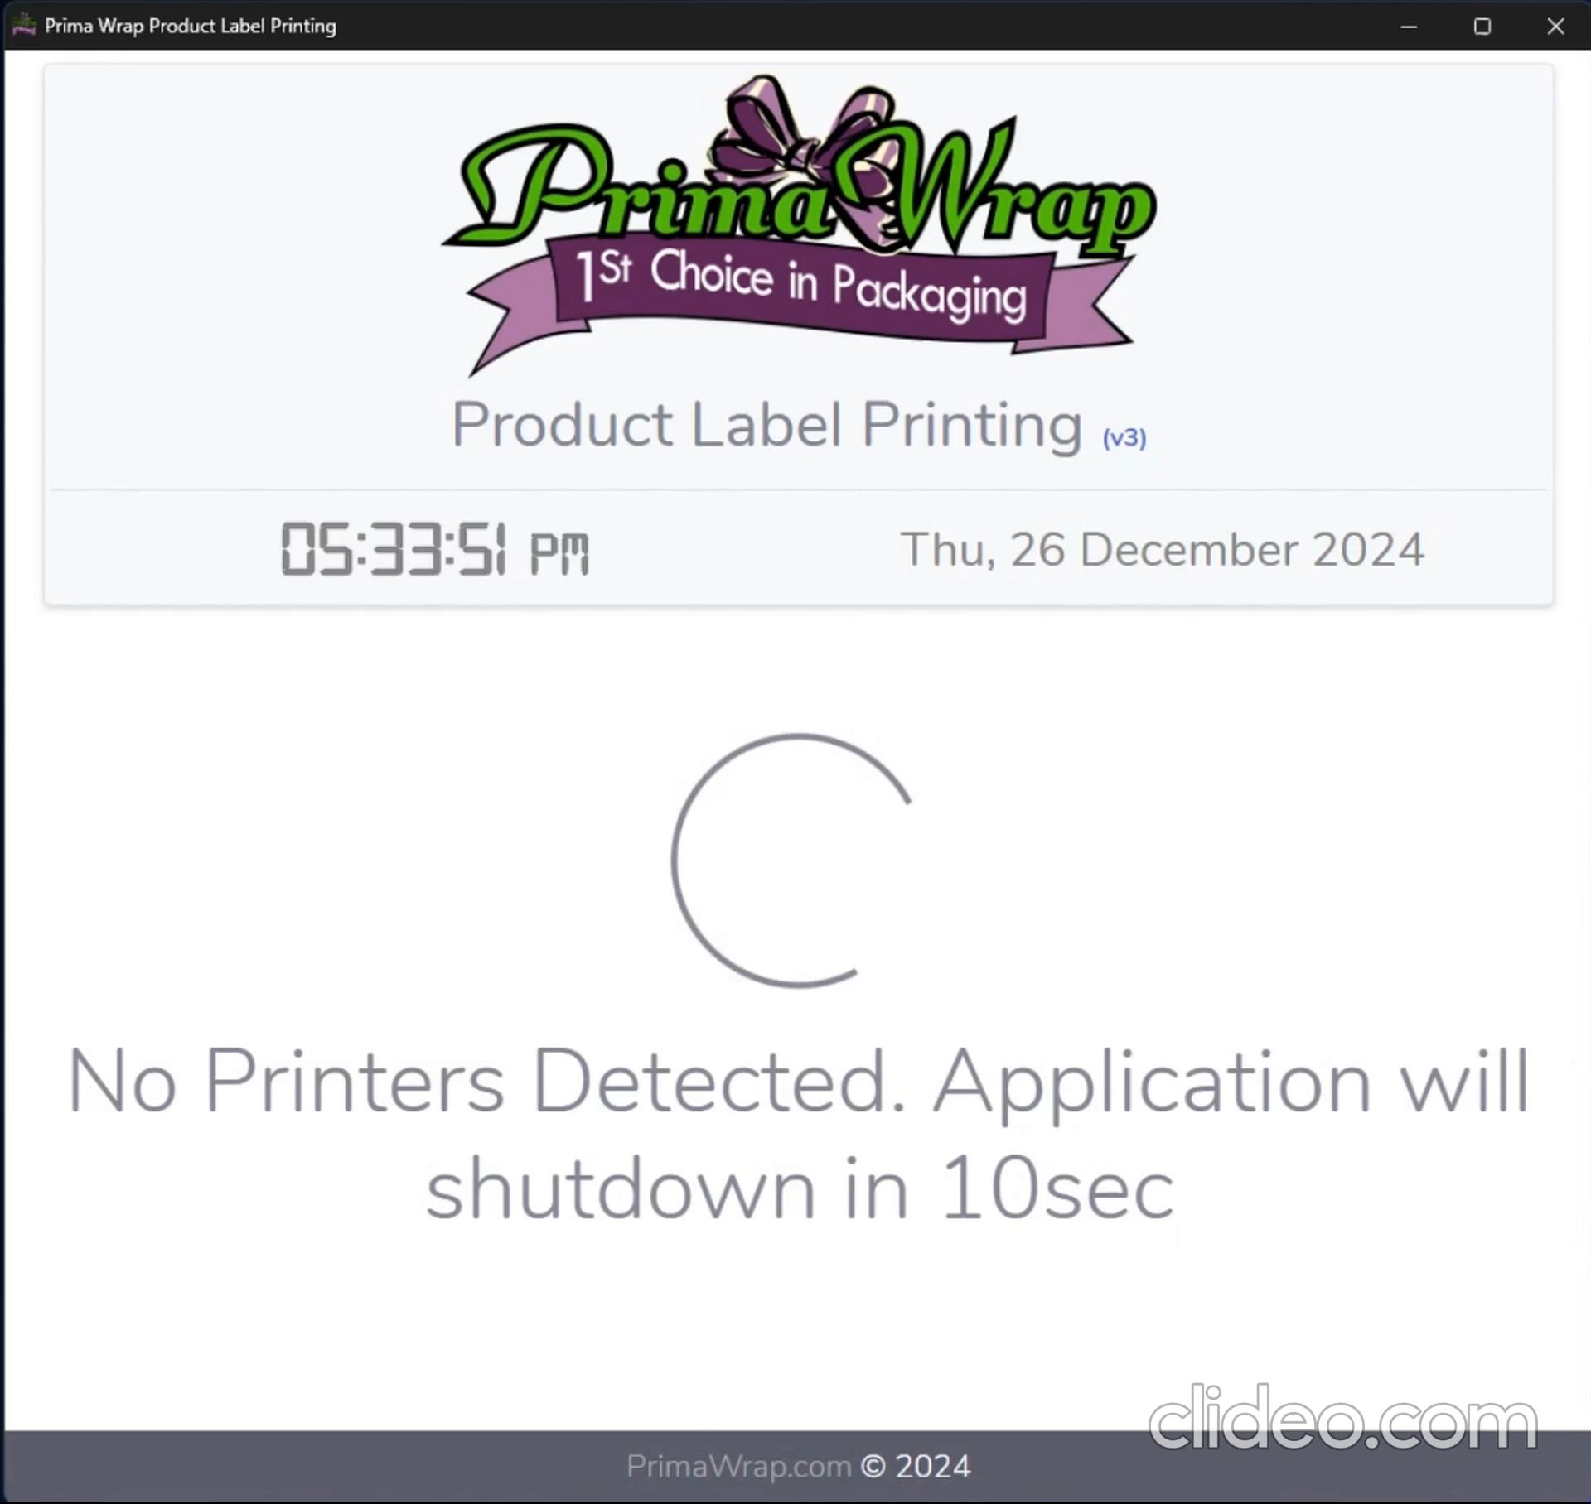
Features (6)
₋
Critical error handling and seamless fallbacks, provide the user clear indications and path forward during issues

Slide 11
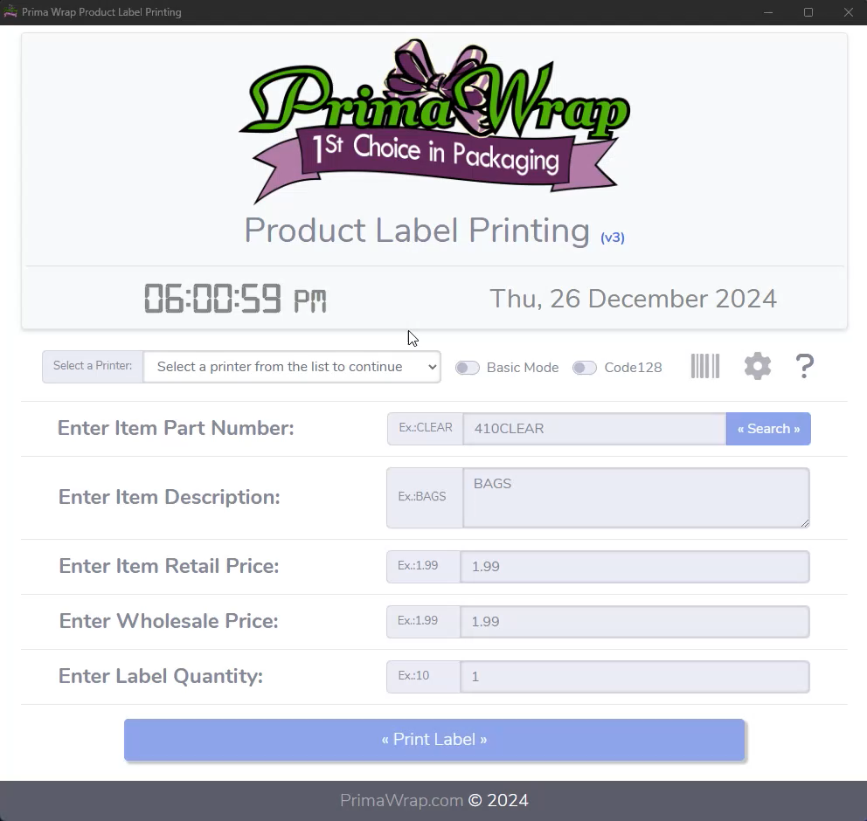
Features (7)
₋
Auto-magically creating suggestions as the user types and auto-populating fields if they exist, or fallback to manual

Slide 12
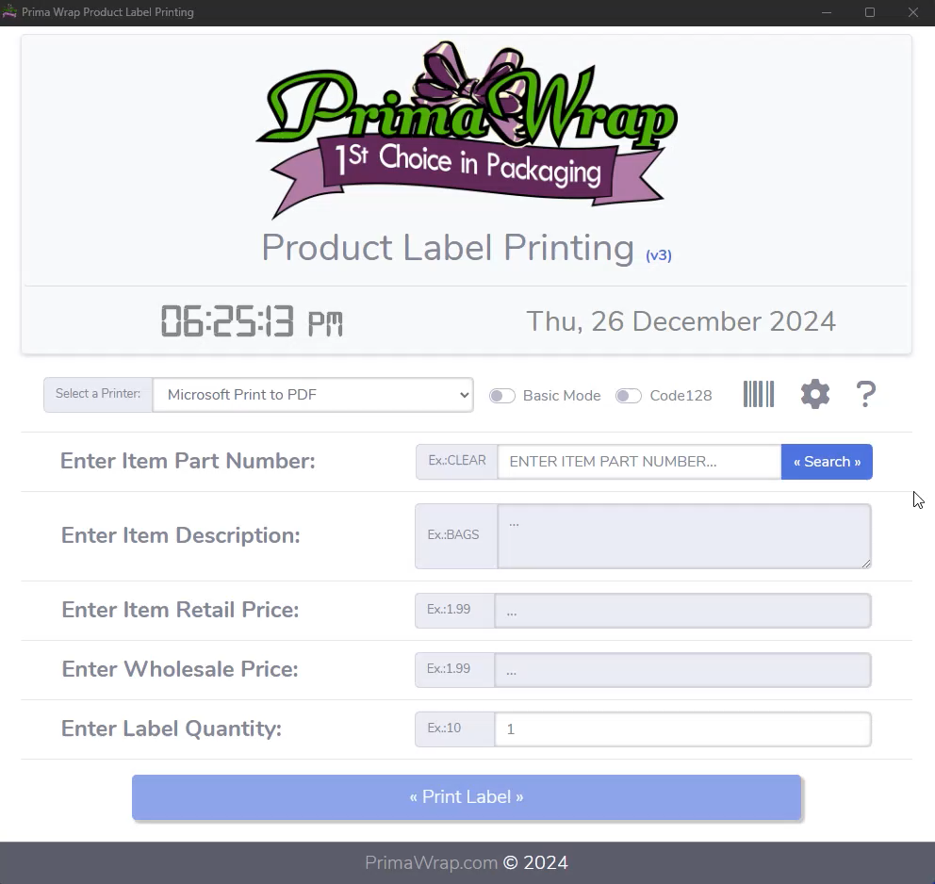
Features (8)
₋
Feedback driven error checking with clear user guidance to avoid any guessing or confusion

Slide 13

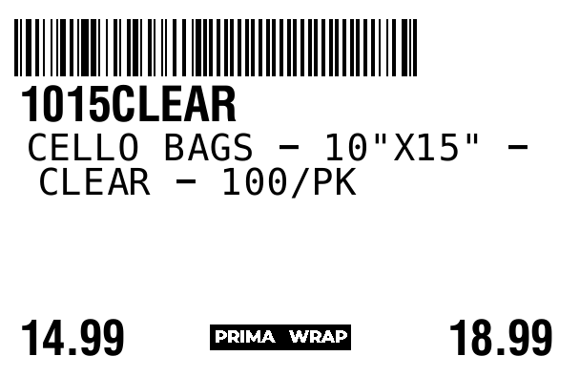
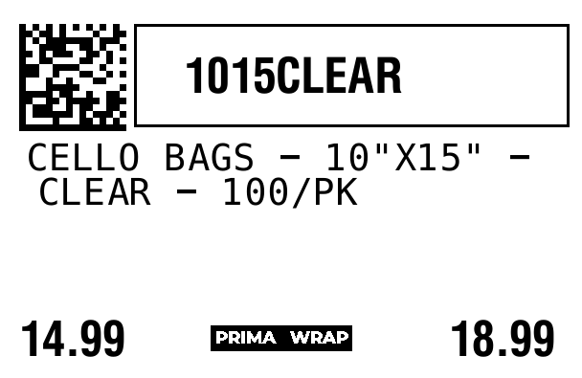
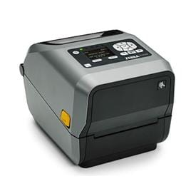
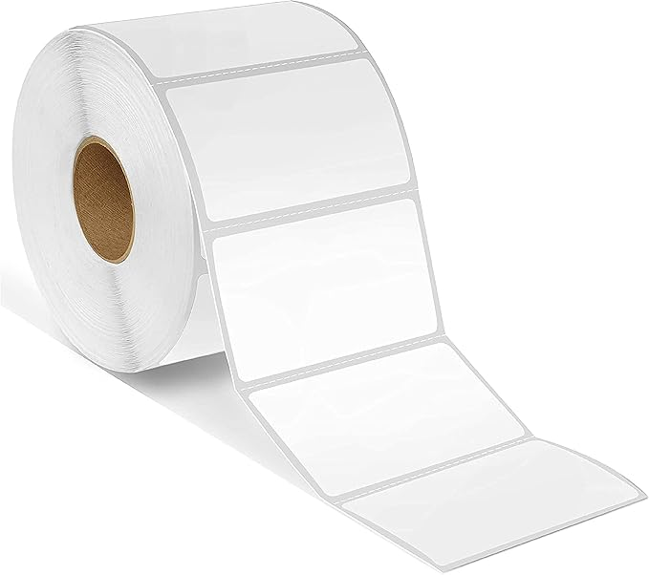
Results
₋
A simple output can sometimes solve a big problem. Sample labels in the 2 barcode modes created using ZPLII.
Code128 Data Matrix
₋
Using a Zebra ZD-620-43 and 2.25inx1.75in Direct Thermal labels, the labels above managed to simplify inventory significantly reducing costs

Slide 14

Thank
You

