Slide 1
Classification of waste materials in very-high-resolution satellite imagery
State of the art and thesis proposal
Alessandro Potenza · M.Sc. Computer Science and Engineering, AI · PERIVALLON

Slide 2
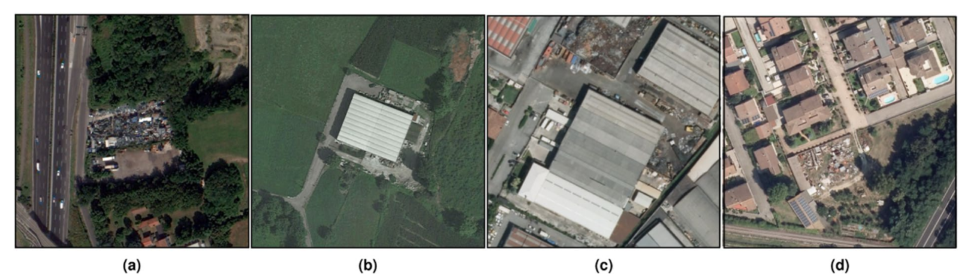
Context
Illegal waste dumping is an environmental crime with direct public-health consequences. Agencies (ARPA) have limited inspection capacity, and priority depends on what is dumped: rubble, plastics and asbestos-cement imply very different hazards.
Detecting dump sites from images is mature. Recognising the material is not: the reference survey (50 works, 1987-2023, almost all RGB) marks it as an open problem.
One thesis in the group has addressed material classification directly (Alari 2024). This work starts from there.
2
Images: AerialWaste positive examples, Torres and Fraternali 2023 (CC BY 4.0) · survey: Fraternali et al. 2024

Slide 3
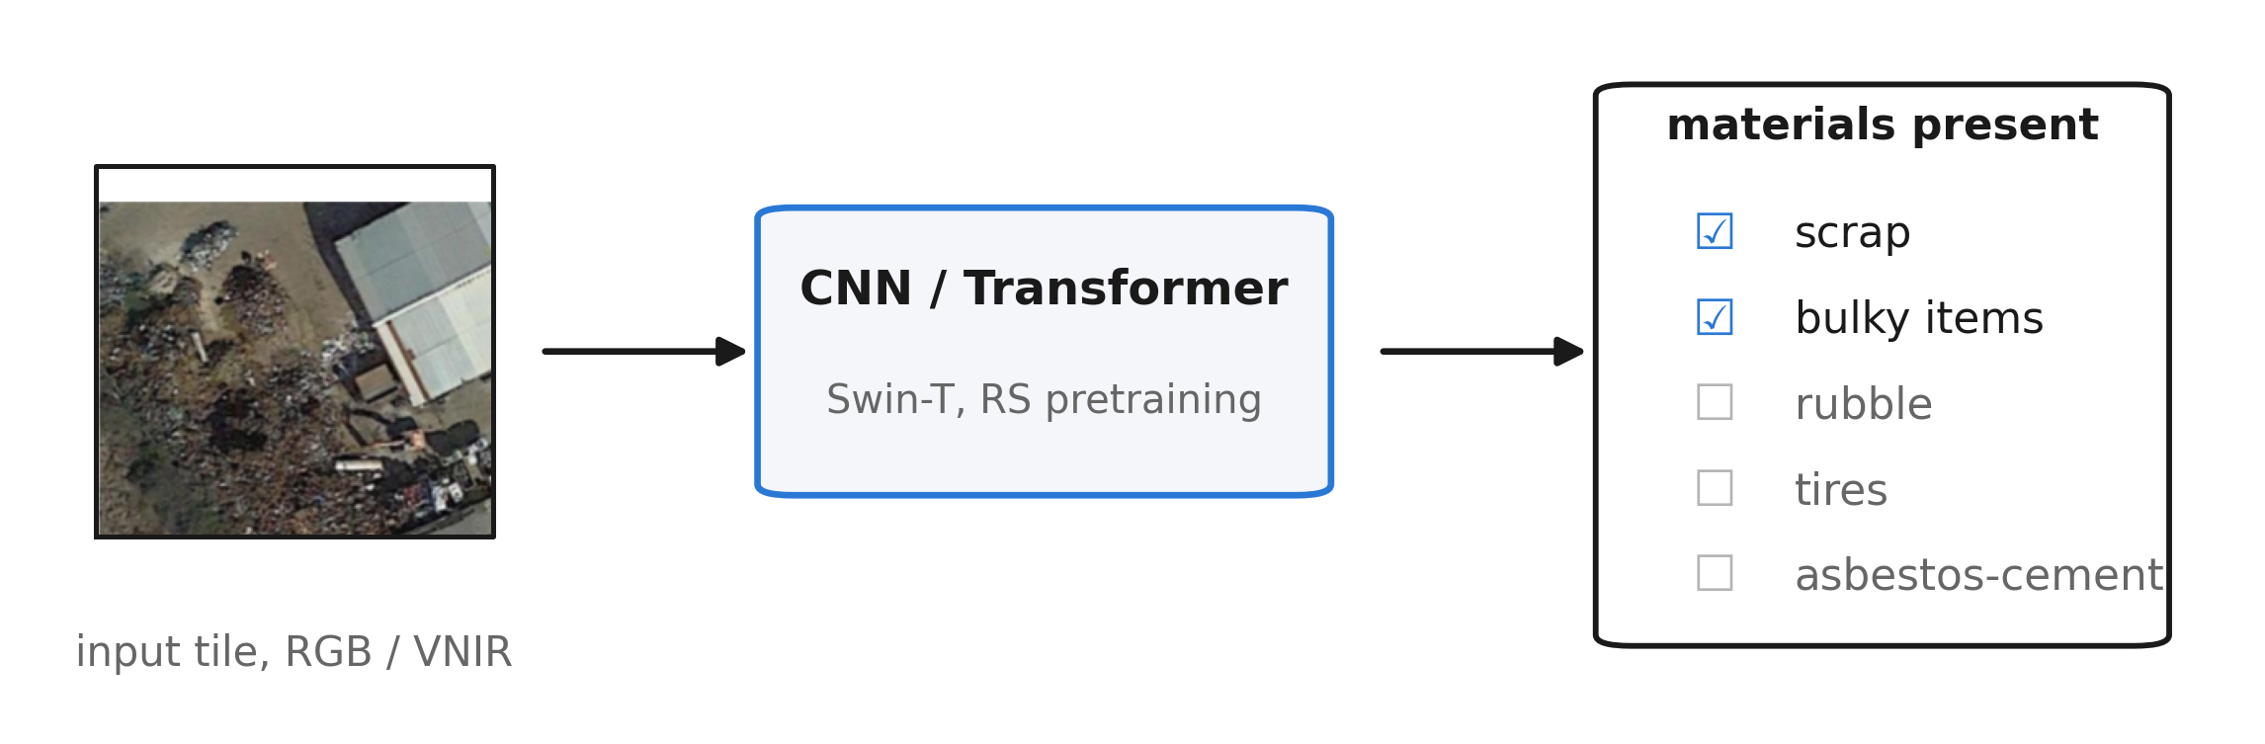
Task definition
Task: multi-label classification of waste materials in satellite images, at image level.
Input: VHR optical imagery, GSD 0.2 to 1.3 m (aerial RGB baseline; satellite VNIR arm, up to 8 bands). SWIR excluded: not in the planned acquisitions, and its 3.7 m GSD does not match the task. Sentinel-2 excluded: too coarse.
Technique: classification, not detection or segmentation. Annotations are image-level (Alari 2024: 11,477 multi-label); waste piles have no stable shape for boxes; no masks exist.
Research question: does VNIR input improve waste-material classification over RGB, and for which materials?
3
Annotations: Alari 2024 · imagery: WorldView-3, Pléiades Neo (VNIR + pan) · tile: Alari 2024

Slide 4
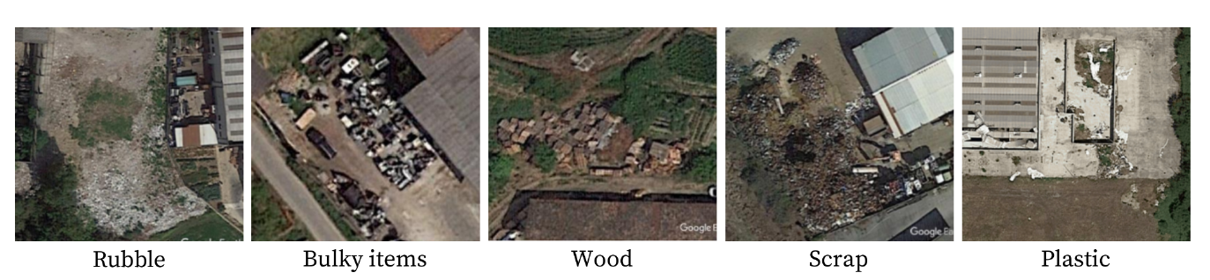
Materials: which are considered and why
Material | Target | Spectral analysis | Reason
Rubble, plastic, wood, tires | yes | yes | frequent and confusable in RGB
Asbestos-cement | yes | yes, dedicated pilot | public regional ground truth (WFS)
Vehicles, tanks, containers, scrap, bulky, big bags | yes | no | shape-based; RGB sufficient in literature
Sludge, foundry waste | yes | no | few labels; visually ambiguous at this GSD
4
13 categories, taxonomy and samples from Alari 2024 (politesi 10589/230633). Band ablation focuses on the ambiguous subset.

Slide 5
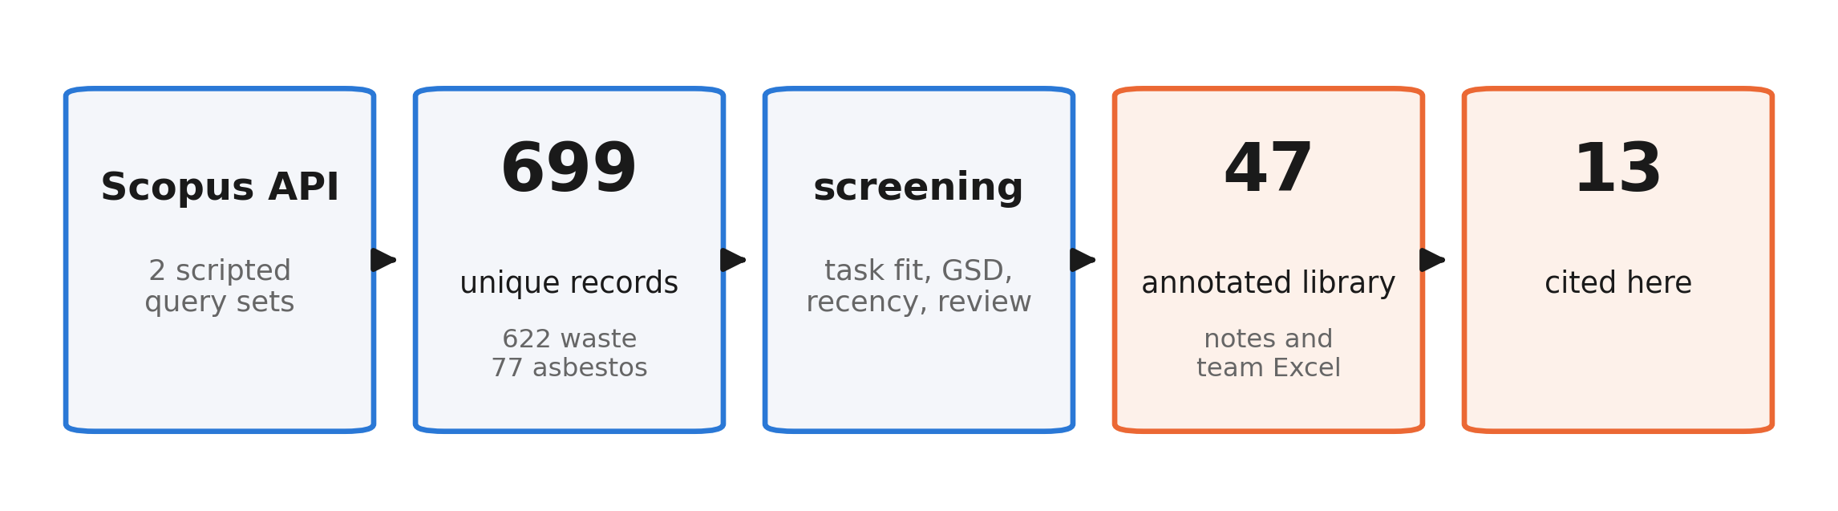
Literature search: method and numbers
Scripted queries on the Scopus API (waste detection in remote sensing; asbestos roof mapping), deduplication, manual screening with explicit criteria, snowballing from the Fraternali 2024 survey and the Alari 2024 references.
5
Search artifacts: papers/literature_search (queries, raw and deduplicated records) · library: papers/notes

Slide 6
Related work: site-level waste detection
Work (year) | Input / GSD | Task | Method | Result
Gibellini 2025 | aerial RGB, 20 cm | classification | Swin-T, RSP pretraining | F1 92.0; cross-region -5.1
Disaitek 2024 | Pléiades Neo, 30 cm | detection | operational service | ~95% on sites >2 m2 (vendor)
CascadeDumpNet 2024 | Pléiades, 50 cm | object detection | two-stage CNN + AutoML | mAP 84.6, cross-city transfer
Sun 2023 | VHR RGB, 0.3-1 m | object detection | BCA-Net (Faster R-CNN) | ~2,500 dumpsites, 28 cities
CWLD 2024 | GF-2 + GE, 0.5-0.8 m | segmentation | DeepLabV3+ variant | F1 88.9, construction waste
AerialWaste, Torres 2023 | aerial RGB, 20-50 cm | dataset + cls. | ResNet-FPN baseline | F1 80.7; 22 material tags
6
All RGB. They answer where a site is, not what it contains. Disaitek is a vendor figure.

Slide 7
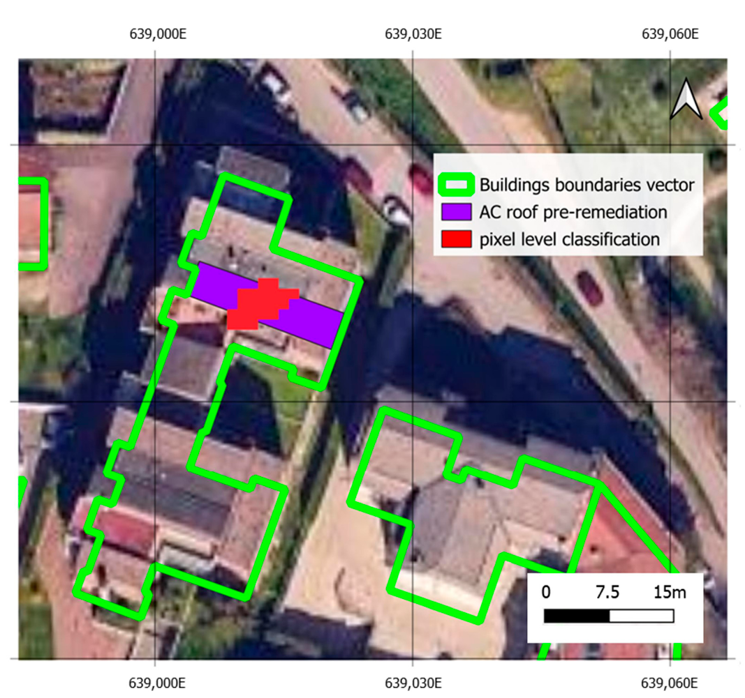
Related work: material-level classification
Work (year) | Input / GSD | Task | Result
Alari 2024 (PoliMi) | satellite RGB | multi-label cls. | wF1 69.2 (5 cat.), 59.4 (10 cat.)
Saba 2026 | WV-3 VNIR, 1.24 m | pixel cls. | asbestos, Macro-F1 97.6
Bonifazi 2026 | WV-3 VNIR+SWIR | pixel cls. | asbestos roofs, removal tracking
Abbasi 2024 | aerial RGB | OBIA cls. | asbestos, OA ~96 (shape + time)
Cilia 2015 | airborne HSI, 3 m | pixel cls. | asbestos, PA 89 / UA 86
One multi-material predecessor (Alari). The rest is asbestos only. Right: building-level asbestos classification on WorldView-3 (Bonifazi 2026).
7
Saba and Abbasi: paywalled or preprint · image: Bonifazi et al. 2026, Geomatics (CC BY 4.0)

Slide 8
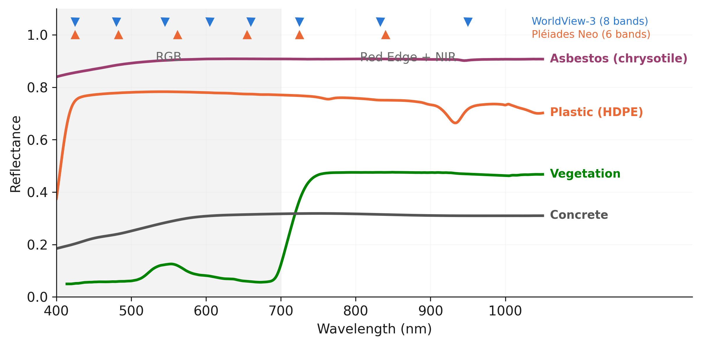
Where RGB falls short, and what VNIR adds
Different materials share the same colour at 0.3-1.3 m: plastic sheets, asbestos-cement and concrete all appear grey.
In the group predecessor, moving from 5 to 10 material categories costs 9.8 F1 points (69.2 to 59.4). Finer material distinctions are the hard part.
Red Edge and NIR separate vegetation, bare soil and weathered surfaces; in Saba 2026 they drive asbestos discrimination.
Whether this helps waste materials, and which ones, has not been measured. It is the object of this thesis.
8
Reflectance: USGS splib07a (Kokaly et al. 2017), 400-1050 nm. Band centres: Maxar, Airbus.

Slide 9
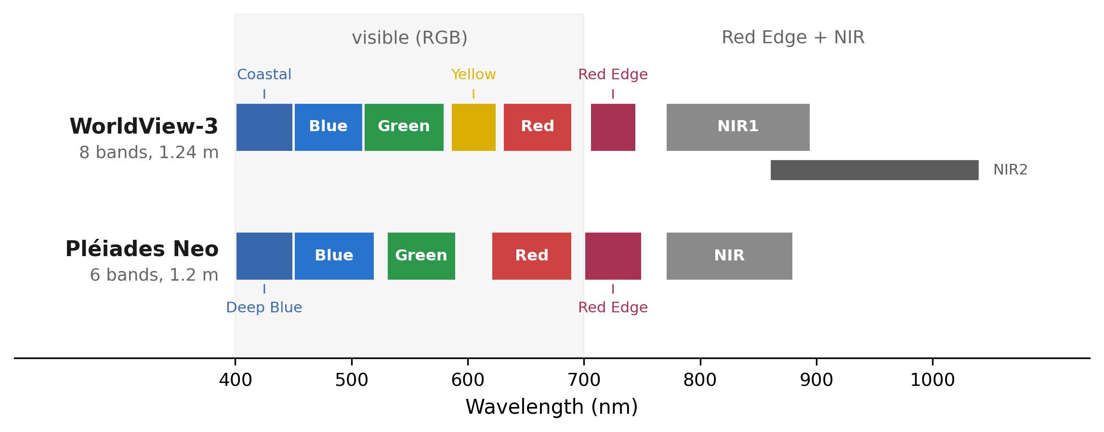
Available imagery
Panchromatic: 0.31 m (WorldView-3), 0.30 m (Pléiades Neo). Access: commercial, or free quota via ESA proposal.
This is the band budget of the study: no SWIR, no Sentinel-2. RGB baseline runs on AerialWaste (20-50 cm).
9
Band ranges: Maxar WorldView-3, Airbus Pléiades Neo data sheets

Slide 10
What is missing in the literature
1. Multi-material classification has one direct precedent, with ample margin: wF1 59-69 (Alari 2024).
2. No work measures the added value of VNIR bands over RGB for waste materials at very high resolution.
3. Results are reported as aggregate scores; per-material behaviour is not analysed.
4. Generalisation across regions is rarely evaluated. At site level it costs 5 F1 points (Gibellini 2025).
5. Asbestos is studied on roofs, in isolation, and never inside a waste-material taxonomy.
10
Each gap maps to one element of the proposal on the next slide.

Slide 11
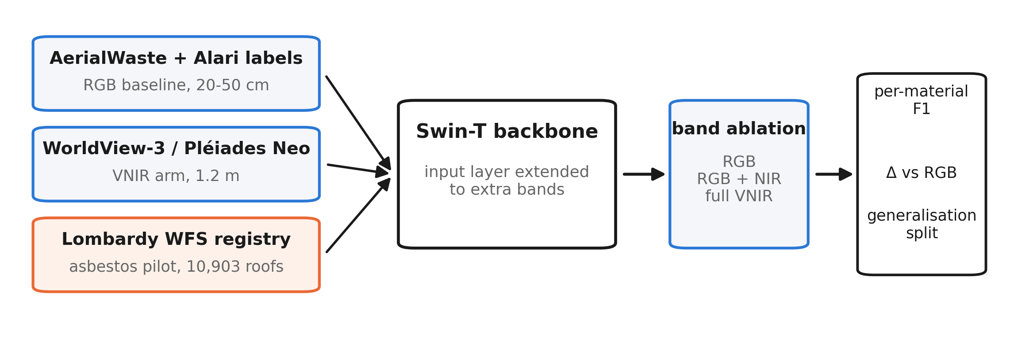
Proposed work: approach
Multi-label image classification, continuing the group line (Gibellini 2025, Alari 2024). Same taxonomy, input extended from RGB to VNIR.
Band ablation with everything else fixed: same architecture, same splits, only the input changes. Asbestos pilot first: public labels, one material, clear VNIR evidence.
11
Backbone: Swin-T with remote-sensing pretraining (group baseline); extra bands enter via the input layer.

Slide 12
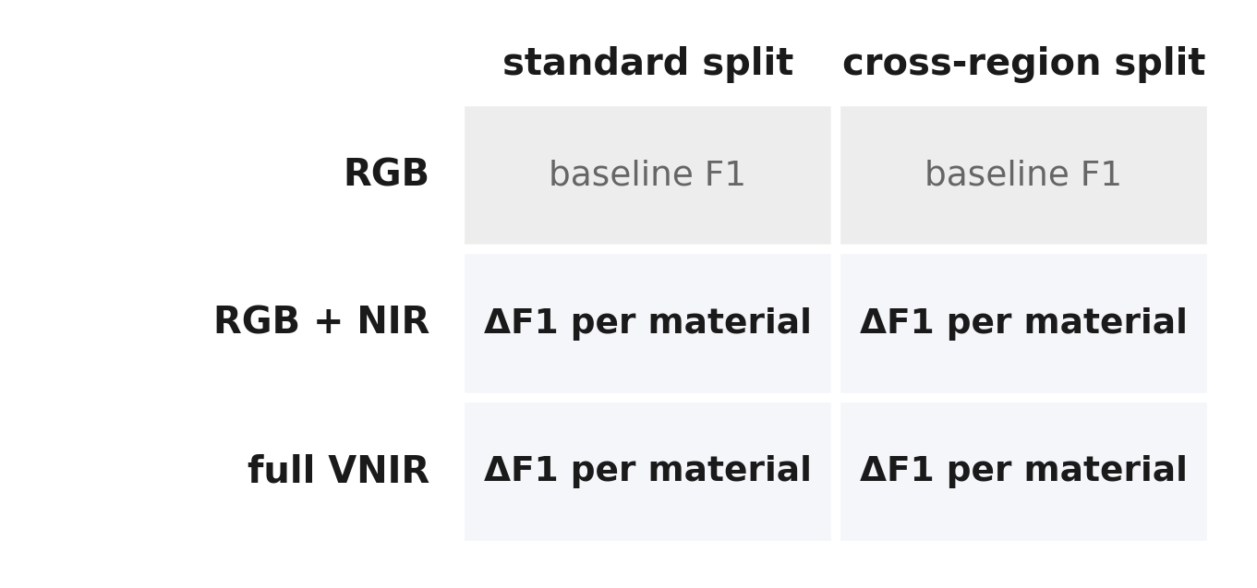
Proposed work: evaluation
Per-material F1 alongside weighted and macro averages: aggregates hide exactly the classes this thesis targets.
Delta versus the RGB baseline for each band configuration, with confidence intervals over repeated runs.
Generalisation: train and test on disjoint geographic areas, besides the standard split.
Reference points: wF1 69.2 / 59.4 (Alari 2024); Macro-F1 97.6 (Saba 2026, per-pixel) as upper reference for the pilot, not directly comparable.
If VNIR does not help a material, that is a documented negative result with practical value for sensor choice.
12
Metrics: per-class F1, macro-F1, weighted F1, confusion matrices. Splits frozen before testing.

Slide 13
References
Alari 2024. Fighting environmental crime with deep learning: classifying waste materials from illegal landfills in satellite imagery. M.Sc. thesis, PoliMi, 10589/230633.
Fraternali et al. 2024. Solid waste detection, monitoring and mapping in remote sensing images: a survey. arXiv:2402.09066.
Gibellini et al. 2025. A deep learning pipeline for solid waste detection in remote sensing images. Waste Management Bulletin.
Torres, Fraternali 2023. AerialWaste: a dataset for illegal landfill discovery in aerial images. Scientific Data.
Zhang, Ma 2024. CascadeDumpNet. Remote Sensing of Environment. · Sun et al. 2023. Nature Communications 14. · CWLD 2024. Scientific Data.
Saba et al. 2026. J. Hazardous Materials. · Bonifazi et al. 2026. Geomatics. · Abbasi et al. 2024. RSASE. · Cilia et al. 2015. ISPRS IJGI.
Kokaly et al. 2017. USGS Spectral Library v7 (splib07a). USGS Data Series 1035. · Disaitek 2024, vendor report (Airbus).
13
Full annotated library: 47 papers, papers/INDEX.md

