Slide 1
Multispectral satellite imagery for illegal waste material classification
State of the art and thesis direction — WorldView-3 + Pléiades Neo
Alessandro Potenza · M.Sc. Computer Science & Engineering (AI) · Politecnico di Milano · PERIVALLON

Slide 2
1
The problem: from detection to risk

Slide 3
Illegal waste dumps: a hidden, widespread environmental crime
Define: EO = Earth Observation · MS = multispectral · GSD = ground sampling distance · VNIR/SWIR = visible-near / short-wave infrared
• Lombardy and Italy face thousands of unauthorised dumping sites — many never reported, only stumbled upon.
• ARPA (the regional environmental agency) must find them and decide where to send a limited number of inspectors first.
• The operational question is not only “where is the waste?” but “how dangerous is it?” — classify by risk, not merely detect.
– Inspector time is the scarce resource; without ranking, agencies inspect blindly.
Framing: Fraternali et al. 2024 (PoliMi survey, arXiv:2402.09066)

Slide 4
Not all waste is equal: risk = hazard × exposure × magnitude
• The danger is material-bound: inert rubble vs plastics vs asbestos-cement are worlds apart.
• “Material” carries the hazard; the European Waste Catalogue (EWC) flags hazardous codes with “*” — asbestos = 17 06 05*.
• Priority risk = hazard (material) × exposure (who/what is nearby) × magnitude (how much).
– So material identification is the missing decision variable, not just site detection.
EWC List of Waste (Dec. 2000/532/EC) · Indice di Degrado d.d.g. 13237/2008 · Fazzo et al. 2023

Slide 5
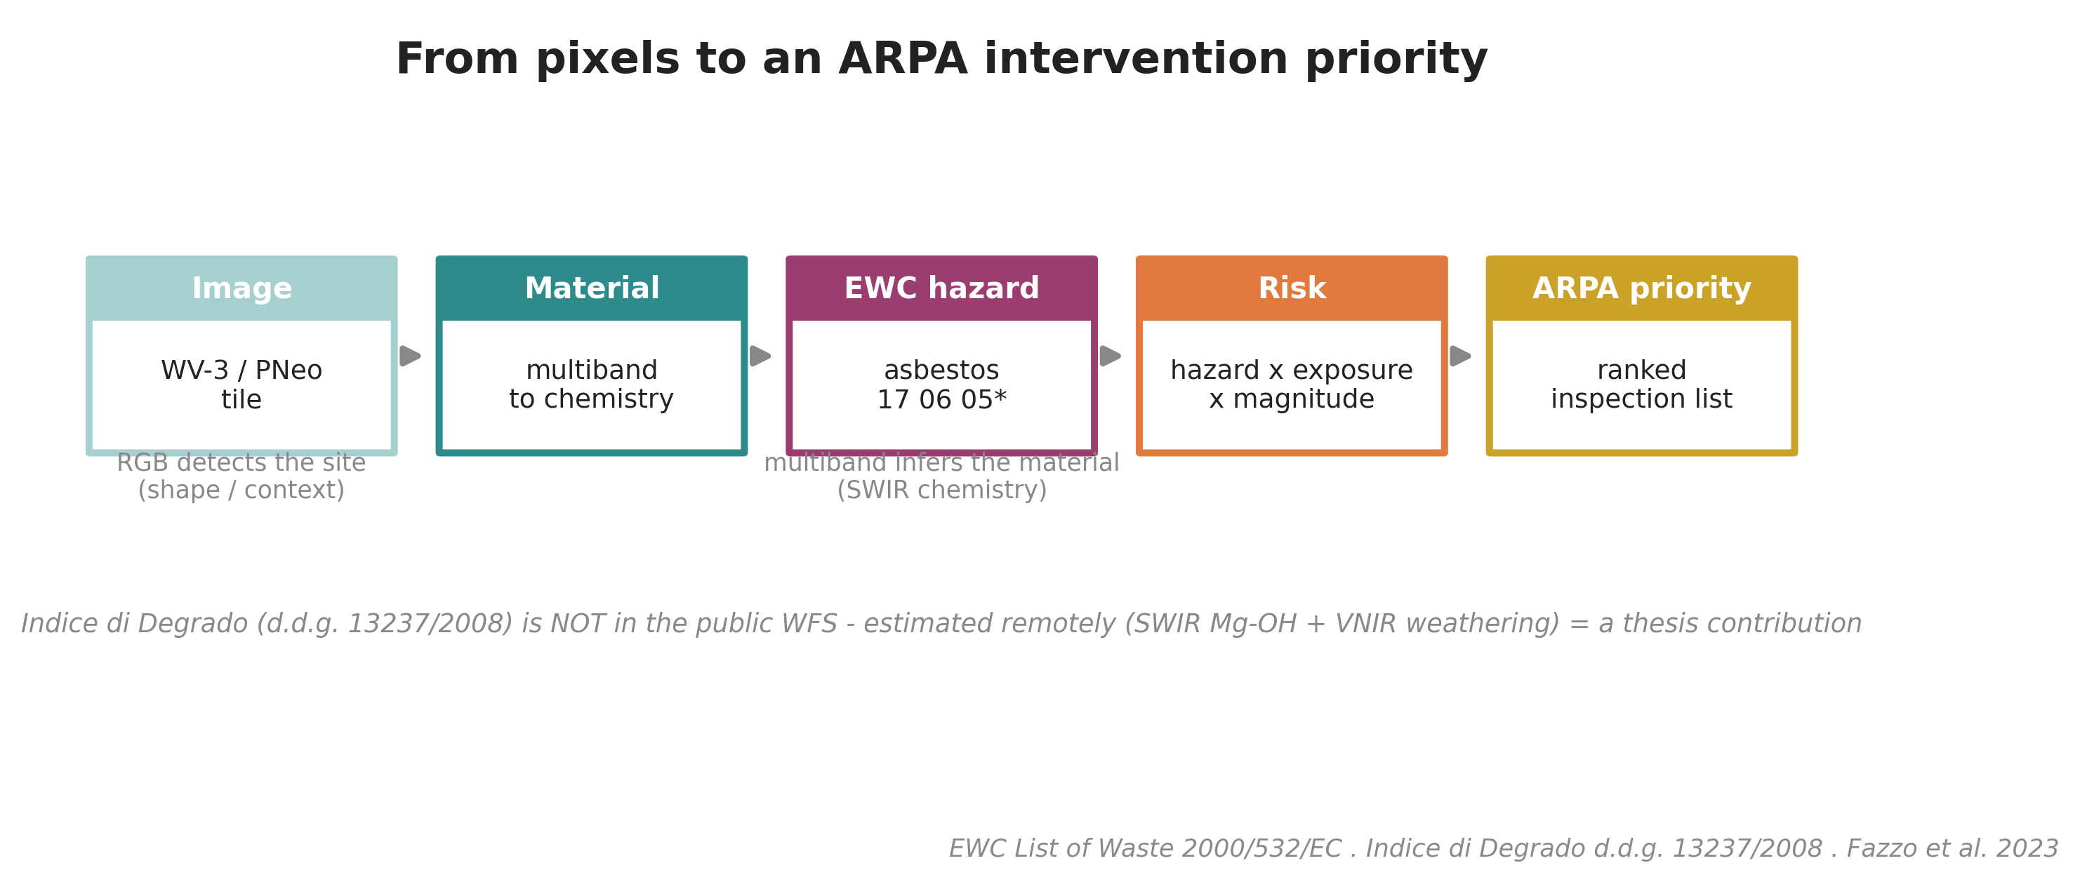
Computer vision reframed as decision support · EWC 2000/532/EC · Indice di Degrado d.d.g. 13237/2008

Slide 6
The research question
• What is the added value of multispectral (MS) data, vs RGB only, for waste MATERIAL classification from satellite imagery?
– Measured, not assumed — and explicitly bounded: where does multiband help, and where does it stop?
– Two confirmed very-high-resolution sensors: WorldView-3 (with SWIR) and Pléiades Neo (VNIR-only).
The core scientific bet of the thesis

Slide 7
2
Why ordinary RGB is not enough

Slide 8
Today’s paradigm: RGB deep learning detects sites, not materials
• Pipeline: VHR RGB tile → CNN/Transformer backbone → EO pretraining → two-step fine-tune → binary waste / no-waste.
• Strong within the geographic context it was trained on: Gibellini et al. 2025 — F1 92.0 %, Acc 94.6 % (20 cm, Swin-T + RSP).
• But three limits motivate the spectrum:
– classifies presence, not material;
– tied to colour only (3 broad bands);
– generalizzazione collapses cross-region (−5.1 % F1: GR 85.5 / SE 83.8 / RO 91.5) and cross-sensor.
Gibellini et al. 2025 (Waste Mgmt Bull., arXiv:2502.06607) · Fraternali et al. 2024

Slide 9
A satellite pixel is a spectrum, not just a colour
• Each pixel is a vector of reflectance values — the material’s spectral signature.
• RGB: 3 broad visible bands (colour only).
• MS (multispectral): 4–15 chosen bands. WorldView-3 records 8 VNIR + 8 SWIR; Pléiades Neo 6 VNIR.
• HSI (hyperspectral): hundreds of contiguous narrow bands (e.g. EnMAP 230, splib07a 2,151 channels @ 350–2500 nm).
– This vector is the raw input from which any classifier reasons.
Spectrum schema after USGS splib07a (Kokaly et al., 2017)

Slide 10
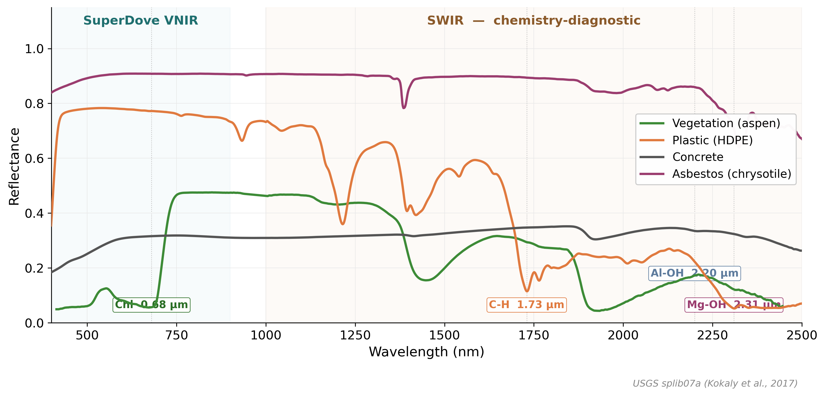
Every material has a spectral fingerprint
Reflectance curves diagnose chemistry, not just colour — USGS splib07a (Kokaly et al., 2017)

Slide 11
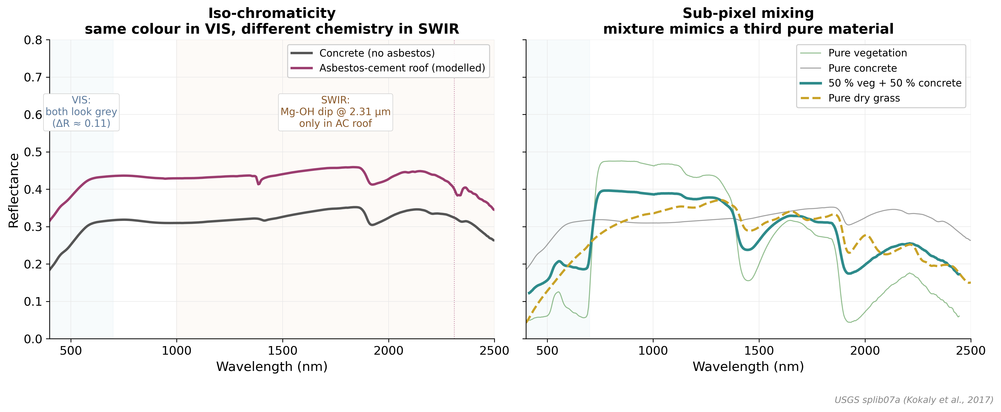
RGB fails in two distinct ways
Iso-chromaticity + sub-pixel mixing — Tasseron 2021 · Aguilar/Uhrin 2025 · USGS splib07a

Slide 12
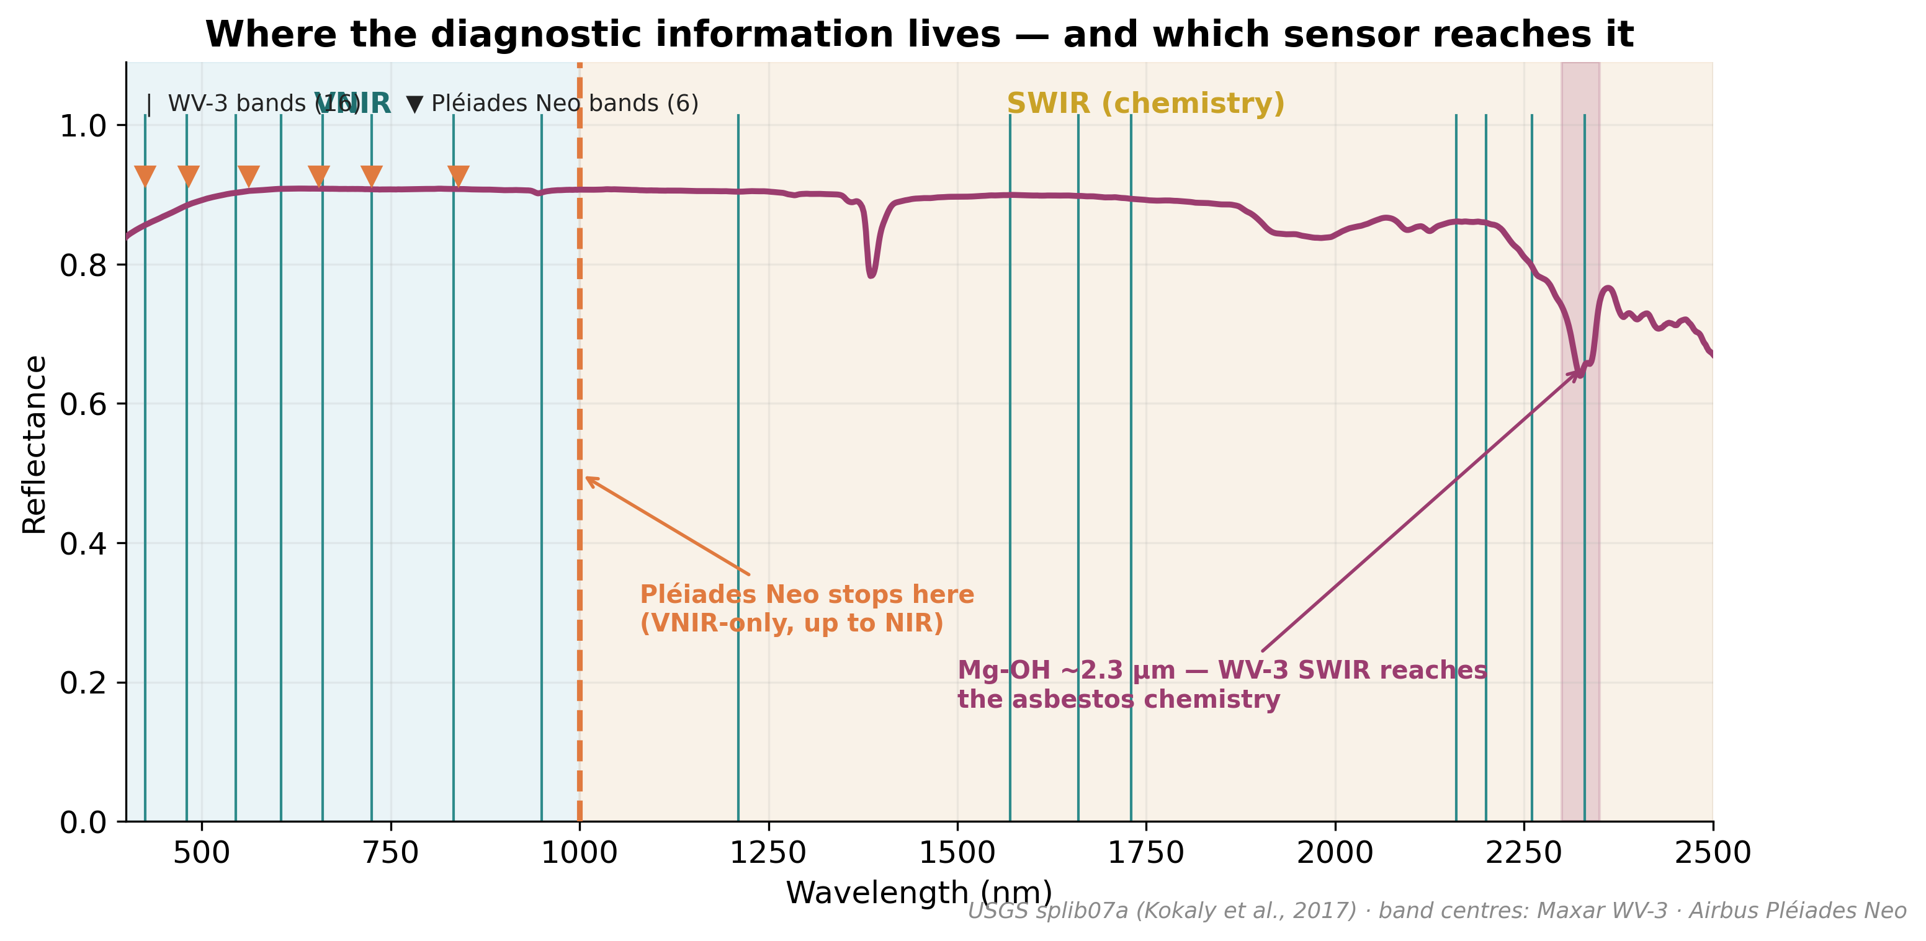
The chemistry-diagnostic clues sit in NIR and especially SWIR — USGS splib07a

Slide 13
3
The sensors — what exists today

Slide 14
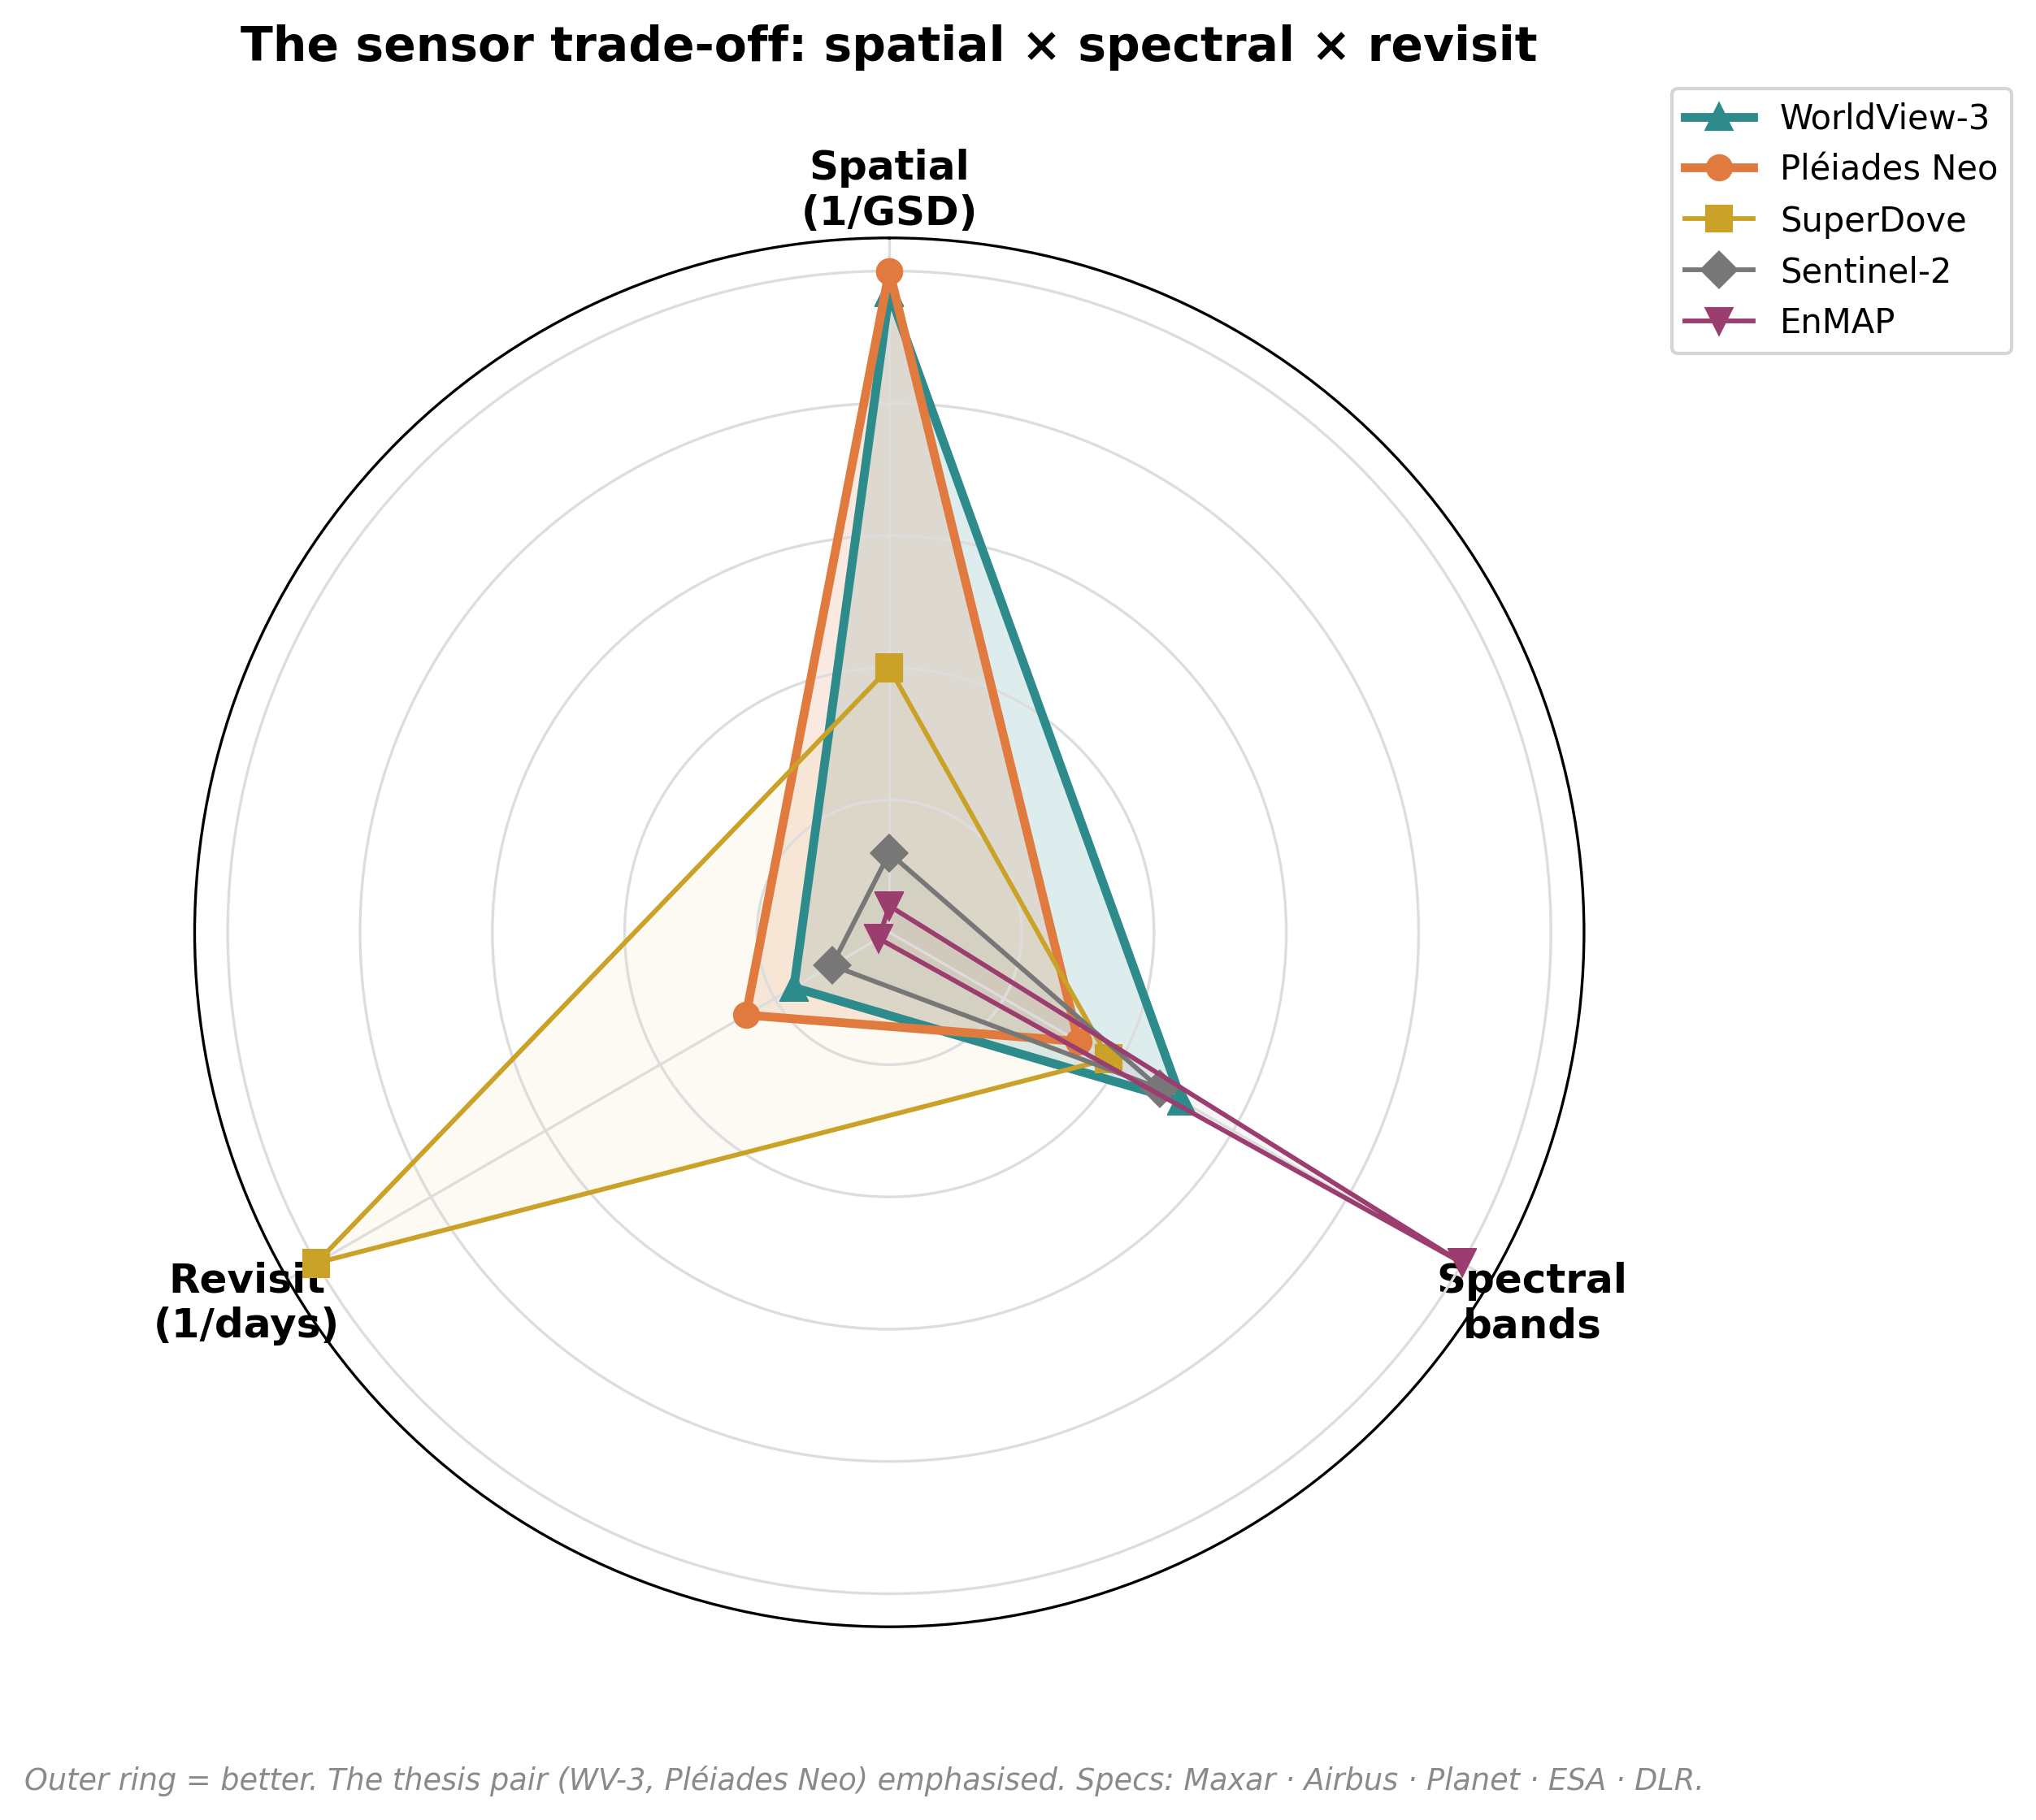
Three axes, one photon budget — no satellite maximises all three

Slide 15
Multispectral at low / medium resolution (10–30 m): too coarse for material
Low resolution answers “where”, not “what”
Sensor | Bands | GSD | SWIR | Verdict for material
Sentinel-2 | 13 | 10–20 m | 20 m | detection only; pixels too mixed
PRISMA / EnMAP | 200+ (HSI) | 30 m | yes | resolves 2.3 µm triplet but 30 m
Landsat 8/9 | 11 | 30 m | yes | regional context only
Kikaki 2022 · Magyar 2023 · Shepherd 2025 · Sun 2023

Slide 16
Low / medium resolution in practice
• MARIDA (Kikaki 2022): marine debris confused with natural organic matter where pixels mix.
• Global dumpsites (Sun 2023, Sentinel-2): 763 dumpsite LOCATIONS across 28 cities (sensitivity 98 %, precision 70 %) — but material identity stays out of reach; mapping in 6 days vs 6 months manual.
• Tisza (Magyar 2023): change detection works; per-tile post-processing still needed.
– Takeaway: low-res localises sites; it cannot tell what they are made of. → we need VHR.
Kikaki 2022 PLOS ONE · Sun 2023 Nat. Commun. 14 · Magyar 2023

Slide 17
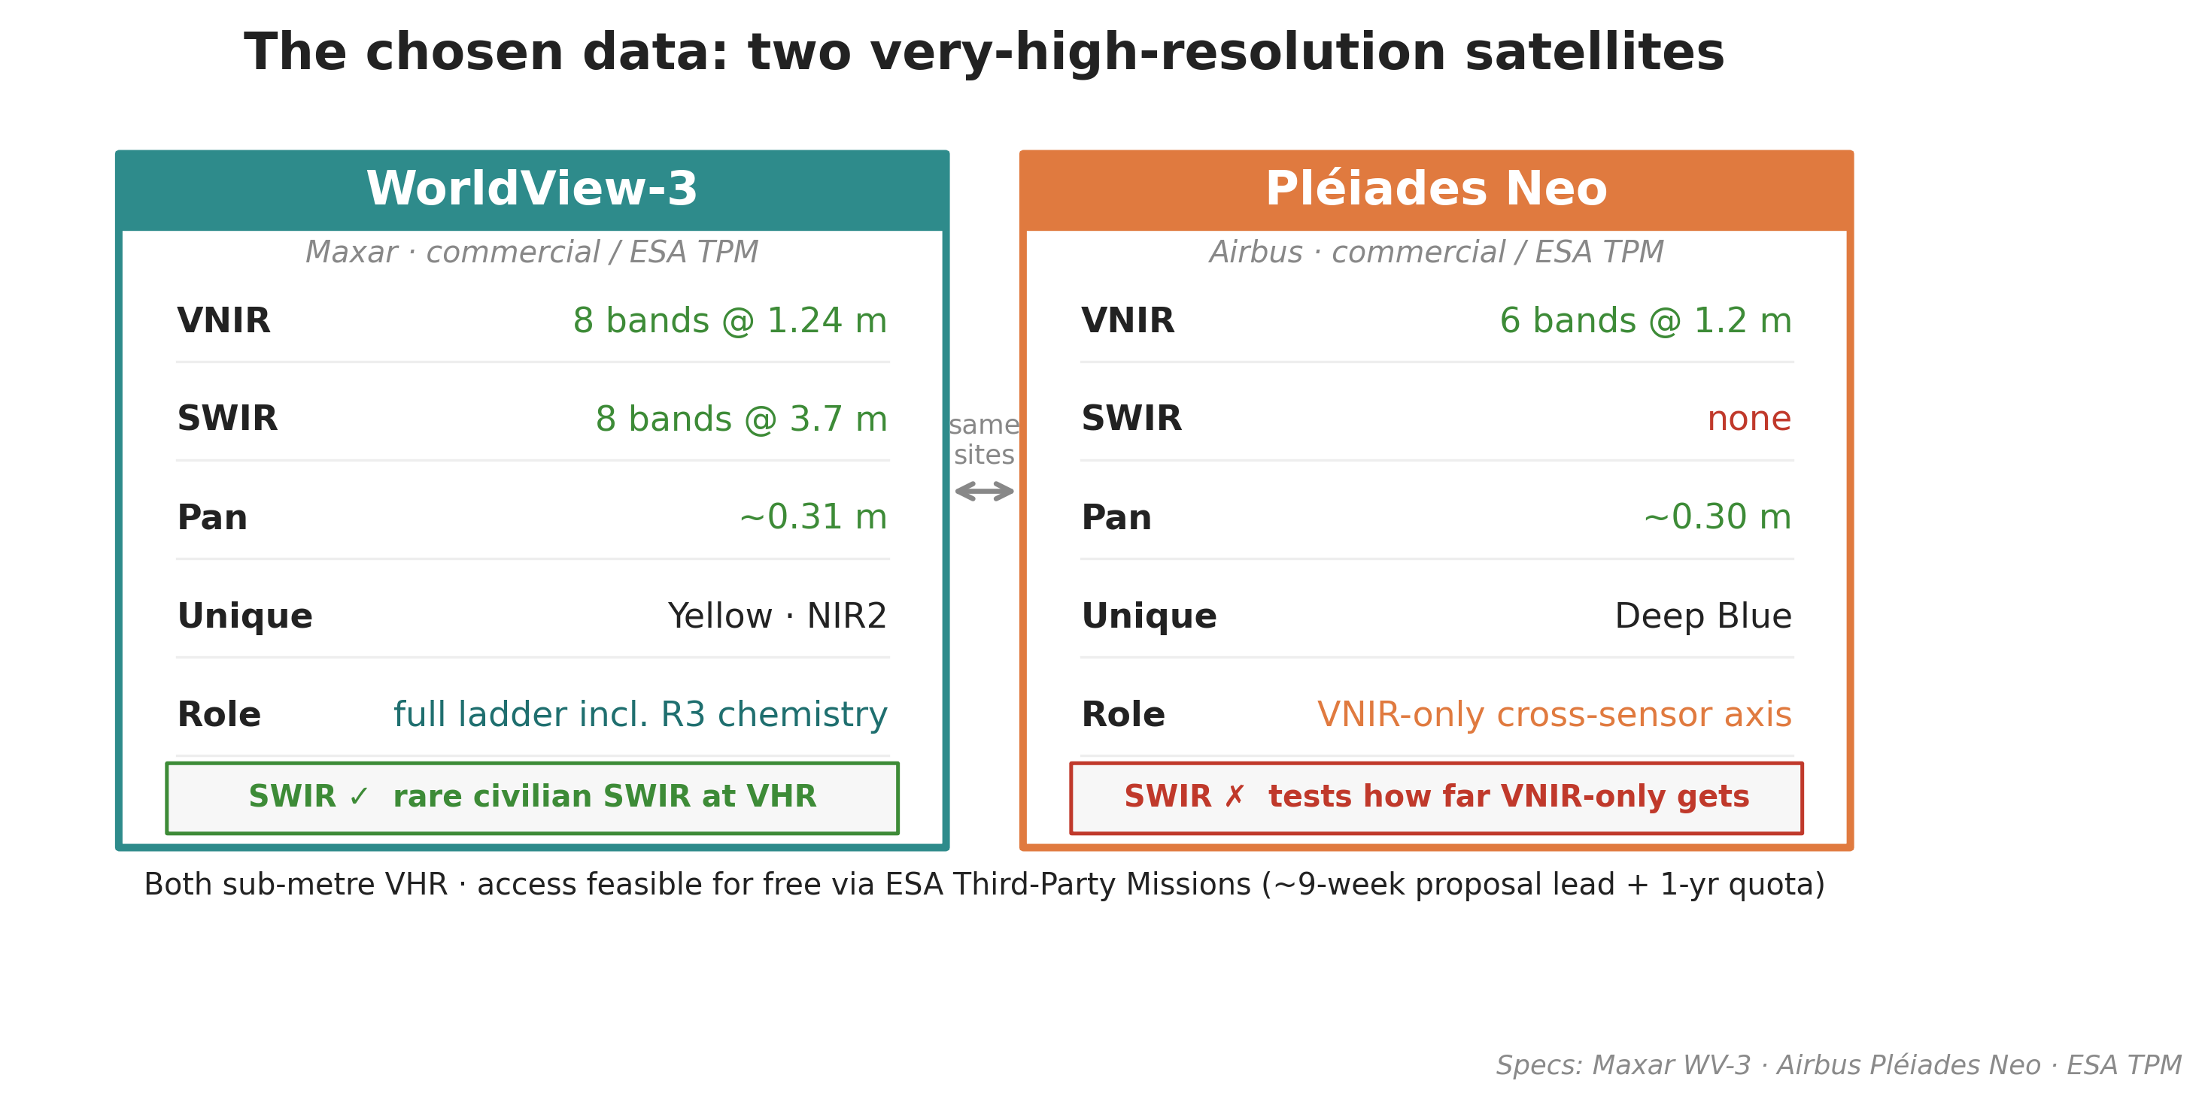
Both sub-metre VHR · free via ESA Third-Party Missions (~9-week proposal lead)

Slide 18
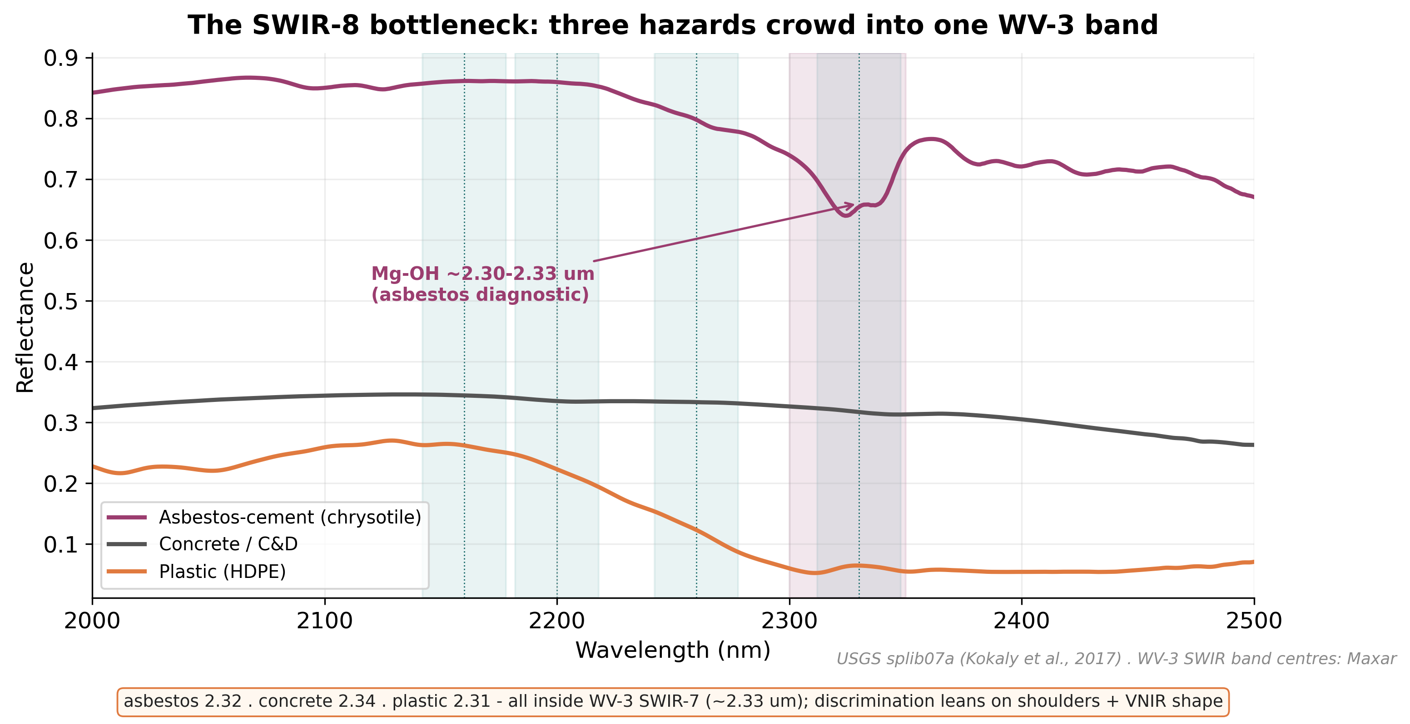
Honest caveat: resolution is split between texture and chemistry
• Spectra sampled coarsely: VNIR ~1.24 m, SWIR ~3.7 m (~14 m² pixels — no pure pixels over a dump).
• Pan gives fine texture ~0.3 m but no material info alone.
• A small dump is easier to SEE (texture) than to chemically IDENTIFY (spectra).
• SWIR-8 bottleneck: asbestos 2.32 + concrete 2.34 + plastic 2.31 crowd one band.
• Honest: at 3.7 m + atmosphere, R3 may ≈ R2 — itself a valid finding.
USGS splib07a · WV-3 SWIR band centres (Maxar)

Slide 19
4
The added value is real — precedents

Slide 20
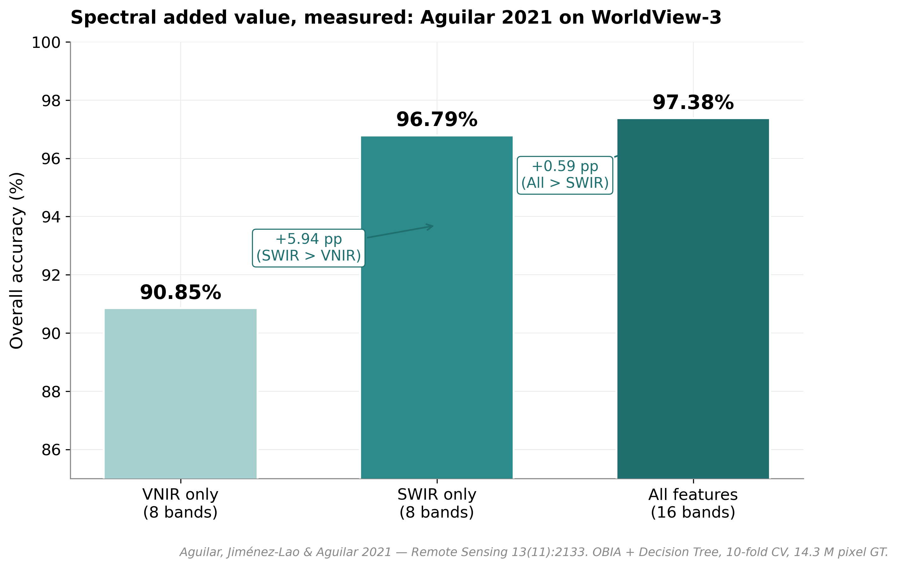
Spectral added value, measured: Aguilar 2021 on WorldView-3
• WV-3 greenhouse-plastic ablation, OBIA + Decision Tree, 10-fold CV.
• Overall Accuracy:
– VNIR only → 90.85 %
– SWIR only → 96.79 %
– All 16 bands → 97.38 %
• SWIR carries the single largest jump (+6.5 pp over VNIR).
• Most-cited direct benchmark for waste-like material classification.
Aguilar, Jiménez-Lao & Aguilar 2021, Remote Sensing 13(11):2133 — κ 0.812/0.932/0.944

Slide 21
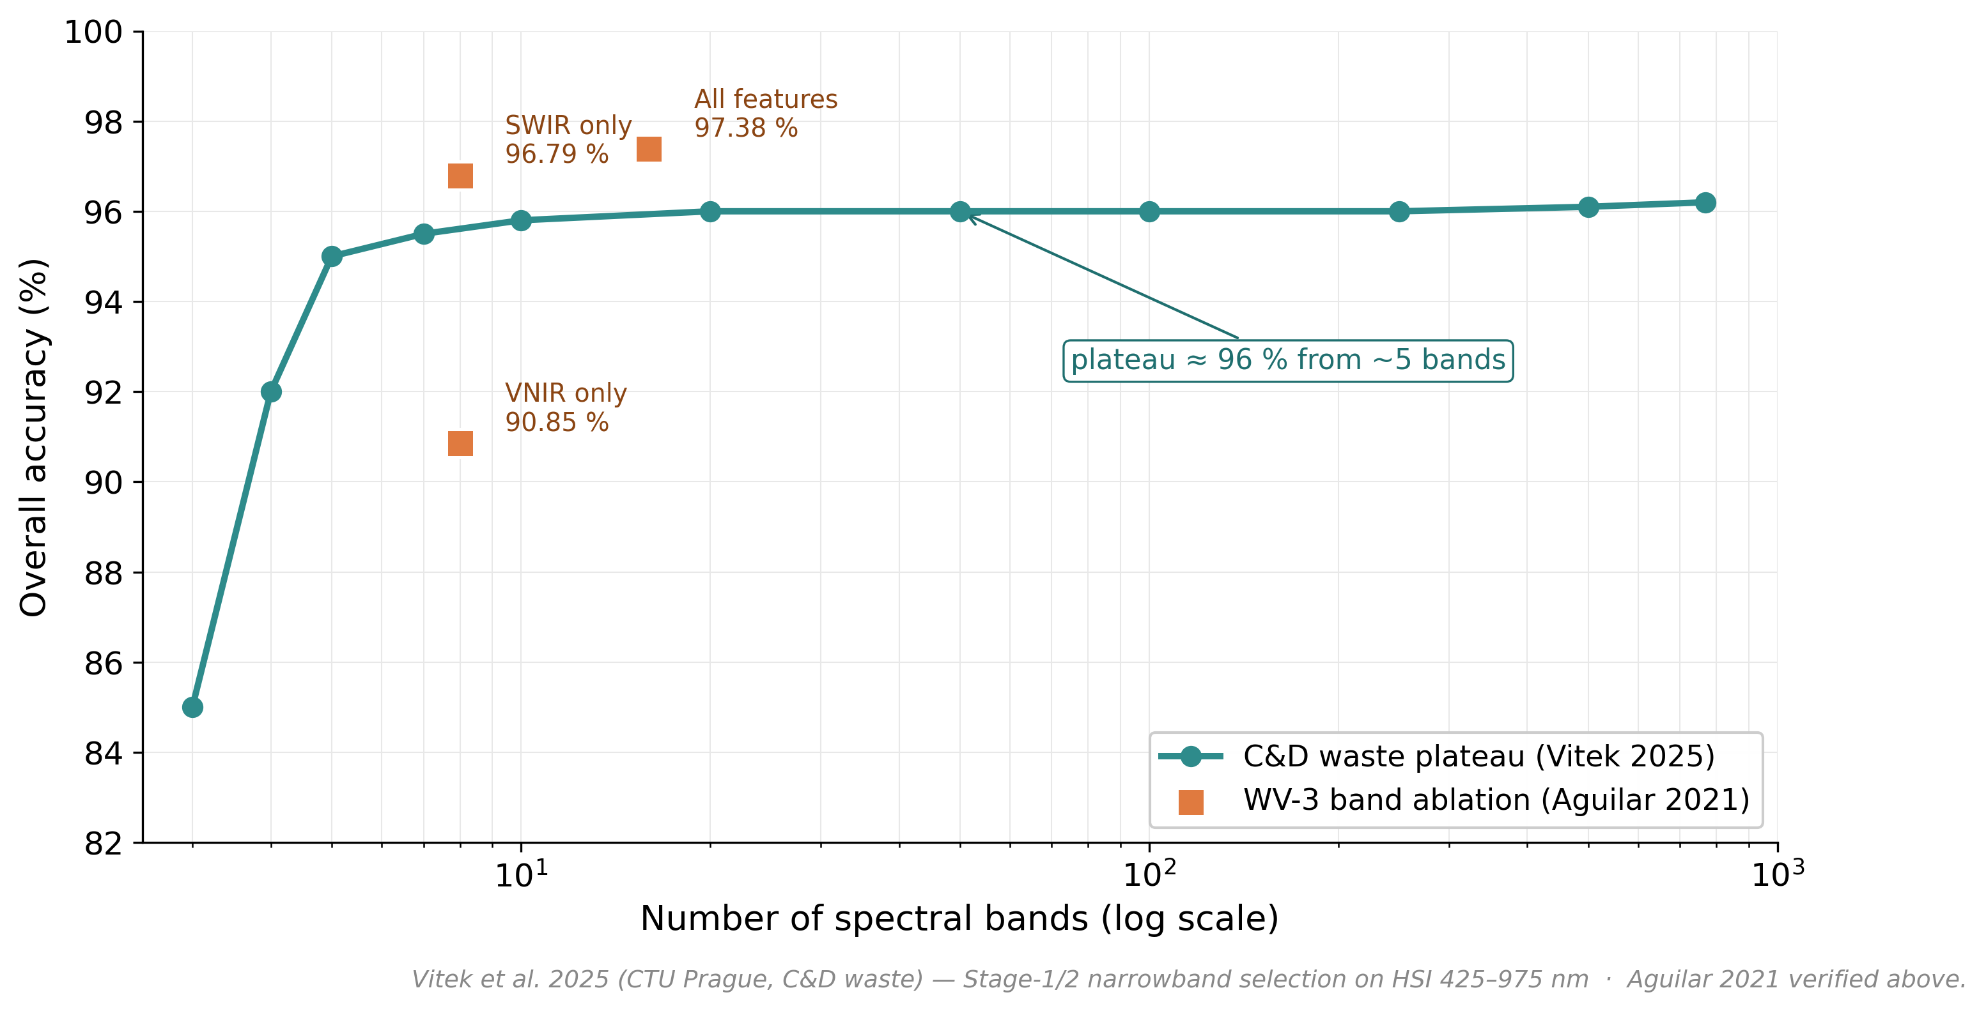
More bands ≠ more — well-chosen few suffice
• Aguilar 2021 (WV-3 plastic): VNIR 90.85 → All 97.38 — SWIR carries the jump.
• Vitek 2025 (C&D waste): RGB + 2 narrowbands ≈ HSI 768 bands.
• Zhou 2021 (WV-3 plastic): 8 SWIR bands separate 3 polymer clusters.
• What matters is WHICH bands, not how many.
• WV-3 gives us SWIR; Pléiades Neo (VNIR-only) measures how far we get without it.
Vitek et al. 2025 (CTU Prague) · Aguilar et al. 2021 · Zhou et al. 2021

Slide 22
Asbestos precedents — direct comparison points
• Saba 2026 (WV-3 VNIR, 8 bands): 32 classifiers tested; Fine-KNN Macro-F1 97.6 % — strong VNIR-only upper bound to beat. [paywalled, single-source]
• Bonifazi 2026 (WV-3, 16 bands, MLC): asbestos-cement roofs F1 0.87 (P 0.81 / R 0.92); 25,319 buildings processed; multi-temporal monitoring.
• Shepherd 2025 (EnMAP, 230 bands @ 30 m): ACE classifier 91.4 % OA / κ 0.87 / F1 91.2 %; 86 % field match — but urban mixed pixels (rubble, paint) mimic asbestos.
– Together: VNIR can detect AC; SWIR + hyperspectral add robustness on clean/ambiguous roofs.
Saba 2026 J. Hazard. Mater. · Bonifazi 2026 Geomatics 6(3):41 · Shepherd 2025 Sci. Rep.

Slide 23
Waste-dump precedents at VHR
• CascadeDumpNet (Zhang & Ma 2024, Pléiades 0.5 m): open-dumpsite detection, 84.6 % mAP; transfers Shenzhen → Shanghai/Guangzhou.
• AerialWaste (Torres 2023): 11,700+ RGB tiles, 22 material categories — but only 11 images contain presumed asbestos; RGB, object-level.
• Aguilar 2025 (WV-3 SWIR macroplastics): precision 92.5 %, lab-to-satellite r = 0.95; targets 80–150 m² aggregations.
– VHR detection is solved on RGB; material/hazard identification is the open frontier.
Zhang & Ma 2024 RSE · Torres 2023 Sci. Data · Aguilar 2025 Env. Monit. Assess.

Slide 24
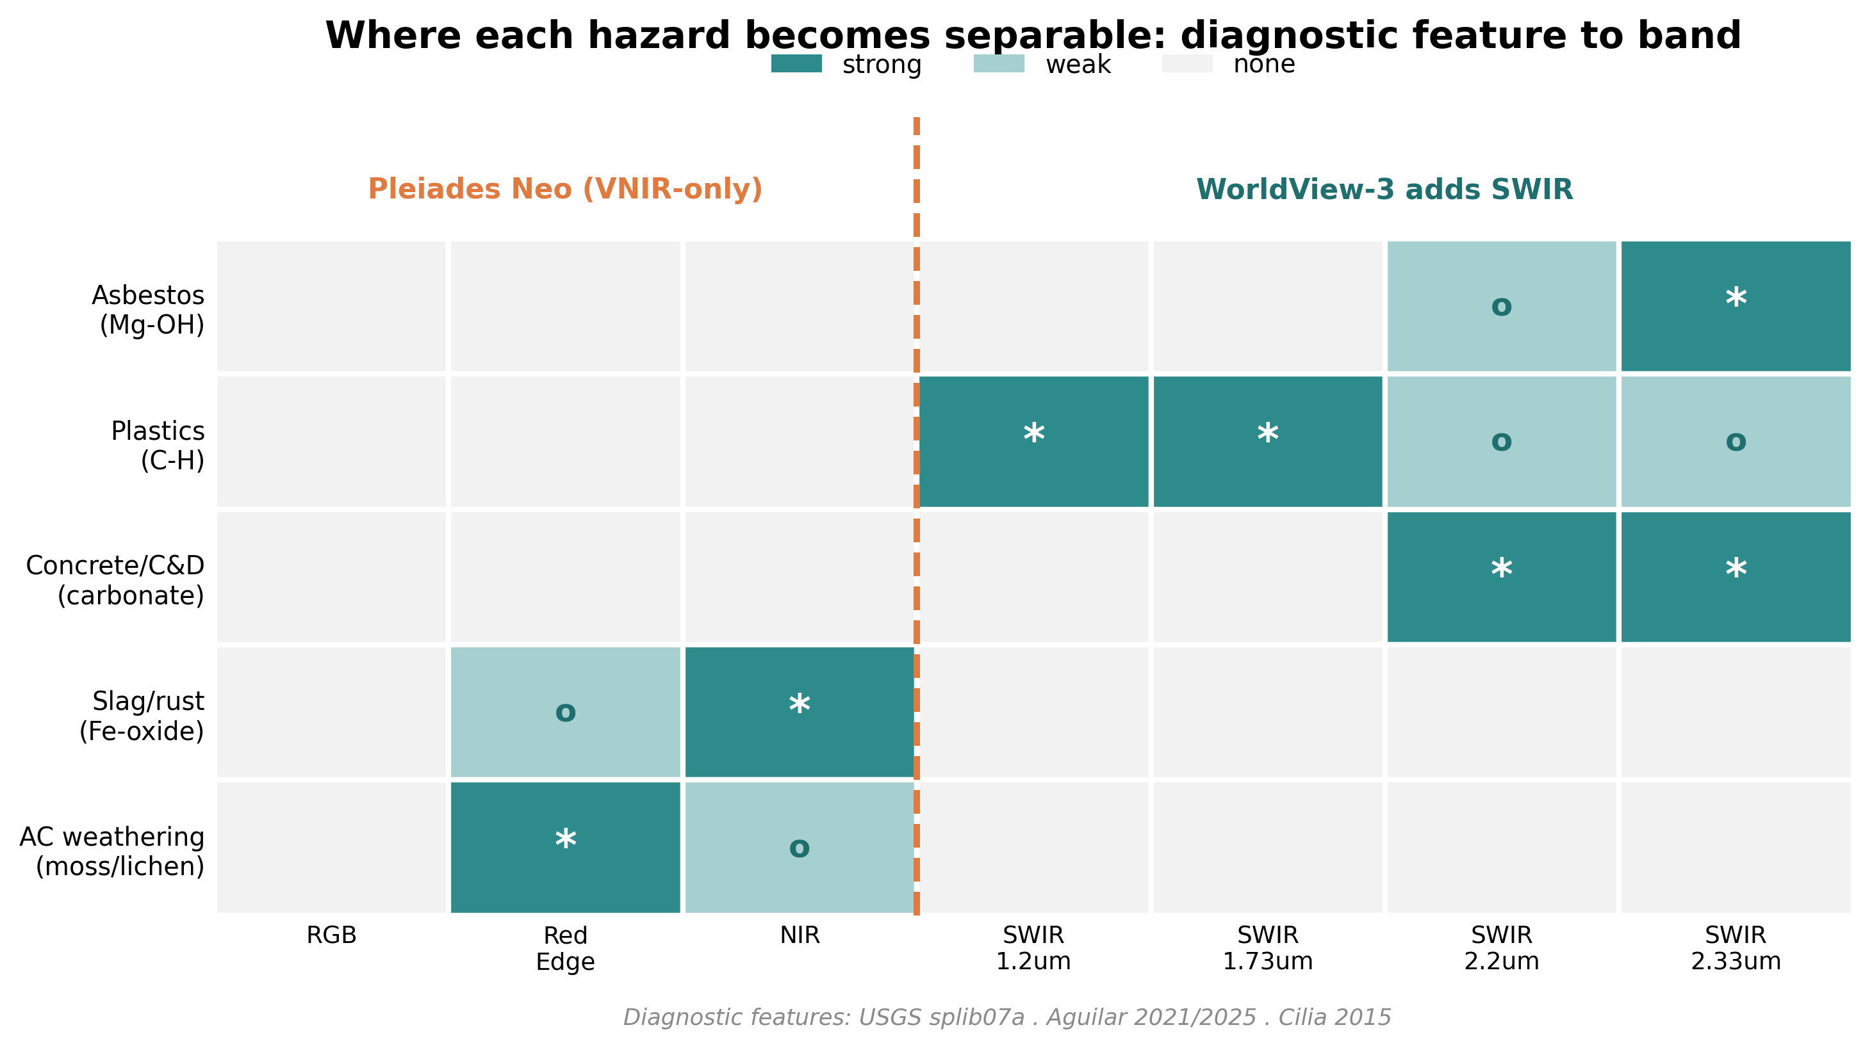
Pléiades Neo reaches up to NIR; WorldView-3 adds the SWIR chemistry — USGS splib07a · Aguilar · Cilia 2015

Slide 25
5
Method — a fair backbone

Slide 26
Foundation models for Earth Observation: a new lever
• 2024–2025: a wave of pretrained EO backbones (Prithvi, SpectralGPT, SoftCon, AnySat, DOFA…).
• Most are pretrained at 10–30 m on Sentinel-2 / HLS — naïve transfer to ~1.2 m VHR is not guaranteed.
• Two routes forward:
– sensor-agnostic models (DOFA, AnySat) accept arbitrary band sets;
– parameter-efficient adapters (DEFLECT) freeze the backbone, add < 1 % params.
• Open question: does 10–30 m pretraining transfer to VHR? — empirical.
FM-RS survey 2024 · Xiong 2024 · Astruc 2024 (AnySat) · Thoreau 2025 (DEFLECT) · Szwarcman 2024 (Prithvi-EO-2.0)

Slide 27
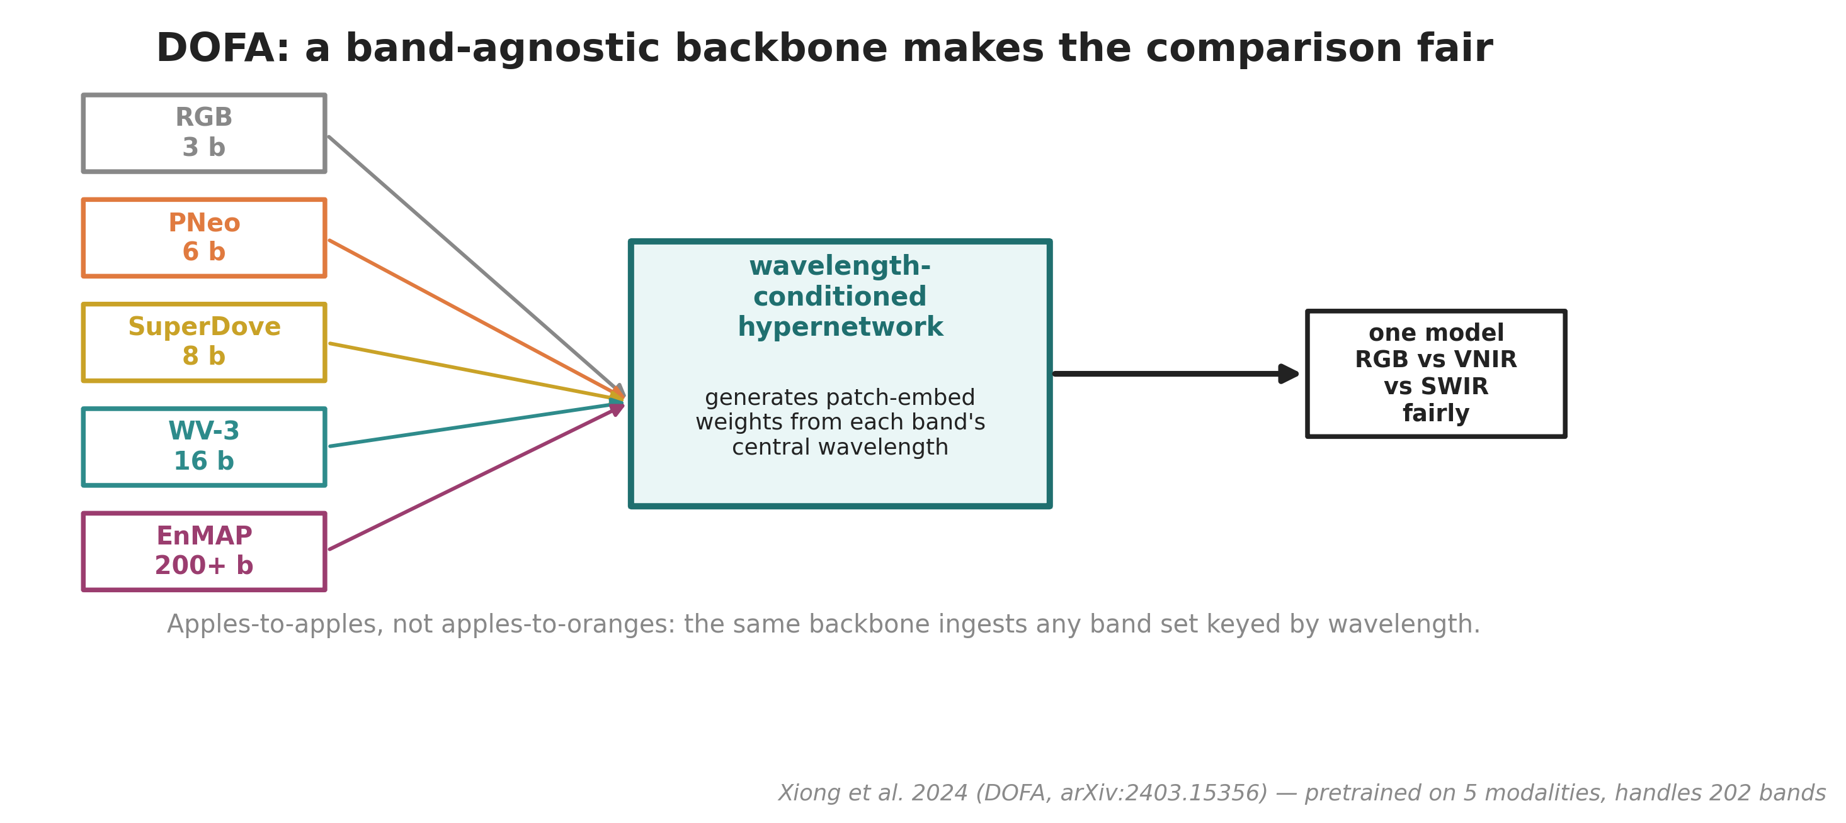
Xiong et al. 2024 (arXiv:2403.15356) — pretrained on 5 modalities (8M samples), handles up to 202 bands

Slide 28
6
The gap & the proposed direction

Slide 29
Gaps in the literature — and the test that matters
• No public VHR dataset pairs waste sites with MATERIAL labels; no peer-reviewed Pléiades-Neo material benchmark exists.
• RGB pipelines conflate iso-colour, chemically distinct materials.
• No pipeline goes from spectra to a regulatory hazard class (material → EWC → risk tier).
• The object-vs-material split is unaddressed; generalizzazione (cross-region / sensor / time) is rarely shown.
• The test that matters: how much does multiband actually beat RGB for material — and where does it stop helping?
Gap list distilled from Fraternali et al. 2024 (arXiv:2402.09066)

Slide 30
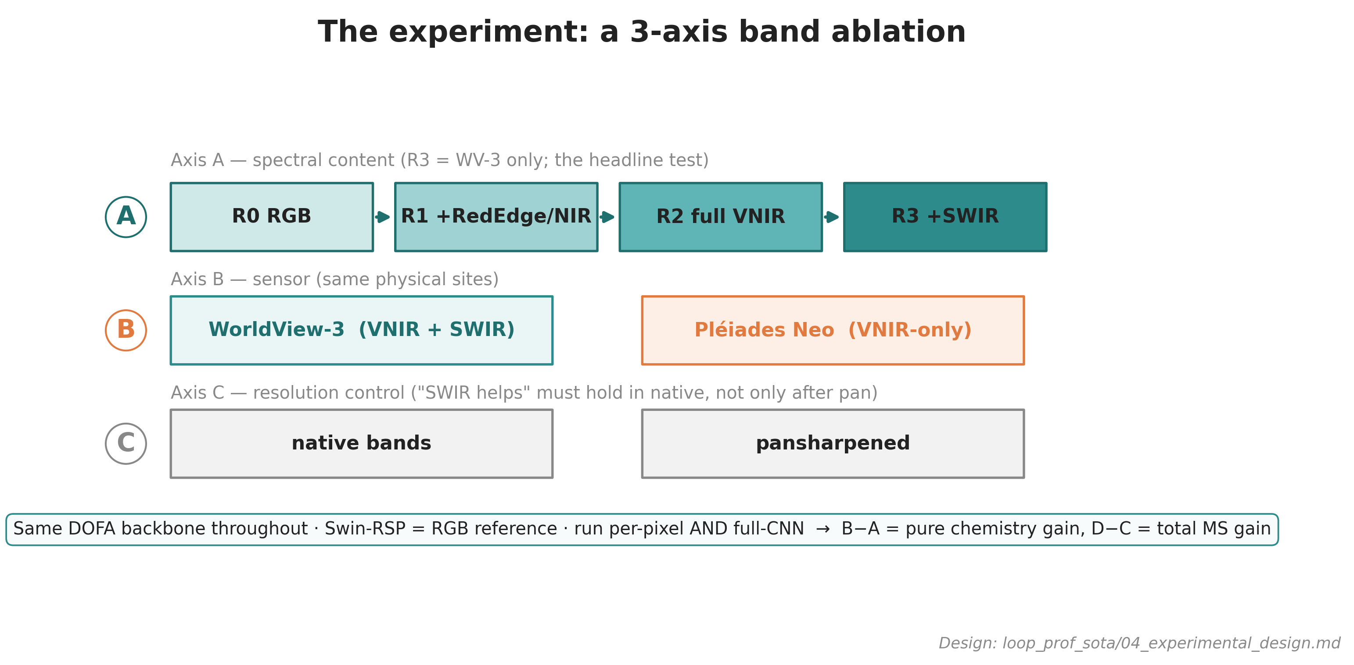
Per-pixel AND full-CNN: B−A = pure chemistry gain, D−C = total MS gain · design in loop_prof_sota/04

Slide 31
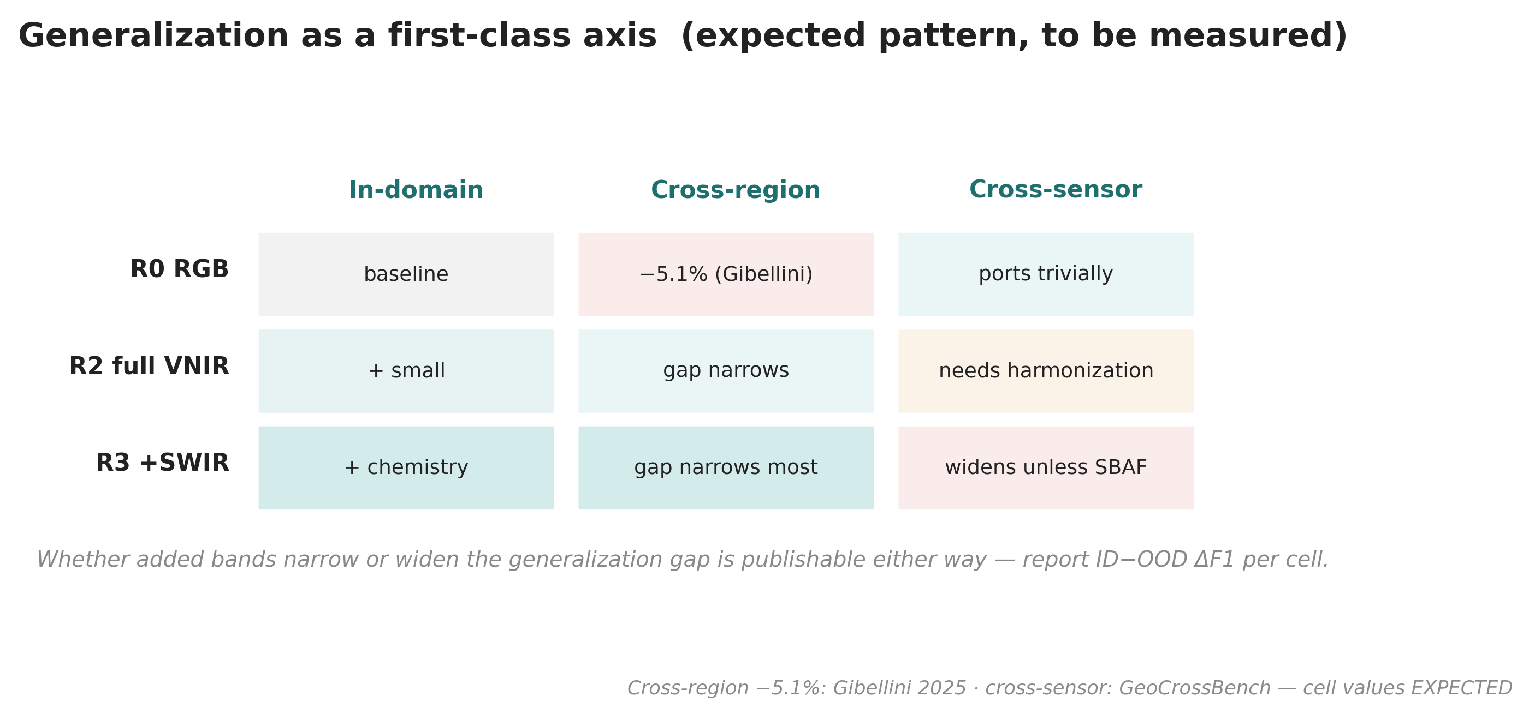
Report ID−OOD ΔF1 per cell — pattern EXPECTED, to be measured · cross-region −5.1 %: Gibellini 2025

Slide 32
From material to risk tier
• Map predicted material → EWC hazard code → Indice di Degrado / PRAL logic × exposure × magnitude → ARPA priority tier.
• Output = a ranked intervention list; every step transparent and auditable.
– Indice di Degrado (ID ≤25 / 26–44 / ≥45 → action windows) is NOT in the public WFS → estimated remotely (SWIR Mg-OH depth + VNIR weathering) = a thesis contribution.
– Exposure grounded in Fazzo et al. (residential-proximity mesothelioma risk); magnitude from roof/site area.
EWC 17 06 05* · Indice di Degrado d.d.g. 13237/2008 · Fazzo et al. 2023

Slide 33
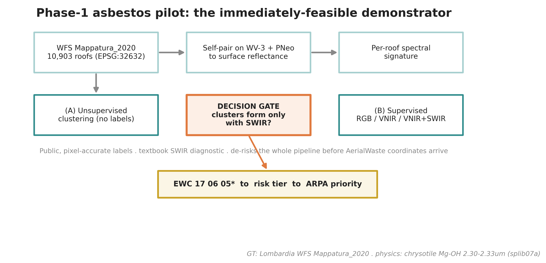
Public pixel-accurate labels + textbook SWIR diagnostic (Mg-OH 2.30–2.33 µm) — de-risks the whole pipeline

Slide 34
Why this matters — and what is genuinely novel
• First to MEASURE RGB vs VNIR vs SWIR added value for waste material at VHR.
• First WorldView-3 vs Pléiades Neo head-to-head for this task (SWIR vs VNIR-only).
• First to connect spectra → EWC hazard → ARPA risk tier — confidence-aware (reports where MS helps and where it doesn’t, incl. generalizzazione).
– Payoff: a transferable, free-data decision-support tool for environmental agencies.
Contributions map one-to-one onto the literature gaps

Slide 35
What to confirm with Thomas — decision checklist
• Data: trigger the ESA TPM proposal now (~9-week lead)? AOI / scene selection over Lombardia?
• Risk-chain depth: full Indice di Degrado / PRAL formalization, or stop at material + EWC?
• SuperDove: kept as a free wide-area screening layer, or dropped?
• Ablation depth: 3 axes as designed, or trim for time?
• Backbone: DOFA primary + Swin-RSP RGB reference — agreed?
• AerialWaste coordinate bridge with ARPA (gates the general-waste MS ablation).
Open dependencies flagged in loop_prof_sota/00_LOOP_LOG.md

Slide 36
A
Appendix — backup

Slide 37
Sensor comparison (full)
Sensor | VNIR | SWIR | Pan | Access | Role
WorldView-3 | 8 @ 1.24 m | 8 @ 3.7 m | 0.31 m | commercial / TPM | full ladder incl. R3
Pléiades Neo | 6 @ 1.2 m | none | 0.30 m | commercial / TPM | VNIR-only cross-sensor
SuperDove | 8 @ 3 m | none | — | free, near-daily | wide-area screening
Sentinel-2 | 10–20 m | 20 m | — | free | too coarse for material
EnMAP / PRISMA | HSI ~6.5 nm | yes | — | free (proposal) | 30 m — context
Specs: Maxar · Airbus · Planet · ESA · ASI · DLR

Slide 38
The 13 target materials: shape vs chemistry
• Shape-identifiable (8 — RGB usually enough): vehicles, tanks, containers, rubble, bulky, wood, tyres, big-bags.
• Chemistry-bound (5 — RGB blind, MS lives here): asbestos, plastic-type, foundry slag, sludge, scrap-metal composition.
– Asbestos + plastics are ideal test beds — shape cue AND chemistry cue coexist.
Taxonomy: loop_prof_sota/09_master_cheatsheet.md

Slide 39
Diagnostic feature → band (memorise)
Material | Feature (µm) | WV-3 band | Pléiades Neo?
Asbestos (Mg-OH) | 2.30–2.33 | SWIR-7 (2.33) | ✗
Plastics (C-H) | 1.215 / 1.73 / 2.31 | S1, S4, S8 | ✗
Concrete / C&D | 2.34 / 2.20 | S8 / S6 | ✗
Slag / rust (Fe-oxide) | 0.87–0.95 | NIR1 / NIR2 | weak
AC weathering | 0.68 + 0.74 | Red + RedEdge | ✓
USGS splib07a · Aguilar 2021/2025 · Cilia 2015

Slide 40
Honesty guardrails & claims to handle with care
• Multiband value is measured, not assumed — and bounded (SWIR earns its keep on chemistry; detection may need little beyond RGB).
• Spectra at 1.24 m / 3.7 m vs pan 0.3 m = texture, not chemistry; SWIR carries chemistry but Pléiades Neo has none.
• Unmixing is out of scope (it sets the ceiling). “generalizzazione”, not “OOD”.
– Downgraded / do-not-quote: Aguilar “+14 % κ” (use OA only); Saba “HS 97.3 vs MS 74.4” (paywalled); chrysotile “~5 nm” (it is tens of nm).
loop_prof_sota/09_master_cheatsheet.md

Slide 41
Key references
• Gibellini et al. 2025 — DL waste pipeline (Swin-T+RSP baseline). Waste Mgmt Bull.
• Fraternali et al. 2024 — waste RS survey / gap analysis. arXiv:2402.09066.
• Aguilar et al. 2021 — WV-3 VNIR+SWIR ablation. Remote Sensing 13(11):2133.
• Xiong et al. 2024 — DOFA band-agnostic foundation model. arXiv:2403.15356.
• Bonifazi 2026 (Geomatics) · Saba 2026 (J. Hazard. Mater.) · Shepherd 2025 (Sci. Rep.) — asbestos.
• Zhang & Ma 2024 — CascadeDumpNet (Pléiades). RSE. · Kokaly et al. 2017 — USGS splib07a.
• Full annotated bibliography: docs/02_research/loop_prof_sota/11_references.md + references.bib
Politecnico di Milano · PERIVALLON Horizon Europe (Grant 101073952)

