Slide 1
PERIVALLON · ASBESTOS PILOT
Asbestos roofs: first real spectral signatures
from SuperDove imagery
Regional asbestos ground truth (Mappatura 2020) × Planet PSScene 8-band, 12 May 2026
Alessandro Potenza — 12 June 2026
1

Slide 2
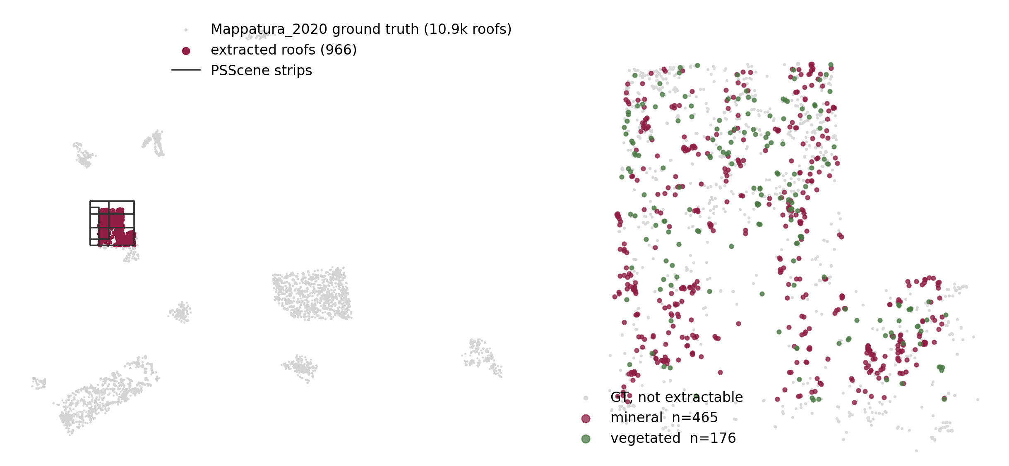
The PSScene strips cover 1,096 mapped roofs — 966 usable signatures
Ground truth: Regione Lombardia “Mappatura 2020”, 10.9k roofs · usable = ≥ 150 m², ≥ 5 clear pixels · Brescia province (Manerbio, Leno, Bagnolo Mella) · 5 strips, single day.
2

Slide 3
Extraction pipeline: from GT polygons to one signature per roof
1
GT selection
Mappatura 2020 census (most recent regional mapping), area ≥ 150 m²
2
Edge erosion
polygon buffered −3 m inward: at 3 m GSD this removes mixed roof/ground border pixels, keeping pure roof pixels only
3
Pixel quality
Planet udm2 clear mask; a roof needs ≥ 5 valid pixels
4
Signature
per-band median of surface reflectance — 8 SuperDove bands (Coastal Blue → NIR); overlapping strips → keep the observation with more clear pixels
5
Vegetation screening
NDVI < 0.2 mineral (bare roof) · NDVI ≥ 0.3 vegetated (likely remediated or overgrown since the 2020 mapping)
6
Similarity
SAM — angle between signatures as vectors: compares spectral shape, ignores overall brightness
966 of 1,096 covered roofs pass all filters · surface reflectance, scale 10⁻⁴.
3

Slide 4
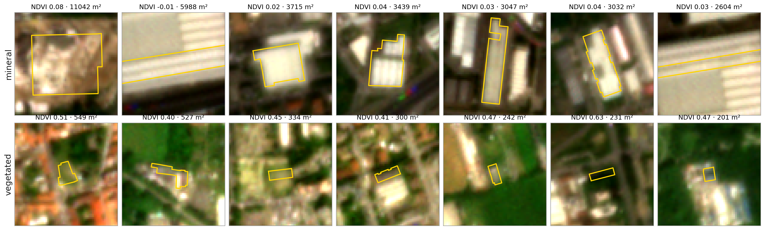
Extraction check on the imagery: GT outlines match the buildings
Planet RGB, 3 m, GT outline in yellow · row 1: largest mineral roofs — industrial sheds, classic asbestos-cement · row 2: roofs flagged as vegetated by NDVI.
4

Slide 5
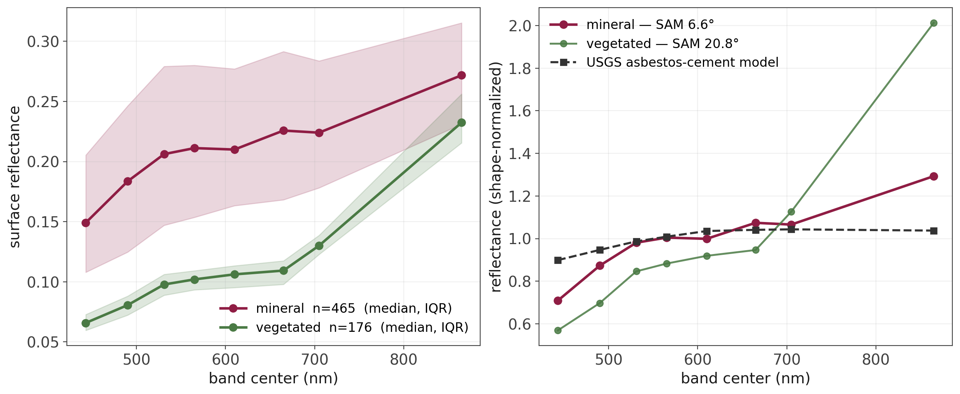
Bare roofs match the lab reference — NDVI flags likely-remediated roofs
GT is from 2020, image from 2026: the vegetated subset (red-edge shape) marks roofs likely remediated or overgrown in between · mineral subset SAM 6.6° vs USGS asbestos-cement model resampled to the 8 SuperDove bands.
5

Slide 6
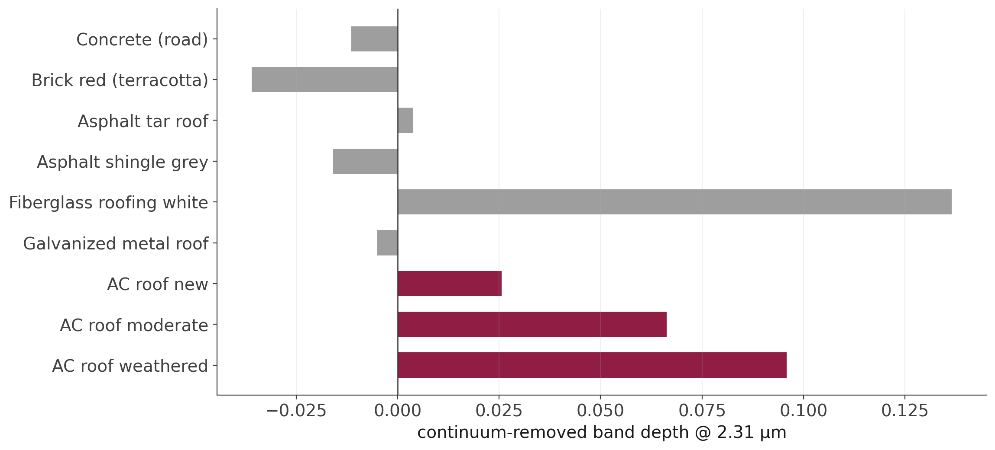
Why SWIR matters: only asbestos-cement shows the 2.31 µm Mg-OH feature
Continuum-removed band depth, USGS splib07a; asbestos-cement modelled as chrysotile–concrete mix (Cilia 2015) · the feature grows with weathering — measurable by WV-3 S8, washed out by Sentinel-2 B12 (FWHM 175 nm), invisible to SuperDove.
6

Slide 7
What the VNIR bands can and cannot do
Asbestos-cement vs terracotta: separable
SAM 21.6° on SuperDove bands — the common Lombardy roof is not a confuser
Asbestos-cement vs bare concrete: not separable
SAM ~4° on every band set — the hard confuser stays hard in VNIR
The diagnostic feature lives in the SWIR
Mg-OH absorption at 2.31 µm: needs WV-3; out of reach for SuperDove and Sentinel-2
Next step
extend the extraction to more covered roofs and validate the SWIR feature on the project WV-3 scenes
7

