Slide 1
Capstone 2
Star Trek: The Next Generation Analysis
Alanna Epstein

Slide 2
Open Movie Database
www.omdb.org
“a free database for film media. There is no set editorial staff, but rather a large number of movie addicts and lovers who volunteer their time to provide material and develop the site. Anybody can add or change existing information on omdb once they have done the quick and simple task of signing up for their user login name.”
API instructions and documentation at: https://www.omdbapi.com/
  Obtained API key for free with email
  Documentation for input required: either a search term or an iMDB ID number (e.g. tt1285016)
Data limitations:
  Retrospective (show aired 1987 to 1994)
  Unknown date

Slide 3
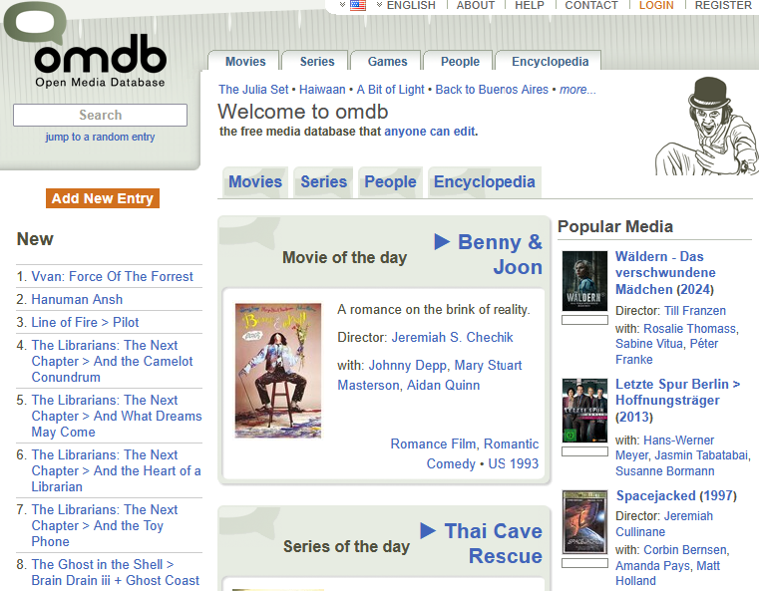
Open Movie Database

Slide 4
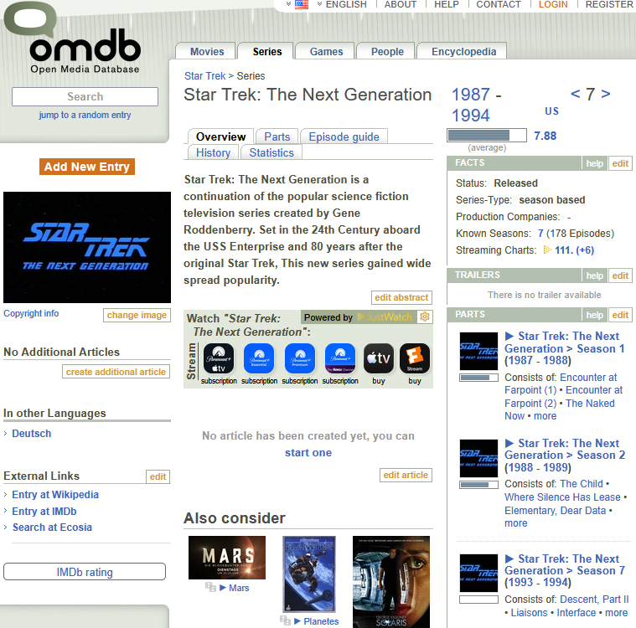

Slide 5
Industry Standard Analyses
For combinations of rating (1 to 10 stars) and engagement data (number of ratings)
Trends within seasons and across seasons
Examining association between rating and engagement
  Controversial, hidden gems, universally acclaimed
Predict rating, engagement, and rating weighted by engagement from show features
  Writer, Director, Actor, Description
Star Trek provides enough episodes and public access
  7 seasons, 176 episodes

Slide 6
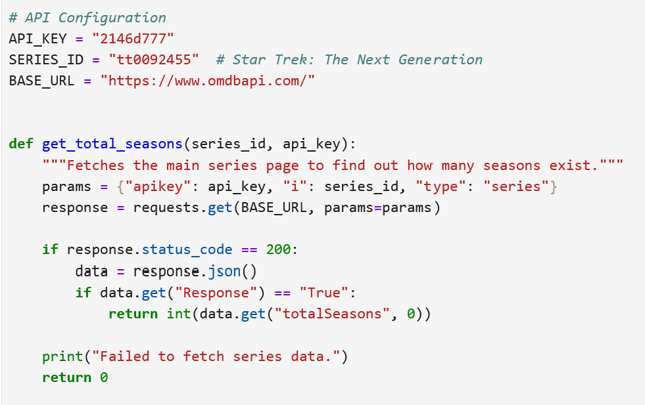
Data scraping

Slide 7
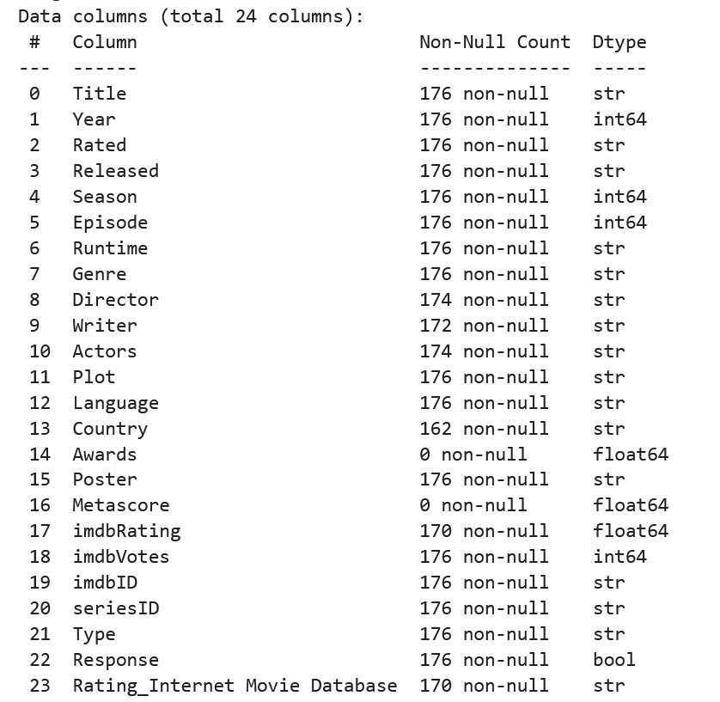
All fields

Slide 8
Variables of interest
Episode order number
imdbRating
imdbVotes
Director
Writer
(“Actors” data was zero variance)

Slide 9
Data cleaning
Total missing cells = 12
Input from imdb search
  6 Imdb ratings
  4 writers
  2 directors

Slide 10
Ratings and engagement trends

Slide 11
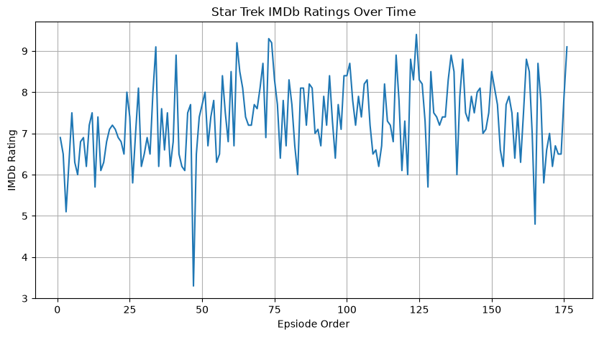

Slide 12
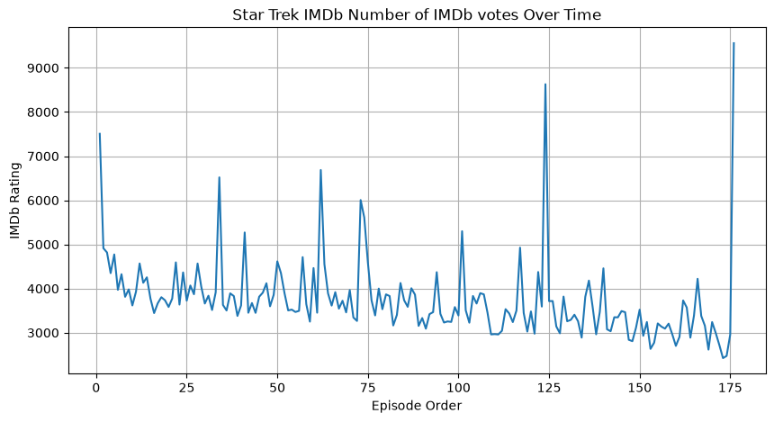

Slide 13
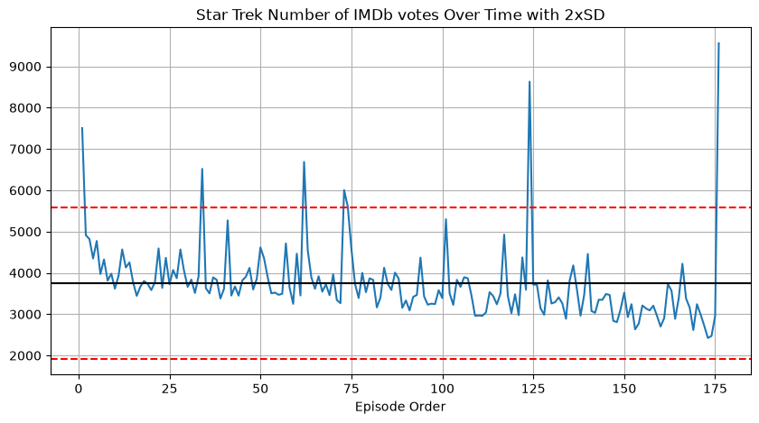

Slide 14
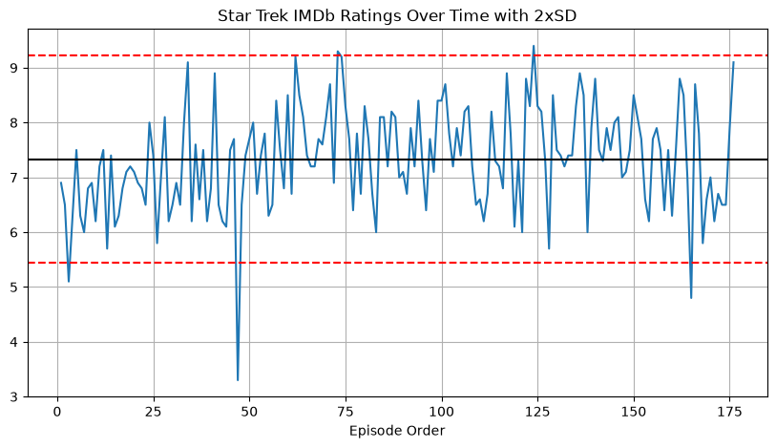

Slide 15
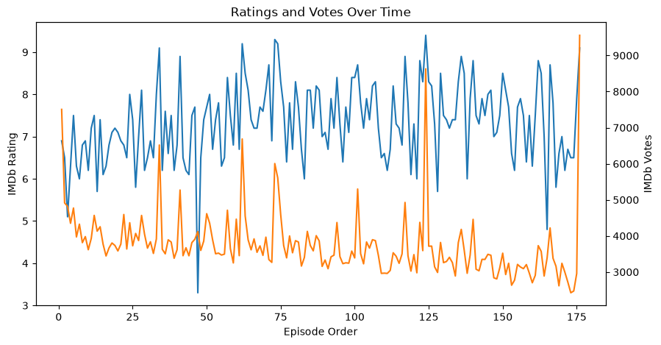

Slide 16
By season

Slide 17
ratings

Slide 18
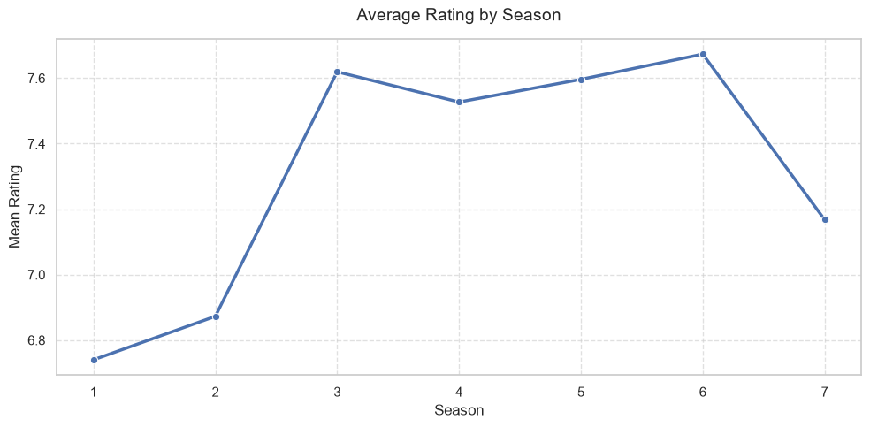

Slide 19
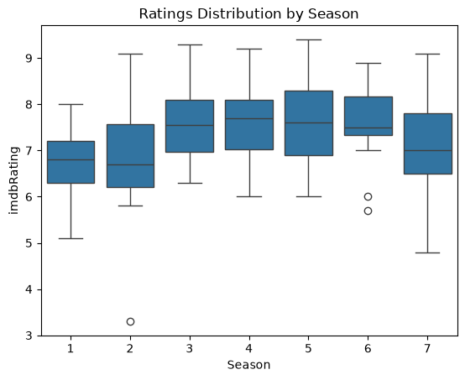

Slide 20
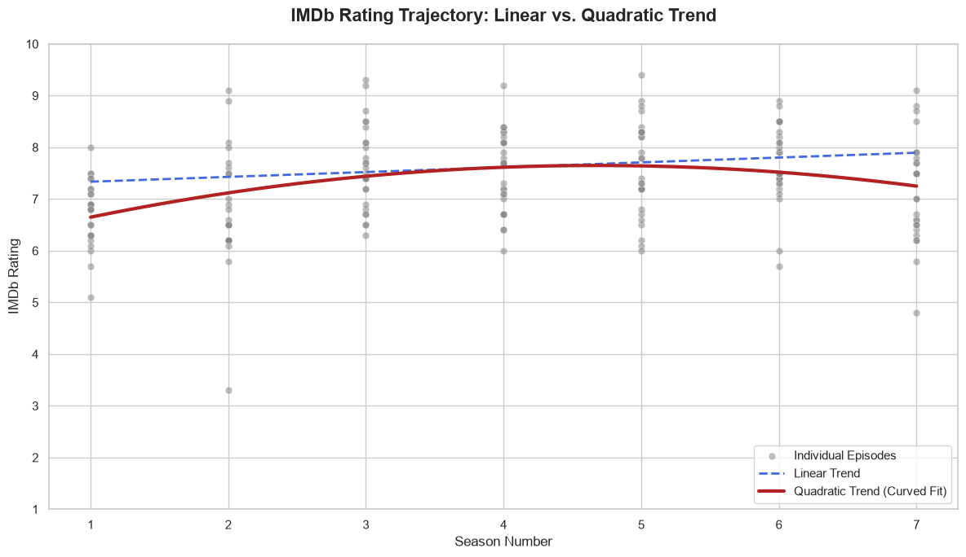

Slide 21
engagement

Slide 22
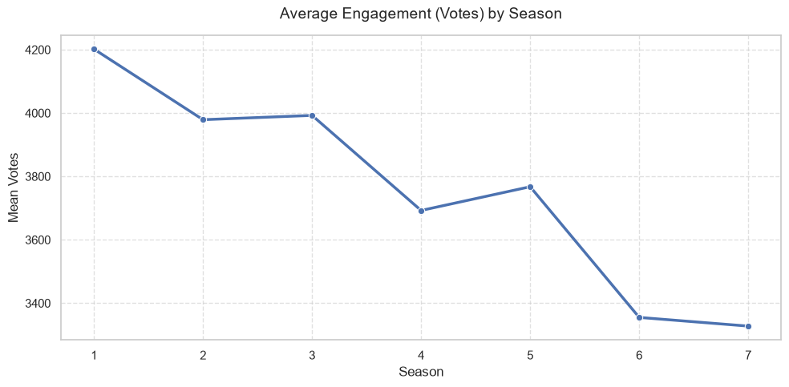

Slide 23
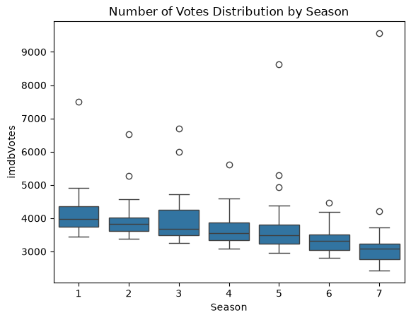

Slide 24
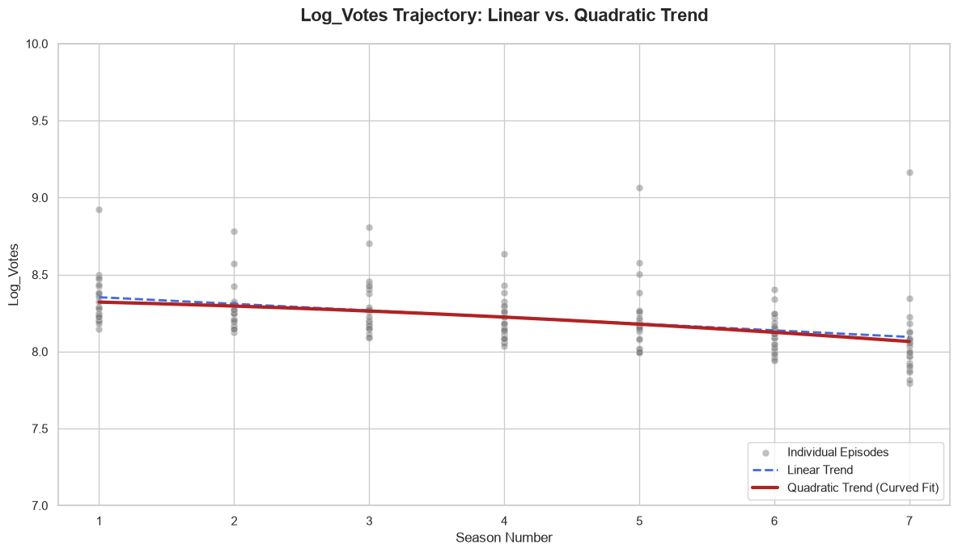

Slide 25
WITHIN-SEASON PATTERNS

Slide 26
RATINGS

Slide 27
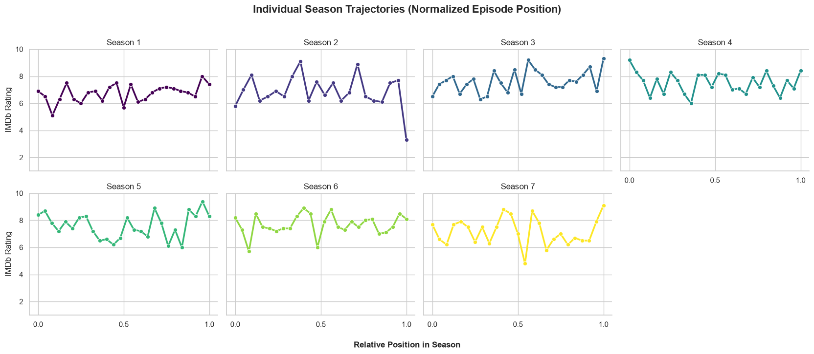

Slide 28
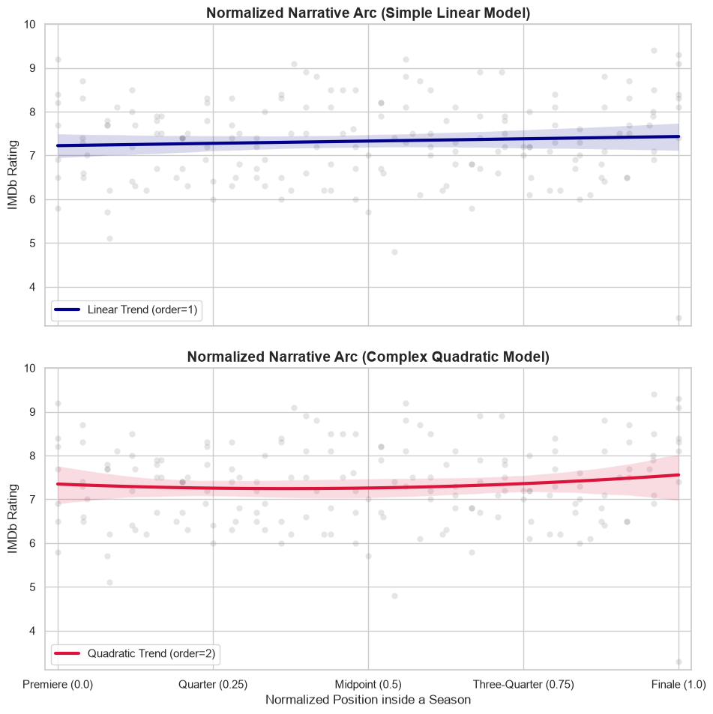
OLS regression:
Linear trend not significant
Quadratic trend significant

Slide 29
engagement

Slide 30
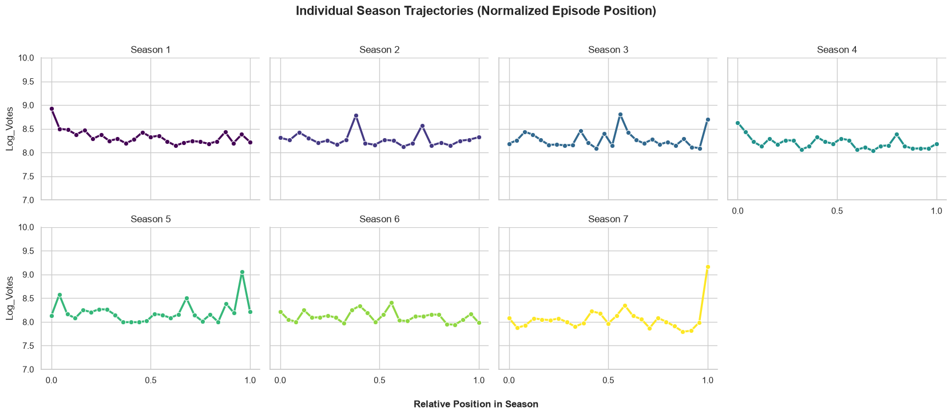

Slide 31
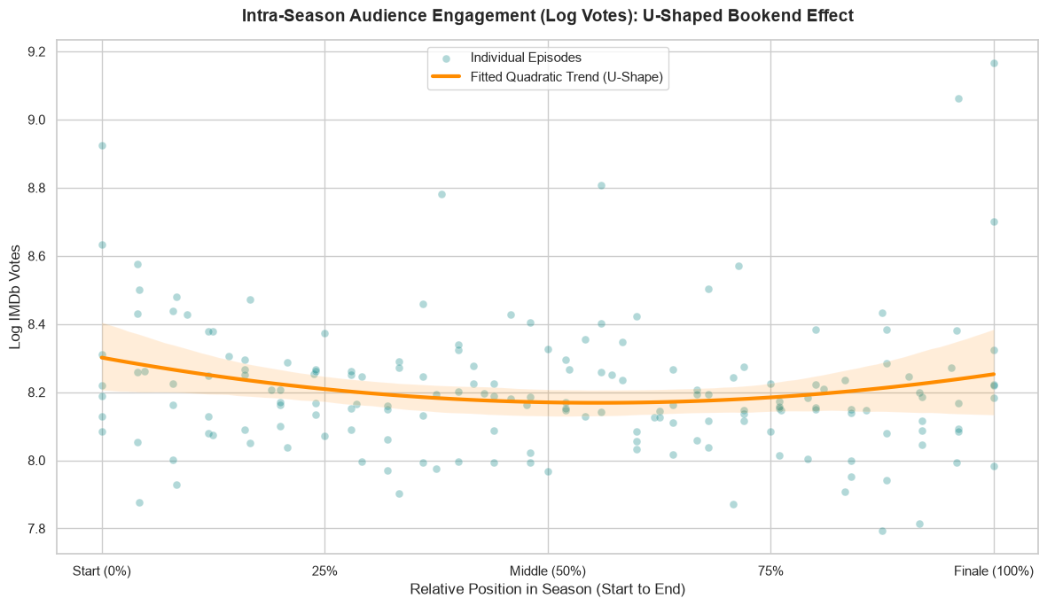
Linear = significant
Quadratic = not significant

Slide 32
Effect of season finale

Slide 33
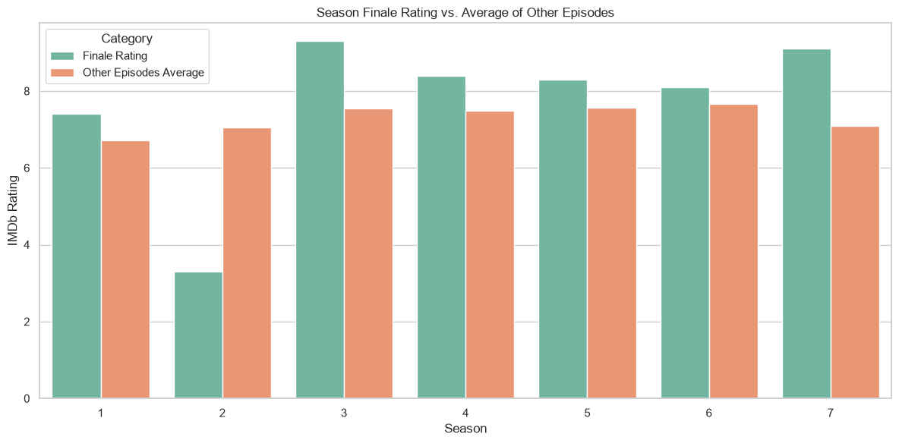

Slide 34
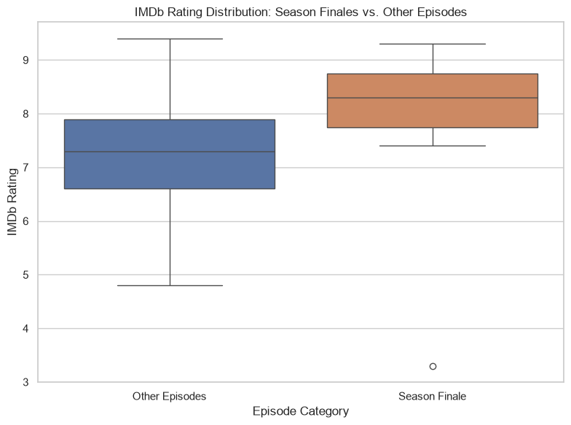

Slide 35
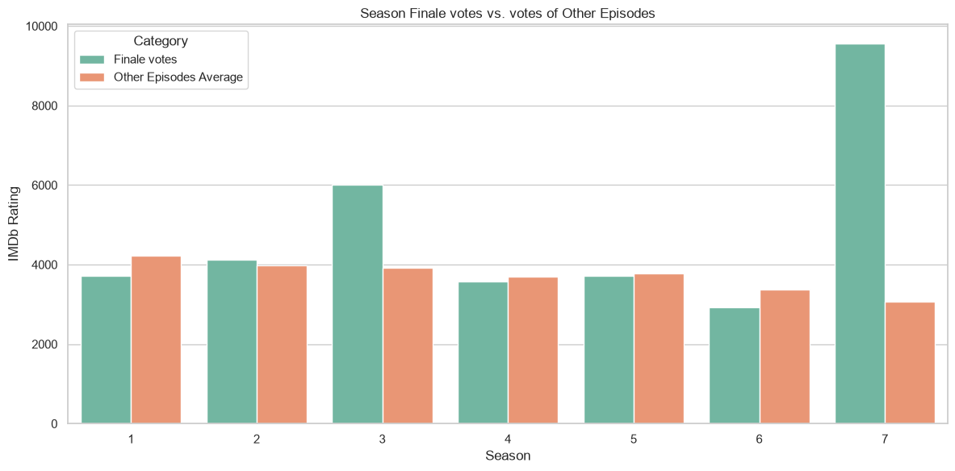

Slide 36
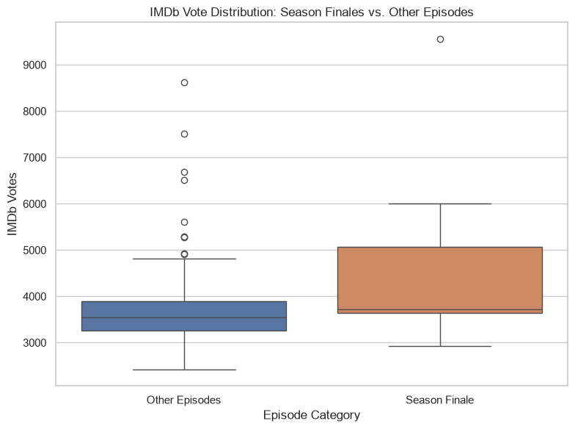

Slide 37
Ratings vs engagement

Slide 38
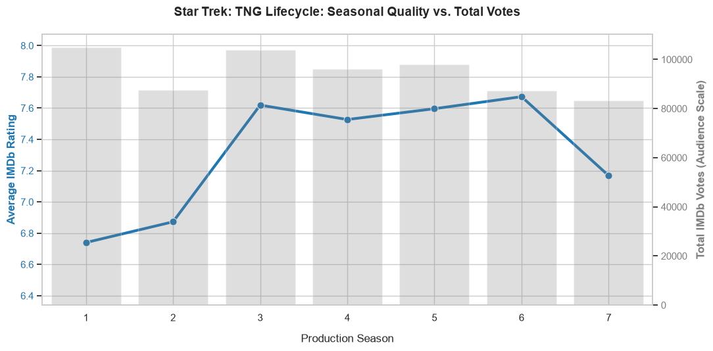

Slide 39
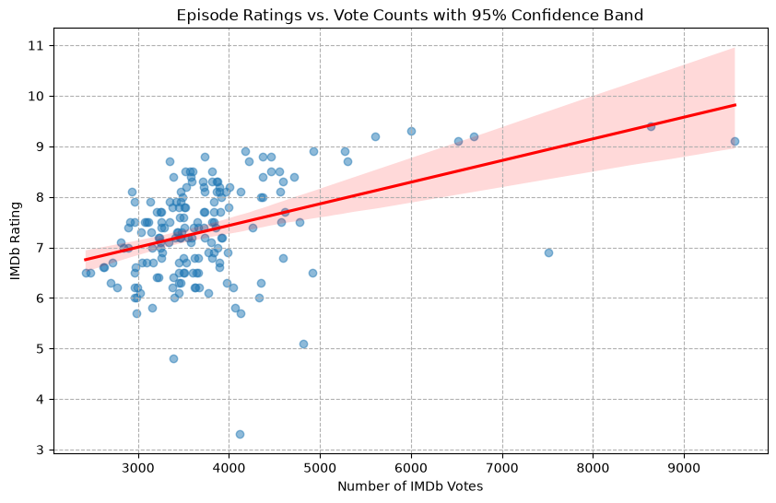

Slide 40
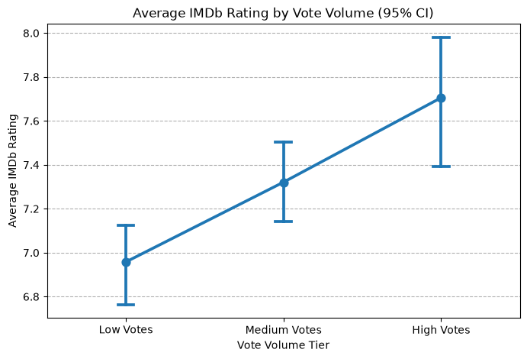

Slide 41
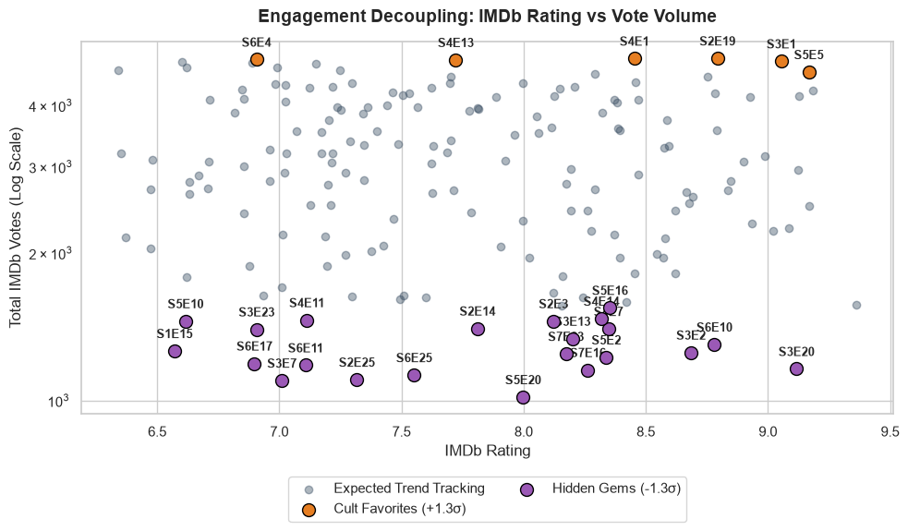

Slide 42
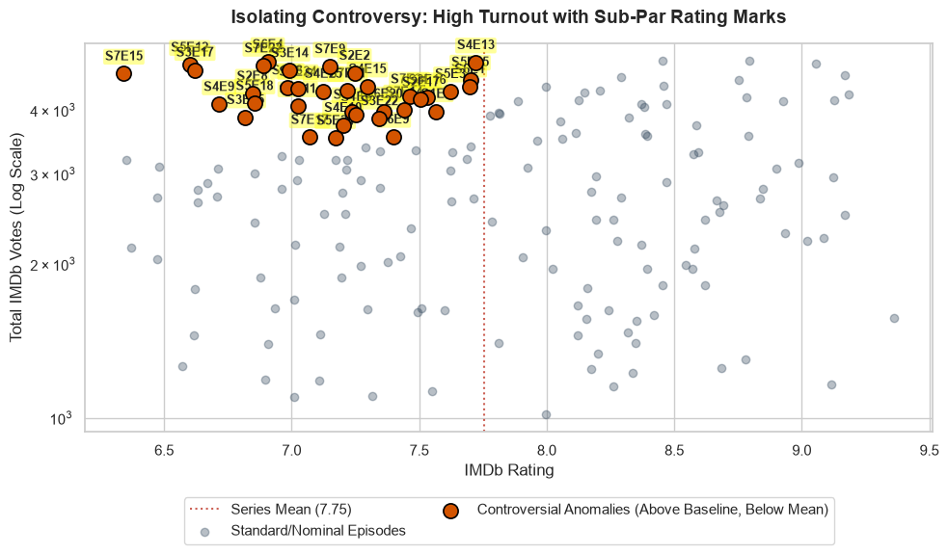

Slide 43
Writers and directors

Slide 44
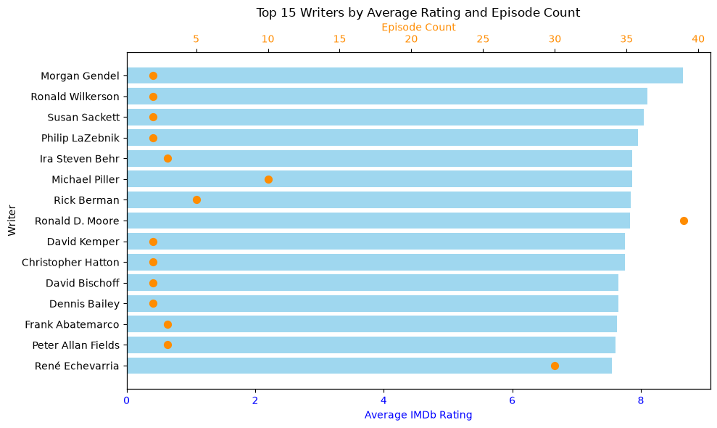

Slide 45
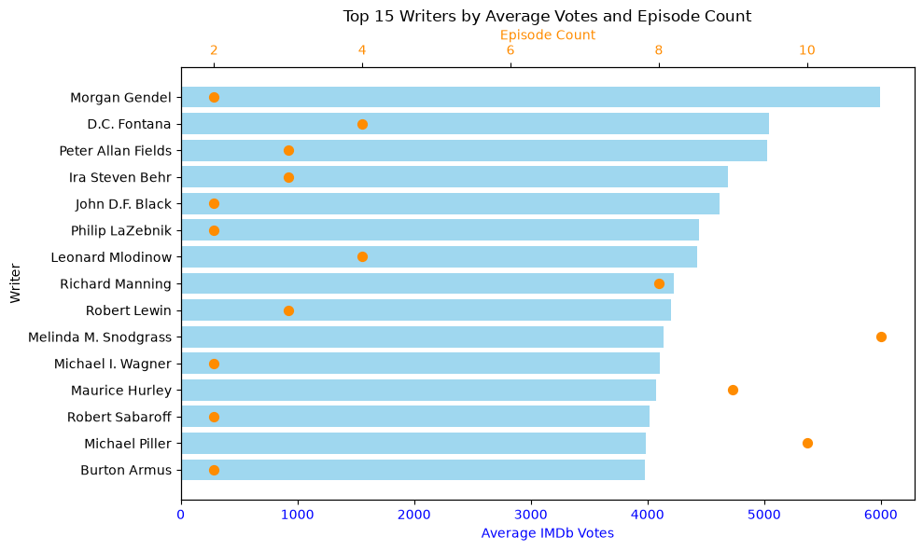

Slide 46
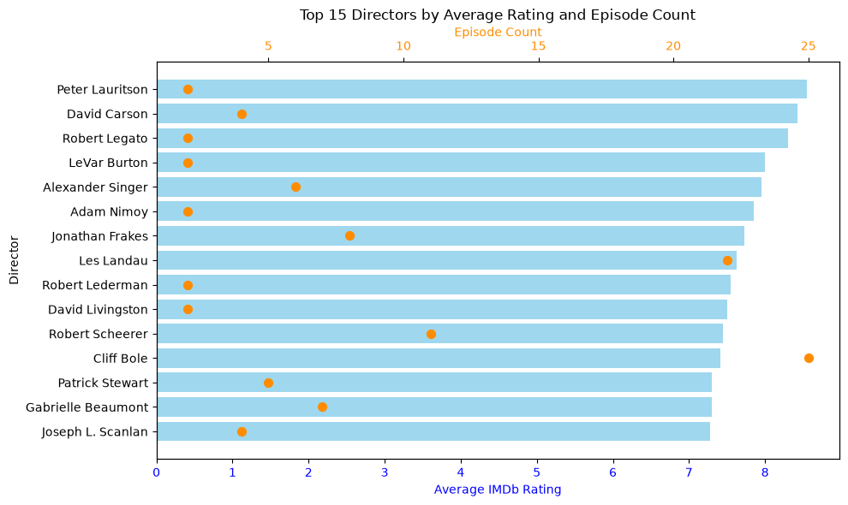

Slide 47
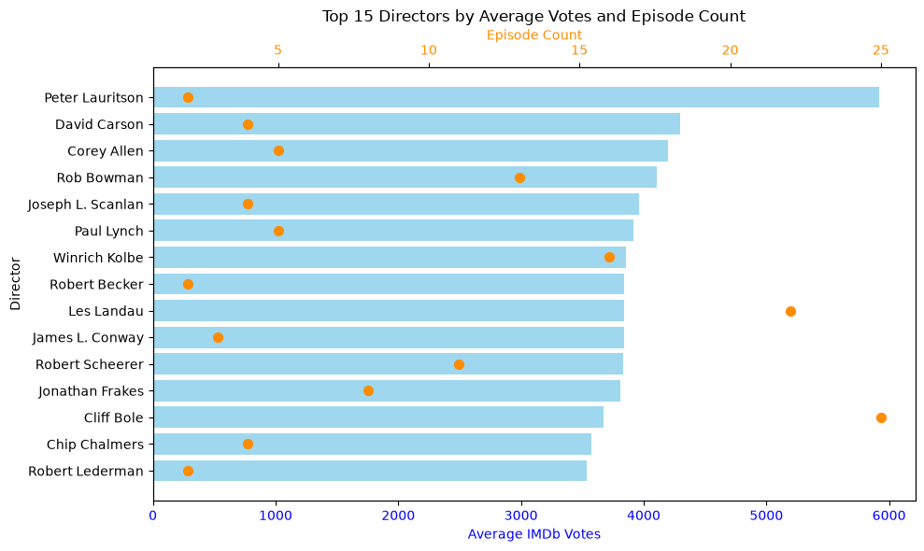

Slide 48
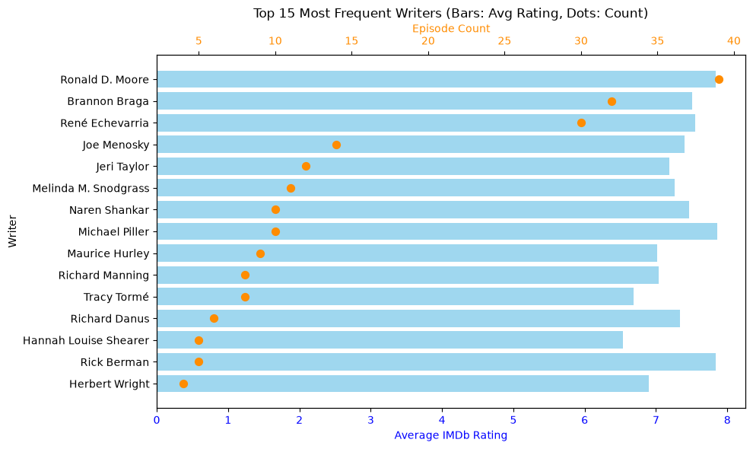

Slide 50
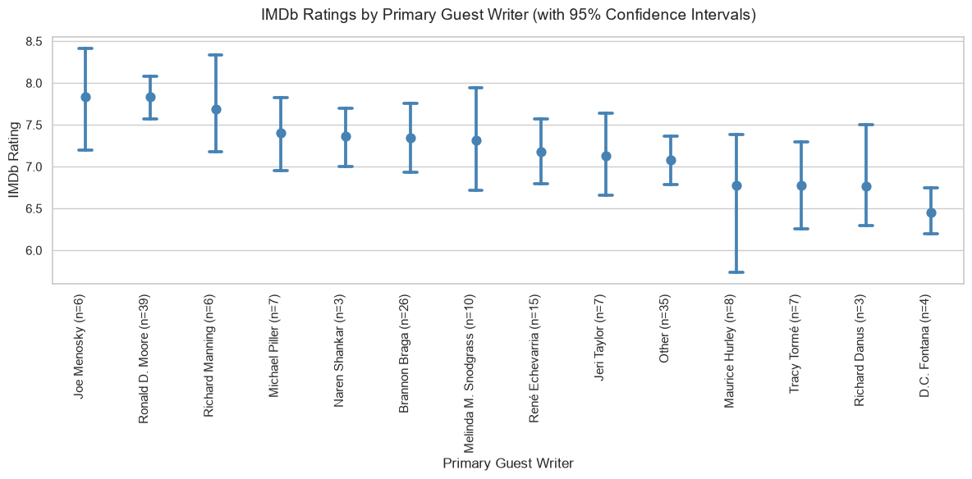

Slide 51
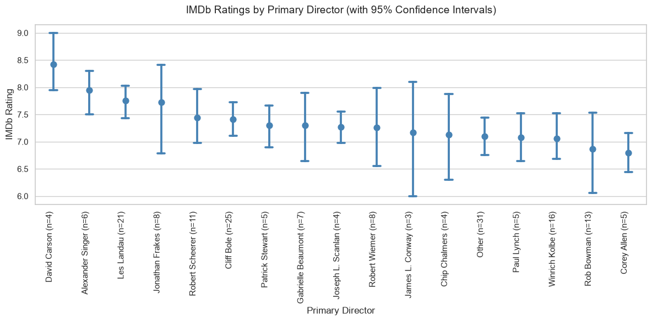

Slide 52
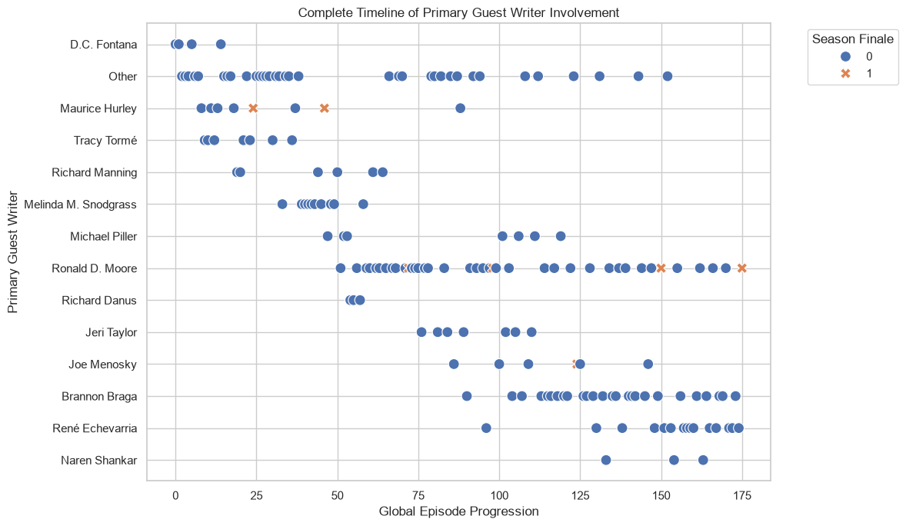

Slide 53
conclusions
Engagement follows expected positively skewed distribution (required log transformation)
Engagement and rating have expected positive relationship
Trends over the show
  Declining engagement
  Rising then falling ratings
Trends within seasons
  No overall effect
  Season finale effect – both ratings and engagement
Identified “controversial” and “hidden gem” episodes
Writer and Director features have too much variance

