Slide 1
Consumer archetypes in public data
Alanna Epstein, 10-16-2026
Trusted sources for messaging

Slide 2
Trusted sources
Suitable for advertising, political messages
How much confidence, if any, do you have in each of the following to act in the best interests of the public?
  Elected officials
  Journalists
  The military
  Religious leaders
  Public school principals
  Police officers
Unsupervised learning models (cluster analyses) gives more detail than averages

Slide 3
 | Recommend | Avoid
Liberals
Conservatives
Men
Women
College+
Some college
H.S. or less

Slide 4
Data Source and Quality

Slide 5
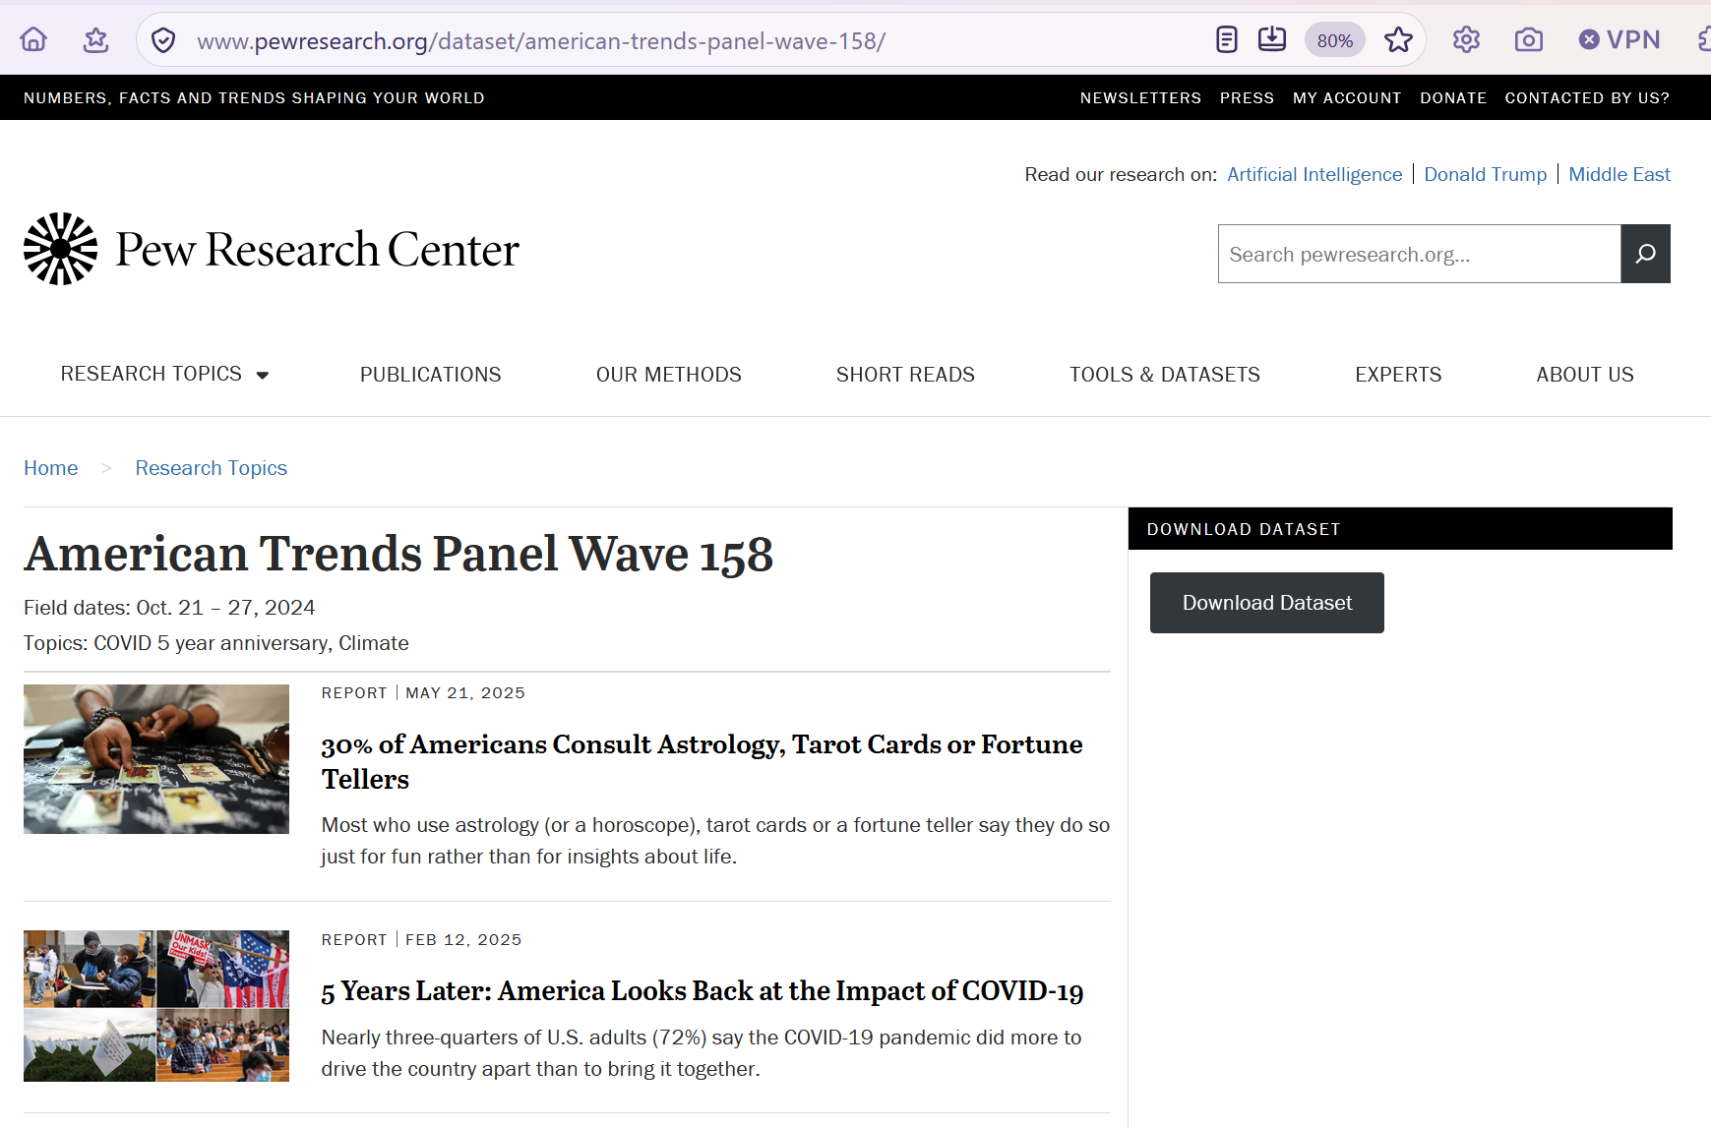

Slide 6
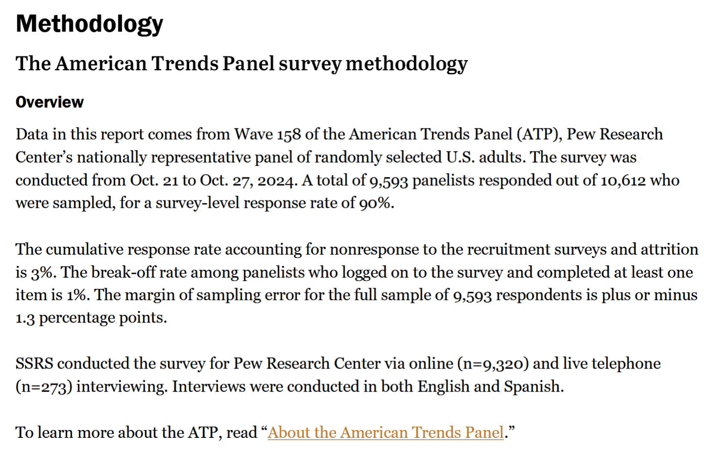

Slide 7
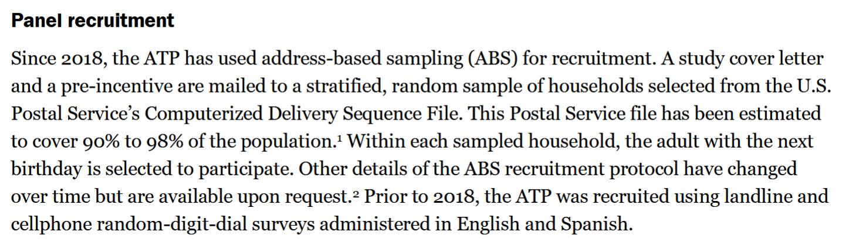

Slide 8
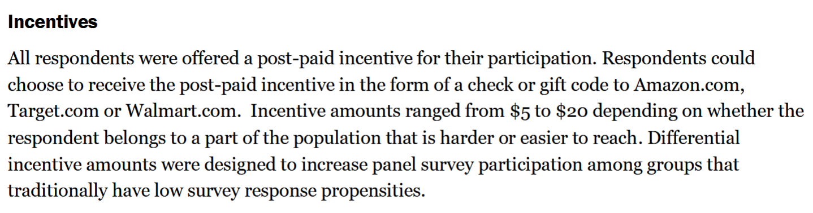

Slide 9
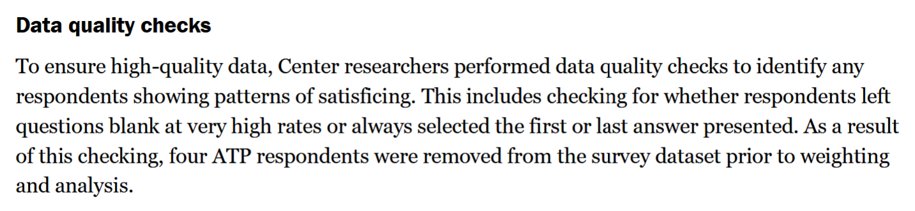

Slide 10
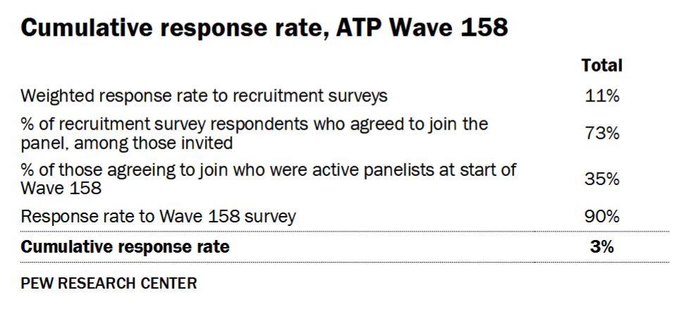

Slide 11
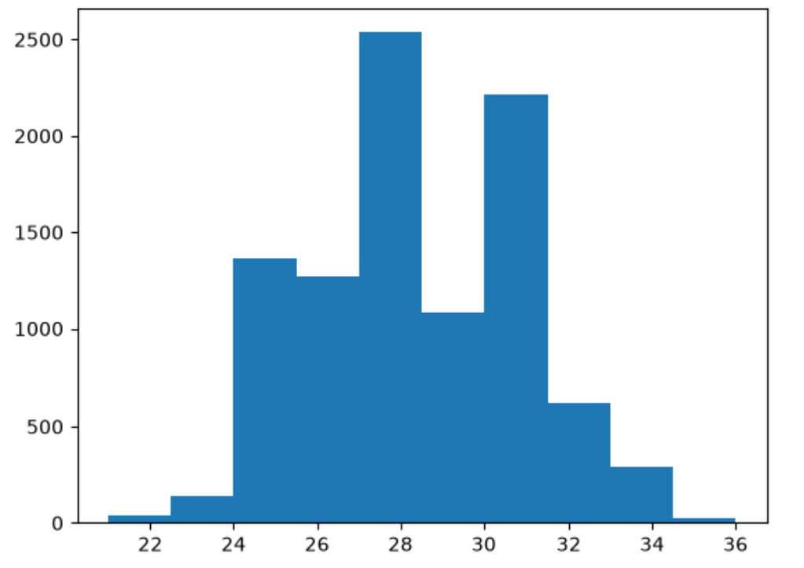
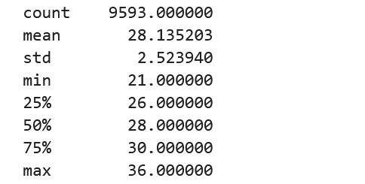
Missing per row

Slide 12
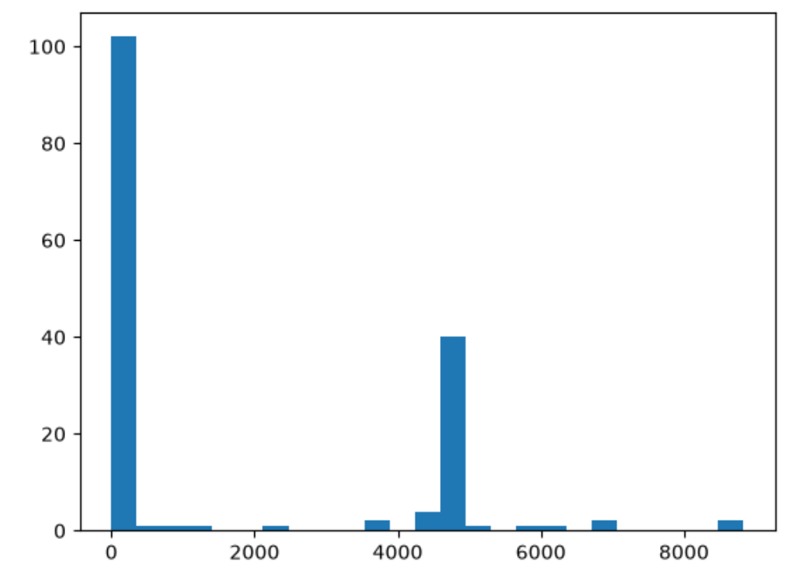
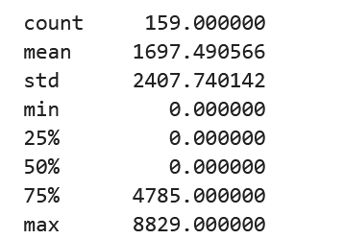
Missing per column

Slide 13
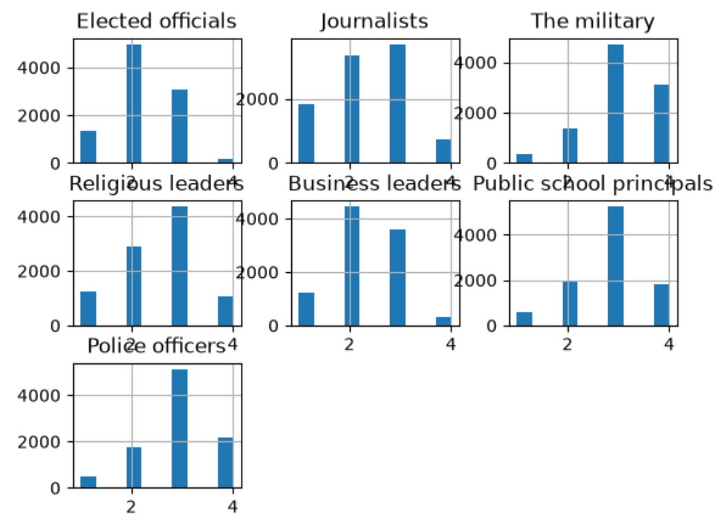
Data source and quality

Slide 14
Data exploration

Slide 15
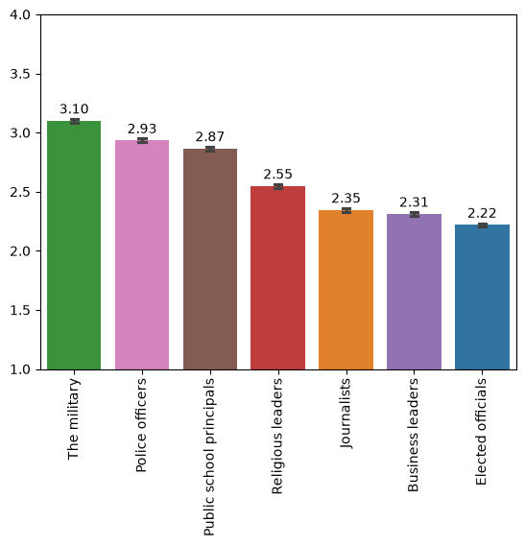
Average confidence in sources
4 | A great deal of confidence
3 | A fair amount of confidence
2 | Not too much confidence
1 | No confidence at all

Slide 16
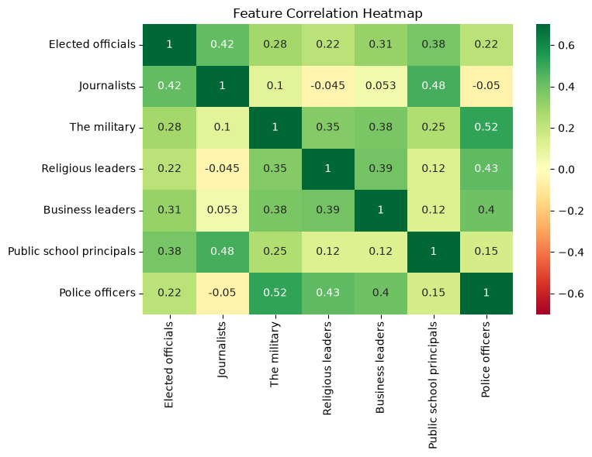

Slide 17
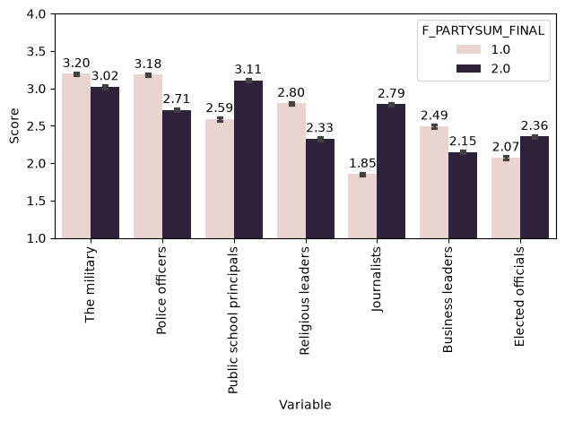

Slide 18
Robust cluster analyses
Average levels may mask important subgroup differences
Usefulness of “archetypes”

Slide 19
Robust cluster analyses
Compared 3 methods:
  K-means
  DBScan
  Hierarchical agglomerative
Assessed overall fit after selecting best cluster solution:
  Smallest cluster
  Largest cluster
  Silhouette
  Davies-Bouldin
  Calinski-Harabasz

Slide 20
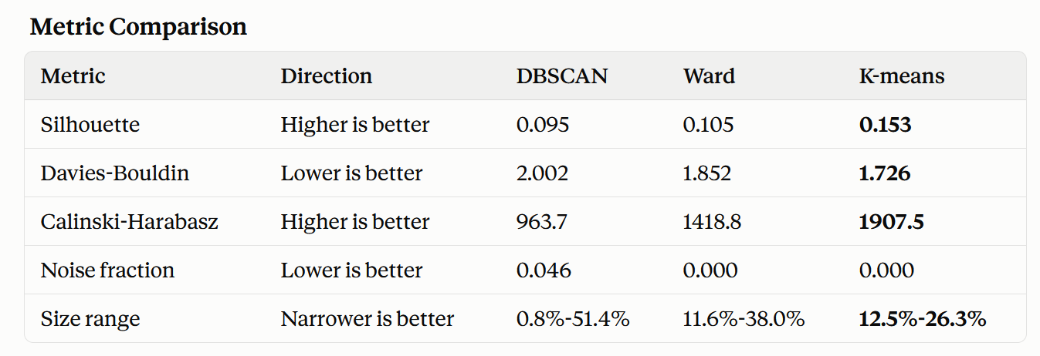
Cluster model selection

Slide 21
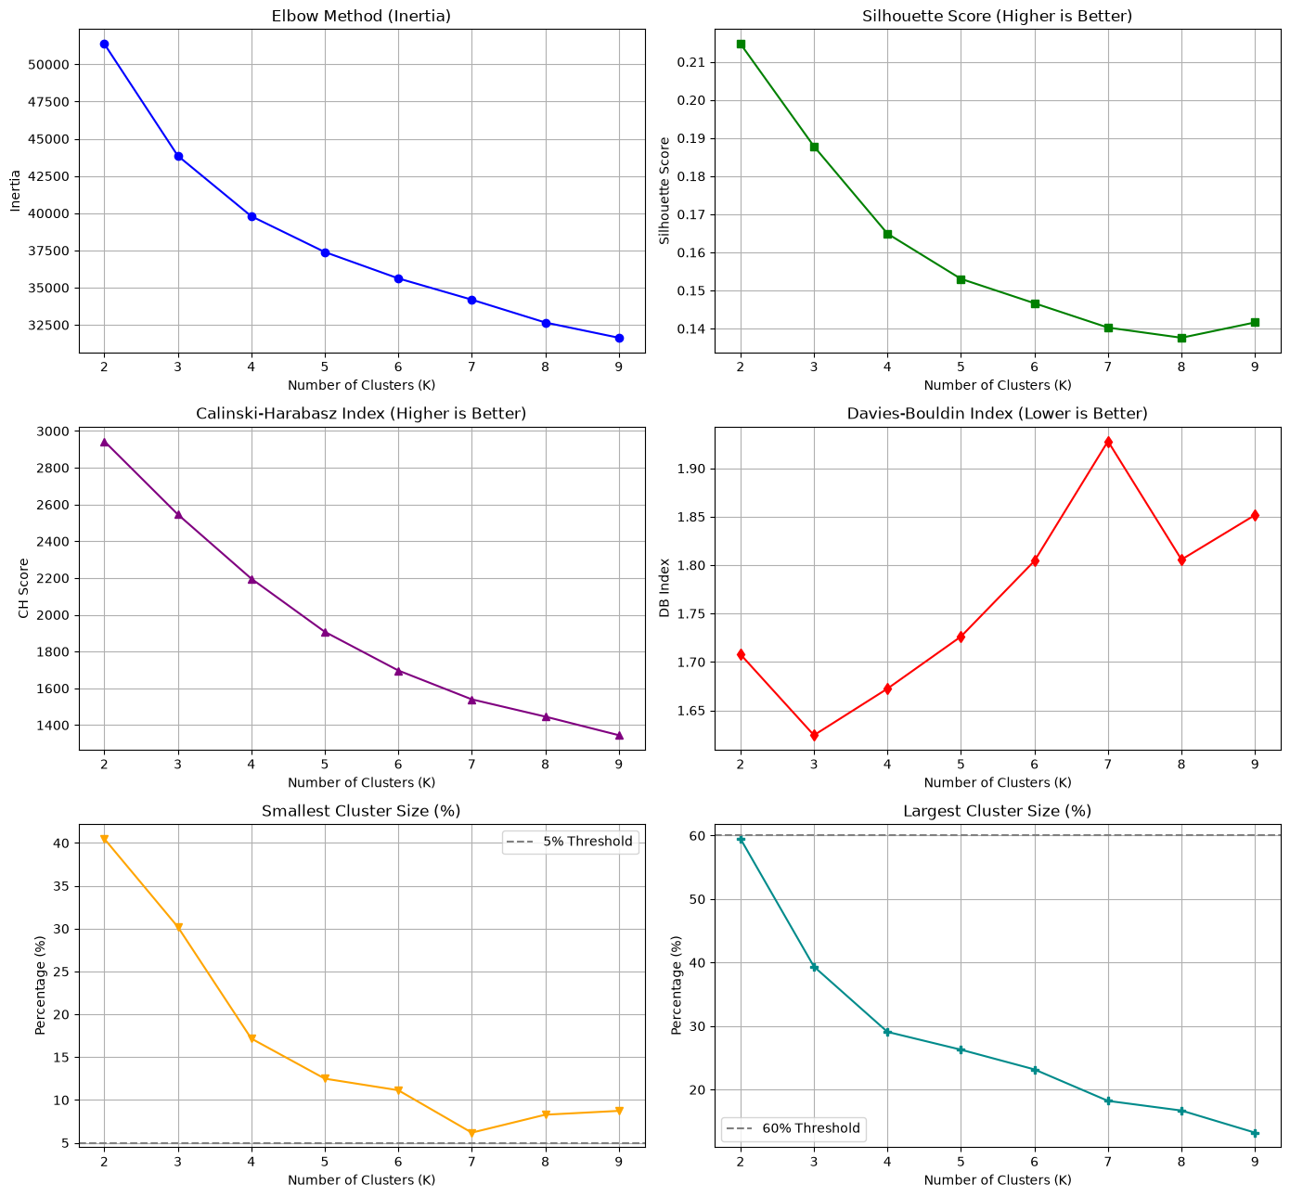

Slide 22
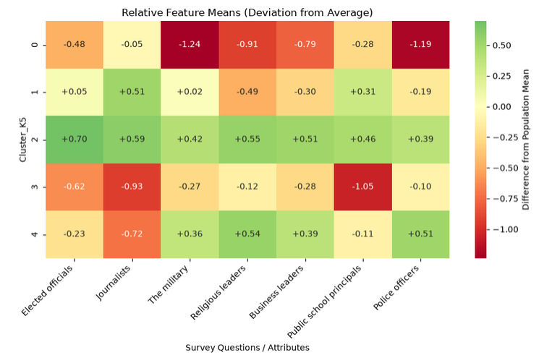

Slide 23
Dislike enforcement
Like journalists and principals
Approving
Dislike journalists and principals
Like religious and police

Slide 24
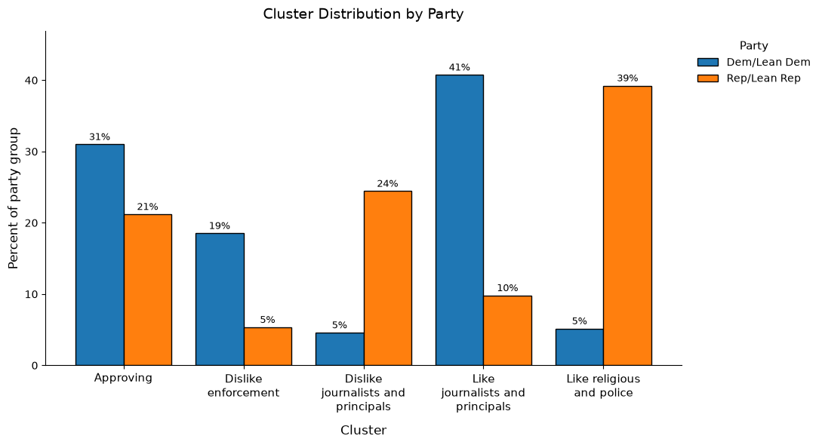

Slide 25
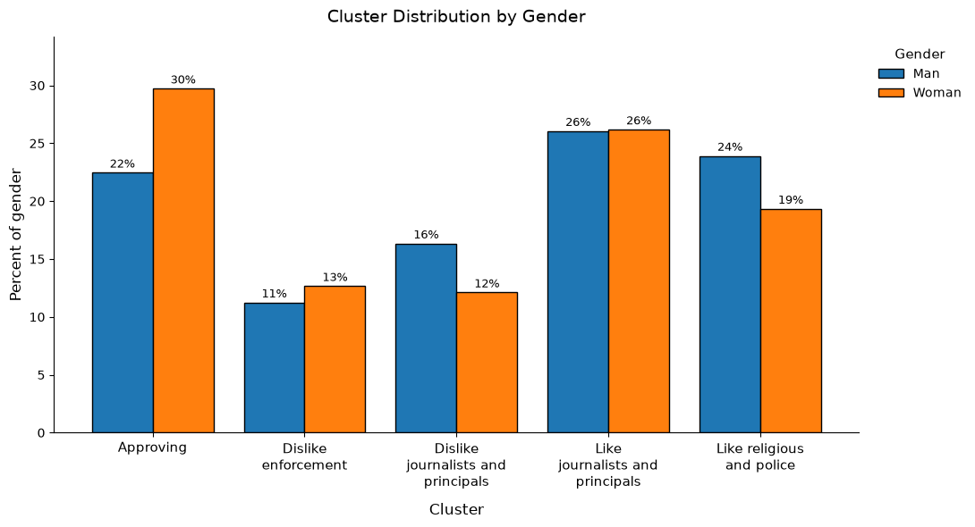

Slide 26
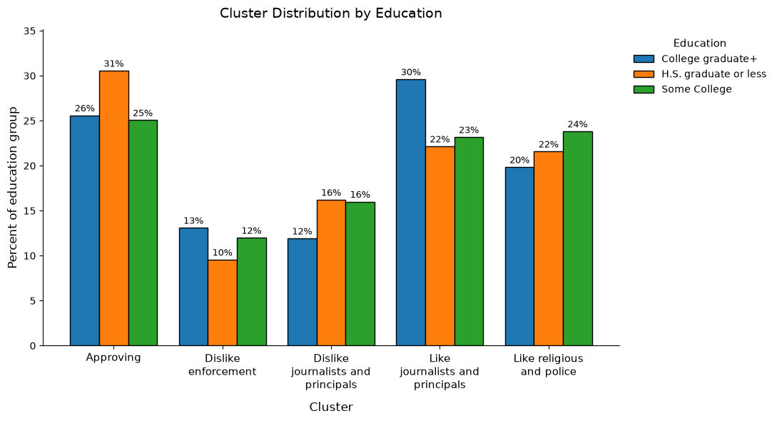

Slide 27
 | Recommend | Avoid
Liberals | Journalists, principals | Enforcement
Conservatives | Journalists, principals | Religious, police
Men | Religious, police
Women | Elected officials
College+ | Journalists, principals
Some college | Elected officials
H.S. or less

