Slide 2
Intro to HTML/CSS
Instructor: Alejandra O.N.
GitHub handle: @alequetzalli
Email: alejandra_quetzalli@yahoo.com

Slide 3
2 questions to determine if you can be in Tech…

Slide 4
1) Do you like learning new things?

Slide 5
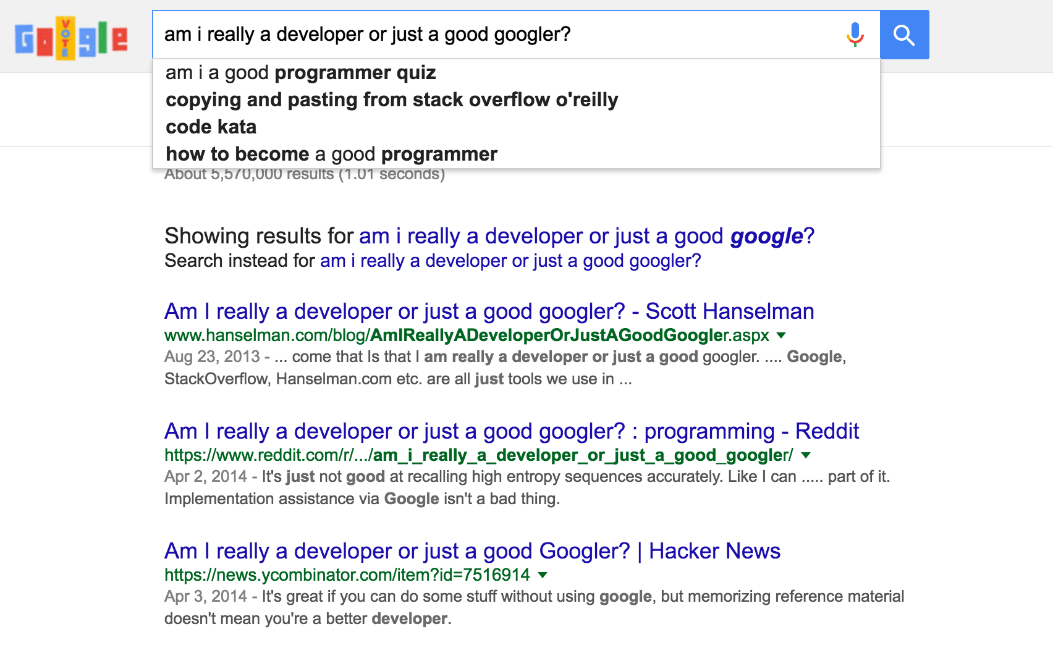
2) Do you know how to Google?

Slide 6
What is HTML?
HTML provides the content on a webpage.
H-T-M-L stands for HyperText Markup Language:
HyperText refers to how you move around on the web — by clicking on special text called hyperlinks, you can move to the next page.
The fact that it is hyper just means it is not linear — you can go to any place on the Internet by clicking on links — there is no specific order you must follow.
Markup is what HTML tags do to the text inside them. (italicized or bolded text, for example)
Language. HTML has code-words and syntax just like any other language.

Slide 7
What are HTML tags and how do they work?
HTML tags are what separate normal text from HTML code. The text is saved as a html file, and can be viewed through a browser like Chrome, Firefox, etc…
Different tags perform different functions:
<i> italicizes text </i>
<b> bolds text </b>
<h1>Signifies that this is a header 1 (title) of a post on the page</h1>
<p> This tag is used to signify the start of a paragraph.</p>
The basic format of a tag is a < >starting tag and a closing one</>.

Slide 8
What is CSS?
CSS provides the look and layout of the webpage.
C-S-S stands for Cascading Style Sheets.
CSS is a style language that defines the layout and look of HTML documents. It changes things such as the font, colors, spacing, height, background images, etc…
h1 {
font-size: 12px;
width: 200px;
margin-top: 25px;
color: purple;
}

Slide 9
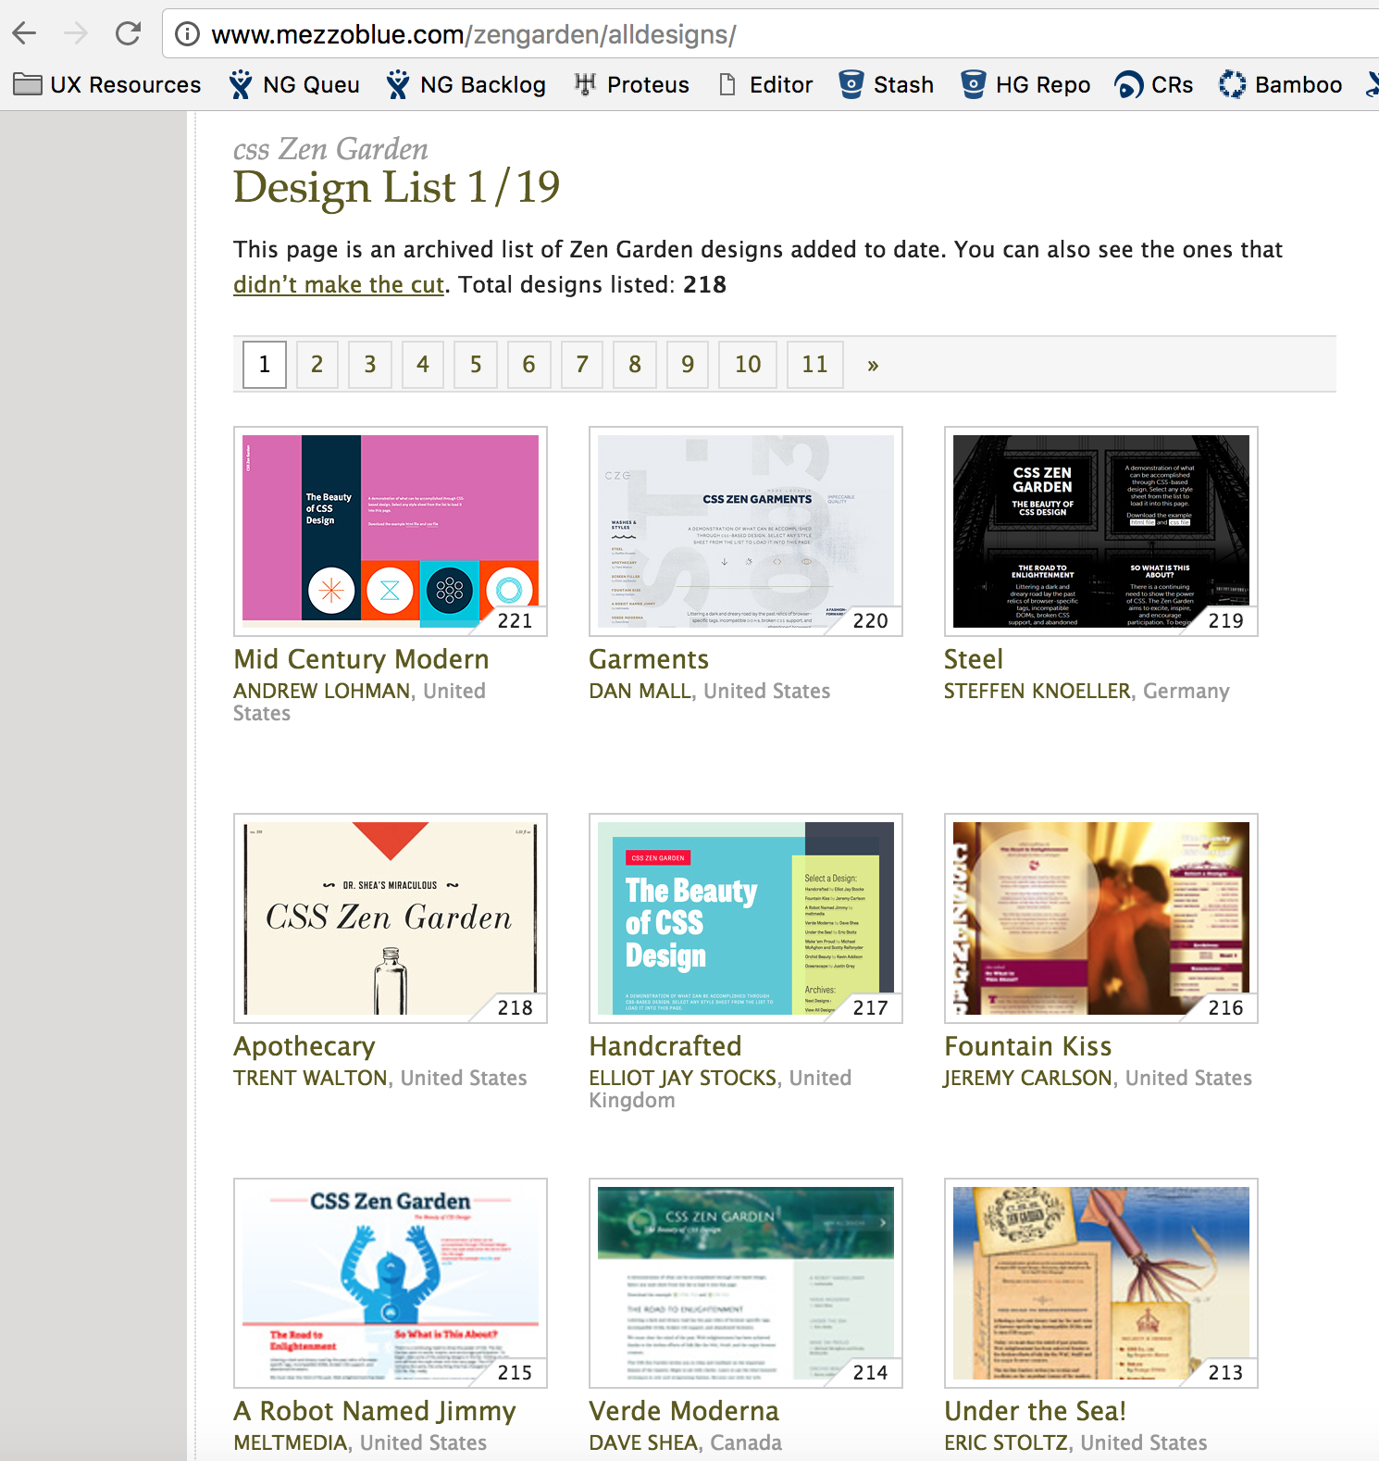
This website has the same HTML, but only the CSS is different!

Slide 10
CSS syntax is comprised of a few fundamental pieces; rules, selectors, declarations, properties and values.
h1 {
font-size: 12px;
width: 200px;
margin-top: 25px;
color: purple;
}
h1 {
font-size: 12px;
width: 200px;
margin-top: 25px;
color: purple;
}
h1 {
font-size: 12px;
width: 200px;
margin-top: 25px;
color: purple;
}
declaration
value
selector
property
rule

Slide 11
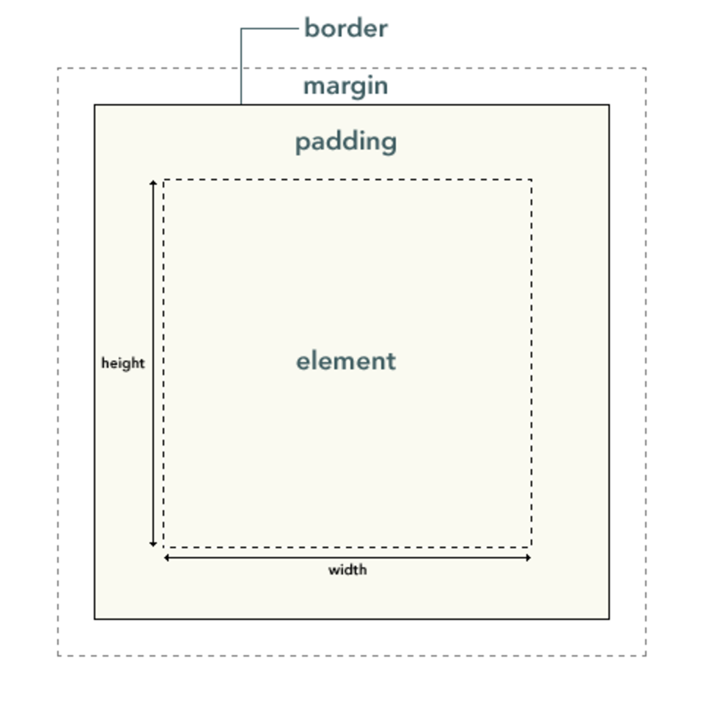
CSS Box Model
In HTML, each element is like a rectangular box.
In CSS, each of these rectangular boxes is represented using the box model. This model describes the content of the space taken by an element.
Each box has four parts:
border
margin
padding
content (element itself)

Slide 12
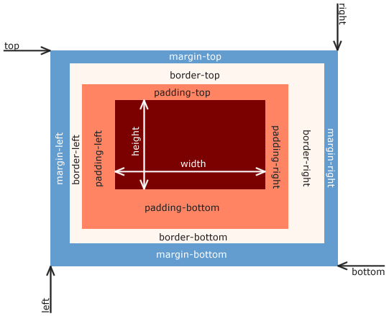
The size of each box is calculated like this…
Width = width + padding-left + padding-right + border-left + border-right
Height = height + padding-top + padding-bottom + border-top + border-bottom
Margin is unique in that it doesn't affect the size of the box itself per se, but it affects other content interacting with the box.
With CSS, you can adjust the size of those boxes and position them.

Slide 13
Block and Inline HTML Elements
In HTML, elements are by default "block" elements or "inline" elements.
A “block” element takes up an entire line, and thus each one lies on top of each other like this:
An "inline" element can lie next to each other in the same line like this:
<div> </div>
<span></span>
<span></span>
<span></span>
<div> </div>
<div> </div>
Let’s look at a code example of how “inline” and “block” elements behave differently here…

Slide 14
Position Content with CSS
One of the best things about CSS is that it gives us the ability to position content and elements on a page.
Here are a few ways you can position elements:
Floats: This allows you to position an element to the left or right of its container (parent) element. Example here…
Absolute positioning: This is a very powerful type of positioning that allows you to literally place any element exactly where you want it. You use the positioning coordinates of top, left, bottom, and right to set the location.
Example here…
Flexbox: (This is more advanced, but you can read more about that here...)

Slide 15
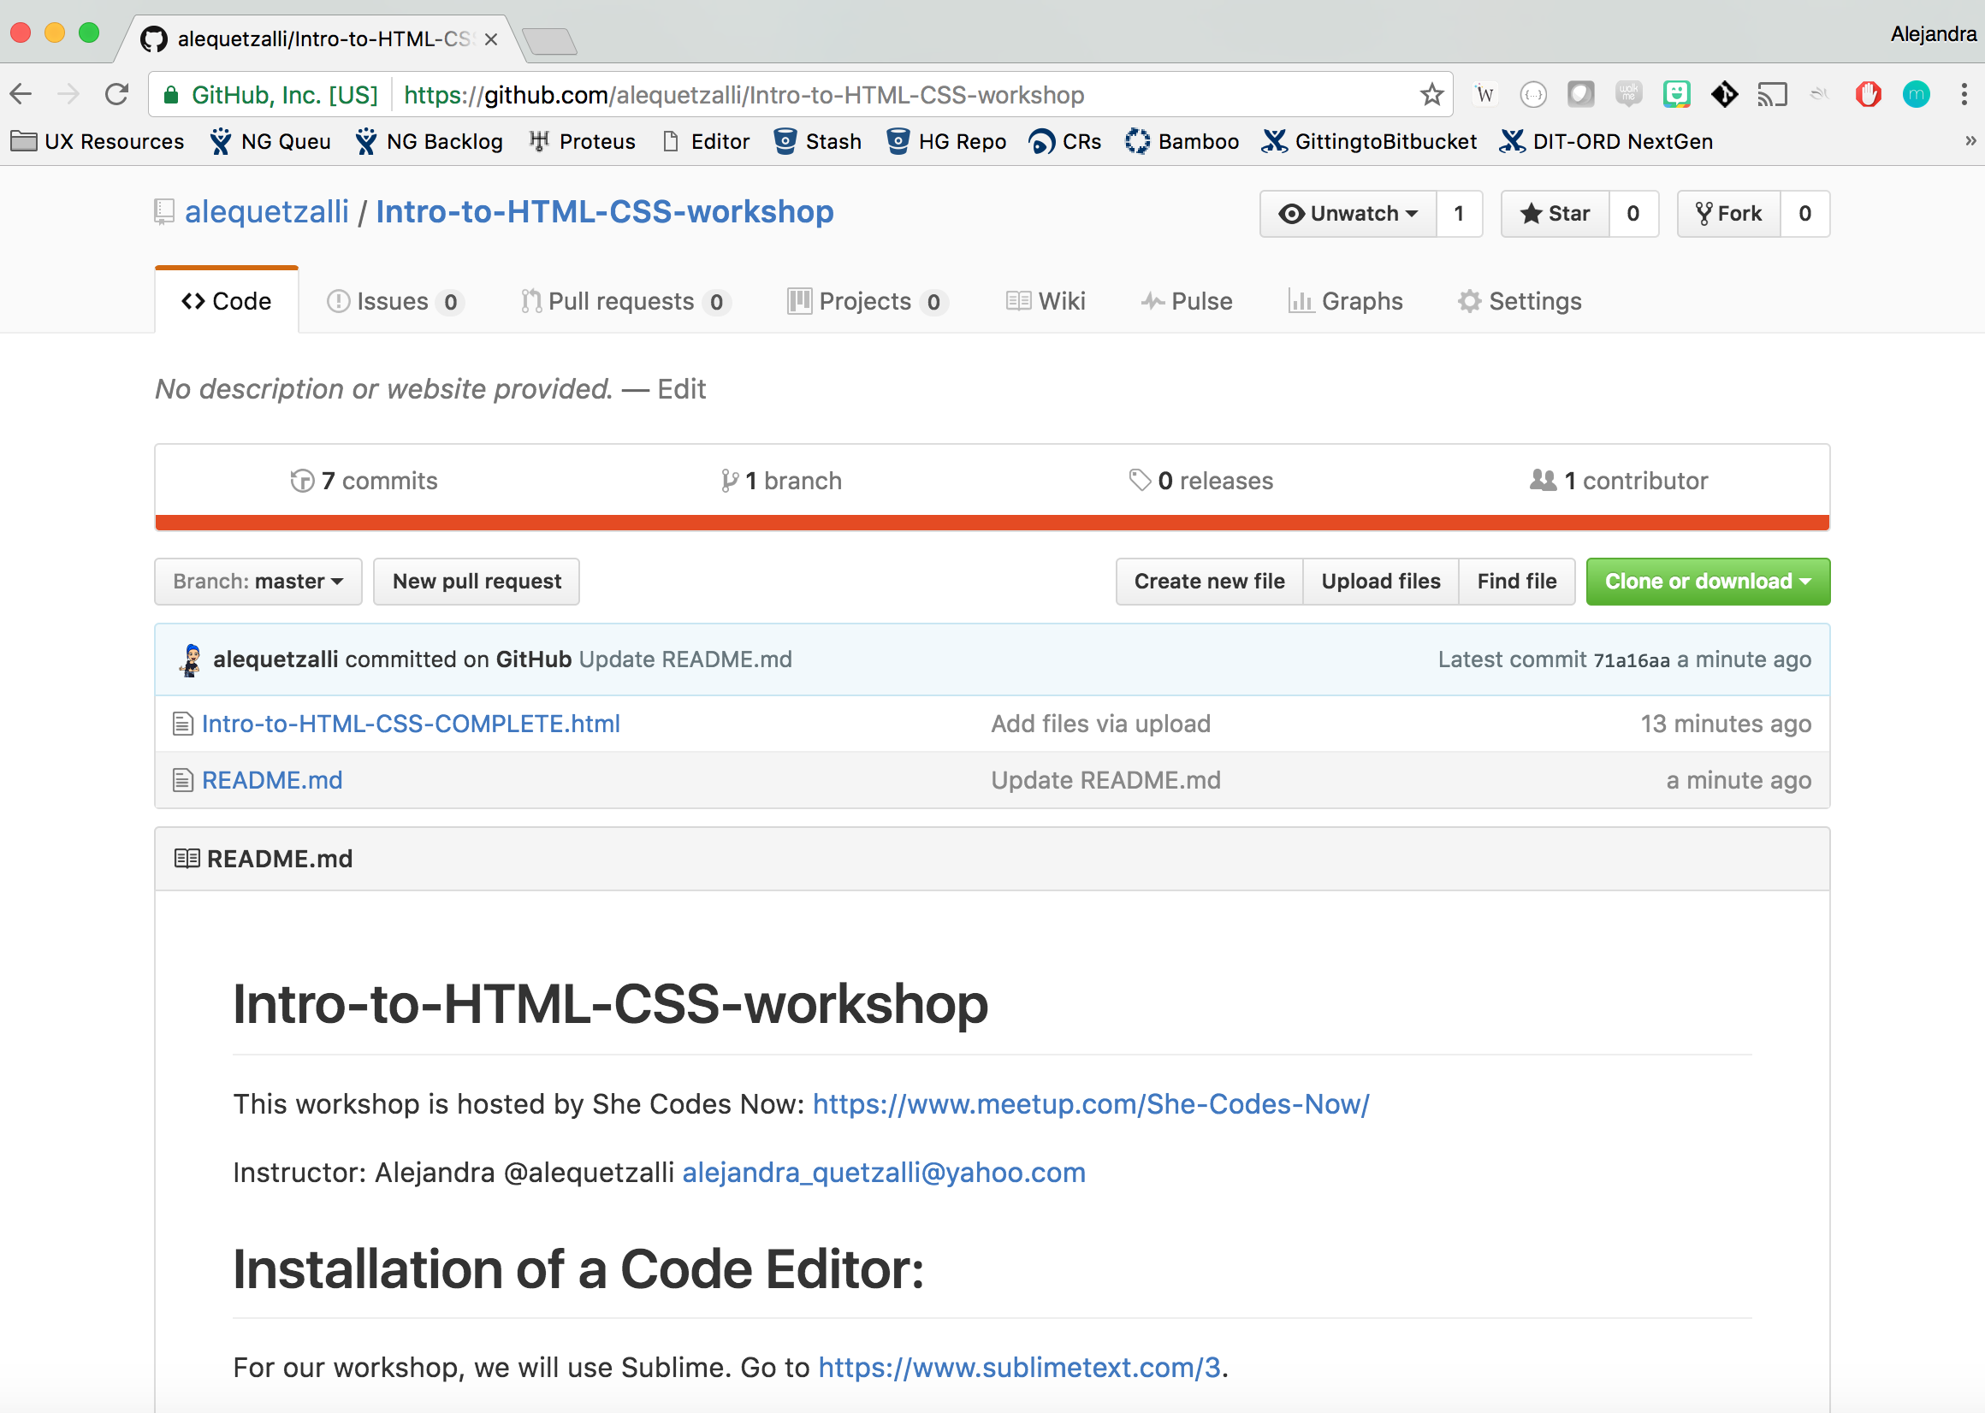
Now let’s build a webpage!
Go to our GitHub repo to get started: https://github.com/alequetzalli/Intro-to-HTML-CSS-workshop
GitHub is a code hosting platform for version control and collaboration.
Learn more here…

Slide 16
More HTML/CSS learning resources:
http://learn.shayhowe.com/html-css/
https://css-tricks.com/the-css-box-model/
https://www.sitepoint.com/web-foundations/css/
https://www.khanacademy.org/computing/computer-programming
http://www.howtogeek.com/180167/htg-explains-what-is-github-and-what-do-geeks-use-it-for/
https://www.codecademy.com/
https://teamtreehouse.com/
HTML and CSS: Design and Build Websites book by Jon Duckett

