Slide 2
Intro to HTML/CSS

Slide 3
2 questions to determine if you can be in Tech…

Slide 4
1) Do you like learning new things?

Slide 5
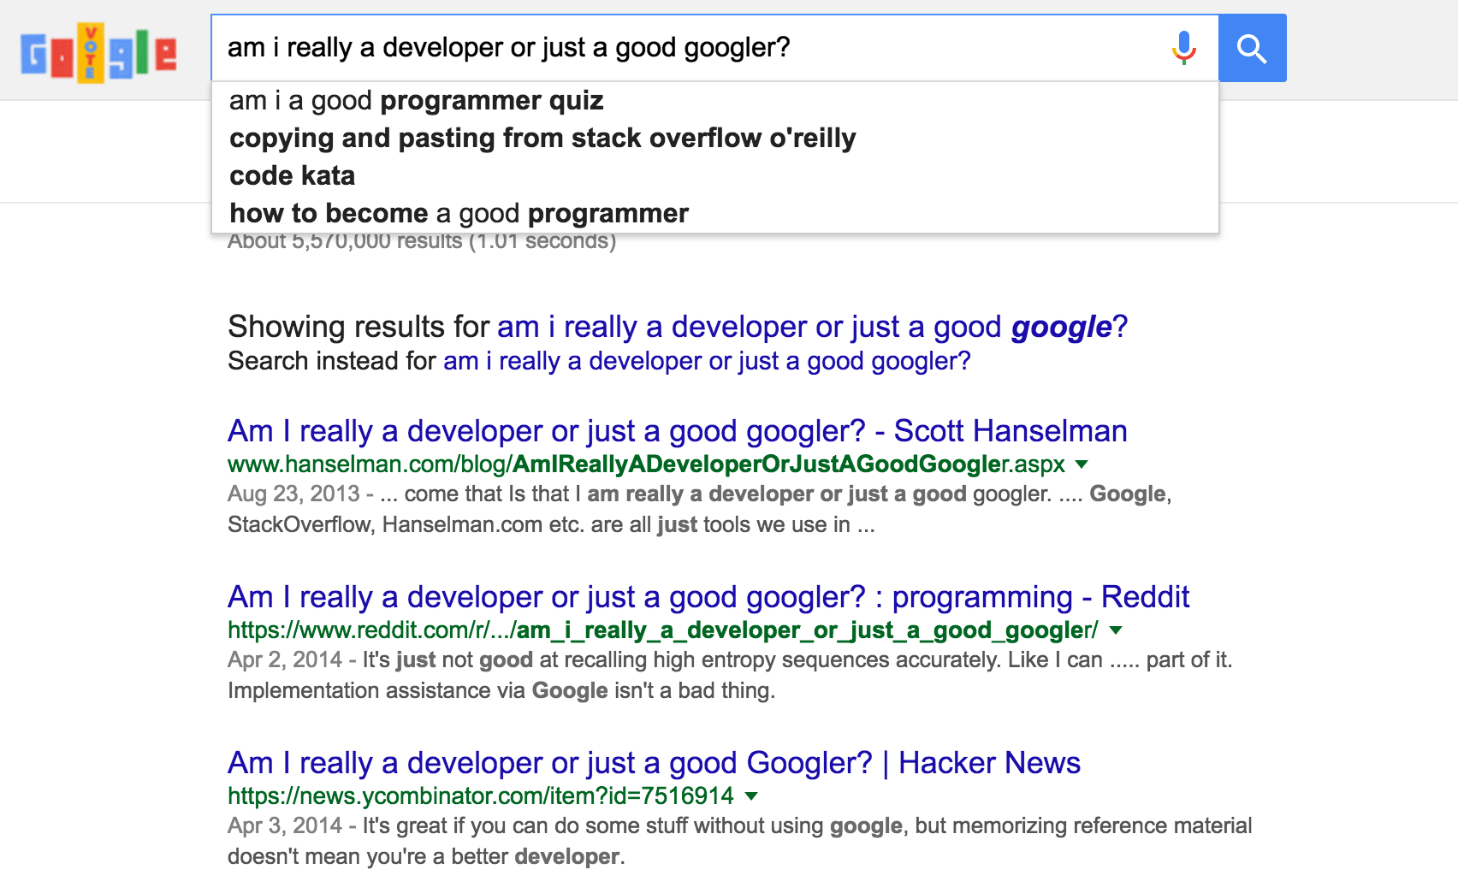
2) Do you know how to Google?

Slide 6
What is HTML?
HTML provides the content on a webpage.
H-T-M-L stands for HyperText Markup Language:
HyperText refers to how you move around on the web — by clicking on special text called hyperlinks, you can move to the next page.
The fact that it is hyper just means it is not linear — you can go to any place on the Internet by clicking on links — there is no specific order you must follow.
Markup is what HTML tags do to the text inside them. (italicized or bolded text, for example)
Language. HTML has code-words and syntax just like any other language.

Slide 7
What are HTML tags and how do they work?
HTML tags are what separate normal text from HTML code. The text is saved as a html file, and can be viewed through a browser like Chrome, Firefox, etc…
Different tags perform different functions:
<i> italicizes text </i>
<b> bolds text </b>
<h1>Signifies that this is a header 1 (title) of a post on the page</h1>
<p> This tag is used to signify the start of a paragraph.</p>
The basic format of a tag is a < >starting tag and a closing one</>.

Slide 8
What is CSS?
CSS provides the look and layout of the webpage.
C-S-S stands for Cascading Style Sheets.
CSS is a style language that defines the layout and look of HTML documents. It changes things such as the font, colors, spacing, height, background images, etc…
h1 {
font-size: 12px;
width: 200px;
margin-top: 25px;
color: purple;
}

Slide 9
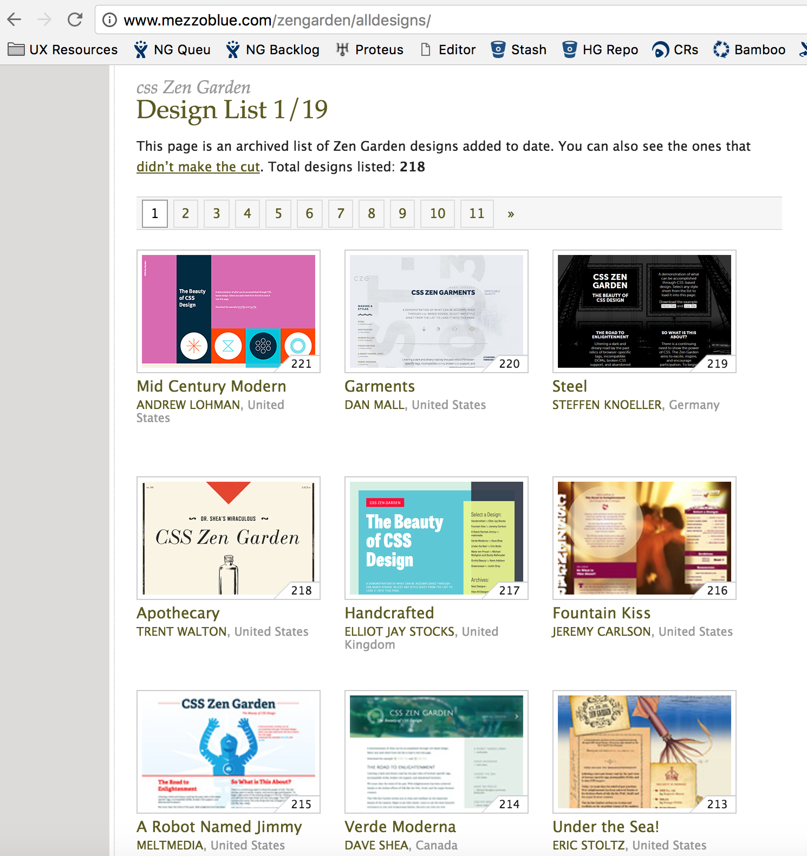
This website has the same HTML, but only the CSS is different!

Slide 10
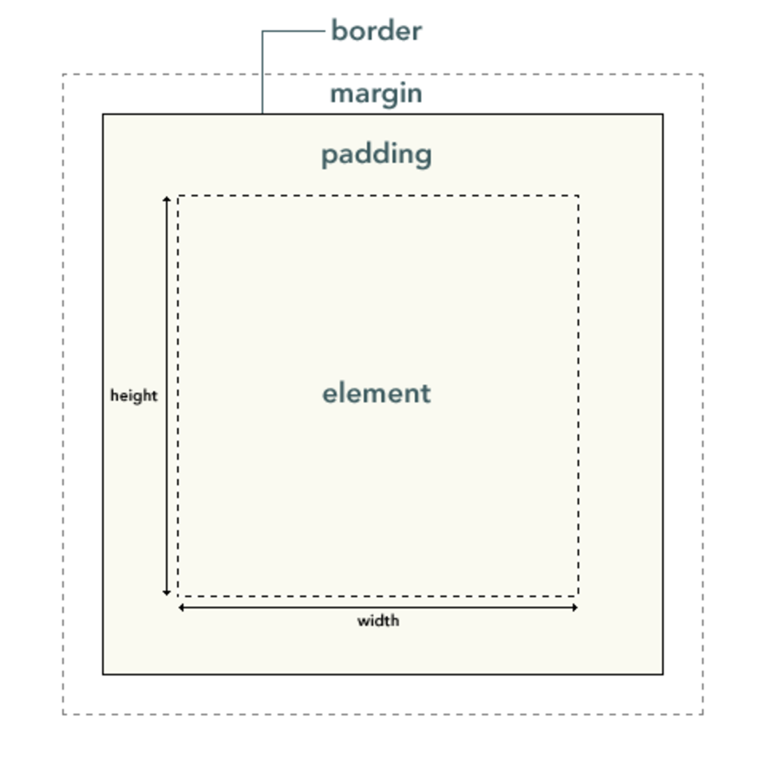
CSS Box Model
In HTML, each element is like a rectangular box.
In CSS, each of these rectangular boxes is represented using the box model. This model describes the content of the space taken by an element.
Each box has four parts:
border
margin
padding
content (element itself)

Slide 11
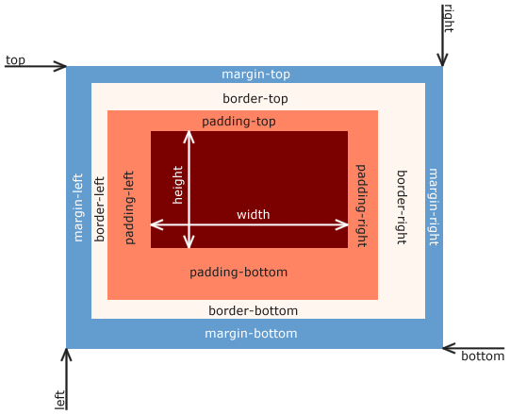
The size of each box is calculated like this…
Width = width + padding-left + padding-right + border-left + border-right
Height = height + padding-top + padding-bottom + border-top + border-bottom
With CSS, you can adjust the size of those boxes and position them.
Psst! Here is a great tutorial that teaches you more about how to position content on a page:
http://learn.shayhowe.com/html-css/positioning-content/

Slide 12
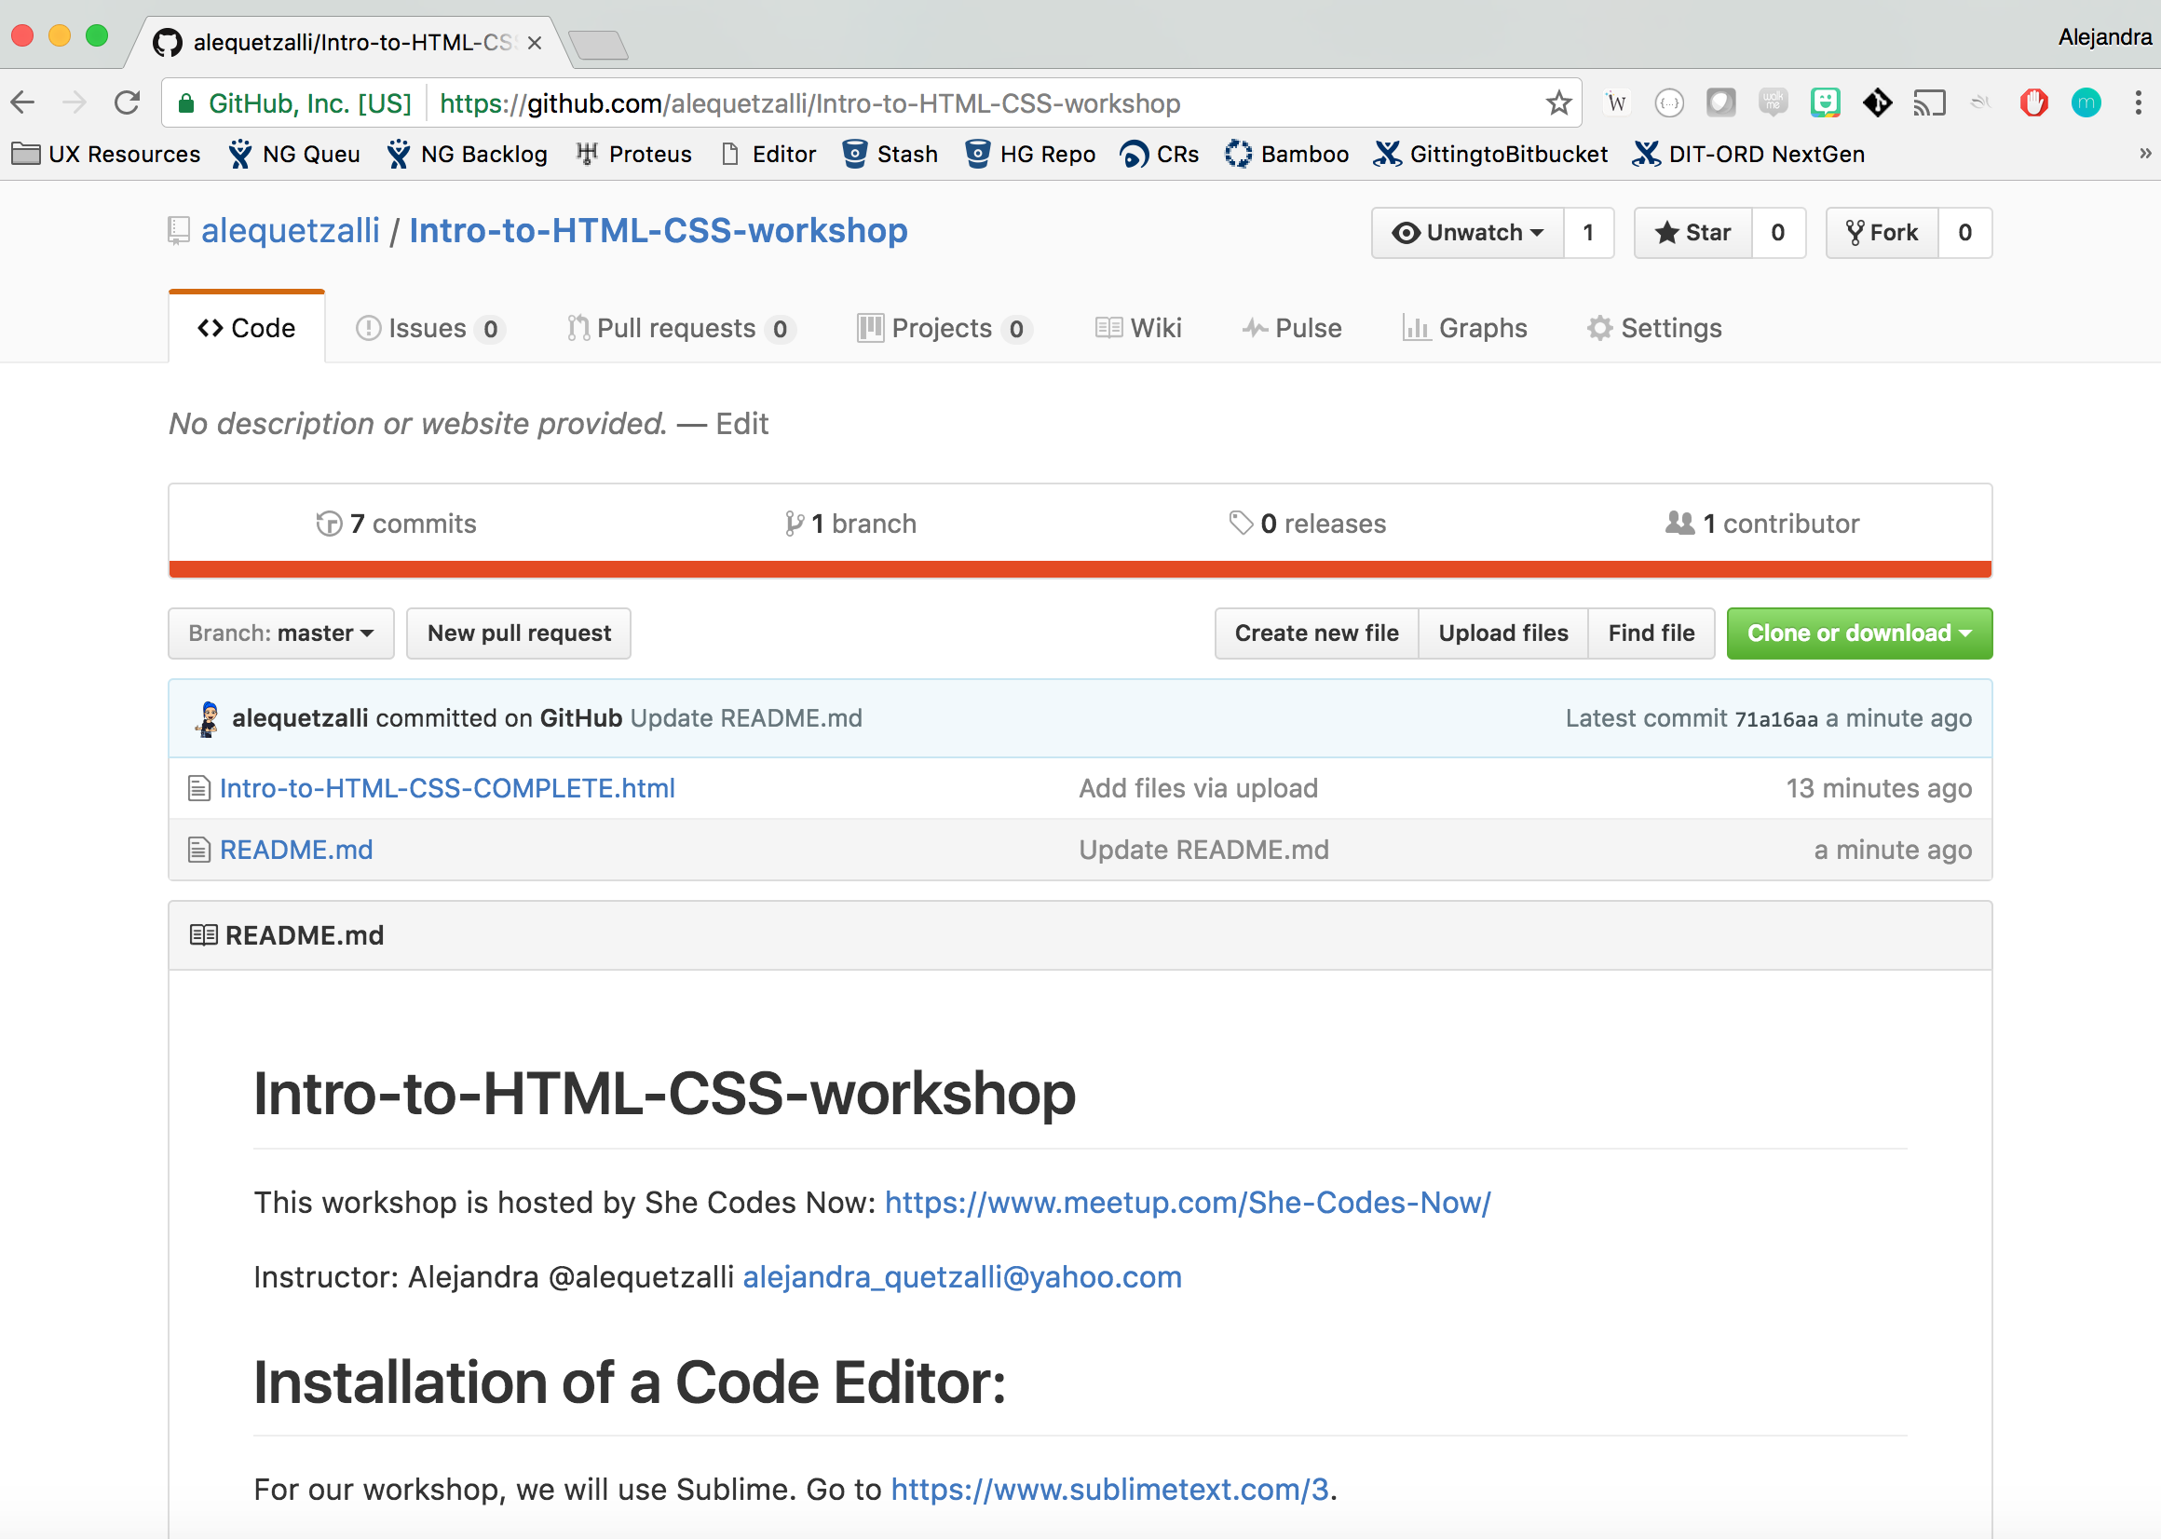
Let’s build a webpage!
Go to our GitHub repo to get started: https://github.com/alequetzalli/Intro-to-HTML-CSS-workshop

Slide 13
More HTML/CSS learning resources:
https://css-tricks.com/the-css-box-model/
https://www.sitepoint.com/web-foundations/css/
http://learn.shayhowe.com/html-css/
https://www.codecademy.com/
https://teamtreehouse.com/
HTML and CSS: Design and Build Websites book by Jon Duckett

