Slide 1

React
Gustavo Nery
Marcelo Blechner

Slide 2
React
MVC
Problem to solve: building large applications with data that changes over time.
Declarative - just specify how your UI should look like at any given point in time (react knows what should be updated when underlying data changes)
Reusable and composable components
JSX – JavaScript objects using HTML syntax.

Slide 3
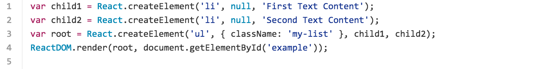
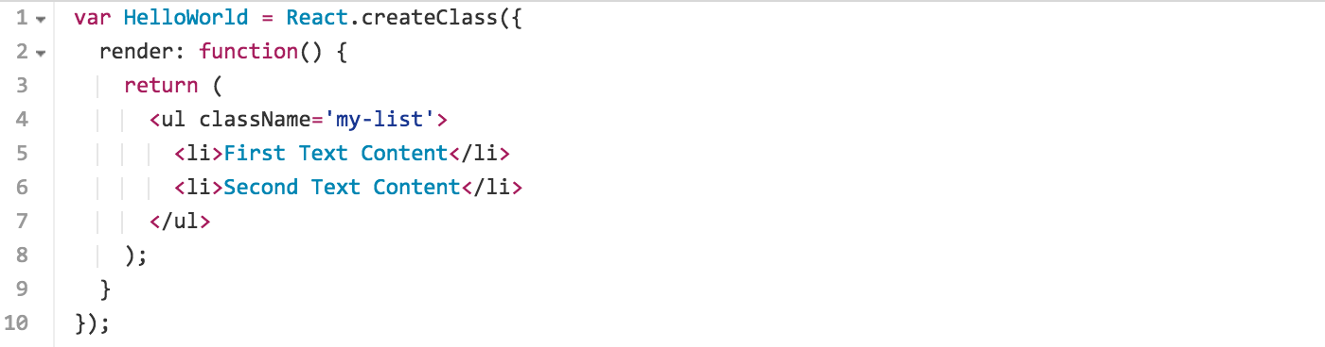
React - JSX
JavaScript
JSX

Slide 4
React - Components
State Machines
By thinking of a UI as being in various states and rendering those states, it's easy to keep your UI consistent.
You simply update a component's state, and then render a new UI based on this new state. React takes care of updating the DOM for you in the most efficient way.
Try to keep as many of your components as possible stateless.

Slide 5
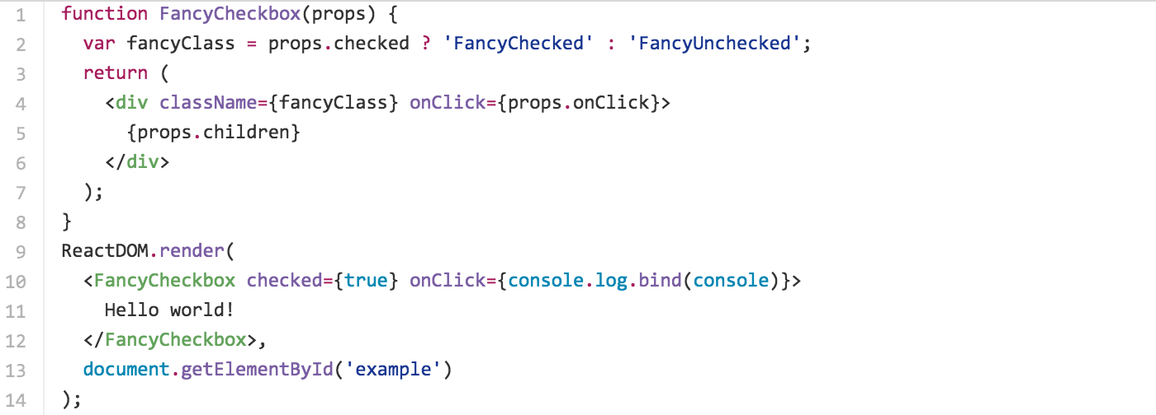
React - Props
Pattern - wrap a component in an abstraction.
The outer component exposes a simple property to do something that might have more complex implementation details.

Slide 6
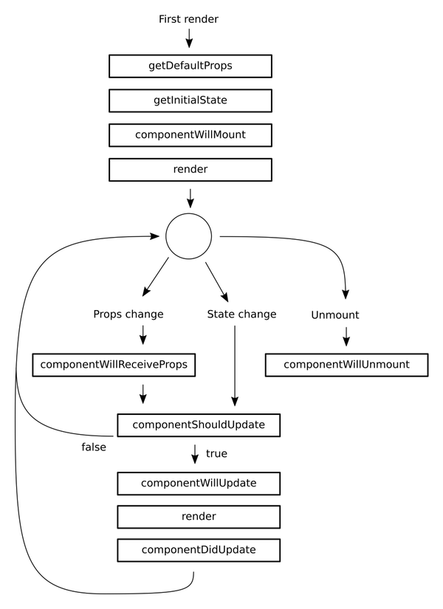
React - Lifecycle

Slide 7
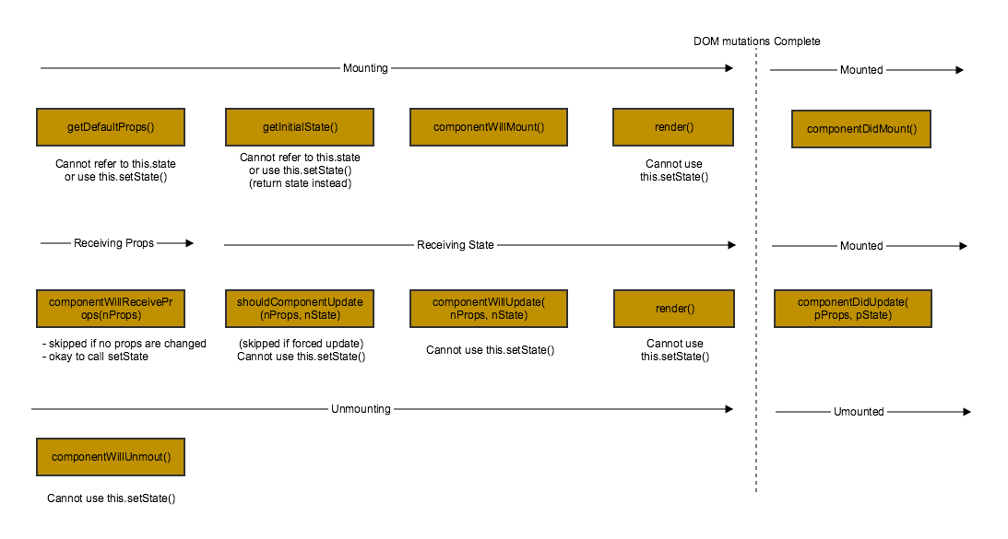
React - Lifecycle

Slide 8
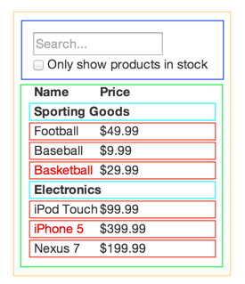
React - Thinking in React

Slide 9
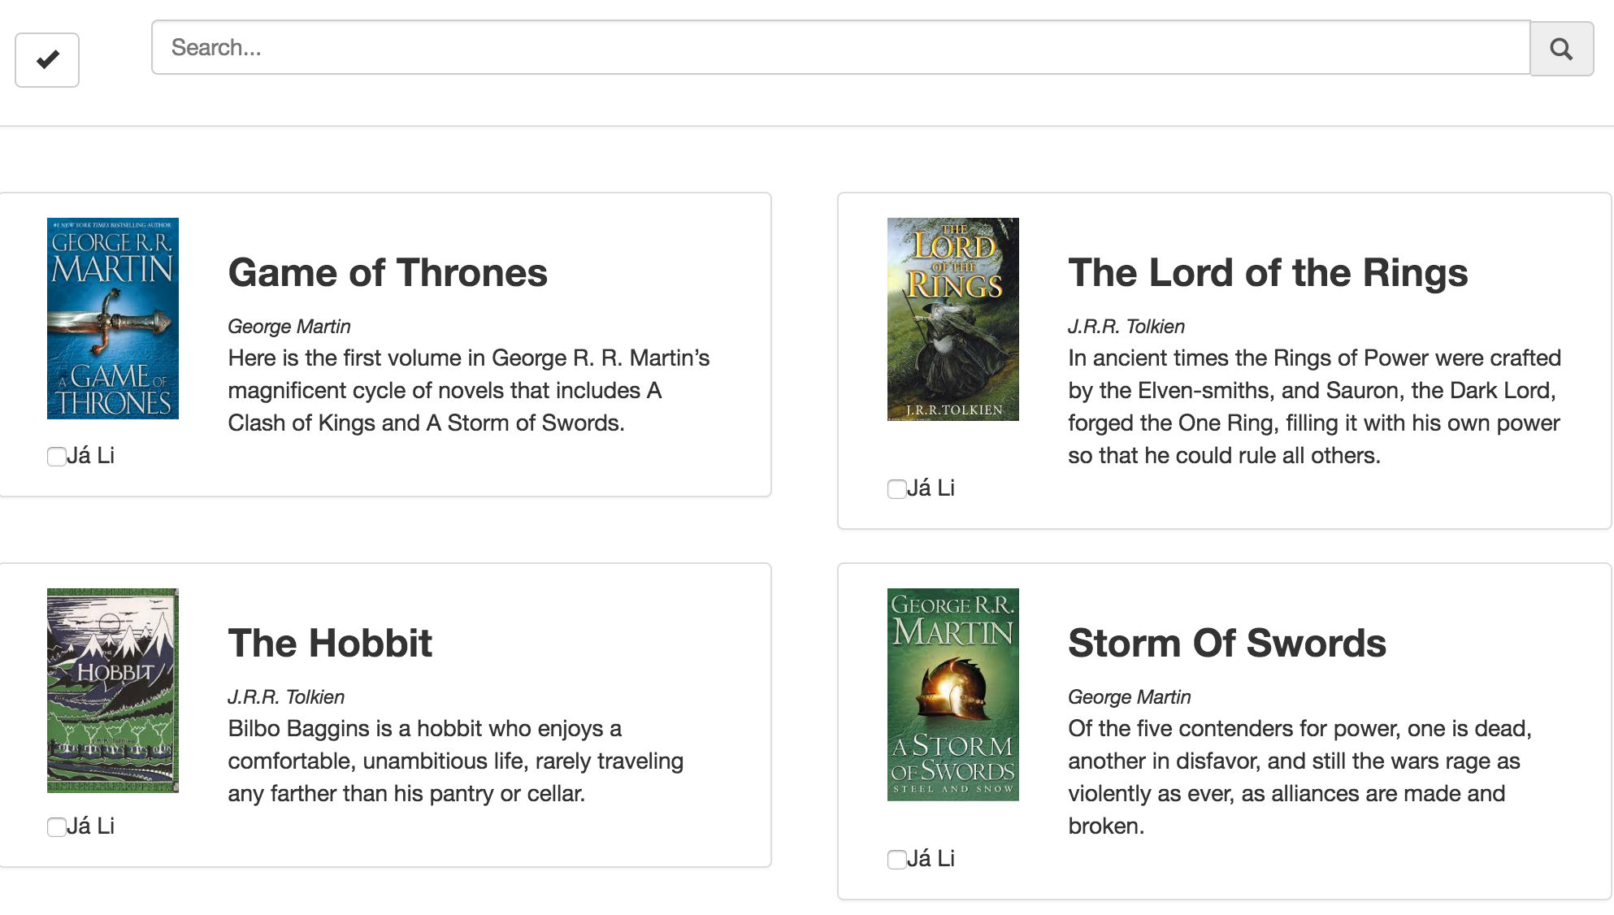
React - Let’s Practice

