Slide 1

Gustavo Nery
Marcelo Blechner

Slide 2

Motivation
our code must manage more state than ever before
server responses, cached data, locally data not yet persisted
lost control over the when, why, and how of its state
model can update another model, then a view can update a model, which updates another model, and this, in turn, might cause another view to update.
you no longer understand what happens in your app
hard to reproduce bugs or add new features

Slide 3
Motivation
mixing two complex concepts: mutation and asynchronicity
Both can be great in separation, but together they create a mess.
React: remove both asynchrony and direct DOM manipulation…
…but managing the state of your data is left up to you.

Slide 4
Motivation
mixing two complex concepts: mutation and asynchronicity
Both can be great in separation, but together they create a mess.
React: remove both asynchrony and direct DOM manipulation…
…but managing the state of your data is left up to you.
Redux attempts to make state mutations predictable

Slide 5
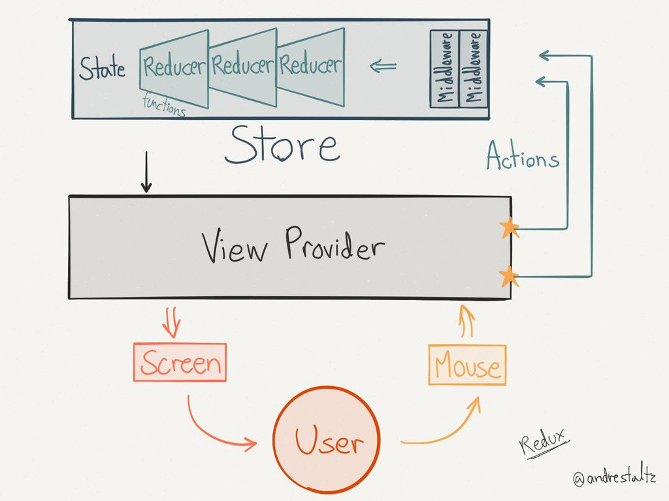
Redux

Slide 6
3 Principles
1. Single source of truth - the state of your whole application is stored in an object tree within a single store
easy to create universal apps
easier to debug
enables you to persist your app’s state (faster development cycle)
functionality traditionally difficult to implement can suddenly become trivial to implement (Undo/Redo, for example)

Slide 7
3 Principles
2. State is read-only - the only way to mutate the state is to emit an action, an object describing what happened.
ensures that neither the views nor the network callbacks will ever write directly to the state.
express an intent to mutate.
all mutations are centralized and happen one by one in a strict order
no subtle race conditions to watch out for.
actions are plain objects - can be logged, serialized, stored, and later replayed for debugging or testing purposes.

Slide 8
3 Principles
3. Changes are made with pure functions - to specify how the state tree is transformed by actions, you write pure reducers.
reducers are pure functions - previous state + action = next state.
return new state objects - never mutate
you can start with a single reducer, and as your app grows, split it off into smaller reducers that manage specific parts of the state tree.
you can control the order in which they are called, pass additional data, or even make reusable reducers for common tasks such as pagination.

Slide 9


