Slide 1
IEEE 802.11 a/b/g and Wireshark Connector
Shashank Gaur

Slide 2
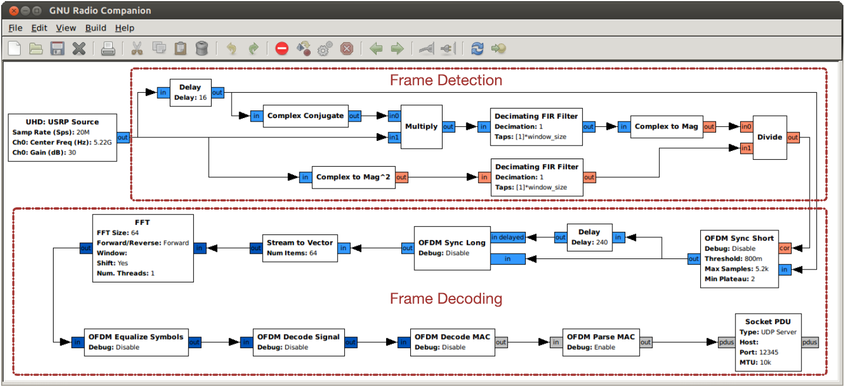
State of the Art
802.11 a/b/g Rx by Bastian Bloessl
FTW Tx for 802.11 (CGRAN Project)

Slide 3
Development
OOT module by Bastian Bloessl
Adaptation for 802.11 Rx
Modifying output of blocks such as decode_mac
Such as passing dictionary with encoding, moving functions between parse_mac and decode_mac
PDU Packets
Wireshark
Connector
PCAP File
Wireshark

Slide 4
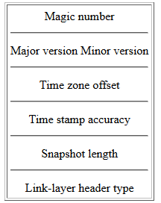
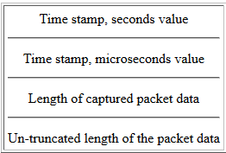
Wireshark Connector
Libpcap format
PCAP Headers

Slide 5
Conclusion
Deliverables
Wireshark Connector block
Creation of pcap per-file and per-packet header
Writing to FIFO file
Creating Pipe between wireshark and gnuradio
Receiver imported to OFDM block
Future Objectives
Finish off the OFDM Import
Deliver independent ofdm blocks
Containing the IEEE 802.11 a/p/g receiver
With some other refined features

