Slide 1

Computer Vision (Bilgisayarla Görü)

Slide 2
Today’s Topics
Image Difference
Object Tracking
Object Detection
Brief Introduction to Machine & Deep Learning

Slide 3
Image Difference
Take difference of 2 consecutive frames (images).
Then check result of each pixel.
If result is zero -> nothing has moved.
If result is not zero -> A movement is detected.
Lets try!
https://www.pyimagesearch.com/2017/06/19/image-difference-with-opencv-and-python/

Slide 4
Image Difference
However this applies only when there is not any noise.
There is always a noise
So we can not use it anywhere.
Or can we? (maybe with blur, erode etc. ?)

Slide 5
Object Tracking
Try to follow an object by tracking it’s position in each frame.
We choose an object in a frame to track it.
So, we have an idea of object’s appearance and we know it’s position in the frame.
Use this information to locate that object’s position in the next frame.

Slide 6
Object Tracking
How to implement object tracking? Image difference?
Lets check one example code: https://github.com/opencv/opencv_contrib/blob/master/modules/tracking/src/trackerKCF.cpp (Remember that we use OpenCV in Python but operations are performed in C/C++)
It is always better for learners (like us) to use already implemented methods ☺

Slide 7
Object Tracking
How do we track object using OpenCV?
Open Google an search for «Object Tracking in OpenCV Python»
Check results and open first 4-5 links (We are lucky if pyimagesearch or learnopencv have a post about it).
Read explanation of the program to gather information and then download the code.
Run the code! (Make some modifications if needed)
So, lets do it!

Slide 8
Some Links for Object Tracking
https://www.pyimagesearch.com/2018/07/30/opencv-object-tracking/
https://www.pyimagesearch.com/2018/07/23/simple-object-tracking-with-opencv/
https://www.learnopencv.com/object-tracking-using-opencv-cpp-python/
https://www.learnopencv.com/multitracker-multiple-object-tracking-using-opencv-c-python/
https://medium.com/@adamaulia/object-tracking-using-opencv-python-windows-616fb23da720

Slide 9
Object Tracking vs. Object Detection
Object Tracking
Works on a sequence of images.
Uses former information.
Applies a little bit of object detection.
Very fast (of course depending on the tracking algorithm)
Not very accurate.
Usually fails on overlapping
Easy to use, (almost) no dataset is required
Object Detection
Works on a single image (frame).
Does not use former information, each frame is a new World to discover.
Slow
Accurate, robust = nice
Not easy to use, huge amount of dataset is required

Slide 10
Object Detection
There are several methods for object detection. All of them is used in real world applications. Some of them are
Template Matching
Keypoint (Feature) Detection
Color
Haar Cascades
Deep Learning

Slide 11
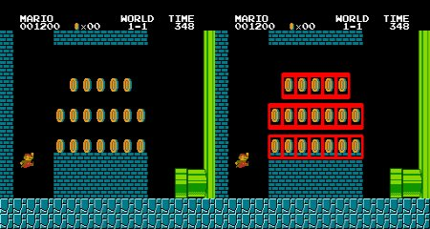
Object Detection
Template Matching
This method matches pixels of source (template) and target image.
If match is accurate enough, object is considered to be found.
However, this method performs poorly and is not invariant for almost all conditions like illumination, view point etc….
Check: https://docs.opencv.org/3.4/d4/dc6/tutorial_py_template_matching.html

Slide 12
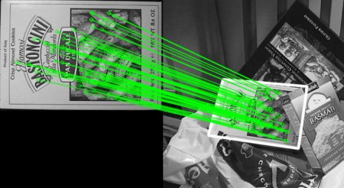
Object Detection
Keypoint (Feature) Detection and Matching
This method extracts important keypoints of source image and target image then tries to match them.
After finding important points, their relationship with their neighbours are also calculated. That is to achieve rotation, view point, resize, illmuation invariance.
There are several definitions for importance of a pixel in an image.
(SIFT is removed from OpenCV as its patented ☹) (https://docs.opencv.org/3.4/d1/de0/tutorial_py_feature_homography.html)
However ORB is made by OpenCV and it is free to use. https://docs.opencv.org/3.4/dc/dc3/tutorial_py_matcher.html

Slide 13
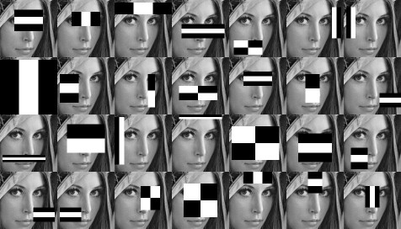
Object Detection
Haar Cascades
An old method, but still is used.
Used a lot in detecting face, eye, lip etc.
It is also used for detecting smiling ☺
Please check: https://www.youtube.com/watch?v=88HdqNDQsEk

Slide 14
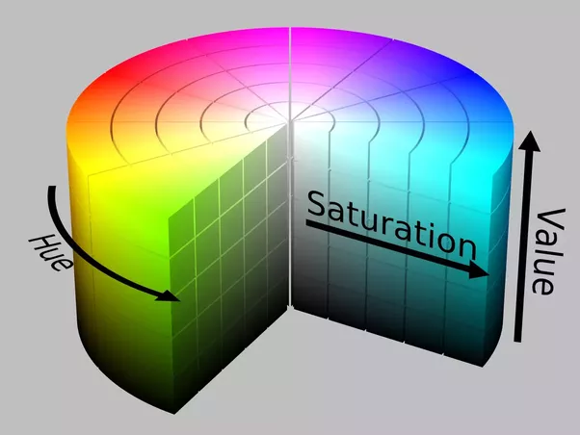
Object Detection
Color
Color itself is not a good object descriptor.
However, it performs well if the object has a single color.
It is very fast.
Please check: https://www.pyimagesearch.com/2015/09/14/ball-tracking-with-opencv/

Slide 15
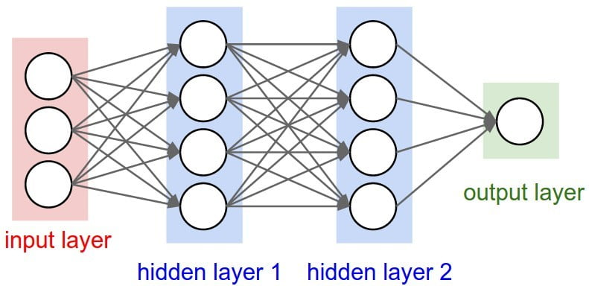
Object Detection
Deep Learning
This method is very useful and accurate.
However, it requires lots of processing power, memory and training image.
Once a model is trained, it can be used in various platforms.
The basic and the most important difference between human created methods and deep learning methods is..
Humans create filters by hand whereas in deep learning computer finds those filters itself.
How?
Please check: https://www.youtube.com/watch?v=aircAruvnKk

Slide 16
YOLO – You Look Only Once
Very fast and very accurate deep learning based object detection method.
So many resources online.
Check it’s official webpage. It is really informative (https://pjreddie.com/darknet/yolo/)
Also type on Google and look around.
For example: https://www.arunponnusamy.com/yolo-object-detection-opencv-python.html

Slide 17
End of the Lecture!
Thank you for listening!
I hope lectures were instructive and helpful!

