Slide 1

Computer Vision (Bilgisayarla Görü)

Slide 2
Last Lecture’s Topics
Histogram
Thresholding and bitwise operations
Morphological operations
Blur and convolution operations

Slide 3
Today’s Topics
Moving on with convolution to find edge and corners (easy)
Inspecting white objects on a black image (not hard ☺)
HSV color space and color filtering (easy)
Live video processing in the classroom (easy)
and…
We will try to solve a hard problem using what we have learnt.

Slide 4
Revision on Convolution
Sliding a little array (i.e. a 3x3 matrix, called kernel, window, filter) on an image.
Aim is to extract pixel neighbourhood information. (How to find edges?? Is it possible to detect an edge by looking only a single pixel? NO. Neighbourhood checking is a must)
Using convolution we can: blur an image, find edges and corners, apply nice filters, apply morphological operations.
How a convolution operation can provide such different things? By using different fillters!
By the way, we don’t need to implement (code) or perfectly understand convolution. Everything is built-in and ready to use in OpenCV ☺ Only thing you need to know is how to approach the problem.

Slide 5
Different Filter Examples (3x3 and 1x3 only)
1 | 1 | 1
1 | 1 | 1
1 | 1 | 1
0 | 1 | 0
1 | 1 | 1
0 | 1 | 0
-1 | -2 | -1
0 | 0 | 0
1 | 2 | 1
1 | 2 | 1
2 | 4 | 2
1 | 2 | 1
-1
0
1
-1 | 0 | 1
-2 | 0 | 2
-1 | 0 | 1
-1 | 0 | 1

Slide 6
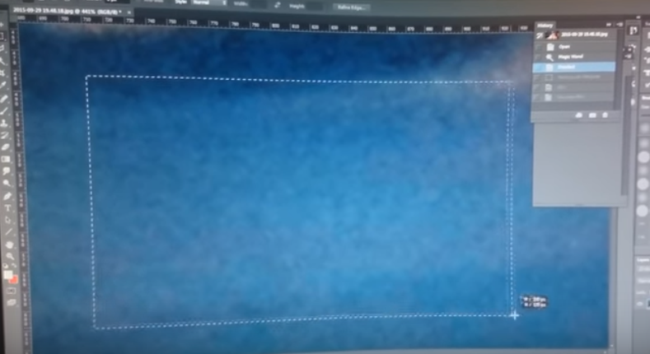
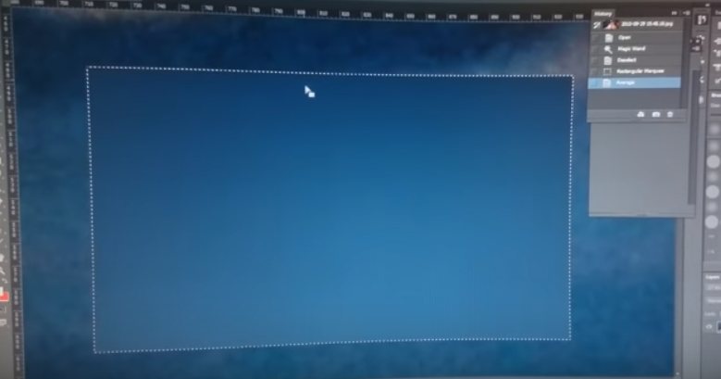
Blurring, An Example of Convolution (from the old slide)
Blurring is so important, it removes noises! (illumination, camera faults etc.)

Slide 7
Edge Detection
There are several methods to detect edges in an image.
Canny edge detector is a complex, powerful algorithm, it applies so much further processing to detect edges correctly. (https://docs.opencv.org/3.1.0/da/d22/tutorial_py_canny.html)
The best thing about Canny is, it is implemented in OpenCV ☺
Example: canny

Slide 8
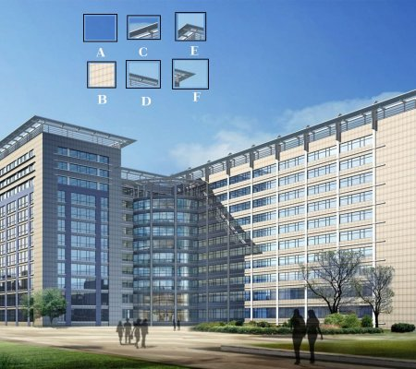
Corner Detection
https://docs.opencv.org/3.0-beta/doc/py_tutorials/py_feature2d/py_features_meaning/py_features_meaning.html
Example: corner

Slide 9
Countour Analysis
Collect locations of each white pixel, group them if they are connected.
Doing that, we can analyze its size and other things like orientation.
Then we can eliminate small areas or areas that do not meet our criterias ☺
But before, we need to create a binary image (black and white)
How? Threshold, canny, corner, your own function?
Lets dive straight into the code: counter_analysis

Slide 10
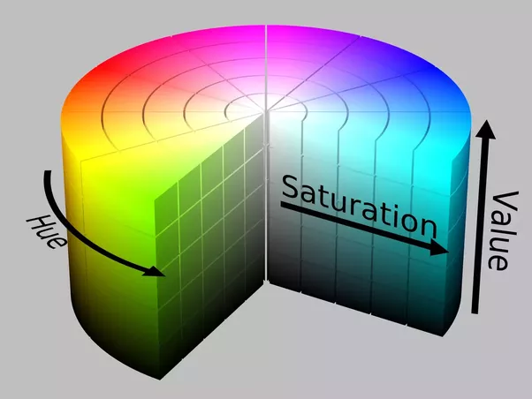
HSV Color Space
RGB color space is bad at describing a color.
How can you describe different shades of a yellow using RGB color space? Lets try
http://colorizer.org/
How can you describe different shades of a yellow using HSV color space? Lets try
The function in_range
Örnek: tennis_ball, inrange_bgr

Slide 11
Video Processing
How to perform these operations on a video? What is a video?
OpenCV provides easy use for both video and live stream processing.
Example: basic_live_stream, live_yellow_filter

Slide 12
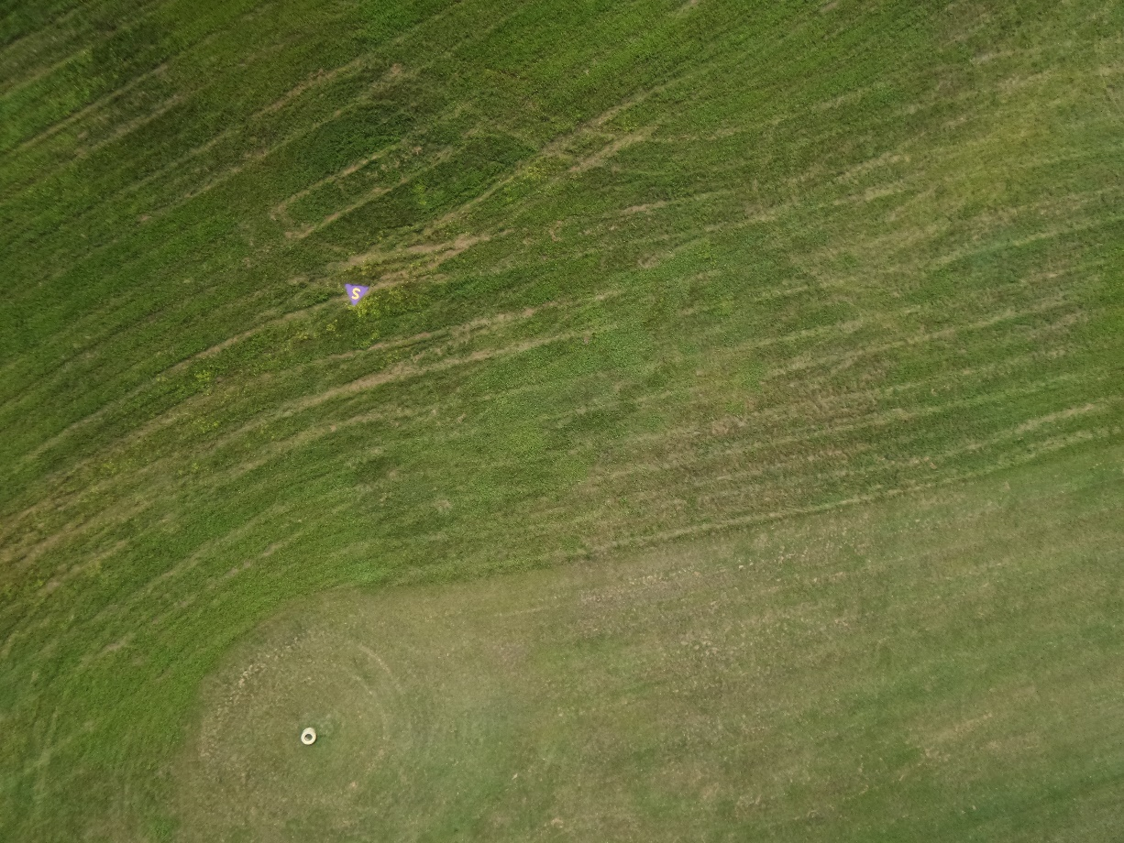
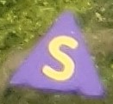
Let’s Test Ourselves!

Slide 13
End of the Computer Vision Series!
Thank you for listening!
I hope lectures were instructive and helpful!

Slide 14
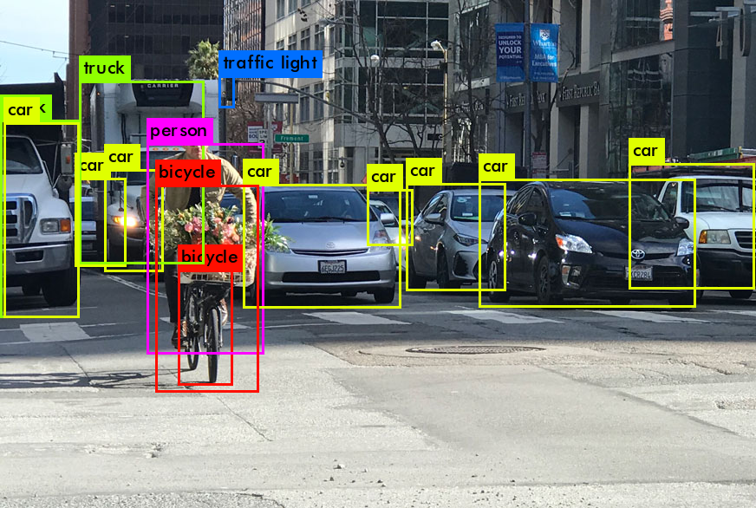
Object Detection, Bonus Lecture!
Face and eye detection using Haar Cascades
Feature detection and matching using keypoints (SIFT)
Object detection using Deep Learning Models (YOLO)
Maybe more ☺
It will be on following Thursday (29 October). Classroom and other information will be announced!

