Slide 1

Computer Vision (Bilgisayarla Görü)

Slide 2
Last Lecture Topics
Image loading and displaying
Binary, grayscale and RGB images
Translation, rotation, flip operations
Resizing an image
Cropping an image

Slide 3
Today’s Topics
Histogram (easy)
Thresholding (easy) and bitwise operations (easy)
Morphological operations (easy)
Blur and convolution operations (not hard ☺)

Slide 4
Histogram
Just a counting operation.
Count pixels that have value 0
Count pixels that have value 1
...
Count pixels that have value 255
Plot the result
How to do it with RGB images? Count pixels in each channel seperately.
Example: histogram

Slide 5
Brightness Correction Using Histogram
Looking at histogram of an image, brightness and value of pixels of the image can be understood easily.
There are several ways to correct an image:
Histogram normalization (https://docs.opencv.org/3.1.0/d5/daf/tutorial_py_histogram_equalization.html)
Gamma correction (https://www.pyimagesearch.com/2015/10/05/opencv-gamma-correction/)
Example: histogram_equalize, gamma_correction

Slide 6
Thresholding
Choose a number (called threshold) between 0 and 255
If a pixel’s value is less then the threshold, make that pixel’s value 0. Otherwise, set it to 255.
How to choose the threshold value?
Histogram result is quite useful. (median, mean, mean of mean and median)
Prior knowledge over the image.
Try and find the suitable threshold value.
Example: threshold

Slide 7
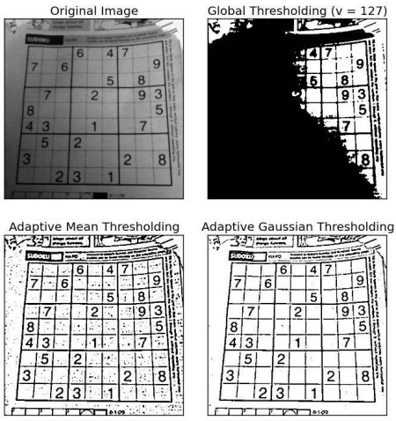
Adaptive Thresholding https://docs.opencv.org/3.4/d7/d4d/tutorial_py_thresholding.html

Slide 8
Bitwise Operations
AND, OR and XOR operations.
Useful for masking operations.
Example: bitwise

Slide 9
Morphological Operations
Elimiating small, undesired pixels and group of pixels
Filling small holes in large group of pixels
Kernel size is important (also its shape)
https://docs.opencv.org/3.0-beta/doc/py_tutorials/py_imgproc/py_morphological_ops/py_morphological_ops.html
Example: lets write it now

Slide 10
Blur and Convolution Operations
Blurring is very important in computer vision. It almost applied all the time before an image is processed.
Blurring is done by convolution operation.
It is quite important to understand how convolution works, almost all image filters (blur, edge, corner, morphological operations) uses convolution.
Special thing about convolution is it considers not only a pixels but also its neighbours. This is how edges are found in an image.

Slide 11
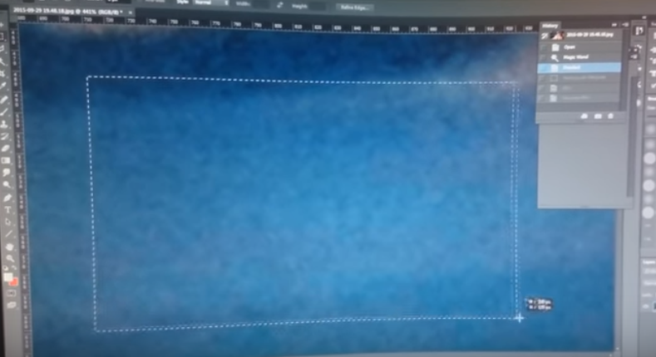
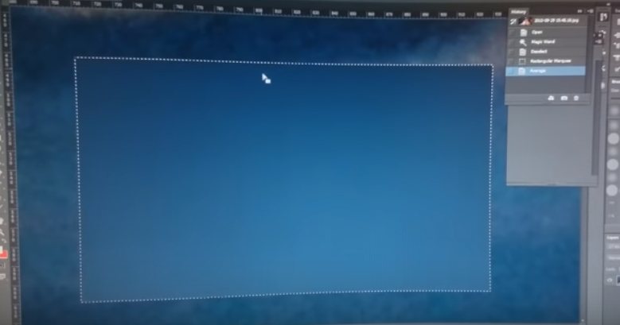
Blur and Convolution Operations
Why is blurring important? It removes noises! (illumination, camera faults etc.)

Slide 12
Blur and Convolution Operations
For more detailed explanation
https://www.youtube.com/watch?v=C_zFhWdM4ic
https://www.youtube.com/watch?v=YgtModJ-4cw
Example: lets write it now

Slide 13

Upcoming Lecture’s Topics
Edge and corner deteciton (easy)
Contour operations, segmentation (a bit challenging ☺)
Color filtering, object detection by color (easy)
Live video processing (easy, requires some programming knowledge)

Slide 14
Thank you for listening!
See you on Thursday
I hope it was instructive, helpful

