Slide 1

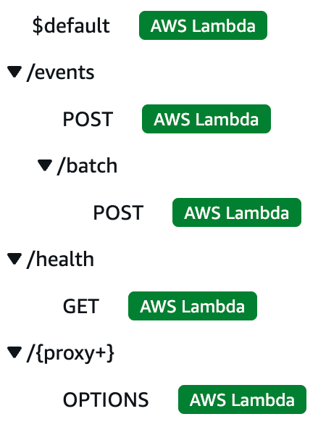






API Gateway
The single front door to our API: it routes every request and checks it before our code runs.
Routes for campuspulse-api (AWS console)
Dashboard
API Gateway
Sends the Cognito token
CORS only our dashboard's address
routes
Token check 401 if invalid
Simulator
Sends the device key
Rate limit 20/s, bursts of 50 · 429 if over
1
2
3
4
Routing
Token check
Rate limiting
CORS
API Gateway routes each request to our Lambda. Sensor and health routes are public; everything else needs a token.
The dashboard sends its Cognito token with every call. Missing or expired tokens are rejected before our code runs.
20 requests per second, with bursts of 50. Extra requests are refused, protecting the backend and our costs.
Browsers may only call the API from our CloudFront address (and localhost, for development).
Notes:
We have our API Gateway, which is in charge of routing each request to our Lambda. After a user signs in, the dashboard sends their Cognito token with every API call, and API Gateway checks it each time, so a missing or expired token is rejected before our code runs. We also use API Gateway for rate limiting: 20 requests per second, with bursts of 50. And we set up CORS on API Gateway so that browsers can only call the API from our CloudFront address.

