Slide 1

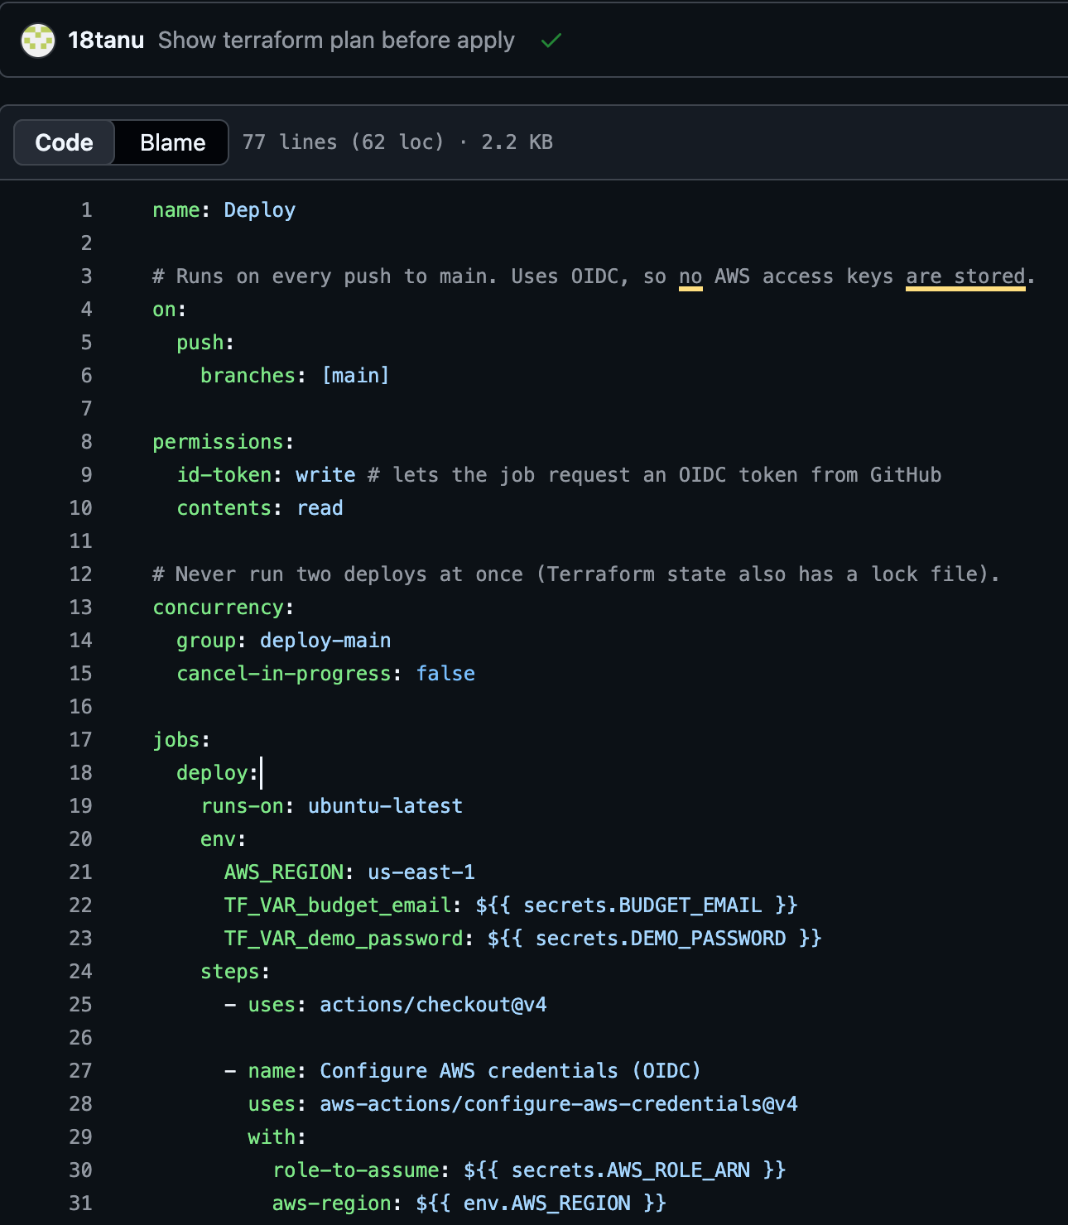










CI/CD with GitHub Actions
The platform deploys itself: checks on every pull request, a full deployment on every merge into main.
Every pull request
No access to AWS
deploy.yml: runs on push to main, signs in with OIDC
Run the Go tests
Check the Terraform configuration
Build the dashboard
Every merge into main
Temporary AWS credentials
Build the Lambda
Terraform plan, then apply
Upload the dashboard to S3
Clear the CloudFront cache
Check the API's health
No stored AWS keys. GitHub gets a short-lived token (OIDC) to use the github-actions-campuspulse role, and only the main branch can use it.
Notes:
I also built a GitHub Actions pipeline to deploy the platform automatically: every pull request runs the Go tests, checks the Terraform configuration and builds the dashboard, with no access to AWS, and every merge into main builds the Lambda, applies the Terraform plan, uploads the dashboard to S3, clears the CloudFront cache and checks the API's health endpoint, using temporary credentials instead of stored keys.

