Slide 1






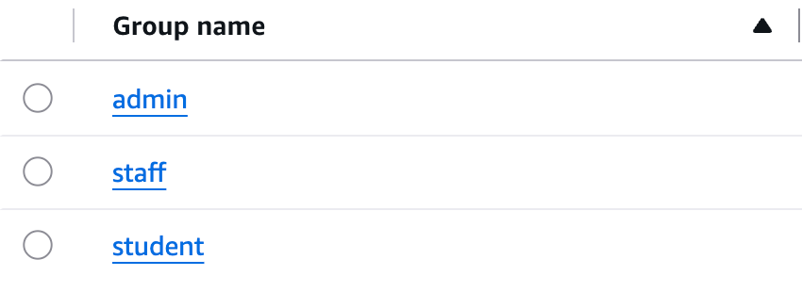


Secure sign-in with Cognito
Cognito manages accounts and passwords, so our backend never handles one. No public sign-up: only admins create accounts.
HOW A USER SIGNS IN
1
2
3
4
5
Click Sign in
Go to Cognito
Check password
One-time code
Token
On the CampusPulse dashboard
The browser opens Cognito's sign-in page
Cognito checks the email and password
Cognito sends the user back with a code
Swapped for a 1-hour token with the user's group
THREE COGNITO GROUPS, CARRIED IN THE TOKEN
See the rooms and their live readings · Submit service requests · See only their own requests
Cognito console: Groups (3)
student
Everything a student can see · Statistics, energy and sensor events · View and acknowledge alerts · Manage all requests
staff
Everything staff can do · Change the alert thresholds
admin
Notes:
For authentication, we use Amazon Cognito. Cognito manages the user accounts and passwords, so our backend never handles passwords directly. We deliberately turned off public sign-up: since this is an internal university tool, accounts should belong to real students and staff, and only admins can create them and assign their roles. Every login token also expires after one hour. We created three user roles as Cognito groups: student, staff and admin. These roles control what each user is allowed to access. When a user clicks Sign in, they are redirected to Cognito. Cognito checks the email and password and sends the user back with a one-time code. Our dashboard exchanges that code for a token, which identifies the user and their role and is then used for secure API requests.

