Slide 1


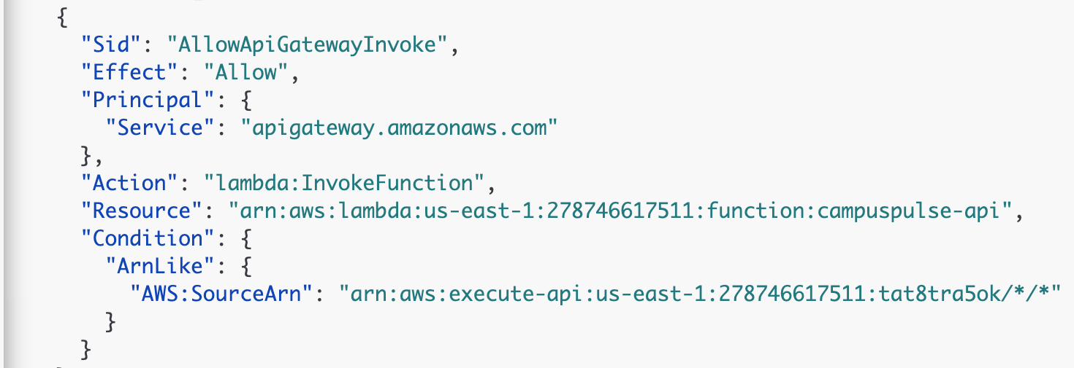


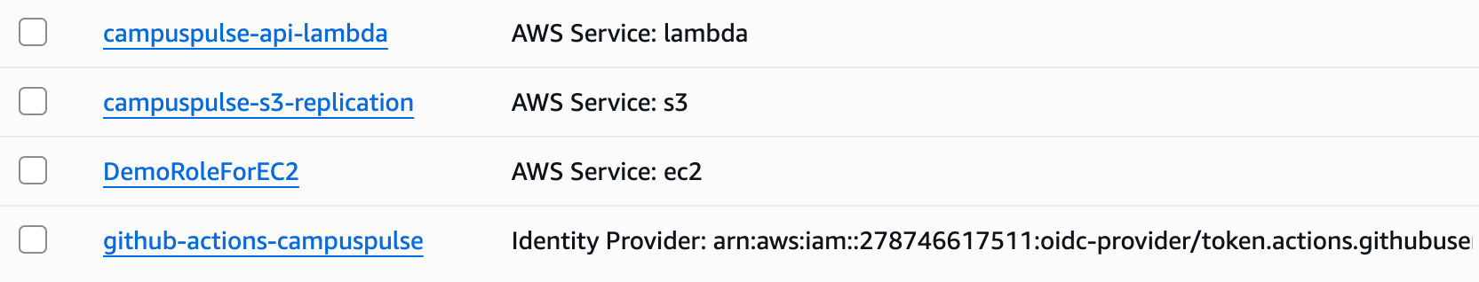
IAM roles: least privilege
Each part of the platform gets its own role, with only the permissions it needs.
Who can call the Lambda
What the Lambda can do
Resource-based policy on campuspulse-api (not a role)
Role campuspulse-api-lambda: DynamoDB actions, table by table
Table
Allowed actions (nothing else)
events
PutItem · Query never edit or delete
rooms
Scan · GetItem · UpdateItem never create or delete
alerts
GetItem · PutItem · UpdateItem · DeleteItem · ConditionCheckItem · Query
service-requests
GetItem · PutItem · UpdateItem · Query
aggregates
UpdateItem · Query
Only API Gateway may invoke the function
Only our API (the SourceArn condition), not any API Gateway
settings
GetItem · PutItem
No users table (Cognito handles accounts) and no permission to create or delete tables.
S3 replication role
GitHub Actions role
IAM console: our roles (cropped; DemoRoleForEC2 is not ours)
Copies the dashboard and Terraform state buckets to Paris; can only read our buckets and write the copies.
Lets the pipeline deploy: main branch only, temporary credentials, no stored keys.
Notes:
For the IAM roles, we followed least privilege. First, who can call our Lambda: a resource-based policy on the function allows only API Gateway to invoke it, and only from our own API, thanks to the SourceArn condition. Then what the Lambda can do: its role lists DynamoDB actions table by table. On events it only has PutItem and Query, so it can add and read readings but never edit or delete them; on rooms it can read and update but not create or delete. There's no users table at all, because Cognito handles accounts. We also created an S3 role to copy our dashboard and Terraform state buckets to Paris, and the GitHub Actions role lets our pipeline deploy, only from the main branch, with temporary credentials instead of stored keys.

