Slide 1


Big Data & Cloud Computing · Final Project S2 2026
CampusPulse 2026
24
6
rooms monitored
DynamoDB tables
A cloud-native smart campus operations platform for NorthBridge University, serverless on AWS and built entirely as code.
2
≈ $0
AWS serverless
Terraform
Go + React
Free tier
AWS regions
per month
TEAM
Om
Alero
Tanushka
Application and secure sign-in
Architecture, data and disaster recovery
Security, monitoring, CI/CD and cost
Notes:
Om opens: what CampusPulse is, the tech stack, and how users sign in with Cognito. Then Alero (architecture, data, disaster recovery), then Tanushka (IAM, monitoring, CI/CD, cost).

Slide 2
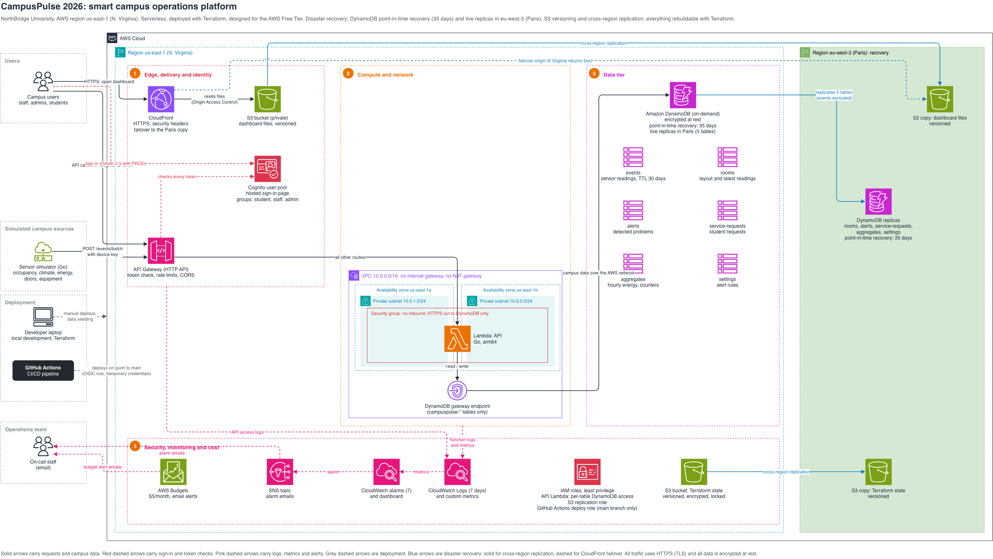
Architecture
Notes:
Walk the request path left to right: CloudFront serves the dashboard from a private S3 bucket; Cognito signs users in; API Gateway checks every token and forwards to the Lambda in private subnets; the Lambda reaches DynamoDB through the gateway endpoint. Bottom row: monitoring, IAM and cost. Right: the Paris recovery region.

Slide 3





How data moves through the app
From a sensor reading to the dashboard.
Simulator
API Gateway
Lambda
DynamoDB
Sensors in 24 campus rooms
up to 25,
device key
The entry point
each
batch
Our function
privately
The database
Every 30 s: occupancy, temperature and energy readings
Limits the traffic and passes each batch to the Lambda
Checks, stores and alerts (steps below)
Reached privately, never over the internet; copied to Paris within seconds
Inside the Lambda, for each reading
Dashboard
1
Check the device key
Validate the reading
Staff sign in through Cognito and see it all
2
3
Store it once in DynamoDB
4
Update the room's live values or energy totals
5
Raise an alert if a rule is broken

Slide 4





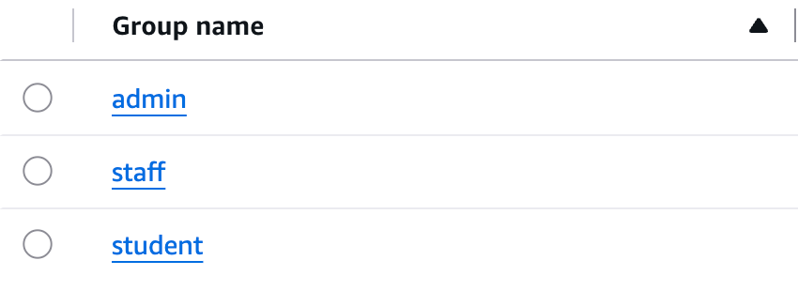


Secure sign-in with Cognito
Cognito manages accounts and passwords, so our backend never handles one. No public sign-up: only admins create accounts.
HOW A USER SIGNS IN
1
2
3
4
5
Click Sign in
Go to Cognito
Check password
One-time code
Token
On the CampusPulse dashboard
The browser opens Cognito's sign-in page
Cognito checks the email and password
Cognito sends the user back with a code
Swapped for a 1-hour token with the user's group
THREE COGNITO GROUPS, CARRIED IN THE TOKEN
See the rooms and their live readings · Submit service requests · See only their own requests
Cognito console: Groups (3)
student
Everything a student can see · Statistics, energy and sensor events · View and acknowledge alerts · Manage all requests
staff
Everything staff can do · Change the alert thresholds
admin

Slide 5



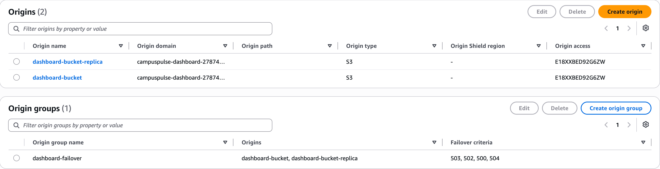
CloudFront + S3
How the dashboard reaches users: fast, over HTTPS, with a backup copy, and a bucket nobody else can read.
CloudFront
primary
S3 · Virginia (primary)
Users
HTTPS
Private · only CloudFront can read
CDN: edge locations cache the files
HTTPS with the default certificate
Fails over to Paris on 5xx errors
if 5xx errors
S3 · Paris (copy)
Private · only CloudFront can read
Origins and origin group in the AWS console: both buckets use our Origin Access Control, and dashboard-failover switches on 500, 502, 503 and 504

Slide 6
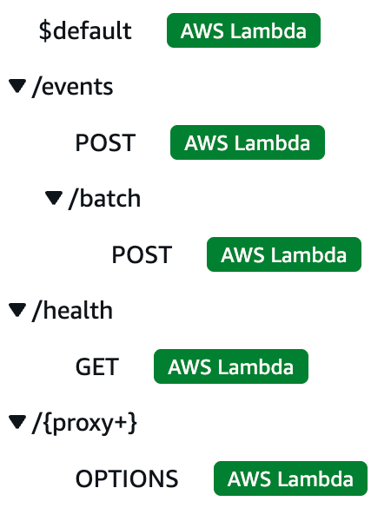



API Gateway
The single front door to our API: it routes every request and checks it before our code runs.
Routes for campuspulse-api (AWS console)
Dashboard
API Gateway
Sends the Cognito token
CORS only our dashboard's address
routes
Token check 401 if invalid
Simulator
Sends the device key
Rate limit 20/s, bursts of 50 · 429 if over
1
2
3
4
Routing
Token check
Rate limiting
CORS
API Gateway routes each request to our Lambda. Sensor and health routes are public; everything else needs a token.
The dashboard sends its Cognito token with every call. Missing or expired tokens are rejected before our code runs.
20 requests per second, with bursts of 50. Extra requests are refused, protecting the backend and our costs.
Browsers may only call the API from our CloudFront address (and localhost, for development).

Slide 7
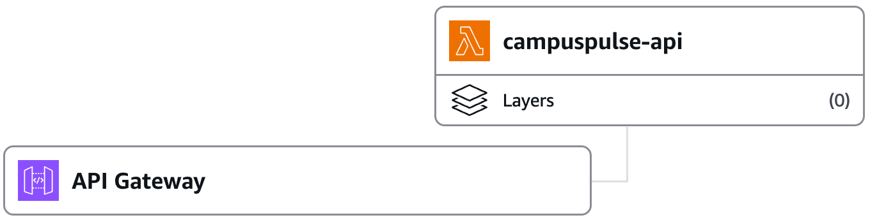
Compute and network
One Lambda function, running in private subnets inside our own VPC, with no internet access.
VPC 10.0.0.0/16 no internet gateway, no NAT
Private subnet
Private subnet
API Gateway
us-east-1a · 10.0.1.0/24
us-east-1b · 10.0.2.0/24
DynamoDB
invokes
private
Lambda
Lambda
Gateway endpoint
our tables only
Security group: nothing in · HTTPS out to DynamoDB only
1
One Lambda function
Our Go API, compiled into a single file called bootstrap
Lambda console: triggered by API Gateway
2
Two private subnets
No internet access; if one zone fails, Lambda runs in the other
3
DynamoDB gateway endpoint
Free, private route to the database; allows only our tables
4
Security group
Nothing can connect in; only HTTPS out to DynamoDB

Slide 8





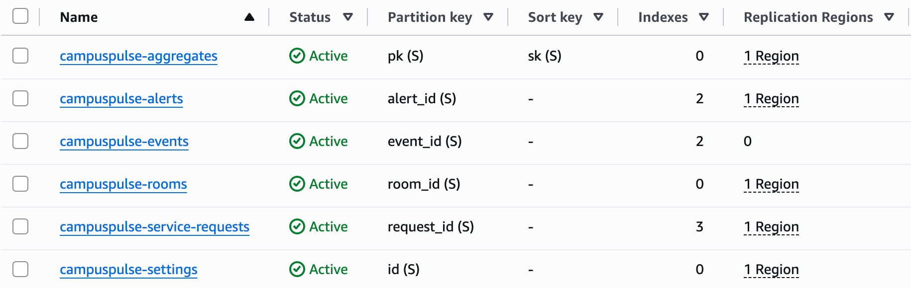

DynamoDB tables
Six tables, one for each kind of data, covering every use case in our setup.
events
rooms
alerts
Every sensor reading, deleted automatically after 30 days
Each room's details and latest occupancy, temperature and humidity
Every problem detected, and whether staff acknowledged or resolved it
service-requests
aggregates
settings
Students' requests, with their priority, status and history
Running totals, like energy per building each hour
Alert rules, like temperature limits, changed without redeploying
Tables (6) in the AWS console: every table except events is copied to 1 other Region (Paris)
Why separate tables
Exact API permissions, table by table
Only the tables worth keeping are copied to Paris for disaster recovery

Slide 9


Scaling
Every service scales automatically. We only set limits, to protect the backend and our costs.
Lambda: one copy of our function per request
Quiet
Traffic spike
Back to normal
Nothing is kept in memory between requests, so any copy can handle any request
One small compiled Go program: a new copy starts in well under a second
10 copies at once is AWS's default for new accounts; it can be raised to 1,000 for free
a few requests
many requests at once
traffic drops
1 copy running
10 copies, our current limit
extra copies disappear
API Gateway
DynamoDB
CloudFront
Cognito
Managed by AWS and scales on its own. We cap it at 20 requests/s (bursts of 50) to protect the backend and costs.
On-demand mode: capacity grows with reads and writes, with nothing to size. Running totals keep dashboard reads small.
Serves the dashboard from edge locations and caches it, so more users barely add load on S3.
Managed sign-in that scales on its own, free up to 10,000 monthly users.

Slide 10

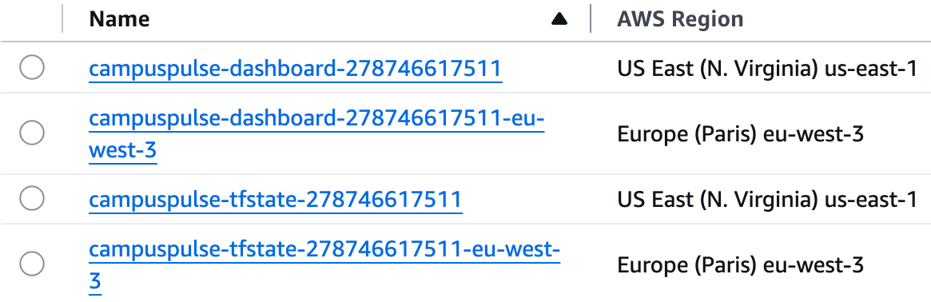


Disaster recovery
Data is continuously copied to Paris; everything else can be rebuilt from Terraform.
Seconds
RPO: how much data we could lose
< 1 hour
RTO: time to be running again
35 days
point-in-time recovery window
Database
Point-in-time recovery (35 days) and live replicas of 5 tables in Paris
S3 console: each bucket has a copy in Paris
Dashboard
Versioned S3 bucket, with every file copied to a bucket in Paris
CloudFront failover
If the Virginia bucket returns 5xx errors, CloudFront serves the Paris copy
Terraform state
Versioned, encrypted S3 bucket, replicated to Paris
Dashboard bucket
Virginia → Paris
Infrastructure
Defined in Terraform: rebuilt in Paris with one terraform apply
Terraform state bucket
Virginia → Paris
Code
In GitHub; deployed by the CI/CD pipeline
Limit: the API and Cognito run only in us-east-1, so a full region outage means redeploying with Terraform in Paris, where the data is already waiting.

Slide 11



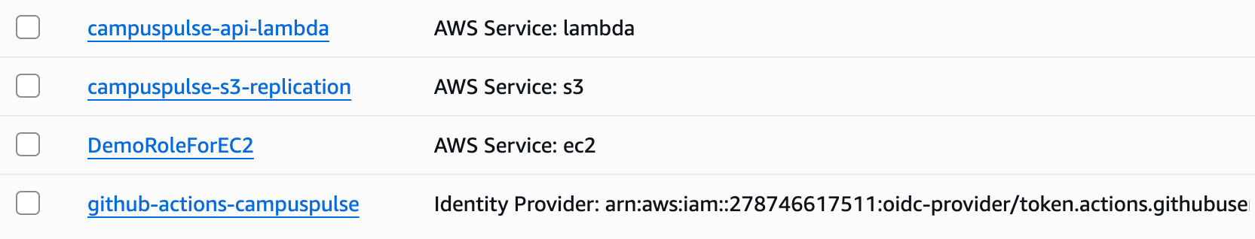
IAM roles: least privilege
Each part of the platform gets its own role, with only the permissions it needs.
API Lambda role
S3 replication role
campuspulse-api-lambda
campuspulse-s3-replication
DynamoDB table
Allowed actions (nothing else)
Used by S3 to copy the dashboard and Terraform state buckets to Paris for disaster recovery. It can only read our source buckets and write the copies.
events
PutItem · Query never edit or delete
rooms
Scan · GetItem · UpdateItem never create or delete
alerts
GetItem · PutItem · UpdateItem · DeleteItem · ConditionCheckItem · Query
service-requests
GetItem · PutItem · UpdateItem · Query
GitHub Actions role
aggregates
UpdateItem · Query
github-actions-campuspulse
settings
GetItem · PutItem
Lets the CI/CD pipeline deploy. Only the main branch of our repository can use it, with temporary credentials instead of stored keys.
No users table: Cognito handles accounts. No permission to create or delete tables.
IAM console
Our three roles and who is trusted to use each one (cropped). DemoRoleForEC2 is not part of CampusPulse.

Slide 12

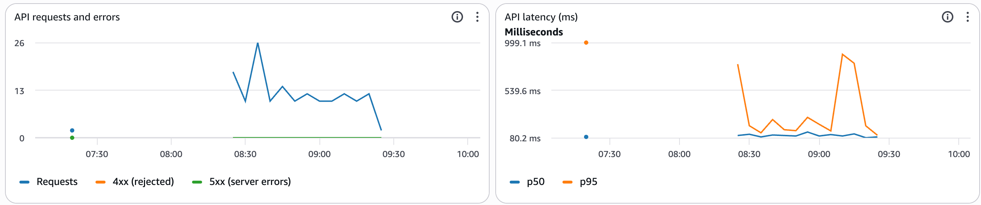


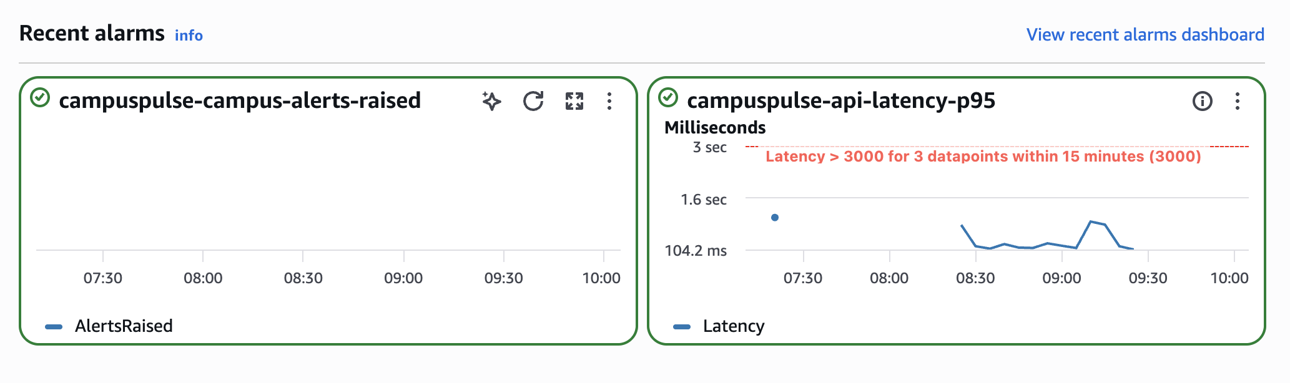


Monitoring
A CloudWatch dashboard tracks the health of the whole platform on one page, and 7 alarms email the team.
A log line per request
CloudWatch dashboard: API requests and errors, and response time
The API prints the route, the role and how long it took
CloudWatch Logs
Lambda sends the lines automatically; kept for 7 days
Metrics
Recent alarms: both OK, with the 3-second latency threshold shown
Custom ones from log lines, like AlertsRaised; AWS measures errors and latency
Dashboard
7 alarms
Built from the metrics with Terraform
Server errors, slow responses, failed readings
Email through SNS
When an alarm fires, and again when it recovers

Slide 13

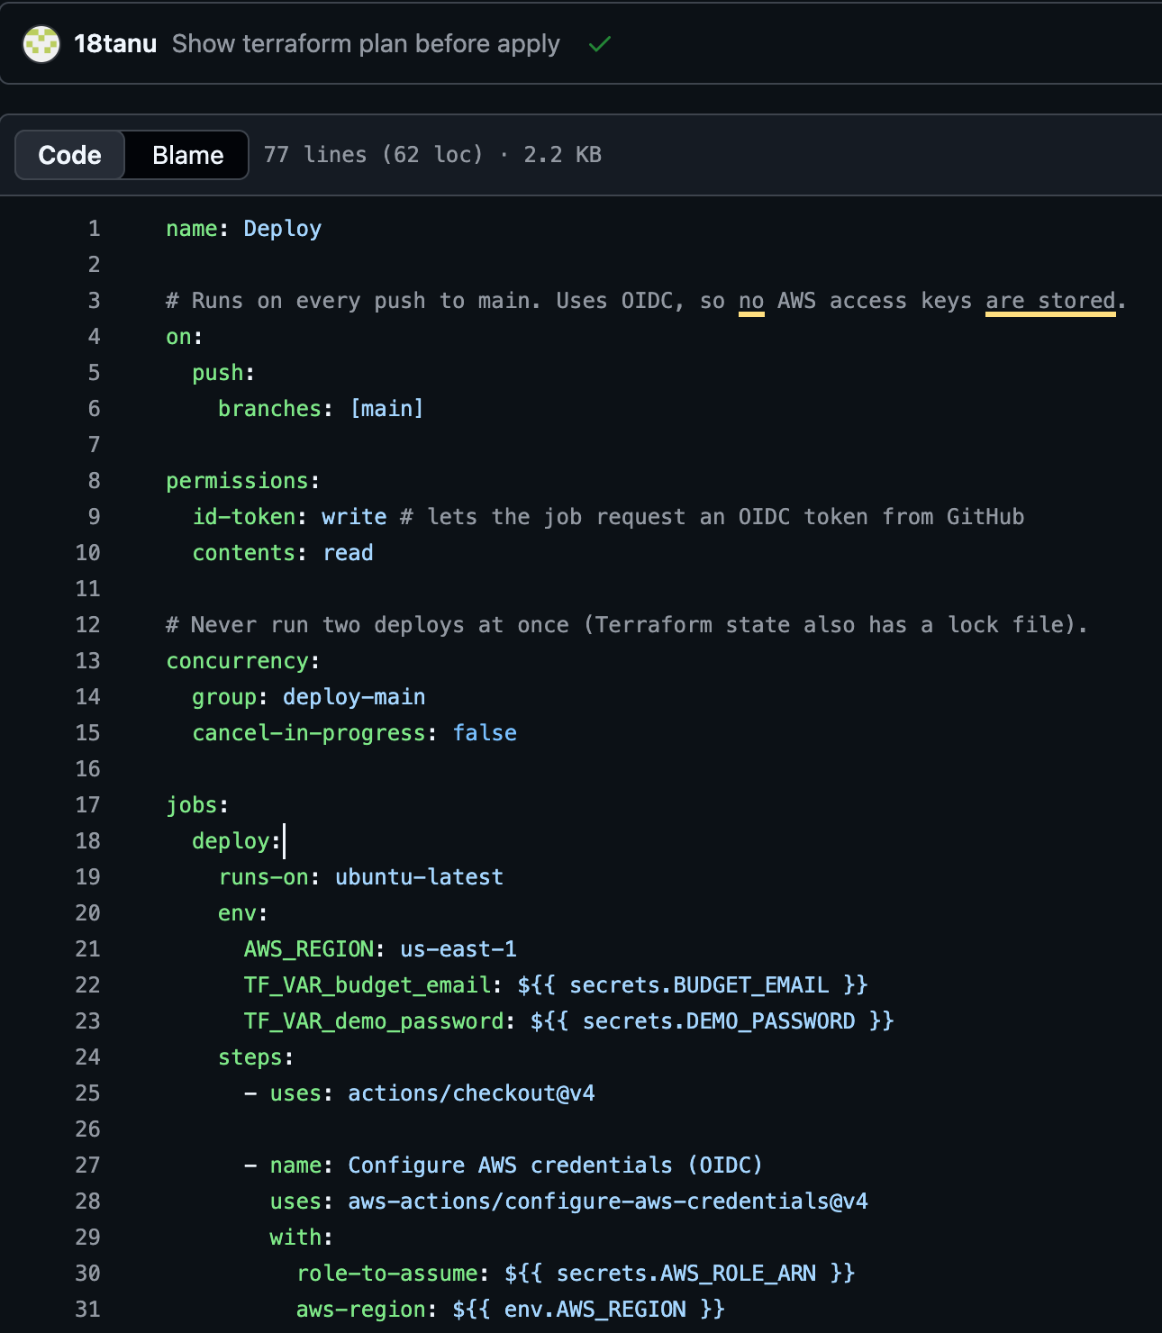









CI/CD with GitHub Actions
The platform deploys itself: checks on every pull request, a full deployment on every merge into main.
Every pull request
No access to AWS
deploy.yml: runs on push to main, signs in with OIDC
Run the Go tests
Check the Terraform configuration
Build the dashboard
Every merge into main
Temporary AWS credentials
Build the Lambda
Terraform plan, then apply
Upload the dashboard to S3
Clear the CloudFront cache
Check the API's health
No stored AWS keys. GitHub gets a short-lived token (OIDC) to use the github-actions-campuspulse role, and only the main branch can use it.

Slide 14



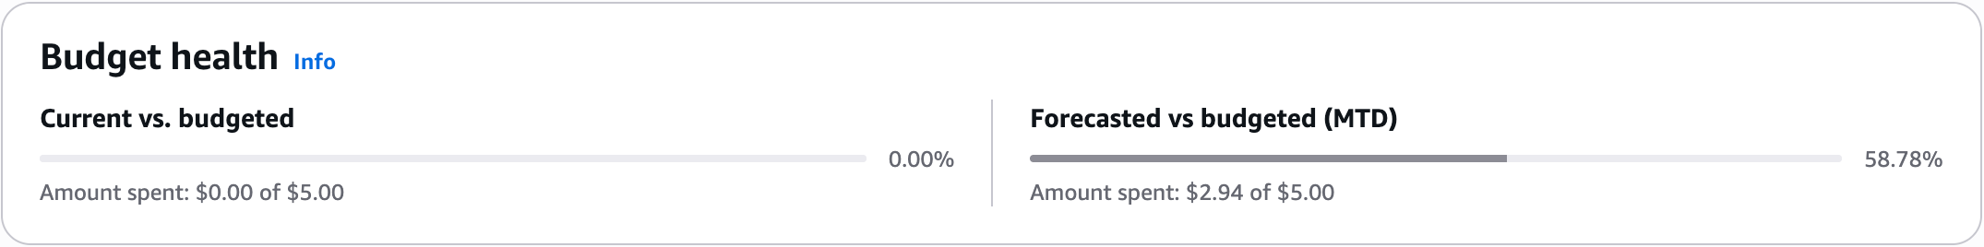
Cost optimization
Every service is pay-per-use or inside the AWS free tier.
Group
What's in it
Cost / month
Why
Compute
Lambda (arm64)
$0
1M requests free, always
API and sign-in
API Gateway, Cognito (4 users)
$0
1M calls free; 10,000 users free
Database
6 DynamoDB tables + 5 Paris replicas
< $0.20
Pay per request; we use thousands
Website and storage
CloudFront, 4 S3 buckets
< $0.01
1 TB free; under 10 MB stored
Monitoring
Logs, 7 metrics, 7 alarms, dashboard, SNS
$0
All under the free limits
Network
VPC, 2 subnets, gateway endpoint
$0
VPCs and gateway endpoints are free
Security and control
IAM roles, OIDC, $5 budget
$0
Always free
Total
< $1 / month
A few cents, with a $5 budget alert
AWS Budgets
campuspulse-monthly: $0.00 spent so far; AWS forecasts $2.94 for the month, under our $5 limit
Notes:
Tanushka: walk the table; close with the $5 budget alert as evidence of cost control. Other choices: ARM Lambdas (cheaper), 7-day log retention, events expire after 30 days, events table not replicated.

Slide 15


Conclusion: Built to scale, stay up, and stay secure
Scalability
High availability
Security
Lambda runs more copies of the function as requests rise, and removes them when traffic drops, with no configuration
Sensors send 25 readings per request; the Lambda processes up to 8 at once
DynamoDB on-demand scales with traffic, and running totals avoid scanning raw data
API Gateway throttles at 20 requests per second (bursts of 50) to cap cost
The Lambda runs in private subnets across two availability zones; if one fails, the other takes over
DynamoDB stores every item in three availability zones
The function keeps no state, so any copy can serve any request
CloudFront serves from edge locations, with automatic failover to the Paris copy
Cognito hosted sign-in: no public sign-up, one-hour tokens, passwords never touch our code
API Gateway verifies every token before our code runs; roles are enforced in the API
Least-privilege IAM: the Lambda's DynamoDB actions are listed table by table
Private subnets with no internet; private S3 behind CloudFront; HTTPS and encryption at rest
Notes:
Alero: scalability and high availability. Tanushka / Om: security points. Key line: API Gateway checks who you are; our code checks what you're allowed to see.

