Slide 1




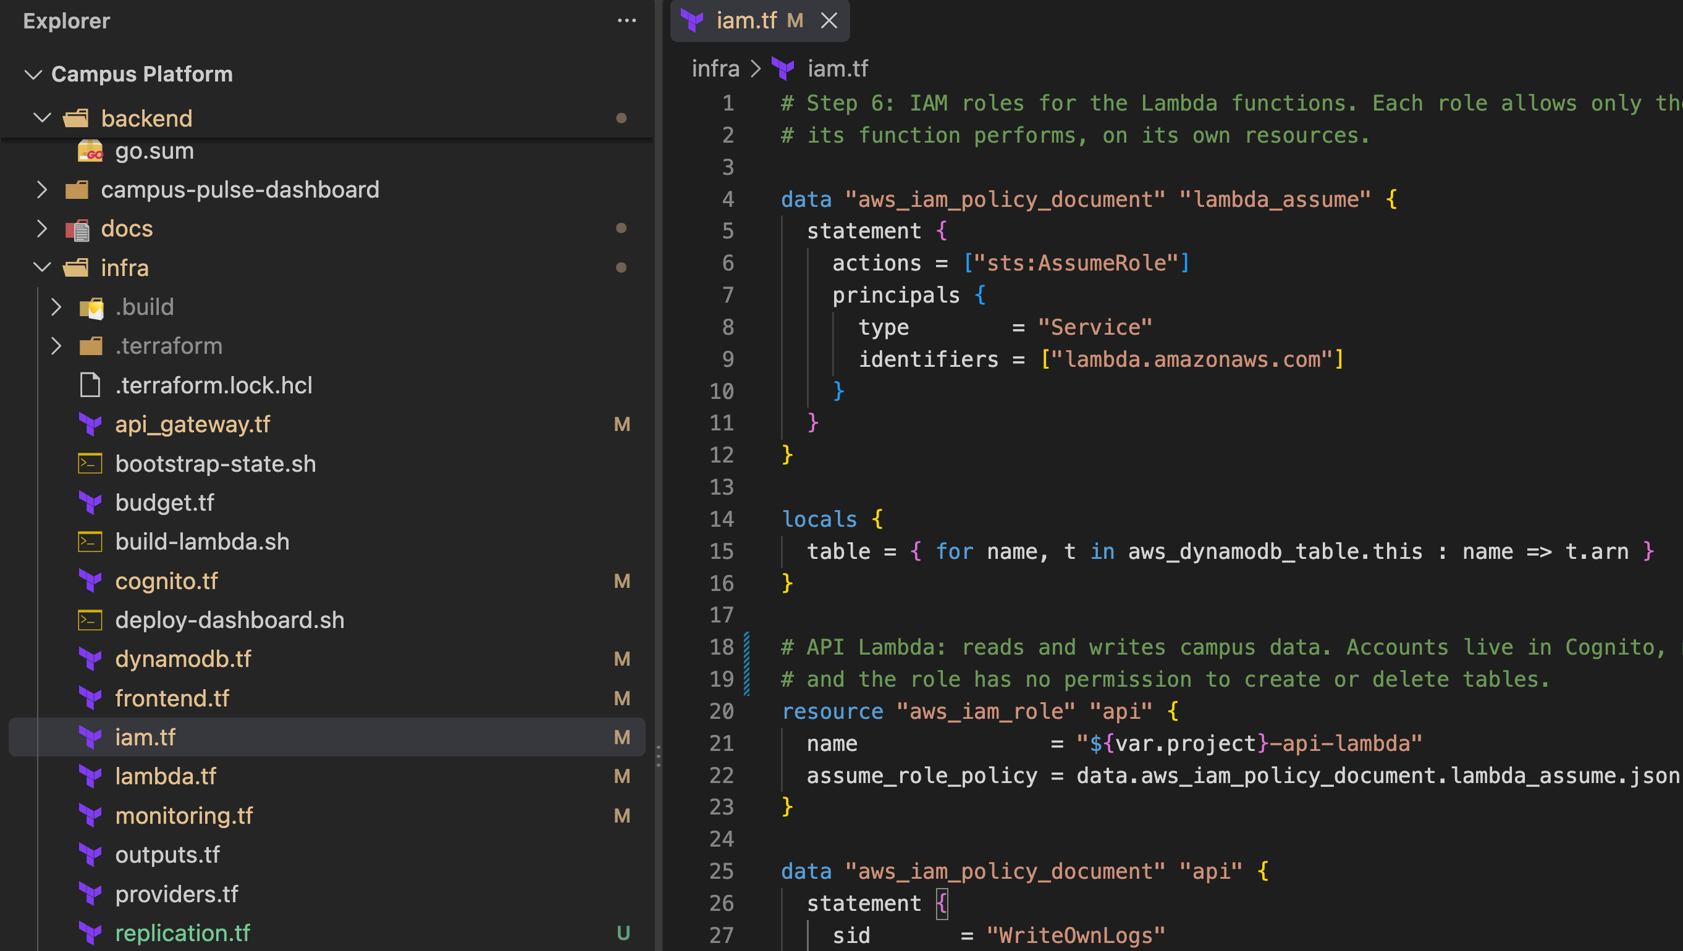
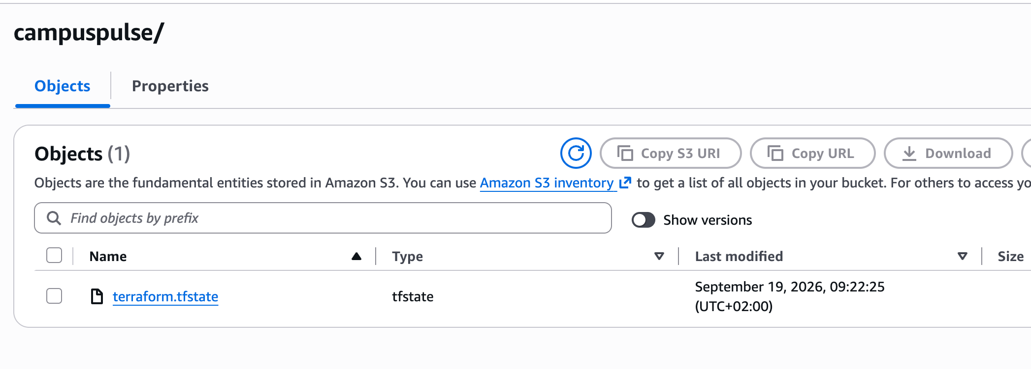
Infrastructure as code with Terraform
Every AWS resource is written as code, so the whole platform can be rebuilt with one command.
Everything is code
One command
Shared state in S3
One copy for everyone
One .tf file per part: vpc, lambda, cognito, dynamodb, frontend, monitoring…
terraform apply creates or updates the whole platform
Terraform's record of what it built: encrypted, versioned, locked
The team and the CI/CD pipeline work from the same state
The infra folder: one Terraform file per part of the platform
The shared state file in S3
Bucket: campuspulse-tfstate
Encrypted and versioned
A lock file stops two runs at once
Copied to Paris for recovery
Notes:
We used Terraform to create our AWS infrastructure as code, so the whole platform can be rebuilt with one command. Terraform keeps track of what it created in a shared, encrypted S3 bucket, so the whole team and our deployment pipeline work from the same copy.

