Slide 1
From JSON to Database
Author: Alejandro Rodriguez Arguimbau
Course: 11756 Storage and Data Recovery Master’s Degree in Intelligent Systems

Slide 2
Objective
The objective is to process a JSON file containing hotel reservation data and evaluate different storage and processing strategies.

Slide 3
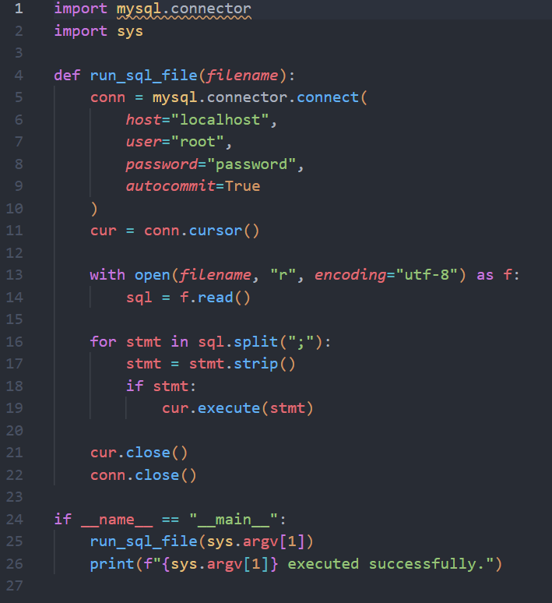
Python script to execute SQL files (run_sql.py)
One-time requirement:
pip install mysql-connector-python

Slide 4
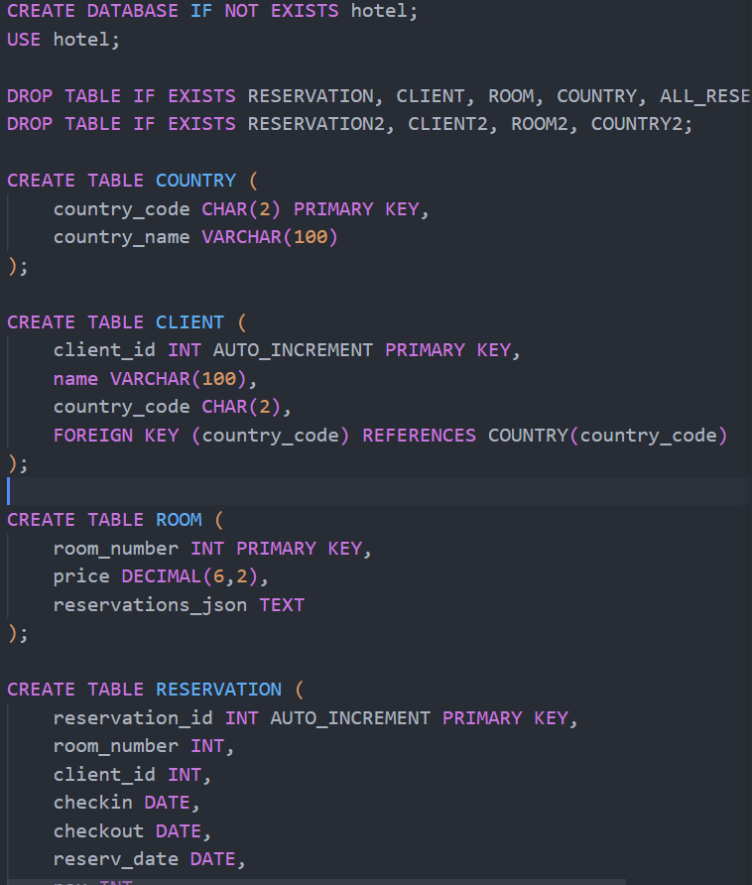
Create Database and Tables (01_schema.sql)
Run command:
python run_sql.py 01_schema.sql

Slide 5
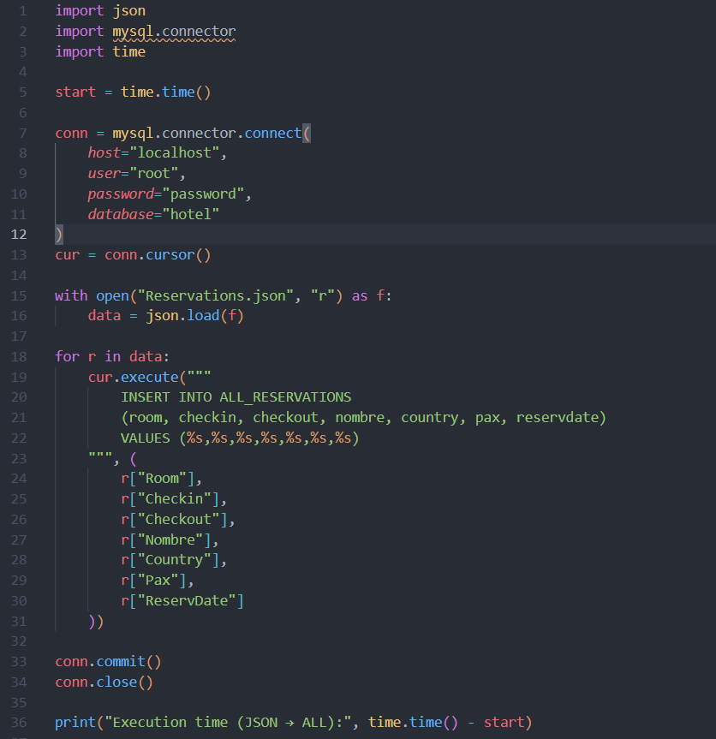
Load JSON into ALL table (02_load_json.py)
Run command:
python 02_load_json.py

Slide 6
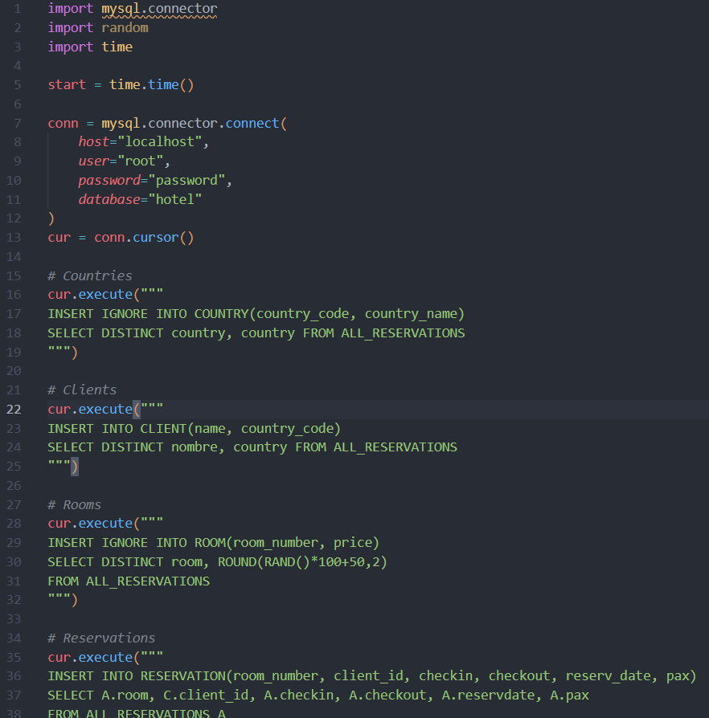
External Population of Normalized Tables (03_external_populate.py)
Run command:
python 03_external_populate.py

Slide 7
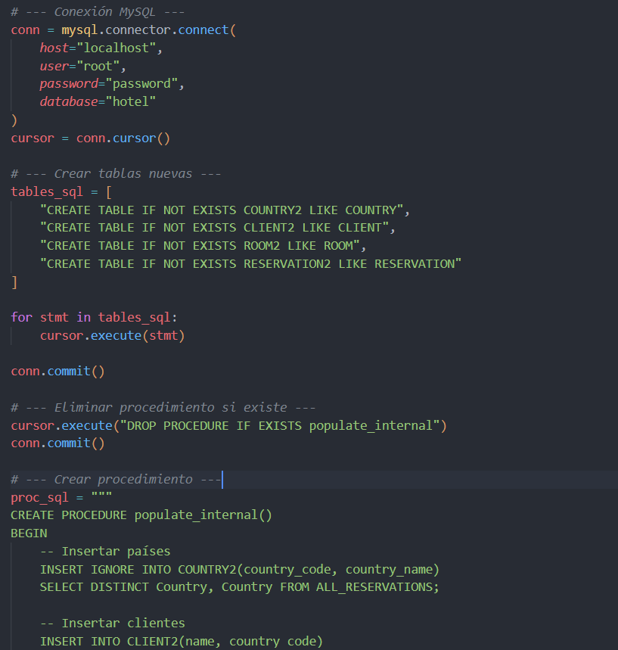
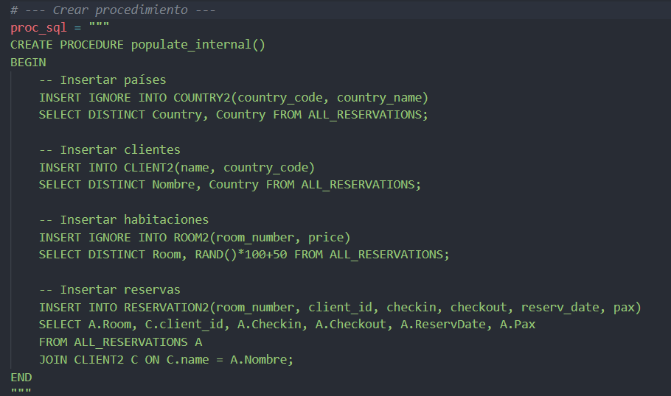
Internal Population Using Stored Procedure (04_internal.py)
Run command:
python 04_internal.py

Slide 8
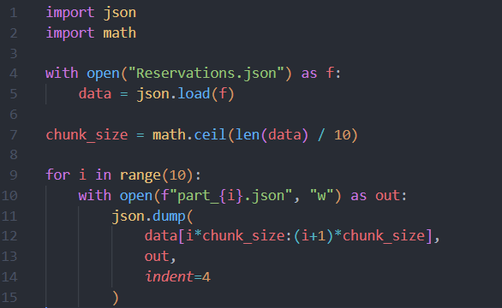
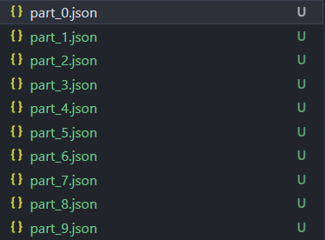
MapReduce Room Occupancy Calculation (05_split_json.py)
Run command:
python 05_split_json.py

Slide 9
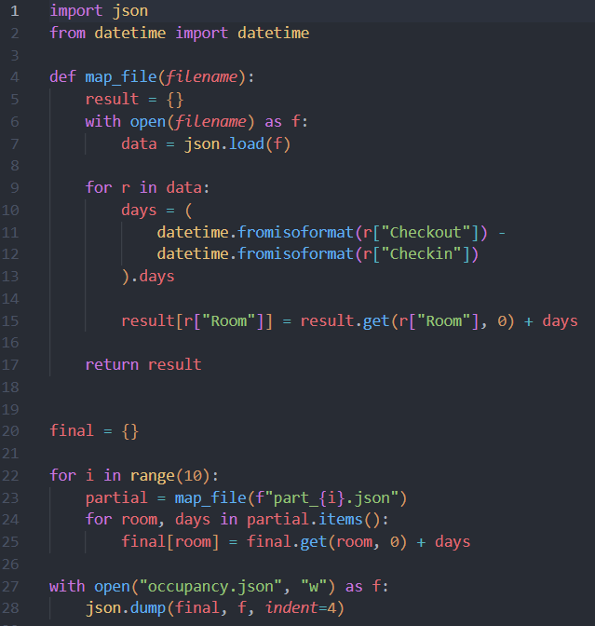
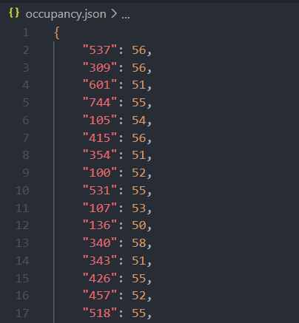
MapReduce Room Occupancy Calculation (06_map_reduce.py)
Run command:
python 06_map_reduce.py

Slide 10
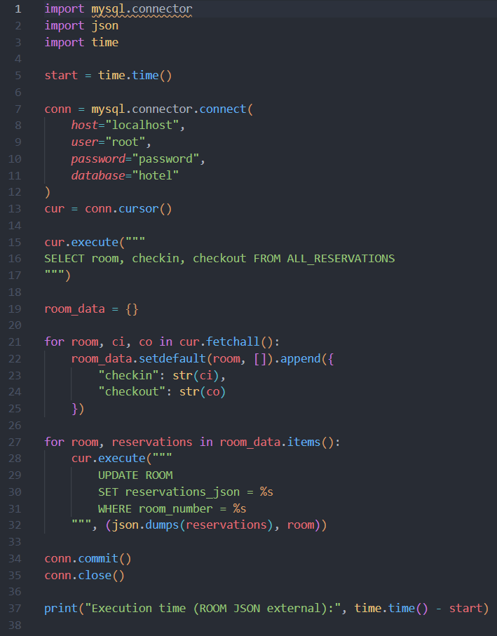
Avoiding JOINs Using JSON Attributes (07_room_json_external.py)
Run command:
python 07_room_json_external.py

Slide 11
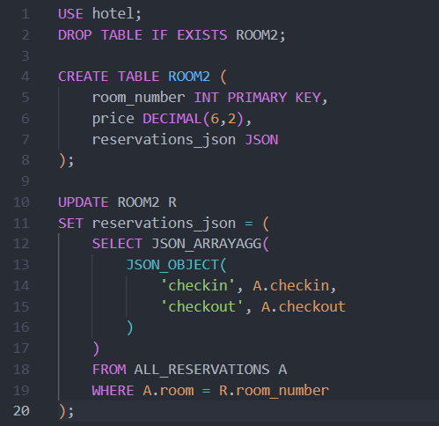
Avoiding JOINs Using JSON Attributes (08_room2_json_internal.sql)
Run command:
python run_sql.py 08_room2_json_internal.sql

Slide 12
DISCUSSION
External programs provide flexibility and easier JSON handling.
Internal procedures are faster due to reduced data transfer.
MapReduce enables scalable processing of large datasets.
JSON attributes avoid JOINs but break normalization.

Slide 13

Project repository
To see the full project:
https://github.com/alerodriargui/json-to-database

