Slide 1



Weather Forecasting via Ensemble Learning (Mixture of Experts)
Global Project - Pattern Recognition (2025-2026)
Authors: José Álvaro García Márquez, Alejandro Rodríguez Barberán
University of Cádiz

Slide 2
1. Historical Data
AEMET Station 5972X
Open-Meteo & AEMET
OpenWeatherMap
Official Spanish meteorological service providing ground truth data for San Fernando, Cádiz
Open-source weather API providing forecast data with global coverage
Commercial weather API offering real-time forecasts with 3-hour temporal resolution
Data Volume: Cumulative historical data exceeding 80000 records collected over one more than one month (from 1/4/2026 to 7/5/2026), providing robust training material for the ensemble system.

Slide 3
1. Historical Data
(Format)
1. Predictions Structure (7 columns):
PRED ; [ SOURCE ] ;[ CAPTURE_DATE ] ; [ TARGET_DATE ] ; [ TEMP ] ; [ WIND ] ; [ PRECIP ] Example: REAL ; AEMET ; 2026-05-04T09:00 ; 18.1 ; 28.1 ; 0.0
2. Ground Truth / Real Data Structure (6 columns):
REAL ; [ SOURCE ] ; [ OBSERVATION_DATE ] ; [ TEMP ] ; [ WIND ] ; [ PRECIP ] Example: REAL ; AEMET ; 2026-05-04T09:00 ; 18.1 ; 28.1 ; 0.0

Slide 4
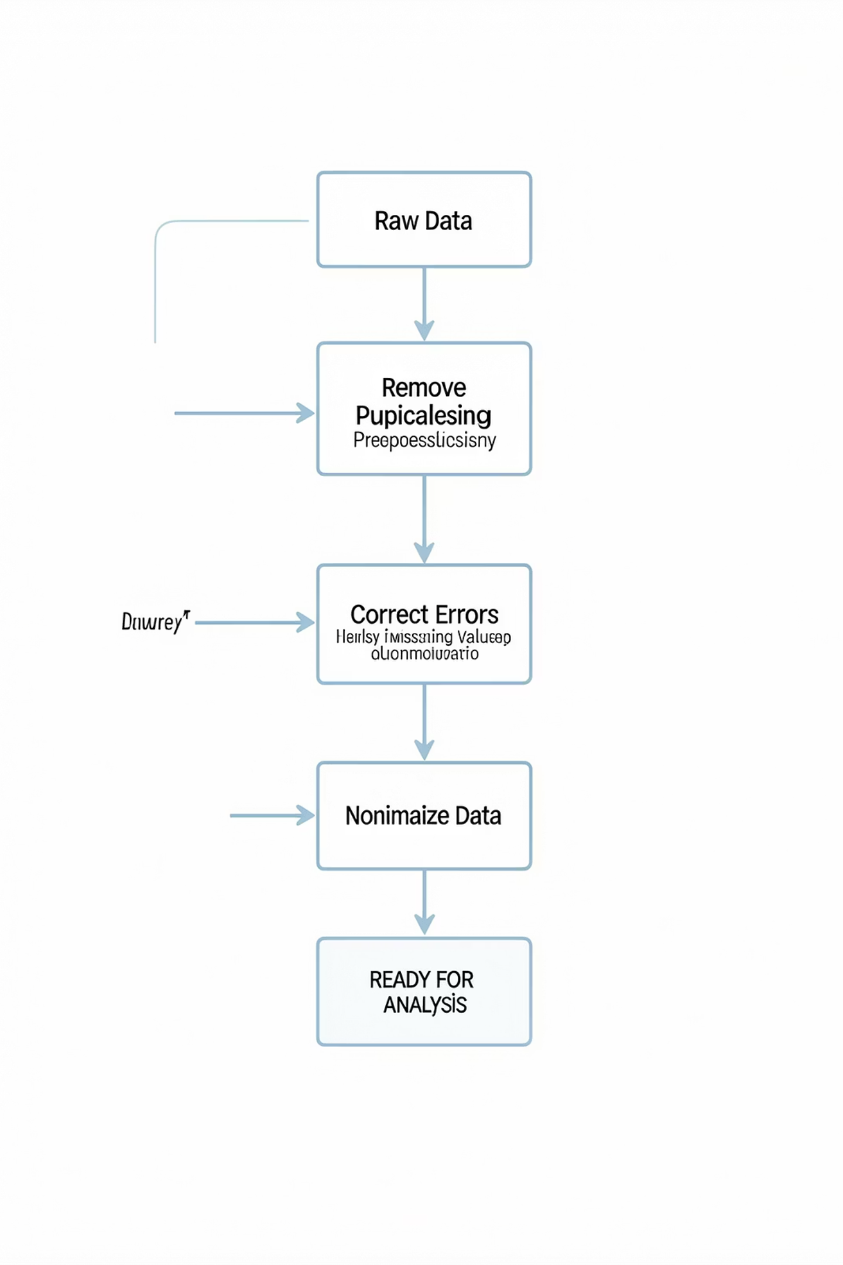



1. Data Preprocessing: Anomaly Resolution
Temporal Offset Detection
AEMET predictions contained UTC+2 timezone offset requiring correction to align timestamps
Unit Conversion
Wind speed reported in knots; applied conversion factor (×1.852) to standardize to km/h
Data Integration
Harmonized all sources to common temporal resolution and measurement units, fixing missing hours prediction with mathematical tools (interpolation).
Impact: These preprocessing steps reduced systematic errors significantly before model training, demonstrating the critical importance of data quality in Pattern Recognition systems.

Slide 5
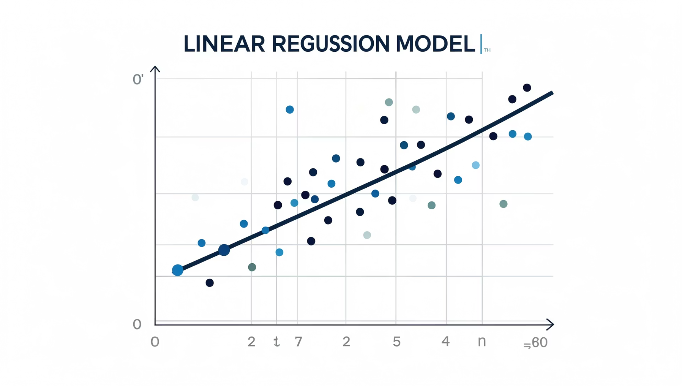

2. Model Design: Generalized Linear Model
Ensemble Architecture
Generalized Linear Model (GLM) trained via pseudoinverse method. The model functions as a Mixture of Experts, dynamically weighting the reliability of each API source based on historical performance.
Model Selection
Following Occam's Razor principle, we discarded a complex model with 9 crossed variables due to high variance and overfitting risk. We opted for a robust simple model using 3 direct variables.
The GLM approach provides interpretability while maintaining predictive power, making it ideal for ensemble systems requiring transparency.

Slide 6
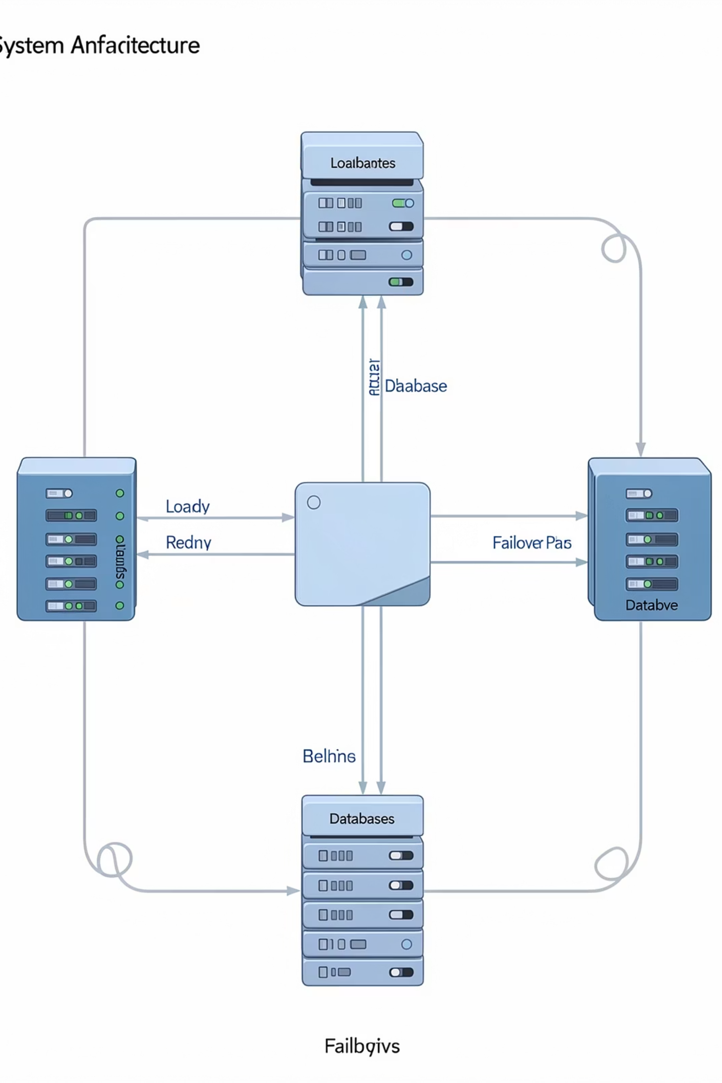
2. Fault Tolerance & Inference Strategy
01
02
Time-Series Imputation
Cross-Substitution Mechanism
Linear interpolation applied to fill 3-hour gaps in OpenWeatherMap data, maintaining temporal continuity
If any API server fails or returns null values, the system automatically redistributes weights among remaining sources
03
Dynamic Weight Adjustment
Model continuously updates source reliability based on recent prediction accuracy

Slide 7
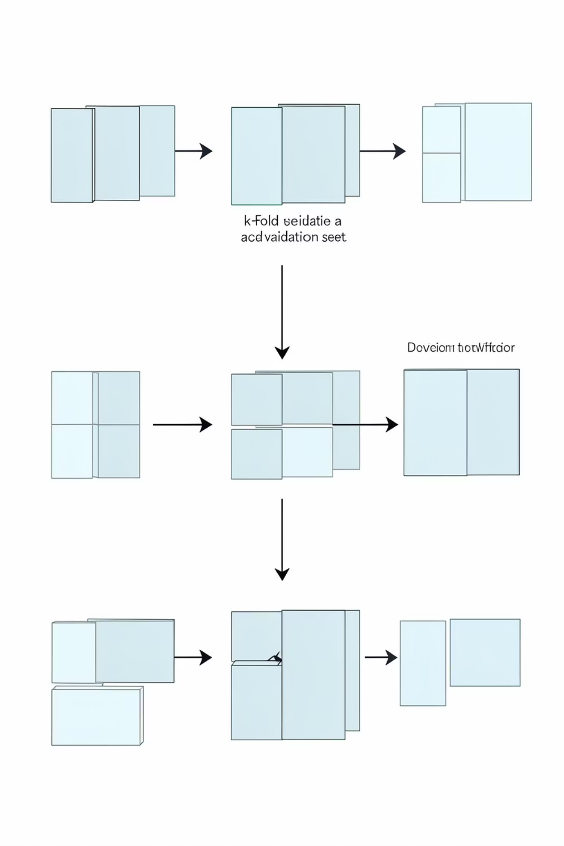
3. Validation Methodology
10-Fold Cross-Validation
Random sampling used to avoid optimistic resubstitution error. Data partitioned into 10 subsets with iterative training and validation.
Production Retraining
Final model re-trained with 100% of available data to maximize incorporation of recent information while maintaining validated architecture.
Placeholder: RMSE Temperature Chart will be inserted here

Slide 8
4. Time Horizon Analysis
Analyzing error progression across four temporal windows reveals the Butterfly Effect in forecasting systems.
1-12 Hours
25-36 Hours
Short-term horizon with lowest error rates. All sources show high reliability as predictions approach actual conditions.
Extended forecasts demonstrate growing uncertainty. System smoothing becomes critical for accuracy.
1
2
3
4
13-24 Hours
37-48 Hours
Medium-term predictions show initial error increase. Ensemble maintains advantage over individual APIs.
Long-term predictions show maximum error. Ensemble remains competitive, outperforming average of individual sources.
Placeholder: RMSE Wind Chart will be inserted here

Slide 9
4. Error Degradation: Precipitation & Wind
Precipitation Forecasting
Wind Speed Prediction
Placeholder: RMSE Precipitation Chart will be inserted here
Placeholder: RMSE Wind Chart will be inserted here
Key Insight: As time horizon increases, uncertainty grows exponentially across all sources. However, our ensemble model maintains competitive error rates, consistently lower than the average of individual APIs, demonstrating the value of intelligent fusion.

Slide 10
5. Final Conclusions: Smart Filtering
Peak Smoothing
False Alarm Correction
The model learned to identify and smooth unrealistic peaks, particularly AEMET's wind overestimation tendencies, improving overall forecast reliability.
System penalizes extreme rain predictions when consensus of other APIs indicates otherwise, reducing Type I errors while maintaining sensitivity.
Placeholder: Backtesting Line Charts will be inserted here

Slide 11
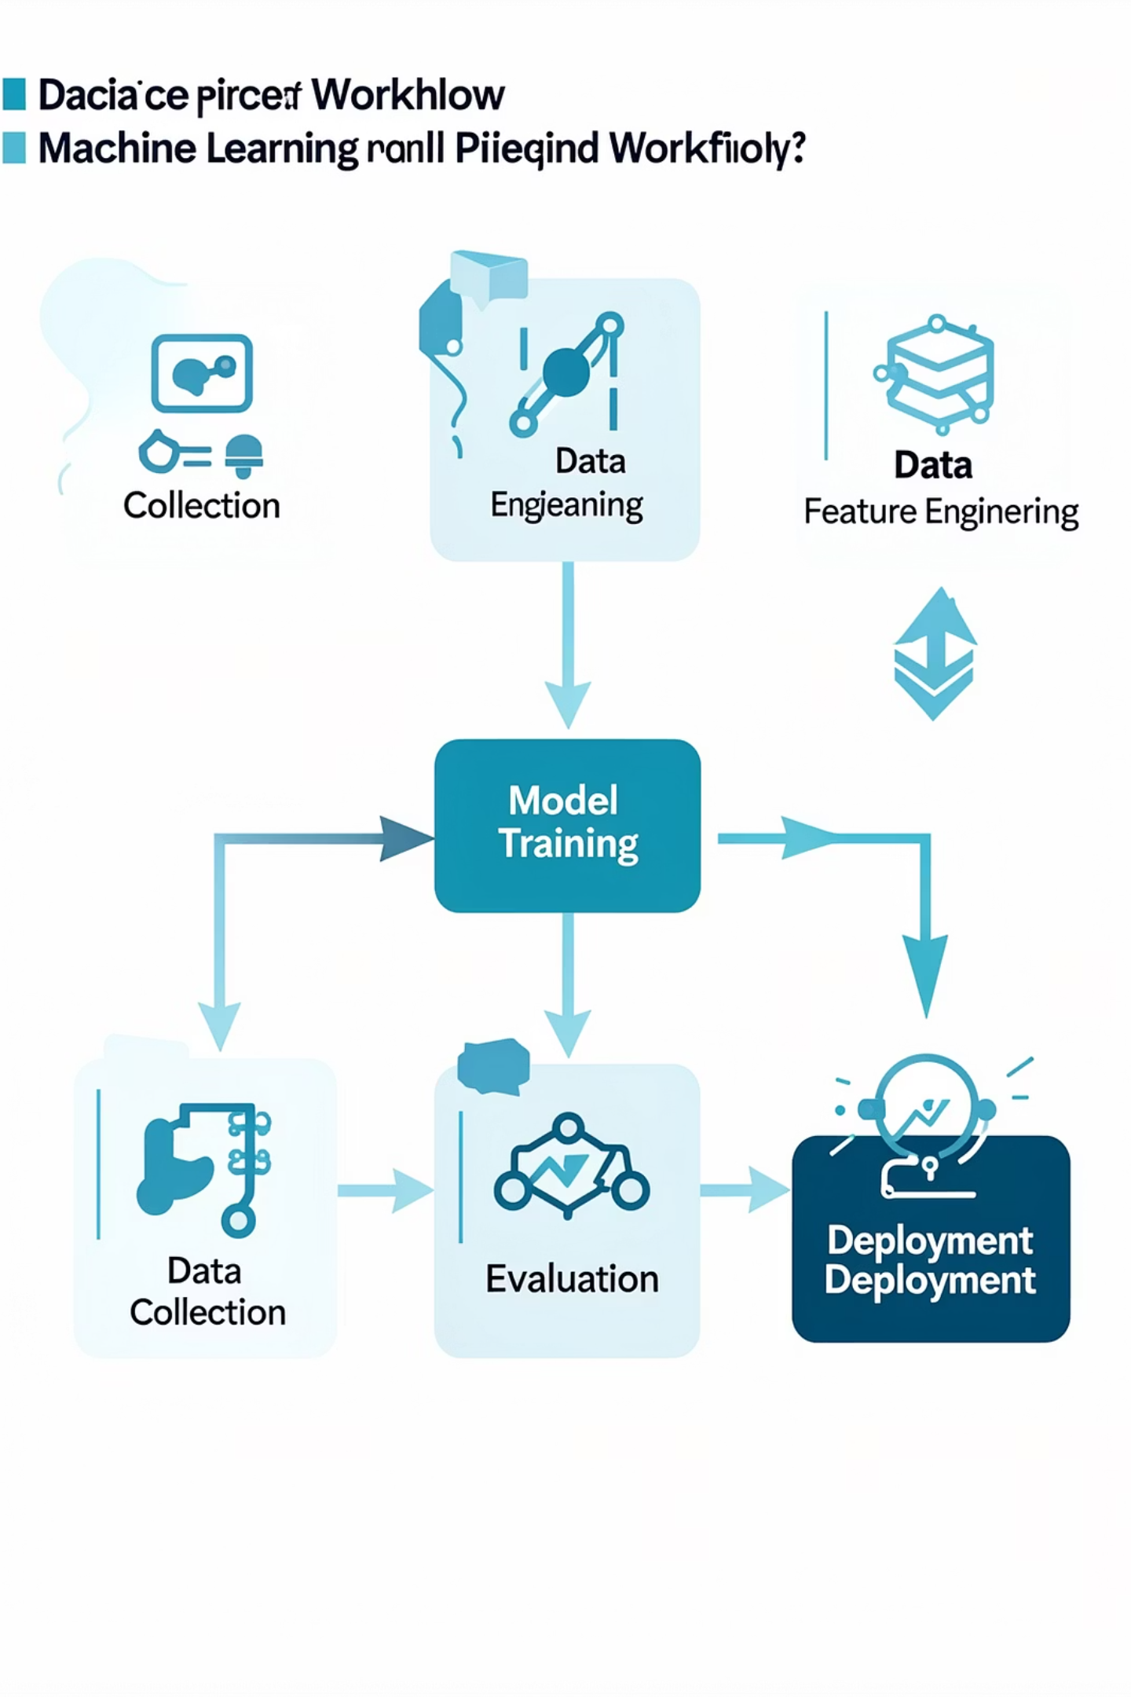
Key Takeaways & Future Work
Preprocessing Dominance
Simplicity Wins
Robust simple model outperformed complex alternatives via Occam's Razor
Data cleaning and fusion proved most critical phase for Pattern Recognition success
Ensemble Value
Intelligent fusion maintains competitive error across all time horizons
Future Directions: Integration of satellite imagery, seasonal adjustment factors, and real-time model updating could further enhance predictive performance.

