Slide 1

KESHAV MEMORIAL INSTITUTE OF TECHNOLOGY
(AN AUTONOMOUS INSTITUTION)
Accredited by NBA & NAAC, Approved by AICTE, Affiliated to JNTUH, Hyderabad
Department of Computer Science and Engineering
A.Y 2026-27
An SDC project on
Memory Augmented Multi Agents with RAG
Under the guidance of
K Yasaswini
Team No:G1371
Ale Sai Triveni 24BD1A05E3
Golem Shivani 24BD1A05GE
Kandur Rishitha Reddy 24BD1A05GR
Ramavath Vandana 24BD1A05HG
Preksha Bolampalliwar 24BD1A05E9

Slide 2
CONTENTS
Problem Statement
Base Paper / Research Paper Reference
Our Proposed Approach
Dataset Details
Improvements over Base Paper
Architecture Diagram
Features
Proposed Deployment Plan
Target Users, Input and Expected Output
Future Scope

Slide 3
PROBLEM STATEMENT
Amazon Rufus may provide inconsistent recommendations across different sessions due to limited memory of previous interactions.
Integrate a Memory Agent to retain chat history, preferences, and context.
Use RAG to retrieve relevant past information for accurate recommendations.
Introduce a Digital Twin to represent customer preferences and behavior.
Improve personalization, recommendation accuracy, and overall shopping experience.

Slide 4
BASE PAPER / RESEARCH PAPER REFERENCE
LLM Agent Meets Agentic AI: Can LLM Agents Simulate Customers to Evaluate Agentic-AI-Based Shopping Assistants?
Objective: The paper evaluates AI shopping assistants like Amazon Rufus using AI Digital Twins.
Technologies Used
LLM
Agentic AI
Digital Twin
Amazon Rufus
Claude 3.7 Sonnet
Limitation
The paper focuses on evaluation only.
It does not include
Memory
RAG
Personalized recommendations

Slide 5
OUR PROPOSED APPROCH
Project Title: Memory Augumented Multi Agents with RAG
To overcome this limitation, our project proposes:
Memory Agent to remember previous conversations.
RAG (Retrieval-Augmented Generation) to retrieve accurate product information.
Digital Twin to model customer preferences and shopping behavior.
Multi-Agent Architecture to divide tasks among specialized AI agents.
Explainable Web-based shopping assistant that recommends products from multiple e-commerce platforms.
Provide personalized recommendations from previous chats.
Maintain conversation history.
Improve recommendation accuracy.
Deliver a consistent shopping experience.

Slide 6
DATASET DETAILS
Agent | Dataset | Search on Kaggle | Recommended Author
1.Intent Detection Agent | Amazon Shopping Queries Dataset | Amazon Shopping Queries Dataset or Amazon ESCI | Amazon Science / Official mirror
2.Search Agent | Amazon Reviews | Amazon Reviews 2023 | Raviraj
3.Recommendation Agent | Amazon Reviews + RetailRocket | Amazon Reviews 2023, RetailRocket Recommender System Dataset | Raviraj + RetailRocket
4.Memory Agent | Application-generated chat history +(Mongodb)+RetailRocket(test) | RetailRocket Recommender System Dataset | RetailRocket
5.Digital Twin Agent | Customer Personality Analysis | Customer Personality Analysis | Akash Patel
6.Review Analysis Agent | Amazon Reviews | Amazon Reviews 2023 | Raviraj
7.Price Intelligent Agent | Amazon Products /reviews | Amazon Products Dataset | Raviraj
8.Budget Planning Agent | Customer Personality Analysis | Customer Personality Analysis | Akash Patel
9.Coupon & Offers Agent | Amazon Products Dataset | Amazon Products Dataset | Raviraj
10.Notification Agent | RetailRocketDataset | RetailRocket Recommender System Dataset | RetailRocket
11.Cart Agent | RetailRocketDataset | RetailRocket Recommender System Dataset | RetailRocket
12.Orchestrator Agent | No dataset required

Slide 7
IMPROVEMENTS OVER BASE PAPER
Base Paper | Our Project
Digital Twin for Evaluation | Digital Twin for Personalization
No Long-Term Memory | Memory Agent for Long-Term User Memory
No RAG | RAG for Product Knowledge Retrieval
Single Agent | Multi-Agent System
No Review Analysis | Review Analysis Agent
Evaluation | Smart Shopping Assistant

Slide 8
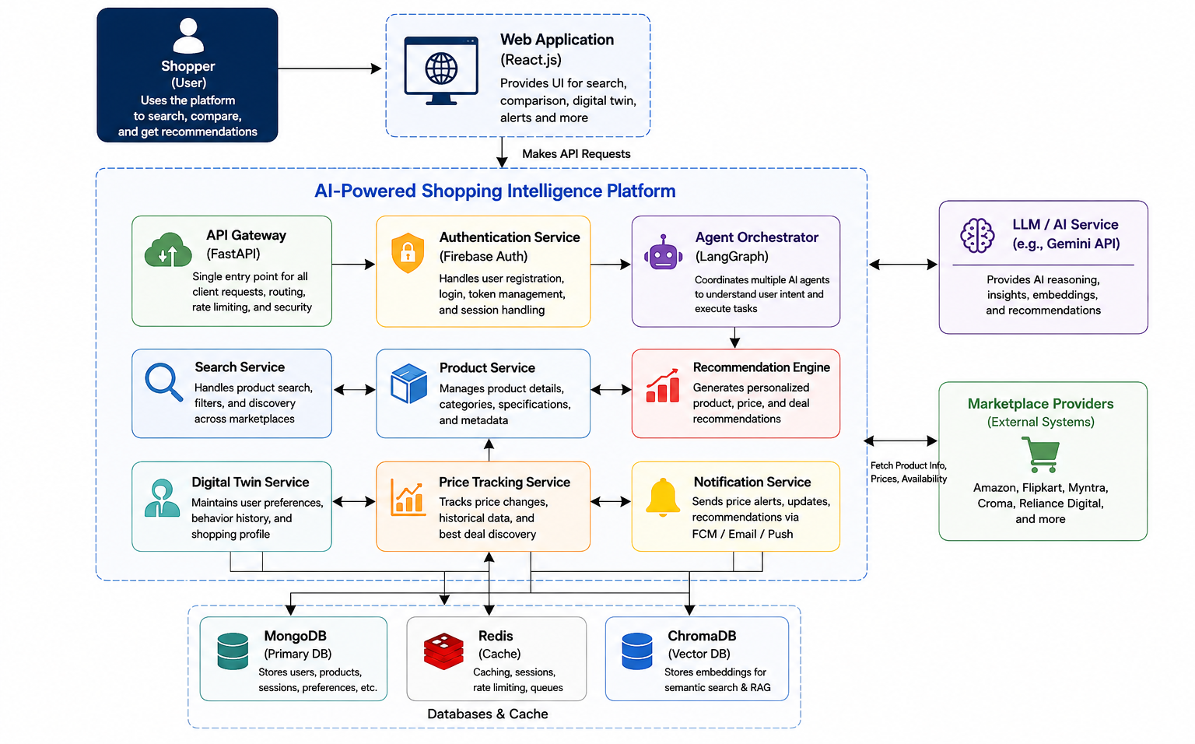
ARCHITECTURE DIAGRAM
Notes:
Now coming to our architecture.
At the top, we have the user interaction layer, where the user provides a shopping query and requirements.
The request is handled by our AI Orchestrator, which acts as the central coordinator of the multi-agent system. Its job is to understand the requirement and delegate different tasks to the appropriate specialized agents.
The first important component is the Memory Agent. It retrieves relevant information from the user's previous conversations, preferences, and shopping history. This provides the system with the user's existing context.
Next, the Search Agent is responsible for finding relevant product information from the available e-commerce sources.
The Recommendation Agent combines the user's current requirements with the retrieved user context and product information to generate suitable recommendations.
We also have specialized agents such as the Review Analysis Agent and Price Intelligence Agent.
These provide additional insights by analyzing product reviews and price-related information.
The RAG component supports the retrieval of relevant product knowledge before the final response is generated.
This helps the system provide recommendations based on retrieved product information rather than relying only on the language model's existing knowledge.
The Digital Twin represents the user's preferences and shopping behavior and helps the system personalize its recommendations.
Finally, all the relevant information from these components is brought together to produce an explainable and personalized shopping recommendation for the user.
So, the key idea behind this architecture is that instead of using one general-purpose agent for the entire shopping process, we use an orchestrator with multiple specialized agents, supported by Memory, RAG, and a Digital Twin.

Slide 9
FEATURES
Persistent Memory | Remembers previous conversations and preferences
Digital Twin | Builds a personalized user shopping profile
RAG-Based Product Retrieval | Retrieves relevant and accurate product information
Multi-Agent Intelligence Specialized agents | Handle different shopping tasks
Multi-Platform Shopping | Compare products across multiple e-commerce platforms, Shopping experience of multiple platform in this single platform
Personalized Recommendations | Recommendations based on user preferences and behavior
Review & Price Analysis | Analyze reviews and track price changes
Smart Notifications | Alerts for price drops of products in wishlist, sale reminders and relevant product updates
Product Comparison | Lets user compare up to 4 products on the basis of their specified features (Determined by digital twin)

Slide 10
PROPOSED DEPLOYMENT PLAN
Application Stack
Client: React.js Web Client
Cloud: AWS
Deployment: Amazon EKS (Kubernetes Cluster)
Backend Services: FastAPI – Authentication, User, Product, Search, Recommendation, Price Tracking & Notification
AI / Agent Orchestration: LangGraph + Gemini API
Database: MongoDB
Cache: Redis
Vector Database: ChromaDB
RAG: LangChain + ChromaDB
External Services: Amazon, Flipkart & Myntra APIs, Firebase for notifications
Application Flow
User
↓
Onboarding
↓
Digital Persona Twin
↓
Query/Intent
↓
AI Orchestrator
↓
Search + Memory + Recommendation Agents
↓
Review/Price Analysis
↓
Personalized Recommendation
↓
Compare/Cart
↓
Purchase
↓
Update Memory & Digital Twin

Slide 11
TARGET USERS, INPUT & FINAL OUTCOME
Target Users
Online & frequent shoppers
Personalization-seeking customers
E-commerce platforms
User Input
Product
Budget
Brand
Category
Requirements
Example: “Samsung phone under ₹30,000”
Expected Outcome
Persistent Memory across sessions
Digital Twin for user preferences
RAG for accurate product information
Personalized & Explainable recommendations
Multi-Agent & Scalable shopping assistant
Final Outcome
An intelligent shopping assistant that remembers users, understands preferences, and delivers accurate, personalized recommendations.

Slide 12
FUTURE SCOPE
1. Cross-Sector Expansion
Extend beyond e-commerce to Instamart, Swiggy, Rapido, Travel, Healthcare, and other services.
2. Advanced User Memory
Deeper long-term understanding of user preferences and behavior.
3. Multi-Platform Expansion
Integrate with more e-commerce and service platforms.
4. Voice & Multimodal Interaction
Enable voice queries and image-based product search.
5. Advanced Multi-Agent Collaboration
Introduce more specialized agents for end-to-end shopping automation.

Slide 13
Thank you!
Notes:
Slide 13 — Thank You
To conclude, our project aims to move beyond a basic AI shopping chatbot.
By combining Persistent Memory, RAG, Digital Twins, and Multi-Agent Intelligence, we aim to build a shopping assistant that can understand the user, remember their preferences, retrieve reliable product information, and provide personalized recommendations.
The ultimate goal is to deliver a consistent, accurate, explainable, and personalized shopping experience across multiple platforms.
Thank you.

