Slide 1

Business Intelligence
Teodora Valova
Alesandro Dragnev

Slide 2
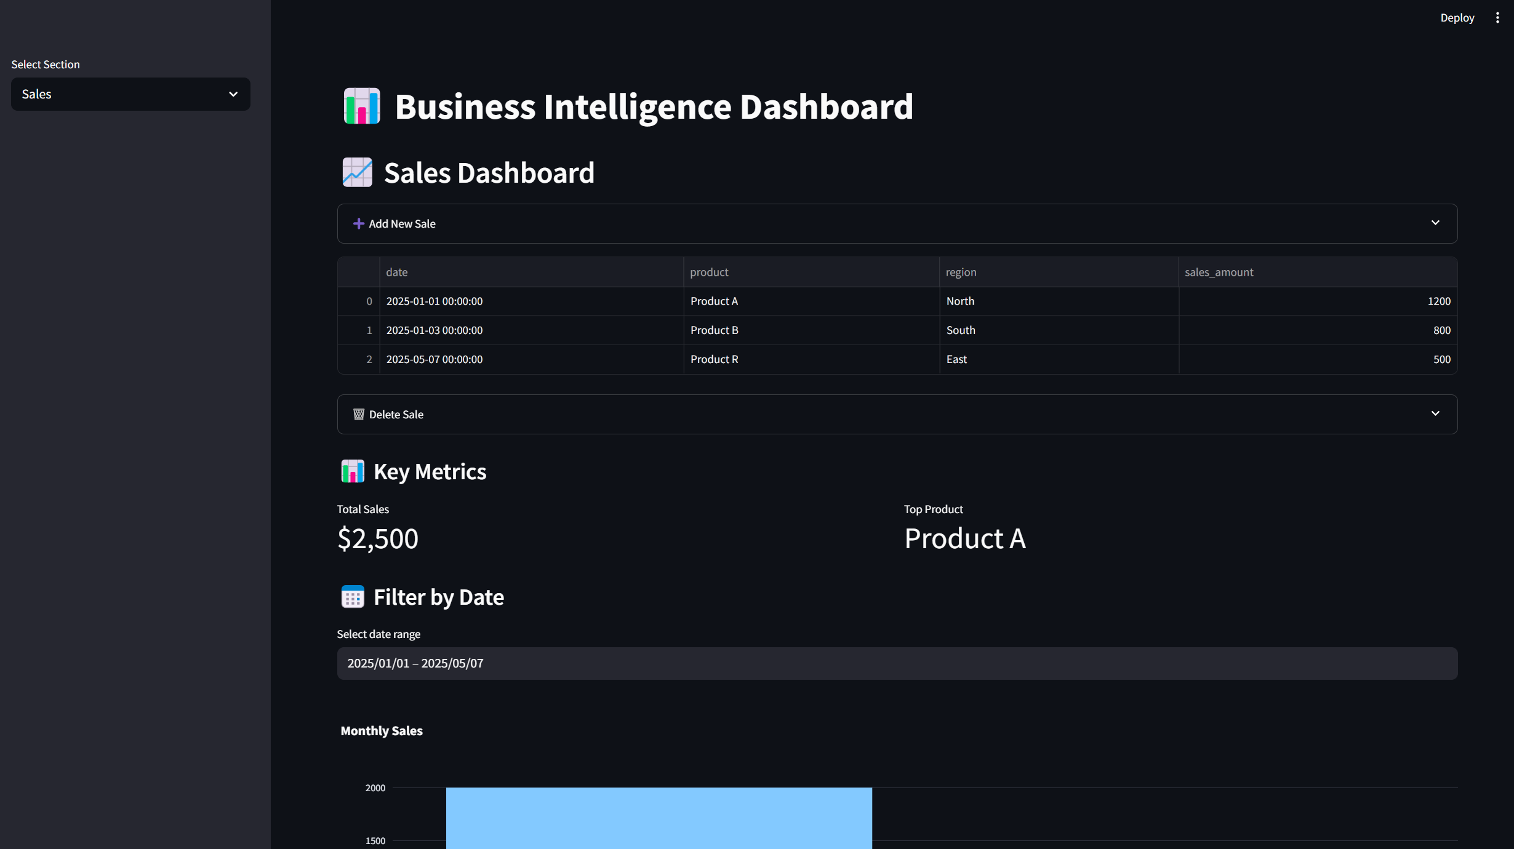
Project Overview
Business Intelligence Dashboard built with Python
Streamlit-based web interface
Tracks and analyzes Sales, Inventory, and Employee Performance
Lightweight CSV-based database backend

Slide 3



Technologies Used
Python – Core programming language
Streamlit – Dashboard UI
Pandas – Data manipulation
Plotly – Interactive visualizations
CSV – Local data storage
Batch Script – One-click Windows installer
Prophet – Machine learning forecasting tool

Slide 4

Project Structure
app.py – Main Streamlit script
data/ – Contains CSV files (sales, inventory, performance)
utils/data_loader.py – Loads CSVs into DataFrames
utils/charts.py – Generates Plotly charts
Install_App.bat – Windows setup script

Slide 5

Dashboard Sections
Sales Dashboard 🛒
Add & delete sales
Date filtering
Metrics: Total Sales, Top Product
Charts: Sales by Month, Product Pie

Slide 6

Dashboard Sections
Inventory Dashboard📦
Add & delete products
Low-stock warnings
Chart: Inventory levels

Slide 7

Dashboard Sections
Performance Dashboard🏆
Add & delete employee performance entries
Chart: Employee sales bar chart

Slide 8
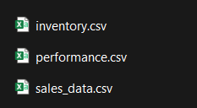
Data Handling
Uses .csv files as a structured database
All UI actions (add/delete) save directly to disk
Data is reloaded after each operation to reflect real-time changes
No external database needed

Slide 9
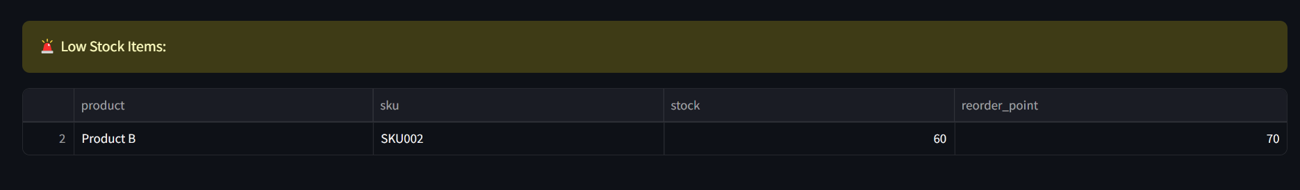
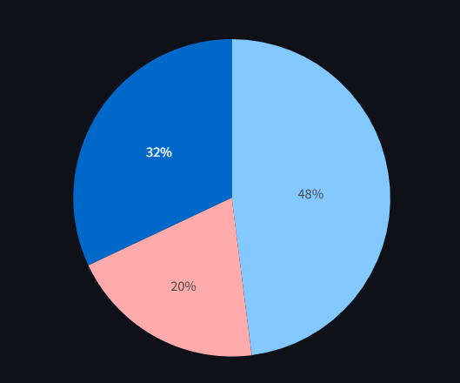
Key Features
Clean UI with collapsible sections
Live table/chart refresh after edits
Modular codebase for scalability
Fully offline / local use
No manual data editing needed

Slide 10
Potential Improvements
Input validation (e.g., date/month)
Undo/backup support
Switch to SQLite for better scalability
Multi-user login support

Slide 11
THANK YOU FOR YOUR ATTENTION

