Slide 1
HOW TO HOST YOUR PERSONAL WEBSITE
Fizădean Alexandru, Staicu Mario, Vlonga Dorina-Nicoleta
Politehnica University of Timișoara
Communication

Slide 2
Table of contents
(01)
(02)
(03)
Infrastructure & Server Choice
Networking, DNS and Identity
Security and Performance

Slide 3
01
Infrastructure & Server Choice
Choosing hardware and configuring the Linux operating system.
Communication

Slide 4
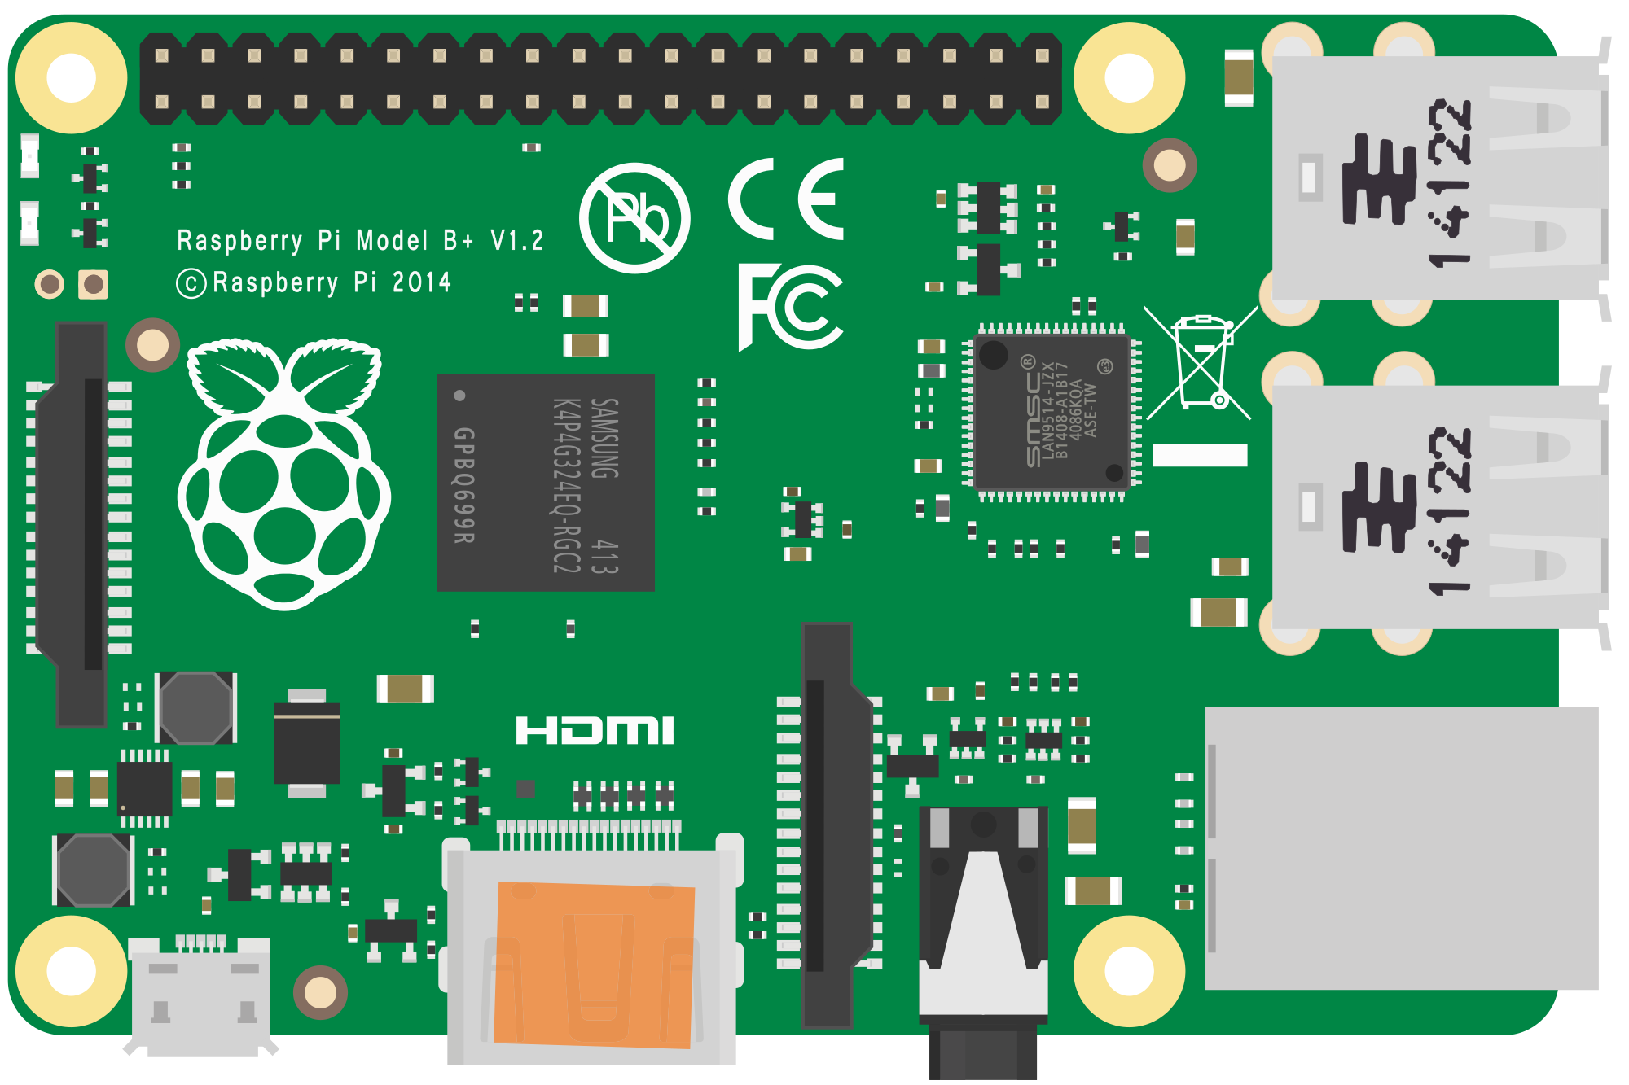

Where do we host the website?
Self-Hosting – using your own hardware, such as an old laptop, PC or Raspberry PI
PROS: Total control, zero recurring costs
CONS: Power consumption, background noise, reliant on your home internet connection
Cloud Hosting – renting a virtual server from providers like Google Cloud or DigitalOcean
PROS: 99.9% availability, static IP, easily scalable
CONS: Requires a monthly subscription fee

Slide 5

Operating System: Why Linux?
Most servers worldwide run on Linux
It doesn’t use a GUI, meaning all resources are dedicated to the website
Extremely robust, it can run for months without needing a restart
No license fees, backed by extensive online documentation and community forums
Ubuntu Server is the most popular distribution

Slide 6


Web Server Software
What is it?
- A background service acting as the entry point of HTTP/HTTPS traffic
How it works:
- It listens to port 80 (HTTP) and port 443 (HTTPS) and establishes a TCP three-way handshake with visitors to ensure data integrity
Apache vs Nginx:
Apache: creates a separate process for each connection and is highly flexible thanks to its loadable modules
Nginx: uses a single “worker” to handle thousands of simultaneous connections, making it much more efficient with RAM and CPU under heavy loads

Slide 7
02
Networking, DNS and Identity
Configuring IP addresses, ports, and the DNS system
Communication

Slide 8
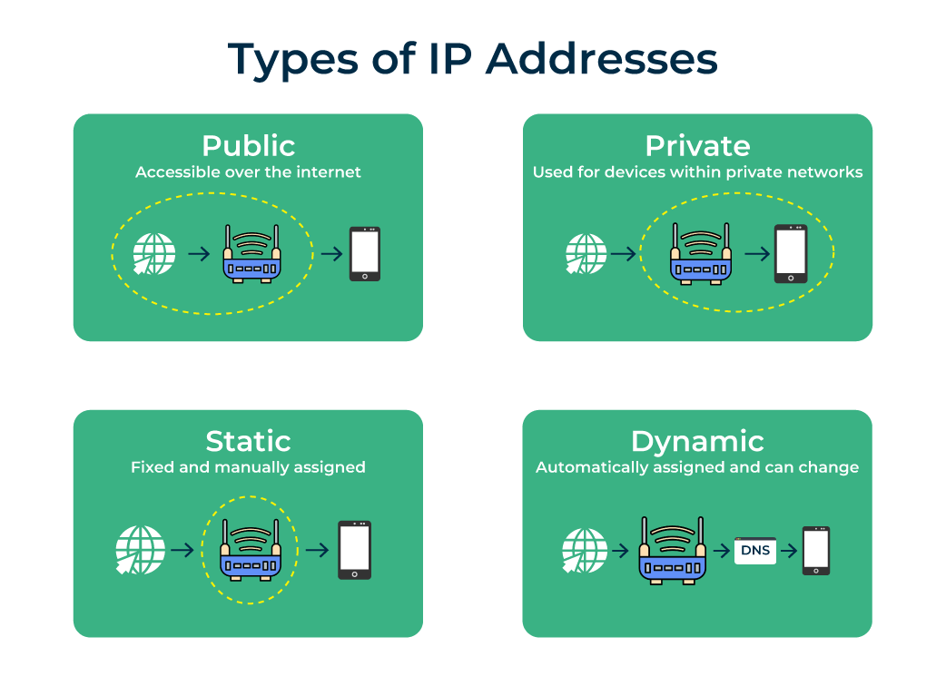
IP Addresses
Private IP
Public IP
- The server’s unique address on your local network, assigned by the router
- The address visible to the entire internet, assigned by your ISP.
Static vs. Dynamic IP
A server needs a fixed (static) address
If the public IP changes (dynamic), DNS is used to automatically map the domain to the new IP
Protocols Used
IPv4 – the standard protocol, but limited to the number of available addresses
IPv6 – allows the direct connection of billions of devices

Slide 9
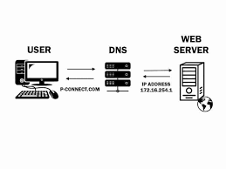
DNS (Domain Name System)
What is DNS?
- Network protocol that translates human-readable domain names (site.com) into numerical IP addresses
Resolution Hierarchy
Root & TLD Servers: Identify the domain extension (.com, .ro)
Authoritative Nameserver: the final server holding the correct IP address
Essential Records
A Record (Address Record): links the domain name directly to the IPv4 address
CNAME: Creates an alias (www.site.com -> site.com)
TTL (Time to Live)
- The time the information is stored in the cache of other servers

Slide 10
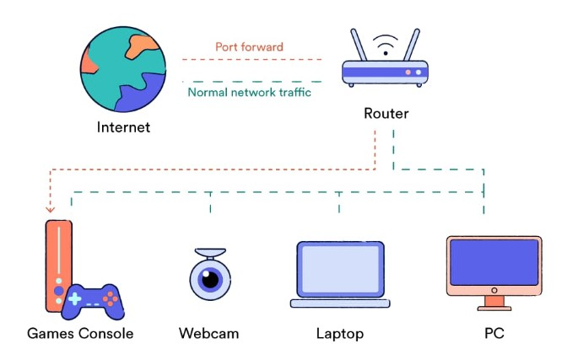
NAT and Port Forwarding
The problem
The router uses NAT to protect the local network, automatically blocking any uninvited external connections.
The Concept of Ports
Each web service has a specific identification number.
Port 80: Standard web traffic (HTTP)
Port 443: Secure web traffic (HTTPS)
Solution: Port Forwarding
A router rule that automatically redirects external traffic arriving on a specific port to the local server’s private IP
Without this, the server would be completely invisible to the outside world

Slide 11
Final Flow
User input – the user types the website name in the browser
DNS Translation – the DNS translates the name into the public IP address
Router Entry – the router receives the request on port 80 or 443
Port Forwarding – the packet is redirected to the Linux server
Response – the server answers and sends the web page back to the user
Communication

Slide 12
03
Security and Performance
Protecting your server and optimizing website speed
Communication

Slide 13

Securing the connection
HTTPS Protocol (SSL/TLS)
– encrypts data in transit to ensure confidentiality and protect against Man-in-the-Middle attacks
Let’s Encrypt
- a widely used service that generates automated and free SSL certificates
Digital Certificates
- validates the true identity of the server to the users

Slide 14
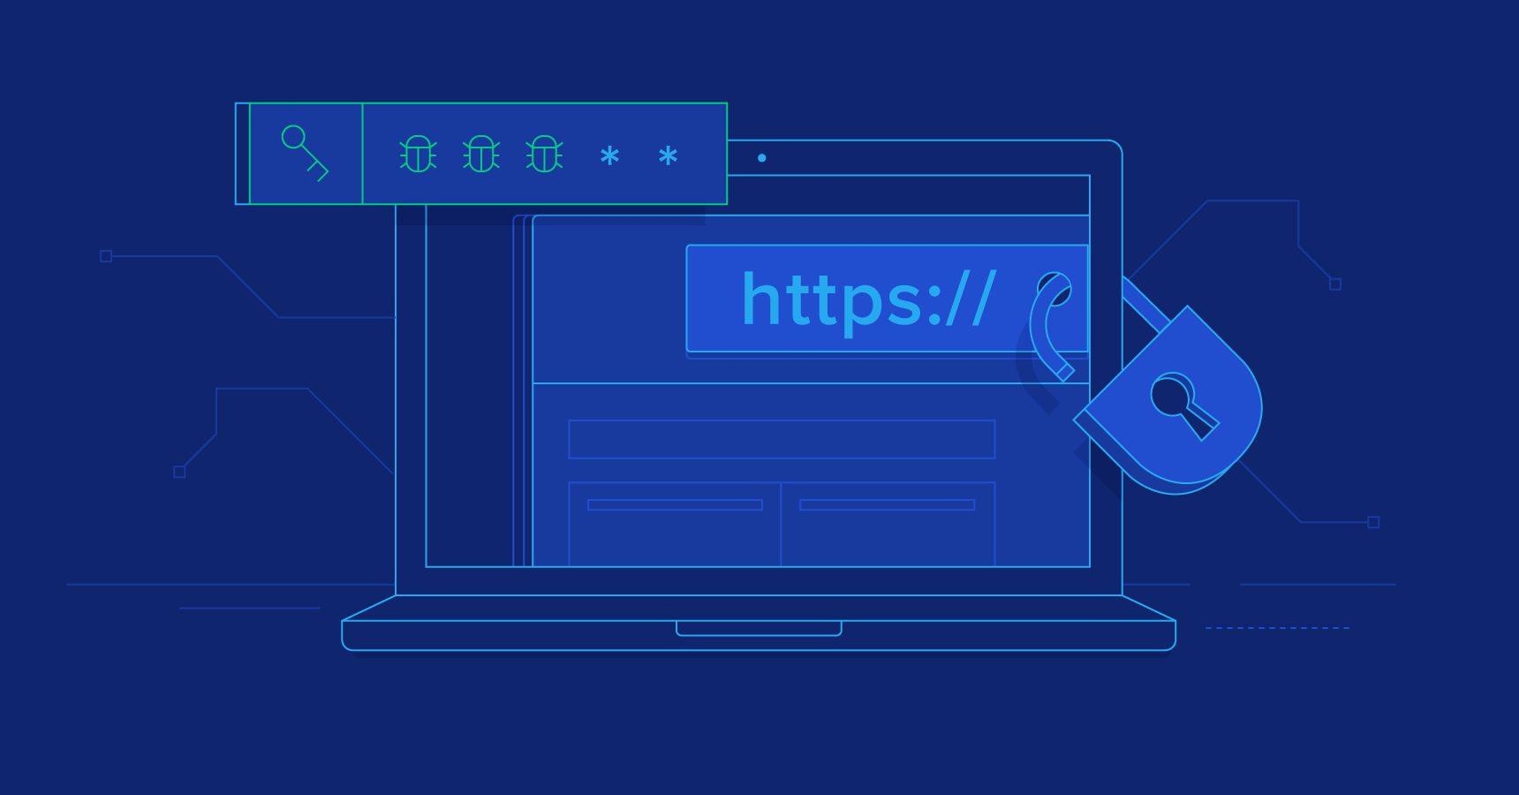
Host-Level Security
Firewall (UFW)
Applies a “Default Deny” policy, blocking all uninvited traffic
Selectively allows only essential ports: 80 (HTTP) and 443 (HTTPS)
SSH Administration Security
Replaces weak passwords with secure SSH Key Pairs
Changes the default port (22) to hide from automated scanning bots
Fail2Ban
- An active protection service that monitors failed login attempts and automatically blocks suspicious IPs

Slide 15

Performance & Availability
Caching Mechanisms
- Reduces loading latency by temporarily storing static files directly in the server’s RAM
CDN (Content Delivery Network)
Uses a network of geographically distributed proxy servers to deliver content from the closest point to the user
Provides an essential layer of basic protection against DDoS attacks
Resource Monitoring
Tracking bandwidth and CPU load in real-time to prevent crashes

Slide 16
Resources
Introduction to Hosting (ubuntu.com/server/docs)
Nginx Beginner’s Guide (nginx.org)
Apache HTTP Server Project (httpd.apache.org)
Cloudflare Learning Center: What is DNS? (cloudflare.com)
Domain Names Specification (RFC 1035)
Mozilla Security: Server Side TLS (wiki.mozilla.org)

