Slide 1

Smart Intersections:
IoT Traffic and Pollution Control on Vasile Pârvan
Fizădean Alexandru
Politehnica University of Timișoara
Notes:
Hello everyone, I’m Fizadean Alexandru and my presentation is about Smart Intersections, more specifically about improving one we are familiar with, the one in front of our university.

Slide 2
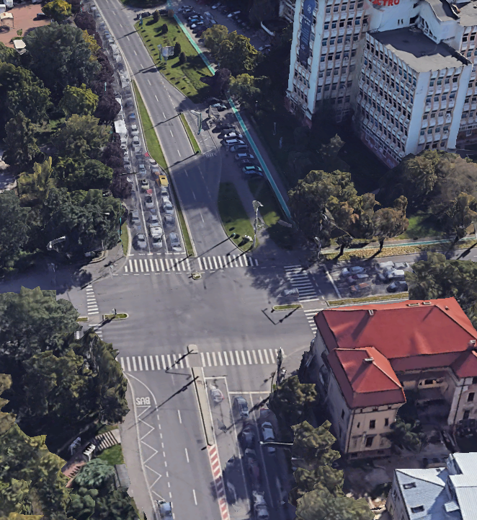
Smart Traffic and Air Quality
Background
Urban congestion degrades air quality
IoT is essential for sustainable smart city mobility
The Problem
Vasile Pârvan bottlenecks occur daily during UPT peak hours
Static lights ignore congestion, increasing vehicle idling and emissions
Purpose
This study aims to design and simulate an IoT-based system to dynamically control traffic lights on Vasile Pârvan, using real-time vehicle density and air quality data.
Notes:
We all know the frustration of the morning commute near the UPT campus.
But beyond just being annoying, urban congestion has a severe impact on localized air quality.
The core problem on Vasile Pârvan is that the current traffic lights operate on blind, static timers.
They don't know if the road is empty or if there are fifty cars idling and burning fuel.
Therefore, the purpose of this study is to propose and simulate a dynamic, IoT-based control system that reacts to real-time data.

Slide 3
Research questions & objectives
Questions
Objectives
How do dynamic IoT traffic lights affect average vehicle wait times on Vasile Pârvan Boulevard?
What is the relationship between traffic flow optimization and localized pollution levels?
To evaluate the reduction in traffic congestion using simulated IoT sensor data.
To examine the impact of reduced vehicle wait times on air quality metrics.
Notes:
To tackle this, my research was guided by two main questions.
First, I wanted to see exactly how much time we could save drivers by switching to a dynamic system.
And second, I wanted to understand the direct mathematical relationship between optimizing that traffic flow and the resulting drop in localized pollution, specifically PM2.5 and NO2.

Slide 4
Literature review
Authors (Year) | Main Finding
Popescu (2023) | Dynamic traffic lights reduce vehicle wait times by up to 15%
Dragomir (2021) | Adaptive systems improve mobility but rarely measure real-time environmental impact
Chen et at. (2024) | Low-cost IoT nodes provide highly accurate PM2.5 tracking in dense urban areas.
Notes:
Before building the simulation, I reviewed the current literature.
As you can see on the slide, researchers like Popescu and Chen have proven that IoT edge computing and low-cost sensors are highly effective

Slide 5
Trends & the gap
The literature strongly agrees that IoT sensor networks successfully optimize traffic flow and reduce congestion.
There is limited integrated research on how these traffic optimizations directly impact localized air quality in real time.
Previous systems isolate traffic management from environmental health monitoring.
Therefore, this study addresses the gap by integrating both real-time traffic density and air quality metrics into a single dynamic control simulation for Vasile Pârvan.
Notes:
However, looking at the trends, I identified a clear research gap: most systems handle traffic management and environmental monitoring as two separate problems.
This study addresses the gap by uniting both traffic density AND air quality metrics intro a single one

Slide 6
Research methodology
Quantitative methodology to test the impact of dynamic IoT traffic control
Environment: 5,000 vehicles passing through the Vasile Pârvan / Mihai Viteazu intersection over a 30-day period.
Sensors: Gathered data for vehicle count (virtual cameras) and localized air quality (PM2.5/NO2 sensors).
Tools: Python for calculating traffic and pollution data sets and Microsoft Excel for chart generation.
Notes:
Because deploying physical hardware on a public boulevard wasn’t possible, I designed a quantitative experimental simulation.
I modeled the Vasile Parvan and Mihai Viteazu intersection, simulating 5000 vehicles over a 30 day period.
To do this I wrote Python scrips using NumPy to generate realistic data sets for vehicle count sensors and for NO2 sensors.
This allowed me to compare the static timer to my dynamic IoT model.

Slide 7
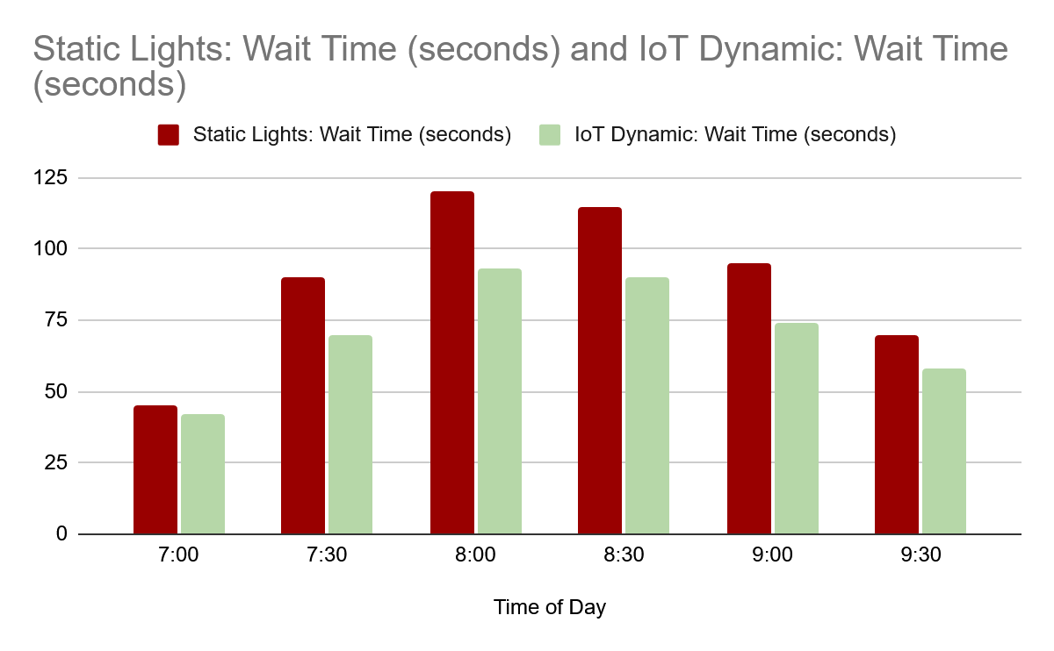
Results
Notes:
Moving to the results, the data clearly shows the advantage of the IoT system.
If you look at the 8:00 AM peak hour on this chart, the red bars represent the old static lights, where drivers waited up to 120 seconds. The green bars show the IoT dynamic system, which reduced that average wait time by 22%, bringing it down to about 93 seconds by adapting to the traffic wave.

Slide 8
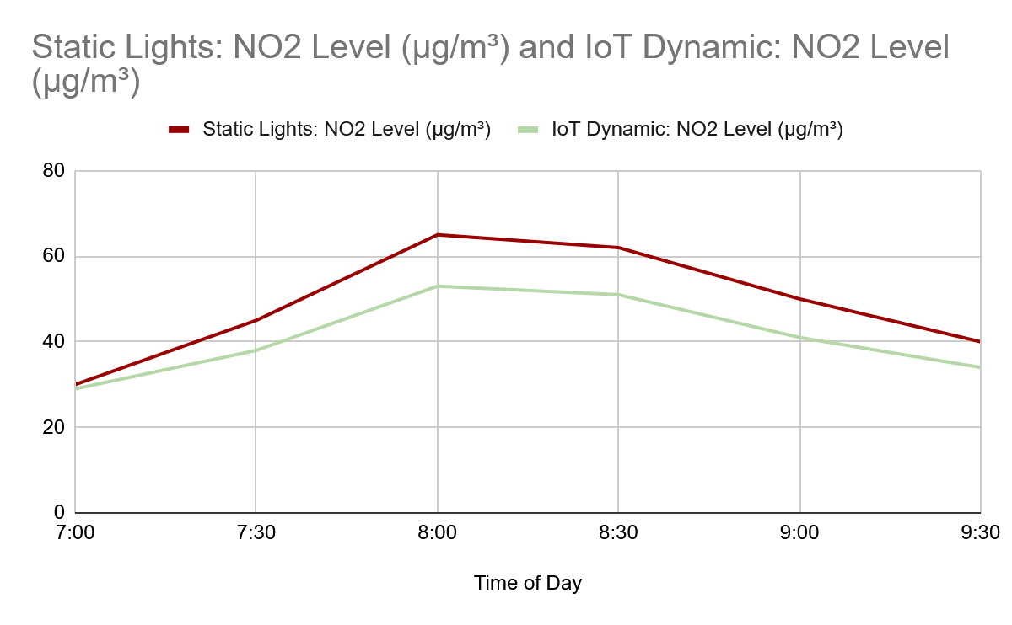
Results
Notes:
But the most important finding is how that time saved translates to cleaner air.
As you can see on this line graph, the shape perfectly mirrors the traffic delays. By reducing the time cars spend idling at red lights, localized NO2 levels dropped by 18% during the exact same morning rush. Statistically, I found a strong positive correlation of 0.85 between vehicle wait times and pollution spikes.

Slide 9
Conclusions & Recommendations
The findings show that dynamic IoT control successfully reduces both peak-hour wait times and localized NO2/PM2.5 pollution.
Recommendations
Practical Action: Timișoara authorities should deploy a physical pilot IoT node at Vasile Pârvan to gather baseline empirical data.
Future Research: The next study should integrate predictive Machine Learning algorithms to anticipate bottlenecks before they form.
Limitation: This is a purely simulated environment and lacks unpredictable real-world variables like erratic driver behavior.
Smart cities start with smart intersections, optimizing one traffic light can let an entire university campus breathe easier.
Notes:
In conclusion, the findings prove that dynamic IoT control successfully reduces both congestion and emissions. However, this study is just a software simulation, which means it can’t fully account for unpredictable human elements.
Smart cities start with smart intersections, optimizing just one traffic light can let an entire university campus breathe easier.

Slide 10
References
Chen, L. Wang, Y., & Popa, D. (2024) – Low – Cost IoT Sensor Networks for High Resolution PM2.5 Monitoring in Urban Environments. IEEE Internet of Things Journal, 11(2), 210-225.
Dragomir, M. (2021) – Evaluating Adaptive Traffic Signal Control systems in Romanian Municipalities. Romanian Journal of Transport Engineering, 19(4), 55-68.
Popescu, A. (2023) – IoT Edge Computing Architectures for Real-Time Traffic Management. Romanian Journal of Automation and Computers, 14(3), 45-60.
Notes:
Here are the key references that grounded my research. Thank you very much for your time and attention today. I would now welcome any questions

